Slide 1
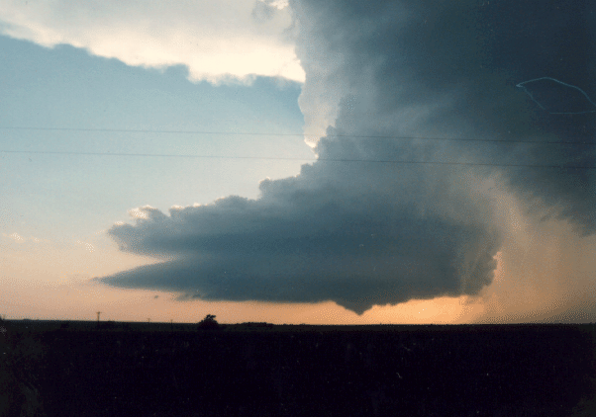
Research: My perspective
WESEP 594 Seminar
William A. Gallus, Jr.
Dept. of Geological and Atmospheric Sciences
Sept. 27, 2013

Slide 2
Who am I?
Education (all degrees Atmos. Sci)
  Ph.D., Colorado State University, 1989-1993
  M.S., Colorado State University, 1987-1989
  B.S., Penn State University, 1983-1987
Academic Experience
  -- Iowa State University, 1995-present

Slide 3
Who am I?
  Professional Highlights
    -- Professsor-in-charge of Meteorology, 2004-2010
    -- Chief Editor, Weather and Forecasting, 2007-2011
    -- ISU Foundation Award for Outstanding Achievement in Teaching
    -- LAS College Master Teacher
    -- American Meteorological Society Editor’s Award
    -- National Science Foundation Graduate Fellow
    -- Appearances on numerous national/international TV, magazine, newspaper, and radio channels (History Channel, Discovery Channel, National Geographic Channel, etc.)

Slide 4
Who am I?
  Research Highlights
  -- Sponsors: NSF, NASA, NOAA, IaDOT, IA Flood Center
  -- Projects: 50+ with total budget of > 10M
  -- Students: 6 PhD (4 graduated), 28 MS, mentored dozens of undergraduate researchers
  -- Publications: 175 articles (~75 Journal Papers)

Slide 5
What do I research?
Mesoscale Meteorology/Numerical Weather Prediction
Dynamics of thunderstorm systems & Tornadoes
Structure/Morphology of systems
Role of Low-Level Jet
Forecasting Techniques
Quantitative Precipitation Forecasts, Probability of Precipitation,
Wind Forecasting

Slide 6
Relationship to WESEP
A guiding principle for my research program has always been – can I impact operations/people quickly?
Forecasting-focused research does this
Wind forecasts have significant errors that are very costly to the wind industry – can these forecasts be improved at multiple time scales? “Error reduction of 1% would save $12,000,000 over the lifetime of a plant”

Slide 7
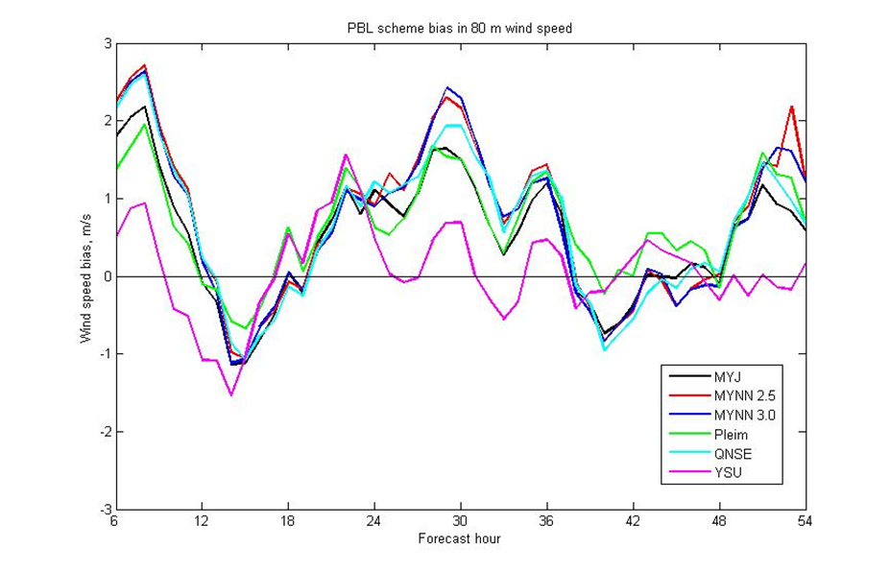
Example from Prior wind-related Research: Biases in 80m wind forecasts using different PBL schemes in WRF model
Note: YSU is most different
Composites of PBL biases by hour. Each line represents a different PBL scheme; MYJ (Black), MYNN 2.5 (Red), MYNN 3.0 (Blue), Pleim or ACM2 (Green), QNSE (Cyan), and YSU (Magenta).

Slide 8
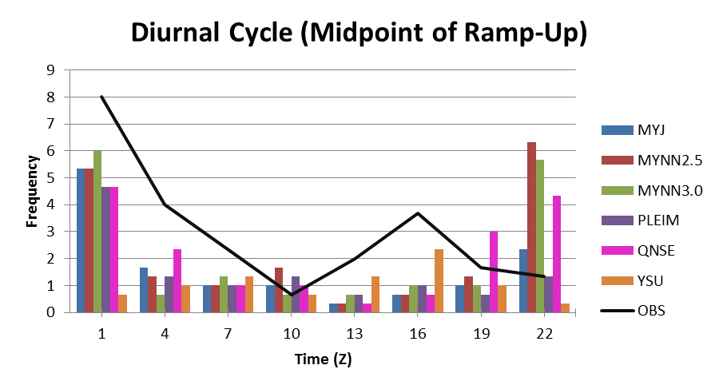
Three hour averaged diurnal cycle of ramp-up events using the midpoint of the ramp event. Black line is observed ramp-up events.
Note the very different behavior of the YSU scheme, and to a lesser extent the Pleim

Slide 9
Open research questions related to wind forecasting:
What are the deficiencies in planetary boundary layer/turbulence schemes in the numerical models that are leading to errors in the forecasts?
What sort of ensemble and post-processing techniques will lead to the most improved forecasts?
What are the causes of many ramp events that are not associated with fronts or thunderstorms?

Slide 10
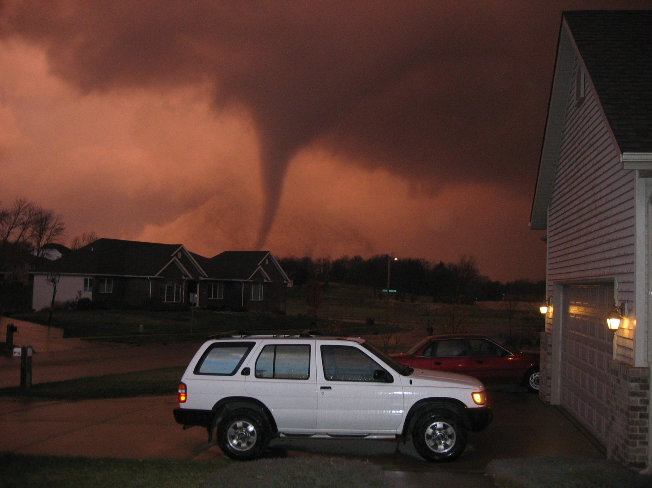
How is Research Done (in my opinion)?

Slide 11
Three main triggers for my research
Observation of interesting weather event
Careful thought about systematic shortcomings in understanding or prediction
New research questions arising as prior research questions are explored (This has been my main path to attract federal funding. The other paths have led to most senior undergraduate theses I mentor).
Some of these ideas imply research cannot be “planned” fully

Slide 12
What is a good research problem?
A good research problem will have a big impact when investigated (societal benefits or break-through in scientific understanding)
It should be well-defined so that specific questions can be answered
It should be answerable – do the data exist to investigate it/can the appropriate model runs be performed?

Slide 13
Creativity vs Current State of Understanding (Lit Review)
I personally find it much easier to think of the problem, using my knowledge of my own recent research, or my memories of weather behavior than fitting the problem into the current state of understanding.
But….a literature review is essential for multiple reasons:

Slide 14
Literature Reviews
Has your question already been answered, fully or in part?
Prior research can help focus or alter a research problem (or suggest even more branches in your research plan)
For external funding, it is essential – nothing worse than a reviewer seeing that you don’t mention their hard work related closely to your proposed research

Slide 15
End products?
In science, until maybe recently, end products were often papers, because those play a big role in getting future money to continue the whole process.
In an idealistic sense, impacts were also good end products, and possibly students
Perhaps more often now, esp. with wind energy work, end products are not papers, but impacts on those providing the funds

Slide 16
Other thoughts about research
I’ve found that research normally requires about 10 steps forward and 9 steps backwards. It would be highly unusual to perform a set of sensitivity tests once. It is much more common to do the set of tests,

Slide 17
Other thoughts about research
discover a stupid mistake,

Slide 18
Other thoughts about research
redo them,

Slide 19
Other thoughts about research
discover another stupid mistake

Slide 20
Other thoughts about research
redo them again,

Slide 21
Other thoughts about research
have the computer crash,

Slide 22
Other thoughts about research
redo them again,

Slide 23
Other thoughts about research
in the end decide that what was shown is not significant enough to use

Slide 24
Other thoughts about research
prompting new design of tests, and repeating of the process! Eventually, you win the lottery, get what you need, and decide results are important enough to share.

Slide 25
It is rare that your first idea of the question you will explore remains the main focus of your research. It is much more common to have that exploration raise different questions, and cause the research to head in a somewhat different direction.

Slide 26
Example
In the late 1990s, I spent much time creating 2 ways to include more surface weather reports in the initialization of weather models to better show the impacts of ongoing thunderstorms. Though complex, neither led to any real noticeable change in the forecasts. In trying to understand why, the only obvious answer was that these methods, by using surface weather data only, were impacting only a narrow layer of a very deep atmosphere.

Slide 27
Example (continued)
Thus, in a very ad hoc fashion, I decided to try a test where I increased relative humidity through a deep layer wherever rain was being reported (or seen on radar). Though very crude, this method led to much bigger improvements in the rainfall forecasts (TODAY assimilation of radar data in a much more sophisticated manner is often done to improve short-term forecasts)

Slide 28
I personally have found collaboration to be fun, and have liked being able to bounce ideas off of other experts
I’ve been part of projects that:

Slide 29
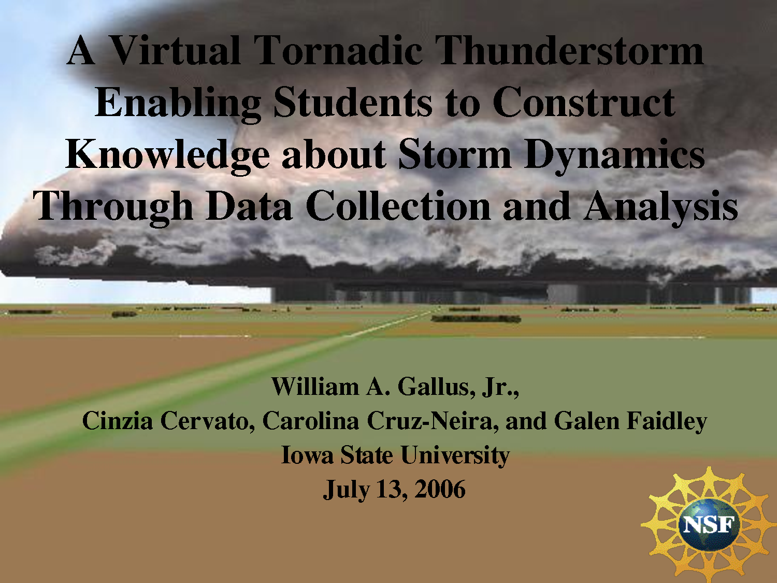
  a) included computer engineers, artists, education (virtual tornadic storm, virtual volcano)

Slide 30
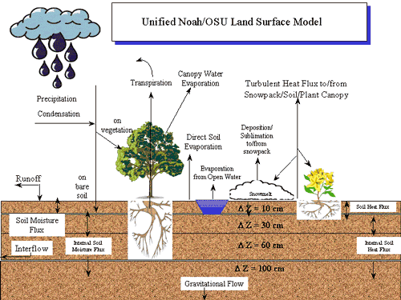
  b) agronomy (soil moisture-atmosphere interaction)

Slide 31
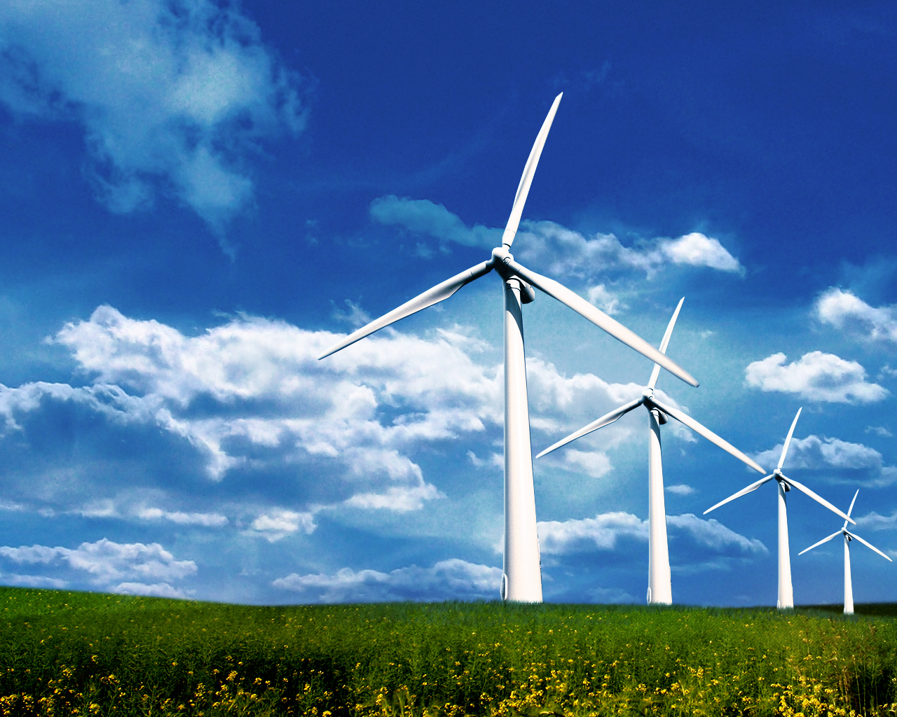
  c) statistics (wind forecasting)

Slide 32
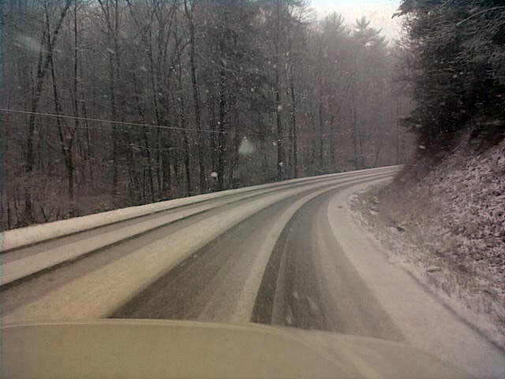
  d) mechanical engineering (neural network for road frost prediction)

Slide 33
  e) numerous sciences and education (HHMI)

Slide 34
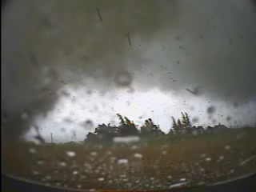
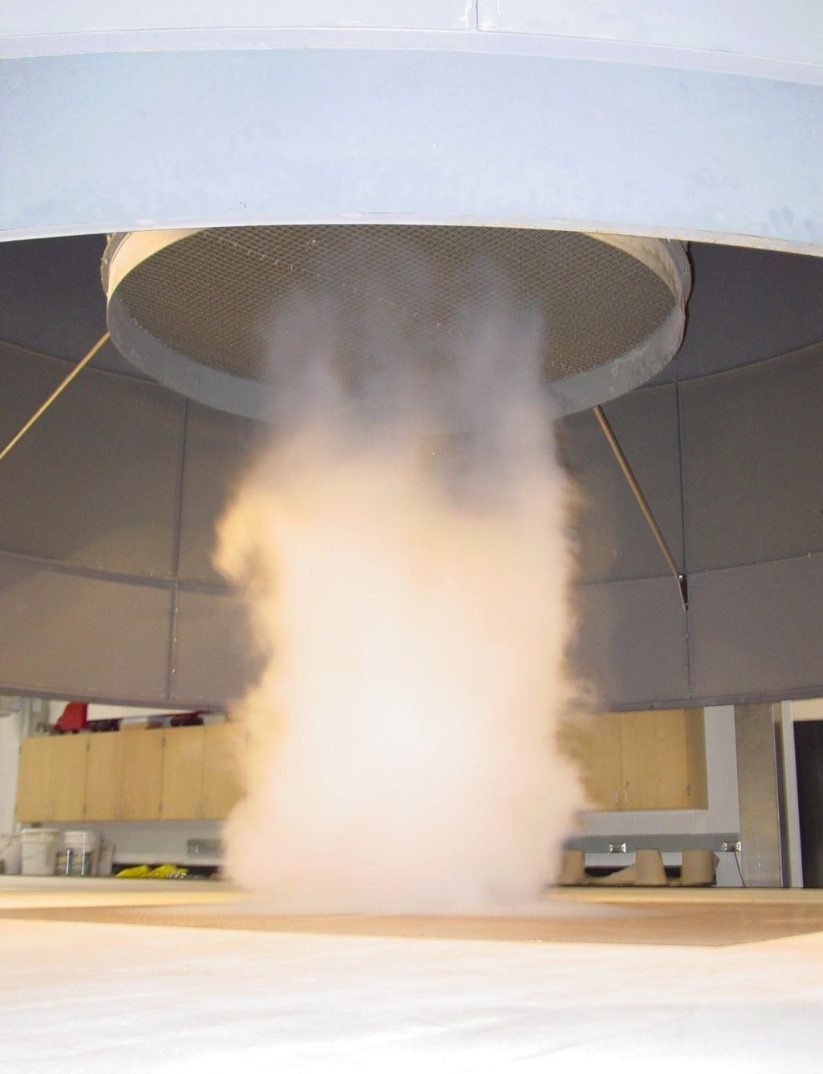
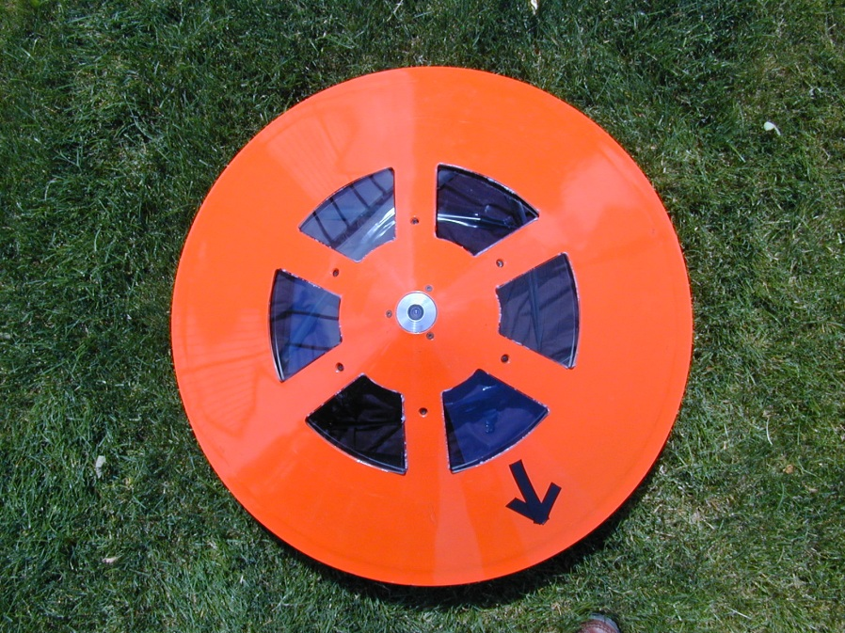
  f) aerospace engineering (tornado simulator)

Slide 35
Structures and Interactions Facilitating Research
Face-to-face discussion is by far most important when research involves others (grad students, collaborators)
Conferences are great places for getting research ideas and thinking of collaborations
Google docs has been very helpful in writing up research results for collaborative work

Slide 36
Final Thoughts
Research motivation likely differs among individuals
Research requires creativity
Research requires lots of patience
Ideas tend to flow from close observation of nature AND careful reading of other research papers

