Slide 1
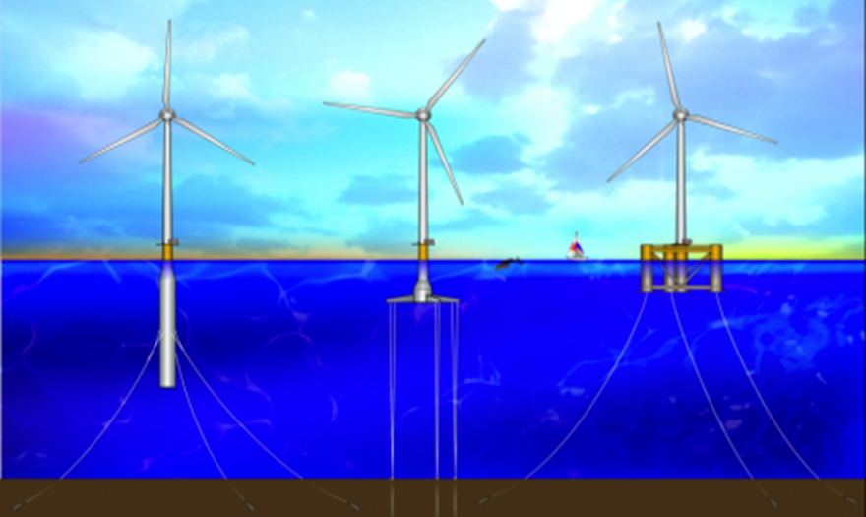
Floating Offshore Wind Turbines
An Aeromechanic Study on the Performance, Loading, and the Near Wake Characteristics of a HAWT Subjected to Surge Motion
Morteza Khosravi
09/11/2014
Source: http://breakingenergy.com/2014/05/07/top-10-things-you-didnt-know-about-offshore-wind-energy/

Slide 2
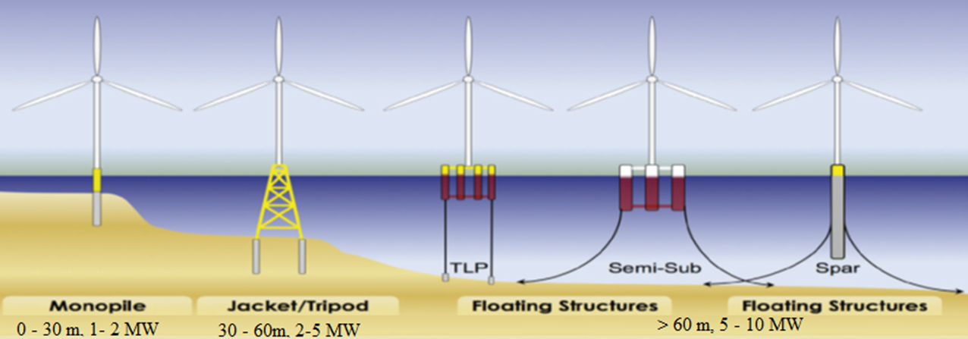
Offshore Wind Energy
Offshore wind technology is divided into three main categories depending on the depth of the water where the turbines will be placed, as follow:
  Shallow water: Any water depth up-to 30 meters.
  Transitional water: Water depths between 30 to 60 meters.
  Deep water: Any water depth greater than 60 meters.

Slide 3
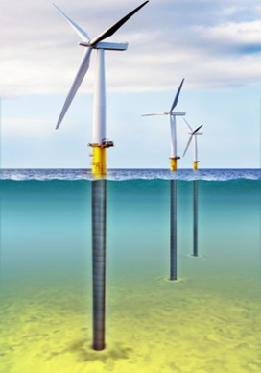
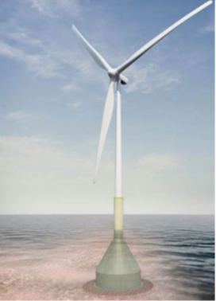
Europe’s Experience With Offshore Wind Energy
Limited land suitable for wind farm developments, but have access to great offshore resources in shallow waters.
69 offshore wind farms in 11 European countries.
2080 operational turbines yielding 6562 MW of electricity.
  72% in North sea, 22% in Baltic Sea, and 6% in Atlantic Ocean
  Average offshore wind turbine size is 4 MW.
  The average water depth of wind farms in 2013 was 20 m.
  The average distance to shore 30 km.
Substructures include:
  75% monopile
  12% gravity
  5% jacket
  5% tripod
  2% tripiles
  There are also 2 full scale grid connected floating turbines and 2 down scaled prototypes.
Source: European Wind Energy Association, Jan. 2014

Slide 4
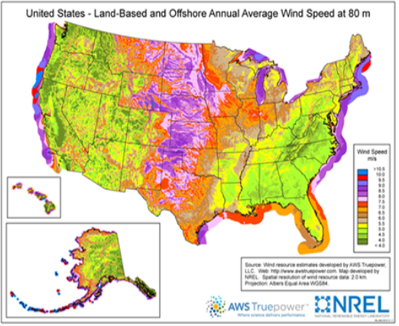
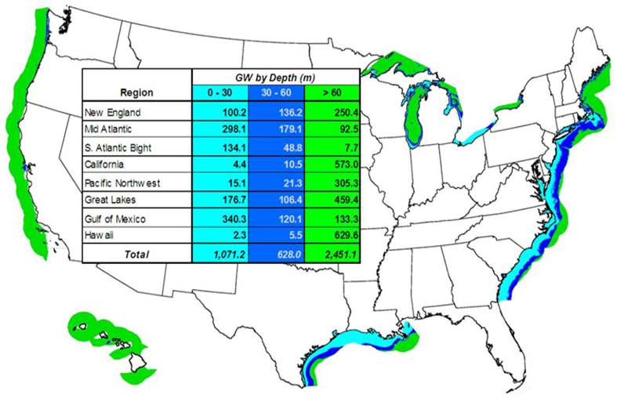
The American Experience With Offshore Wind Energy
Good wind resources onshore but far away from major load centers.
  Insufficient transmission lines.
53% of U.S. population live within 50 miles of the coast lines.
  70% of US electric consumption occurs in 28 coastal states. (1)
Over 4000 GW of wind potential within 50 NM from shores, at the height of 90m. (2)
Water depths are mostly deep, hence floating platforms required.
(1) http://breakingenergy.com/2014/05/07/top-10-things-you-didnt-know-about-offshore-wind-energy/
(2) Musial W., Ram B., 2010, Large-Scale Offshore Wind Power in the United States, Technical Report NREL/TP-500-40745.
Source: Musial W., Ram B., 2010, Large-Scale Offshore Wind Power in the
United States, Technical Report NREL/TP-500-40745.

Slide 5
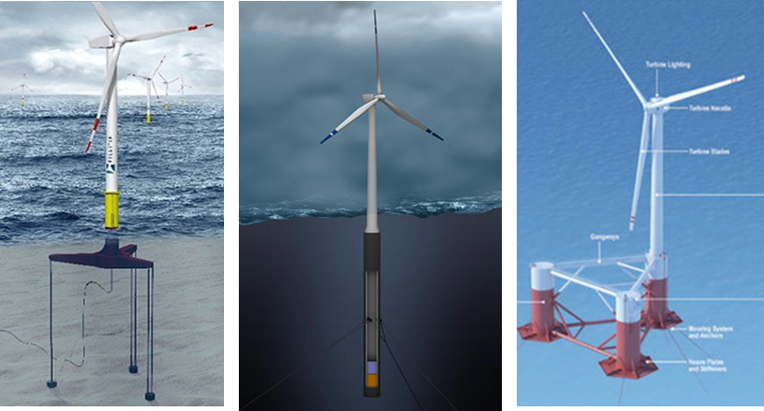
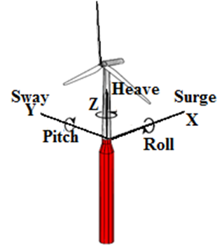
Floating Wind Turbines
Common types of floating platforms include:
  Tension-Leg Platform (TLP)
  Spar Buoy
  Semi-Submersible
  Barge ➔ eliminated due to excessive motions
Floating offshore structures have 6 D.O.F.
  3 displacements: Surge, Sway, Heave
  3 rotations: Roll, Pitch, Yaw
  The mass of the floater and the rotor/nacelle are in the same order of magnitude, hence, the dynamic excitation of wind and waves will result in:
  Excessive motions along each of the DOF’s of floating platform
  These motions will then be transferred to the turbine, affecting turbines performance and loading.

Slide 6
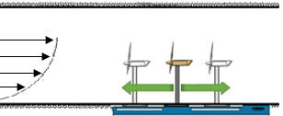
The Scope of My Experiments
The dynamics of FOWT was simplified by only considering the following 3-DOFs:
    Surge, Heave, and Pitch
The experiments began by uncoupling the motions first and then coupling them in the following manner:
  Surge
  Heave
  Pitch
  Surge + heave
  Surge + pitch
  Heave + pitch
  Surge + heave + pitch
The current study focuses only on the effects of surge motion.

Slide 7

Offshore Wind Characteristics
Offshore wind/wave resources are:
  Site specific
  Coastal region vs. Open sea
  Z0 ~ 0.0002 m
    Since $α=0.096\log\left(z_{0}\right)+0.016 {\left(\log\left(z_{0}\right)\right)}^{2}+0.24$
    Therefore $α=0.1$
Barthelmie et al reported TI’s of 6~8% at the height of 50m.
Different standards and regulations describe different α’s and TI’s for offshore wind turbine applications. (very conservative values)
  Japanese wind load standard prescribes
    $α=0.1$
  Design standard IEC (Ed 2, 1999)
    $I_{u}=\frac{I_{15}\left(a+\frac{15}{U}\right)}{a+1} , I_{15}=0.18 or 0.16 a=2, 3$
  Design standard IEC (Ed 3, 2005)
    $I_{u}=I_{ref}\left(0.75+\frac{5.6}{U}\right) , I_{ref}=0.16, 0.14, 0.12$ depending on wind class
For the current study$α=0. 1 , TI=0.1$

Slide 8
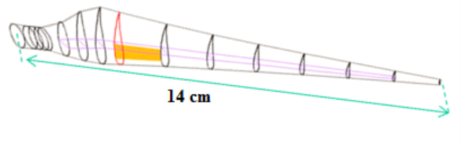
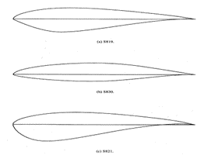
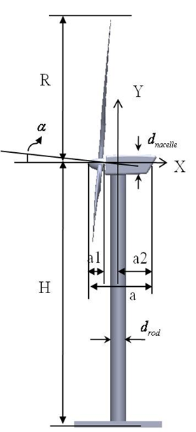

Scaling Methodology
Geometric scaling ($λ_{l}$):
  A 1:300 scaled model turbine was chosen and 3D printed.
    Rotor diameter = 30 cm
    Blade span = 14 cm
    Hub height = 27 cm
Froude Scaling:
  $Fr=\frac{U^{2}}{gl}=\frac{inertial forces}{gravitational forces}$
  The Froude scaling is applied to determine the exact forces and response on the floater and the turbine.
    Waves: $λ_{{Fr}_{prototype}}=$ $λ_{{Fr}_{model}}$
    Wind: $λ_{{Fr}_{prototype}}=$ $λ_{{Fr}_{model}}$
$TSR_{model}=TSR_{prototype}$

Slide 9
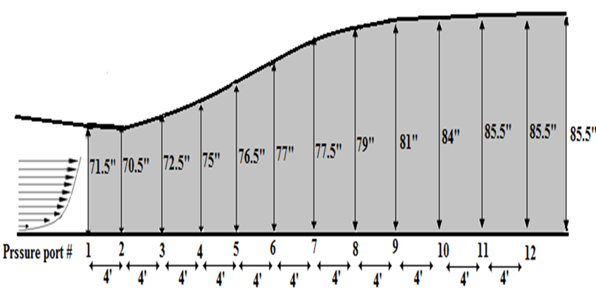
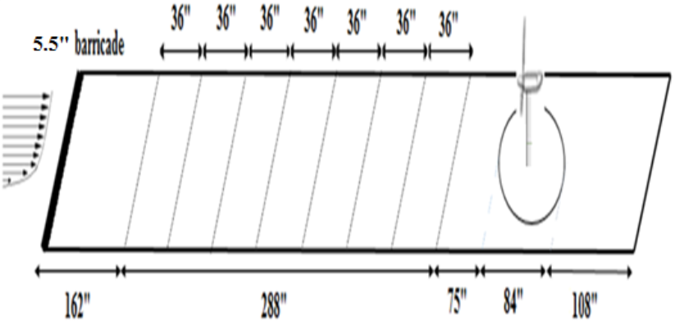
Operating Conditions
Wind Speed: 5.71m/s at hub height
TSR: 4.8
Surge Motion:
    Operational
      Displacement: -2 cm to + 2cm
      Velocity: 2 cm/s , Freq:0.18 Hz
      Acceleration, Jerk: 5 cm/s^2, ^3
    Extreme
      (i) Max velocity, acceleration, and jerk
        Displacement: -2 cm to + 2cm
        Velocity: 10 cm/s , Freq:0.31 Hz
        Acceleration, Jerk: 10 cm/s^2, ^3
      (ii) combination max range and max vel, accel, jerk
        Displacement: -5 cm to + 5cm
        Velocity: 10 cm/s , Freq:0.21Hz
        Acceleration, Jerk: 10 cm/s^2, ^3

Slide 10
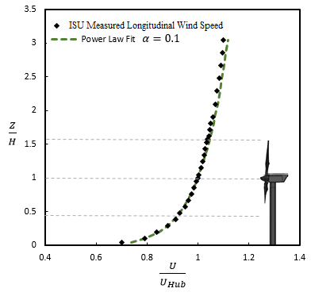
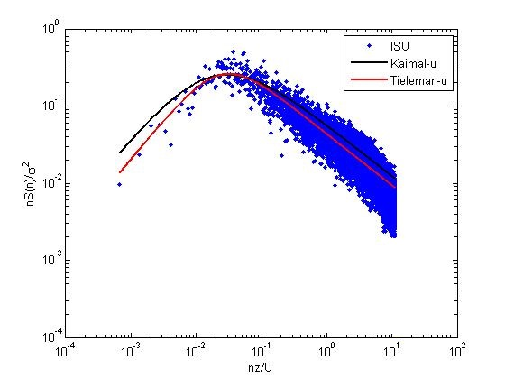
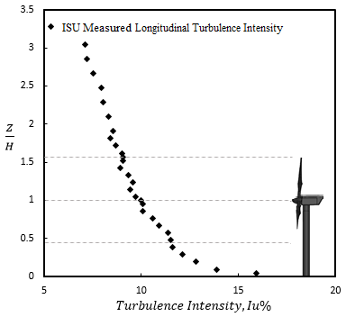
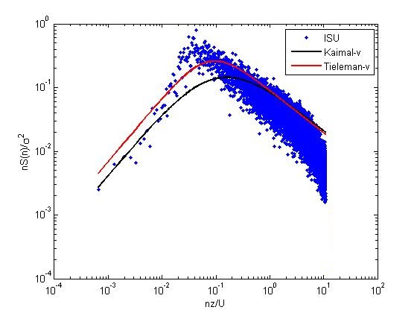
Experimental Setup

Slide 11
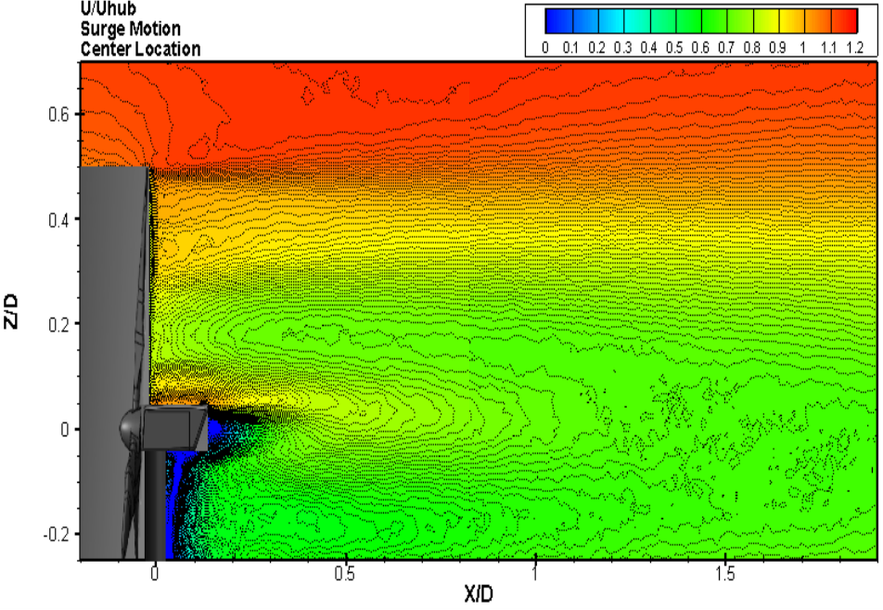
U/Uhub for a Stationary Turbine VS. Moving in Surge

Slide 12
U/Uhub for Surge Motion (Center Location)
Moving Into the Flow VS. Moving With the Flow

Slide 13
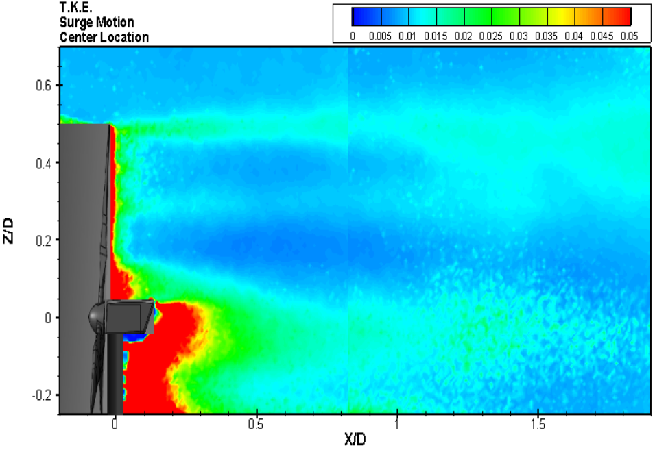
T.K.E./Uhub for a Stationary Turbine VS. Moving in Surge

Slide 14
T.K.E./Uhub for Surge Motion (Center Location)
Moving Into the Flow VS. Moving With the Flow

Slide 15
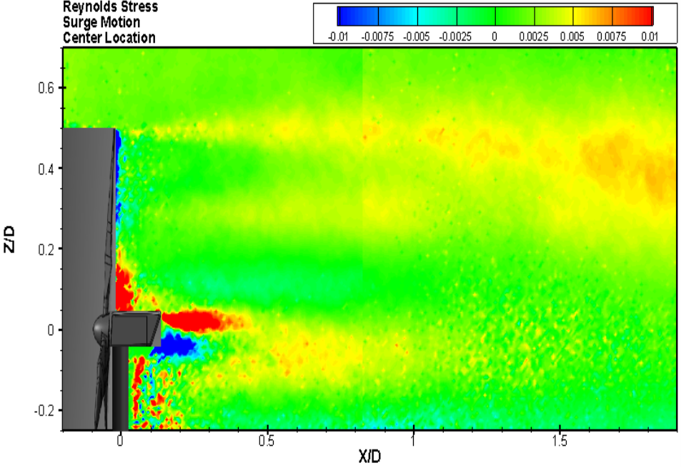
Reynolds Shear Stress/Uhub for a Stationary Turbine VS Moving in Surge

Slide 16
R.u.u./Uhub for Surge Motion (Center Location)
Moving Into the Flow VS. Moving With the Flow

