Slide 1
Improved Design of Compact Permanent Magnet Generators for Large Scale Wind Turbines
Helena Khazdozian
Wind Energy Science, Engineering and Policy
Co-Major: Electrical Engineering
Advisor: Dr. David Jiles

Slide 2
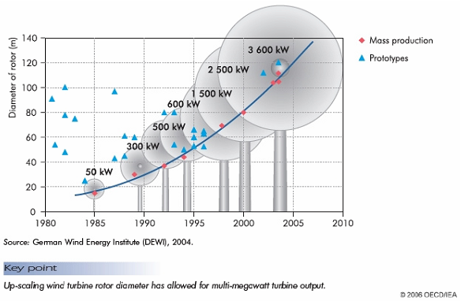
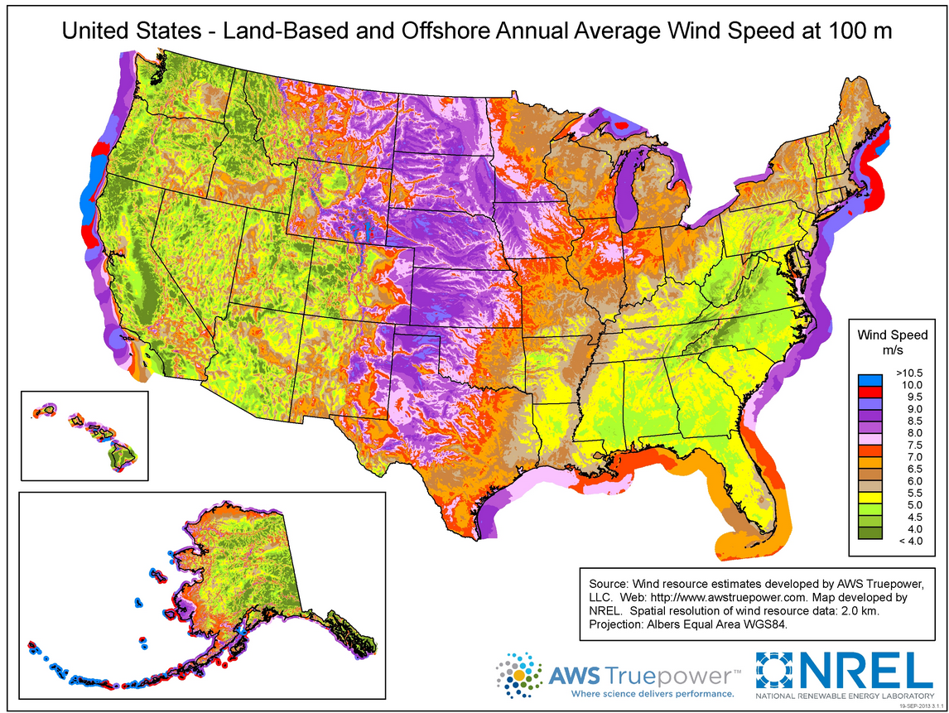
Motivation
20% wind energy electricity generation by 2030 proposed by Department of Energy [1]
Large scale and offshore wind turbines are necessary and inevitable
Fig. 1: Scaling of wind turbines over time.
Fig. 2: Wind resource characterization at 100m.

Slide 3
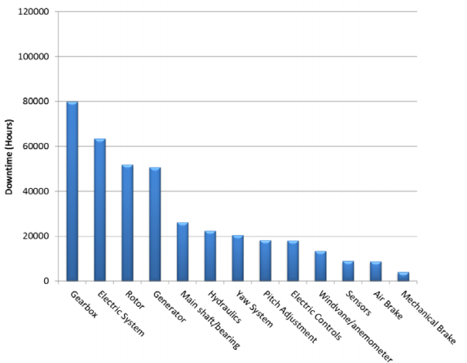
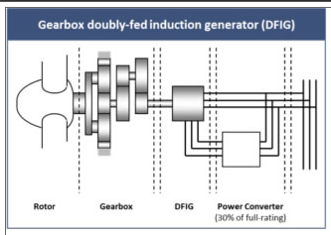
Doubly-Fed Induction Generators (DFIGs)
Gearbox doubly-fed induction generator (DFIG)
Rotor
Gearbox
DFIG
Power Converter
(30% of full-rating)
Fig. 3: Drive train configuration with DFIG.
Source: http://www.goldwindamerica.com/technology-capabilities/pmdd/
Fig. 4: 2008-2012 Aggregated Downtown per Turbine Subsystem [3]

Slide 4
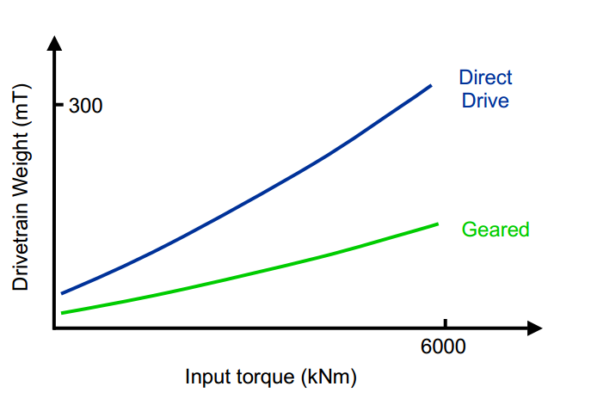
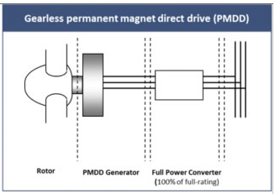
Direct Drive Permanent Magnet Generators (PMGs)
Gearless permanent magnet direct drive (PMDD)
(PMGs)
(DFIGs)
Rotor
PMDD Generator
Full Power Converter
(100% of full-rating)
Fig. 5: Drive train configuration with DFIG.
Source: http://www.goldwindamerica.com/technology-capabilities/pmdd/
Fig. 6: Scaling of drivetrain weight due to input torque in wind turbines [12].

Slide 5
Size Reduction of PMGs
For large power ratings, direct-drive PMGs are not practical
Rapid scaling with power rating results in large, massive machine
Reach 4-10m in diameter
$$P=Tω$$
$$T=KD_{r}^{2}L_{stk}$$
$$K=\frac{k_{wl}π^{2}}{4\sqrt{2}}BA$$
$$P∝[T=f\left(BD_{r}^{2}L_{stk}\right)]$$
P = power
T = torque
ω = rated speed
D_{r} = rotor diameter
L_{stk} = stack length
k_{w1} = fundamental harmonic winding factor
B = average flux density over rotor surface
A = electrical loading [13-15]
Fig. 6: Scaling of drivetrain weight due to input torque in wind turbines [12].

Slide 6
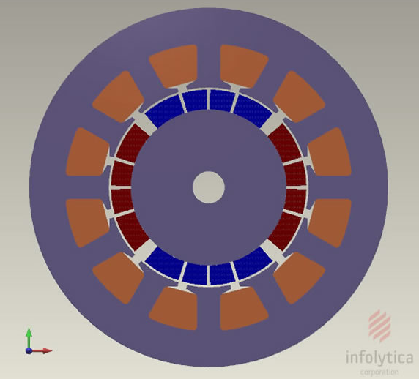
Background: PMGs

Slide 7
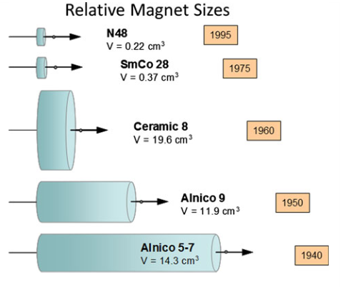
Background: Permanent Magnets
$$Energy Product=|BH|$$
B_{r}
H_{c}
Fig. 7: Energy density of permanent magnet materials.
Source: Arnold Magnetic Technologies
Fig. 8: a) Energy product given by the optimal operating point for NdFeB 48/11, b) operating point and corresponding energy product given by the intersection of the demagnetization curve and load line for NdFeB 48/11.

Slide 8
Method 1: Magnetic Properties
Scale 3.5kW PMG design [16] to 10MW
Hypothesis: 25% reduction in the size of the 10MW inner rotor PMG achievable by increase in permanent magnet remanence & energy product (stronger magnet)
$$P∝[T=f\left(BD_{r}^{2}L_{stk}\right)]$$
Case 1: 10MW PMG with no design innovation
Case 2: 10MW PMG with 25% size reduction
Case 3: 10MW PMG with 25% size reduction and increased remanence

Slide 9
Magnetics
Case 3
Case 3
Case 1
Case 1
Fig. 9: Operating point of theoretical permanent magnet given by the intersection of the demagnetization curve and the load line (Case 3).
Fig. 11: Comparison of the magnetic flux density over the rotor surface for two 10MW PMGs.
 | Operating Point
 | H (MA/m) | B (T) | |BH| (kJ/m³)
Case 3 | -0.322 | 1.478 | 474.77
Case 1 | -0.172 | 1.037 | 177.79
$$P∝[T=f\left(BD_{r}^{2}L_{stk}\right)]$$
Fig. 10: Comparison of a) magnetic flux path and magnetic flux density in Case 3 and b) magnetic flux path and magnetic flux density in Case 1.

Slide 10
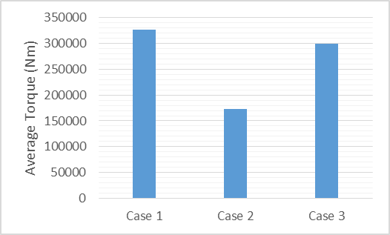
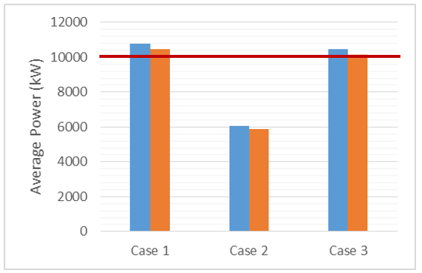
Proof of Concept
Rated torque and power achieved for cases 1 & 3
Increased energy product is able to compensate for torque not provided from the rotor volume
Rated Torque
Rated Power
Fig. 12: Comparison of the average torque of each PMG.
Fig. 13: Comparison of the average input power (blue) and output power (orange) of each PMG.
H. A. Khazdozian, R. L. Hadimani, D. C. Jiles. “Size Reduction of Permanent Magnet Generators for Wind Turbines with Higher Energy Density Permanent Magnets,” North American Power Symposium (NAPS), 2014, pp.1-6, in press.

Slide 11
Loss Mechanisms
Significant increase in core losses in rotor and stator
Ohmic losses increase by 77.6%
Efficiency is not compromised despite losses
Case 3
Case 1
Fig. 14. Comparison of a) Mean time averaged hysteresis loss in Case 3 and b) mean time averaged hysteresis loss in Case 1.

Slide 12
Implications
Proof of concept demonstrated
Increase in flux density over rotor surface will allow for size reduction
Achievement by altering magnetic properties
Operating point need to be closer to remanence as increase energy product
Contingent on development of new permanent magnet materials
Can we increase the flux density over the rotor surface by another means?

Slide 13
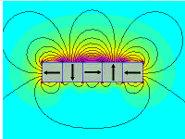
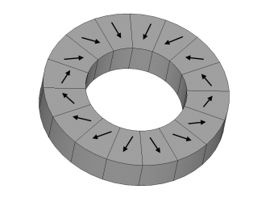
Method 2: Magnetic Flux Focusing
$P∝[T=f\left(BD_{r}^{2}L_{stk}\right)]$
Focus magnetic flux over rotor surface
Halbach arrays
Benefits of Halbach arrays
Focuses flux to one side of array
Elimination of stray field losses
Sinusoidal air gap flux density
Negligible cogging torque
Low iron loss
Disadvantages
High manufacturing and material costs

Slide 14
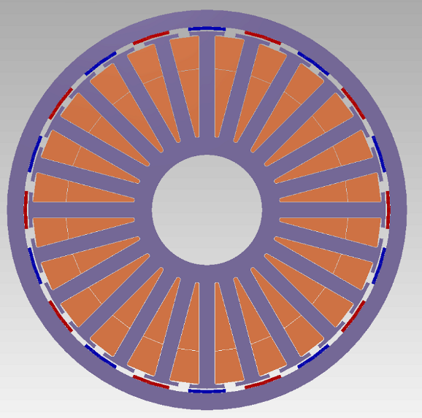
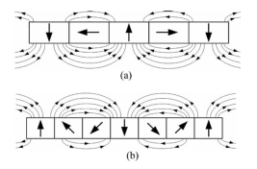
Initial Work
Replace rotor with Halbach cylinder
Investigation relationship between performance and Halbach array variation
Table I: Specifications of 3.5kW PMG.
Rated Power (kW) | 3.5
Rated Torque (Nm) | 100
Supply Voltage (V) | 162.8
Rated Current (I) | 21.5
Rated Speed (rpm) | 333.333
Rotor Topology | exterior
# poles | 20
# phases | 3
# slots | 24
Rotor Inner diameter (mm) | 275
Rotor Outer diameter (mm) | 300
Airgap length (mm) | 1
Stator Inner diameter | 82.6
Stator Outer diameter | 268
Fig. 15. Model of 3.5kw PMG.
Fig. 16. a) 2 segments per pole,
b) 3 segments per pole [20].

Slide 15
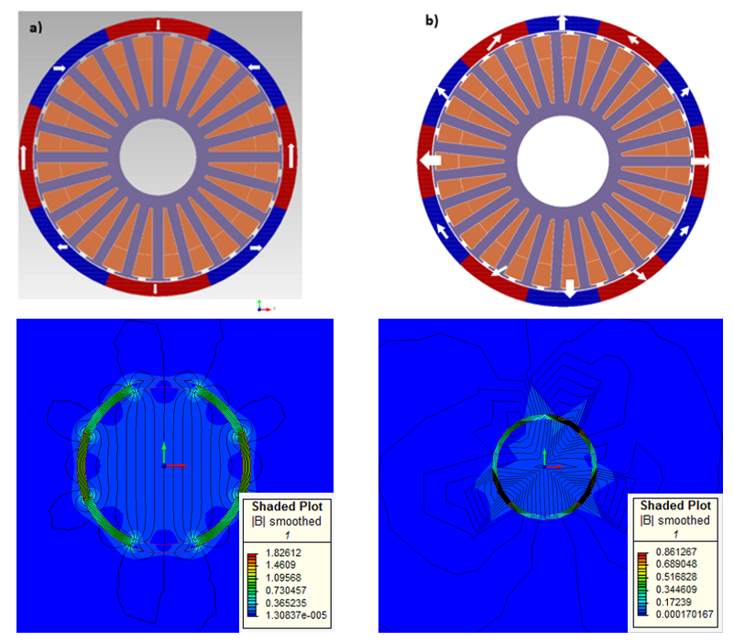
Investigation of number of segments per pole
Fig. 17: Comparison of magnetic flux density generated by Halbach cylinders with 2 and 3 segmemts per pole

Slide 16
Investigation of number of poles
Fig. 18: Comparison of magnetic flux density generated by Halbach cylinders with 4 and 8 poles (3 segmemts per pole).

Slide 17
Application in PMG
Flux Density over Rotor Surface (T)

Slide 18
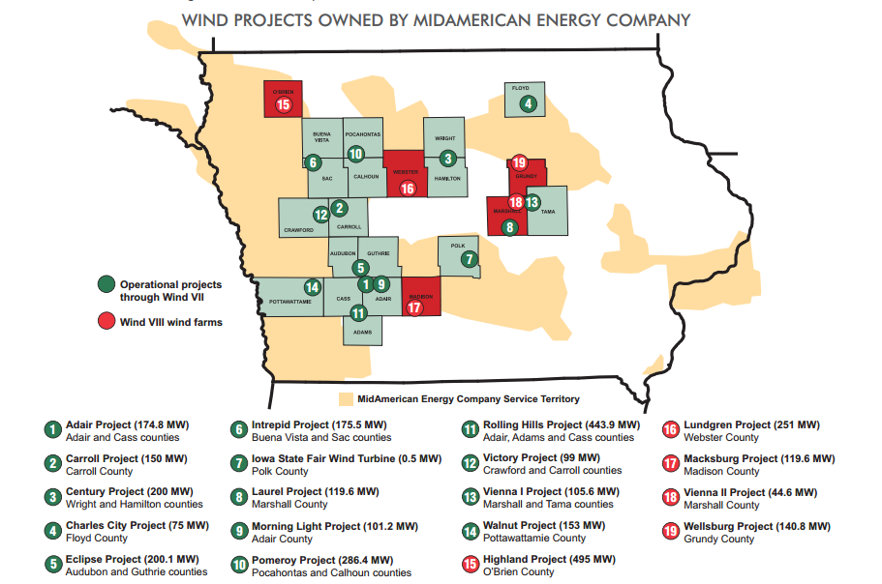
Risk Communication: Wind Turbines
“Client”: MidAmerican Energy
Wellsburg Project
140.8 MW
Audience: Grundy County, IA residents
Development of risk communication materials

Slide 19
References
“AWEA U.S. Wind Industry Annual Market Report Year Ending 2010,” American Wind Energy Association, 2011.
“20% Wind Energy by 2013,” U. S. Department of Energy, Oak Rdige, TN, Tech. Rep. DOE/GO 102008-2567, July 2008.
S. S. Sheng. “Report on Wind Turbine Subsystem Reliability – A Survey of Various Databases,” National Renewable Energy Laboratory, Golden, CO, Tech. Rep. NREL/PR-5000-59111, June 2013.
K. S. Morey. (2014, Feb. 27). “GE opens wind turbine repair, innovation lab in Albany,” Albany Business Review [Online]. Available: http://www.bizjournals.com/albany/news/2014/02/26/ge-opens-wind-turbine-repair-facility.html?page=all.
S. S. Sheng. “Report on Wind Turbine Subsystem Reliability – A Survey of Various Databases,” National Renewable Energy Laboratory, Golden, CO, Tech. Rep. NREL/PR-5000-59111, June 2013.
W. Musial, S. Buttefield, B. McNiff. “Improving Wind Turbine Gearbox Reliability,” in 2007 European Wind Energy Conference. Milan, Italy, 2007, pp. 1-10, National Renewable Energy Laboratory, NREL/CP-500-41548.
F. Spinato, P. J. Tavner, G. J. W. van Bussel, E. Koutoulakos. “Reliability of wind turbine subassemblies,” IET Renewable Power Generation, vol. 3, pp. 387-401, Dec. 2009.
R. S. Semken, M. Polikarpova, P. Rӧyttӓ, J. Alexandrova, J. Pyrhӧnen, J. Nerg, A. Mikkola, J. Backman. “Direct-drive permanent magnet generators for high-power wind turbines: benefits and limiting factor,” IET Renewable Power Generation, vol. 6, pp.1-8, doi: 10.1049/iet-rpg.2010.0191, 2012.
G. Shrestha, H. Polinder, D. Bang, J. A. Ferreira. “Structural Flexibility: A Solution for Weight Reduction of Large Direct-Drive Wind-Turbine Generators,” IEEE Tran. Energy Convers., vol. 25, pp. 732-740, Sept. 2010.
O. Gutfleisch et al. “Magnetic materials and devices for the 21st century: stronger, lighter, and more energy efficient,” Adv. Mater,. vol. 23, pp. 821-842, Feb. 2011.
L Lewis, F. Jiménez-Villacorta. “Perspectives on permanent magnetic materials for energy conversion and power generator,”Metall. Mater. Trans. A, vol. 44A, pp. S2-S20, Jan. 2013.
J. Purahen. (2014, Apr. 21). “The Big Wind Energy Drive Train Technology Debate,” Renewable Energy World [Online]. Available: http://www.renewableenergyworld.com/rea/news/article/2014/04/the-big-wind-energy-drive-train-technology-debate?cmpid=WNL-Wednesday-April23-2014.
R. Qu. “Development and Challenges of Permanent Magnet Wind Generators,” presented at Workshop on Next-Generation Wind Power, RPI, May 2010.
J. R. Hendershot, TJE Miller. “Sizing & Computer-Aided Design,” in Design of Brushless Permanent-Magnet Motors. Oxford, UK, Magna Physics Publishing and Clarendon Press, 1994, ch. 12, sec. 12.2, pp. 12-2 – 12-5.
D. C. Hanselman. “Basic Concepts,” in Brushless Permanent-Magnet Motor Design. New York, McGraw-Hill, Inc., 1994, ch. 1, pp. 11-12.
J. R. Hendershot, T. J. E. Miller, “Basic Design Choices,” in Design of Brushless Permanent-Magnet Machines. Venice, U.S., Motor Design Books LLC, 2010, ch. 3, sec. 3.3.1, pp. 87-91.
A. S. Abdel-Khalik, S. Ahmed, A. M. Massoud, A. A. Elserougi. “An improved performance direct-drive permanent magnet wind generator using a novel single-layer winding layout,” IEEE Trans. Magn., vol. 49, pp. 5124-5134, Sept. 2013.
J. R. Hendershot, TJE Miller. “Basic Design Choices,” in Design of Brushless Permanent-Magnet Motors. Oxford, UK, Magna Physics Publishing and Clarendon Press, 1994, ch. 3, sec. 3.7, pp. 3-27.
Z. Q. Zhu. “Instantaneous magnetic field distribution in permanent magnet dc motors, part I: open-circuit field,” IEEE Trans. Magn., vol. 29, pp. 124-135, Jan. 1992.
H. Yu, C. Liu, B. Yuan, M. Hu, L. Huang, and S. Zhou, “A permanent magnet tubular linear generator for wave energy conversion,” J. Appl. Phys., vol. 111, no. 7, p. 07A741, Mar. 2012.
L. Jian and K. T. Chau, “A Coaxial Magnetic Gear With Halbach Permanent-Magnet Arrays - Iowa State University,” IEEE Transactions on Magnetics, 2010. [Online].
J. Choi and J. Yoo, “Design of a Halbach Magnet Array Based on Optimization Techniques,” IEEE Trans. Magn., vol. 44, no. 10, pp. 2361–2366, Oct. 2008.
Z. Q. Zhu, IEE Proc-Electr. Power Appl. 148, pp. , July 2001
P. Jin, S. Fang, H. Lin, X. Wang, W. Zhou, J. of Appl. Phys. 111, 2012

Slide 20
Thank you for your time
Questions?

