Slide 1
Iowa state University
Department of Civil, Construction and Environmental Engineering
Cost Estimate for Different
Wind Turbine Technologies
Bin Cai
Wind Energy Science, Engineering and Policy
Major Department: Civil, Construction and Environmental Engineering
Advisor: Dr. Sri Sritharan

Slide 2
Outline
Background
A Breakdown of Components for Levelized Cost of Energy
Cost Estimate Uncertainties
Future Work

Slide 3

Background
Levelized Cost of Energy (LCOE) is a convenient way of comparing generation technologies on a common basis and is used throughout the utility industry as a high level screening tool.
$$LCOE=\frac{\left(ICC∗FCR\right)+AOE}{({AEP}_{net}/1000)}$$
ICC: Initial Capacity Cost
FCR: Fixed Charged Rate
AOE: Annual Operation Expense
AEP(net): Net Annual Energy Production

Slide 4
Major Components to be included in the LCOE
A Breakdown of Wind Turbine Costs
Rotor
Drivetrain, Nacelle
Control, Safety system
Tower components and Foundation
Site preparation
Mobilization, Assembly and Installation
Balance of Station (BOS)
  Electrical interface & connections
  Communication system
  Engineering & permits
Annual Operating Expense (AOE)
  Replacement cost
  O&M cost
  Land lease cost
Overhead and profit

Slide 5
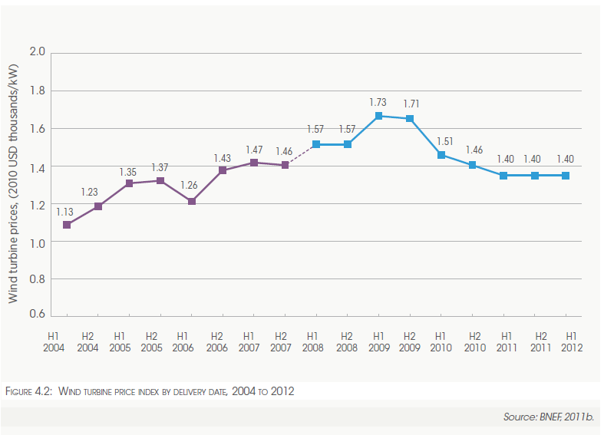
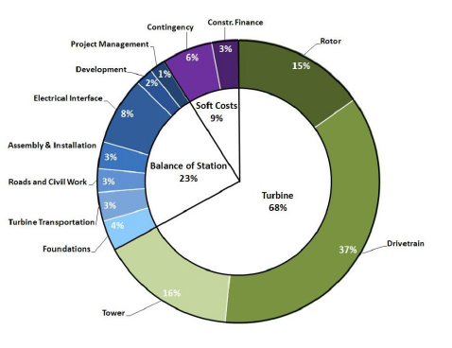
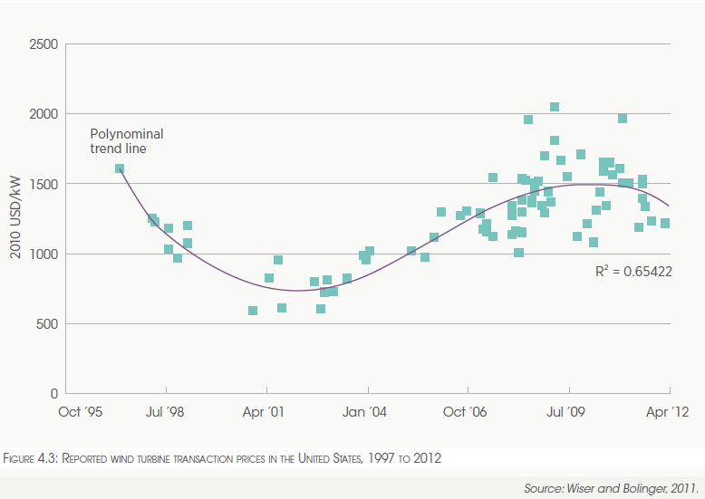
A Breakdown of Wind Turbine Costs
Data from: Installed capital costs for the land-based wind reference project, NREL, 2010

Slide 6
A Breakdown of Tower and Foundation Costs
 | Major component | Sub-component | Cost
Tower | Foundation |  | Hub height, swept area
 | Shop fabrication | Concrete modules, Steel tubes | Conceptual design
 | Connection elements | Connections between tower and turbine; Tower segments of different materials | Conceptual design
 | Tower erection and post-tensioning of concrete tower | Segments erection; Tendons installation; Allowance | Conceptual design
 | Access ladders and platforms | Ladders, platforms | Included in concrete to steel connection
 | Interior and exterior surface paint as needed | Surface paint | Included in concrete to steel connection

Slide 7
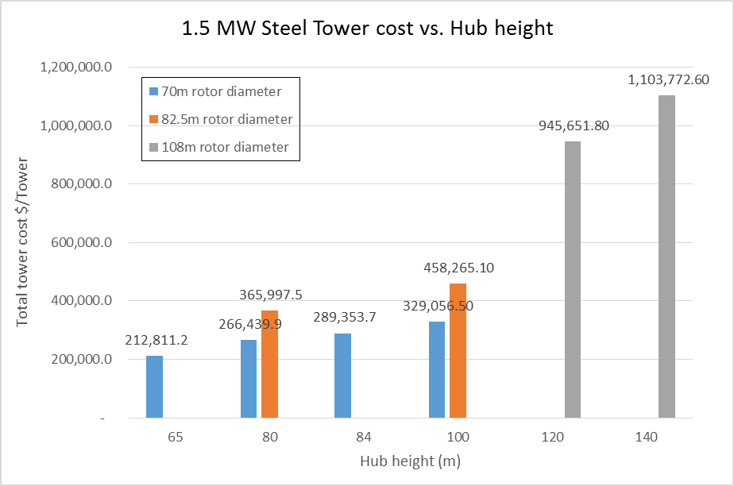
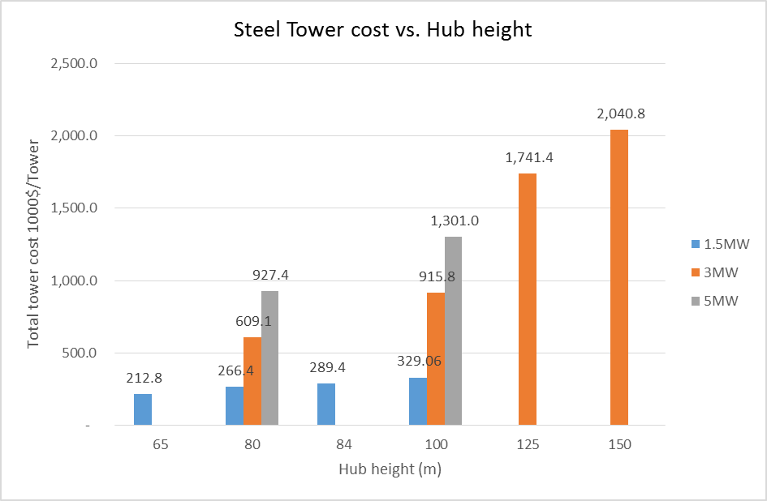
Tower cost

Slide 8
Steel Tower LCOE

Slide 9
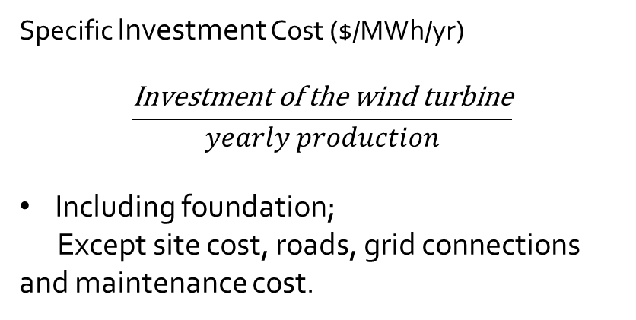
Steel Tower LCOE
Specific Investment Cost ($/MWh/yr)
$$\frac{\text{Investment} \text{of} \text{the} \text{wind} \text{turbine}}{yearly production}$$
Including foundation;
Except site cost, roads, grid connections and maintenance cost.
Data from Vindforsk project report, July 2010

Slide 10
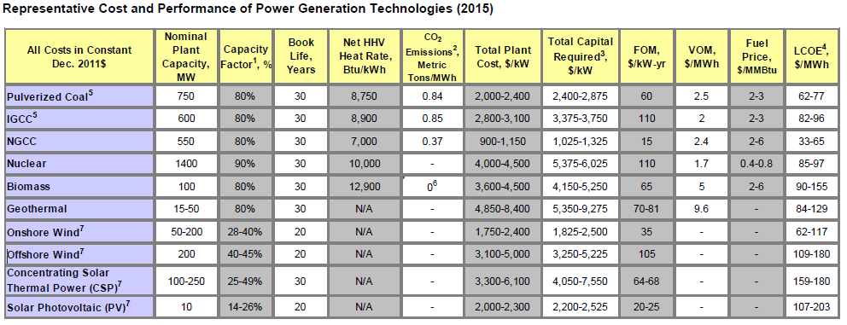
Levelized Cost of Energy
------ Electric Power Research Institute
Source: Electric Power Research Institute Program on Technology Innovation: Integrated Generation Technology Options 2012, Feb. 2013. Available online at http://www.epri.com/search/Pages/results.aspx?k=1026656&r=mpkeyword%3AAREBVGVjaG5vbG9neSBUcmVuZHMJbXBrZXl3b3JkAQJeIgIiJA%3D%3D,mptabresults%3AARABUmVzZWFyY2ggUmVzdWx0cwxtcHRhYnJlc3VsdHMBAl4iAiIk
Notes:
Fixed O&M costs typically include insurance, administration, fixed grid access fees and service contracts for scheduled maintenance. Variable O&M costs typically include scheduled and unscheduled maintenance not covered by fixed contracts, as well as replacement parts and materials, and other labor costs

Slide 11
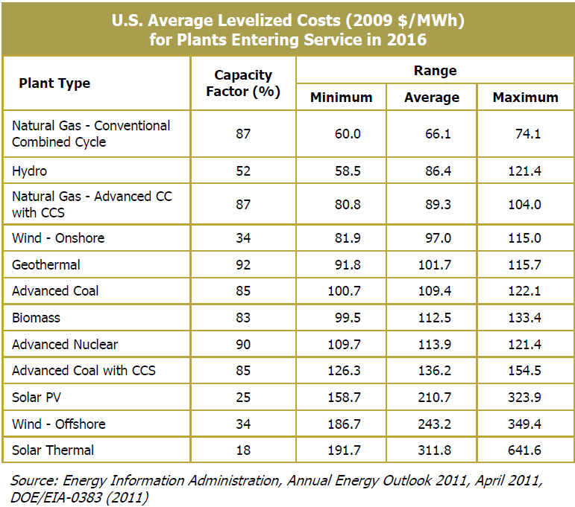
Levelized Cost of Energy
------ Department of Energy

Slide 12
Cost Estimation Uncertainty
Physical process, performance of key components in new technology
Preliminary designs and project execution
  The total project schedule: 2-3 years on the order of wind turbines
Unanticipated changes in cost of available materials, labor, or capital
Permitting, licensing, forthcoming environmental regulation and other regulatory actions
Others
  Labor disruptions
  Weather conditions
Notes:
Higher uncertainty with respect to performance of a key component in a new technology will result in more significant impact on the cost estimate

Slide 13
Cost Estimation Uncertainty
Source: Electric Power Research Institute Program on Technology Innovation: Integrated Generation Technology Options 2012, Feb. 2013.

Slide 14
Future Work
Land based Wind Turbine Tower cost with different technologies
  Tower material
  Transportation
  Assembly and installation
  Site development
  Decommissioning
Labor cost
Risk Analysis

Slide 15
Thank You For You Time!
Questions?

