Slide 1
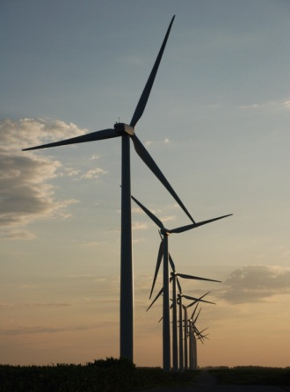
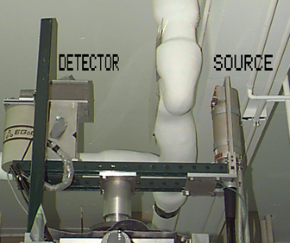
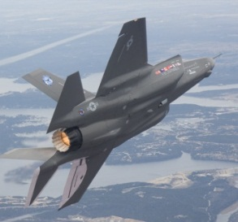
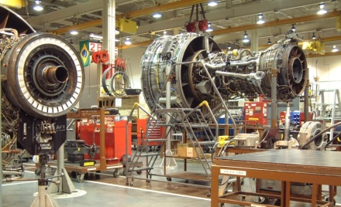
Wind Turbine NDE
Jeremy Van Dam

Slide 2
Levelized Cost of Energy
LCOE = the average lifetime levelized cost of electricity generation
I_{t} = investment expenditures in the year t;
M_{t} = operations and maintenance expenditures in the year t;
F_{t} = fuel expenditures in the year t;
E_{t} = electricity generation in the year t;
r = discount rate; and
n = economic life of the system.
(RENEWABLE ENERGY TECHNOLOGIES: COST ANALYSIS SERIES, 2012)

Slide 3
Levelized Cost of Energy
(RENEWABLE ENERGY TECHNOLOGIES: COST ANALYSIS SERIES, 2012)

Slide 4
Levelized Cost of Energy

Slide 5
Reduce Operation and Maintenance Costs
Table: (Levelized Cost of New Generation Resources in the Annual Energy Outlook 2013, 2013)

Slide 6
Reduce Operation and Maintenance Costs
The fixed and variable operations and maintenance (O&M) costs are a significant part of the overall LCOE of wind power. O&M costs typically account for 20% to 25% of the total LCOE of current wind power systems.
(EWEA, 2009)

Slide 7
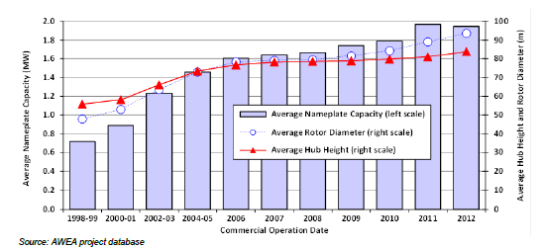
Turbines are Getting Bigger

Slide 8
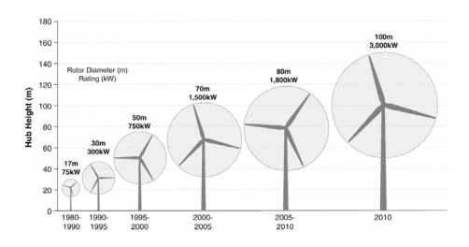
Turbines are Getting Bigger
Source: NREL. (Lantz, Hand, & Wiser, 2012)

Slide 9
The state-of-the-art

Slide 10
State-of-the-art
Nacelle Monitoring
Displacement Monitoring
Temperature Monitoring
Vibration Censors
Accelerometers
Ludeca, Inc
The green arrows indicate sensor (accelerometer) locations for standard wind turbines.

Slide 11
State-of-the-art
Blade Monitoring
Strain Gauges
Fibre Bragg Grating
Offer physical correlation between wavelength and strain
Long term stability and no recalibration required
Limited number of sensors
P.J. Schubel et al. / Renewable Energy 51 (2013) 113e123

Slide 12
State-of-the-art
Blade Monitoring
Strain Gauges
Electrical Sensors
Require Large Sensor arrays
Stress Field is required
Applicable in Operation
Mature technology
P.J. Schubel et al. / Renewable Energy 51 (2013) 113e123

Slide 13
State-of-the-art
Blade Monitoring
Strain Gauges
Acoustic Emissions
Crack initiation
Breaking of Fibers
Few Sensors needed
High levels of Noise
Integrity Diagnostics

Slide 14
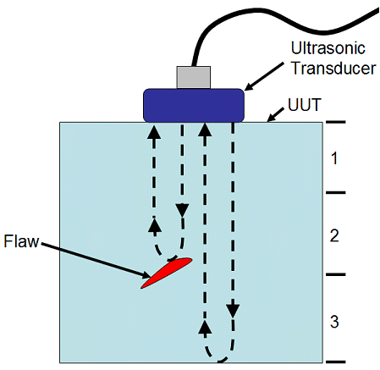
State-of-the-art
Blade Monitoring
Strain Gauges
Acoustic Emissions
Ultrasonic
Reveals certain flaws quickly
Scattering effect has a negative impact
National Instruments

Slide 15
State-of-the-art
Blade Monitoring
Strain Gauges
Acoustic Emissions
Ultrasonic
Thermography
Record Temperature differences – identify flaws
Condition monitoring and fault detection of
wind turbines and related algorithms (Hameed)

Slide 16
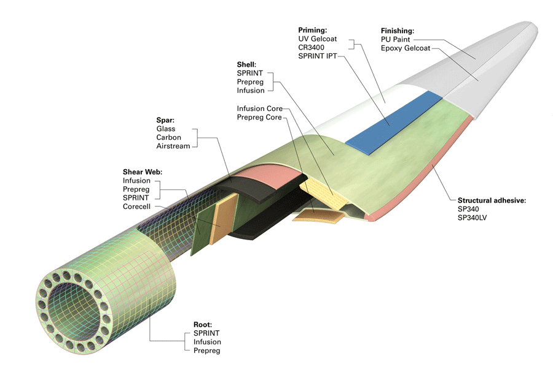
Turbine Blade
Windpower: Engineering & Development

Slide 17
Turbine Blade
Cracking
Typical blade damage
Study of fatigue failure damage
in wind turbine blades (Marin)

Slide 18
Turbine Blade
Out-of-Plane Waviness
Reduces Structural
integrity
Iowa State University

Slide 19
Turbine Blade
Custom created hole for testing
Joint Failure
De-bonding
Lack of Resin
Cracking
Iowa State University

Slide 20
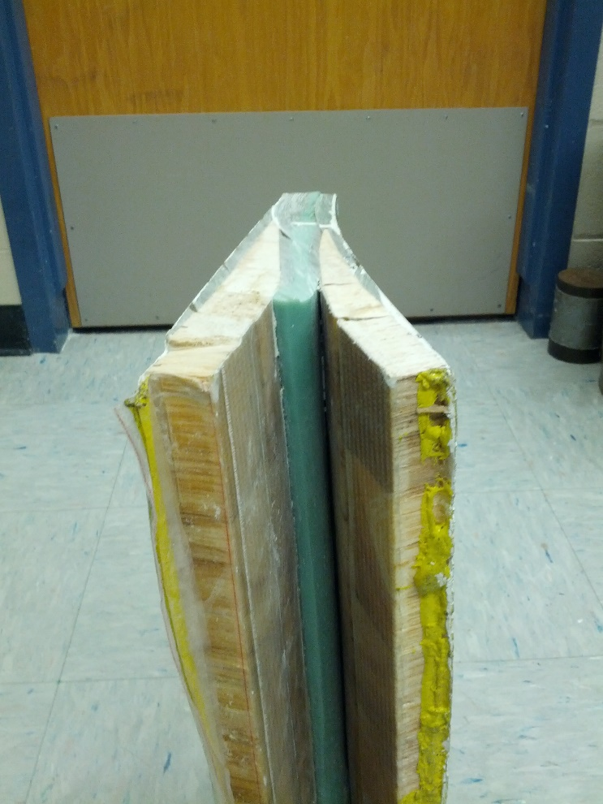
Turbine Blade
Iowa State University

Slide 21
Turbine Blade
Iowa State University

Slide 22
Future Work
Determine Method of NDE
What are the areas of need?
Combine multiple methods?
Determine Failure Mode
How to actively monitor for the Failure

Slide 23
Related Work
Wind Turbine Reliability
Keep the wind turbine functioning when the wind is blowing
Avoid critical failures
Reduce Wind Turbine Costs
Reduce the O & M costs
Manage downtimes

