Slide 1
Power System Flexibility Assessment
InFLEXion flexibility assessment tool
Aidan Tuohy
EPRI Grid Ops and Planning
atuohy@epri.com
Iowa State University Seminar
March 21, 2016

Slide 2
Overview
Introduction and Background
EPRI Multi-Level Flexibility Assessment Approach
Flexibility Requirements
Flexibility Adequacy Metrics
Conclusions

Slide 3
Background

Slide 4
Impact of Variable Generation: Increased Variability
More upward ramping capability is required when sun goes down
Increased requirement for downward ramping capability in the morning
Need lower minimum generation levels to avoid over-generation
Source: ENEL

Slide 5
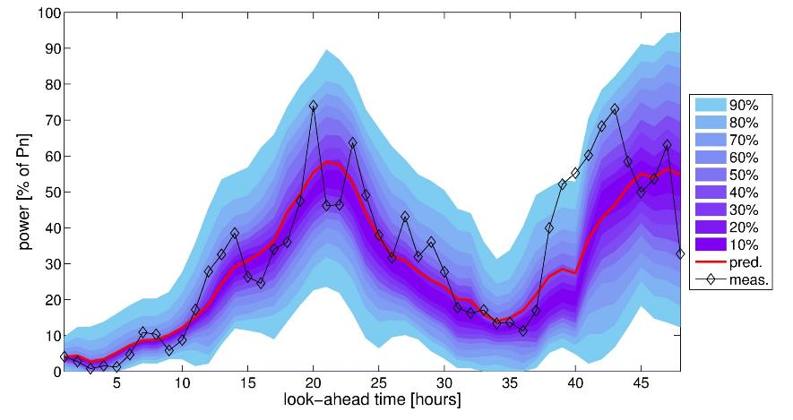
Impacts of Variable Generation: Increased Uncertainty
Example Wind Power Forecast
Increased Operational Uncertainty Requires Capability to Respond to Unexpected Changes in Net Load
Source: Pierre Pinson, DTU, Denmark
Notes:
The system has always dealt with some uncertainty. For example load forecast error on a day ahead basis (when much of decisions get made) is approx 2%-5%, depending on size and location of system. But VG will significantly increase uncertainty. At a wind farm level, typically 8%-10% expected mean absolute error. However, aggregating over larger areas can smooth this error to about half this (over 60 wind farms in Germany for example, 8% error is reduced to 4%). Even then, while average error is 10% or less, that doesn’t tell full picture. What may be most important is when the wind changes (or clouds come in). If we miss the large up or down ramps by 30 minutes or more, then it can be very problematic, as we really need to lean on reserves. Ramp forecasting is more difficult than average conditions. For the most extreme events (i.e. all on to all off or vice versa) we can have very large errors. Data from Northwest IPP shows for example that once you start having ramps of half the size of wind farm (so 25-75 MW on a 100 MW wind farm) error can be 60% or ramp (you may have missed by over 30 MW) on average. Figure shows predicted (red) and measured (black) – will talk about blue later, but you can see a typical type of error
Wind and solar forecasts can be improved. We can improve forecast accuracy. For example on a day ahead basis the underlying meteorological forecasts can be improved and many national laboratories and federal organizations are looking at how to do this. Significant computing and scientific resources are improving this, and errors may be reduced, particularly average error. Ramp forecasts may also be improved by improving day out forecasts, as well as better statistical methods form commercial forecasting companies. In shorter time scales, other tech can also be used. Sensors deployed on wind turbines or wind plants and solar plants can improve the data streams going back to commercial vendors so they can produce better forecasts. We are looking, with CAISO at deployment of a LiDAR technology at the Tehachapi wind farm. This is an advanced technology (expensive) – it can tell us a lot more about air flow, cloud movement etc. This can be used to see if large changes in wind speed are about to happen and give system operators awareness of this – even an extra 10 minutes can be very valuable from a reliability perspective and eventually mean we can reduce reserves (think of how you could use that with a storage device with 1 hour of energy storage, or a demand response resource)
So we can improve forecasts in short and longer time scales, so that we have a better idea of what’s happening. However, we still need to deal with some uncertainty. Can be done in a number of ways. Probabilistic forecasts such as that shown could be extremely useful. This shows the expectation around the predicted wind. So the lightest color shows what you would expected to happen at the extremes (10% of time you would be outside this), while the darker shows what you expect. You can see at some periods forecasters are more sure than others – system operators can then use this information. However, they want to make one decision, not think in probabilities, so R&D needed to take above information and turn it into something actionable. This should be expected to manage risk better while minimizing costs (in times of high uncertainty/large spread you would need a lot of flexibility to manage risk, but in times of lower uncertainty you have a better idea of what’s coming). Another thing which can be done from an ops perspective is to move things closer to real time as much as possible. While you can’t start a coal unit in less than, say, a day, you may be able to wait an start a combined cycle unit later, or wait even longer to determine when to charge storage. If you move decisions closer to real time, it reduces risk, as you can see.
Takeaway: Market design, system ops and the flexibility of your resources all impact on how you can manage uncertainty. Risk will be reduced, but never disappear

Slide 6
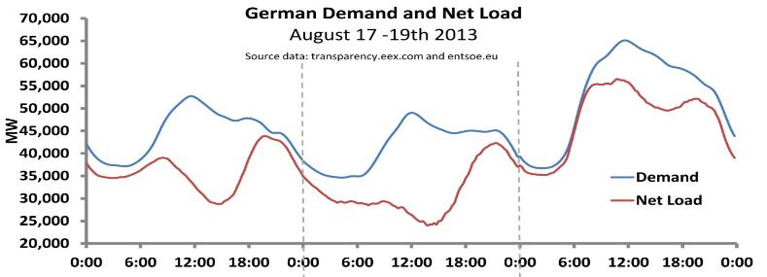
When do we need flexibility?
Source: V. Silva, EdF R&D
Need ramping capability for variability and uncertainty over multiple time periods
Both physical and institutional sources of flexibility are important

Slide 7
Consequences of Insufficient Flexibility
Reliability Economic
Operational Issue
High reserve prices
High cost energy
Energy and Reserve Scarcity
Reserve shortages
Over-generation
Under-generation
Area Control Error (ACE)
Frequency deviation
Load shedding
Generator disconnection
RES Curtailment
Planning Issue

Slide 8



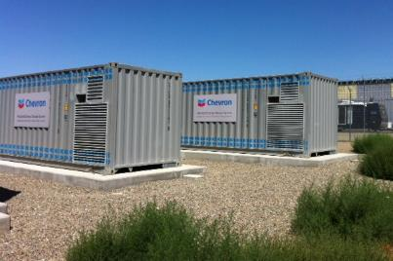
Options to provide flexibility
Generation Flexibility
Transmission & Distribution
Demand Response
Energy Storage
Notes:
The key options for balancing are:
Generation Flexibility (running plants to both follow load and account for competing variable generation)
Transmission & Distribution (Grid)
Demand Response (consumer interaction with electricity)
Energy Storage (buffer to accept excess generation and fill in demand shortfalls)
Markets (financial mechanism to promote technology or operational response)

Slide 9
Multi-Level Flexibility Assessment

Slide 10
EPRI Flexible System Planning R&D
Flexibility Assessment Software Tool
Resource and Transmission Flexibility
Utility/ISO
Flexibility
Case Studies
Flexibility metrics
Screening analysis
Detailed flexibility evaluation
Resource adequacy: variability/uncertainty & operation methods
Order of magnitude of possible risk
Insights as to time horizons concerns
Transmission impact on flexibility
Notes:
Three main efforts in 2013
Short description of each
All outcomes achieved
Report and software tool published

Slide 11
Flexibility Metrics for system planning
Multi-Level Approach
  Levels 1 and 2 →screening Levels 3 and 4 →detailed metrics
Three detailed metrics:
  Periods of Flexibility Deficit
  Expected Unserved Ramping
  Insufficient Ramping Resource Expectation
Post processed metrics based on simulation or historical data
White paper available on epri.com
Level 1
Variability Analysis & Flexibility Requirement
Resource Flexibility Calculation
Level 3
System Flexibility Metrics
Level2
Level 4
Transmission and Fuel Constrained Flexibility

Slide 12
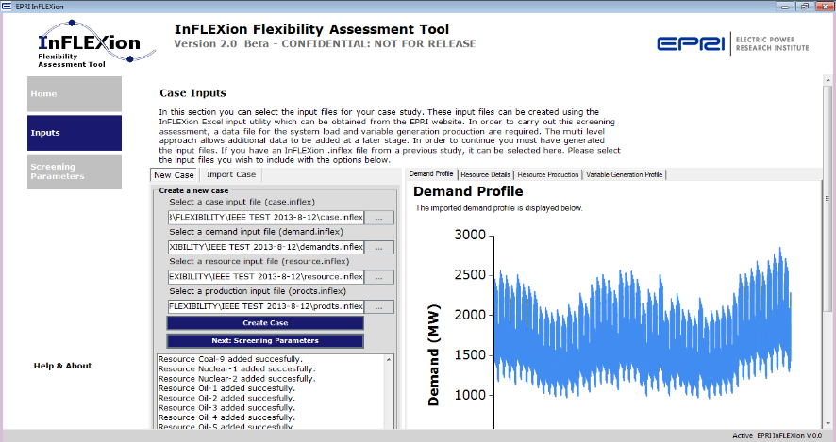
Inflexion Screen Shot

Slide 13
Example Flexibility Assessment Study – Southwest Power Pool (SPP) Wind Integration Study
Recently completed study for SPP
  Part of larger wind integration study
  Other parts covering thermal and voltage issues
  Ramping analysis performed by EPRI
Uses historical analysis to understand ramping issues
  How much does wind increase ramping?
  How much ramping was available?
  Baselines for future years → not expecting flexibility issues for 2014/15 period studied
  Simulations of future years are also possible
Installed wind during study period increased from 7.3 GW to 8.6 GW (now over 12 GW)
  Used actual dispatches, including some wind that was dispatched down as part of Dispatchable Variable Intermittent Resource (DVER) study
  5-minute and hourly resolution market data for 1 year
Provides example results for use of metrics and tool

Slide 14
Flexibility Requirements

Slide 15
Level 1 - Flexibility Requirements
Aim: Understand how much flexibility is required and when it is needed.
Concept: Time Horizons
Ramping occurs at a variety of time scales
Magnitude and speed of ramping different in different time scales
Resources can respond differently in different time horizons
Concept: Direction
Upward ramps and downward ramps tend to occur during certain periods
Resources ability to provide upward flexibility differs to its downward flexibility contribution
Up Flexibility
Down Flexibility
Capacity
Slower
Variability
Min. Gen
Fast Variability
Unit 1
Unit 2

Slide 16
Level 1 – Flexibility Needs
Variability Needs
Predictable ramping needs
Uncertainty Needs
Forecast error induced ramping needs
Timing of Requirements
Seasonality
Diurnal nature
Using historical production data
Useful in planning horizon to characterize needs in:
short horizons (< 10 mins.) longer horizons (> 5 hours)
Using historical forecast error data
Useful for identifying the need for operational flexibility for time horizons between 5 minutes and 36 hours
Helps to understand cycling
requirements
Identifies changes needed
to operating practices

Slide 17
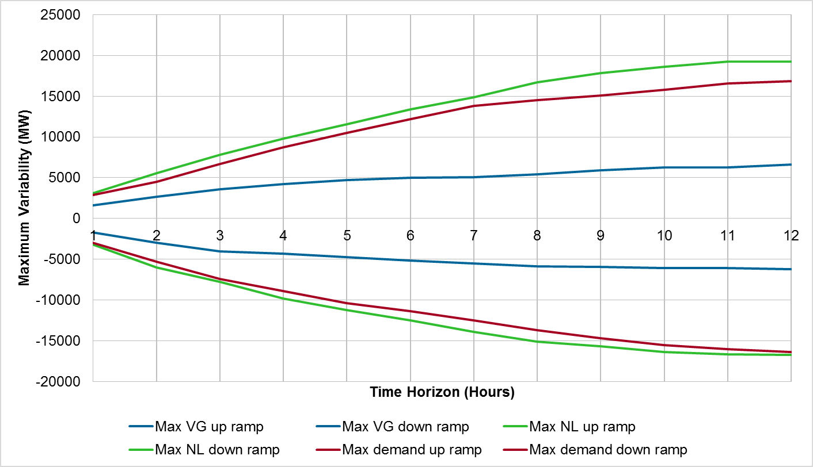
Maximum Inter-Hour Variability over different time horizons
Values are Ramp over given time period, starting from every hour in 8760 dataset

Slide 18
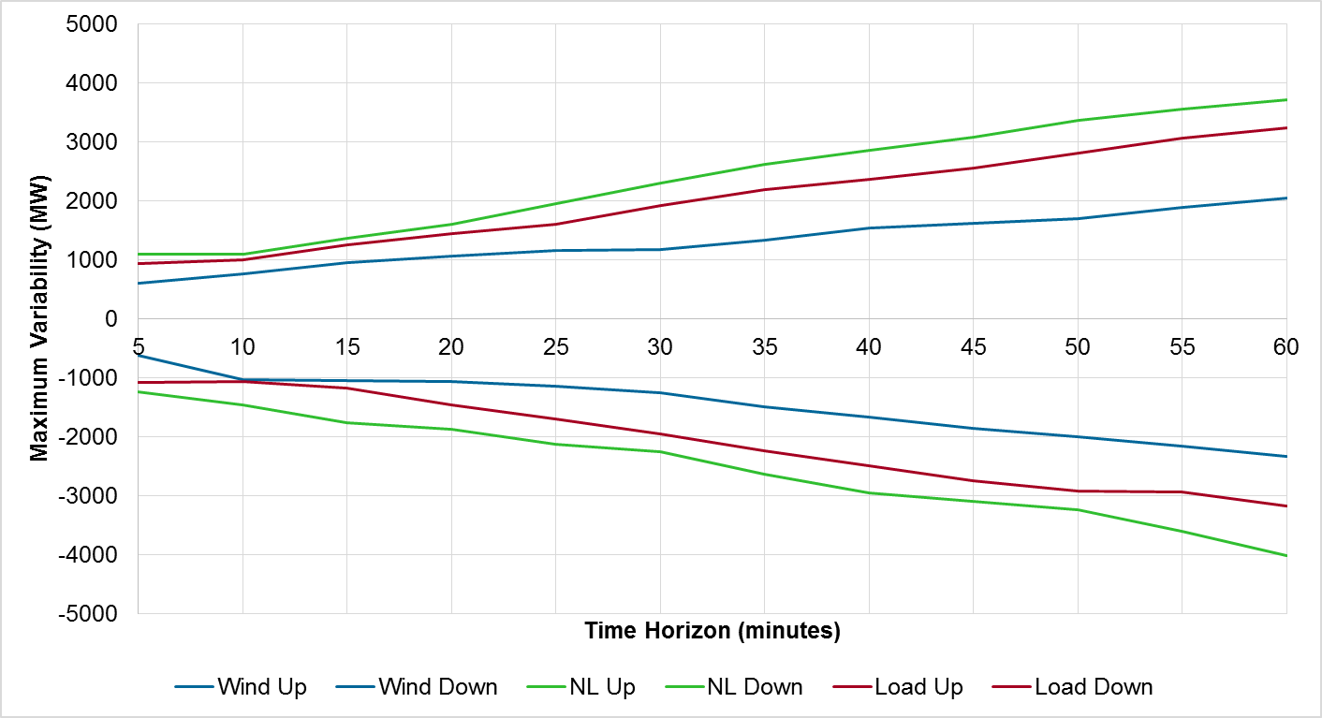
Within-Hour Ramps as Function of Time Horizon
Wind does increase ramping within hour also- by 5%-10% of installed capacity

Slide 19
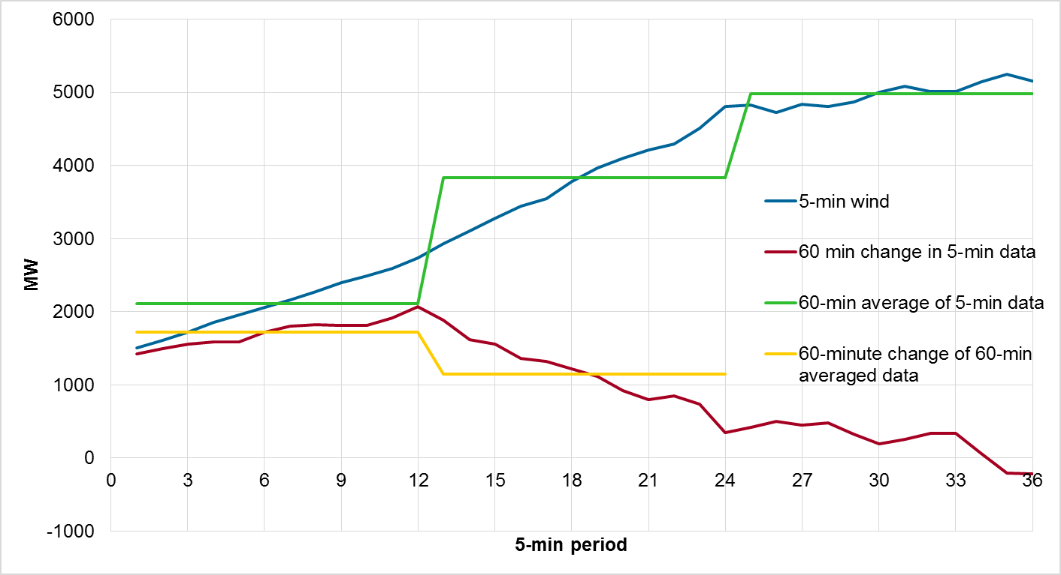
Differences between inter- and within-hour analysis results, due to data used
More granular data used to study within-hour ramps compared to day ahead look in previous results – more ramping is expected

Slide 20
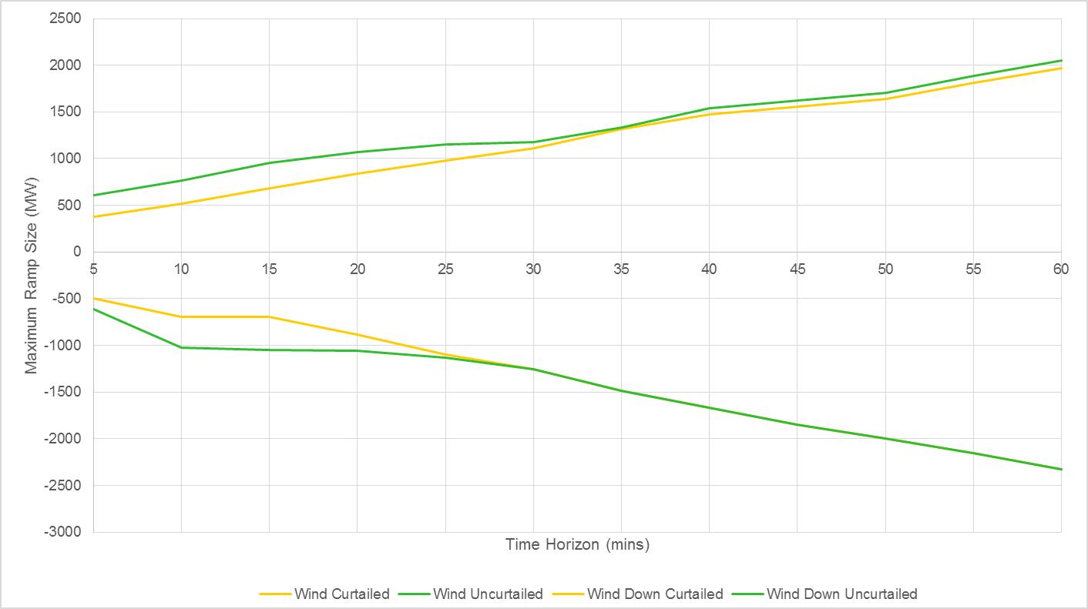
Curtailment – Impact on Wind Ramping
DVER can reduce wind ramp sizes, especially at very short intervals

Slide 21
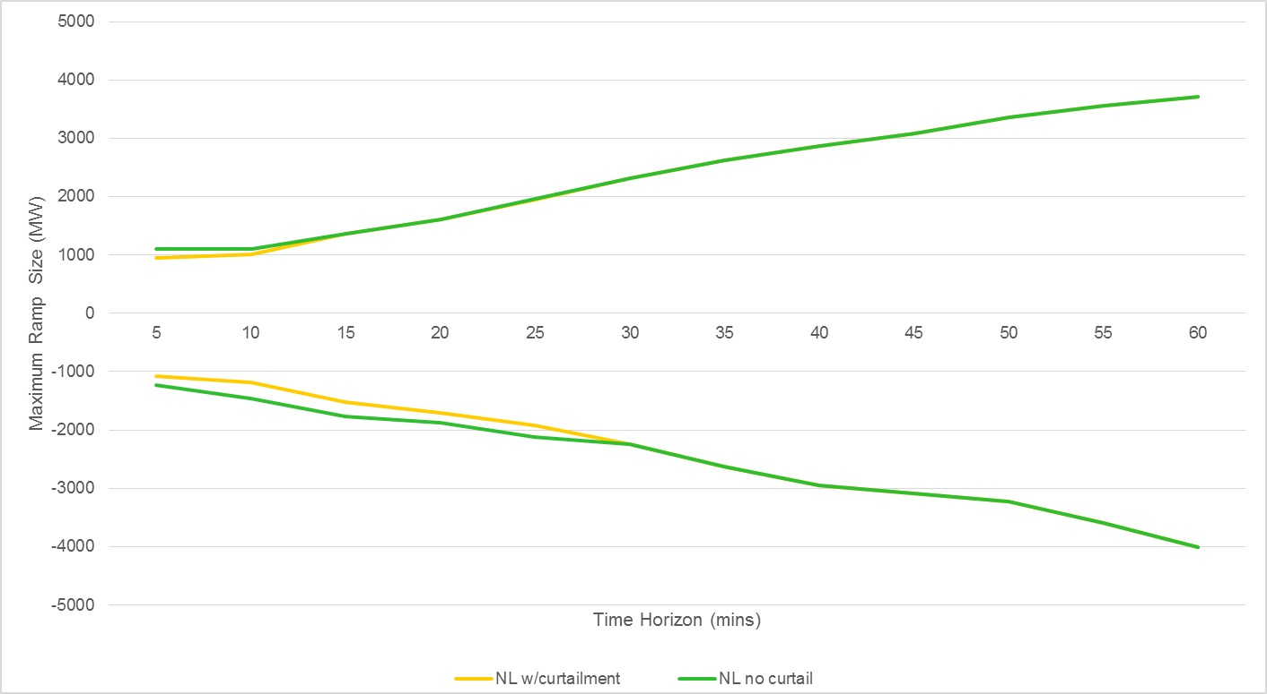
Curtailment – Impact on Net Load Ramping
DVER reduces net load variability, particularly down ramps

Slide 22
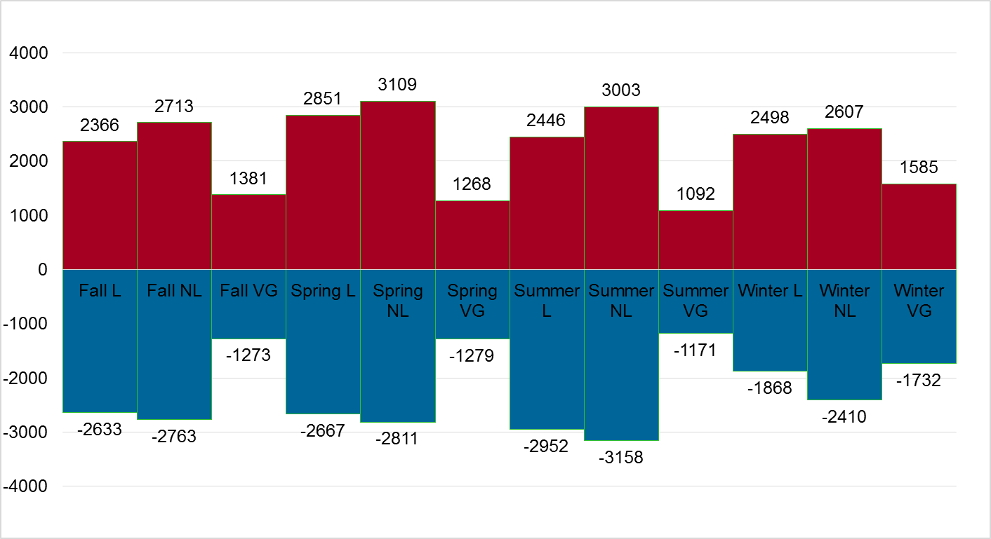
Seasonal Maximum 1-hour Wind Variability
Generally wind showed more variability in winter
But impact on net load was greater in summer for short time horizons (<3 hr)

Slide 23
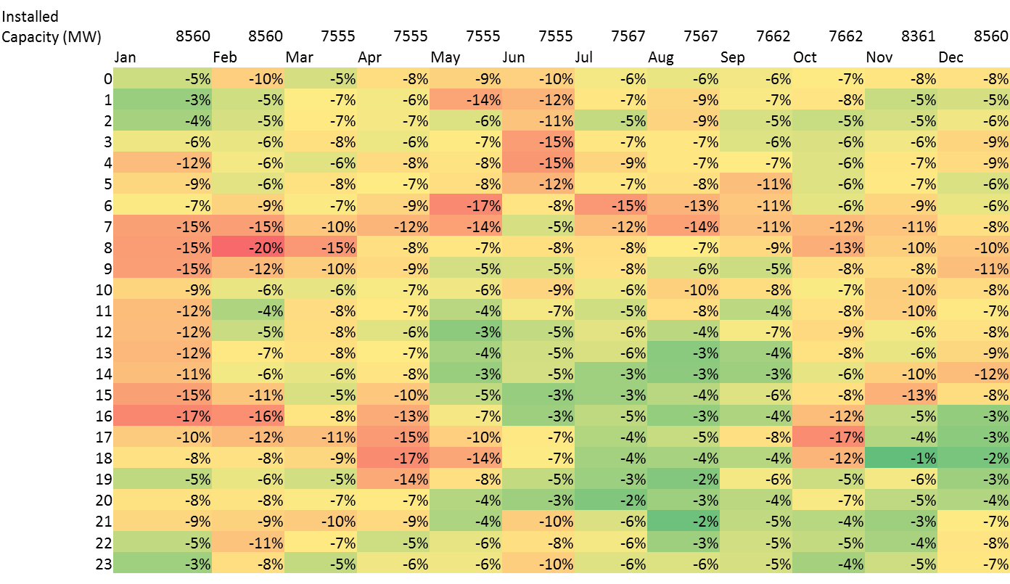
Largest 1-hour Wind Down Ramps by Hour of Day and Month
Largest ramps in morning, particularly during winter and spring

Slide 24
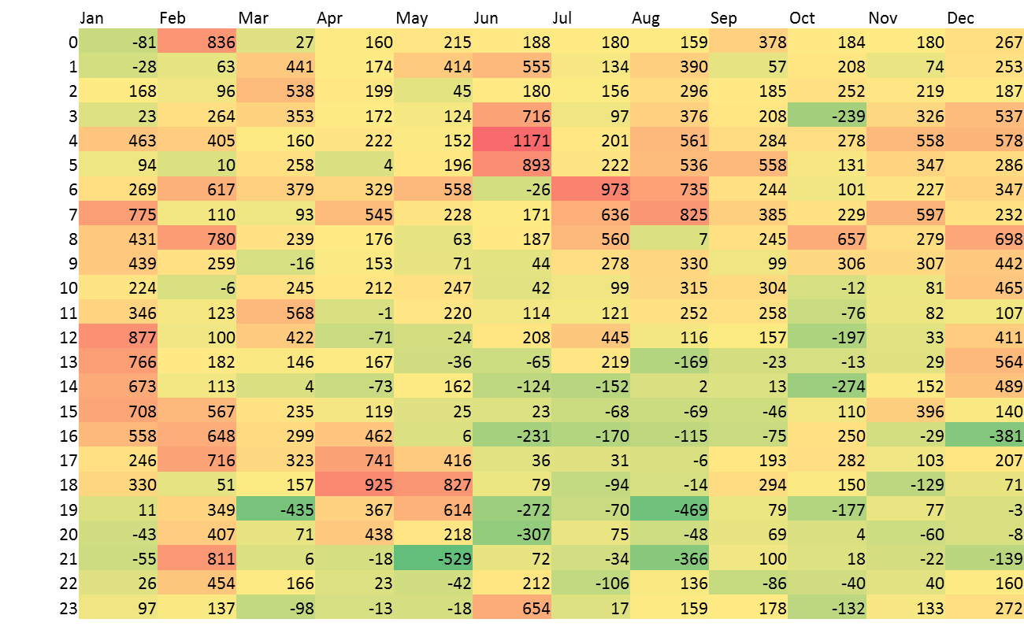
Impact of wind on largest 1-hour ramps by time of day and month
Wind Increases Ramping in Some Hours, Decreases In Others

Slide 25
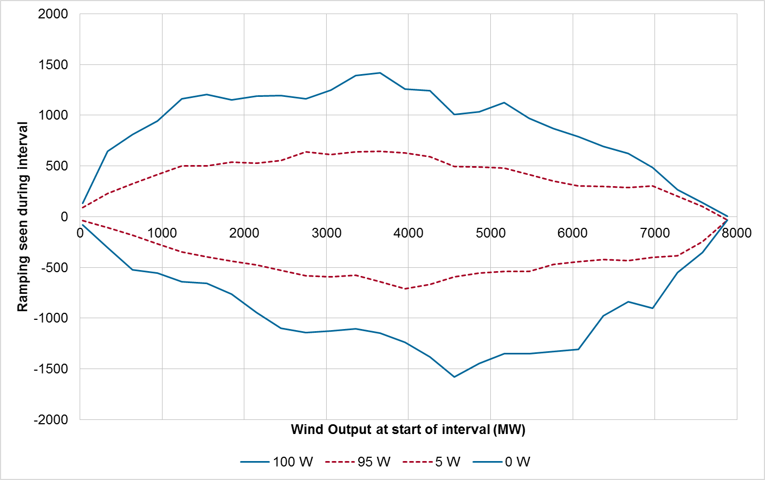
1-hour Wind Ramping as Function of Output – Maximum and 95th percentile

Slide 26
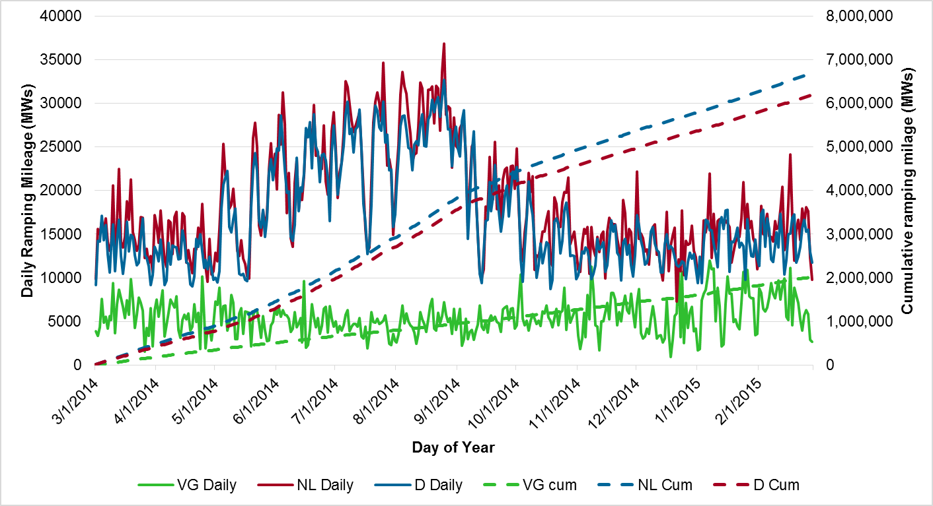
Inter-Hour Ramping Mileage
More general ramping behavior in hourly ramps when wind is added
Approx 10% more ramping mileage when wind is 12.2% of installed capacity

Slide 27
Flexibility Adequacy

Slide 28
Level 2 – Flexible Resources
Aim: Understand how much flexibility is available from system resources
Online Flexibility
Flexibility limited by
  Production level
  Ramp rate (MW/Min)
  Capacity (MW)
  Minimum generation level (MW)
  Minimum up time (hours)
Understanding the online flexibility available to the system will give an initial estimate of the overall flexibility of the system’s resources.
Offline Flexibility
Flexibility limited by
  Start up time (Hours)
  Minimum down time (hours)
  Run up rate (MW/Min)
  Outages and availability
Understanding the contribution of cycling resources to ramping needs is critical to managing longer time horizon ramps.
Increasing Speed
Battery HVDC Hydro Recip. Gas CT Gas CCGT Coal Nuclear
Increasing Quantity

Slide 29
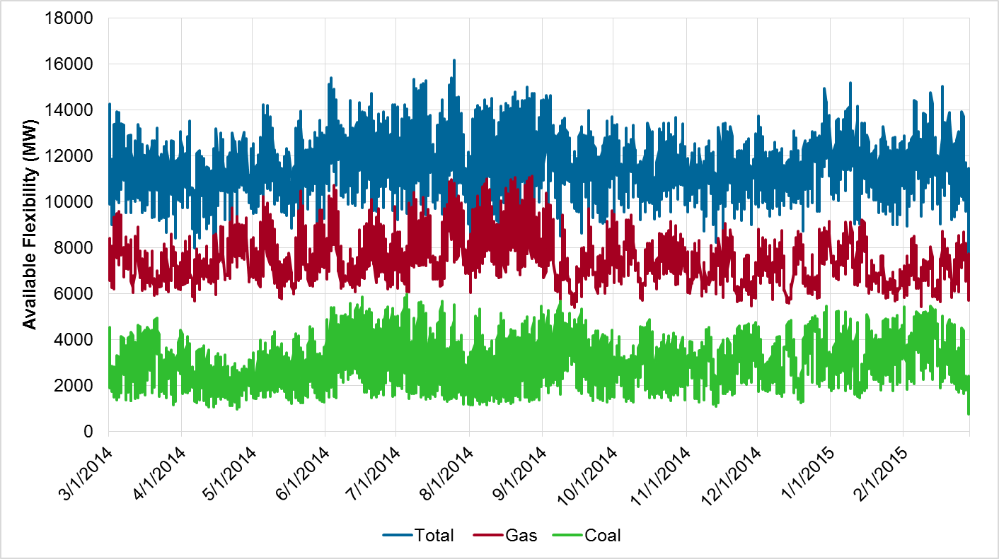
Available upwards 1-hour Flexibility by hour
Calculated based on actual dispatch – more than 8 GW ramp in most hours

Slide 30
Level 3 - System Flexibility Assessment
Operations
Planning
Ex-Post Analysis
NERC Standards
Control Performance Standards (CPS2)
Balancing Authority ACE Limit (BAAL)
Price spike magnitude and frequency
Load shedding incidents
Ex-Ante Analysis
Early stage development
Ramp Forecasting
Reserve price offers
Reliability Analysis
EPRI Flexibility Metrics
LOLE with Commitment & Dispatch
Generation Expansion
Early stage development
Probabilistic expansion planning
Monte Carlo scheduling and analysis

Slide 31
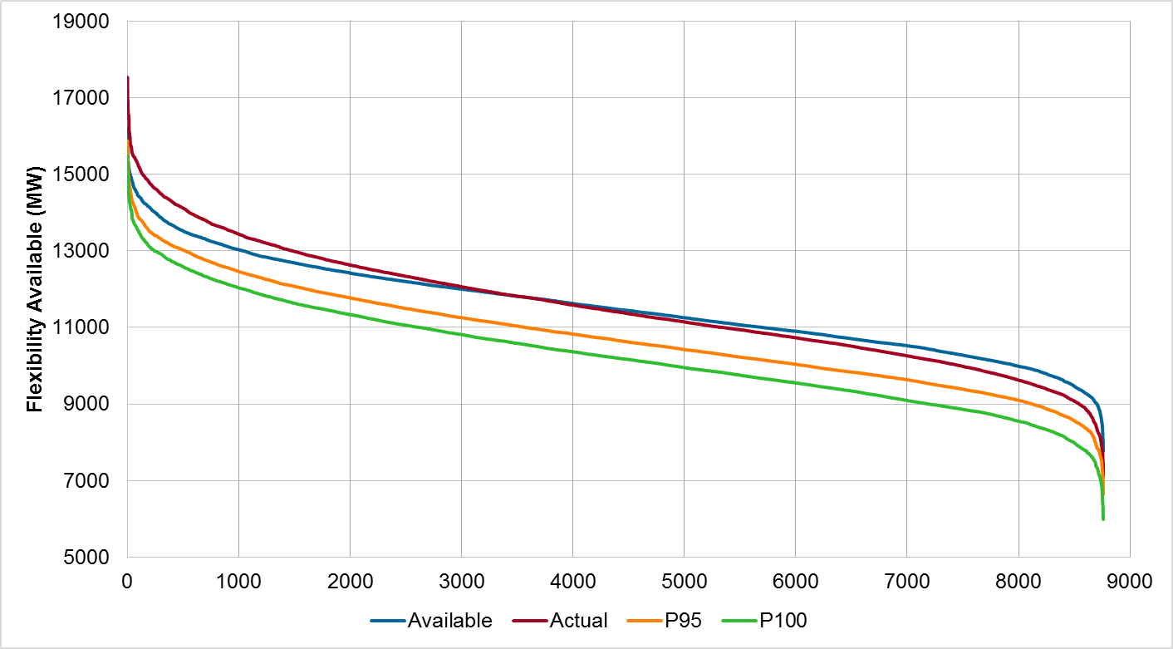
Flexibility Available and Net Flexibility Duration Curves
Sorted data from high to low ramping requirements, then subtracted actual or potential needs – always more than enough 1-hour ramping

Slide 32
Level 3 - System Flexibility Assessment – EPRI Metrics
Periods of Flexibility Deficit
Number of periods when the system has insufficient ramping capability to manage the expected ramping of the system’s net load
By: direction, time horizon and ramp percentile
Expected Ramping Unserved
Total shortage of flexibility when the system has insufficient ramping capability to manage the expected ramping of the system’s net load measured in MW
By: direction, time horizon and ramp percentile
Xth percentile up ramp
Xth percentile down ramp
Time Horizon

Slide 33
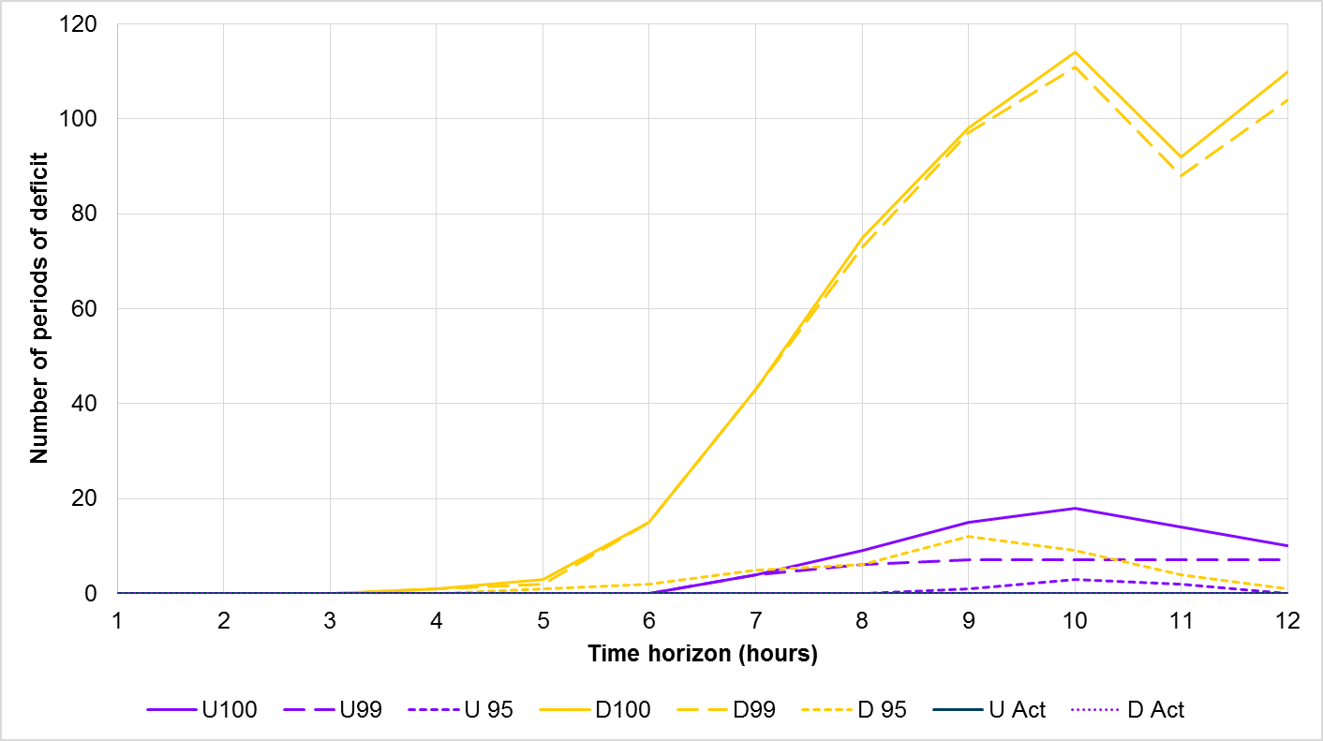
Periods of Flexibility Deficit
Longer time horizons may require redispatch/recommitment, particularly downwards load ramping which can be managed with DVER

Slide 34
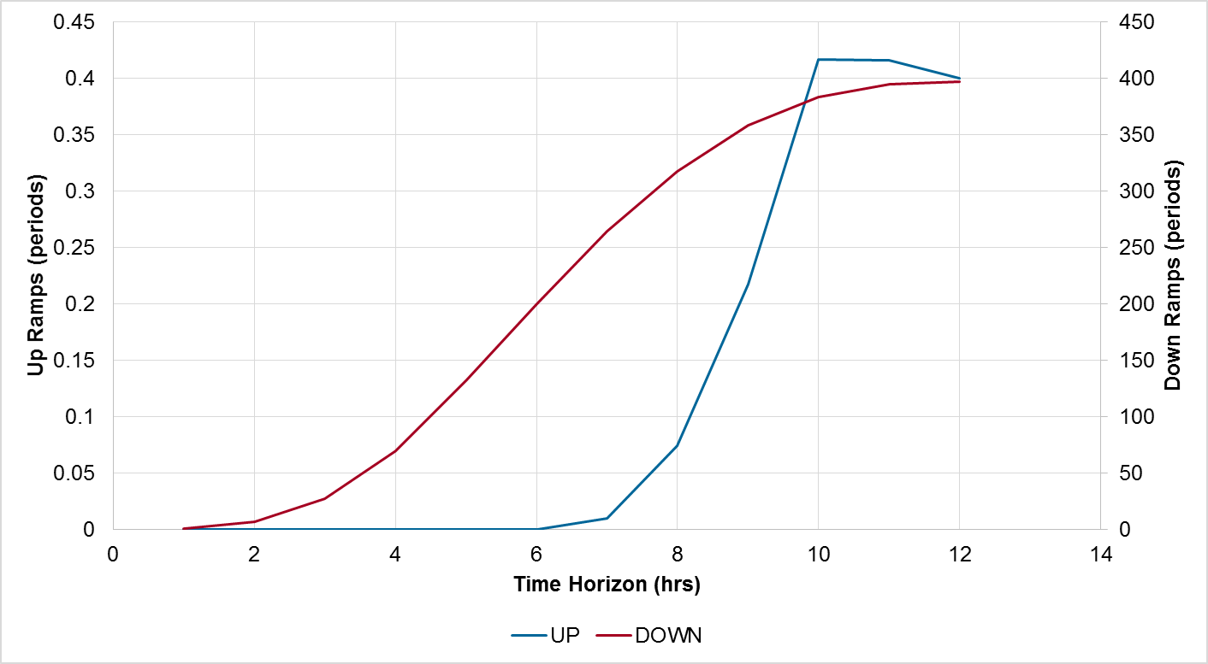
Insufficient Ramp Resource Expectation
Probabilistically, very little problems with upwards ramping but need to think about dispatching wind down relatively often

Slide 35
Summary and Conclusions

Slide 36
Summary
Increasing VG penetration is impacting system operations and may need to be considered in planning
Flexibility is needed to manage net load variability
Planning time frame methods and tools available
  Flexibility requirements
  Resource flexibility
  System flexibility assessment
Can be integrated into existing and evolving planning processes
  Production Cost Tools for Simulating Operation
  EPRI InFLEXion metrics to post-process historical or simulated data

Slide 37
Current R&D in the area of flexibility assessment
‘Deliverability’ of flexibility
  Developing and testing a number of methods for how flexibility is deployed through the network
  A number of methods were developed and are being tested on realistic systems (likely ERCOT)
  Aim is to understand how existing and new transmission can be used to provide flexibility
Resource Adequacy and Resource Expansion
  Understand how resource adequacy metrics such as Loss of Load Expectation can consider flexibility
  Investigate how standards such as Planning Reserve Margin can be adjusted to consider flexibility
  Examine if and how resource expansion tools should consider flexibility metrics
Demonstration of InFLEXion and development of guidelines
  Projects to demonstrate the metrics, with vertically integrated utilities and ISOs, and improvements to InFLEXion through working with multiple end users
  Improving data handling capabilities and user interface of InFLEXion and vendor engagement to transfer technology (long term plan is to get metrics into vendor tools)
  Guidelines for flexibility assessment for utility/ISO planners based on experience to date

Slide 39
Appendix/Additional Materials

Slide 40
Integrated Grid: Benefit Cost Framework
Distribution System
Hosting Capacity
Energy
1
4
Thermal Capacity
Reliability
Benefit/Cost
Core Assumptions
System Net Costs
Societal Costs/Benefits
Market Conditions
3
6
Adoption/ Deployment Scenarios
System Benefits
Customer or Owner Cost/Benefits
Bulk System
Resource Adequacy
Transmission Performance
2
Flexibility
Transmission Expansion
5
Operational Practices & Simulation
Notes:
In the IG Framework, Bulk Power System (BPS) analyses interact with other utility operations:
Two way flow of information to and from Dx process to identify and quantify impacts
Pass impacts to Benefit/Cost analyses for monetization and characterization
Collaborative definition of scenarios to consider with DER study focus and distribution system characterization
The depth of modeling of BPS operation requires extension of existing processed and procedures
Coordination and interstation of planning and operational activities
More detailed analysis of process
New models and modeling protocols

Slide 41
Integrated Grid: Bulk System Analysis
2 FLEXIBILITY
Value:
Measures system flexibility based on variability and uncertainty in the system
Provides input into transmission and generation expansion processes on kinds of flexibility required by system (e.g. short term or long term flexibility)
3 OPERATIONAL SIMULATION
Value:
Examines the functioning of the system under future scenario
Provides cost and resource operation information which guides investment options
Evaluates the effectiveness of operational policies (e.g. reserve, scheduling times, etc.)
4 TRANSMISSION PERFORMANCE
Value:
Evaluates the performance of the future transmission network in future scenarios
Considers thermal, PQ, protection and frequency impacts as well as losses.
Contributes to decisions on transmission and resource expansion
1 RESOURCE ADEQUCY
Value:
Measures system generation adequacy
Proposes actions to change generation resources to meet reliability with requirements
Provides system information for other core processes
5 TRANSMISSION EXPANSION
Value:
Evaluates potential transmission expansion options to improve performance to expected levels
Determines minimum mitigation cost for selected scenario
Provides input into operational simulation process
1 RESOURCE ADEQUCY
2 FLEXIBILITY
3 OPERATIONAL SIMULATION
5 TRANSMISSION EXPANSION
4 TRANSMISSION PERFORMANCE
Notes:
Tried to capture the main processes which would result in costly or significant impacts
Some aspects have less emphasis, like SSO and protection
Walk through each of the processes
Then the overall flow of data from left to right
No new analysis: rather it draws together and coordinates what traditionally have been separately undertaken (disparate – means different, not strong enough) analyses of operations and planning

Slide 42
Flexibility Considerations & Metrics
Many Regions (Regulators + ISO+ Utilities) Considering Future Flexibility Needs Now
  Planning and Operations time frame
Other systems experiencing similar needs (Renewables and/or Retirements)
  Germany, Spain, New York, Hawaii etc.
New flexible resources now becoming deployable in the bulk system
California Flexible Resource Adequacy Flexi-Ramp Market Product Long Term Procurement Plan | Ireland Long Term Flexibility Incentives
Oregon Integrated Resource Planning Process | MISO Market Rule Changes to Incentivize Flexibility

Slide 43

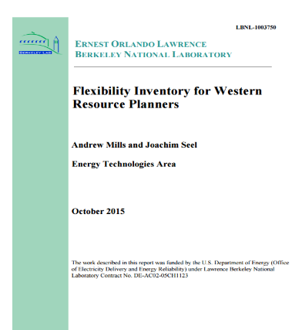


Industry Activities and Coordination – Flexibility Assessment
CES-21 flexibility metrics project (PG&E, SDG&E and others)
Northwest Power and Conservation Council 2014/2015 flexibility study
NERC Essential Reliability Services Task Force – Ramping
SPP Wind Integration Study – Ramping Task
Many others….

