Slide 1
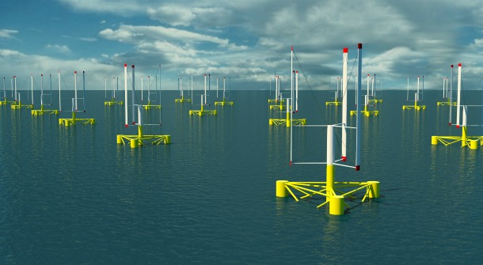
An Experimental Investigation on Loading, Performance, and Wake Interactions between Floating VAWTs
____________________________________________
Morteza Khosravi
18 Oct. 2013

Slide 2
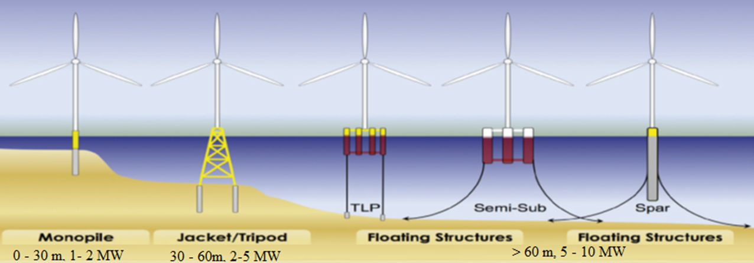
Introduction & Background
Oceans are dynamic environments, containing many different types of energy sources.
  Wind, tides, current, waves, etc.
Offshore wind turbine technology
Classification of offshore wind substructures:
  Shallow water: 0-30 m depth, turbine is being fixed to the sea floor. Monopile, Gravity
  Intermediate waters:30-60 m, turbine is being fixed to the sea floor. Jacket, Tripod
  Deep waters: > 60 m depth, turbine is being floated on the water.

Slide 3
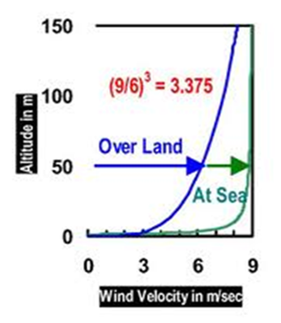
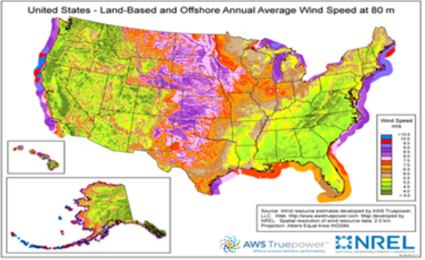
Reasons for going offshore
Vast availability of areas offshore suitable for wind farm development, since 71% of the Earth is covered by water.
Wind farms can strategically be placed offshore near the
major load centers, but far enough offshore so that the
visual and sound issues will not impact the coastal residents.
The blade size is not limited by inland transportation, hence multi-megawatt turbines usually in the range of 10MW can easily be placed offshore.
Multi-pole generators may be used in big
offshore wind turbines which eliminates the
need for a gear box, hence reducing the
cost of O&M.

Slide 4
But why do we need to float the turbines

Slide 5
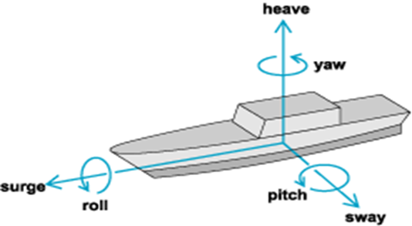
Deep Water Technologies
In deep waters (depth > 60m), the turbines need to be floated.
Common types of floating platforms include:
  Tension-Leg Platform (TLP)
  Spar Buoy
  Semi-Submersible
Offshore structures have 6 D.O.F.
  3 displacements: Surge, Sway, Heave
  3 rotations: Roll, Pitch, Yaw

Slide 6
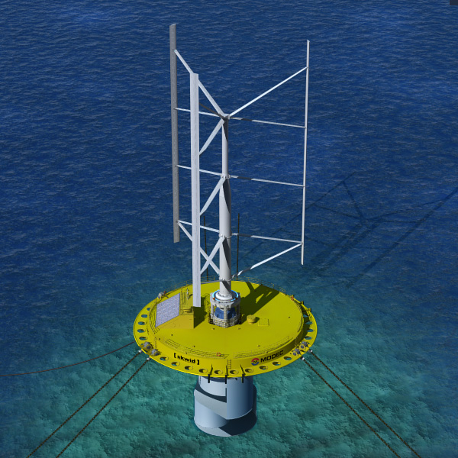

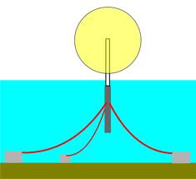
Stability and Mooring lines
Stability is an issue with floating turbines
  HAWT vs. VAWT
Mooring lines (tendons) functions:
  Keep turbines in place
  Tensions help stabilize the turbines
    The horizontal component of the tension force in the
    lines counteracts the lateral loads.
    The vertical component will counteract the bouncy
    force.

Slide 7
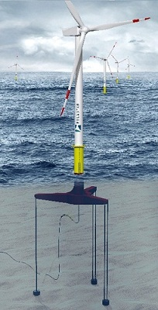
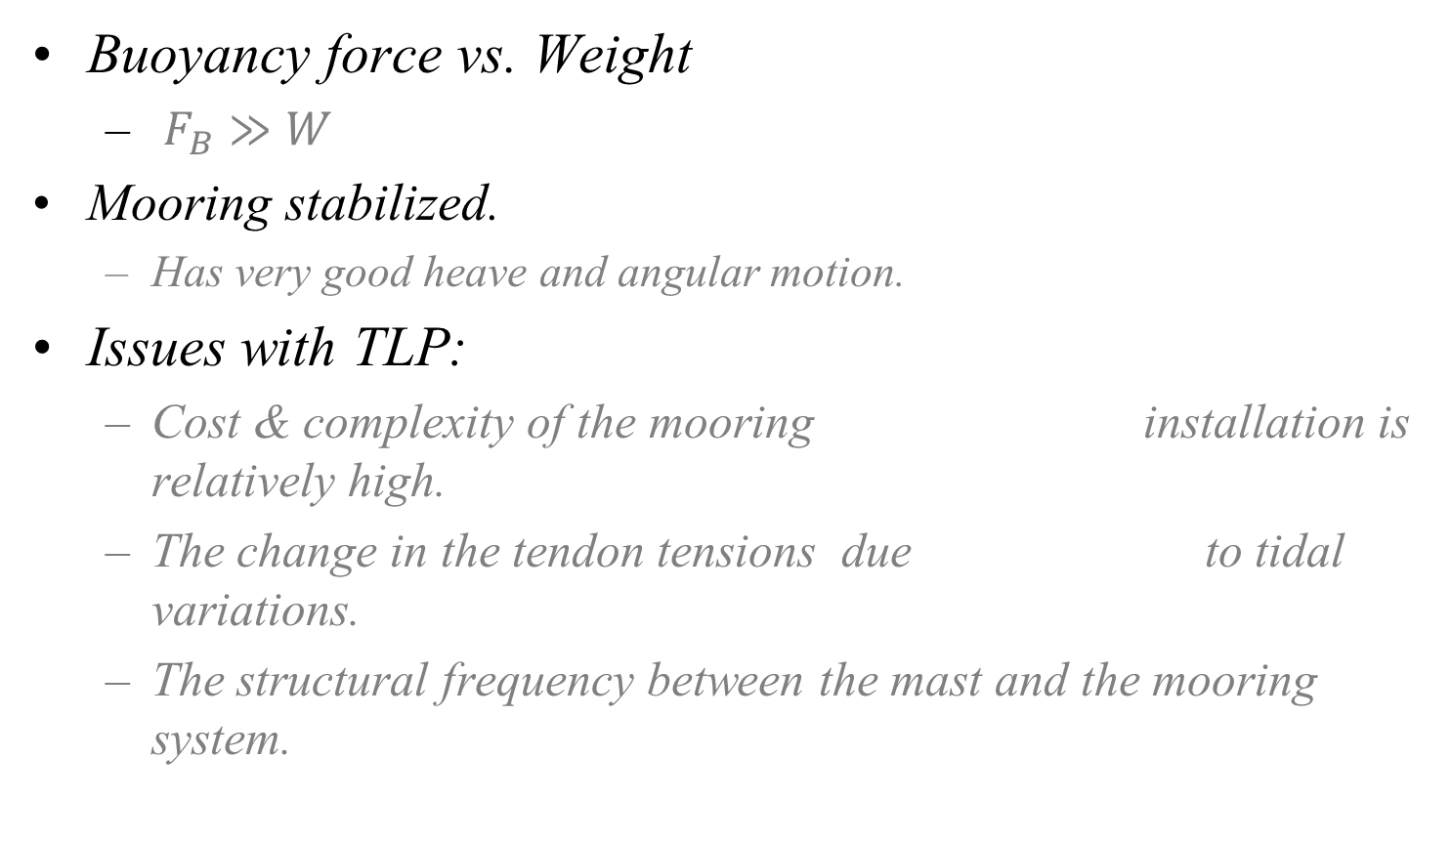
Tension-Leg Platform (TLP)
Buoyancy force vs. Weight
  $F_{B}≫W$
Mooring stabilized.
  Has very good heave and angular motion.
Issues with TLP:
  Cost & complexity of the mooring installation is relatively high.
  The change in the tendon tensions due to tidal variations.
  The structural frequency between the mast and the mooring system.

Slide 8
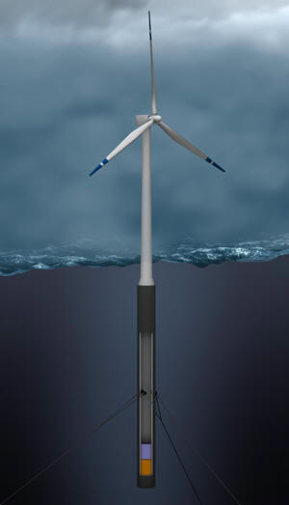
Spar Buoy Floater
A long closed cylinder that floats vertically below the sea surface.
Ballast stablized.
  CG located below CB.
Have very deep draft.
  Hywind project by Statoil deployed a 2.3MW in water depth
  of 200m using spar buoy with draft in excess of 100 m.
Uses taut lines and drag anchor to hold it in place.
  The horizontal component of the tension force in the lines counteracts the lateral loads.
  The vertical component will counteract the bouncy.

Slide 9
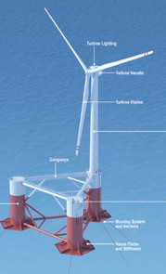
Semi-Submersible Platform
Essentially a floating deck supported by few
submerged columns.
Buoyancy stabilized.
Windfloat project
  By Principle Power
  Deployed a 2MW turbine off the coast of Portugal.
  Turbine placed on one of the hallow columns.
  Used 4 slack catenary mooring lines.
DeepCWind project
  By the Univ. of Maine
  Composed of 3 light weight concrete columns.
  Turbine placed in the center of the platform
  Uses only 3 slack catenary lines.

Slide 10
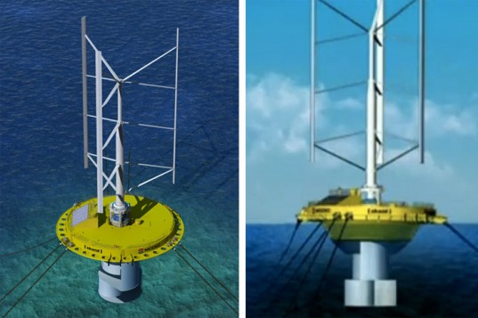
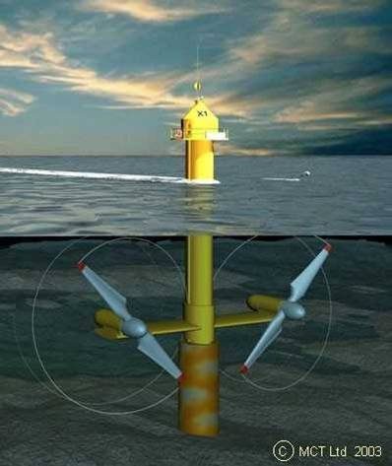
Offshore Hybrid technologies
The cost of offshore wind is still 50% more expensive than onshore wind.
To offset the cost of offshore wind energy, it is possible to combine different energy technologies.
The 1st offshore hybrid wind-current farm will be deployed off the coast of western Japan.

Slide 11
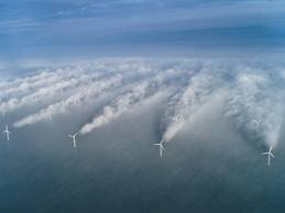
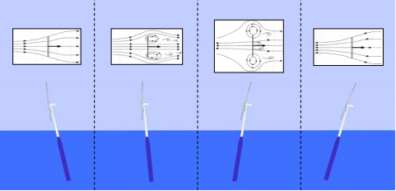
My Research
My research will mainly focus on the following areas:
  To experimentally investigate the wake recovery and wake interaction between VAWTs for both onshore and offshore cases.
  To perform an experimental study on the effects of floating platform motions on wind turbine loading and performance.
  To perform a numerical study and compare with my experimental results.

Slide 12
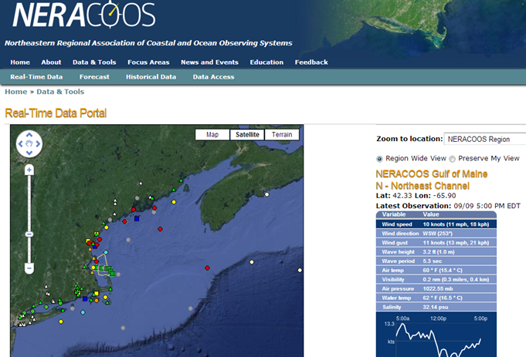
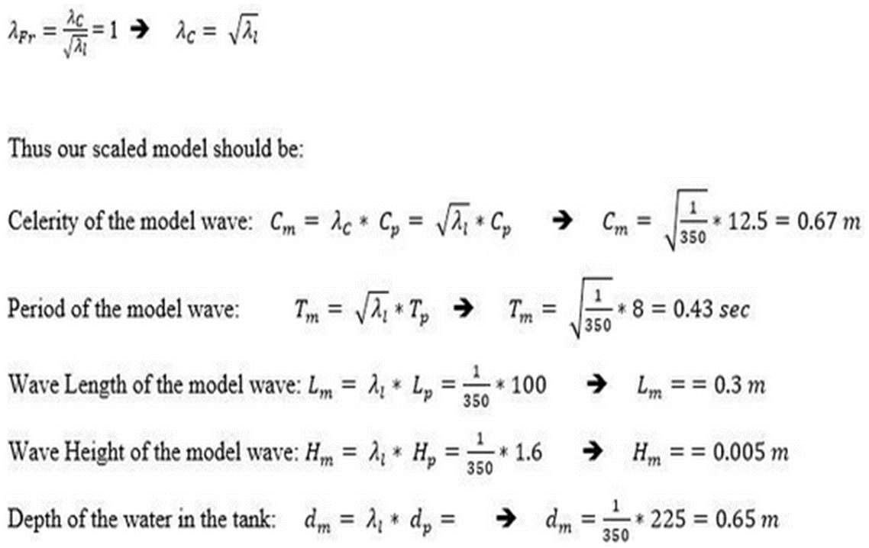
Starting my research
Steps in doing my research:
  1st: Design a VAWT and optimize it for best performance.
  2nd: Choose a specific offshore location and determine the scaling.
  3nd: Wind tunnel testing to get some initial data.
  4th: Wind-wave basin testing.
  5th: Comparing my experimental results with numerical tools.

Slide 13
________________________________
Thank you for your attention
Questions?
________________________________

