Slide 1


Valuing Ecosystem Services
Catherine L. Kling
Economics, Iowa State University
Center for Agricultural and Rural Development (CARD)
WESEP 594
April 4, 2013

Slide 2
Outline
Define externality and “Value” as used in Cost Benefit Analysis, NRDA, and economics in general
Categories of Services that Create Value
Valuation Methods
Wind Energy Applications

Slide 3
Externality
Production of many goods are associated with externalities --- a form of market failure
Externality = unintended side effect of production that imposes costs on others
Market outcomes are not efficient when externalities are not accounted for
Lots of examples from production of energy

Slide 4
Value from Ecosystem Services
Concept of “Economic Value” applies to all goods
  Private, public, nonmarket, market, environment, etc.
  Marshall (1890, “Principles of Economics)
Premise: people take their personal resources (time, income) and allocate it to make themselves and families as well off as possible
  They consider their likes, time, concern for nature, altruism etc.
  To do this, they make trade-offs
Economic value of a good measures how much people are willing to give up to of other goods to attain or keep the good in question

Slide 5
Maximum Willingness-to-Pay (WTP)
Economic Value of a good or service = maximum amount an individual is willing to pay for a good or service
  Do people want to pay this? No, but they would rather pay it than be forced to live without the good
  Do they have to pay it? No, but would be willing to rather than be forced to do without the good
  If they get it for less, then they get surplus.
Asides on WTP
  Anthropocentric
  Values are not intrinsic to a good
    Units of “energy” or “species richness” intrinsic to a good doesn’t work unless they translate into something valuable to people
    this DOES NOT mean mere existence preservation of natural world is not valuable (I value it, do you?)

Slide 6
Ecosystem Services and Markets
Market Goods
  Estimate demand
  Sometimes prices alone enough
  Hard, but market data available
Nonmarket Goods=goods for which markets do not exist
  water quality, biodiversity
  health, safety, and environmental goods generally

Slide 7
Ecosystem services
From the Millenium Ecosystem Assessment: Ecosystem services are the benefits people obtain from ecosystems. These include:
Provisioning services such as food and water;
Regulating services such as regulation of floods, drought, land degradation, and disease;
Supporting services such as soil formation and nutrient cycling; and
Cultural services such as recreational, spiritual, religious and other nonmaterial benefits.

Slide 8
Economic Impact
Economic Impact, amount of economic activity lost or gained in local community induced by ecosystem services
Local economic impact = how many dollars exchange hands near the lake
  Useful and relevant for some questions, but not cost-benefit assessments
  Represents benefits of economic activity to a region, but some of that activity comes at expense of activity elsewhere
Notes:
Too much on this slide, but I did not split it up into two slides in case you just want to cut out part of it. I don’t know if you want to mention the Local Economic Impact survey or not, or how much detail is needed in how we value a public good.

Slide 9
Methods for Empirically Measuring the Value of Changes in Ecosystem Services
  Revealed Preference Studies
    Look for behavior and changes in behavior that reveal tradeoffs
    Recreation demand studies
    House prices related to ecosystem amenities
    Wage studies
  Stated Preference Studies
    Direct questioning about tradeoffs
    Contingent Valuation
    Choice Experiments

Slide 10
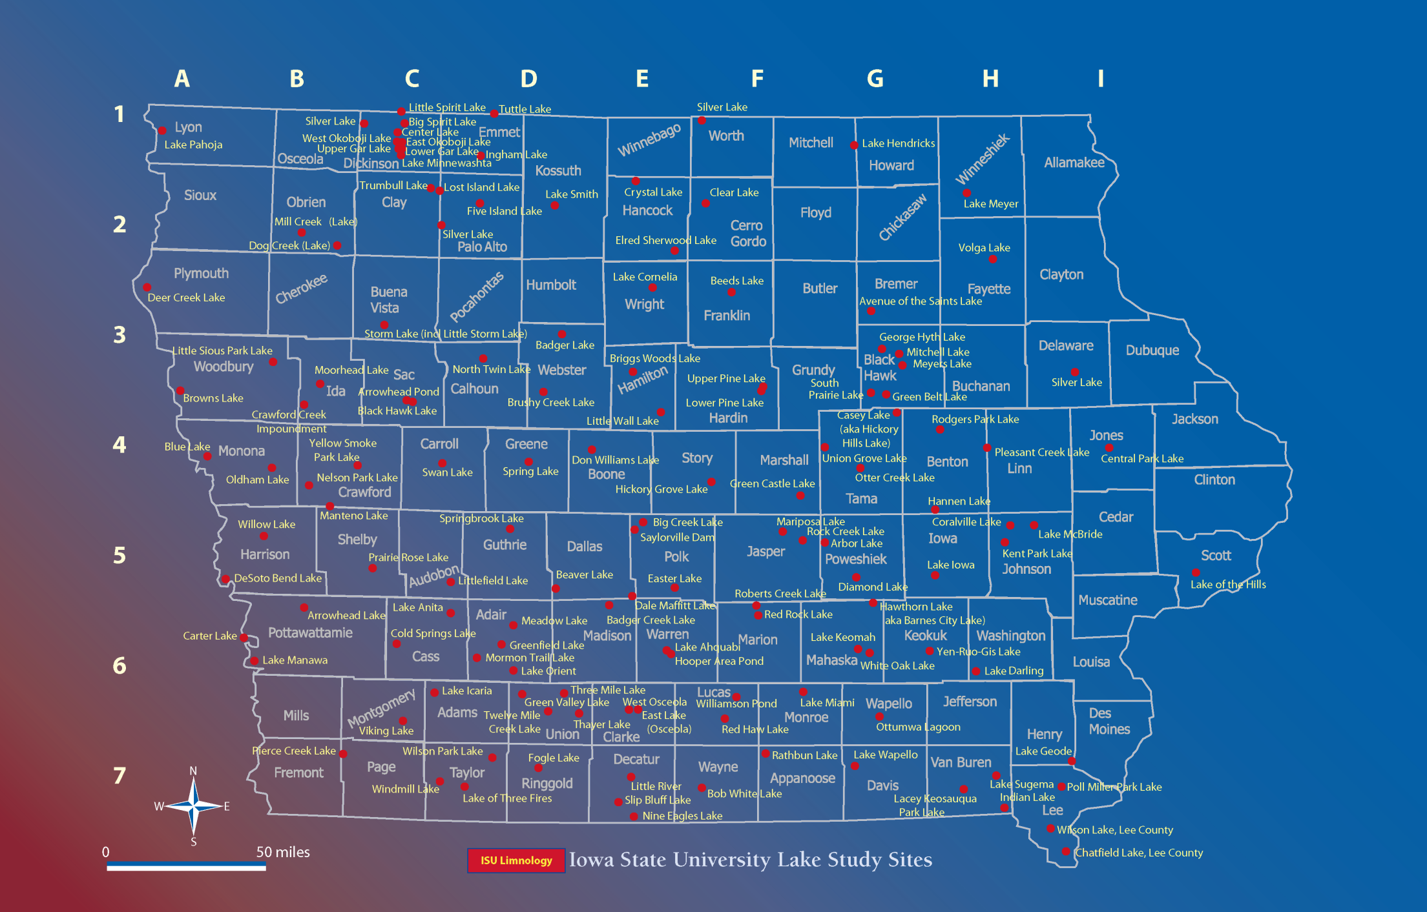
Using Travel Patterns to Reveal Valuation

Slide 11
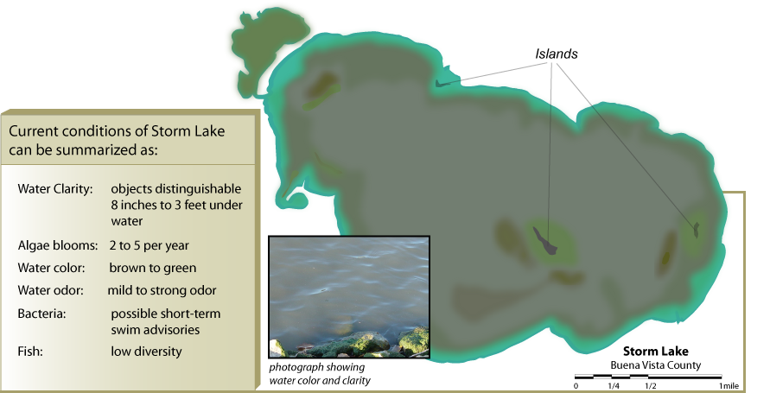
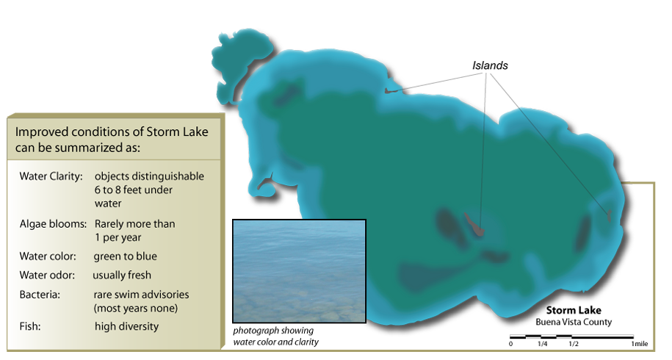
Stated Preference Question: Would you be willing to pay $25/year in property taxes to support a project to improve the conditions of Storm Lake to those described below?

Slide 12
CE Landry, T Allen, T Cherry, JC Whitehead. “Wind turbines and coastal recreation demand,” Resource and Energy Economics, 34 (2012), pp. 93–111
Examine impact of coastal wind turbines on recreation and coastal tourism in North Carolina
Use both stated and revealed preference information
East Carolina Center for Survey Research phone survey:
  Summer 2009
  $20 gift cards as incentive
  Contacted 1162 households, 361 completed
  Of 361, n=118 participated in internet follow up

Slide 13
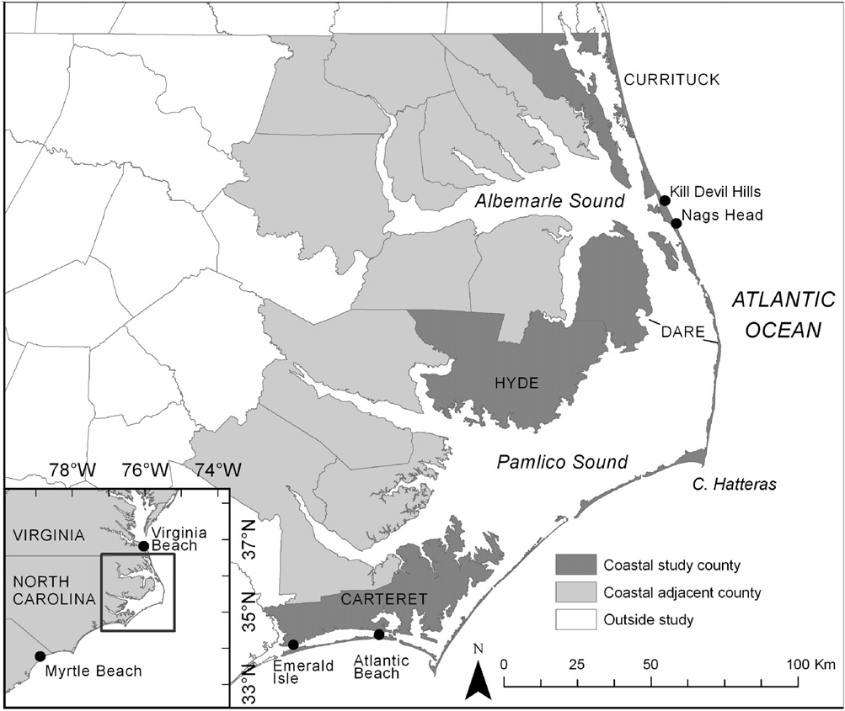
Figure 1: Study area location

Slide 14
Data and Contingent Scenarios
How many visits did you take to NC beaches in the last year? Where do you plan to go next year?
‘‘Now we are interested in how your beach trips might change if there are wind farms in North Carolina.
Scenario 1: Suppose that a wind farm is built at _____ [insert beach respondent is most likely to visit]. The wind farm has 100 windmills, standing about 400 feet high and 1 mile from the shore. The next time you go to the beach would you still go to this beach, a different beach without a view of a wind farm, or would you take no beach trip at all?
Scenario 2: Now suppose that similar wind farms are built at each of the 31 major beach towns in North Carolina. How many total beach trips would you expect to take to North Carolina beaches in the next 12 months?’’

Slide 15
Telephone Data (Taken from their Table 1)
Definition | Raw
Total trips to NC beaches in previous 12-months (RP) | 11.81 (18.08)
Single-day trips to NC beaches in previous 12-months (RP) | 8.57 (16.36)
Overnight trips to NC beaches in previous 12-months (RP) | 3.12 (6.74)
Trips to NC beaches over next 12-months under current conditions ( | 14.76 (40.84)
Trips to NC beaches over next 12-months w/wind farms (SP) | 14.10 (41.48)
Respondent would visit same beach under wind farm scenario | 0.89 (0.32)
Respondent would visit different beach under wind farm scenario | 0.06 (0.24)
Respondent would visit no beach under wind farm scenario | 0.05 (0.21)
Very or somewhat concerned over climate change | 0.72 (0.45)
Strongly or somewhat agreed that most recent climate change is due to manmade pollution | 0.91 (0.39)
Strongly or somewhat support coastal wind energy development | 0.91 (0.28)
Very positive or positive impact of wind farms on view at the beach | 0.53 (0.50)
Strongly or somewhat support wind energy development at nearest beach | 0.88 (0.33)
Strongly or somewhat support wind energy development at all NC beaches | 0.84 (0.37)
Travel cost to NC beach (closest of Nags Head or Atlantic beach) | 160.86 (477.44)
Household income (in thousands) | 78.80 (50.27)
Male respondent | 0.38 (0.48)
Respondent age | 54.65 (15.34)
Less than High School education | 0.03 (0.16)
College or graduate school is highest educational attainment | 0.42 (0.49)
Member of environmental organization | 0.11 (0.31)
Respondent considers themselves politically liberal | 0.17 (0.37)

Slide 16
Internet Data
Choice experiment – visualization of beaches with and without turbines and other characteristics (including travel cost)
Imagine you are deciding on a destination for a single-day beach trip (i.e., no overnight stay). In what follows we have laid out a set of alternatives for this decision. Each alternative is described by characteristics of the available sites. The characteristics have a number of levels. The characteristics and possible levels are below:

Slide 17
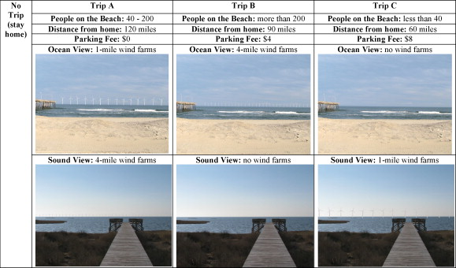
Fig. 2 Example of choice set for beach site choice experiment.
Craig E. Landry , Tom Allen , Todd Cherry , John C. Whitehead Wind turbines and coastal recreation demand
Resource and Energy Economics Volume 34, Issue 1 2012 93 – 111 http://dx.doi.org/10.1016/j.reseneeco.2011.10.001

Slide 18
Table 3. summary stats
Variable | Definition | Obs | Raw | Weight | Census
adjacent | Resident of adjacent county | 118 | .64 (.48) | .77 (.42)
ocean | Resident of ocean county | 118 | .36 (.48) | .23 (.42)
t_trips1 | Total trips to NC beaches in previous 12-months (RP) | 112 | 43.16 (95.77) | 27.77 (73.57)
inc | Household income (in thousands) | 97 | 88.56 (46.16) | 63.11 (43.26) | 42.25
male | Male respondent | 111 | .37 (.48) | .33 (.47) | 0.486
age | Respondent age | 109 | 51.38 (13.86) | 51.96 17.73 | 39.662
hschool | High School is highest educational attainment | 112 | .13 (.34) | .49 (.50) | 0.323
some_coll | Some college is highest educational attainment | 112 | .27 (.44) | .29 (.45) | 0.287
college | College or graduate school is highest educational attainment | 112 | .58 (.50) | .18 (.38) | 0.170
env_org | Member of environmental organization | 108 | .14 (.35) | .12 (.32)
liberal | Respondent considers themselves politically liberal | 112 | .19 (.39) | .10 (.30)

Slide 19
Table 5. Conditional expected demands, elasticities, and welfare estimates.
 | Raw data | Weighted data
E[y₁|x_{ij}] (RP) | 12.88 | 11.54
E[y₂|x_{ij}] (SP) | 16.40 | 12.96
E[y₃|x_{ij}] (SP_wind) | 15.60 | 13.07
ɛ_{op}: own-price elasticity (RP) | −1.41 | −1.89
ɛ_{op_future}: own-price elasticity (SP) | −1.61 | −2.16
ɛ_{op_future_wind}: own-price elasticity (SP_wind) | −1.62 | −2.21
ɛ_{cp_MB}: cross-price elasticity for Myrtle Beach | 1.83 | 1.75
ɛ_{cp_VB}: cross-price elasticity for Virginia Beach | 1.31 | 1.07
ɛ_{inc}: income elasticity | −0.25 | −0.32
Consumer surplus (RP) (95% confidence interval) | $1456.30 ($1227.73–$1784.90) | $1082.08 ($890.49–$1375.25)
Consumer surplus (SP) (95% confidence interval) | $1635.86 ($1387.86–$1988.40) | $1068.41 ($888.63–$1336.75)
Consumer surplus (SP_wind) (95% confidence interval) | $1539.91 ($1313.48–$1865.61) | $1050.70 ($877.86–$1312.05)

Slide 20
Table 7. Welfare estimates for visualization choice experiment.
 | Raw data | Weighted data
No-trip | $341.25 ($290.24, $394.22) | $270.14 ($196.81, $342.89)
Park_fee | $11.99 ($8.59, $15.38) | $9.95 ($6.16, $13.93)
Medium congestion | $20.81 (−$7.85, $47.96) | −$6.24 (−$36.25, $21.70)
High congestion | $104.69 ($72.09. $141.13) | $32.39 (−$1.76, $69.33)
Ocean1 | $102.48 ($56.95, $140.75) | $54.58 ($5.07, $103.47)
Ocean4 | −$2.24 (−$35.37, $29.19) | −$18.77 (−$57.37, $26.32)
Sound1 | −$1.03 (−$31.76, $28.70) | $26.25 (−$9.20, $65.79)
Sound4 | −$42.25 (−$83.62, $1.35) | −$6.92 (−$39.46, $27.34)
  The numbers in parentheses are 95% confidence intervals for WTP.

Slide 21
Their conclusions
“Overall, we find little impact of offshore/sound wind turbines on recreational visitation of regional residents. Respondents to the telephone survey took around 9 trips to beaches in the previous 12 months, plan to take almost 10 trips in the next year, and will take approximately the same number of trips if wind turbines were built at each of the 31 major beach towns in North Carolina”

Slide 22
Review piece on wind externalities
Ladenburg, J. and S. Lutzeyer (2012). "The economics of visual disamenity reductions of offshore wind farms—Review and suggestions from an emerging field." Renewable and Sustainable Energy Reviews 16(9): 6793-6802.
“Offshore wind farms close to shore generate cheaper electricity, but also cause higher levels of visual impacts”
This paper reviews several studies (European)to quantify this externality (disamenity)

Slide 23
Offshore wind turbines
More costly to develop and operate, but
  Better wind conditions
  Lower visual impacts
  Lower noise impacts
Report by European Environment Agency (2009) : investment costs increase linearly with distance from shore, exponentially with water depth
This provides cost estimates, what about benefits from lowering the externalities?

Slide 24
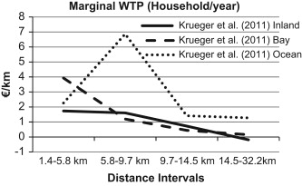
Fig. 1 Marginal benefits of moving an offshore wind farm an additional km from the coast, based on Krueger et al. <ce:cross-ref refid="bib40"> [40]</ce:cross-ref> .
Jacob Ladenburg , Sanja Lutzeyer
The economics of visual disamenity reductions of offshore wind farms?Review and suggestions from an emerging field
Renewable and Sustainable Energy Reviews Volume 16, Issue 9 2012 6793 - 6802
http://dx.doi.org/10.1016/j.rser.2012.08.017

Slide 25
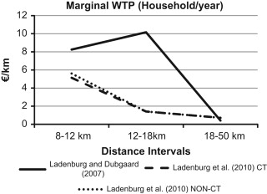
Fig. 2 Marginal benefits of moving an offshore wind farm an additional km from the coast, based on Ladenburg and Dubgaard <ce:cross-ref refid="bib34"> [34]</ce:cross-ref> and Ladenburg et al. <ce:cross-ref refid="bib36"> [36]</ce:cross-ref> .
Jacob Ladenburg , Sanja Lutzeyer
The economics of visual disamenity reductions of offshore wind farms?Review and suggestions from an emerging field
Renewable and Sustainable Energy Reviews Volume 16, Issue 9 2012 6793 - 6802
http://dx.doi.org/10.1016/j.rser.2012.08.017

Slide 26
Some Additional References
Champ, Boyle, and Brown. A Primer on Nonmarket Valuation: the Economics of NonMarket Goods and Resources, Kluwer, 2003
Arrow et al. Report of the NOAA Panel on Contingent Valuation, Federal Register 58, 10, January 1993
Batemena and willis.Valuing Environmental Preferences: Theory and Practice of the Contingent Valuation Method in the US, EU, and Developing Countries. 1999, Oxford
Valuing the Protection of Ecological Systems and Services: a Report of the EPA Science Advisory Board, 2009
Carson and Hanemann. “Contingent Valuation,” in Handbook of Environmental Economics, 2005

Slide 27
Carson, bibliography of over 2000 contingent valuation/stated preference studies
Haab and McConnell, 2002 Valuing Environmental and Natural Resources, Elgar
National Research Council, 2004. Valuing Ecosystem Services: Toward Better Environmental Decision-making, National Academies Press

