Slide 1
Increased Energy Efficiency of Permanent Magnet Generators for Wind Turbines
Helena Khazdozian
WESEP
Major Department: Electrical Engineering
Major Professor: Dr. David Jiles

Slide 2
Outline
Problem Definition
Commercial Wind Turbines
Permanent Magnet Generators
Magnetic Materials
Soft Magnet Materials
Hard Magnet Materials
Alternative Materials
Approach to Research

Slide 3
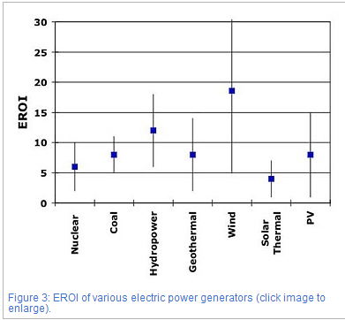
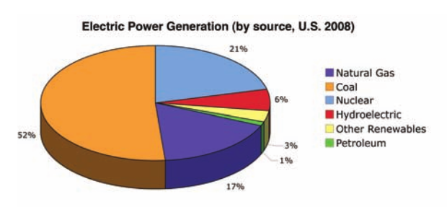
Problem Definition
Broad Definition: Energy Crisis!
U.S. relies on fossil fuels to generator power
Contributes to climate change
Solution: Wind Energy
Energy return on investment (EROI)
EROI = $\frac{cumulative electricity generated}{cumulative primary energy required }$
Source: O. Gutfleisc et al, Adv. Mater. 23, 2001, 821-842
Source: I. Kubiszewski, C. Cleveland, “Energy return on investment (EROI) for wind energy,” The Encyclopedia OF EARTH, 3/28/2013

Slide 4
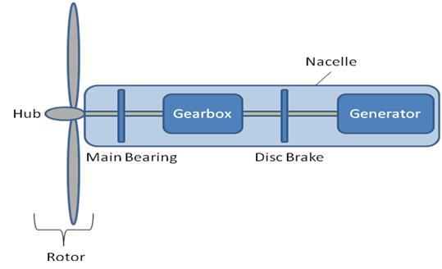
Commercial Wind Turbines
Problem Definition
Need for Renewable Energy
Need for Alternative Generators
in Wind Turbines
3 phase induction generators are industry standard
Require multistage gearboxes
Gearboxes fail before designed lifetime of 20 years and account for majority of system losses
High operation and maintenance costs
Variable speed operation is expensive
Direct drive permanent magnet generators present an efficient alternative

Slide 5
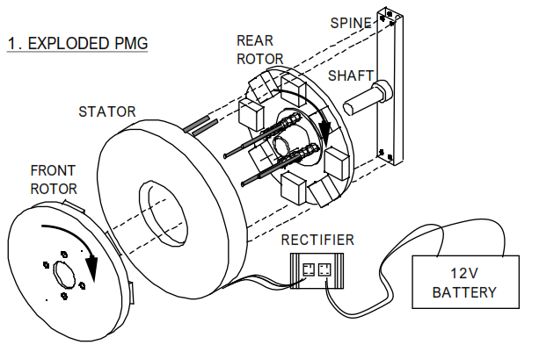
Permanent Magnet Generators (PMG)
Synchronous operation
Direct drive
Drive shaft coupled to turbine blade rotors
Rotor
Generates field/excitation current
Rotor disk
Permanent magnet blocks
Provides magnetic flux
Stator
3 phase voltage induced in copper windings
Commercial efficiencies 85-98%

Slide 6
Permanent Magnet Generators (PMG)
Advantages
Elimination of gearbox
Variable speed operation
Higher energy yield
Disadvantages
High torque, low speed operation
Cogging torque
More expensive
Requires inverter for grid connection
Increase in size and mass of generator with increase in output power
Design challenge!
Problem Definition
Need for Renewable Energy
Need for Alternative Generators
in Wind Turbines
Need for Efficient PMG
with Reduced Size and Mass

Slide 7
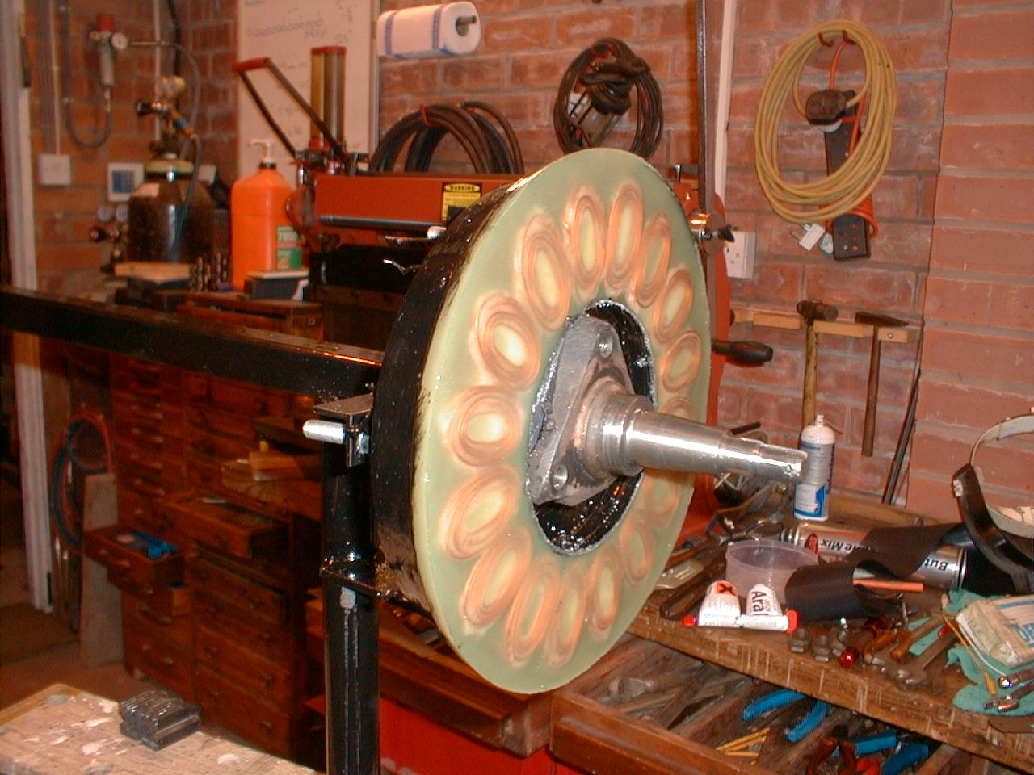
Permanent Magnet Generators (PMG)
Efficiency Losses
Cu losses
I²R losses
Fe losses
Core losses, eddy current losses
Rotational/mechanical losses
Can we reduce these with material choices?

Slide 8
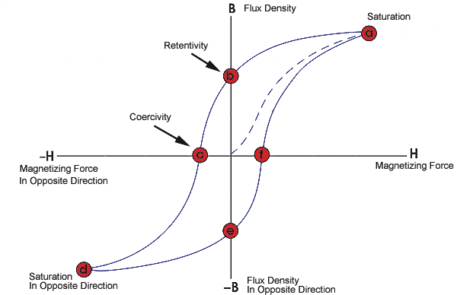
Magnetic Materials
Soft magnetic materials
High saturation magnetization, Ms
High permeability
Low coercivity, Hc
Low core loss
Hard magnetic materials
High remanence, Br
High coercivity, Hc
Energy Product = (BH)_{max}

Slide 9
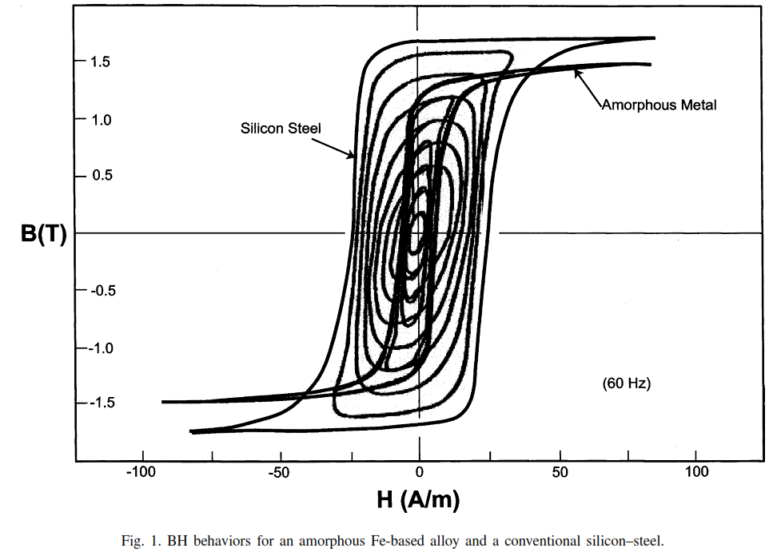
Soft Magnetic Materials
Application
Rotor disk
Stator (steel laminations)
Types of Soft Materials
Electrical steels
FeNi and FeCo alloys
Ferrites
Amorphous metals
Reduce core loss through material choice

Slide 10
Permanent Magnetic (PM) Materials
PMs are hard magnetic materials
Provides flux in PMG
Types of PM Materials
Rare Earths
Nd-Fe-B
Sm-Co
Non-Rare Earths
Alnico
Ceramics/hard ferrites

Slide 11
Permanent Magnetic (PM) Materials
Problem Definition
Nd-Fe-B is industry standard
Considered a critical element by EPA
Rare earths
China controls 97% of market
Expensive!
Hardrock mining results in potential environmental/human exposure to Al, As, Ba, Be, Cu, Mn, Sn, Pb
Refining process:
Dissolution of sulfide mineral deposits
Dissolution of carbonate mineral deposits
City of Boatou where 2/3 of Chinese rare earths are refined has resulted soil and groundwater contamination
Need for Renewable Energy
Need for Alternative Generators
in Wind Turbines
Need for Efficient PMG
with Reduced Size and Mass
Need to Reduce Critical
Materials in PMG

Slide 12
Permanent Magnetic (PM) Materials
Methods to reduce/eliminate critical materials
Exchange spring magnets
Alternative materials
Advanced Research Projects Agency – Energy (ARPA-E)
Rare Earth Alternatives in Critical Technologies (REACT)
Ames Laboratory
Cerium based magnets
Northeastern University
Iron-nickel based supermagnets
Manganese based magnets

Slide 13
Approach
Choose Application:
HAWT or VAWT?
Design PMG
Magnetic Material Choice
Axial or radial?
Inner or outer rotor?
Magnet mounting?
Finite element analysis simulation using MagNet
Number of poles?
Optimize operating point and efficiency

Slide 14
Questions?

