Slide 1
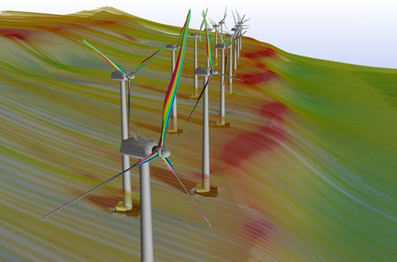
Reducing Runtime of Wind Turbine Simulation
Matthew Fischels
Aerospace Engineering Department
Major Professor : Dr. R. Ganesh Rajagopalan
Los Alamos National Lab
CD-adapco: STAR-CCM+

Slide 2
CFD Intro
CFD = Computational Fluid Dynamics
Navier-Stokes Equations = Conservation of mass, momentum, & energy
Wind Turbines
Assume incompressible (slow)
Blade Modeling: geometry or as momentum source
Turbulence
Directly simulate (DNS)
Model (LES,RANS)
Ignore (Laminar)

Slide 3
Motivation
Current wind turbine CFD simulations require large time and computing resources

Slide 4
Goal
Simulate a wind farm on limited computing resources in a reasonable time
limited: a single machine or a small server?
reasonable: a day or a week?
How many wind turbines?

Slide 5
How to reduce runtime?
Hardware Utilization
Parallelization/GPU
Algorithm Development
Develop more efficient methods for solving N-S
My goal is to reduce runtime while on limited computing resources -> Algorithm Development

Slide 6
Algorithm Development
Runge-Kutta Methods
Multigrid Methods
Interface Flux Computations

Slide 7
Runge-Kutta Methods
Runge-Kutta methods efficiently/accurately integrate momentum equations in time
RK-SIMPLER Algorithm
Explicit (computationally inexpensive)
Implicit (stable for larger time steps)
For 2D flow over flat plate results
Method | Speedup Compared to SIMPLER (C-N)
Explicit | 5.4
Implicit | 14.0

Slide 8
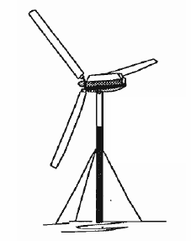
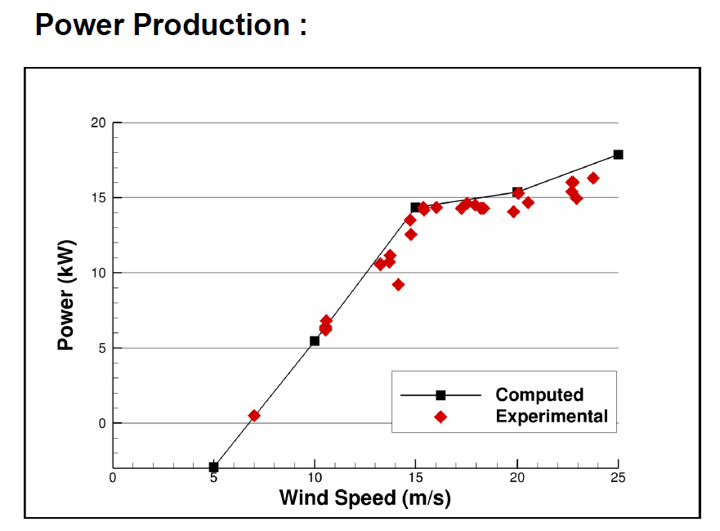
Runge-Kutta Methods
3D Isolated NREL Combined Experiment Rotor
Downwind turbine
No tower/nacelle
Uniform inflow
SIMPLER & RK-SIMPLER results identical

Slide 9
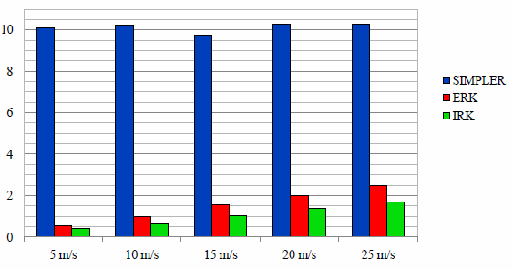
Runge-Kutta Methods
 | Max. Time Step
Wind Speed | ERK | IRK
5 m/s | 0.070 s | 0.100 s
10 m/s | 0.040 s | 0.060 s
15 m/s | 0.025 s | 0.040 s
20 m/s | 0.020 s | 0.030 s
25 m/s | 0.016 s | 0.024 s
Runtime (hours) for each wind speed and method
 | 5 m/s | 10 m/s | 15 m/s | 20 m/s | 25 m/s
ERK | 18.0 | 10.4 | 6.2 | 5.1 | 4.0
IRK | 24.4 | 16.0 | 9.4 | 7.4 | 5.9
Speedup compared to SIMPLER

Slide 10
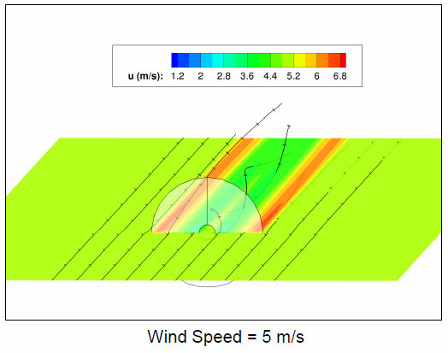
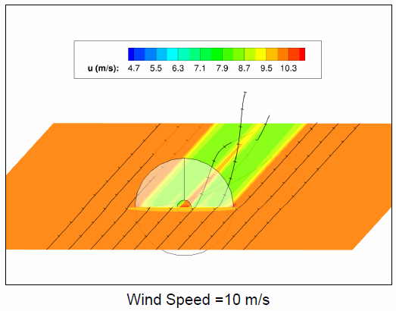
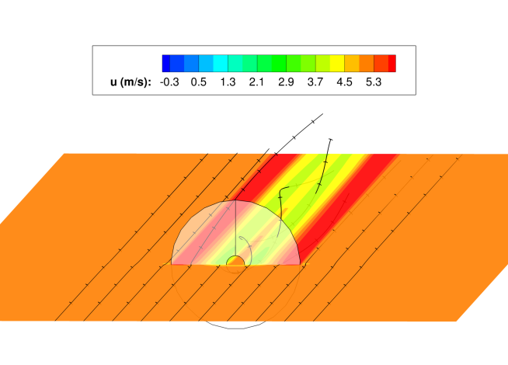
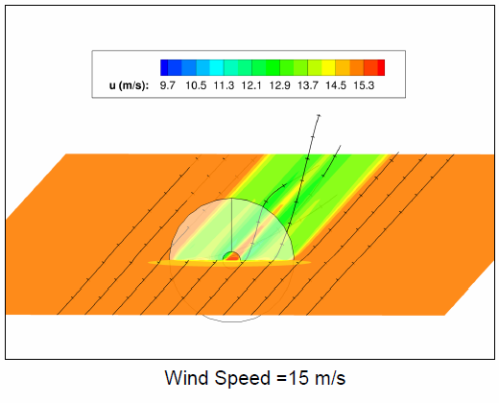
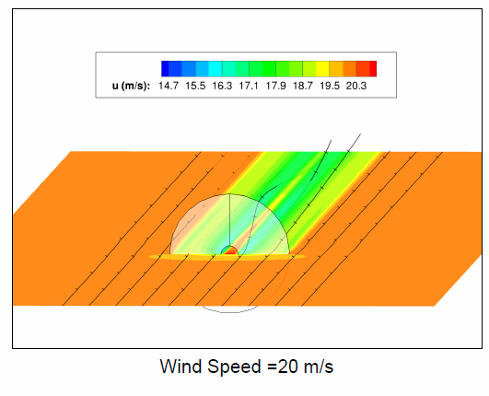
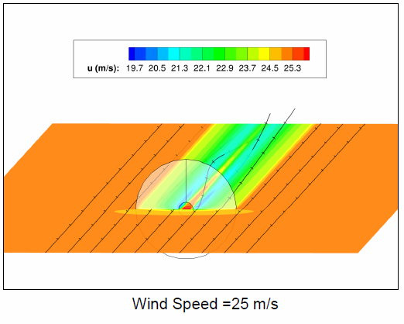
Runge-Kutta Methods

Slide 11
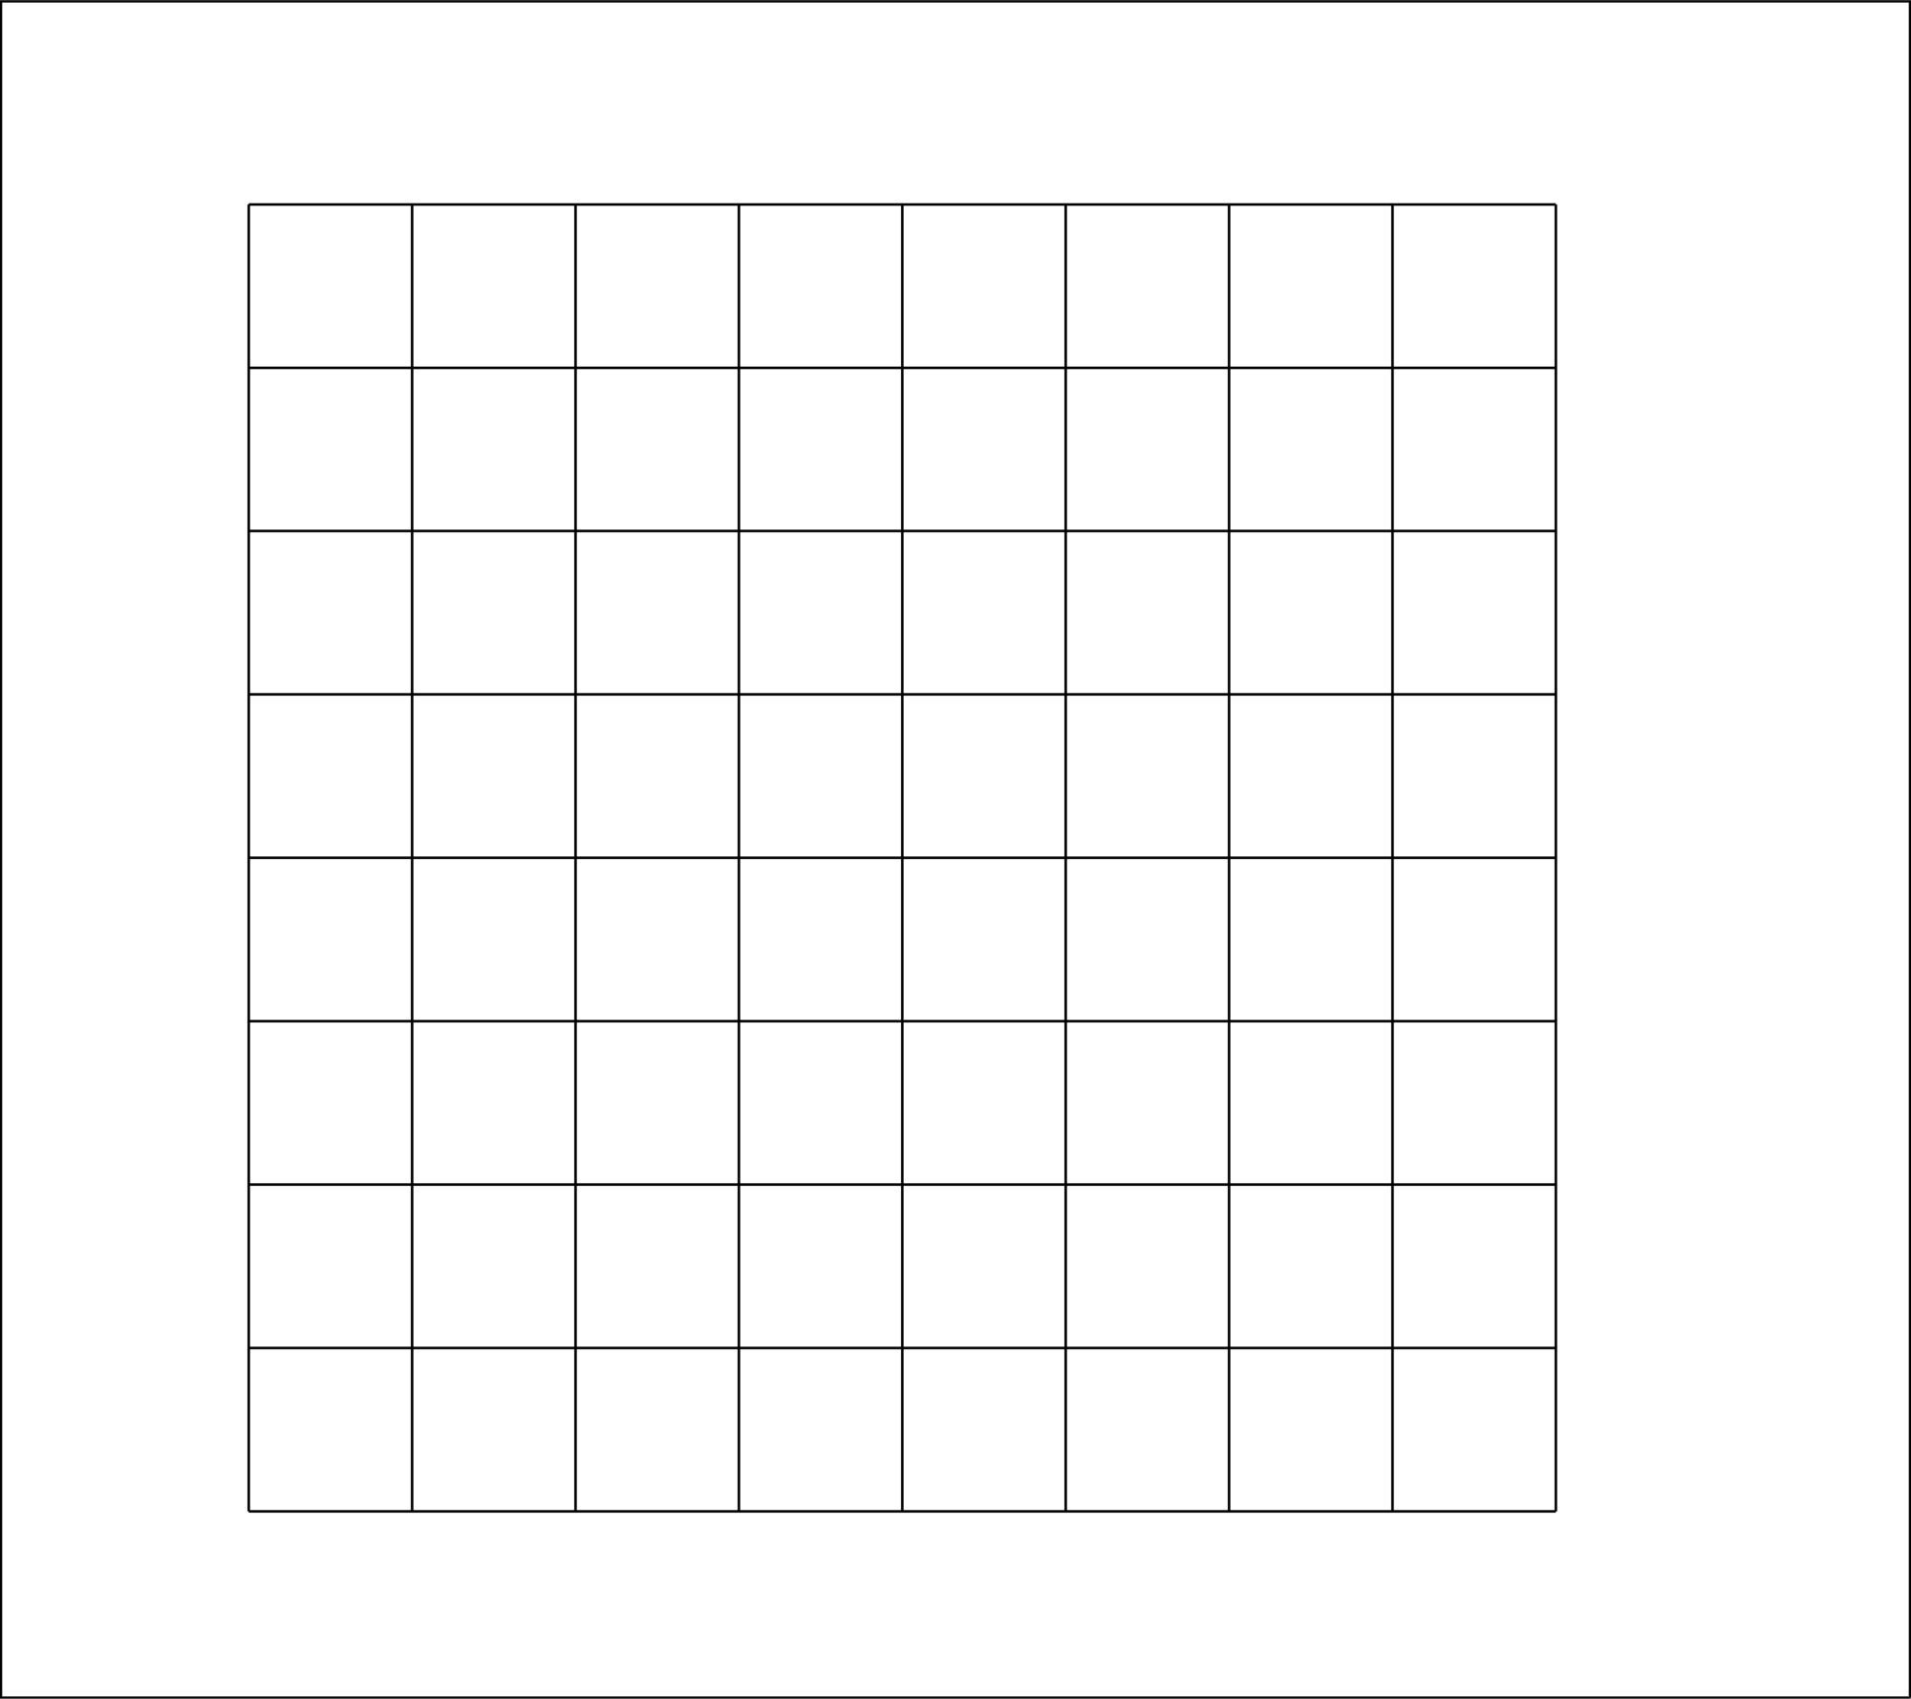
Multigrid Methods
Iterate on multiple grid levels
Removes errors of wave length ~ grid spacing
Restrict to coarser grids, prolong errors to finer grids

Slide 12
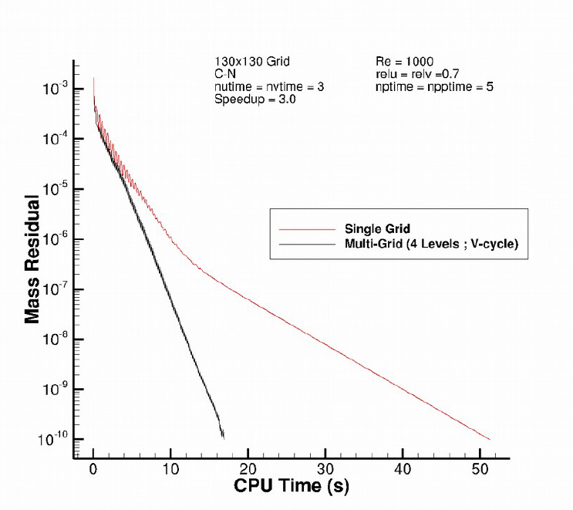
Multigrid Methods
Error (or residual) drops at a faster rate with multigrid
Multigrid speedup can be 14x or higher

Slide 13
Interface Flux Computations
How to find a value between points?
Linear Interpolation
Upwind (1st Order, 2nd Order)
Power Law
QUICK
Flux Corrected Method

Slide 14
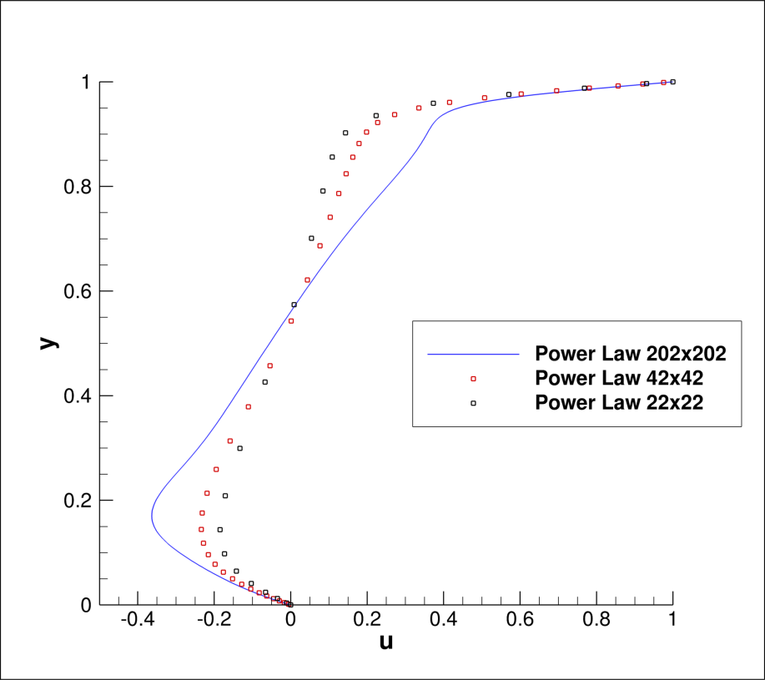
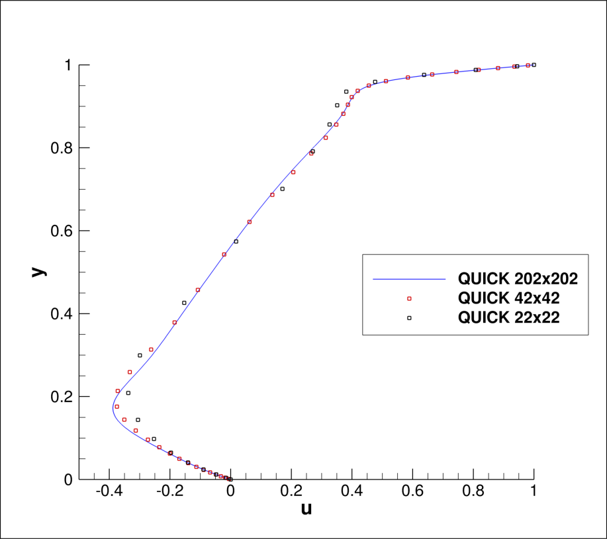
Interface Flux Computations
Power Law
QUICK

Slide 15
Interface Flux Computations
Two ways to look at these improvements
Can get greater accuracy on the same grid
Can get the same accuracy on a coarser grid
Develop more accurate methods to further reduce grid requirements

Slide 16
How will these methods interact?
Additive or Multiplicative?
Example:
Multigrid has speedup of 14
RK has a speedup of 10
Will the combination yield 24x speedup or 140x speedup?
Probably somewhere in between
Some combinations could be negative

Slide 17
Questions?

