Slide 1
Statistical methods for reliability forecasting and prognostics
Presenter: Michael Czahor
Major Professor: Dr. Bill Meeker
Home Department: Statistics

Slide 2
A Brief Background
Drexel University-BMES Dept.
Rowan University-Mathematics
Statistical motivation (Dr. Lacke/Dr. Thayasivm)
Alternative Energy Motivation
Comcast Spectacor Statistician Intern (Senior Year)

Slide 3
Iowa State University
IGERT Fellow *Funded through NSF*
WESEP Student
Home Department: Statistics
Major Professor: Dr. William Meeker
WESEP Faculty: PI: Dr. James D. McCalley
For Co-PI refer to: WESEP Faculty

Slide 4
Goal
Prevent unplanned maintenances with the use of statistical analysis

Slide 5
Today’s Presentation
Motivation for Research/Sample Study
Needs and Challenges for Reliability Study
Address the need to analyze field data
Formally share my Research Idea
Initial Analysis
Concluding Remarks/Q&A

Slide 6
Part 1: Motivation For Research
Hahn, Durstewitz, and Rohrig (2007) Study
98 Percent of Availability
Design lifetime is expected to be around 20 years.
Reliability: Number of failures per unit time
Failures: Early(IM), Random, Wear-out (Degradation)

Slide 7
Failures

Slide 8
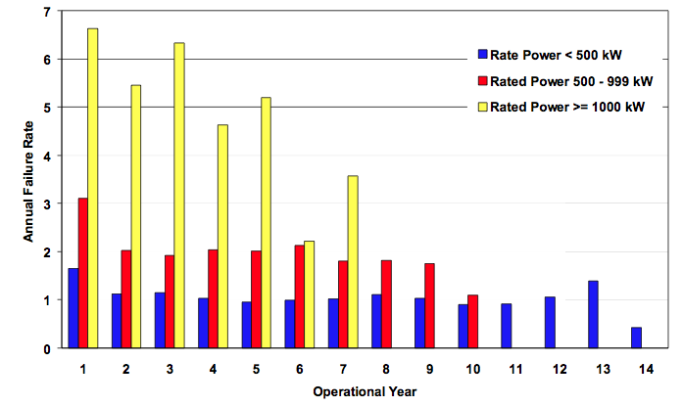
Sample Study

Slide 9
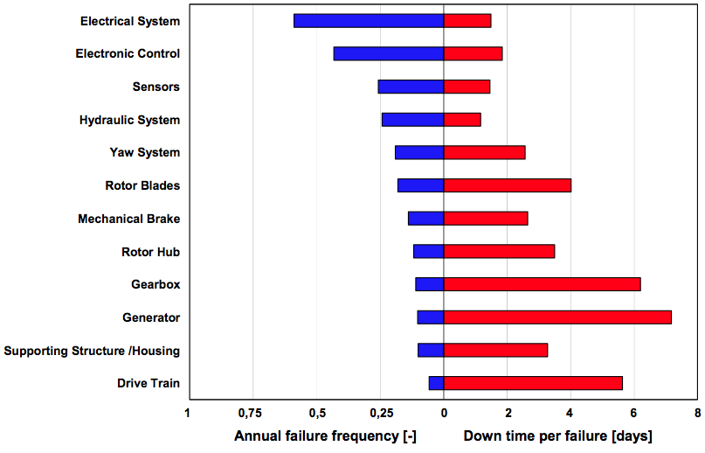
Malfunctions vs. Downtime

Slide 10
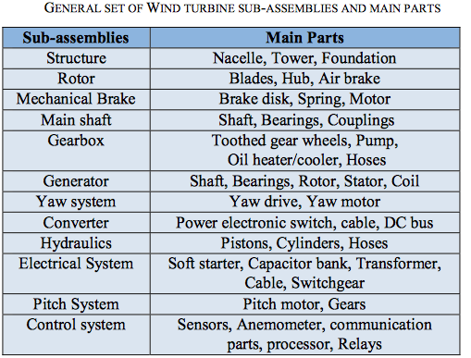
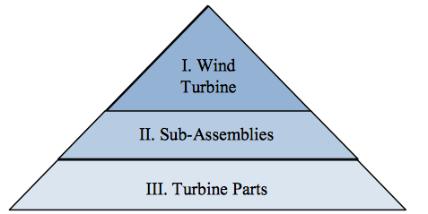
Failure Modes

Slide 11
Industry Approaches

Slide 12
Sandia’s Take on Reliability

Slide 13
Big Data
“Big data” refers to datasets whose size is beyond the ability of typical database software tools to capture, store, manage, and analyze. This definition is intentionally subjective and incorporates a moving definition of how big a dataset needs to be in order to be considered big data—i.e., we don’t define
Big data in terms of being larger than a certain number of terabytes (thousands of gigabytes). We assume that, as technology advances over time, the size of datasets that qualify as big data will also increase. Also note that the definition can vary by sector, depending on what kinds of software tools are commonly available and what sizes of datasets are common in a particular industry.
With those caveats, big data in many sectors today will range from a few dozen terabytes to multiple petabytes (thousands of terabytes).

Slide 14
“Big Data” for Wind Turbines
Sensors/Smart Chips
Use Rate
System Load
Vibrations
Physical/Chemical Degradation
Indicators of Imminent Failure

Slide 15
Reliability Field Data
Maintenance Contracts/ Maintenance Reports
Optimize cost of system operation
Sensors
Prognostics Information Systems
System Health Monitoring (SHM) to predict system performance in the field

Slide 16
Applications
Prevent in-service failures
Prevent unplanned maintenance
System Operating/Environmental will do better job

Slide 17
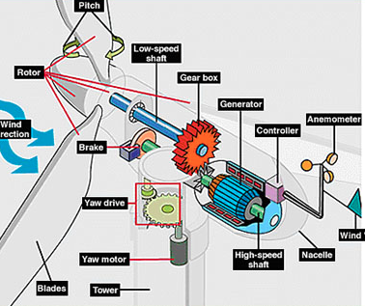
Main Research Topic
Wind Turbines are producing a large amount of environmental field data that describe the loads being put on individual turbine components. This data will be used to model system lifetimes and hopefully draw strong conclusions in regard to maintenance needs for individual components within and among the turbine for nearby time intervals.

Slide 18
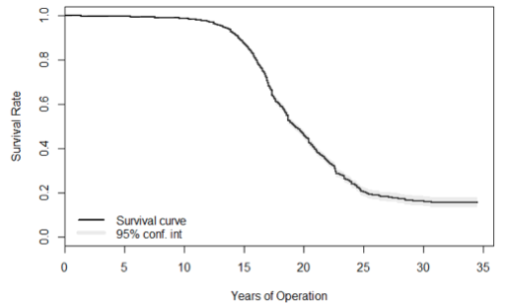
Example of Non-Parametric Analysis
A Kaplan-Meier estimate is a completely non-parametric approach to estimating a survivor function. A survival function can be estimated by calculating the fraction of survivors at each failure time as in the following equation:

Slide 19
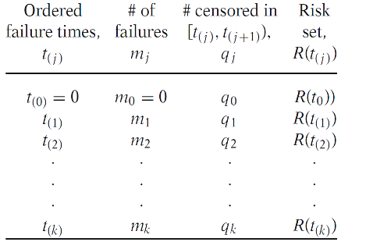
An Idea of KM Datasets

Slide 20
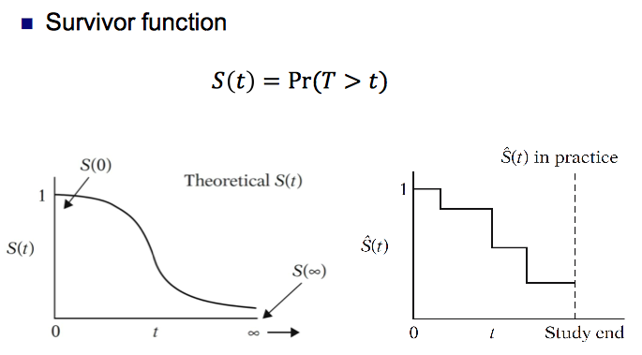
Graphical Representation

Slide 21
Relation to other WESEP Students
Quantifying failure modes of design flaws in individual components.
Relating environmental conditions to failure modes of individual components.
General System Health Monitoring practices

Slide 22
Conclusion/Q&A
Field data is being produced at as high of level as it has ever been.
Sensing technology allows us to collect large amounts of data to be analyze (Big Data).
Next Semester:
Preliminary Survival code to analyze data (Non Parametric)
A better understanding of each individual component
Implement Statistics 533 Knowledge into next WESEP 594 presentation.
Summer:
DATA

Slide 23
References
[1] Hahn, Berthold, Michael Durstewitz, and Kurt Rohrig. "Reliability of Wind Turbines." Institut Für Solare Energieversorgungstechnik (ISET). N.p., 2007. Web.
[2] Kahrobaee, Salman, and Sohrab Asgarpoor. "Risk-Based Failure Mode and Effect Analysis for Wind Turbines (RB- FMEA).” Digital Commons. University of Nebraska-Lincoln, 1 Jan. 2011. Web.
[3] Meeker, William Q., Dr., and Yili Hong, Dr. Reliability Meets Big Data: Opportunities and Challenges. N.p., 23 June 2013.
[4] Sandia Wind Reliability Workshop http://windworkshops.sandia.gov/?page_id=353
[5] Walters, Stephen J. "What Is a Cox Model?" School of Health and Related Research (ScHARR). Hayward Medical Communications, 2001. Web.

