Slide 1
Research overview and cognitive approaches
home.eng.iastate.edu/~jdm/wesep594/index.htm
J. McCalley
WESEP 594 (EE 594B)
Real-Time Research Collaborative (RTRC)
August 31, 2012

Slide 2
Overview
Objective
My background
My research program
High-level view of how I do research
General perspectives
Responses to (some of) the questions
Final comment

Slide 3
Objective
The RTRC is a “fertilization” effort, from which we hope to see you share your own perspectives and adopt/adapt those of others.
2. Broaden cognitive approaches:
Seasoned researchers will provide lectures on how they “do” research; how they think while doing it, addressing:
How do we become aware of the problems we work on?
What are the attributes of a “good research problem”?
To what extent can research be planned?
What is the interplay between creativity and literature review?
What is the desired “end-product” of a research project (paper? “contribution”? patent? technology transfer? impact? graduated student?); how in the research process does choice of “end-product” affect what happens?
When does bottom-up and top-down thinking yield their greatest potential?
How are solution approaches identified?
What constitutes acceptable evidence that a problem is indeed solved?
What organizational structures and modes of human interaction are effective in facilitating research?
Presenters to bring 1 or more existing students to write reflections (not assess) on what they think is most effective.
Presenter is encouraged to share this with class via email.

Slide 4
My background
1977-1982: BSEE, Georgia Tech
1977-1981: Co-op with Atlanta Gas Light Company
1982-1984: Taught high school physics, math, Applied EE
1984-1986: MSEE, Georgia Tech
1985-1990: Transmission planning engineer, PG&E, SanFrncs
1990-1992: PhD in EE, Georgia Tech
1992-now: Iowa State University

Slide 5
My research program
Infrastructure investment planning
Venkat Krishnan, Post-doc: Energy & transportation systems
Diego Meijia, PhD: Long-term uncertainty
Santiago Lemos, PhD: Integrated planning for electric & natural gas infrastructure
Joseph Slegers, MS: Long-term planning with natural gas for light-duty vehicles
Transmission planning
Oluwaseyi Olatujoye, PhD: Flexibility based planning
James Slegers, MS: Resource to backbone transmission for high wind penetration
Yifan Li, PhD, PhD: High capacity continental transmission overlay design
Integration of variable generation/storage/frequency
Trishna Das, PhD: Storage technologies for high penetration of variable gen
Mei Li, PhD: Transmission reconfiguration for large-scale generation shifts
Guangyuan Zhang, PhD: Slow dynamics, markets, and variable generation
Pat Kreymborg, PhD: Cap/ancillary service mrkts & cntrl for increased wind pen
Risk-based security constrained economic dispatch (SCED)
Qin Wang, PhD: Risk-based SCED for electricity markets
Dynamic analysis
Siddhartha Khaitan, Post-doc: Hi-perf comp apps for dynamic analysis in pwr sys
Lei Tang, PhD: A dynamic security assessment processing system (DSAPS)

Slide 6
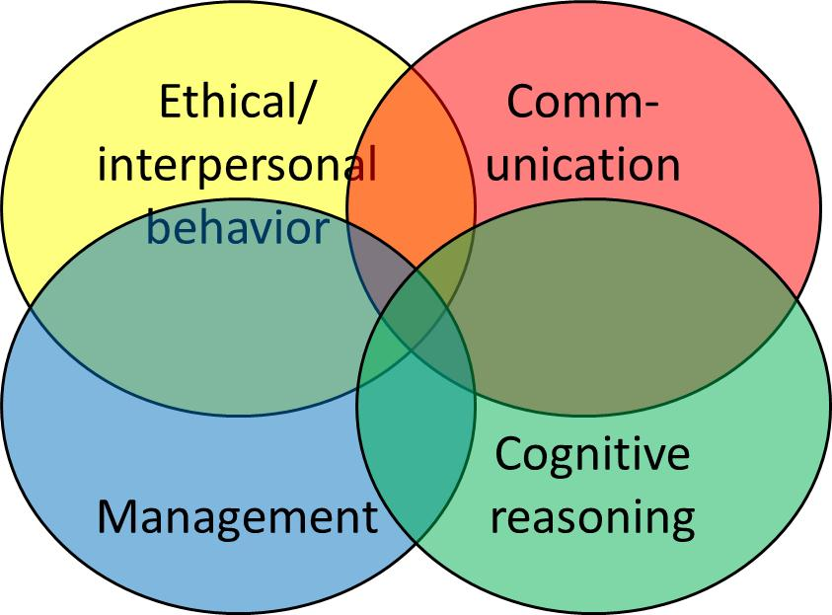
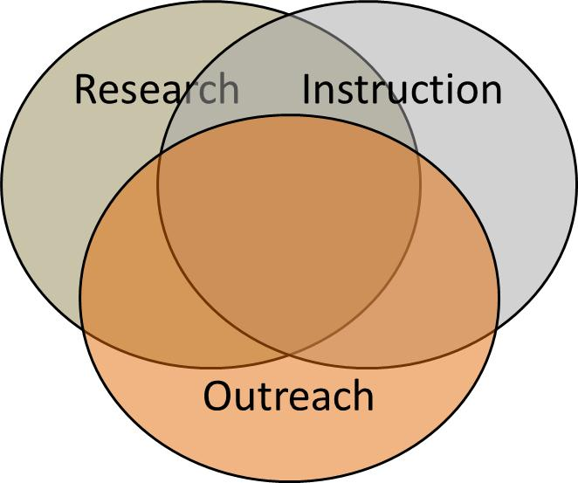
High-level view of how I* do research
* I work in a university; doing research in industry may look somewhat different.
*I am a professor; a student’s scope is different.
and other effects on the mind
reviewing papers
attending a seminar
preparing a lecture
reading a novel
reading trade journal
reading the paper
listening to a webinar
visiting a company
talking with a student
answering a question in-class
participating in a panel review
taking a shower
prayer
driving…

Slide 7
General perspectives (of which I am aware)
Some good, or at least, not bad….
Research, instruction, and outreach are heavily dependent
Look for efficiencies: do 1 thing, use it in 2-3 ways
Like to work with/learn from industry folks
See big picture well
Like to praise good work/effort
Put much intlctl effort in proposals; expect to win all
Look to avoid pride in knowledge; remain teachable
Some bad, or at least, not good….
Less patient exploring details of a problem
Expect all students to be very autonomous
Do not say “no” often enough and become overloaded
Often don’t do what I don’t like to do until I have to
Don’t allocate reading time: read only for directed purpose

Slide 8
Response to (some of) the questions
How do we become aware of the problems we work on?
What are the attributes of a “good research problem”?
To what extent can research be planned?
What is the interplay between creativity and literature review?
What is the desired “end-product” of a research project (paper? “contribution”? patent? technology transfer? impact? graduated student?); how in the research process does choice of “end-product” affect what happens?
When does bottom-up and top-down thinking yield their greatest potential?
How are solution approaches identified?
What constitutes acceptable evidence that a problem is indeed solved?
What organizational structures and modes of human interaction are effective in facilitating research?

Slide 9
Research problems
How do we become aware of the problems (areas) we work on?
#1: Do not be afraid….
to dream,
to imagine,
to create and
to express it.
#2: Be patient: it is a process that benefits from learning deeply about the area and its attributes.
Some take-aways from the next slide:
Proposals are fertile ways to dream, imagine, create,…
My “research problems” have evolved over much time
Students have helped me in this process a great deal!
Teaching academic and short courses have also helped
Earlier, partly-related experiences contributed.
I can, in hindsight, recognize pivotal moments

Slide 10
Research problems
Yellow: successful proposal
Blue: unsuccessful proposal
Bold outline: pivotal moments
How do we become aware of the problems (areas) we work on?
Infrastructure investment planning
Bailey proposal
NSF HSD proposal
NSF HSD proposal
NSF EFRI proposal
Grad course
NSF SRN proposal
MISO gas wrk
Portugal conf talk
PhD1
PhD3
PhD4
PhD5
NARUC proposal
PhD2
2000
2001
2002
2004
2005
2007
2008
2009
2012
Integration of variable generation/storage/frequency
EPRC proposal
PSERC proposal
DOE turbine proposal
Short-course
Grad course
Short-course
SCE proposal
IGERT
Grad course
SRN
MS1
MS2
Post-doc
DOE storage proposal 1
MS3
PhD1
DOE storage proposal 2
PhD3
MS4
PhD2
2005
2006
2007
2008
2009
2010
2011
2012
Risk-based security constrained economic dispatch (SCED)
Industry exp. at PG&E
Fouad & Farmer:
Risk-based dynamics
NSF Career Proposal
EPRI/SoCo project
Grad course
DOE-CERTS project
ISONE
collab
ERCOT project
PhD1
PhD2
Post-doc
PhD3
PhD4
1985-1990
1993
1994
1999
2005
2007
2012

Slide 11
Research problems
What are the attributes of a “good research problem (area)”?
#1. YOU: You are intrigued (excited) by something in it
#2. THEM: You can see the larger picture and express why in terms that show the potential for positive impact in the world we live
#3. RICHNESS: You can identify several general directions of exploration
#4. SCHOLARSHIP: You (eventually) see that there is some perspective related to your intrigue/interest that does not have heavy presence in the literature.

Slide 12
Research problems
To what extent can research be planned?
What is the interplay between creativity and literature review?
It is more like entering a deep forest at night than it is like reading Mapquest instructions
But we can still plan: With k=1
Identify research step k given what you know
Project/hypothesize what you expect to learn in step k
k=k+1 and return
Be comfortable to change plans when I learn something (e.g.., when projection/hypothesis was wrong)
Creativity comes first (trust my instincts): Document problem/objective/plan before reading much literature, then change it as I read and learn

Slide 13
Research project
Yellow is what academic P&T committees easily count/use.
What is the desired “end-product” of a research project (paper? “contribution”? patent? technology transfer? impact? graduated student?); how in the research process does choice of “end-product” affect what happens?
Graduated student
Technology transfer to industry
Citations in the literature
Additional funding to continue or extend the work
Peer-reviewed publications: journal paper or patent
Dissertation or thesis
Contributions (“to archived literature”)
Impact
Student Requirements
Shorter-term perspective maximizes publication count.
Longer term perspective maximizes impact. I would like to see high tech transfer to the industry in WESEP.

Slide 14
Research approach
When does bottom-up and top-down thinking yield their greatest potential?
Top-down thinking: Let me reshape the system in which the application resides.
Bottom-up thinking: Let me improve this algorithm.
PhDs should work at both levels, think top-down but be able to operate bottom-up.

Slide 15
Research approach
What organizational structures and modes of human interaction are effective in facilitating research?
Iowa State University
Graduate students
Faculty
Undergrad students
Industry
Other universities
Graduate students
Faculty
Undergrad students
Industry
Have scheduled times where
students present their work to other students and faculty.

Slide 16
Final comment
Successful PhD students have the following attributes:
Steady, continuous work habits
Not command and control people but rather
Good listeners, autonomous thinkers, and objective decision-makers
Willingness to learn new things
…and to attack hard parts of the problem
You cover a lot of ground when you take your first solid bite

