Slide 1
Environmental benefits of molecular biotechnology
Shu-Hao Chang

Slide 2
Introduction
In the 20th century, the problems of the environmental pollution become worst. There are many kinds of environmental treatments, but only the molecular biotechnology are the most widely used.
Dividing into six parts:
Environmental monitoring and inspecting
Environmental management and risk evaluation
Soil and ground water treatment
Molecular Nanotechnology
Green Technology
Examination Responsibility of environment disputes

Slide 3
1.Environmental Monitoring And inspecting
There are many place need the environmental monitoring and inspecting such as the pathogen or virus in the environment , microbial growth and decline, and water treatment plan…etc.
Tools: Polymerase chain reaction(PCR),
Reverse Transcription PCR(RT-PCR),
Quantitative Competitive-PCR (QC-PCR)

Slide 4
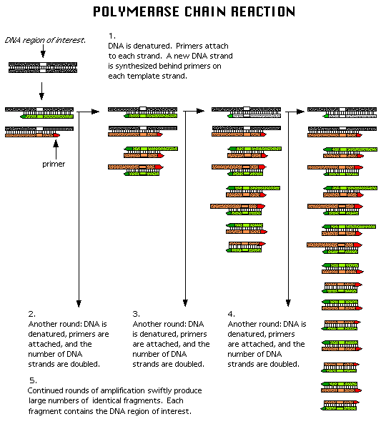
1.Environmental Monitoring And inspecting
we can use this phylogenetic tree to provide the microbial characteristic of the environmental sample or pure culture. By this processing, we can find this high concentration target model which is very similar for our sample.

Slide 5
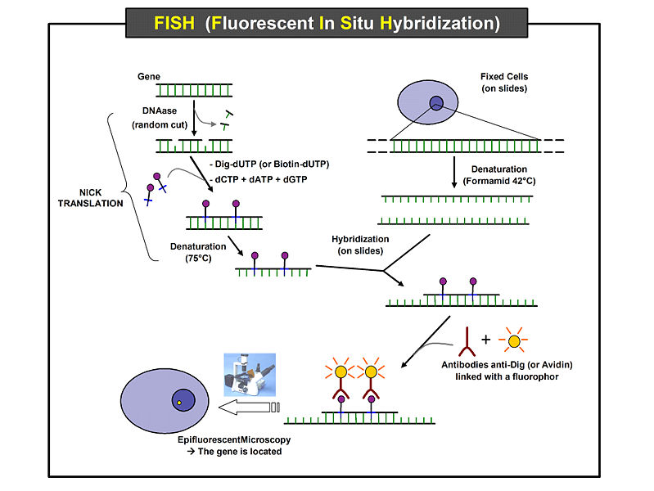
.
Tool: Fluorescent In Situ Hybridization (FISH)
It is often used for finding specific features in DNA. These features can be used species identification.

Slide 6
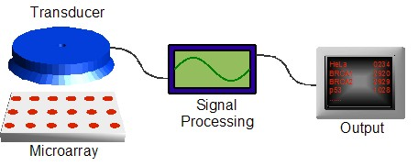
2.Environmental Management and Risk Evaluation
The new molecular biotechnology can be use on the environmental management, risk evaluation and pollution prevention of the environmental jobs.
Tools: DNA microarray, and DNA-chip
For example, the new bioassay technology such as DNA microarray, which can detect very fast the cadmium chloride (CdCl₂) or trichloroethylene (TCE) these toxicity substances in the examinate’s liver.
The goal= As soon as batter:
Making our environmental management become accurate
Reducing the risk of evaluation
Notes:
Then we can get the data as soon as possible. And also To get the better environmental management and to reduce the risk

Slide 7
3.Soil and Ground Water Treatment
There are a lot of pollutants in the soil and ground water, and the most of research is about enzyme for treatment. However, it usually took a lot of time to decompose the pollutants such as TCE in the soil and ground water.
Tool: promoter
Do together!!
Hybrid
Enzyme
Starvation Signal
Do Fast!!
mutation
Don’t die so soon! ok!

Slide 8
4.Molecular Nanotechnology
Nano = 1 x 10⁻⁹ = Very Small.
We can use this “function” to treat a lot of pollution problems.
Acid Rain and Smog
Sulfur dioxide (SO₂) and nitrogen oxides (NOx) are the main cause of acid rain and smog.
Tools:
nano-desulfurizer can be sent up to the atmosphere to capture SO₂ gas, and reduce it to sulfur and precipitate to earth surface as dust.
nano-catalytic-converter can also be sent up into atmosphere to converter NOx into nitrogen and oxygen.

Slide 9
Global Warming
The reason of global warming is from greenhouse effect gas - CO₂
Tool:
nano- photosynthesizer , it can extract those excess CO₂ from atmosphere
H2O
sun
CO2
Earth
None-photosynthesizer

Slide 10
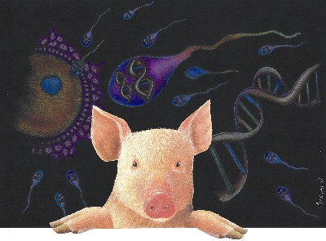
5.Green Technology
Transgenic Technology
Tool: phytases
The ” transgenic pigs” is one of famous case of transgenic technology. There are special phytases in there transgenic pigs’ saliva, which can help those pigs to decompose the phosphate in the feeds when they eat. By this process, we can
reduce the phosphate
contents of swine wastes
and pollutants about 75%
in our environment.

Slide 11
5.Green Technology
Green Energy
Tool: anaerobic digestion
Green energy is a term describing what is thought to be environmentally or friendly sources of power and energy. Typically, this refers to renewable and non-polluting energy sources.
Example:
Fuel in Auto
CO2
Corn
ethanol
sludge
methane
anaerobic digestion

Slide 12
5.Green Technology
Green Production
To reduce the cost of environmental pollution treatment is the best economic way for the business.
Due to the reason , green production will help the business not only for earn the money but also can reduce the pollution.
Tool: Bacillus Thuringiensis(BT)
For example :
Bt-corn, type of genetically modified organism(GMO), is using for genetic traits to provide protection from pests, tolerance to pesticides, or improve its quality now.

Slide 13
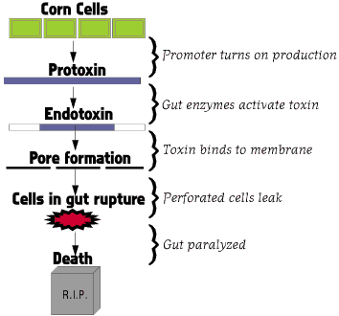
5.Green Technology
Corn borers may eat a toxic dose of Cry proteins in just a few bites from a Bt corn leaf

Slide 14
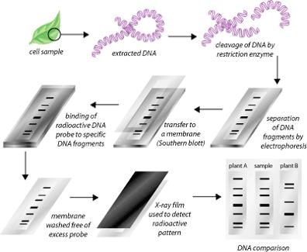
6.Examination Responsibility of Environment Disputes
What is the DNA fingerprinting?
Different types of DNA fragmentary will have different sizes and numbers after the restriction enzyme suitably cut. Then, it will form a map after one of the DNA fragmentary did the electrophoresis treatment. We call this kind of map is DNA fingerprinting

Slide 15
6.Examination Responsibility of Environment Disputes
Tool: DNA fingerprinting
The DNA fingerprinting technology can effectively exanimate DNA from what kind of organisms without any dispute. Therefore, we can use the DNA fingerprinting for:
1. The source of pollutant.
2. The judgment of environment disputes.

Slide 16
Conclusion
Molecular biotechnology is a powerful tool can apply all environmental region.
By combining different regions of technology , it will become a more useful tool for the treatment process of the pollutant in the future. For example, chemistry and biotechnology combining with nanotechnology , it will become nanotoxiology.

Slide 17
Question?

