Slide 1
Modeling Suspended Growth Systems – see Grady, Daigger & Lim
Environmental Biotechnology
CE421/521
Tim Ellis (originally prepared by Dr. Eric Evans)
October 25, 2007

Slide 2
Monod Equation and Unified Model
Reactor performance as a function of SRT.
Fails to account for:
Particulate removal rate
Anaerobic/anoxic conditions
Variable flow and loading
Biological nutrient removal
Notes:
One of the main things to realize about the traditional model is that it only accounts for the biochemical reactions of readily degradable soluble substrate at steady state conditions. It’s a good starting point, but may result in misleading performance predictions, especially if there is a large proportion of particulate substrate or there are wide fluctuations in hydraulic and organic loading.

Slide 3
International Association on Water Quality Activated Sludge Model 1 (IAWQ-ASM 1)
In 1983, IAWQ appointed a task group to develop a model.
In 1986, ASM 1 was completed.
ASM 1 able to predict performance of soluble and particulate substrate removal, nitrification and denitrification under steady state and dynamic conditions.

Slide 4
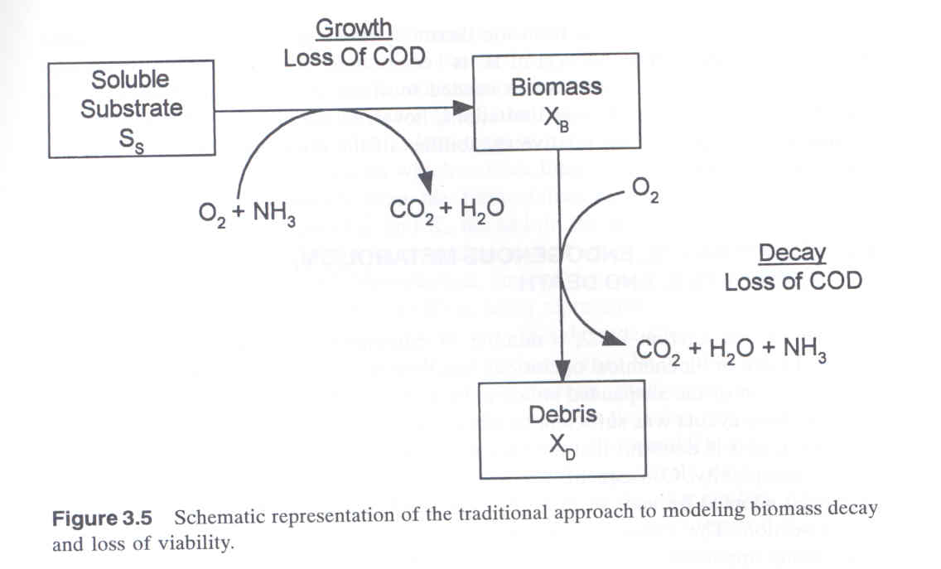
Traditional vs. Lysis-regrowth

Slide 5
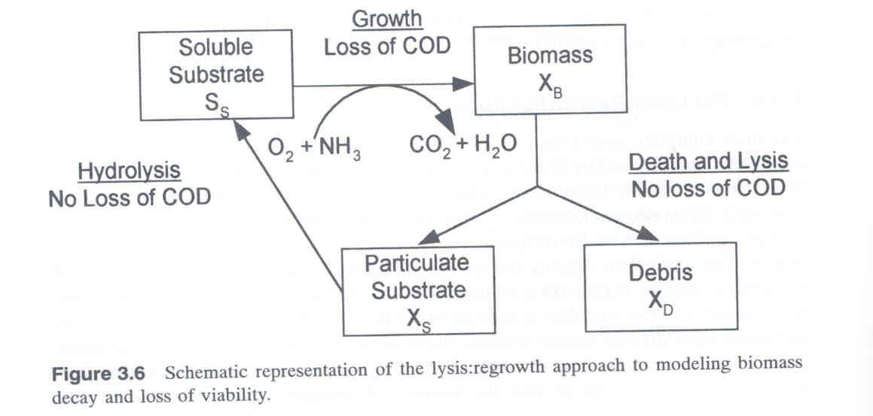
Traditional vs. Lysis-regrowth

Slide 6
ASM 1
Tracks 13 individual components through eight separate processes.
Assumes heterotrophic growth under anoxic conditions.
Limited anaerobic activity.
Uses lysis-regrowth approach

Slide 8
IAWQ – ASM 2
In 1995, ASM 2 was released capable of tracking biological phosphorus flows.
Now able to model enhanced biological phosphorus removal.

Slide 9
ASM 2
Tracks 19 separate components through 19 processes.
22 stoichiometric coefficients and 42 kinetic parameters
Ammonification and hydrolysis simplified to stoichiometric terms; i.e. rates implicit.
Includes anaerobic fermentation, uptake of acetate, formation of PHB and PHAs, and release of soluble phosphate from hydrolysis of polyphosphate.
Several assumptions made that constantly need revision as knowledge evolves.

Slide 10
Activated Sludge Models
Cannot solve analytically.
Use computer algorithm based on numerical techniques
SSSP, Bidstrup and Grady (MS-DOS based, ASM 1)
GPS-X, Hydromantis, Inc.
BioWin, EnvironSim Associates Limited.
ASIM & AQUASIM, Swiss Federal Institute of Aquatic Science and Technology, EAWAG.
EFOR, DHI, Inc.
STOAT, WRc Group.
WEST, Hemmis N. V.
SIMBA, IFAK-System GmbH.
ASM 2 integrated into software algorithm provides a powerful tool.

Slide 11
Steady-state performance – Particulate versus Soluble
Particulate hydrolysis is a rate limiting step.
A particulate feed requires a longer SRT to achieve treatment.
Particulates compose all of MLSS at low HRTs and active fraction is washed out.

Slide 12
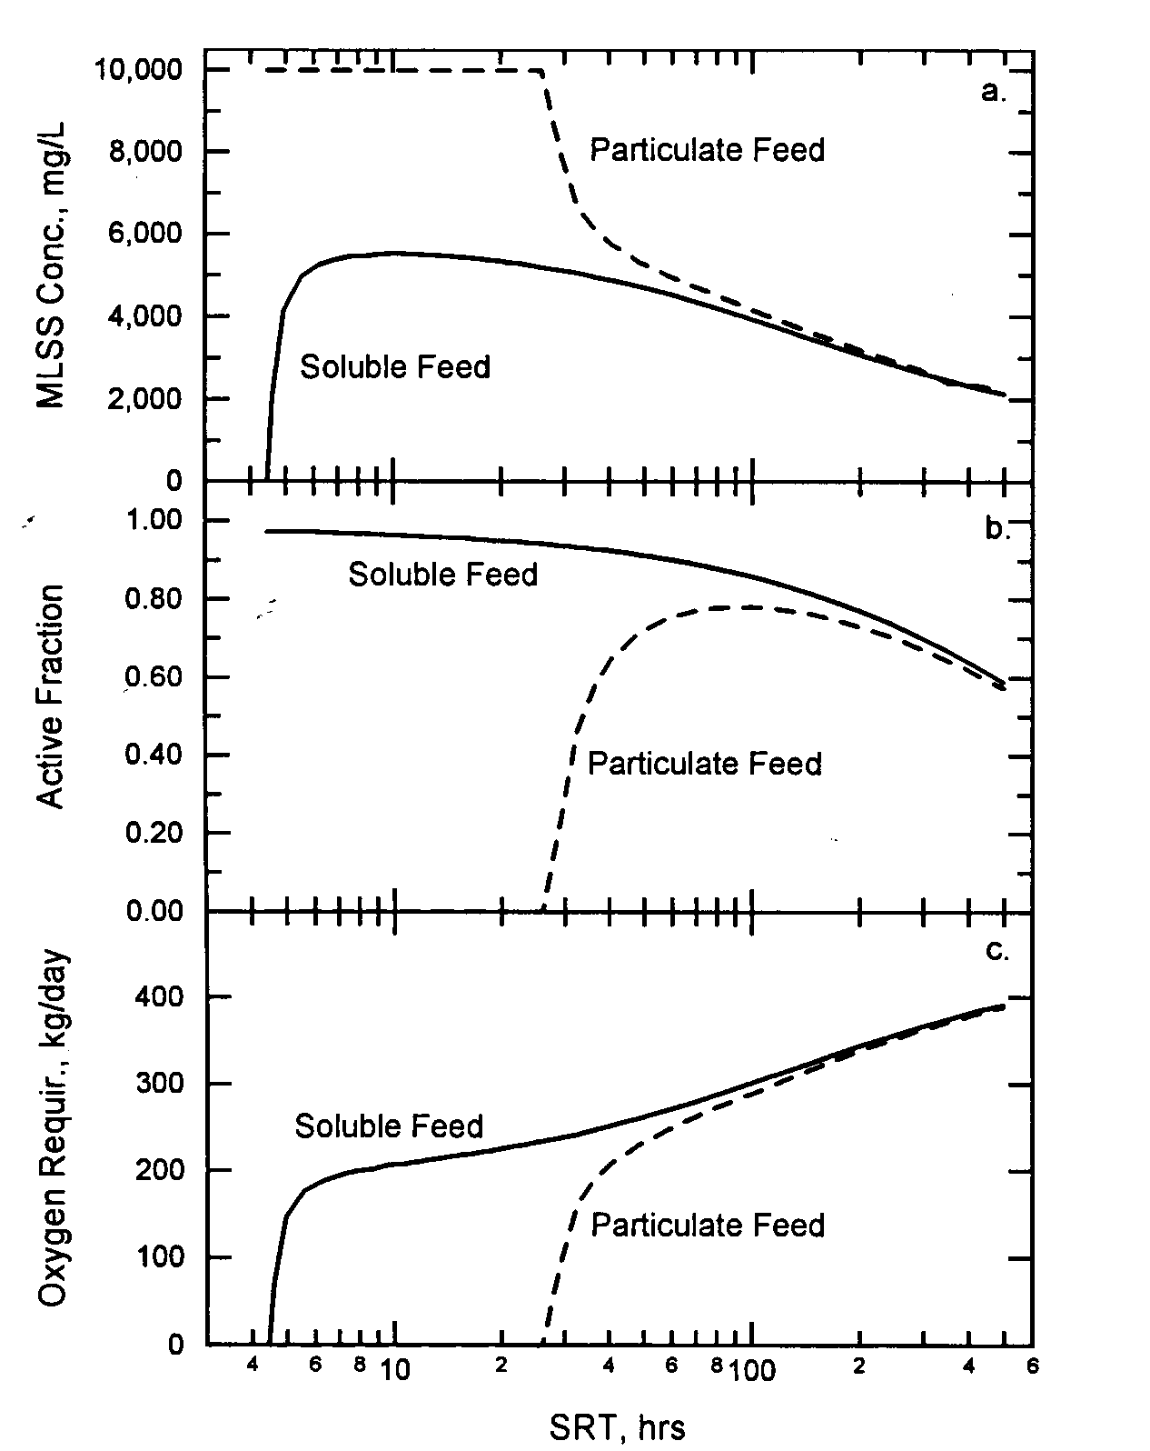

Slide 13
Dynamic performance – Particulate and Soluble
Flow & substrate concentrations vary during diurnal pattern.
Particulate and soluble feeds have different effects on performance.

Slide 14
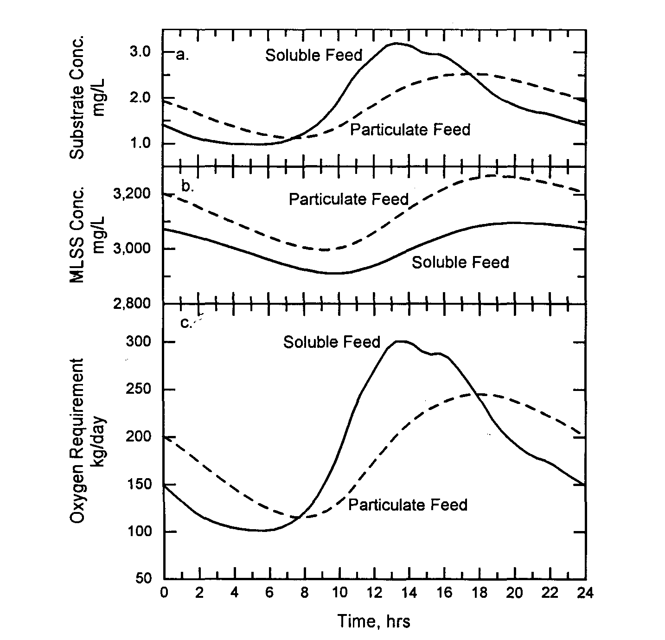

Slide 15
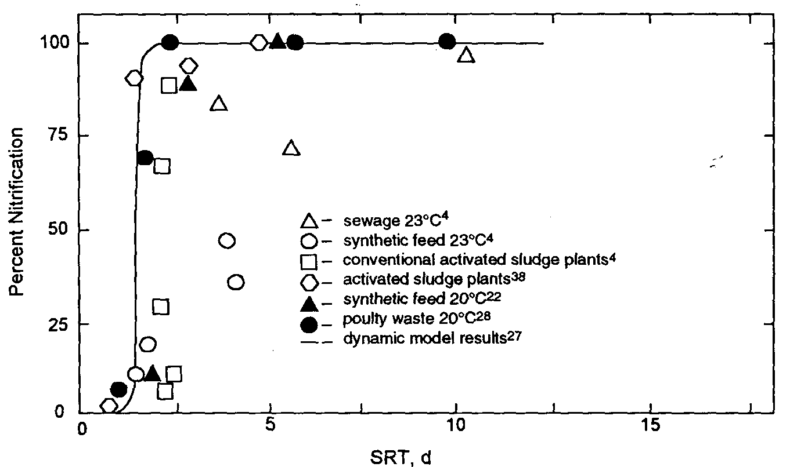
Nitrification – low μ_{max} and K_{S}

Slide 16
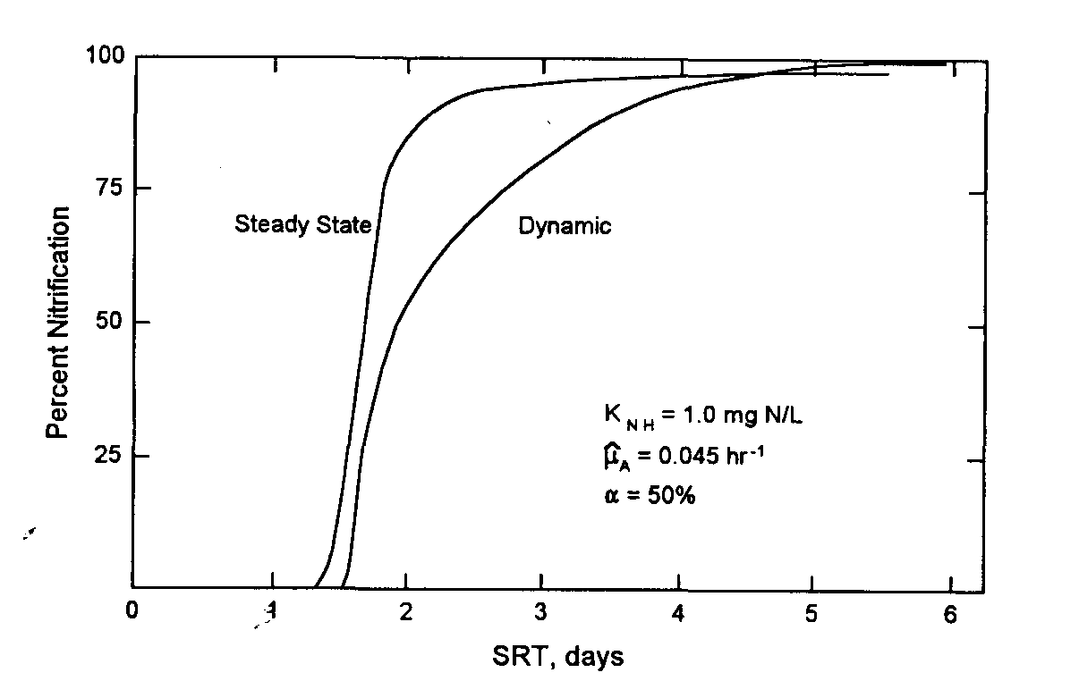
Diurnal flow has a negative effect on nitrification

Slide 17
Nitrification
Nitrifiers are affected by:
Temperature
Low oxygen concentrations
Inhibition by some organics

Slide 18
Nitrification
Autotrophs are a small fraction of MLSS.
Nitrification consumes large amount of oxygen.

Slide 19
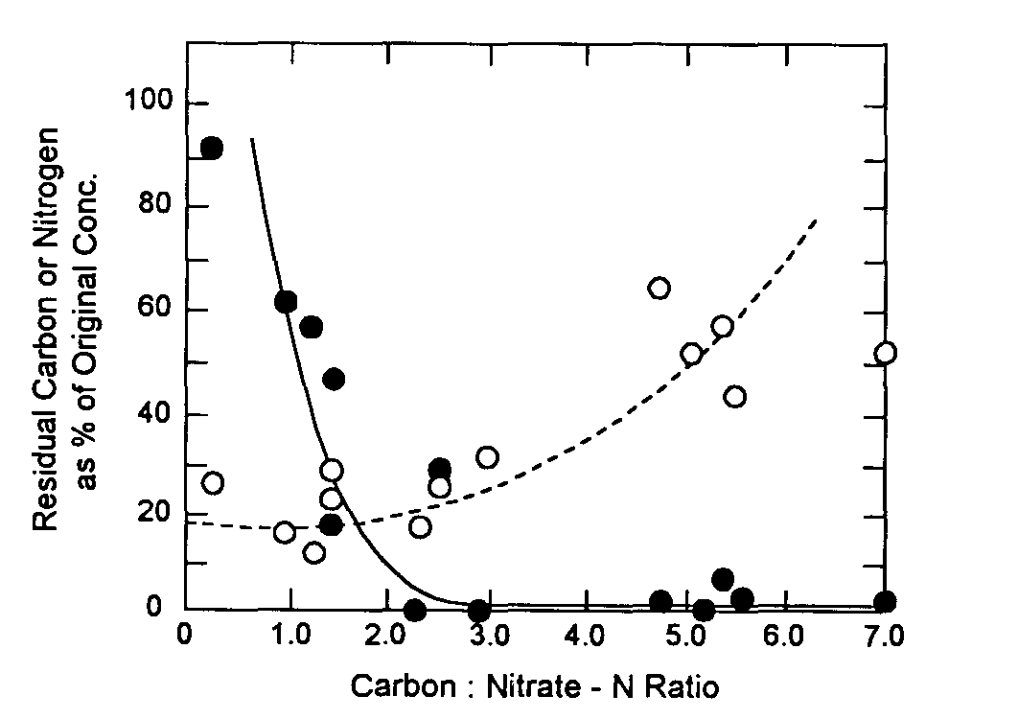
Denitrification
Denitrification –
Organics are electron donor
Nitrates are electron acceptor
Optimum Carbon to Nitrate ratio based on balance between electron donor and acceptor.
Nitrate
Carbon

Slide 20
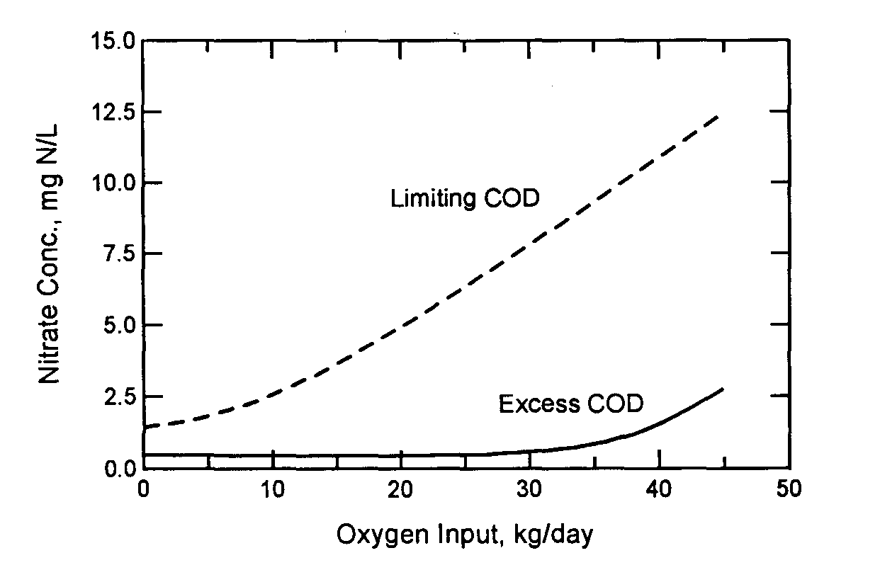
Denitrification
Oxygen is preferred electron acceptor…

Slide 21
Diurnal flow with different aeration strategies
Single CSTR may be set to:
Maintain a constant dissolved oxygen concentration in the tank
Constant oxygen flow into tank

Slide 22
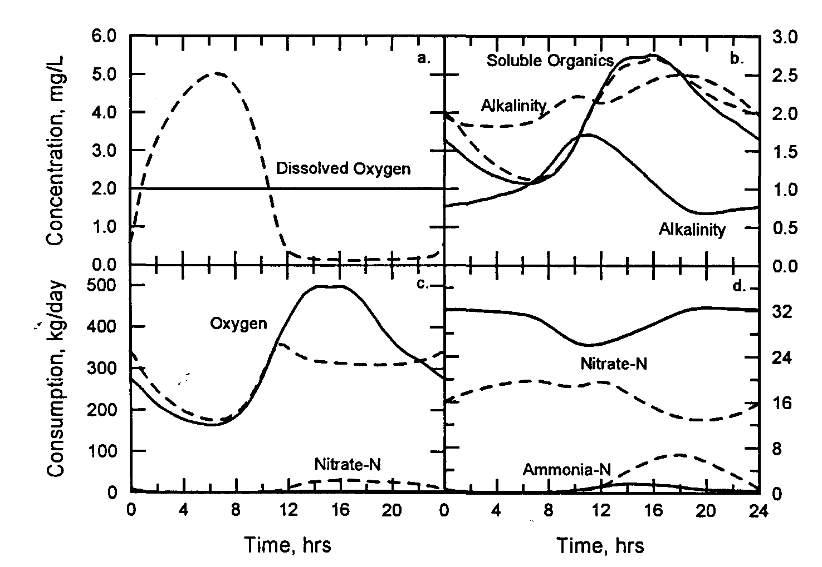

Slide 23
Modified Ludzack Ettinger
Use an anoxic basin and an aerobic basin to select for denitrification after nitrification…
Why denitrify?
Where would you place anoxic selector in flow scheme?

Slide 24
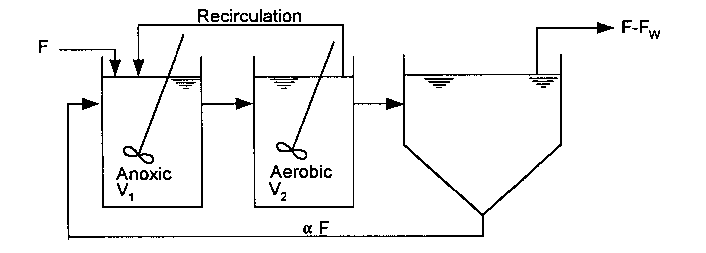

Slide 25
Effect of SRT on MLE
SRT is biomass in system divided by biomass wasted from system where system includes both aerobic and anoxic basins…

Slide 26
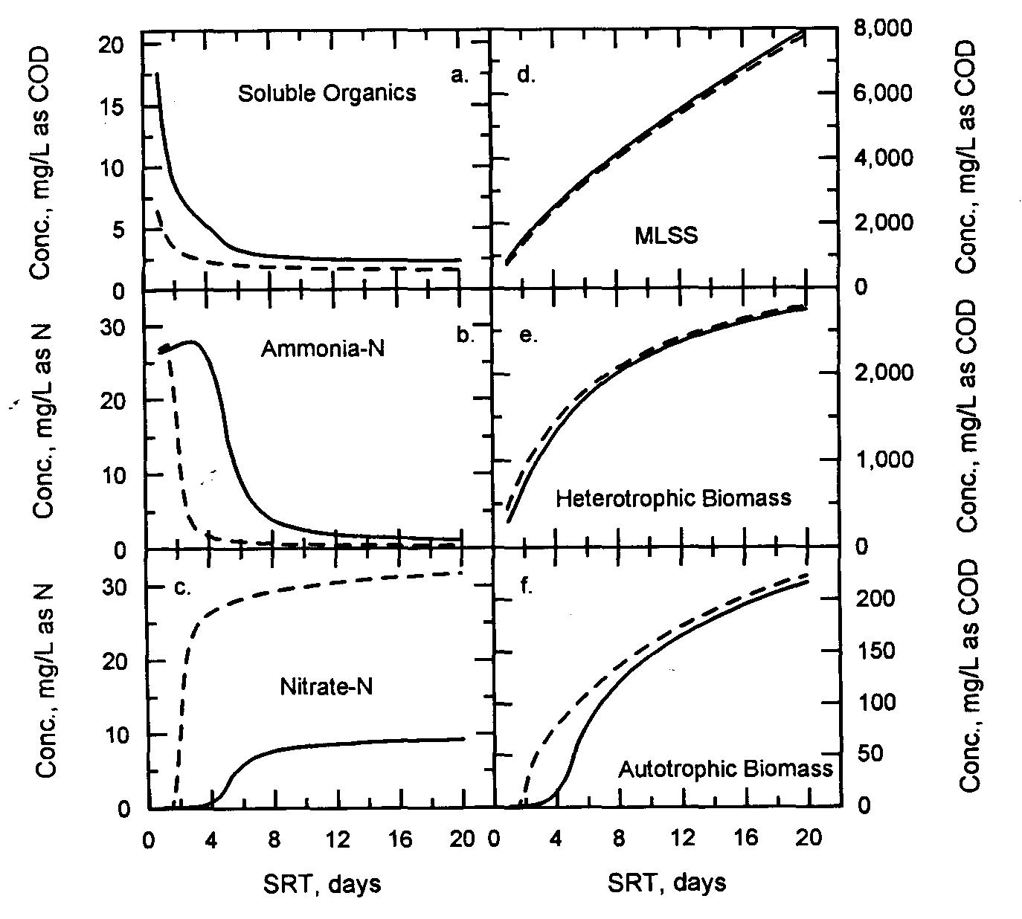
CSTR
MLE
Dashed lines indicate performance of a single CSTR of the
same volume as the anoxic and aerobic reactors.

Slide 27
MLE
Recycle affects performance in MLE
Greater recycle leads to:
Nitrate flow into anoxic reactor and thus higher consumption of nitrates and organics.
Dilution of ammonia in anoxic reactor.

Slide 28
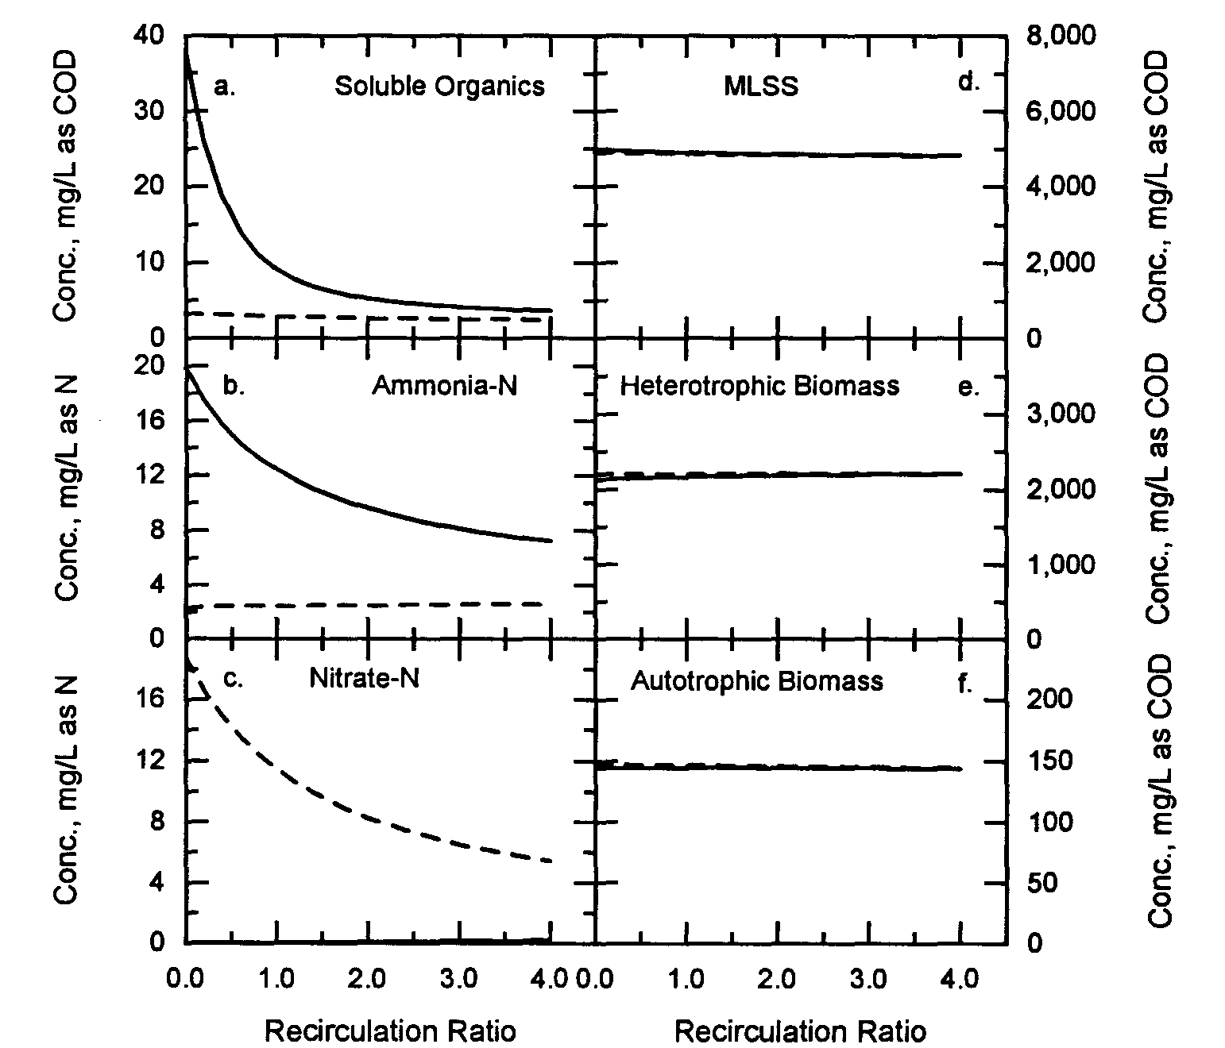
ANOXIC
AEROBIC
Solid lines indicate the anoxic (first) reactor and the dashed indicate
The second (aerobic) reactor.

Slide 29
Diurnal Flow
Wastewater flow and strength reflect activity of population.
Expect diurnal flow pattern.

Slide 30
Diurnal Flow
Steady-state equation
Dynamic flow results in lower performance.
Performance not solely a function of SRT.
Also depends on biomass change as a result of changing input.
Dynamic equation

Slide 31
Diurnal Flow
Recall effect of diurnal flow on flow weighted nitrification in CSTR.
Must increase SRT to compensate for dynamic condition.

Slide 32
Active Populations
Heterotrophs
Environment=Aerobic
Electron Donor
Organics
Electron Acceptor
Oxygen
Benefits
Removes organics that suffocate or are toxic to the environment
Drawbacks
Consumes Oxygen (Costs money)
Produces large amounts of sludge

Slide 33
Active Populations
Heterotrophs
Environment=Anoxic
Electron Donor
Organics
Electron Acceptor
Nitrates
Benefits
Removes nitrates
Reduces oxygen use
Generates alkalinity
Drawbacks
Anoxic environment may be difficult to create

Slide 34
Active Populations
Autotrophs
Environment =Aerobic
Electron Donor
Ammonia
Electron Acceptor
Oxygen
Benefits
Removes ammonia
Drawbacks
High oxygen consumption
Reduces alkalinity

Slide 35
Active Populations
Phosphate Accumulating Organisms
Environment=Anaerobic/Aerobic
Benefits
Removes Phosphorus
Drawbacks
Complex life cycle
Requires numerous recycle lines
Phosphorus rich sludge

Slide 36
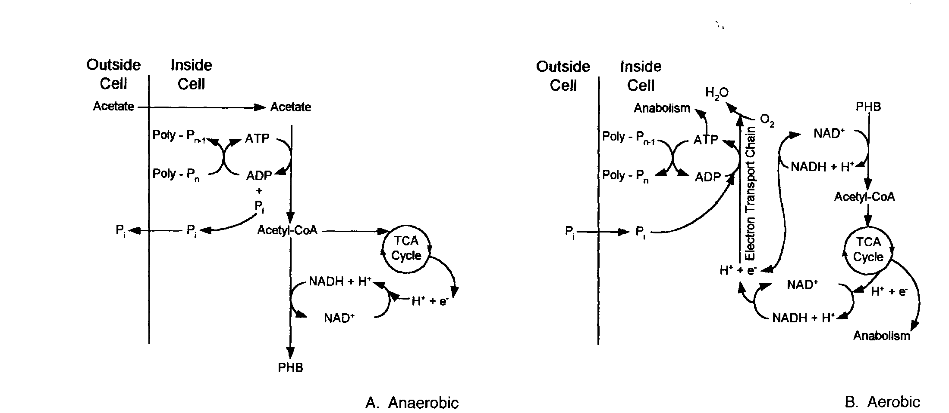
EBPR

Slide 37
Virginia Initiative Plant
System to remove:
Organics
Nitrogen
Ammonia
Nitrates
Phosphorus
Environments needed:
Aerobic
Anoxic
Anaerobic
System configuration?

Slide 38
Virginia Initiative Plant
System configuration:
Anaerobic
Anoxic
Aerobic
Recirculation
RAS to Anoxic
MLR from Aerobic to RAS
MLR from Anoxic to Anaerobic

Slide 39
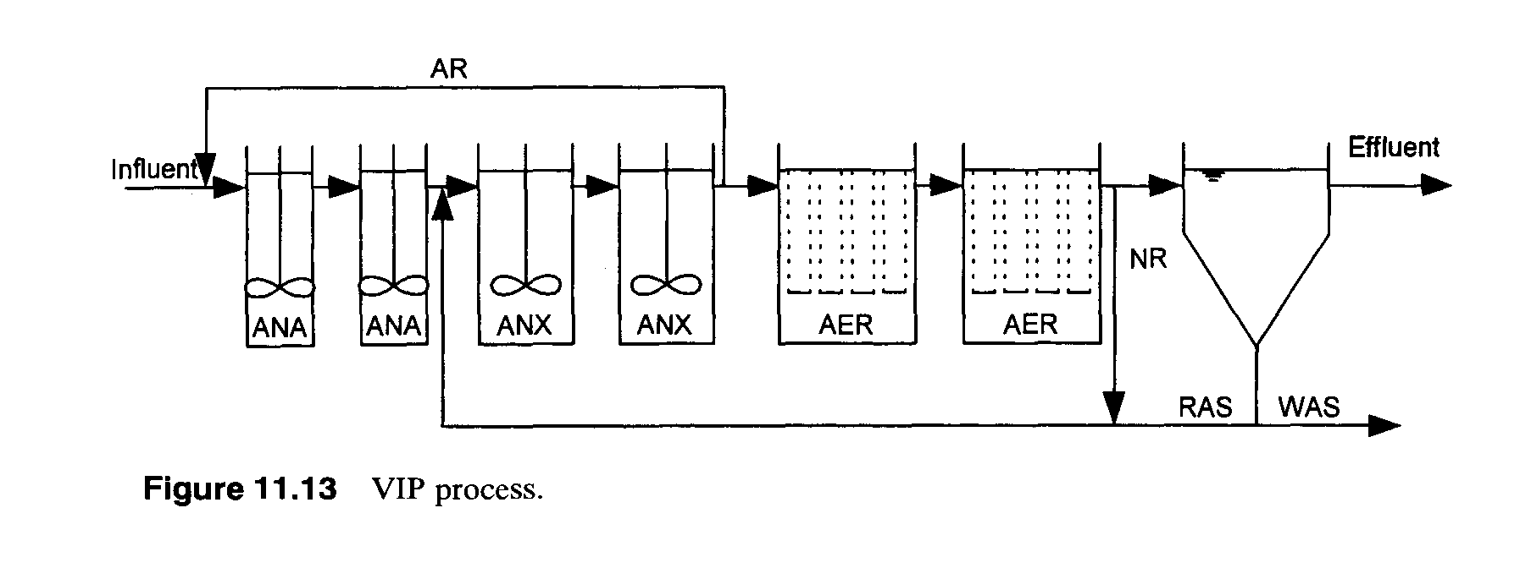
VIP

Slide 40
VIP
Benefits?
Drawbacks?

Slide 41
VIP

Slide 42
VIP
Important consideration:
BOD₅/Total P ratio

Slide 43
Virginia Initiative Plant
BOD₅/ΔP ratio needed for VIP Process?
15-20 mg BOD₅/mg P

