Slide 1
The characteristic of the sequencing batch reactor (SBR), anaerobic sequencing batch reactor (ASBR) and sequencing batch biofilm reactor (SBBR)
KooBum Kim

Slide 2
Introduction
Operation of several full-scale fill-and-draw systems were introduced at between 1914 and 1920.
Interest in SBRs was reconsidered in the late 1950s and early 1960s.
Improvements in aeration devices and controls have allowed SBRs to successfully compete with conventional activated sludge systems.

Slide 3

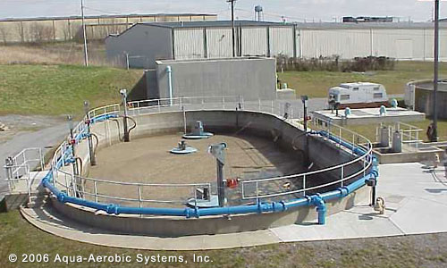
What is SBR ?
1. Screening:
2. Pumping:
3. Aerating
4. Removing sludge
5. Removing scum:
A single reactor
6. Killing bacteria:

Slide 4





Operation of SBR
1. Mix fill
2. React fill
3. React
4. Settle
5. Decant/Sludge waste

Slide 5
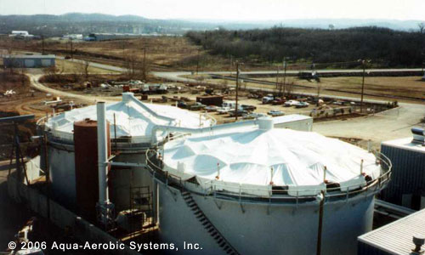
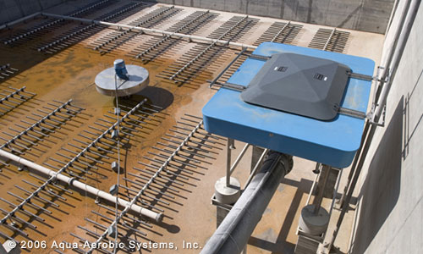
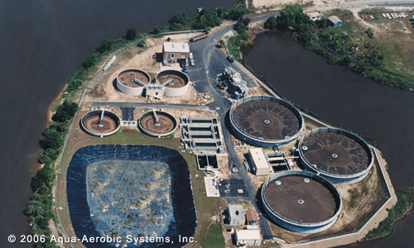
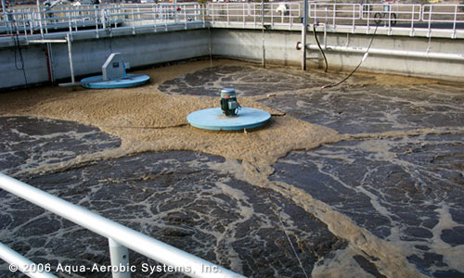
Operation of SBR

Slide 6
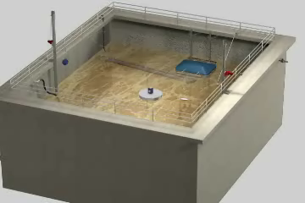
Operation of SBR

Slide 7
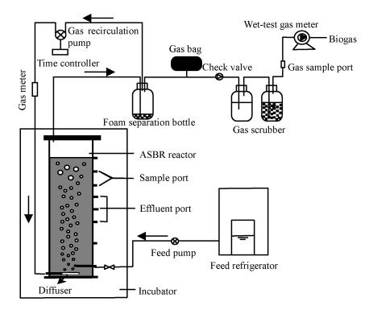
Operation of ASBR

Slide 8
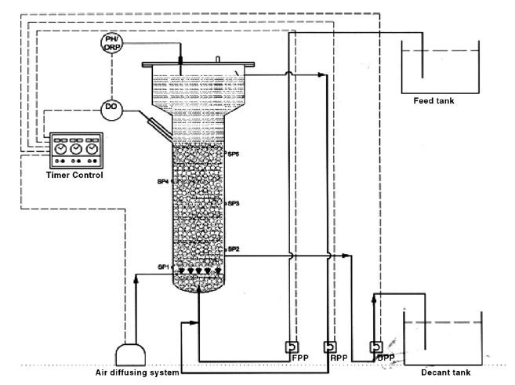
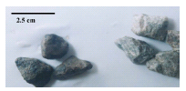
Operation of SBBR system

Slide 9
What are advantages of SBR ?
Advantages
  Equalization, primary clarification (in most cases), biological treatment, and secondary clarification can be achieved in a single reactor vessel.
  Operating flexibility and control.
  Minimal footprint.
  Potential capital cost savings by eliminating clarifiers and other equipment.

Slide 10
What are disadvantages of SBR ?
Disadvantages
  A higher level of sophistication such as automated switches, and automated valves. is required especially for larger systems.
  Lots of sludge amount and high sludge volume index.

Slide 11
Influence of salt in SBR
COD, NH₄-N and PO₄-P removal rates decreased with increasing salt concentration.
Because of adverse effects of salt on microorganisms.

Slide 12
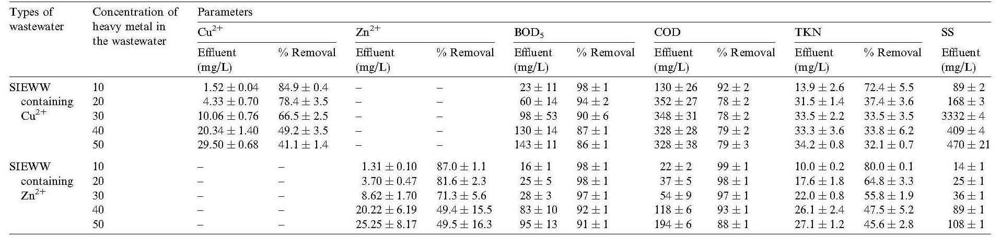
Influence of heavy metal in SBR
The bio-sludge could adsorb Zn²⁺ and Cu²⁺ from the wastewater.
The heavy metals adsorption efficiency of the system increased with
the increase of MLSS concentration of the system.
The adsorption efficiency can affect the removal efficiency other nutrient.

Slide 13
What are advantages and disadvantages of ASBR
Advantages
  No short circuit, as in the case of fixed-bed continuous systems.
  High efficiency for both COD removal and gas production.
  No primary and secondary settles.
  Flexible control.
Disadvantages
  Low performance efficiency if overloaded

Slide 14
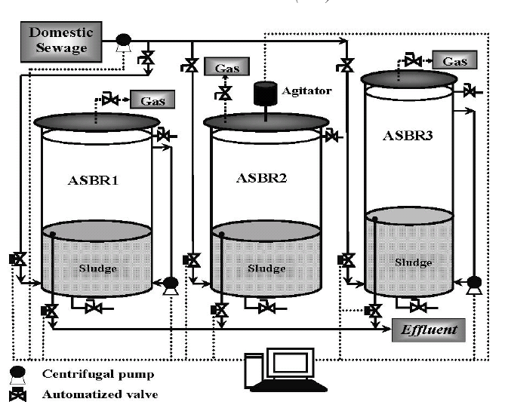
Influence of mixing in ASBR
The removal efficiencies in the two ASBR1 and ASBR2 reactors operated
under mixed liquor recirculation and Mechanic show mean values of
COD and TSS removals efficiencies of 40% and 65%, and average
removal efficiencies of 60% and 80% for COD and TSS, respectively
Mixing type in react step : Liquor recirculation / Mechanic

Slide 15
Comparison of SBR and SBBR
SBR system
SBBR system (media)

Slide 16
Comparison of SBR and SBBR
Comparative performance evaluation of SBBR with other reactor

Slide 17
Conclusion
Advantages of SBRs are that equalization, primary clarification, biological treatment, and secondary clarification can be achieved in a single reactor vessel. These advantages can reduce the treatment area and cost.
The pollutant removal efficiency of SBR system is shown high removal efficiency for nitrogen and phosphate. And the SBR system can remove heavy metal such as Zn²⁺, Cu²⁺, Pb²⁺ and Ni²⁺ with organic pollutant and nitrogen.

Slide 18
Conclusion
The efficiency of SBR system to treat specific nutrient (COD, NH₄-N and PO₄-P) is affected on salt concentration in wastewater due to adverse effects of salt on microorganisms.
The heavy could reduce COD and BOD₅ removal abilities, because adsorption efficiency of the heavy metals of the system increased with the increase of MLSS concentration of the system.
The comparison of removal efficiency between SBR and SBBR shows that the efficiency of SBBR system is higher than SBR system for COD, BOD.

Slide 19
Thank you

