Slide 1
Environmental Biotechnology
CE421/521
Tim Ellis
October 25, 2007

Slide 2
INDICATOR MICROORGANISMS
Need for indicator organisms
Not possible to test for every pathogen
Use indicator that will be easy to test routinely
Early warning if there is a problem
Used in regulations
Water treatment and distribution
Wastewater treatment discharges (NPDES permit)
When to close beaches and lakes for recreational uses
Beaches closed when FC is over 300 colony
forming units per 100 mL or when monthly
average is over 140 CFU per 100 mL

Slide 3
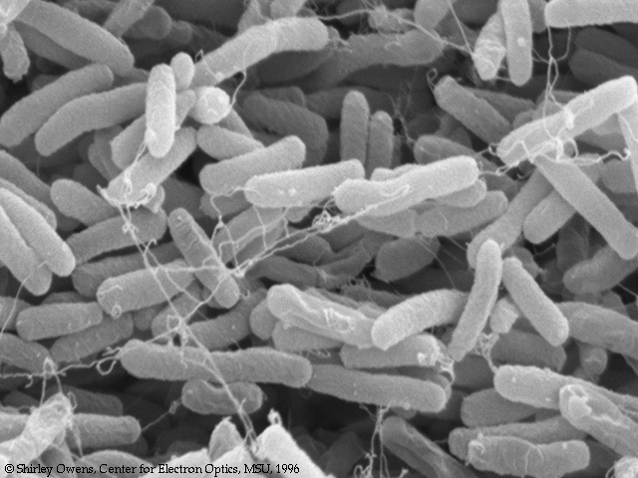
INDICATOR MICROORGANISMS
Use of indicator organisms dates back to 1914 when U.S. Public Health Service adopted the c______________ test as an indication of fecal contamination
Ideal indicator should have the following characteristics:
Found in i___________________ of warm blooded animals
Should be present when p__________________ are present and absent when pathogens are absent
Present in greater n___________________ than pathogens
As r____________________ as (or more resistant than) pathogens
It shouldn’t m__________________ in the environment
Easily detectable by r___________, inexpensive method
Non-p_____________________ itself
E.coli

Slide 4
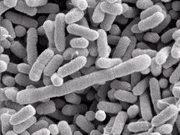
Total Coliforms
Characteristics:
Aerobic and f___________________ anaerobic organisms
gram n_________________
non s_____________ forming
r_______ shaped
ferment l__________________ within 48 h at 35°C as evidenced by gas production
includes E. coli, Enterobacter, Kleibsiella, and Citrobacter
high levels in human and animal feces ______ per capita per day

Slide 5
Fecal Coliforms
all coliforms that can ferment lactose at 44.5°C as evidenced by g________ production
includes groups such as E. coli and Kleibsiella
p________________ is an indication of human and animal contamination
human and animal contamination cannot be d_______________
s___________________ pattern is similar to bacterial pathogens
much l______ resistant to disinfection than protozoan pathogens

Slide 6
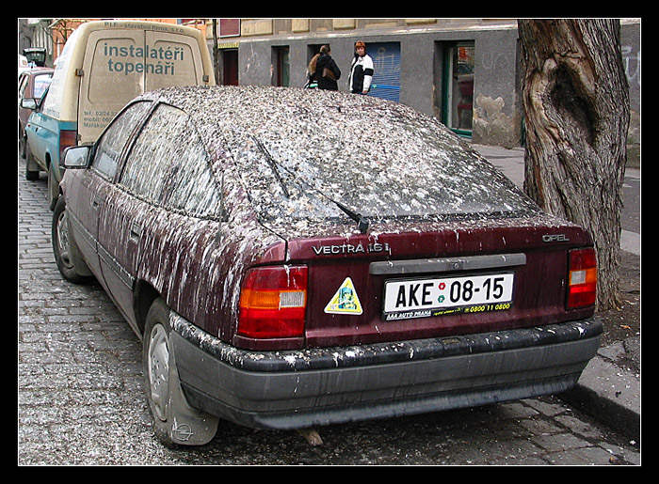
Fecal Streptococci
includes groups such as Streptococcus faecalis, S. bovis, S. equinus, and Kleibsiella
inhabit i______________ of warm blooded animals and humans
Historically fecal coliform/fecal strep r_______ serves as useful indicator of origin of contamination
ratios greater than 4 indicate h____________ origin
ratios less than ________ indicate animal contamination
In-between ratios indicate a m__________________ of human and animal contamination
Currently there are probably better
indicators of human contamination
(pharmaceuticals and personal care
products)

Slide 7
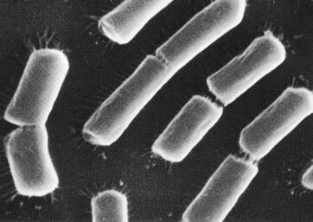
Clostridium perfringens
Anaerobe
forms s______________ that are resistant to disinfection and environmental stress
possibly t_____ resistant to be useful as an indicator
good for tracking contamination in m__________ environments
http://chem.ch.huji.ac.il/~eugeniik/
biofuel/biofuel_cells_bacteria12.jpg

Slide 8
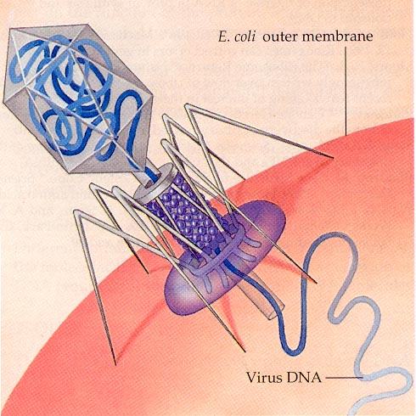
Bacteriophages
Similar to enteric v___________ and found in higher numbers
Suggested as water quality indicators in e___________________, seawater, recreational waters, and drinking water
C________________ exhibit
best correlation to enteric
viruses

Slide 9
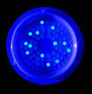
Heterotrophic Plate Count (HPC)
Measure of aerobic and facultative anaerobic bacteria that derive their c______________ and e________________ from organic compounds
No known effects of high HPC on h____________ health
HPC in drinking water ranges from less than _____ CFU/mL to more than ____ CFU/mL
Good indicator of pathogens in r___________________ wastewater

Slide 10
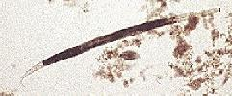
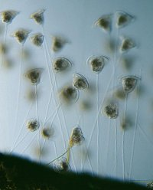
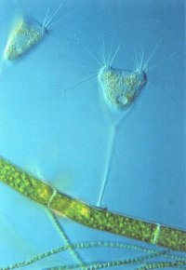
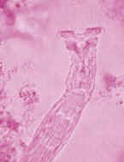
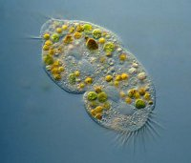
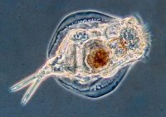
BULKING and FOAMING
Sludge settling can be the most important operational problem in an activated sludge plant
Nematodes
Ciliates
Rotifers

Slide 11
FILAMENTOUS BULKING
Measurement of sludge settleability
Sludge v___________ index
Measure of s_____________ characteristics
Measured in a g_____________ cylinder after 30 min of settling
Units of mL/g
A d_____________ SVI is in the range of 75-150

Slide 12
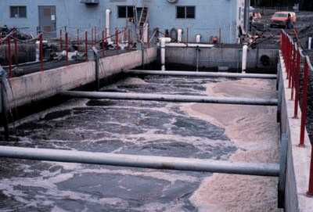
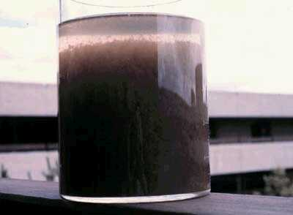
Bulking and Foaming

Slide 13
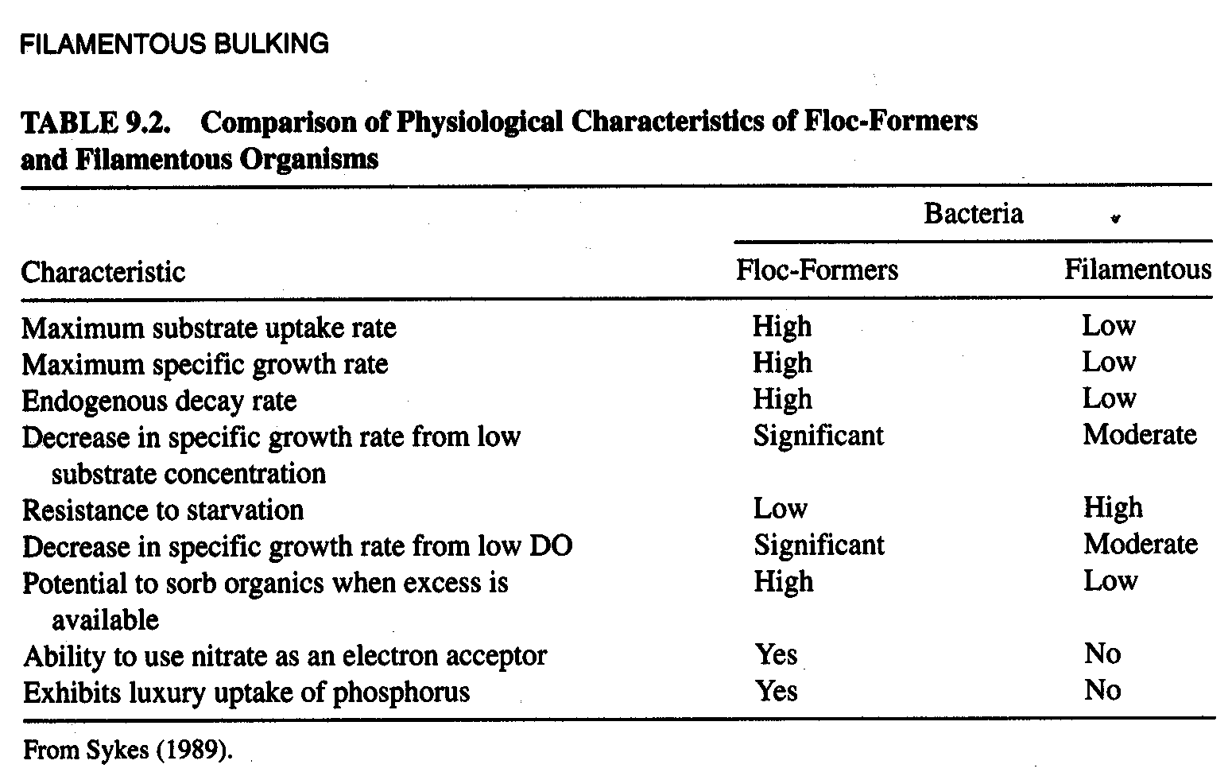
Filamentous Bulking
Kinetic Selection Theory (Chodoba et al.

Slide 14
Types of Filaments
filament s_________
size and shape within filament
b___________
motility (e.g. Beggiatoa move by g___________ )
presence of s_____________
presence of epiphytic b_____________ on filament surface
filament size and d__________________
presence of g_____________________

Slide 15
Isolation of Filaments
m___________________ analysis
fluorescent-a___________________ techniques
RNA chemotaxonomy (g____________ p____________)

Slide 16
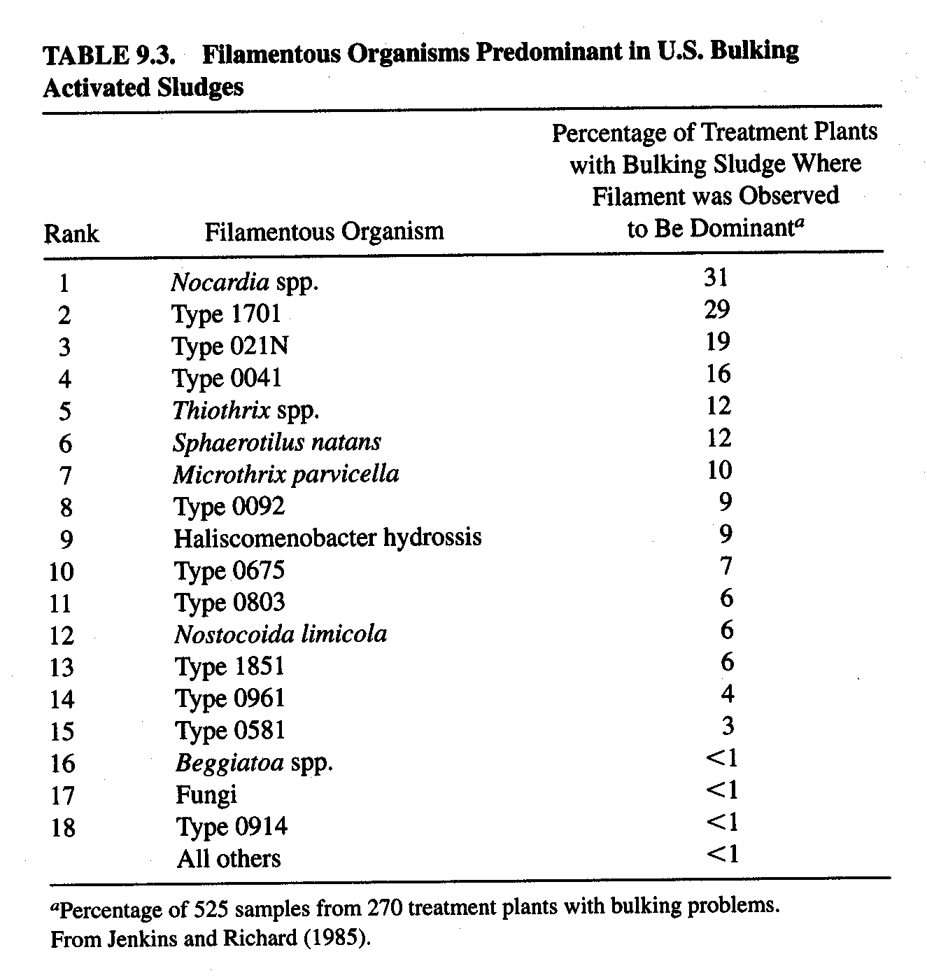
Predominant Filaments

Slide 17
CAUSES
Waste composition
high c___________________
v__________ a__________
readily d__________________ substrates

Slide 18
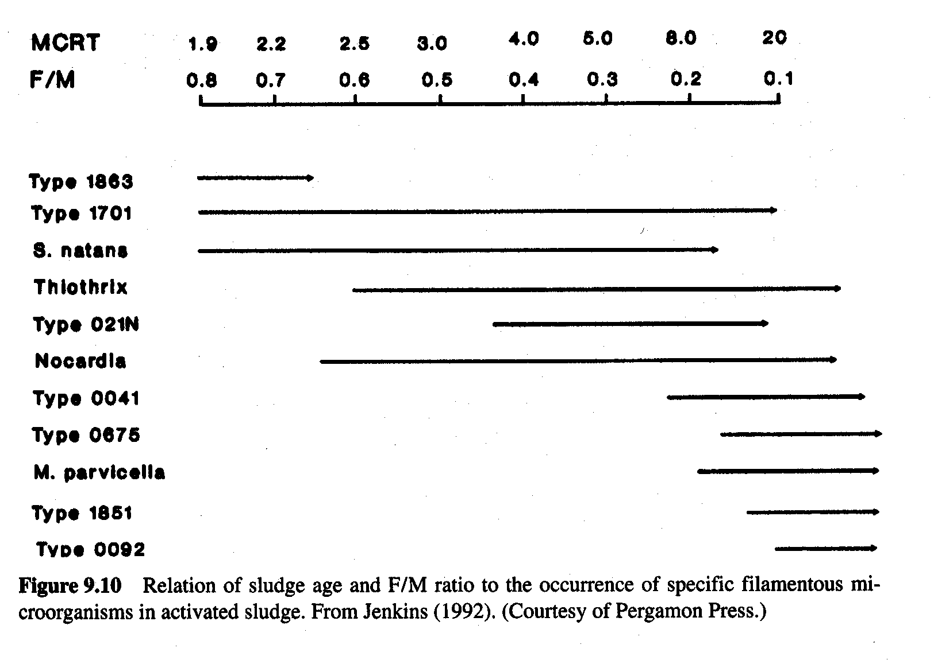
Causes
Substrate Concentration
l_____ s__________ concentrations favor filaments due to their low K_{S} values
Sludge Loading (Food to Microorganism Ratio)

Slide 19
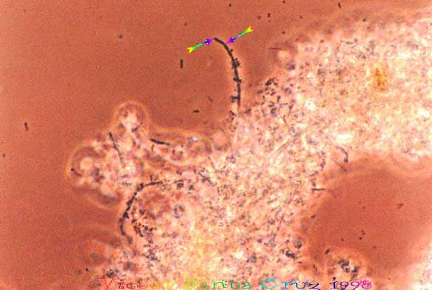
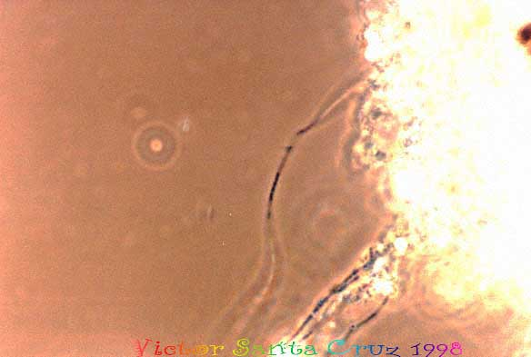
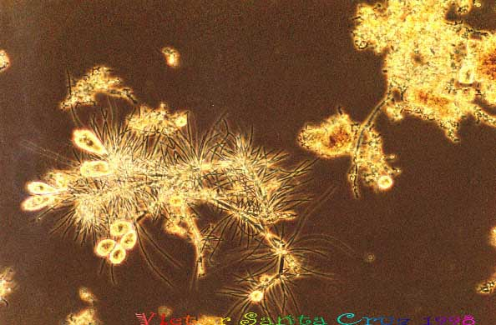
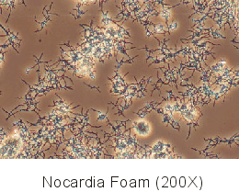
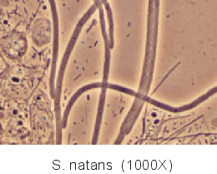
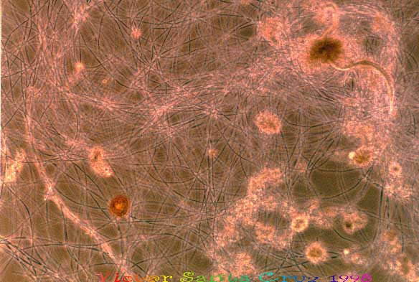
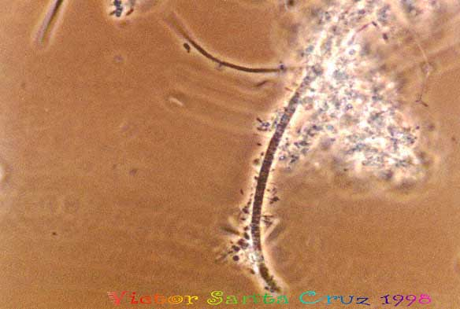
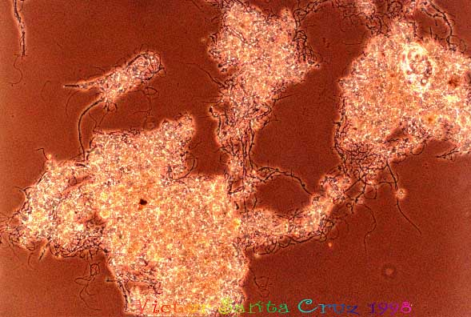
Photos of bulking organisms
Thiothrix spp.
Type 021N
Type 1701
Type 0041N
Microthrix parvicella

Slide 20
Causes
pH
l________ pH tends to favor filaments
Sulfide
sulfide tends to encourage growth of s_______ f_______________ such as
Thiothrix
Beggiatoa
021N
D.O.
Sphaerotilus natans K_{S} for oxygen is 0.01
K_{S} for oxygen for floc formers is 0.15

Slide 21
BULKING CONTROL
C_________________ or O_____________________ of RAS
Biological Selector
a______________ selector
a______________ selector
a_________________ selector

Slide 22
FOAMING IN ACTIVATED SLUDGE
Types of activated sludge foams:
s______________ a_______________ compounds
d____________________
s___________ (e.g., as a result of denitrification)
actinomycetes f___________

Slide 23
Foam Nuisance
a____________________ and safety hazard (e.g., slippery walkways)
increased levels of o_________________ c________________ in effluent
foaming in a____________________ digesters
nuisance o_______________
opportunistic p___________________ (e.g., Nocardia asteroides)

Slide 24
Foam Microbiology
A_______________________ is the most predominant foam causing organism
N________________ is a predominant member of this classification (e.g., Gordona amarae, formerly Nocardia amarae, N. asteroides, N. pinensis, and Rhodococcus).
Gordona amarae and N. pinensis are usual suspects
foaming is problematic when Nocardia concentration exceeds ______ mg Nocardia per g VSS

Slide 25
Mechanisms of Foam Production
Gas b__________ from aeration or denitrification assist in flotation
h_____________________ nature of cell wall assist in their transport to air-water interface
b_______________________ produced by microorganisms accelerate foaming
foaming is exacerbated by:
l____________ SRTs (i.e., >9 d)
w____________ temperatures (i.e., >18°C)
wastewaters with high f_______ , o_______, and g_____________ (FOG)

Slide 26
FOAM CONTROL
c_________________________ of foams
l____________ SRT
s________________
reduced a_______________
r__________ FOG, pH
recirculation of a_____________ d______________ supernatant
water s______________
a____________ agents
p___________________ modifications (e.g., overflow weirs)

Slide 27
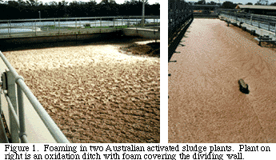

Slide 28
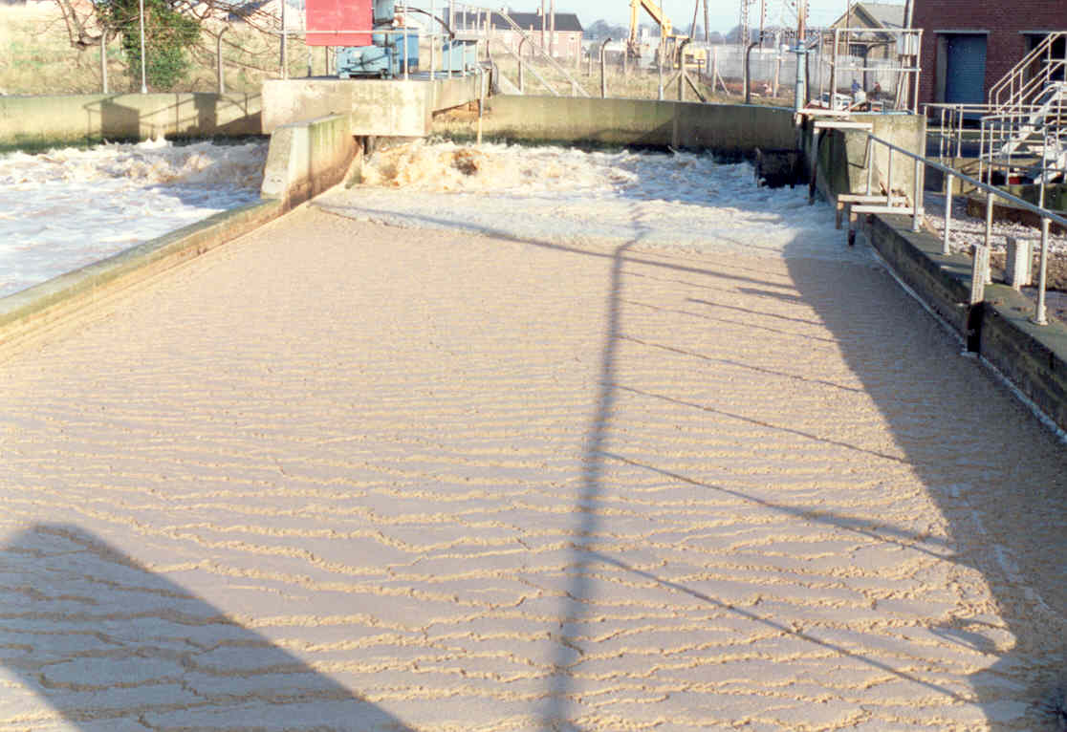
http://www.tcd.ie/Centre_for_the_Environment/watertechnology/images/17.2.jpg

Slide 29
