Slide 1
Effects of leachate recirculation on anaerobic treatment of municipal solid waste
by
Chayanon Sawatdeenarunat

Slide 2
Municipal Solid Waste (MSW)
Municipal Solid Waste (MSW)
  Predominantly household waste
  The addition of commercial waste
which are collected by a municipality within a given area.

Slide 3
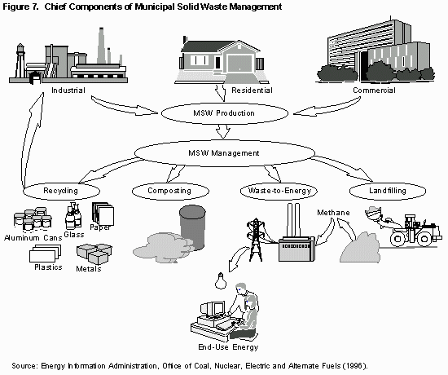
MSW management

Slide 4
Characteristics of MSW in US (2005)
Food waste 9.8%
Yard trimming 9.6%
Paper & paper board 39.6%
Glass 4.7%
Metal 7.8%
Plastic 11.2%
Wood 6.6%
Total MSW generated 340 million tons

Slide 5
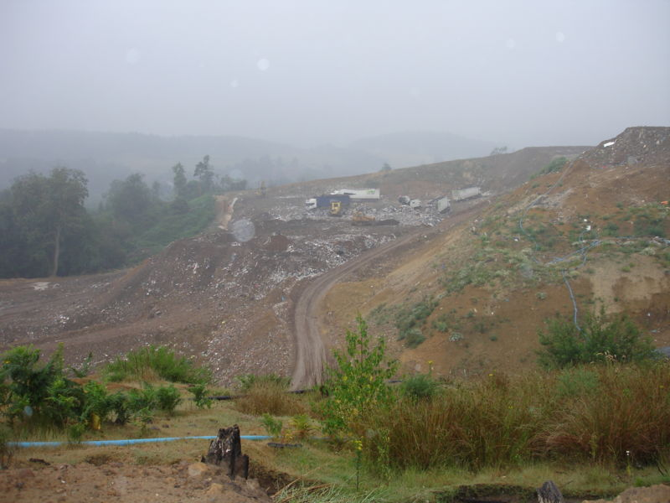
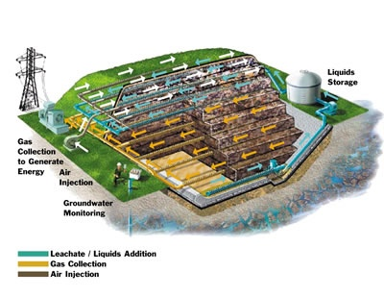
Landfill
is a site for the disposal of waste materials by burial and is the oldest form of waste treatment

Slide 6
Leachate
is the refuse from landfills
The compositions vary regarding the age of each landfills and characteristics of MSW
High COD, sulfate and metal ion
Anoxic, acidic

Slide 7
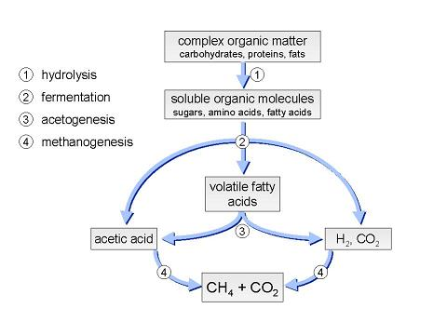
Anaerobic digestion

Slide 8
Effects of leachate recirculation on organic compounds removal
Conventional landfills
  Washed out
  Bio-conversion
Bioreactor landfills
  Accelerated bio-conversion

Slide 9
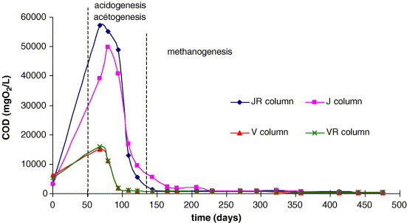
Effects of leachate recirculation on organic compound removal

Slide 10
What are the benefits of leachate recirculation on organic compound removal?
Increase moisture content
Enhance hydrolysis stage
Enhance contact between organic compounds and microorganism
Recirculate organic compounds
Recirculate methanogen microorganism
Reach stabilization more rapidly

Slide 11
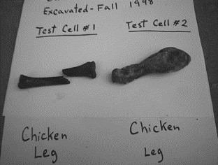
Accelerated biodegradation

Slide 12
Effects of leachate recirculation on landfill gas production and methane content
Methane production increase in recirculating landfills
  The acceleration of organic compounds removals
  Return organic compounds
  Improve methanogenic activities
Methane content is not significantly change
High recirculation rate
  Cause acid accumulation
  inhibit methanogen microorgsnism
  Reduce methane production rate

Slide 13
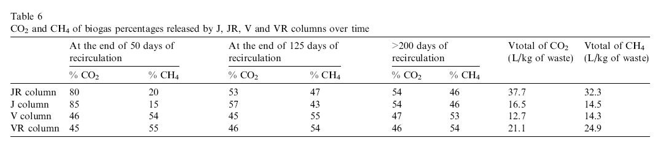
Methane production and methane content

Slide 14
Effects of leachate recirculation on metal concentration
Metal precipitation
  In the beginning (acidogenesis stage)
    pH is between 4 and 6
    High solubility of metal
  Reach stabilization (methanogenesis stage)
    pH is between 7 and 9
    Metal sulfide and metal hydroxide precipitate
Metal concentration in MSW
  Higher due to the accumulation of precipitated metal

Slide 15
Effects of leachate recirculation on metal concentration
Conventional landfills
  Need longer time to reach methanogenesis stage
  Remove less metal from leachate when compared with bioreactor landfills at the same time
Bioreactor landfill
  Increase contact between waste and leachate
  Remove metal from leachate more effectively

Slide 16
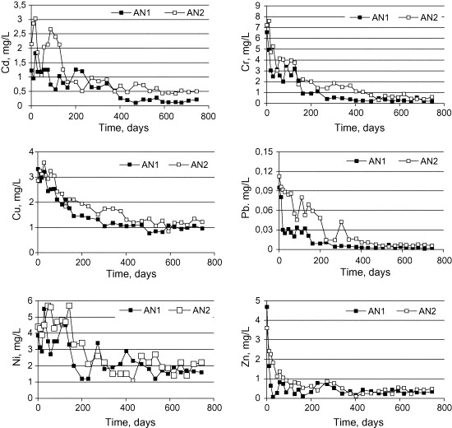
Metal concentration in leachate

Slide 17
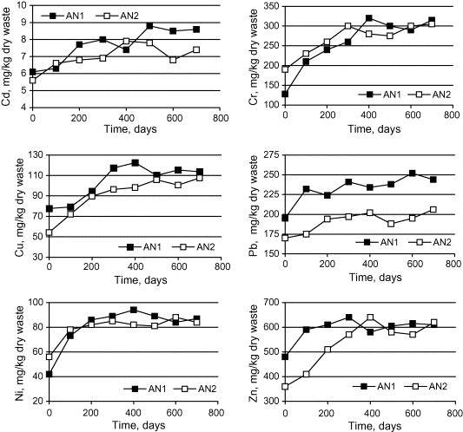
Metal concentration in MSW

Slide 18
Other mechanisms of metal removal from leachate
  Subsequent capture within waste metrix by encapsulation
  Sorption
  Ion-exchange
  filtration

Slide 19
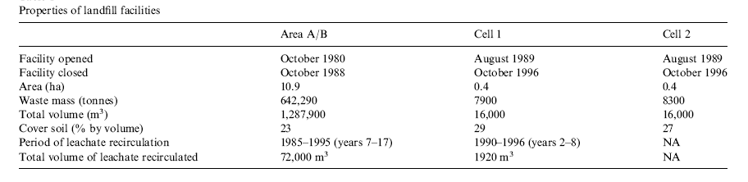
Study in full-scale landfills
Properties of landfill facilities

Slide 20
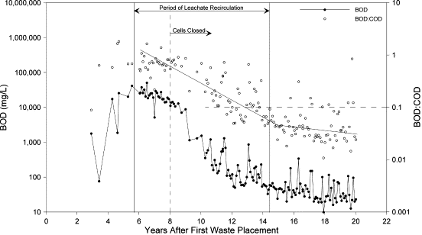
BOD and BOD:COD & Time
reach methanogenesis stage within 6 years

Slide 21
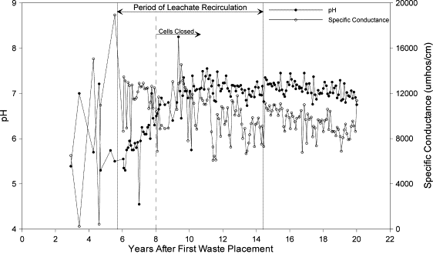
pH & Time

Slide 22
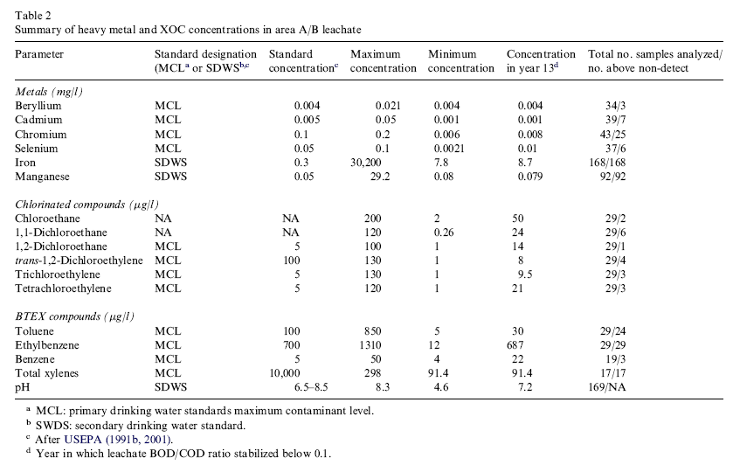
Metal concentration in leachate
Metal concentration is below standard within 13 years

Slide 23
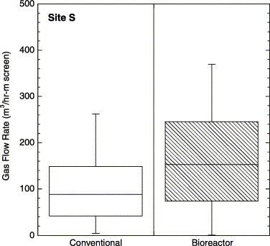
Gas flow rate (production rate)
About 60% higher in bioreactor landfills

Slide 24
Disadvantage
Accumulation of NH₃-N
  Leakage of Nitrification bacteria
    NH₃ + O₂ → NO₂⁻ + 3H⁺ + 2e⁻
    NO₂⁻ + H₂O → NO₃⁻ + 2H⁺ + 2e⁻
  Leachate should be pre-aerated off site before recirculation

Slide 25
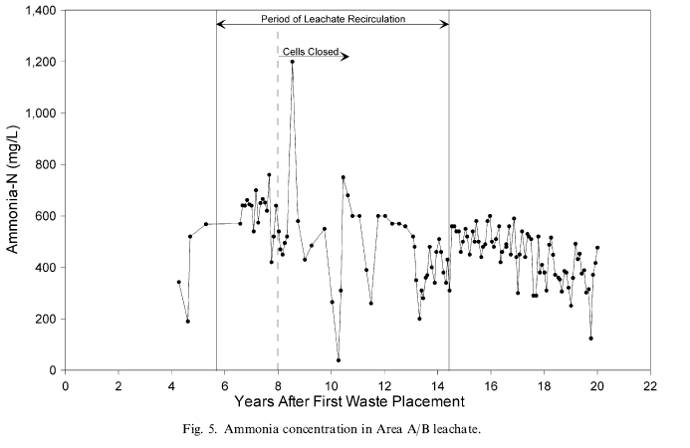
NH₃-N & Time

Slide 26
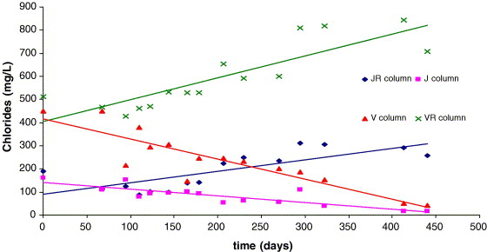
Disadvantage
Accumulation of Cl⁻ in leachate

Slide 27
Recirculation Strategies
The balance of biological process and hydraulic capacity of the waste
  Recirculate slowly before reaching methanogenesis stage
    To prevent acid stuck which could inhibit methanogen bacteria
    To prevent bacteria washed out
  Initiated as soon as possible following waste placement
    To ensure the appropriate moisture content of biodegradation

Slide 28
Recirculation Strategies
Leachate should be recirculated uniformly
  To prevent short circuiting
  To Increase contact between leachate and MSW

Slide 29
Thanks and Questions

