Slide 1
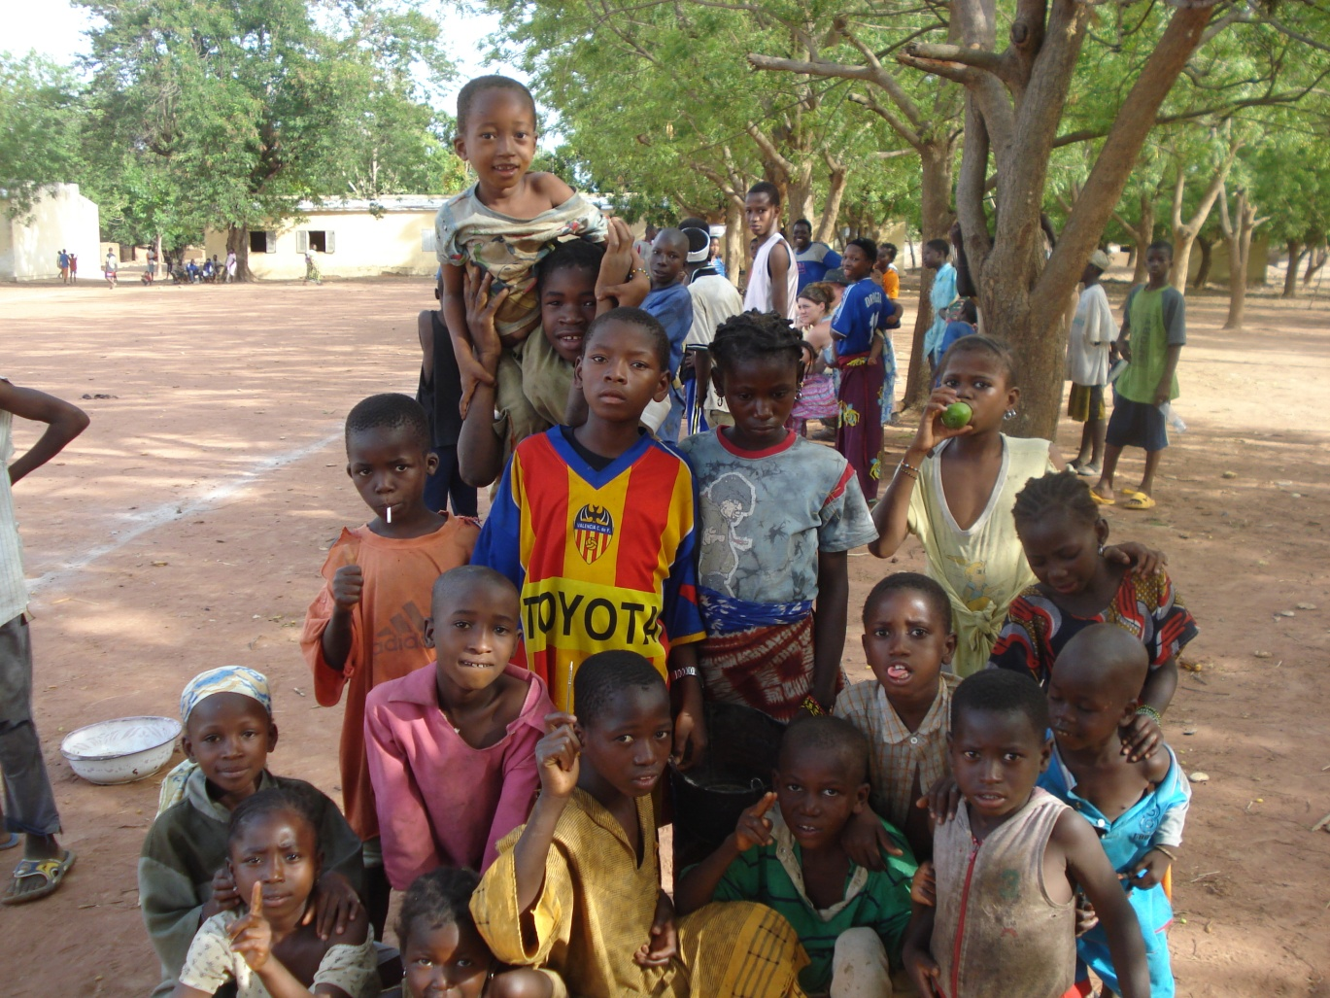
A Summer outside the States China, Mali, Uganda
Meghan Roberts

Slide 2
China Program
12 days in 5 cities (April 28th-May 8th)
Beijing, Lanzhou, Wuhan, Xi’an, Shanghai
Lanzhou Jiaotong University
18 students here!
Sightseeing!
Great Wall, Clay Soldiers

Slide 3
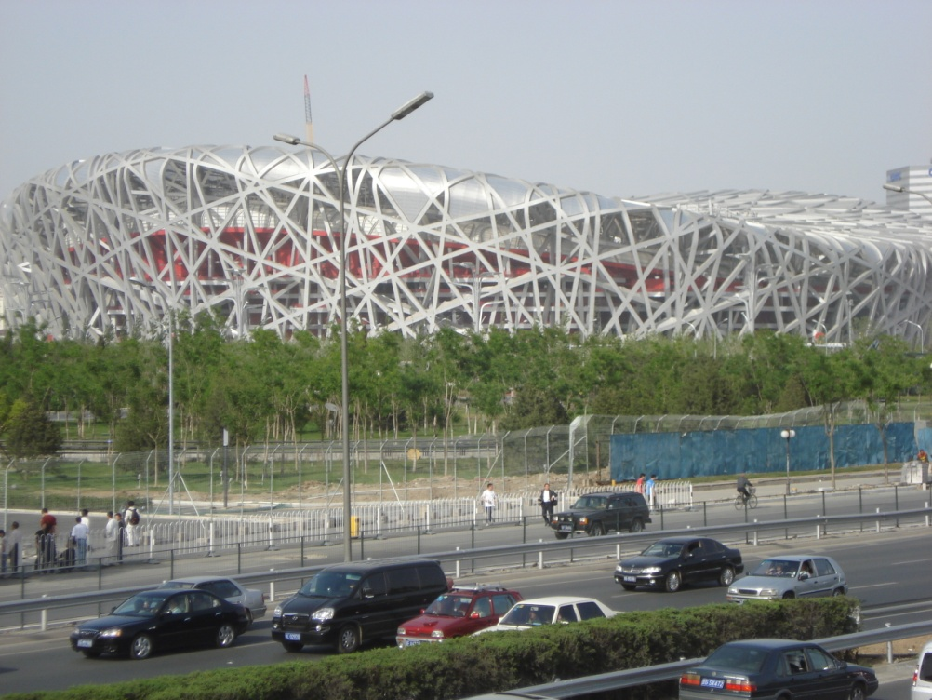
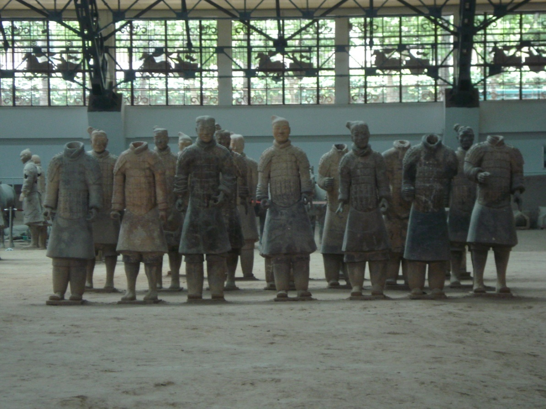
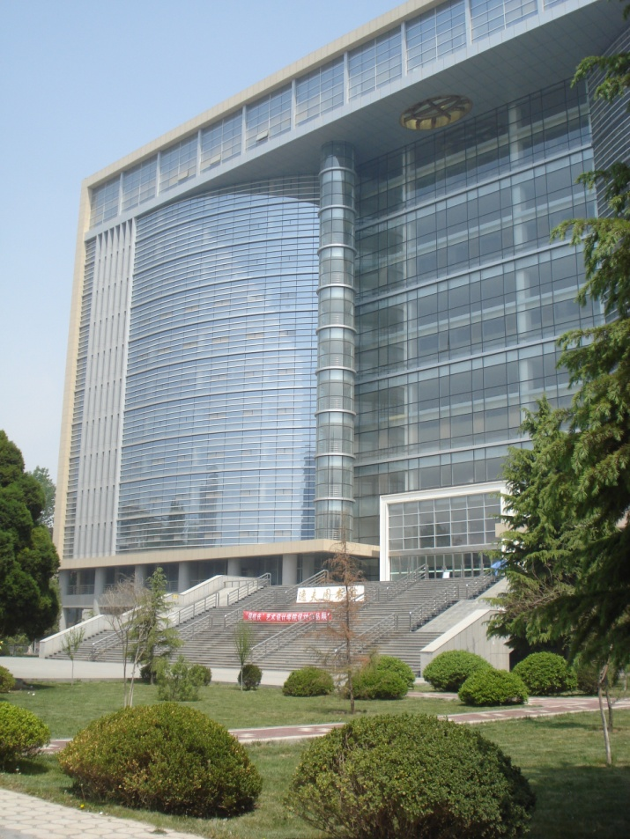

Slide 4
ME 389X – Study Abroad in Mali
May 12th – May 31st
3 Credits
Appropriate Technology
Stove Design
Lighting projects
Kids!!

Slide 12
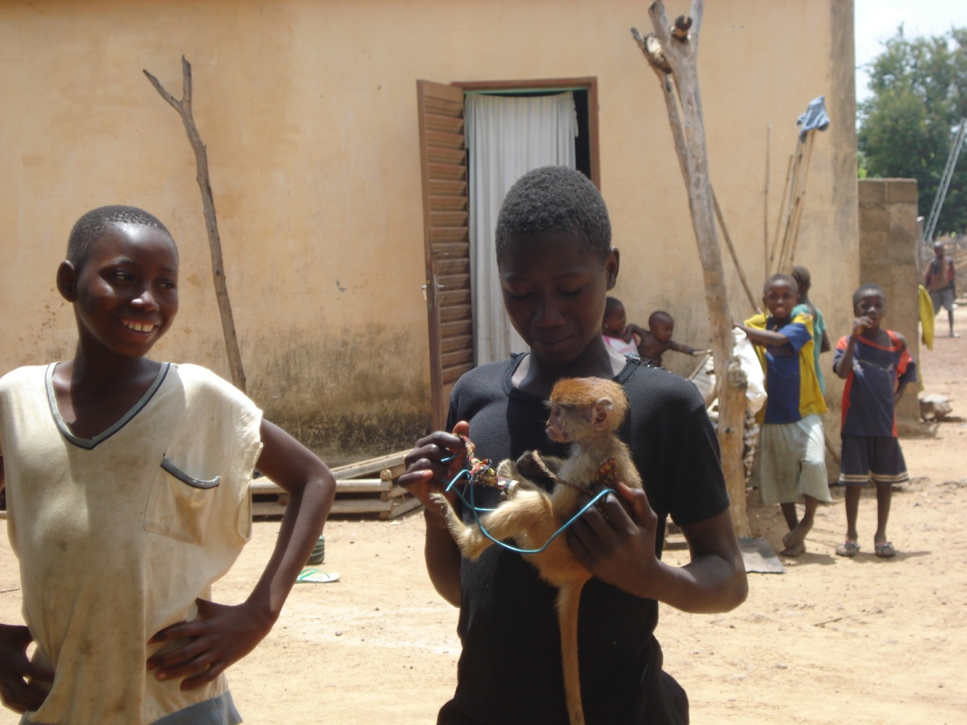
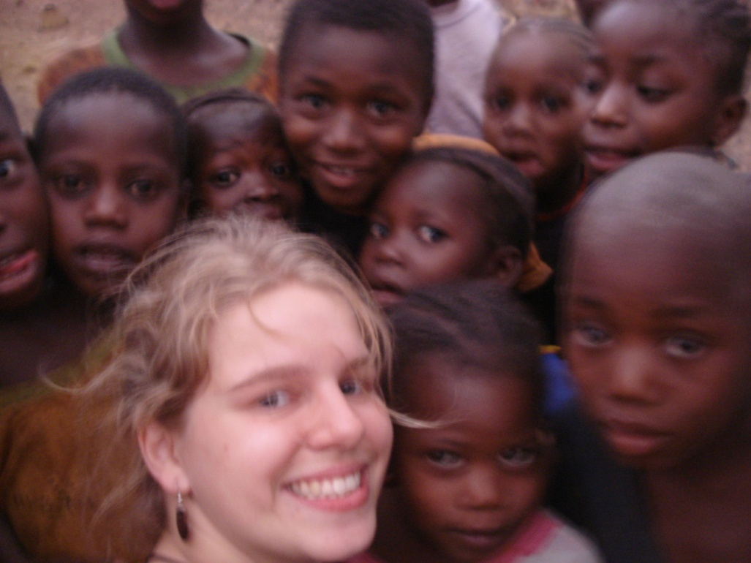

Slide 13
Uganda
June 1st – July 19th
Engineers for a Sustainable World
2 Students
No credit, but almost all paid for!
Rooftop Rainwater Harvesters

Slide 20
Questions?
megh8788@gmail.com

