Slide 1
Water Quality Considerations for Treatment
Water sources
Pollution
Treatment needs

Slide 2
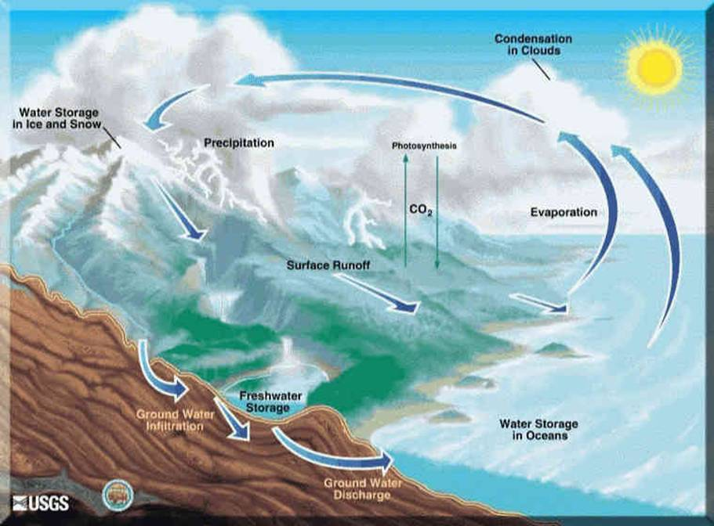
Hydrological cycle

Slide 3
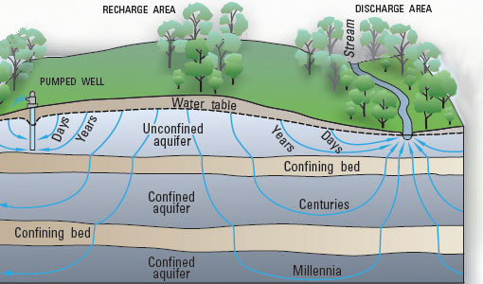
Water retention in aquifers

Slide 4
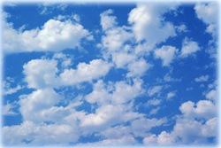
Atmospheric water
Atmosphere: superhighway for fresh water cycle around the globe
Volume of water in the atmosphere
(if condensed) ~ 3,100 mi³ or 12,900 km³
= 0.001 % of Earth's total water volume
= 0.035% of all fresh water
= 4.5% of all surface water
= 1 inch to cover all of Earth’s surface

Slide 5
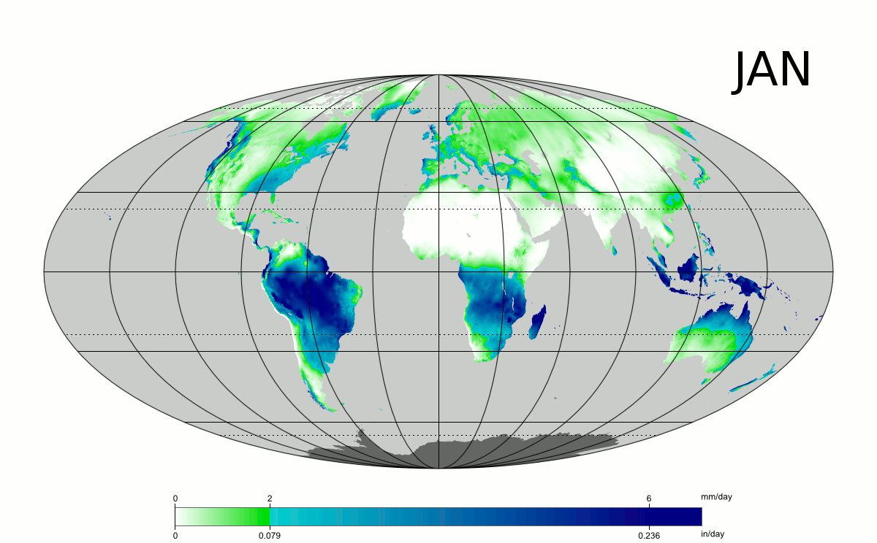
Rainfall distribution on Earth

Slide 6
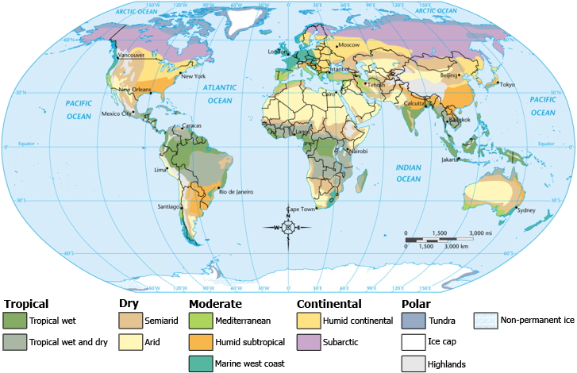
World climatic areas
World climatic areas

Slide 7
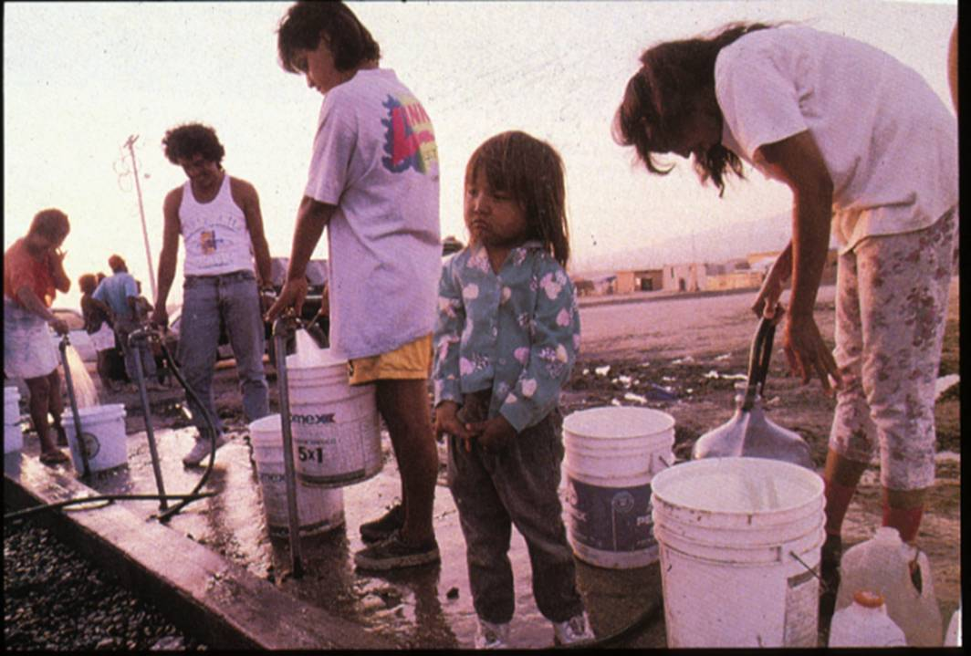
Safe and reliable supplies of water

Slide 8
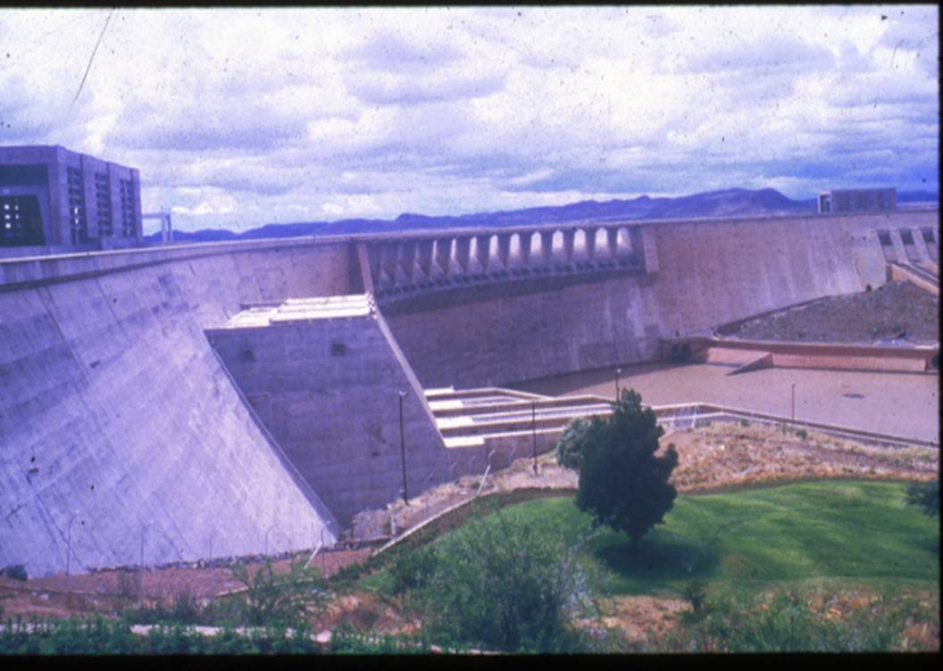
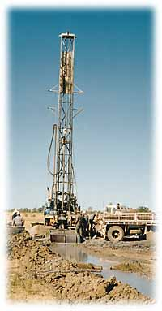
Ensuring supplies
Not without environmental consequences

Slide 9
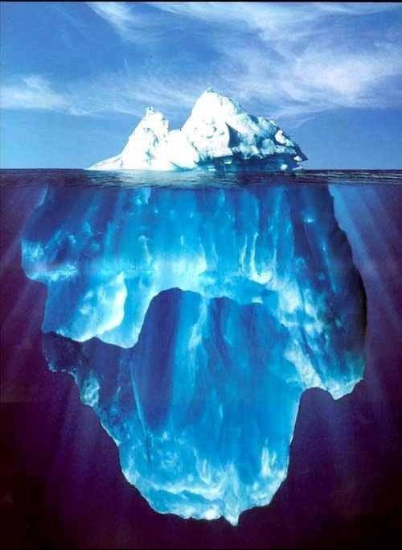
Alternative water sources
Promising, yet elusive

Slide 10
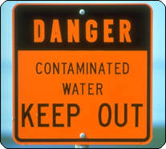
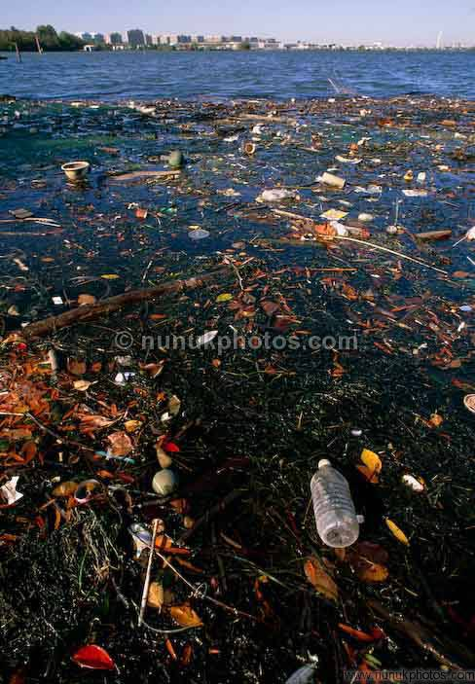
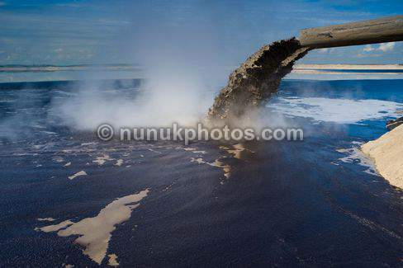
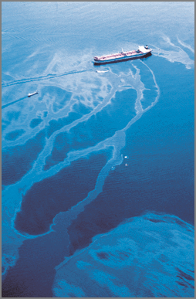
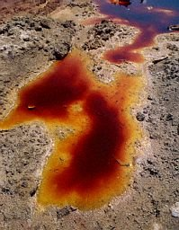
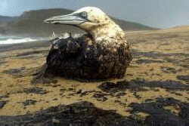
Water pollution

Slide 11
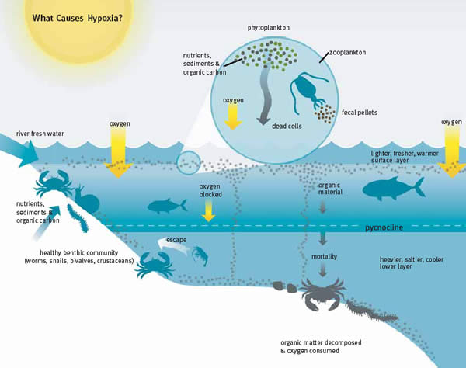
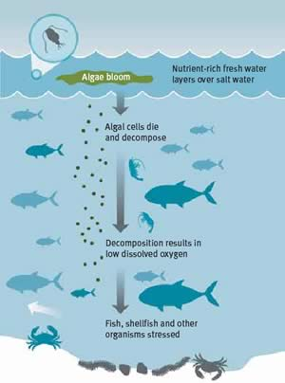
Hypoxia

Slide 12
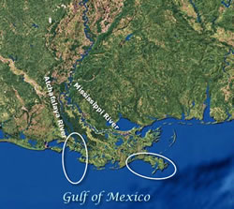
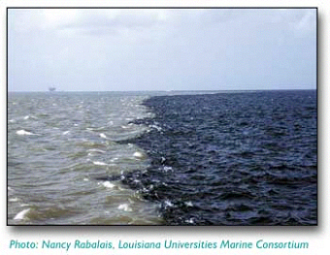
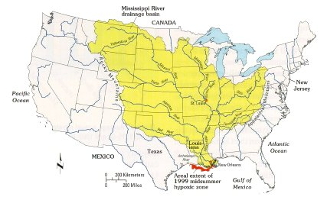
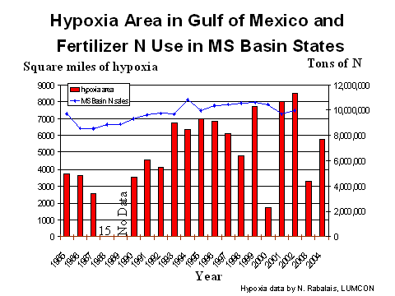
Hypoxia Mississippi Delta

Slide 13
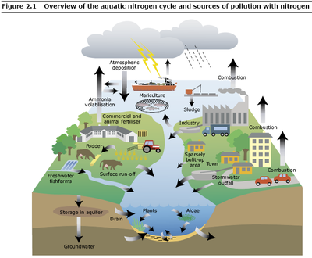
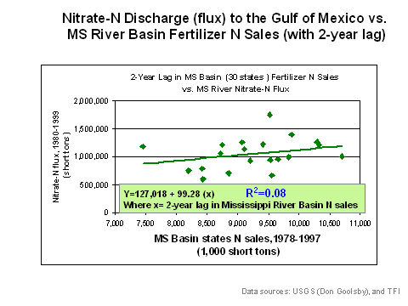
Fertilizer and nitrogen cycle

Slide 14
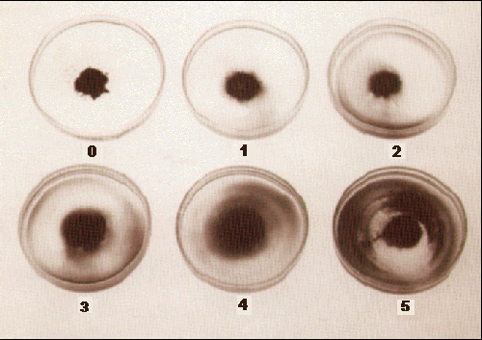
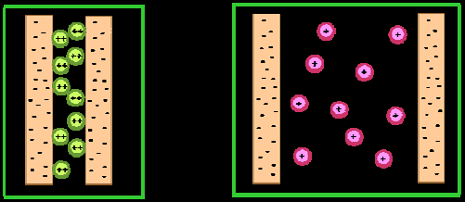
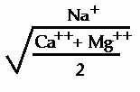
Effect of Salinity on Soils
Salinity: Sodium and Chloride
Good Salts: Calcium, Magnesium
Hold soil particles together
Problem Salts:
Sodium – soil dispersion
Chloride - toxicity
Ca⁺⁺
Mg⁺⁺
Na⁺
Sodium Absorption Ratio (SAR)

Slide 15
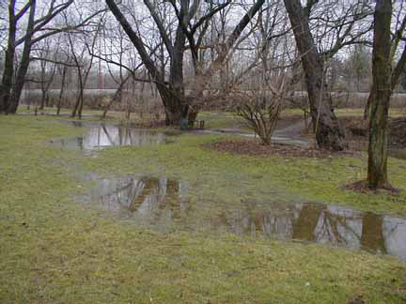
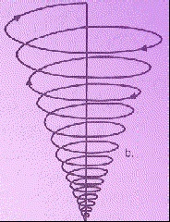
Consequences of Soil Dispersion
Poor Drainage
Less infiltration of water
Increased water runoff
Less efficient leaching of salt
Loss of Soil Structure
Loss of soil pore space
Decreased oxygen
Increased soil erosion
Plant Effects
High soil bulk density
Decreased root growth
Anoxia and root death
Poor water infiltration leads to soil ponding: poor leaching,
salt accumulation, low soil oxygen, root death from
anoxia, and increased Phytophthora root rot.

Slide 16
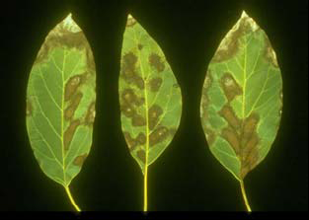
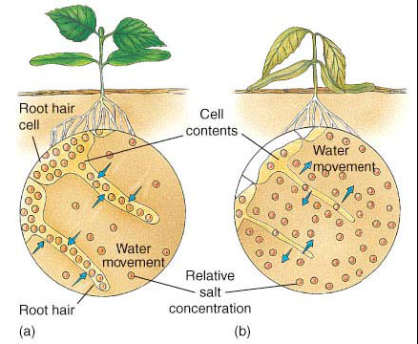
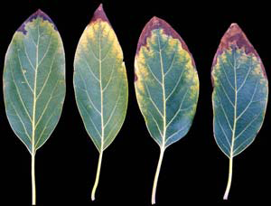
The effect of salinity on plants
Chloride 0.58%
Sodium 0.35%
Chloride 0.61%

Slide 17
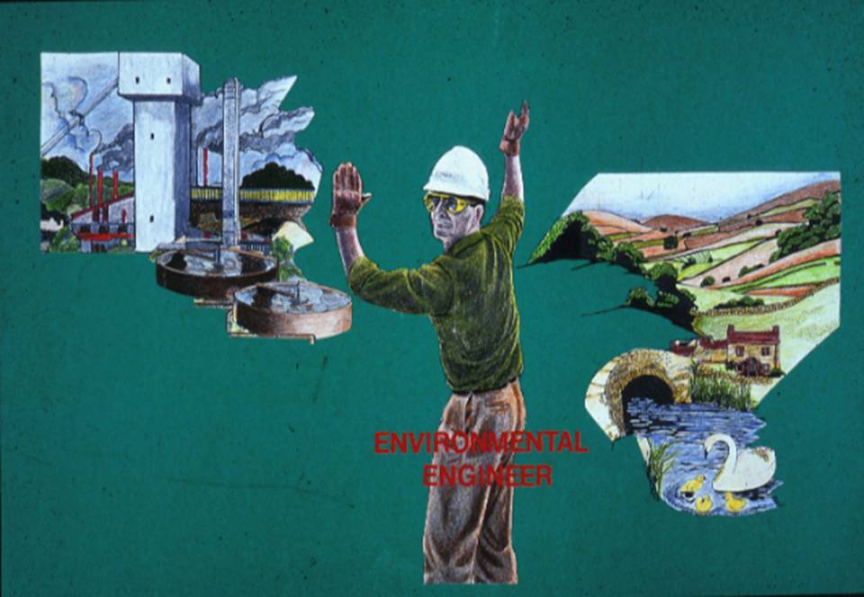
Environmental protection

Slide 18
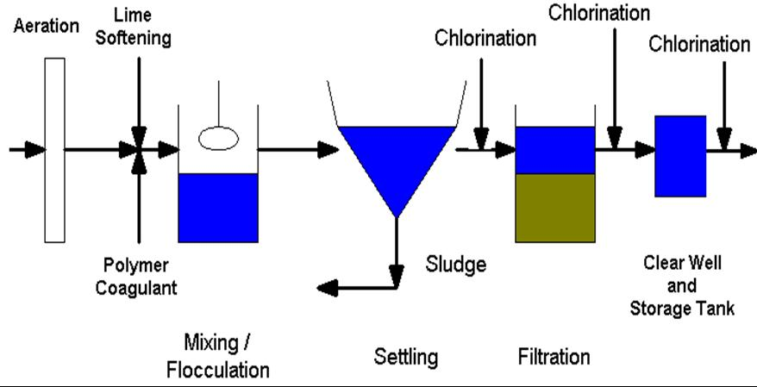
Typical water treatment process with lime softening

Slide 19
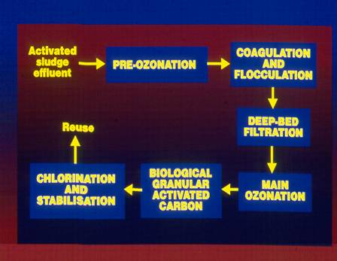
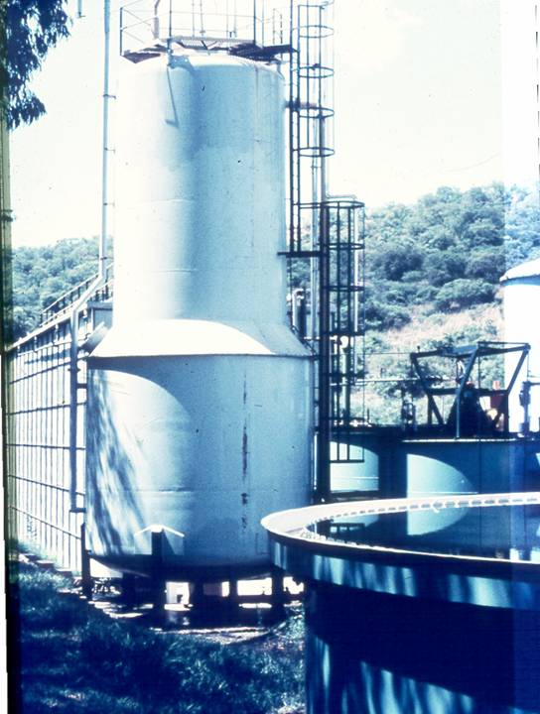
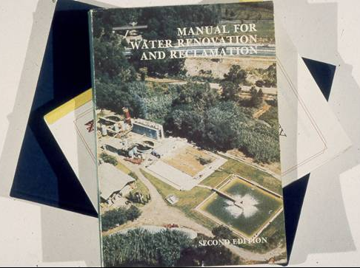
Water reclamation

Slide 20
Process units in water treatment
Pre-chlorination – for algae control and arresting any biological growth
Aeration – along with pre-chlorination for removal of dissolved iron and manganese and stripping volatiles
Coagulation – for flocculation
Coagulant aids, such as polyelectrolytes – to improve coagulation and for denser floc formation
Sedimentation – for initial solids separation, that is, removal of suspended solids trapped in the floc
Filtration – removing additional solids from water
Desalination – removing soluble inorganics from water
Softening – removing calcium from water
Disinfection – inactivating microbes
Adsorption – removing undesirable organic compounds

Slide 21
Reflection
The general technologies are well developed and generalized designs are available which are used by many water utilities (public or private)
No unique solution (selection of unit processes) for any type of water
New technologies are still developed
Difficult to standardize unit processes for different water sources. Treatability studies for each source of water in different seasons required for appropriate processes.

