Slide 1
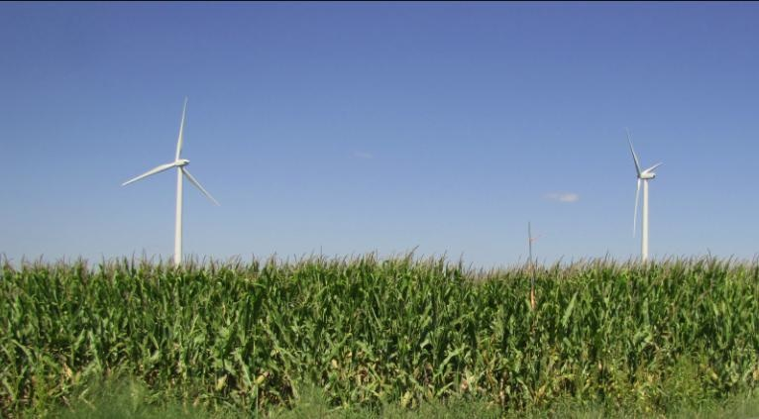
CWEX
(Crop/Wind-energy Experiment)
Dan Rajewski¹
Gene Takle^{1,2,}, Tom Horst³, Steve Oncley³,, Julie Lundquist⁴, Mike Rhodes⁵, John Prueger⁶, Richard Pfieffer⁶, Jerry Hatfield⁶ , Russell Doorenbos², and Kris Spoth²
(drajewsk@iastate.edu)
¹Geological & Atmospheric Sciences, ²Agronomy
Iowa State University, Ames, IA
³National Center for Atmospheric Research
⁴Atmospheric and Oceanic Sciences, ⁵Aerospace Engineering Sciences University of Colorado, Boulder, CO
⁶ National Laboratory for Agriculture and the Environment, Ames, IA

Slide 2
CWEX Overview
Introduction
CWEX: Crop/Wind-energy Experiment: Observations of surface-layer, boundary-layer and meso-scale interactions with a wind farm
Changes in fluxes of heat, H₂O, and CO₂ caused by a large wind farm
Air temperature and heat flux measurements within two lines of turbines in a large operational wind farm

Slide 3
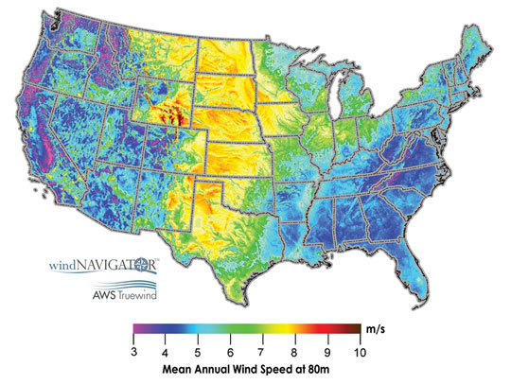
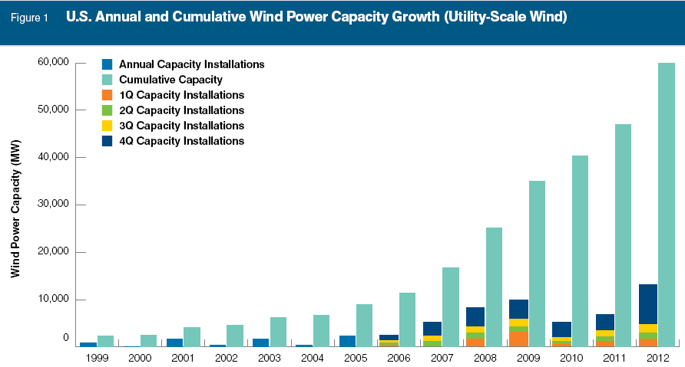
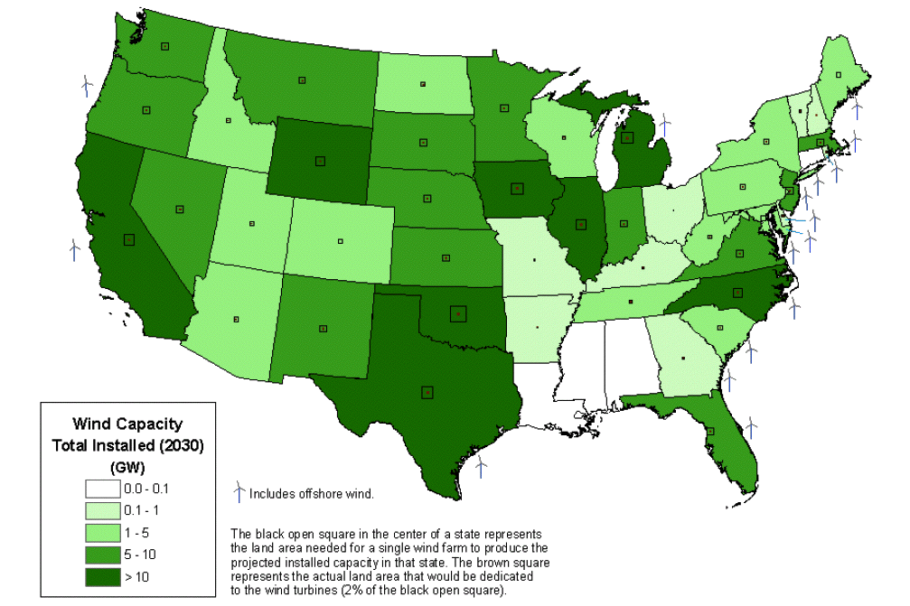
Motivation
Wind farm expansion ongoing across several million acres of cropland in U.S. Midwest
Several tens of additional GWs installations are needed to facilitate energy independence (US DOE 2008a)
Turbine construction allows for cropland management within a few feet of the base of the turbines (USCUSA 2010)
Iowa
5.1 GW
to date
From: AWEA 2012 Year End Report

Slide 4
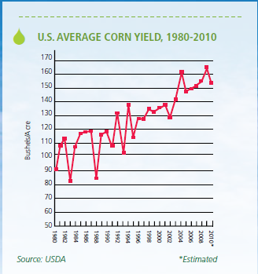
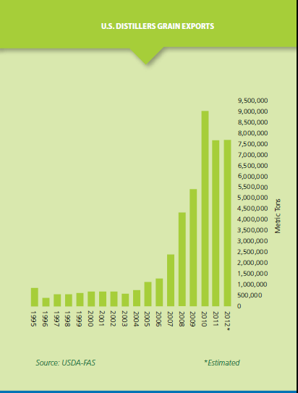
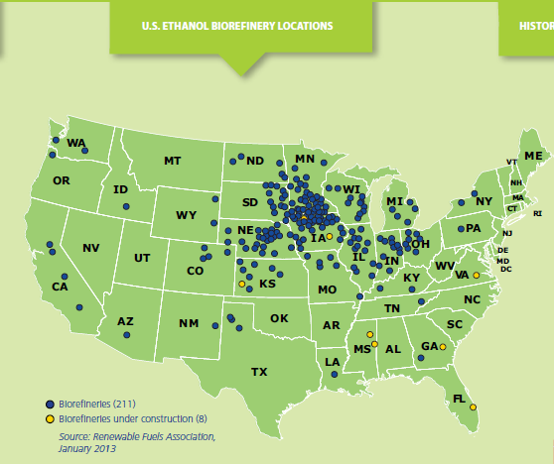
Motivation
Agricultural crop production serves as a vital industry of many U.S. Midwest states
Ethanol and biodiesel conversion from crop biomass has also undergone recent expansion in the U.S. Midwest.
  Iowa produces 19% of national corn crop, 12% of soybean
  Bio-derived ethanol amounts to 10% of U.S. gasoline supply
From Renewable
Fuels Association
2012, 2013
Reports

Slide 5

Motivation
Convergence of two energy industries in the same geographical area presents an interaction
  (I): Crop and field management impacts on wind power
  (II): Wind turbine/wind farm influences on crop microclimate and overall yield
Can strategies of optimization be
developed by studying this interaction?

Slide 6
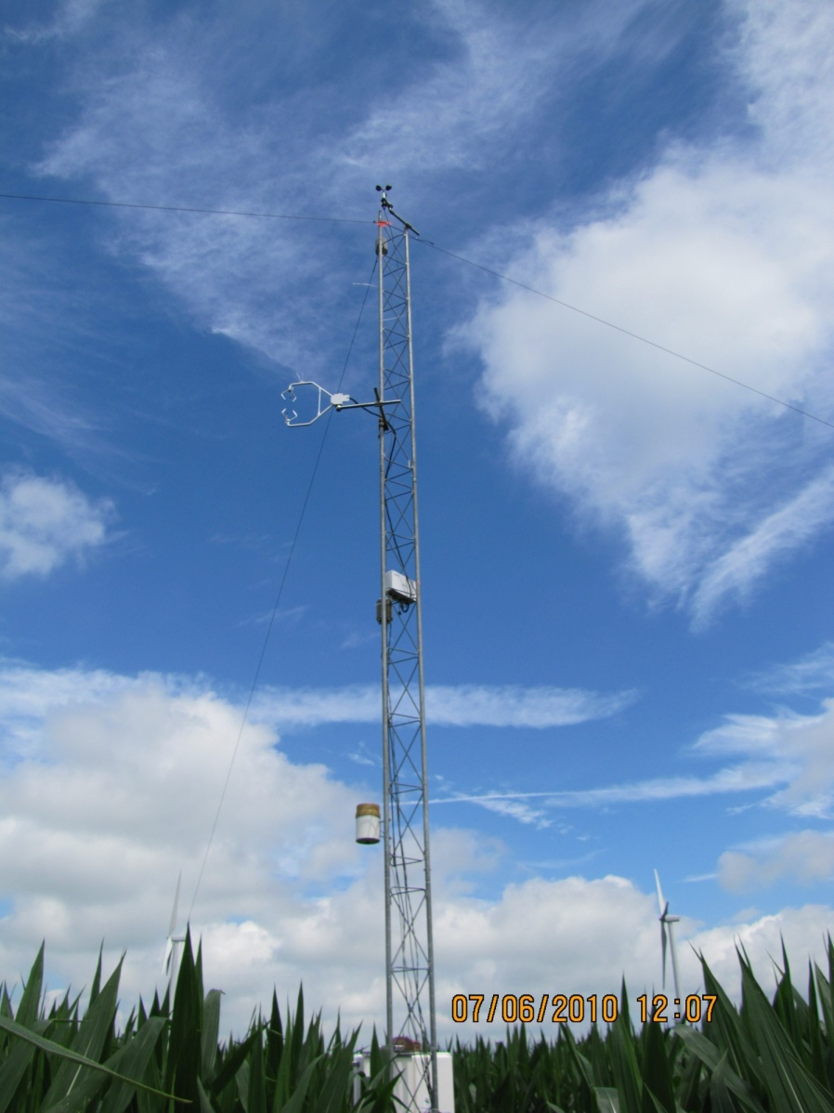
Objectives of CWEX
Measure change in fluxes produced by turbines in a wind farm co-located with intensively managed agriculture
  Multi-use, high-land-value environment
  Crops are tuned to climate conditions
  Do turbines influence the microclimate for crops?
Develop a test bed for validating high-resolution models of wind-farm performance and coupling to surface and PBL
  General understanding of impacts of turbines
  Understand turbine-turbine interaction and wind-farm performance
  Options for further wind farm build-out: Go higher? More dense?
  Iowa has a flat terrain, strong LLJ, not unlike coastal jets, many existing wind farms and component manufacturers: zero-order test bed for off-shore
Develop a deeper understanding of how the PBL interacts with a wind farm
  How momentum is replenished from above as air flows through the wind farm?
  How does the wind farm change mesoscale flow fields and possibly rearrange convection in the PBL
Picture by: Russell Doorenbos

Slide 7
(I) Crop and field management impacts on wind power
Crop density, cultivar
Change in tillage practices
changes in surface roughness (z₀)
Tillage influence on snowcover/
Snowmelt and surfact stability
impacts of cropland management on wind power
Change in regional agroecosystems
changes in diabatic heating/cooling
regional climate change/variability effect on wind speed
Soil evap & plant transp. impact on
surface stability from crops and tillage
Continental and global impacts

Slide 8

  (I): Crop and field management impacts on wind power
Wind speeds are influenced from both conditions near the boundary layer top and the surface
  Rough surfaces create drag of mean momentum and increase turbulence via z₀
  thermal stability from moist soils or cloudiness reduces near-surface profile of wind speed via (Ψ_{M})
Large z_{o}
Small z_{o}
Night
(no jet)
Day
Night
(Jet)

Slide 9
(II) Impacts of turbines and Wind Farms on Agriculture
Enhance CO2 flux into canopy:
crop growth
Reduced dew duration:
fungal diseases
Change of Tmax, Tmin:
crop growth
Changes in evapotranspiration:
soil wetness
Impacts of turbines
Effect on snowmelt: soil wetness
Pollination: crop yield
Snow drifting: soil wetness
Fall / spring killing freeze :
crop damage
Natural crop dry-down: energy cost
Impacts of wind energy generation on crops
Accumulation of effects of individual turbines
Modified flow convergence:
impact on precipitation
Impacts of wind farms
Fog dissipation: solar radiation
Modification of the atmospheric boundary layer thermodynamics:
Impact on precipitation

Slide 10
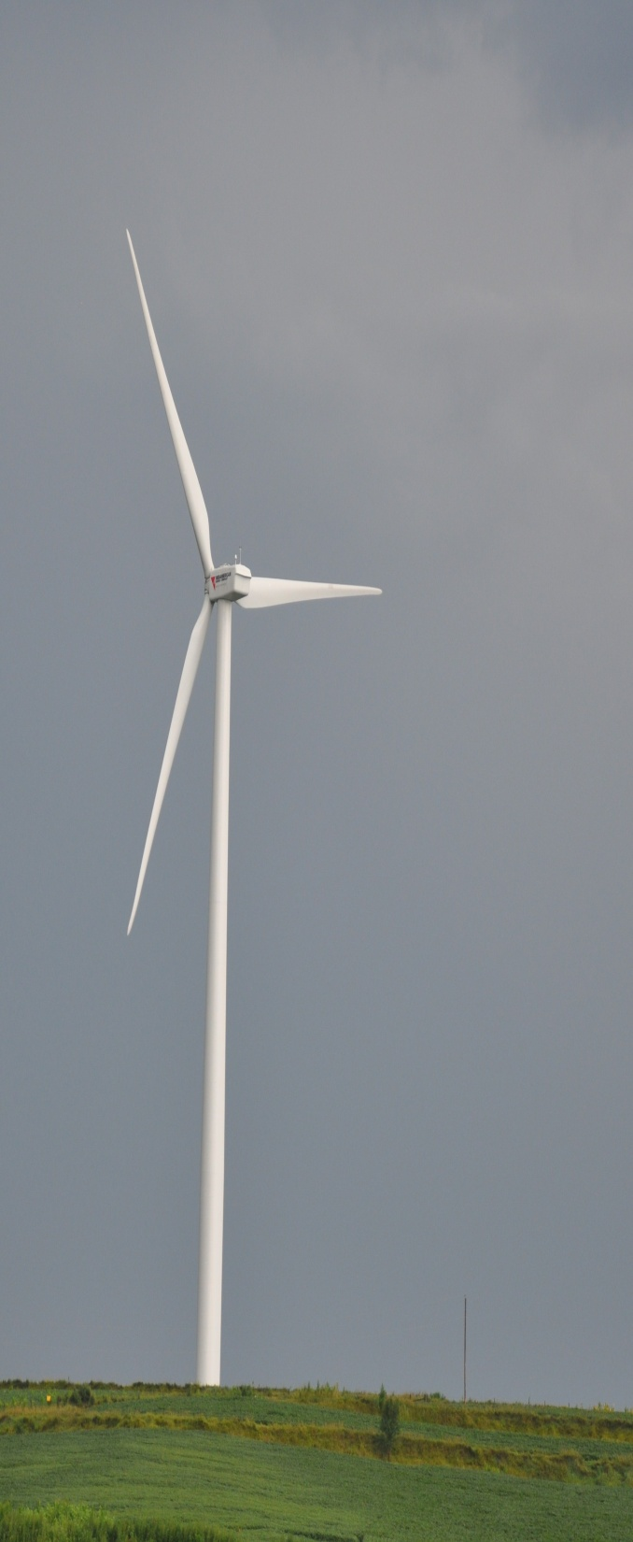
Potential Impact on Crops: Discussions with Agronomists
Reduce daytime max temps: avoid summer moisture stress
Increase nighttime temps: decrease grain fill (respiration), extend growing season (avoid late spring freeze, avoid early fall frost)
Enhance evaporation: reduce dew duration (reduce favorable conditions for pests and pathogens; accelerate fall crop dry-down)
Enhance evaporation: accelerate spring soil drying; accelerate moisture loss during drought
Enhance atmospheric CO₂ exchange with the crop: enhance daytime photosynthesis; enhance nighttime respiration
Enhance CO₂ pumping from soil: enhance photosynthesis
Reduce mean wind speed at top of the canopy: reduce potential for lodging and green snap in corn
Enhance plant movement through increased turbulence: increase light penetration into canopy and enhance photosynthesis
Modify mesoscale-scale convergence/divergence patterns: altered/enhanced rainfall patterns (????????)
Green = favorable, Red =unfavorable

Slide 11
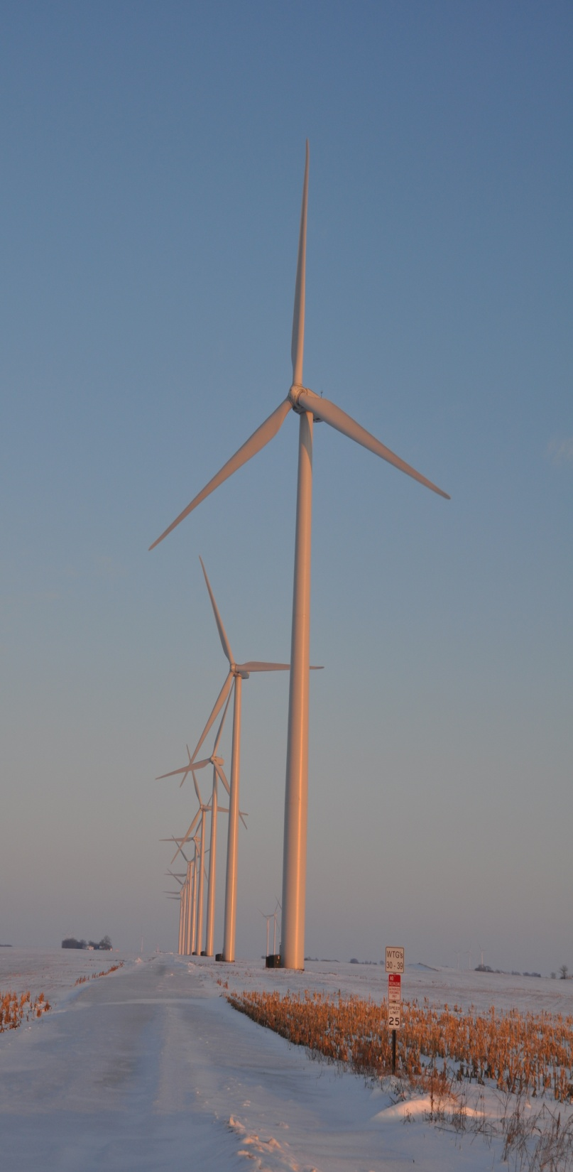
Turbine-Crop Interactions:
Overview
Do turbines create a measureable influence on the microclimate over crops?
If so, does this influence create measureable biophysical changes?
And if this is so, does this influence affect yield?
Agricultural shelterbelts have a positive effect on crop growth and yield.
Will wind turbines also have a positive effect?

Slide 12
Conceptual model of Turbine-crop Interaction via mean wind and turbulence fields, adapted from Wang and Takle (1995)
over-speeding zone
turbine wake
H
L
Speed recovery
wind-ward
reduction zone
day
H₂O
CO₂
H
L
Heat
night
leeward ‘bleed’ through and
speed up-zone
day
night

Slide 13
Turbine wakes over the
North sea near Denmark
Sea fog is created over
Smooth ocean surface
(Credit: Vattenfall)

Slide 14
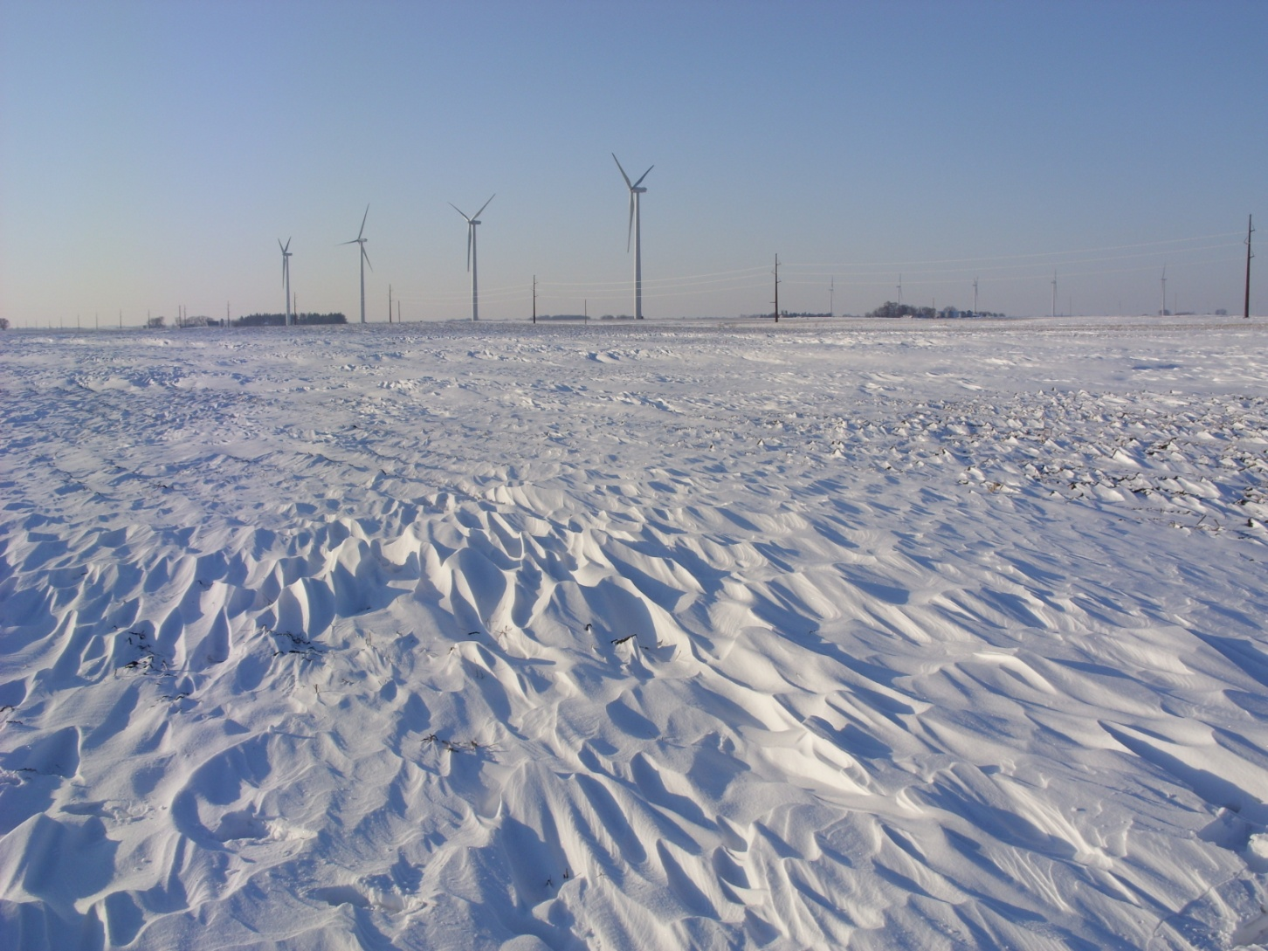
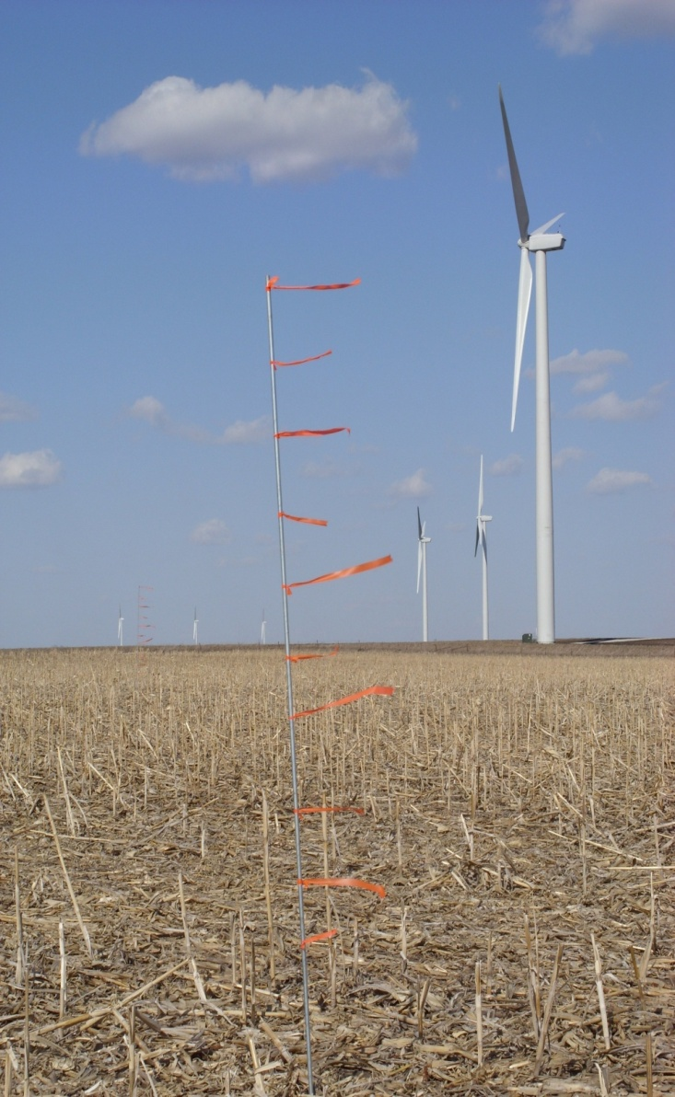
Detecting on-shore differences in turbulence
“frozen turbulence” after a blizzard

Slide 15
CWEX: Crop/Wind-energy Experiment: Observations of surface-layer, boundary-layer and meso-scale interactions with a wind farm
Bulletin of the American Meteorological Society: May 2013

Slide 16
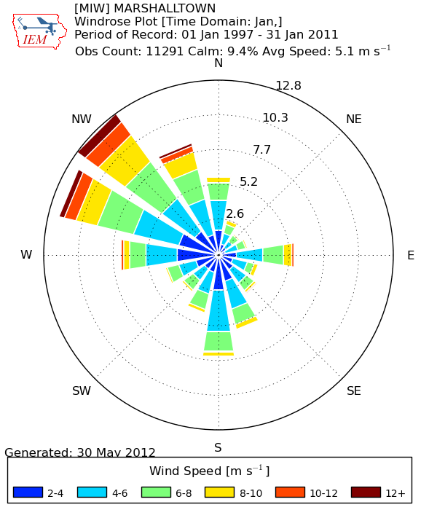
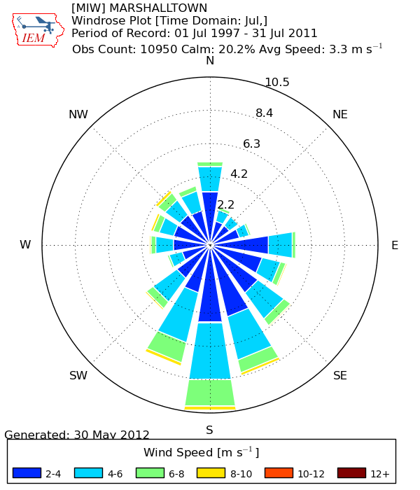
CWEX-10/11 layout
Central Iowa wind farm (~200 1.5-MW turbines with 80-m hub height (H) and 74 m and 82-m rotor diameter (D) )
Measurements taken on southern edge of a wind farm according to prevailing winds at nearby airports
January
July
http://mesonet.agron.iastate.edu/sites/dyn_windrose.phtml?station=DSM&network=IA_ASOS

Slide 17
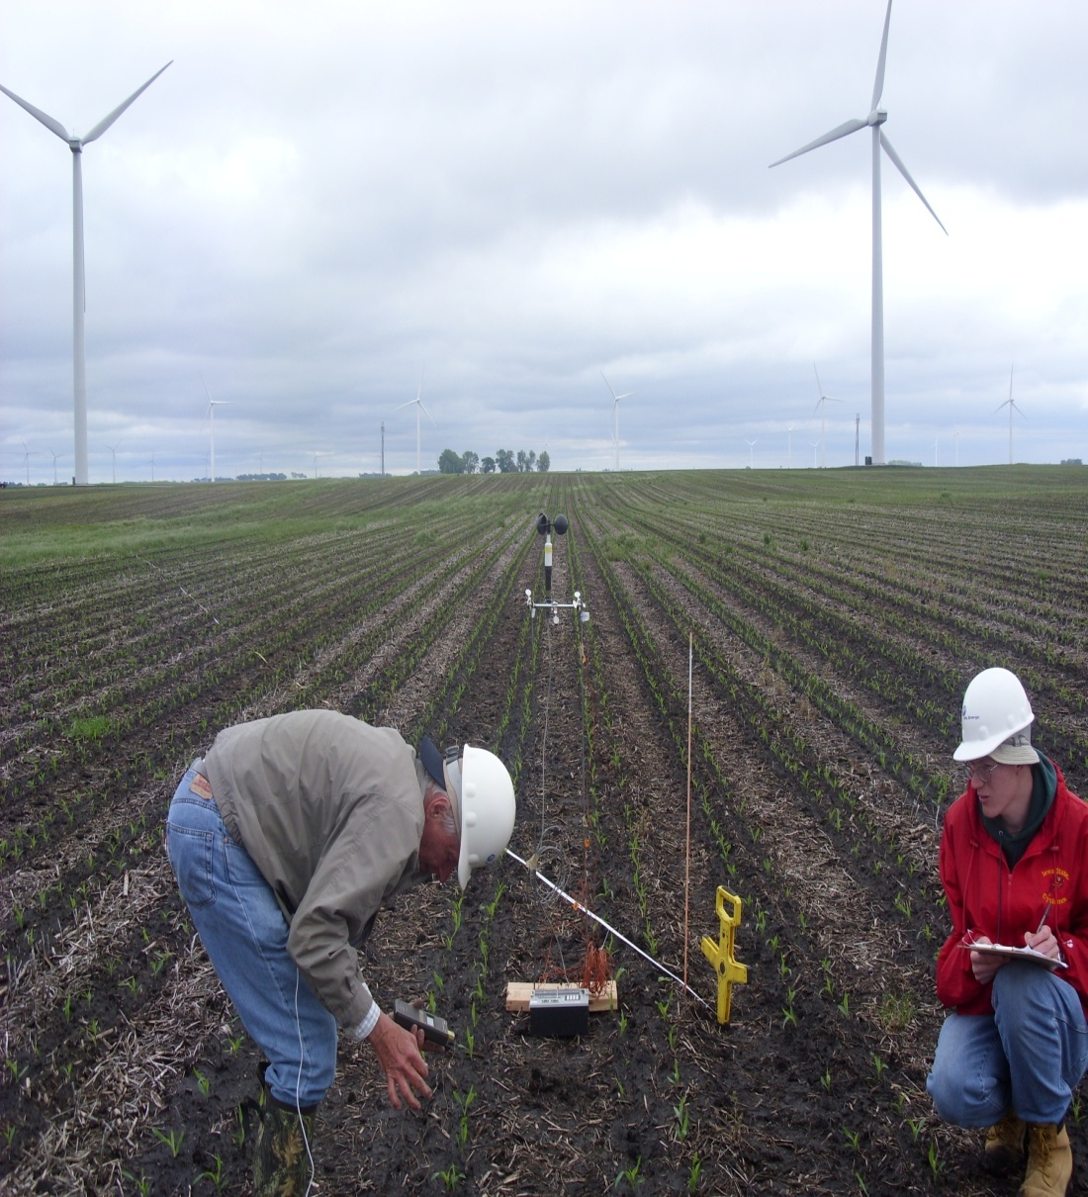
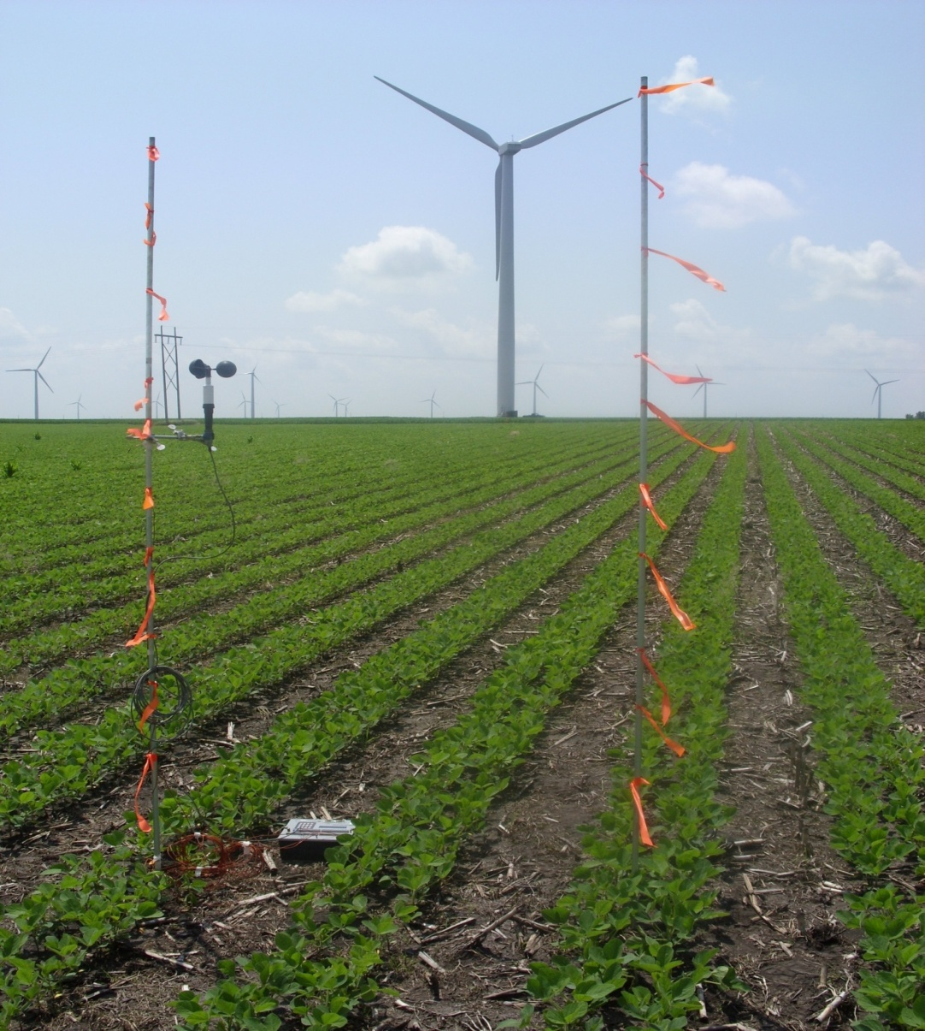
Preliminary measurements in 2009
Hot, high humidity with southerly flow
Cloudy, north wind
measuring over corn
cup anemometer
2 m above the canopy
thermocouples
at 1.5, 1.0, 0.5 m above
the soybeans
wind speed and temperature measured every 0.5 s
at upwind and downwind masts

Slide 18
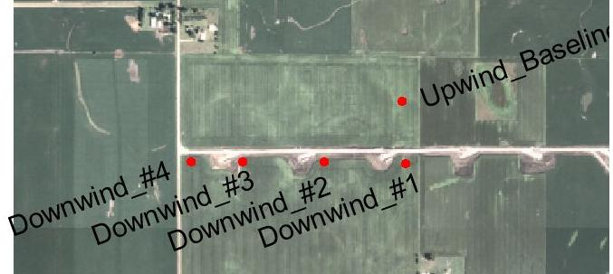
4 Sept 2009: Few clouds, NE surface winds NE, ENE hub height winds
Turbulence intensity ( σ_{U}/U )
Turbulence intensity higher in wind turbine wake
More interactions with turbine wakes as wind blows directly through the line of towers
As skies become more cloudy the upwind measurement trends to near neutral stability whereas in the perturbed location thermal instability remains above the canopy
N
soybeans

Slide 19
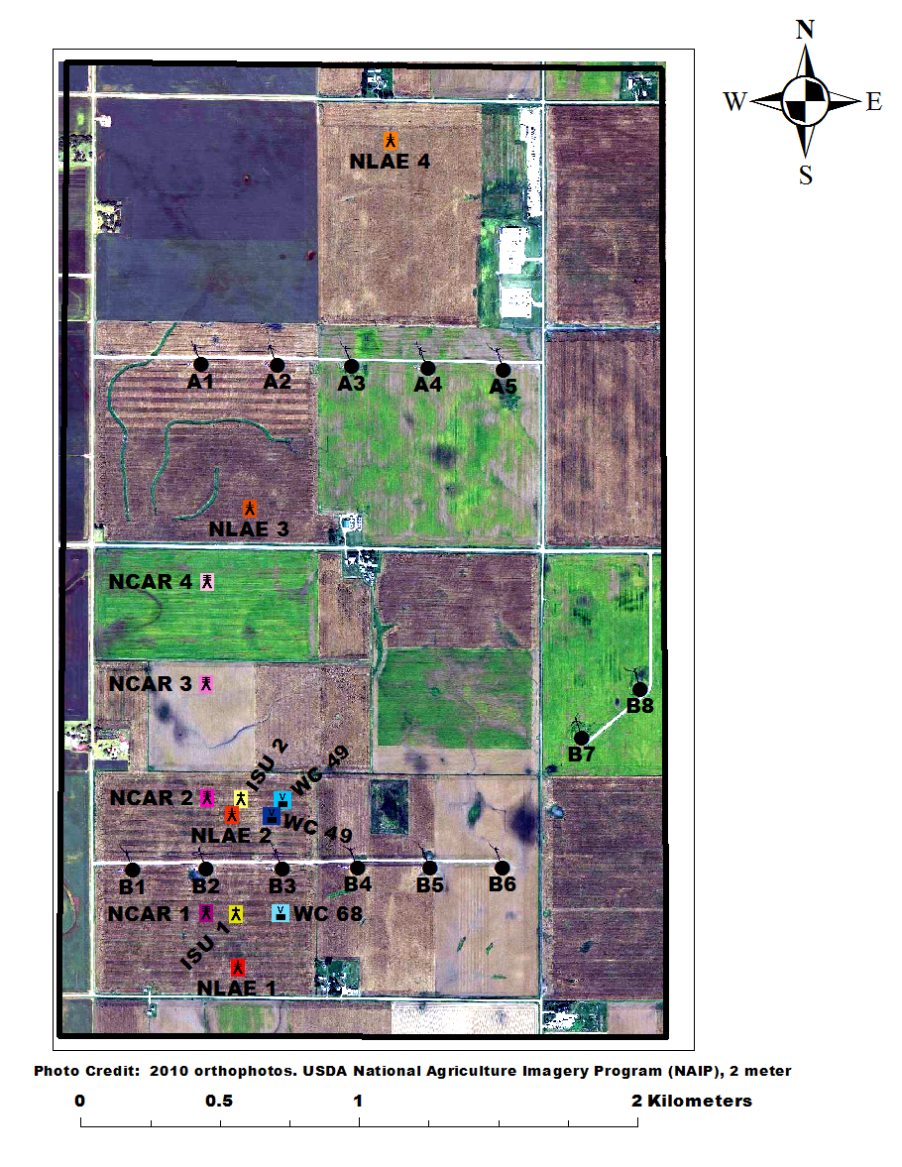
CWEX-10/11 expanded layout
Corn-soybean cropping pattern (measurements in corn)
CWEX-10: 26 June – 7 September; turbines off 0700 LST 26 July –1740 LST 5 Aug
  Four flux towers (NLAE)
  NREL/CU Lidar (J. Lundquist) from 28 June-9 July in CWEX-10
Fluxes were measured from:
upwind (4.5 D south of B-line of turbines) NLAE 1 [D=74m]
near-wake (2.5 D north and between turbine B2 and B3) NLAE 2
far-wake (17 D north of B-line of turbines) NLAE 3
double wake (34 D north of B-line of turbines) NLAE 4
Wind cube in near-wake between turbine B2 and B3

Slide 20
CWEX-10/11 expanded layout
CWEX-11: 29 June - 16 August
  6 flux towers in 2011
  (4—NCAR, 2– ISU)
  2 NREL/CU Lidars from 30 June to 16 Aug
Fluxes were measured from:
2.0 D (D=74 m) south of turbine B2 NCAR 1
2.0 D south and between turbine B2 and B3 ISU 1
3.5 D north of turbine B2 NCAR 2
3.5 D north and between turbine B2 and B3 ISU 2
9.0 D north of turbine B2 NCAR 3
14.0 D north of turbine B2 far-wake from B-line of turbines NCAR 4
Wind cube measurements at:
2.0 D south of turbine B3 WC 68
3.5 D north of turbine B3 WC 49

Slide 21
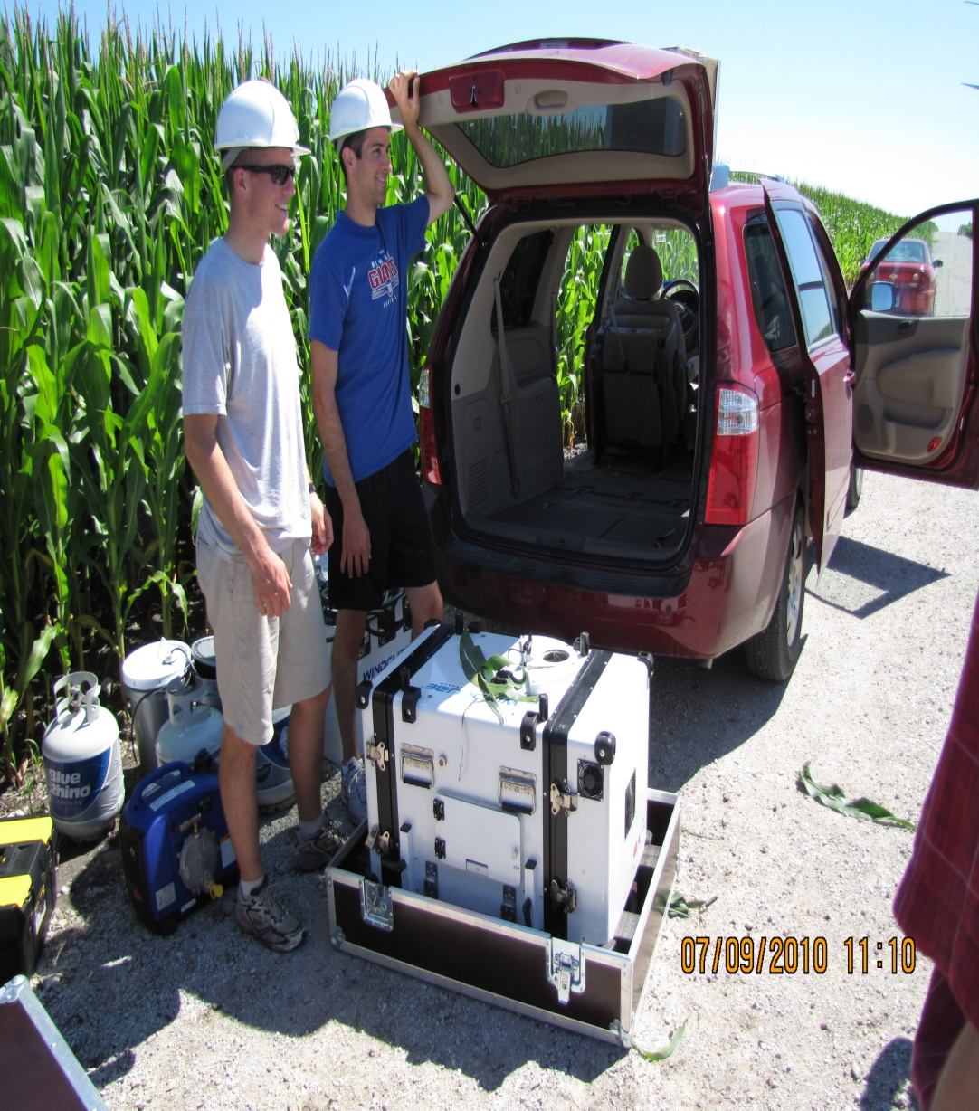
CU-NREL Lidar instrumentation
Lidar (laser-beam radar) measures vertical profile of wind speed and turbulence
Data output is every 2 min from composite scans every 2 sec from 40 to 220 m at 20 m intervals every 2 sec
‘Ideally’ one lidar is placed south of the turbines and the other north of the turbine lines to capture the near wake flow
Systems are powered by a generator
Picture by: Russell Doorenbos

Slide 22
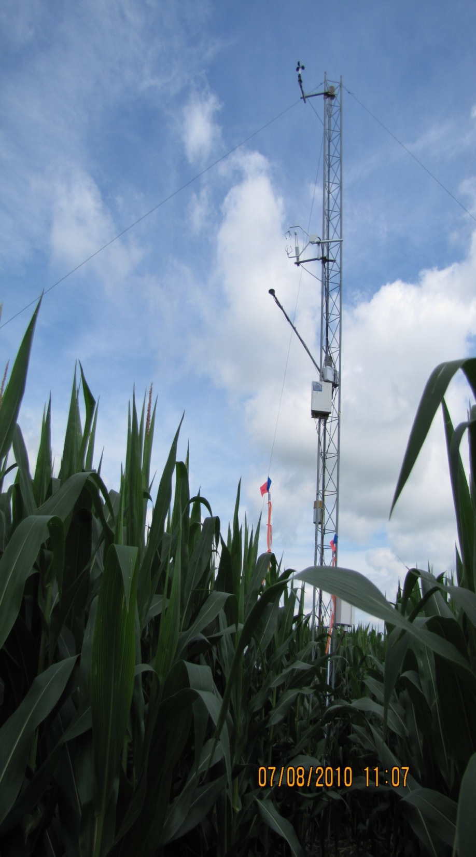
N
CWEX-10: Flux tower measurements
Cup anemometer at 9.1 m
T & RH at 9.1 m and 5.3 m
Sonic anemometer at 6.45 m
Tipping bucket at 3.75 m
Two towers (reference and near-wake location) additionally contained
  Net radiometer (net long wave and short wave radiation) at 5.3 m
  Open path CO₂/H₂0 IRGA LI-7500 gas analyzer
Sonic anemometer and gas analyzer sampled at 20 Hz w/ 5 min averages
T, RH, cup anemometer, rain gage output archived at 5 min
All sensors are connected to a data-logger
Systems are powered with solar panels and deep cycle batteries
Picture by: Russell Doorenbos

Slide 23
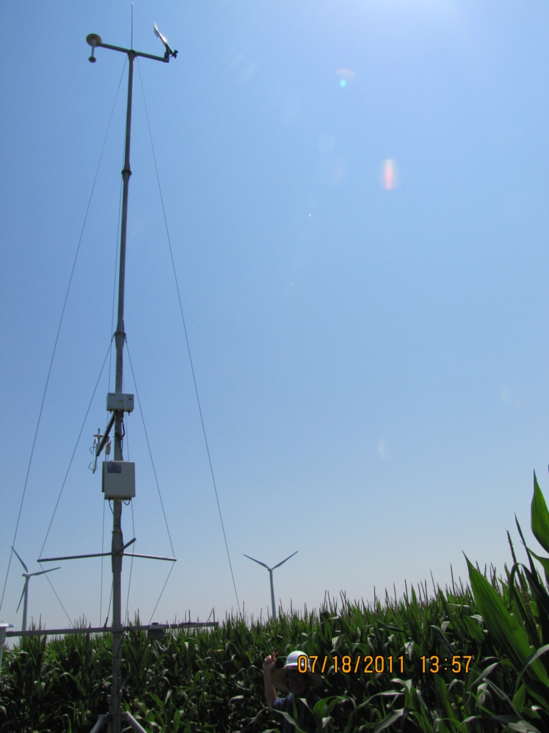
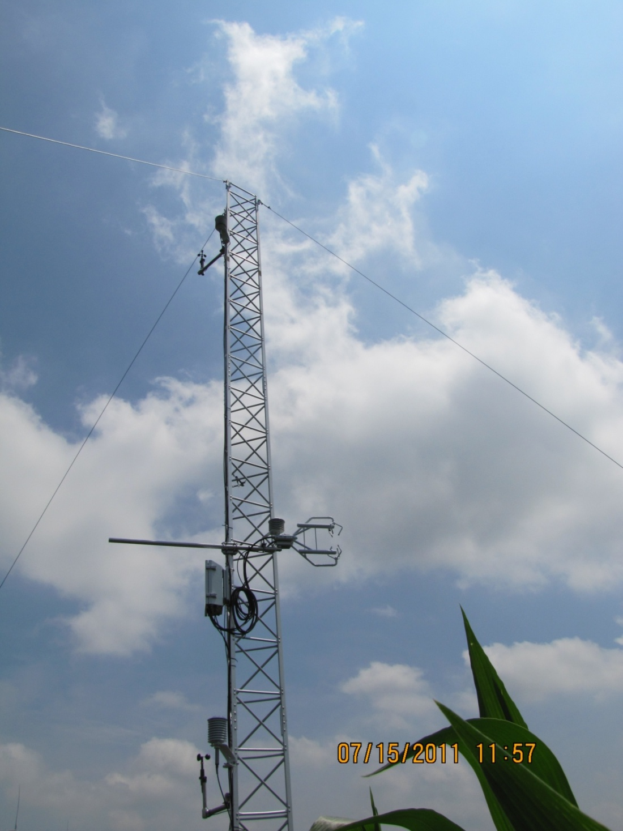
CWEX-11: Instrumentation of towers
NCAR ISU
NOT SHOWN IN PHOTO:
net radiation probe
2 m above canopy
rain gauge at canopy
leaf wetness probe
at 2/3 canopy height
1 m Temp/RH
Soil temp, moisture,
soil heat flux (ISU1)
10 m wind speed, direction
Temp/RH
8 m Temp/RH
wind speed
S
4.5 m Temp, wind,
turbulence
CO₂ and H₂O (ISU1)
4.5 m Temp/H2O,
wind, turbulence
(NCAR 1-4)
CO₂ (NCAR 1,3 only)
E
2 m Temp/RH
2 m Air Pressure
3 m Temp/RH
wind speed
Picture by: Russell Doorenbos
Picture by: Russell Doorenbos

Slide 24
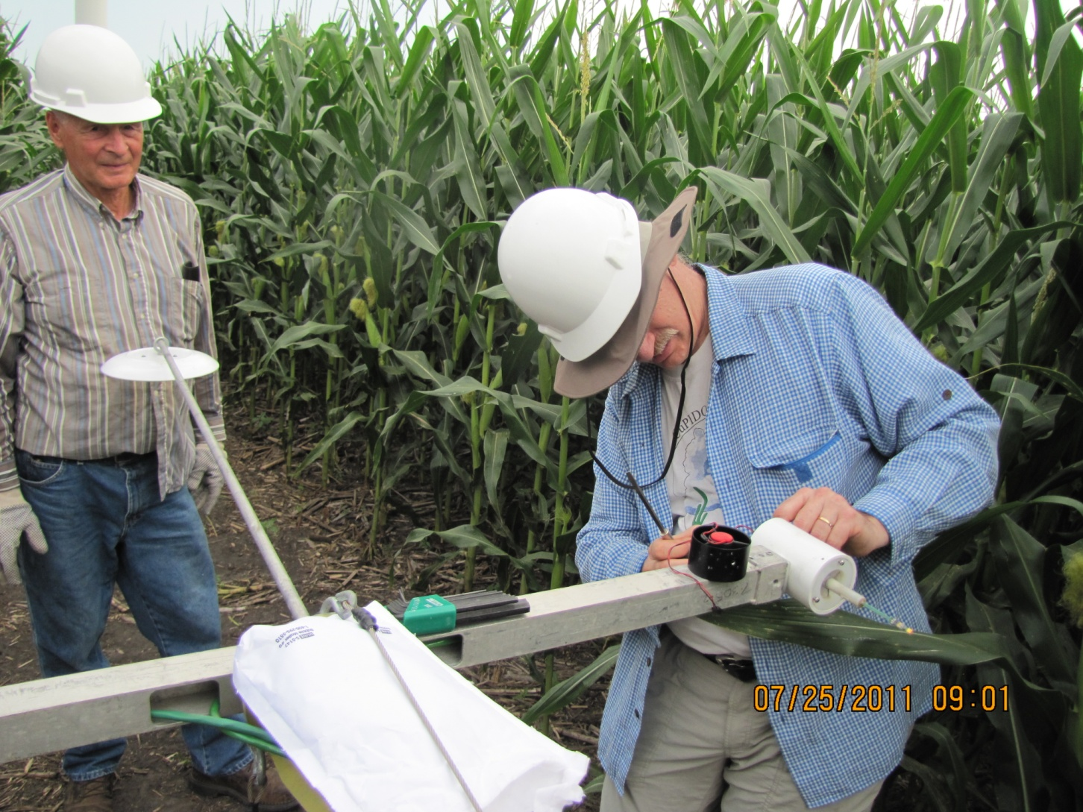
NCAR tower replacement of temperature/RH probe after fan failure
Replacement of sensors
can take a few days
of diagnosing a problem…
and another few hours or day
to fix the problem
Picture by: Russell Doorenbos

Slide 25
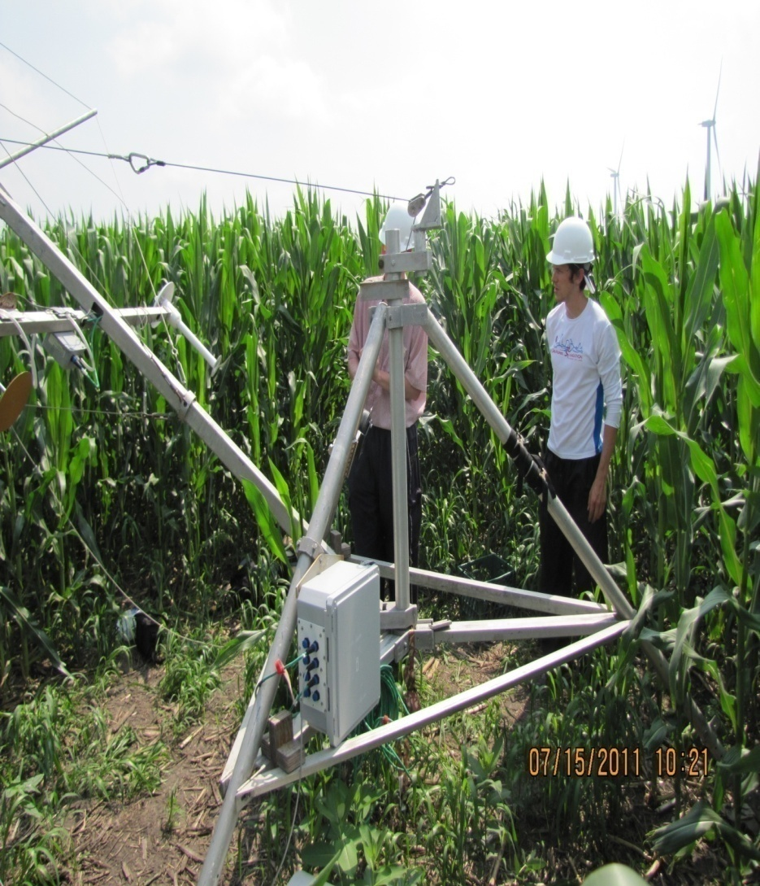
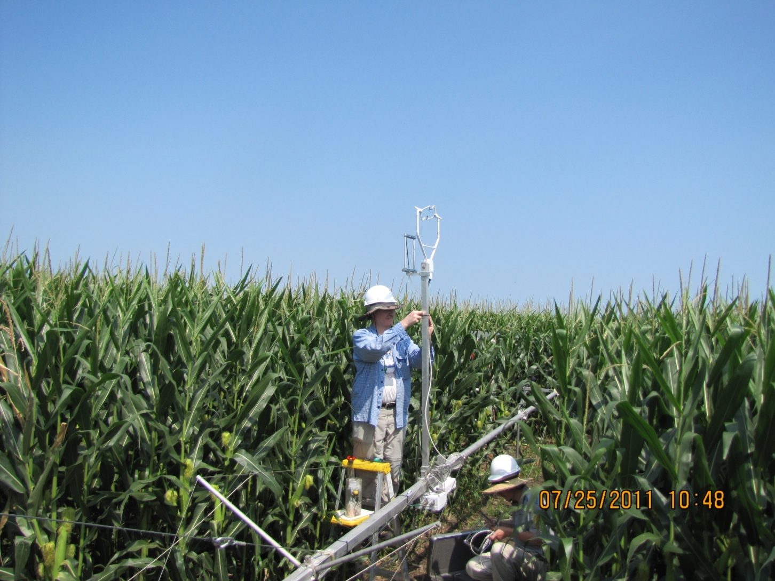
NCAR tower lowering to service krypton hygrometer
Picture by: Russell Doorenbos
Picture by: Russell Doorenbos

Slide 26
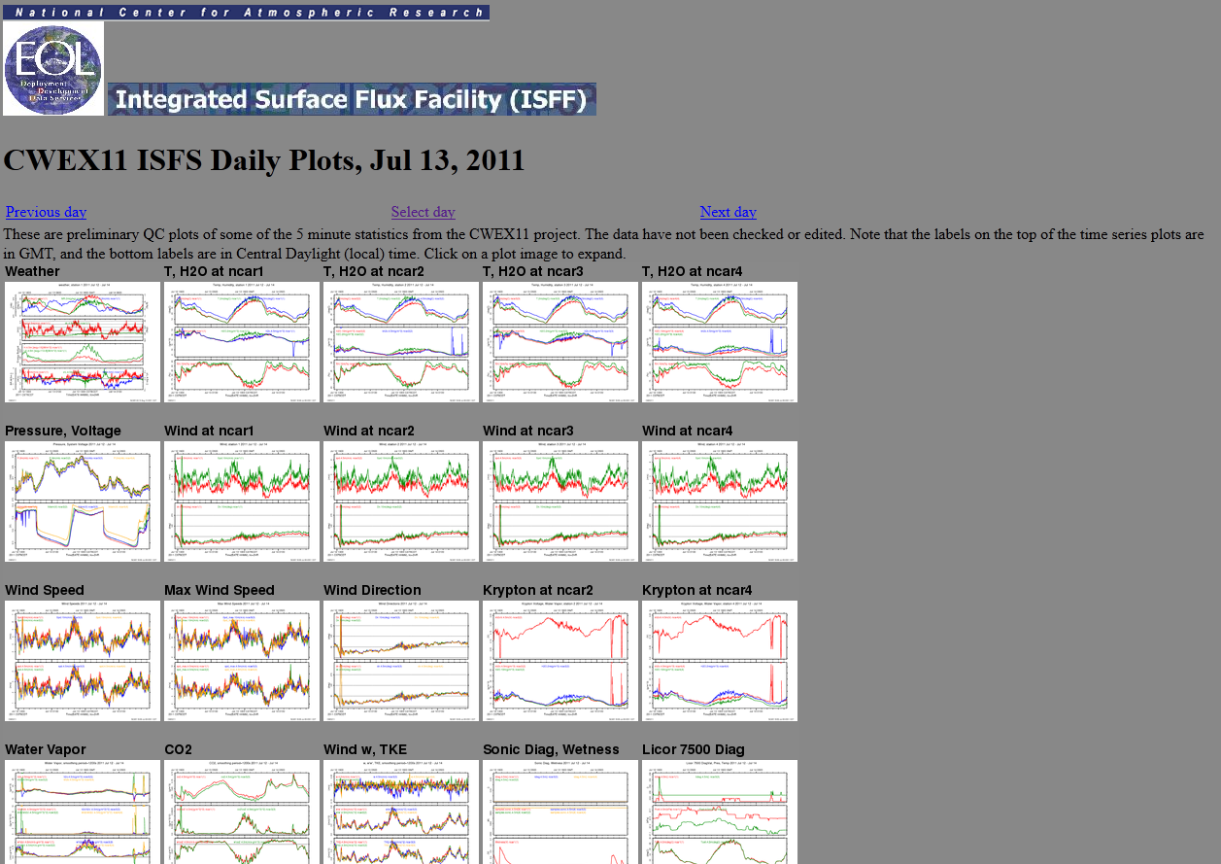
Data monitoring
On-site data downloads required at ISU flux towers in 2011 and at all NLAE flux towers in CWEX-10
Near-real time quality controlled time series information in CWEX-11 for NCAR flux towers
Plots available: http://www.eol.ucar.edu/isf/projects/CWEX11/isfs/qcdata/plots/

Slide 27
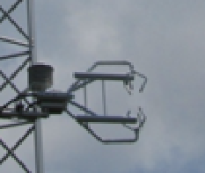
Post experiment corrections
5-min fluxes were converted to a larger averaging period (15-min or 30 min) using the 20 Hz time series
sonic anemometer conversion of coordinates from ‘instrument’ to ‘meteorological’ coordinates
sonic tilt correction so that all measured fluxes are for true ‘vertical’, ‘north’, and ‘west’
Uz>0
w>0
Uy>0
X
u>0 (west)
Ux>0
v>0 (south)

Slide 28
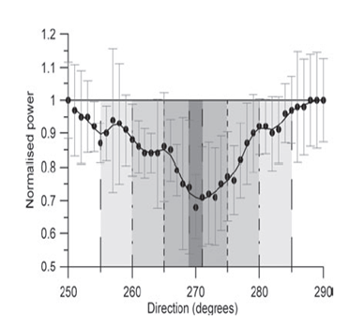
Analysis procedure
Calculate flux and scalar differences (‘Downwind’- ‘Upwind’ reference) for all masts north of the turbines using 15-min averages
Use wind directions from the first flux tower north of the turbine line to determine when turbine wakes would be above the surface stations
Assume wake expansion factor of (+/- ) 5°
Wake events at surface co-located to 80 m wind direction (same daytime waked wind direction for the appropriate wind direction for each turbine wake)
  South events: B2 wake overhead NCAR 2 (166°-195 °) or flow between B2 and B3 wakes at NLAE 2 (151°-189°)
  West events, no wake overhead or tower influence: (245°-282°)
15°
10°
5°
1°
(Barthelmie et al. 2010a)
Largest power deficit in
between +/- 5° of centerline
of wake

Slide 29
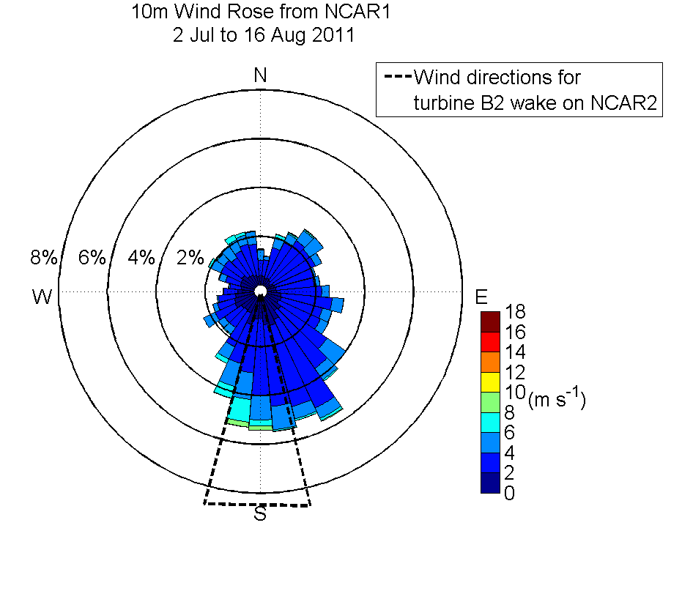
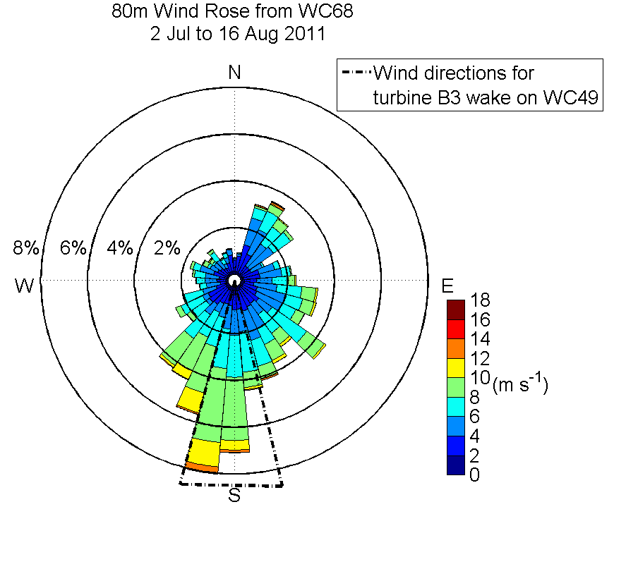
Comparison on 10 m and 80 m wind speed from CWEX-11
Directional shear can be a complicating factor in wake impacts within the rotor depth
vs. near the crop surface

Slide 30
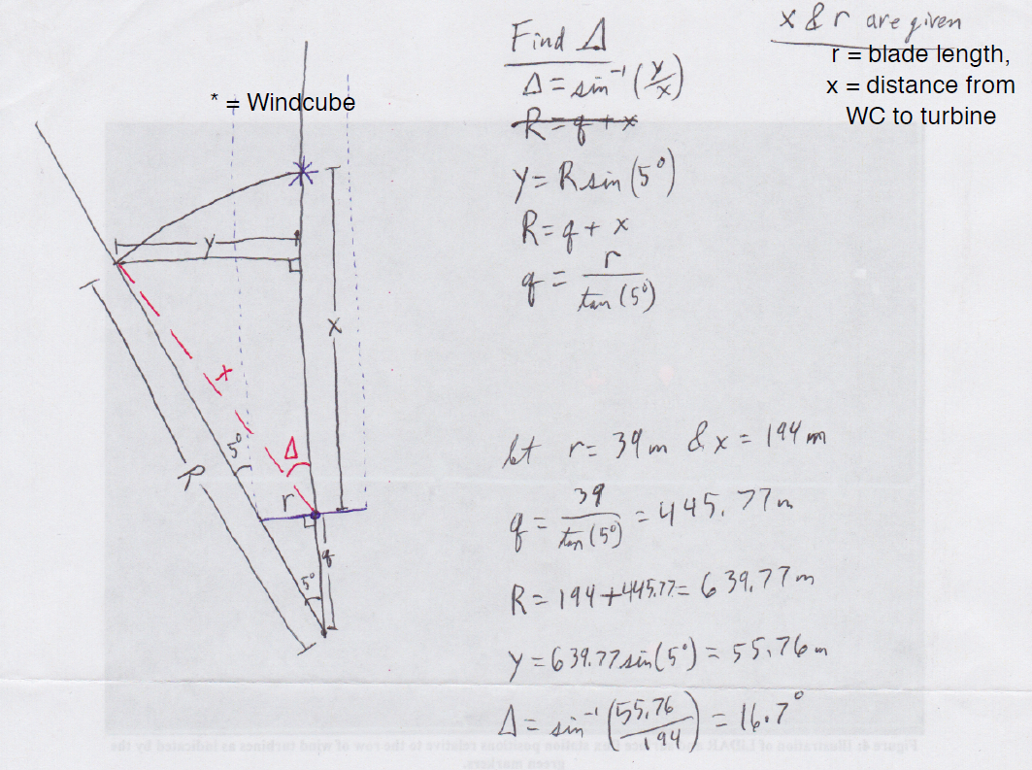
Wake wind direction procedure
Lundquist and Rhodes
(2010, personal
communication)
y
x
x
R
r
q
r= turbine
rotor radius

Slide 31
Flux difference composites sorted by stability and wind direction
Wake wind directions for the presumed 5° expansion factor from Barthelmie et al. (2010) of where a wake may be overhead of a flux station
Downwind-Upwind flux towers examined herein:
NLAE 2-NLAE 1 (x=3.5 D downwind of B turbine line)
NLAE 3-NLAE 1 (x=9 D downwind)
NLAE 4-NLAE 1 (x=14 D downwind)
Compare change in flux tower .vs. reference stability z/L₀
z=6.45 m (height of sonic)
L>0 during night near calm [STABLE]
L<0 for daytime, sunny, low-wind speed [UNSTABLE]
L very large ➔ well-mixed, windy/and or cloudy conditions [NEUTRAL]
ratio of turbulence generation
due to wind shear over thermal buoyancy

Slide 32
Stability vs. Flux station difference
Normalized speed
difference (Δu/u₀ )
Normalized TKE
difference (ΔTKE/TKE₀)
West
(no
wake)
some higher
turbulence
from A line
at NLAE 4
Unstable
Stable
Unstable
Stable
SSW
(B2
wake)
30% reduction
in daytime
speed
Unstable
Stable
Unstable
Stable
S-SSE
(between B2 and B3 wake)
Near doubling
(or higher)
of turbulence
at NLAE 3 and
NLAE 4
40-50%
over speeding
zone for nighttime
stable conditions
Unstable
Stable
Unstable
Stable

Slide 33
Stability vs. Flux station difference
Air temperature difference (°C)
Sonic heat flux difference (W m⁻²)
West
(no
wake)
Nighttime wake
influence
from line of turbines WNW of NLAE 4
Daytime
cooling
by 0.5 °C at
northern-most
station
Unstable
Stable
Unstable
Stable
SSW
(B2
wake)
Unstable
Stable
Unstable
Stable
2X ambient
nighttime
downward heat flux at NLAE 4
Nighttime
warming by
1+ °C
at NLAE 4
S-SSE
Unstable
Stable
Unstable
Stable

Slide 34
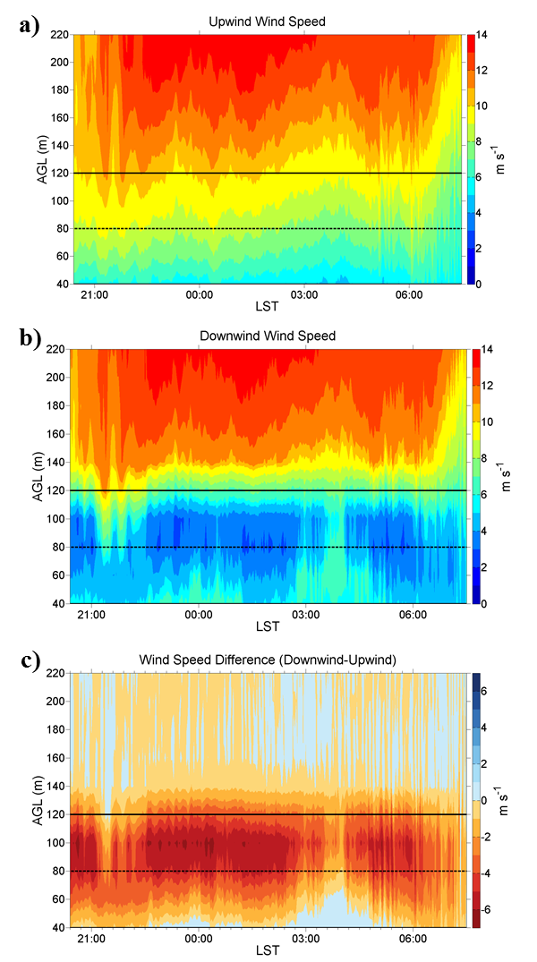
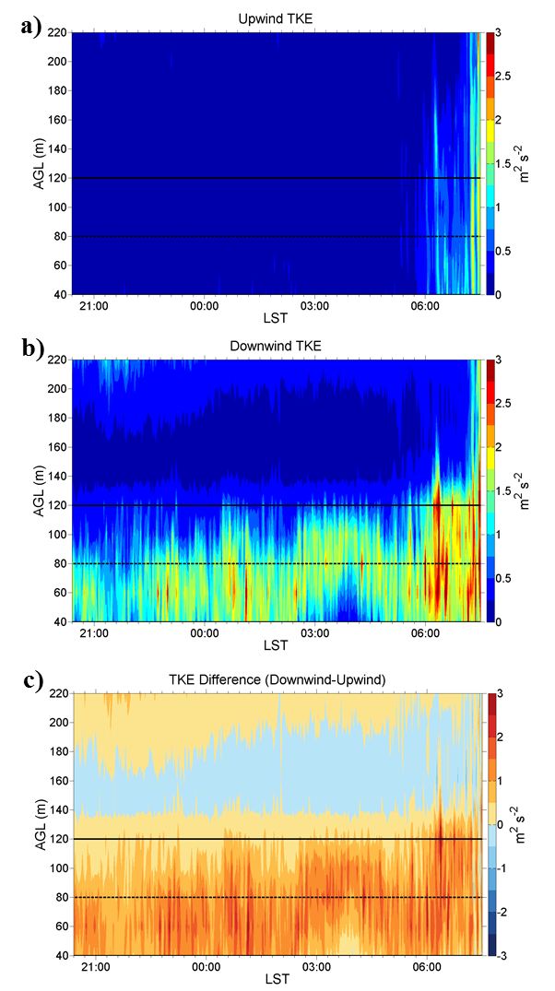
Wind cube analysis (CU/NREL team)
Case study: 20:00-8:00 (LST) 16-17 July, 2011
winds remain strong
(with very little TKE)
throughout the night
top of turbine rotor
hub height
wake region of
reduced wind speed
and enhanced TKE
Wake not being measured for 1.5 hr period?
Wind direction changes from SSE to SE

Slide 35
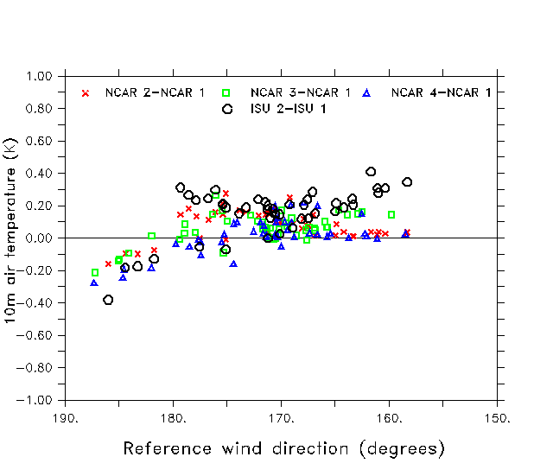
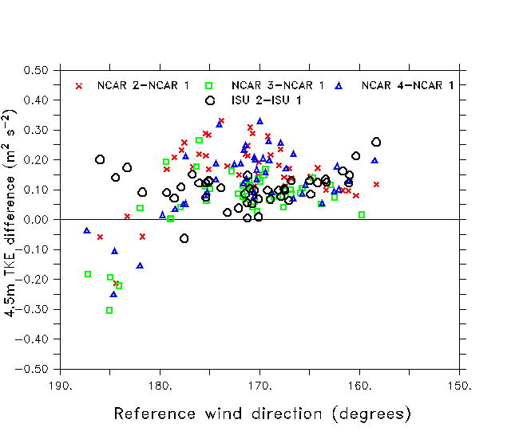
Surface flux station comparison
10-m wind speed
10-m temperature
ISU 2 waked by
turbine B3 for
90-min
(increase in U, TKE, T)
ISU 2 over-speeding not as strong as waked NCAR 2-4
locations
4.5-m TKE
Reversal of differences
for wind direction of
between 180-190°
occurs during morning
breakup of surface
inversion
Increases in TKE are
co-located with
over-speeding

Slide 36
Energy and CO₂fluxes
Steady SW winds
SW to NW transition
a)
b)
Daytime sensible heat flux
differences are similar for both
cases (evidence of difference in crop management
practices )
c)
d)
Latent heat flux for SW
case is consistently higher by about 50 W m⁻² at flux tower north of B-line
of turbines
Transition case features a reduction in plant transpiration during wind shift and period of cloudiness (between dashed lines)
e)
f)
CO₂ flux differences correspond to
the H₂O flux differences
These will be expanded upon in
the next section

Slide 37
Key insights gained from CWEX
Near-wake influences from individual turbines or a line of turbines are detectable at the surface via the following mechanisms
  1. Wakes intersect with the surface and the turbulent fluctuations are detected at the flux stations
  2. Wakes overhead of the flux station lead to changes in vertical mixing between the surface and the low-levels of the boundary layer
  3. Static pressure fields around the line of turbines may produce perturbations in flow and scalars within 5D of the turbine base (nighttime is favorable)

Slide 38
Key insights gained from CWEX
Wake influences are highly dependent on wind direction, wind speed, and surface/boundary layer thermal stratification
Vertical shear within the boundary layer is also important in surface detection of wakes (interaction with nighttime low-level jet)
Asymmetries in turbulence depending on wake location are evident in lidar profiles and there is similarity to impacts on surface fluxes
Need for additional surface flux stations and wind profiler at several turbine lines within the wind farm

Slide 39
Summary of CWEX-10/11
CWEX-11 expansion of objectives for CWEX-10
  Improved placement and increased quantity of flux tower and Lidar measurements
    Measurements taken only around one line of turbines
  Repeatability of some of the flux differences indicated by CWEX-10
  Near wake comparison of flux measurements behind a turbine and in the gap region between two turbines (NCAR, ISU)
  Comparison of upwind and downwind wind profiles for several weeks in the growing season (CU/NREL)

Slide 40
Changes in fluxes of heat, H₂O, and CO₂ caused by a large wind farm
To be submitted to Agricultural and Forest Meteorology

Slide 41
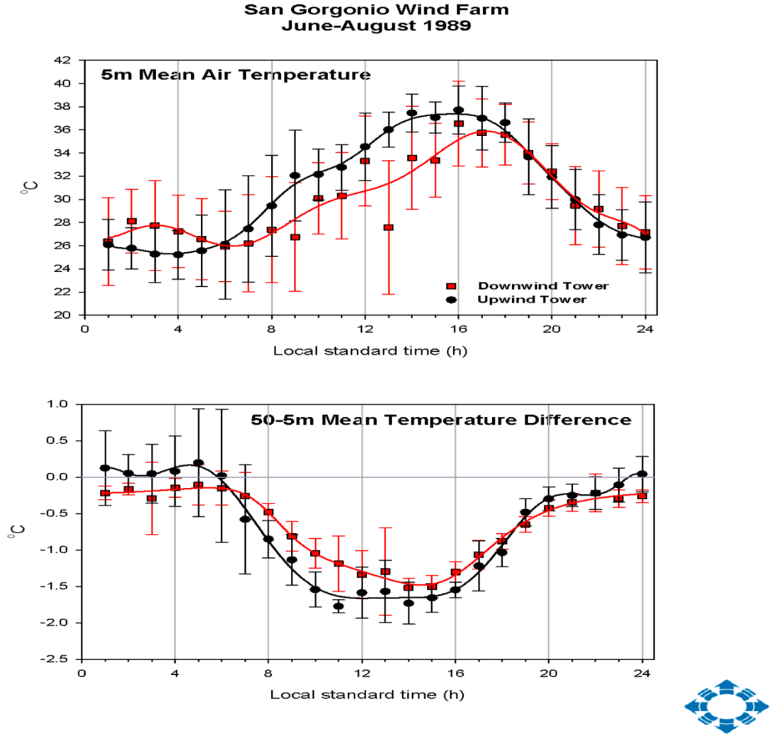
Studies on temperature and heat flux changes in wakes
Daytime cooling
Nighttime warming
Field measurements:
  For a isolated turbines a near doubling of heat flux in the wake region: Högström et al. 1988, Kambezidis et al. 1996
  Strong signal of uniform temperature profile in these studies
  San Gorgonio 41-turbine line wind farm (15-m H, 23-m D): Kelley 1989; personal communication 2008
Suppression of
nighttime thermal
inversion
Daytime enhanced
mechanical mixing

Slide 42
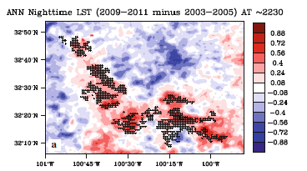
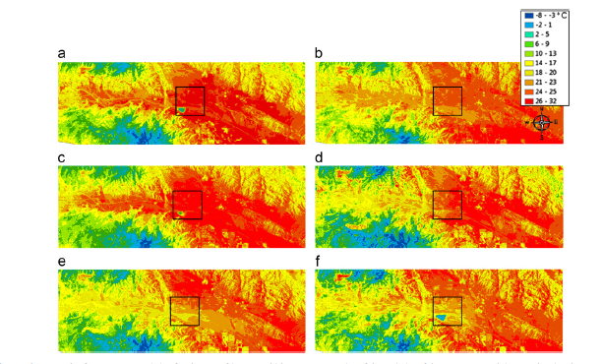
Studies on temperature and heat flux changes in wakes
Remote Sensing:
  Nighttime temperatures in Texas wind farm 0.5-1.0 °C higher than outside of wind farm (Zhou et al. 2012 a,b)
  one to several degrees difference in downwind temperature at San Gorgonio wind farm but
  Heavy effect of topography
  (Walsh-Thomas et al. 2012)
Nighttime
warming

Slide 43
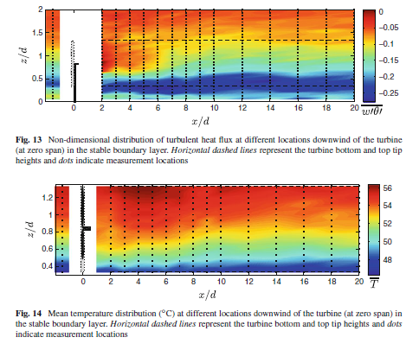
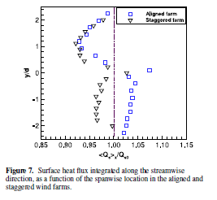
Wind tunnel measurements of scalars
Turbine mixing increases near surface temperature and downward heat flux by 15-25 W m⁻² for nighttime
Rotation of heat flux differences on either side of turbine for a aligned array in unstable conditions
Less scalar difference when turbines arranged in staggered grid
Chamorro and Porte-Agel (2010)
X
Negative heat flux
+
+
+
+
+
+
+
+
Positive heat flux
+
+
+
+
Zhang et al. (2013)
+
+
+

Slide 44
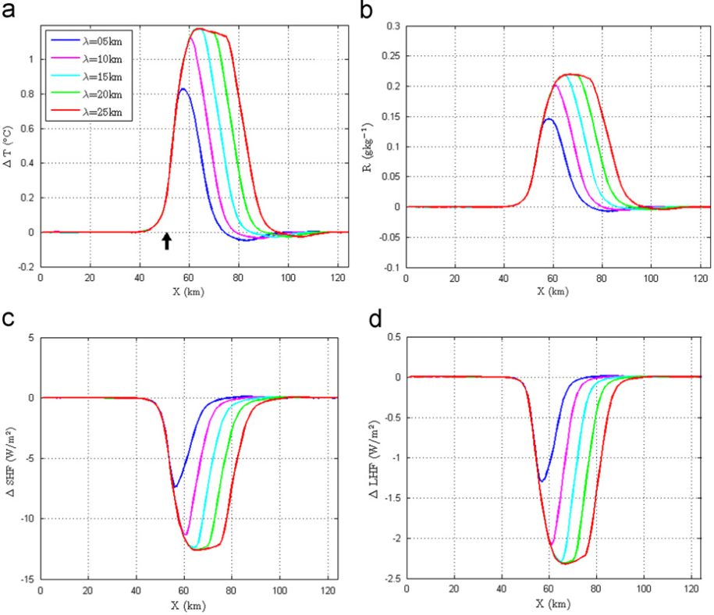
Wind turbine modeling parameterizations
Baidya Roy et al. (2004) applied drag sinks to the momentum equations, TKE source term to simulate increased evapo-transpiration over a large wind farm in the U.S. Southern Plains
similar study done by Adams (2007) for Manitoba
C_{TKE} = C_{T}(U) – C_{p} (U)
Baidya Roy 2011;
RAMS modeling (2 MW turbines
D=80 m, H=100 m
larger wind farm size increases differences
in (a) temperature, (b) specific humidity, (c) sensible heat flux , and (d) latent heat flux
Turbine-produced
TKE coefficient
Thrust
coefficient
Power
coefficient

Slide 45
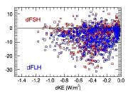
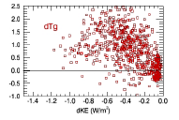
Wind turbine modeling parameterizations
40-yr mean differences in fluxes and temperature
Large scale wind farm parameterizations depict similar warming patterns (10-25 W m⁻²) within on the downwind side of wind farms (Wang and Prinn et al. 2010, Keith et al. 2004, Kirk-Davidhoff and Keith 2008, Fitch et al. 2012,2013a,2013b)
Fine scale modeling of turbine components illustrate a reduction in scalar transport within the wind farm several lines downstream from the leading line of turbines (Calaf et al. 2011, Lu and Porte-Agel 2011)
Wind farms
Reduce
Latent heat
Sensible heat?
(W m⁻²)
Extraction of energy
(°C)
Wang and Prinn et al. 2010

Slide 46
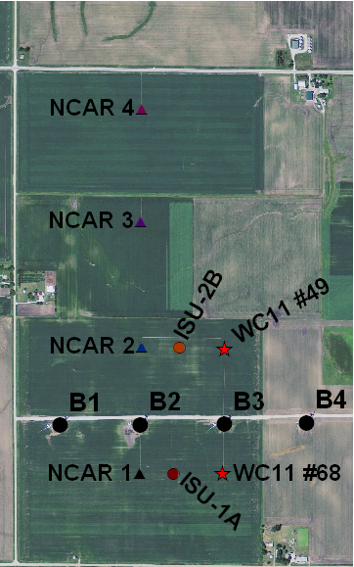
Evidence for Flux Variability Induced by Crop Management in CWEX-11
Coloration of the field an indicator of plant health
Darker green fields at NCAR-3 and 4, indicate cooler leaf temperature → increased transpiration and carbon assimilation?
No-till, corn
on soybean
“Refuge” and non-refuge buffer strips
Corn on soybean,
conventional till
Lighter color field in similar location for poor drainage areas
Special treatment strips south
of the upwind flux towers
No-till, corn on corn
Stick to showing crop flux differences in CWEX-10
(on same managed field)

Slide 47
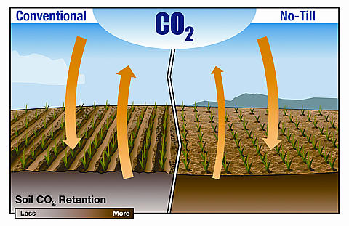
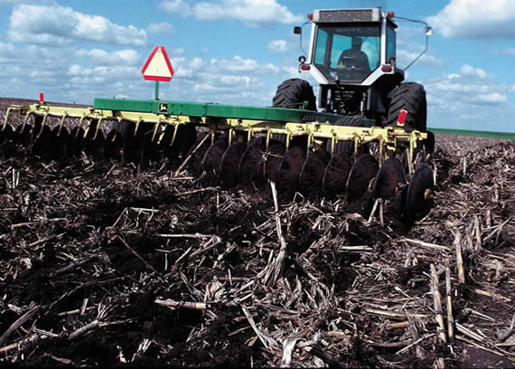
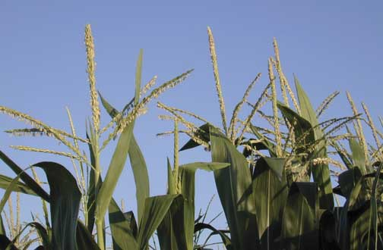
Closer Examination of H, λE, and CO₂ flux
Consider differences in flux as a composite of the following factors in addition to turbines:
  Agricultural management decisions (tillage, chemical application, crop hybrid, plant density)
  Soil (drainage, moisture,
  temperature, chemistry)
  Physiological stage of the crop
strip-till
larger CO₂ flux
when crop is at
maximum transpiration

Slide 48
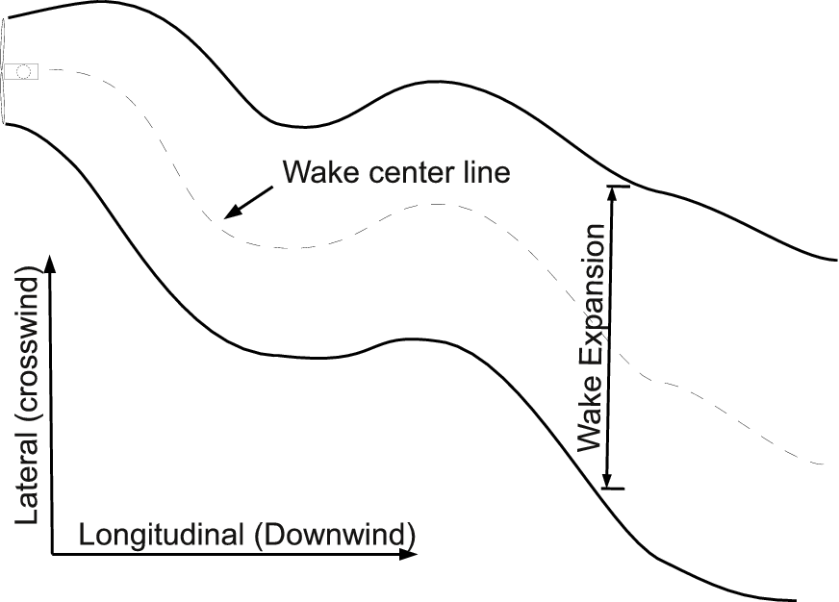
Turbine-related factors Energy and CO₂ fluxes
Consider differences in flux as a composite of the following wind turbine factors:
  Hub height wind speed (C_{TKE} ~ C_{T}(U) – C_{p} (U)
  Temporal changes in speed, direction, and thermal stability influence the structure of the wake
NCAR 1
wake meandering more common in low-wind and sunny conditions?
NCAR 2
Wake is not overhead in the middle flux tower
The edge of the wake may only be reaching the surface at NCAR 3
NCAR 3
NCAR 1
NCAR 2
NCAR 3

Slide 49
Flux analysis sorting procedures
Evaluate 30-min flux differences: Downwind-Upwind stations (NLAE 2- NLAE 1)
Sort by a simplified DAY or NIGHT condition removed from transitional PBL events use Net Radiation (Sum of solar and terrestrial radiation)
  DAY: R_{net} > 300 W m⁻², NIGHT: R_{net} < 0 W m⁻²
Filter bad data periods (rain, instrumentation error)
Use 10-min SCADA to combine all periods when turbines are offline to an OFF composite (similar wind direction as for ON composite)
  2/3 or greater of B1 to B3 turbines ON for 2/3 or greater of 30-minute period: ON
  <2/3 of B1 to B3 turbines ON for <2/3 of 30-minute period: OFF
  Turbines were offline about 75% of the experiment period in 2010
Keep differences in ON and OFF composites only for wind directions that indicate first-line turbine impacts at NLAE 2 tower (SSE to WSW winds)
  S-SSE (between turbines B2 and B3
  SSW (B2 wake)
  SW (between turbines B1 and B2)
  WSW (B1 wake)
  W (null)

Slide 50
Refined filtering detection of wind turbine impacts on H, λE, and CO₂ fluxes
Case direction | Turbine wake | Sample size (N) | Sample size (N)
category | Indicator | DAY | NIGHT
ΣOFF | (combination turbines offline) | 94 | 98
ΣON | (combination turbines operating) | 333 | 529
W | (Westerly no-wake, turbines on and off ) | 35 | 60
WSW [B1] | B1 (5.3 D to turbine) | 25 | 43
SW [B12G] | gap between B1 and B2 (3.8 D to line) | 31 | 19
SSW [B2] | B2 (2.7 D to turbine) | 79 | 51
S-SSE [B23G] | gap between B2 and B3 (2.6 D to line) | 198 | 416

Slide 51
Flux differences analyses
Compare means and standard deviations and accumulations of the downwind-upwind flux difference
  DAY: CO₂ flux accumulations are Positive (GPP)
  NIGHT: CO₂ flux accumulations are Negative (Re)
Determine whether differences under each directional category/composite are statistically significant to the null westerly wind and turbines offline cases
  t-test and Wilcoxon paired tests with 95% level of confidence (similar to Baidya Roy and Traituer 2010 analysis of temperature difference in San Gorgonio wind farm)

Slide 52
ΔH flux (NLAE 2-NLAE 1)
Means and accumulated differences
Negligible daytime differences in heat flux because ambient scales of turbulence >>
turbine-generated turbulence
Nighttime opposite effect: Turbine-scale turbulence > Undisturbed nocturnal
scales of turbulence
Night: 1.3X ambient flux at NLAE 2
between the edges of the B1 and B2
turbine wakes for SW winds

Slide 53
ΔH flux (NLAE 2-NLAE 1): Significance testing
a) | DAY
 | R_{net} > 300 W m⁻²
Directional comparison | t-test p-value | Wilcoxon pair p-value
to null hypothesis | (α=0.95) | (α=0.95)
ΣΔH_{ON} = ΣΔH_{W} | 0.25 | 0.30
ΔH_{WSW [B1]} = ΣΔH_{W} | 0.30 | 0.27
ΔH_{SW[B12G]} = ΣΔH_{W} | 0.73 | 0.73
ΔH_{SSW [B2]} = ΣΔH_{W} | 0.17 | 0.19
ΔH_{S-SSE [B23G]} = ΣΔH_{W} | 0.25 | 0.33
ΣΔH_{ON} = ΣΔH_{OFF} | 0.02 | 0.05
ΔH_{WSW [B1]} = ΣΔH_{OFF} | 0.13 | 0.10
ΔH_{SW [B12G]} = ΣΔH_{OFF} | 0.99 | 0.86
ΔH_{SSW [B2]} = ΣΔH_{OFF} | 0.02 | 0.04
ΔH_{S-SSE [B23G]} = ΣΔH_{OFF} | 0.02 | 0.08
Negligible daytime differences in heat flux because ambient scales of turbulence >>
turbine-generated turbulence
Weak significance but the mean differences
are small
b) | NIGHT
 | R_{net} < 0 W m⁻²
Directional comparison | t-test p-value | Wilcoxon pair p-value
to null hypothesis | (α=0.95) | (α=0.95)
ΣΔH_{ON} = ΣΔH_{W} | <0.001 | <0.0001
ΔH_{WSW [B1]} = ΣΔH_{W} | <0.001 | <0.0001
ΔH_{SW [B12G]} = ΣΔH_{W} | <0.001 | <0.0001
ΔH_{SSW [B2]} = ΣΔH_{W} | <0.0001 | <0.0001
ΔH_{S-SSE [B23G]} = ΣΔH_{W} | 0.003 | <0.0001
ΣΔH_{ON} = ΣΔH_{OFF} | <0.001 | <0.001
ΔH_{WSW [B1]} = ΣΔH_{OFF} | <0.0001 | <0.0001
ΔH_{SW [B12G]} = ΣΔH_{OFF} | <0.0001 | <0.001
ΔH_{SSW [B2]} = ΣΔH_{OFF} | <0.001 | 0.001
ΔH_{S-SSE [B23G]} = ΣΔH_{OFF} | 0.01 | 0.001
Nighttime opposite effect: Turbine-scale turbulence > Undisturbed nocturnal
scales of turbulence
Strong statistical significance that turbines
do transport heat to the surface at night
Intensity of flux variable to location within
wake

Slide 54
ΔλE flux (NLAE 2-NLAE 1)
Means and accumulated differences
Daytime latent heat flux somewhat higher at downwind tower, yet high
variability for all wind directions
Night: higher upward flux of H₂O for between wakes of B1 and B2
Transpiration yet occurring during the night, crop physiological understanding needed
Day: transpiration increased for farther
distance in wake of B1 turbine

Slide 55
ΔλE flux (NLAE 2-NLAE 1): Significance testing
a) | DAY
 | R_{net} > 300 W m⁻²
Directional comparison | t-test p-value | Wilcoxon pair p-value
to null hypothesis | (α=0.95) | (α=0.95)
ΣΔλE_{ON} = ΣΔλE_{W} | 0.50 | 0.57
ΔλE_{WSW[B1]} = ΣΔλE_{W} | 0.003 | 0.004
ΔλE_{SW[B12G]} = ΣΔλE_{W} | 0.006 | 0.03
ΔλE_{SSW [B2]} = ΣΔλE_{W} | 0.04 | 0.03
ΔλE_{S-SSE [B23G]} = ΣΔλE_{W} | 0.38 | 0.34
ΣΔλE_{ON} = ΣΔλE_{OFF} | 0.95 | 0.66
ΔλE_{WSW [B1]} = ΣΔλE_{OFF} | 0.007 | 0.02
ΔλE_{SW [B12G]} = ΣΔλE_{OFF} | 0.01 | 0.07
ΔλE_{SSW [B2]} = ΣΔλE_{OFF} | 0.07 | 0.14
ΔλE_{S-SSE [B23G]} = ΣΔλE_{OFF} | 0.04 | 0.02
Moderate significance of the daytime differences but the mean differences
are small
b) | NIGHT
 | R_{net} < 0 W m⁻²
Directional comparison | t-test p-value | Wilcoxon pair p-value
to null hypothesis | (α=0.95) | (α=0.95)
ΣΔλE_{ON} = ΣΔλE_{W} | 0.46 | 0.80
ΔλE_{WSW [B1]} = ΣΔλE_{W} | 0.98 | 0.01
ΔλE_{SW [B12G]} = ΣΔλE_{W} | 0.16 | 0.01
ΔλE_{SSW [B2]} = ΣΔλE_{W} | 0.23 | 0.29
ΔλE_{S-SSE [B23G]} = ΣΔλE_{W} | 0.19 | 0.65
ΣΔλE_{ON} = ΣΔλE_{OFF} | 0.23 | 0.25
ΔλE_{WSW [B1]} = ΣΔλE_{OFF} | 0.10 | <0.001
ΔλE_{SW [B12G]} = ΣΔλE_{OFF} | 0.00 | 0.001
ΔλE_{SSW [B2]} = ΣΔλE_{OFF} | 0.81 | 0.08
ΔλE_{S-SSE [B23G]} = ΣΔλE_{OFF} | 0.38 | 0.85
Turbine modification of nighttime H₂O flux: INCONCLUSIVE
(previous chart indicates high variability
and mean differences are small)

Slide 56
ΔCO₂ flux (NLAE 2-NLAE 1)
Means and accumulated differences
CO₂ flux in turbine-influenced
conditions higher than for
ambient westerly flow
Night: 2X higher respiration
flux than upwind
between wakes of B1 and B2
Day: 10-12 % larger downward flux than upwind when NLAE 2 in B1 wake or between
the wakes of B1 and B2
Maximum daytime differences in flux
are about half the strongest
flux difference reported between
two differently managed corn fields
[C on S vs. C on C] (Suyker et al. 2004)

Slide 57
ΔCO₂ flux (NLAE 2-NLAE 1): Significance testing
a) | DAY
 | R_{net} > 300 W m⁻²
Directional comparison | t-test p-value | Wilcoxon pair p-value
to null hypothesis | (α=0.95) | (α=0.95)
ΣΔf_{cON} = ΣΔf_{cW} | 0.03 | 0.06
Δf_{cWSW [B1]} = ΣΔf_{cW} | 0.004 | 0.003
Δf_{cSW [B12G]} = ΣΔf_{cW} | 0.002 | 0.01
Δf_{cSSW [B2]} = ΣΔf_{cW} | 0.01 | 0.002
Δf_{cS-SSE [B23G]} = ΣΔf_{cW} | 0.20 | 0.53
ΣΔf_{cON} = ΣΔf_{cOFF} | 0.92 | 0.38
Δf_{cWSW [B1]} = ΣΔf_{cOFF} | 0.12 | 0.24
Δf_{cSW [B12G]} = ΣΔf_{cOFF} | 0.09 | 0.35
Δf_{cSSW [B2]} = ΣΔf_{cOFF} | 0.44 | 0.60
Δf_{cS-SSE [B23G]} = ΣΔf_{cOFF} | 0.31 | 0.03
Moderate significance of the daytime differences for turbine wake influence
at a distance of 3-5 D downstream
for westerly null case
Significance test fails for comparing
turbines offline (e.g. pressure effects
controlling the flux perturbation)
b) | NIGHT
 | R_{net} < 0 W m⁻²
Directional comparison | t-test p-value | Wilcoxon pair p-value
to null hypothesis | (α=0.95) | (α=0.95)
ΣΔf_{cON} = ΣΔf_{cW} | 0.09 | 0.34
Δf_{cWSW [B1]} = ΣΔf_{cW} | 0.02 | 0.004
Δf_{cSW [B12G]} = ΣΔf_{cW} | <0.001 | <0.0001
Δf_{cSSW [B2]} = ΣΔf_{cW} | <0.001 | <0.0001
Δf_{cS-SSE [B23G]} = ΣΔf_{cW} | 0.41 | 0.70
ΣΔf_{cON} = ΣΔf_{cOFF} | 0.05 | <0.001
Δf_{cWSW [B1]} = ΣΔf_{cOFF} | 0.008 | <0.0001
Δf_{cSW [B12G]} = ΣΔf_{cOFF} | <0.0001 | <0.0001
Δf_{cSSW [B2]} = ΣΔf_{cOFF} | <0.0001 | <0.0001
Δf_{cS-SSE [B23G]} = ΣΔf_{cOFF} | 0.44 | 0.04
Strong statistical confidence that turbines enhance CO₂ ventilation from the canopy at a distance from 3-5 D from a turbine

Slide 58
Δu* (NLAE 2-NLAE 1)
Means and accumulated differences
Daytime differences are
negligible, similar justification
as Sensible heat flux
Nighttime
significant differences
indicating NLAE 2 tower has
enhanced mixing at 2-5 D
downstream of a turbine

Slide 59
Energy and CO₂ fluxes Summary
Daytime: CO₂, Latent Heat collocated forcing by turbines at distance of 5.4 D, momentum flux differences washed out in 30-minute average (e.g. u*)
Nighttime: CO₂, Sensible Heat collocated forcing for all distances within turbine wake and between the wakes, momentum flux perturbation also supports these patterns
DAY: Something is causing higher water and CO₂ transport but the mechanism is highly variable and cannot be detected in a standard flux average (30-min)
NIGHT: Turbine influence from wake/edges of wake
  (expanded analyses of H and T in next section)
Daytime drawdown of CO₂ flux is balanced by
nighttime release of CO₂ from the canopy
  No significant variations in yield around NLAE 2 vs. NLAE 1

Slide 60
Air temperature and heat flux measurements within two lines of turbines in a large operational wind farm

Slide 61
Analysis Procedure
Expand upon analyses from the crop energy and CO₂ fluxes
Compare downwind-upwind temperature and sensible heat flux differences at several flux tower locations from both CWEX-10/11
  All NLAE stations (#1-4) for T and H
  All NCAR stations (#1-4) for T and H
  All ISU stations (#1-2) for H
Include SCADA and profiling data in refined direction and speed classification of wake effects on temp and heat flux

Slide 62
Analysis procedure (continued)
Retain original sort of NEUTRAL/STABLE/UNSTABLE as in BAMS analyses
Refine further into DAY and NIGHT categories as in crop energy flux analyses
  focus on 3 of 6 possible combinations:
  DAY-NEUTRAL, DAY-UNSTABLE, NIGHT-STABLE
Compare identical time averages of surface fluxes to nacelle observations from SCADA
  turbines OFF when all 3 turbines (B1-B3) are offline
  turbines ON when all 3 turbines are operational

Slide 63
Directional Composite categories
Case direction | NLAE 2 Turbine wake indicator
 |  | Sample size (N) | Sample size (N) | Sample size (N)
category |  | DAY-NEUTRAL | DAY-UNSTABLE | NIGHT-STABLE
W | (Westerly no-wake, turbines on and off ) | 32 | 38 | 138
ΣOFF | (combination turbines offline) | 88 | 183 | 265
ΣON | (combination turbines operating) | 715 | 260 | 1327
WSW | B1 (5.4 D to turbine) | 51 | 17 | 83
SW | gap between B1 and B2 (3.8 D to line) | 60 | 7 | 40
SSW | B2 (2.7 D to turbine) | 174 | 51 | 106
S-SSE | gap between B2 and B3 (2.6 D to line) | 350 | 151 | 889
Case direction | NCAR 2 Turbine wake
 |  | Sample size (N) | Sample size (N) | Sample size (N)
category | Indicator | DAY-NEUTRAL | DAY-UNSTABLE | NIGHT-STABLE
W-WSW | (Westerly no-wake, turbines on and off ) | 17 | 54 | 144
ΣOFF | (combination turbines offline) | 29 | 182 | 112
ΣON | (combination turbines operating) | 508 | 103 | 659
SW | B1 (5.0 D to turbine) | 117 | 9 | 59
SSW | gap between B1 and B2 (3.9 D to line) | 68 | 6 | 137
S | B2 (3.4 D to turbine) | 199 | 42 | 229
SSE | gap between B2 and B3 (3.9 D to line) | 96 | 35 | 177
All but 5 categories have
sample size adequate
for good statistics
W-WSW category is a ‘no-wake’ direction for NCAR 2 but not at ISU 2
NLAE 2 distance of 2.6 D to ‘B’ line
NLAE 3 distance of 17 D
NLAE 4 distance of 34 D
NCAR 2 distance of 3.5 D to ‘B’ line
ISU 2 distance of 3.5 D
NCAR 3 distance of 9 D
NCAR 4 distance of 13 D

Slide 64
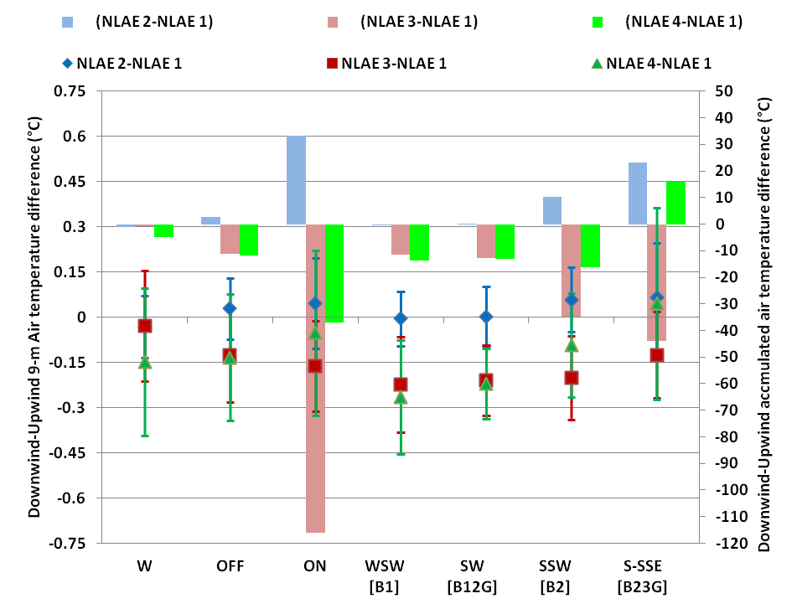
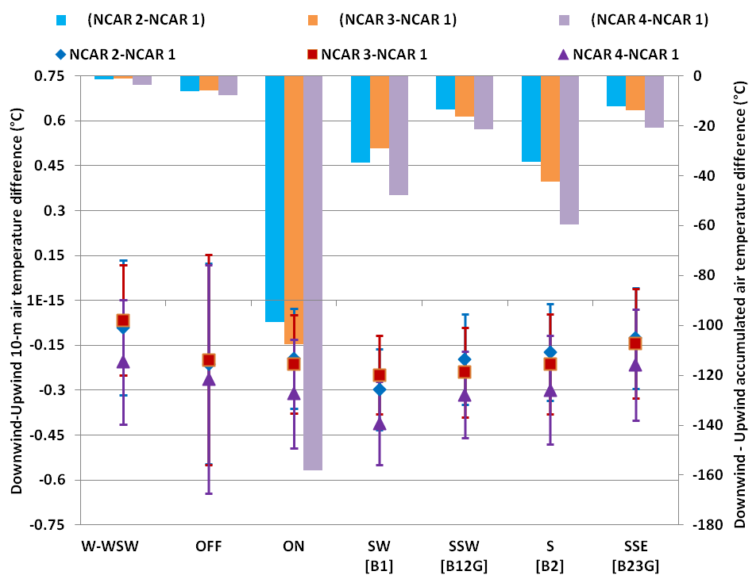
Air temperature: DAY-NEUTRAL
CWEX-10
CWEX-11
NCAR station differences
have similar variability among
turbine influenced and
non-wake conditions
Slight cooling only at NLAE 3 and 4
for wake expansion beyond 10 D
from turbine line

Slide 65


Air temperature: DAY-UNSTABLE
CWEX-10
CWEX-11
Wake cooling not evident
in either NLAE tower differences or
in NCAR tower differences
Slight warming? in tower shadow of wake due to pressure zone
(Ainslee 1988)

Slide 66


Air temperature: NIGHT-STABLE
CWEX-10
CWEX-11
NCAR 2-4 consistently warmer temperature
by 0.3 C° for the location between the wake
Edges from turbines B2 and B3
Nighttime warming < 0.4 °C near the turbine
at NLAE 2, or about same difference at northernmost station (NLAE 4) for S-SSE winds

Slide 67


Heat flux: DAY-NEUTRAL
CWEX-10
CWEX-11
Higher downward heat flux
at NLAE 2 for between wakes of B1 and B2
Far wake influence of two or more turbines
enhances daytime heat flux at NLAE 4
Flux differences more related to field-scale
variability at NCAR 3 and NCAR 4

Slide 68


Heat flux: DAY-UNSTABLE
CWEX-10
CWEX-11
Far wake influence of two lines of turbines enhances daytime heat flux at NLAE 4
Otherwise turbine forcing is negligible
High variability of flux difference at the
NCAR and ISU stations related to
deep boundary scale mixing

Slide 69


Heat flux: NIGHT-STABLE
CWEX-10
CWEX-11
Most intense downward flux -25 W m⁻²
between wakes of B1 and B2 turbine
for SW wind
Turbine effect decreases with distance or position
in the wake (centerline vs. edge)
Edge of B2 wake at ISU 2 for SW wind
produces similar warming as edge of
B2 wake at NCAR 2 for SSW wind
NCAR 2-4 report 15 W m⁻² warming on
edge of B3 turbine wake for SSE wind

Slide 70
Temperature and Heat flux summary
Less or similar differences in temperature noted in CWEX location as previous remote sensing studies
Near average or slightly higher examples of heat flux differences are indicated in field measurements as compared to modeling experiments
Near wake location on edge of wake clearest example of nighttime downward heating; less warming within the center of the wake
Warming pattern increased for two lines of turbines (double wake aligned) at NLAE 4 both in day and night conditions
Daytime mixing in PBL convolutes turbine turbulence in both temperature and heat flux for isolated wake; Less intense scales of ambient turbulence can be modified by turbine vortices during the nighttime especially when the blade scale turbulence is at or near the size of the ambient scales at the upwind tower

Slide 71
DAY: Projection of wake influence on surface
B2
B1
Turbine wake may intersect the surface for neutral conditions at
7-10 D downwind, 2-5 D downwind for unstable conditions
Site 1
Site 2
H₂O
CO₂
Daytime H₂O and CO₂ flux increased by turbine mixing (response lag)
Site 3
?
Heat flux difference negligible near wake centerline, counter gradient forcing on right facing edge opposite the flux on left facing edge
Site A
Site B
Cross wind vortex rotation affecting flux is (simulated)
Do we observe this ? (high variation in differences)

Slide 72
NIGHT: Projection of wake influence on surface
Turbine wake may not
intersect the surface until 10-15 D or more (after two lines of wakes)
Yet surface-flux
differences correspond
to directional edges of
wake aloft
B2
B1
Site 1
Site 3
Heat
CO₂
Site 2
Nighttime Heat and CO₂ fluxes increased by turbine mixing (via u* and TKE)
Twice the ambient downward heat flux at the edges of the wake Does stable stratification squash upward motion of wake vortices?
?
No counter gradient flux of heat noticed at the surface
Site A
Site B

Slide 73
NIGHT: ALIGNED DOUBLE WAKE Projection
B2
A1
L
H
L
H
Heat
Site 4
Heat
Site 2B
Heat
Site 2A
Site 3
Site 1
<25% higher Heat
<0.25 °C warmer
<25% increase U,TKE
2X ambient heat flux
0.5-1.5 °C warmer
1.5X increase U,TKE
50-75% higher heat flux
0.25-0.5 °C warmer
25-50% increase U,TKE
25-50% higher Heat
<0.5 °C warmer
50-75% increase U,TKE
Wake structure from 1st turbine dependent on ambient wind speed, direction
thermal stability, and thrust specification of turbine

Slide 74
NIGHT: MERGED WAKE Projection
A5
B6
C12
D5
D1
C4
C1
Site 5
A1
Site 4
Site 3
Site 2
B2
Site 1
Turbine eddies become smaller and smaller after passing through additional turbine lines
Merged wakes dissipate energy therein and are unable to change surface fluxes
Negligible downwind-upwind differences in surface aerodynamic and scalar fluxes
Surface –wake interaction resumes several turbine lines downstream when a wake-boundary layer sheet has developed?

Slide 75



Multiple turbine wakes (CWEX-10)
80-m wind direction on Aug 20
80-m wind direction on Aug 23
Northernmost tower has most turbulence
in SSW case but least TKE in SE-ESE case
Interaction of LLJ with turbine wake
sensitive to wind direction

Slide 76
Summary of CWEX measurements
Differences in surface fluxes and mean wind speed were similar to those found in CWEX-10
  Need additional measurements to verify pressure influence behind a turbine line (similar to wind break flow, Wang et al. 2001)
Variations in scalar fluxes cannot be easily attributed to turbine influence
  Differences in CO₂ flux are small and turbine interaction of scalar transports may not be collocated with surface modification to wind speed and TKE
  Scalar transports of H₂O and CO₂ should be measured with consistent instrumentation (LI-7500) and for multiple locations within the same field to more carefully determine the influence of agricultural factors on the fluxes
The question remains if these differences in flux, albeit small have any quantifiable response on crop vegetative growth, reproductive development and yield?

Slide 77
Overall conclusions
large datasets have been accumulated from a field study for both years of wet and dry conditions for validation of high-resolution simulation models of wind farms.
Tall meteorological towers, vertically pointing lidar profiles, and a more extensive surface network of sensors will be needed for such validation.
Such models, when appropriately validated, will be needed to evaluate alternative strategies for wind farm build-out in the high-resource regions of the Midwest and could be used to better inform potential configurations for off-shore wind-power development

Slide 78

CWEX-in the future
Need for more measurements:
duplication of consistent surface flux instrumentation and wind profiling lidars
multiple locations within and at the northern edge of the wind farm
(Phase II)
More instrumentation will help increase knowledge in:
1. wind-farm operational issues
  turbine-to-turbine wake interactions
  wind farm-boundary layer interactions
  representation of boundary layer in models → wind forecasting
key science questions
  boundary layer and surface exchanges, low level jet (nighttime)
  formation/intensity of individual storm cells and storm systems
3. refine quantification of turbine effects on crop yields
(Phase I)
0
3.0
6.0
12.0 (miles)
Proposed location of 120-m towers
Inside wind farm
Outside wind farm

Slide 79
Acknowledgements
All members of the CWEX team
My research committee and graduate advisor
Moti Segal for assistance in modeling and early field project objectives
All parties helping with technology, field planning, deployment (REU undergraduate alumni), post experiment analyses
Wind farm operator/ owner of measurements to provide SCADA data
Funding assistance through the University of Iowa, Ames Lab DOE, NSF EPSCoR

Slide 80

Thank you for your attention

