Slide 1
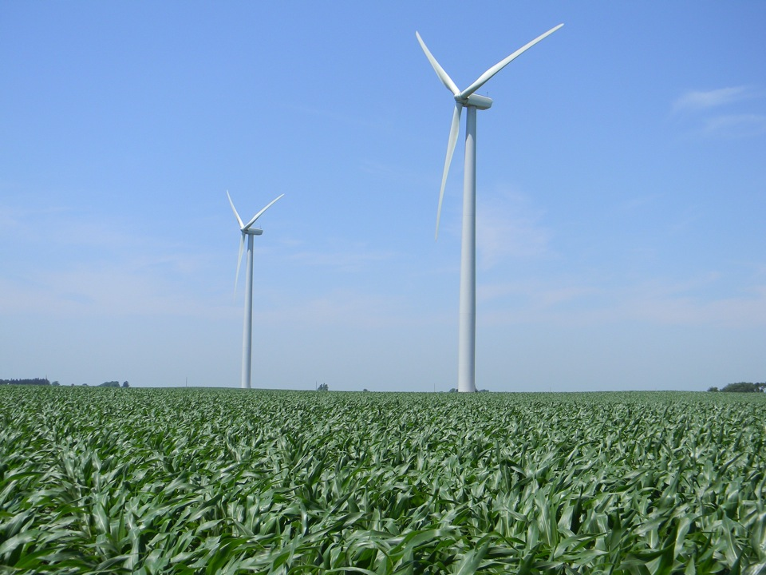
Wind Science 101
Summer 2013 REU
Eugene S. Takle, Coordinator
gstakle@iastate.edu
30 May 2013

Slide 2
Outline
Global scale
3-D global circulation patterns and wind energy
Surface and upper-air tropical and mid-latitude weather systems, including prevailing westerlies
Mesoscale
Great Plains Low-Level Jet and nocturnal LLJs
Sea-breeze
Monsoon circulation
Off-shore resources
US wind resource maps
Forecasting wind resources
Atmospheric boundary layer
Structure and diurnal/seasonal evolution
Impact of static and dynamic stability on horizontal wind speeds and vertical profiles
Turbulent flows and interactive wakes

Slide 3
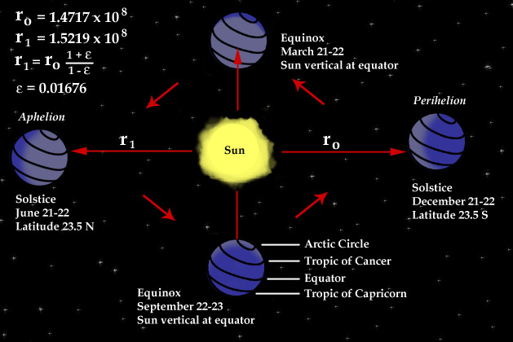
Sun-Earth Relationships

Slide 4
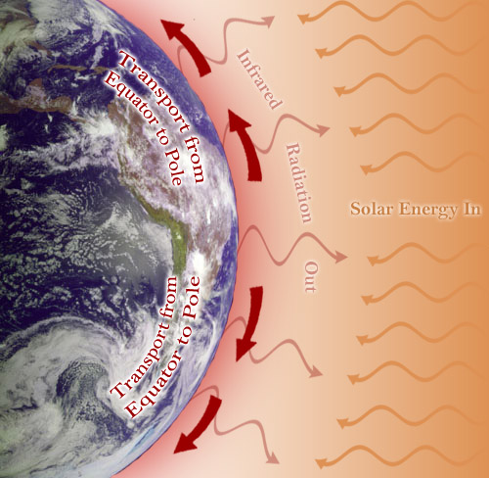

Slide 5
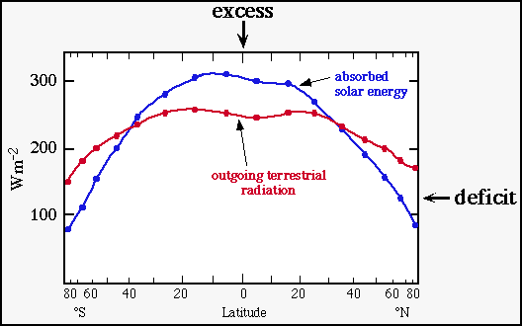
Differential Gain and Loss of Energy from the Earth System
http://eesc.columbia.edu/courses/ees/climate/lectures/gen_circ/index.html

Slide 6
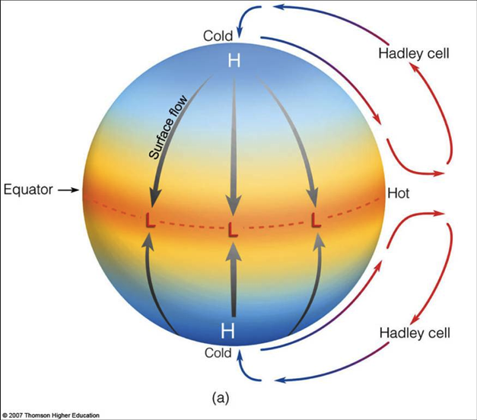
Non-Rotating Earth Heated at its Equator
Not to scale!
Mean radius of the earth:
6371 km
Height of the troposphere:
0-7 km at poles
20 km at Equator
90% of atmosphere is in the lowest 15 miles (24 km)
99% in lowest 30 miles (48 km)

Slide 7
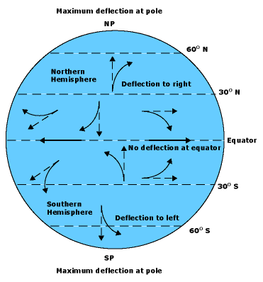
Rotating Planet: Coriolis Force
Ω
Coriolis Force
F_{c} = -2ΩxV

Slide 8
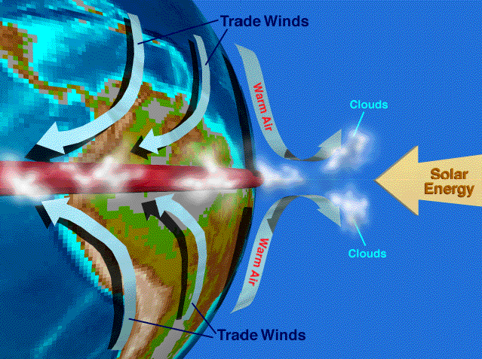
Thermally Driven Circulation

Slide 9
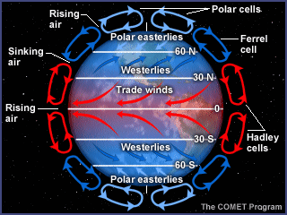
The Global Circulation

Slide 10
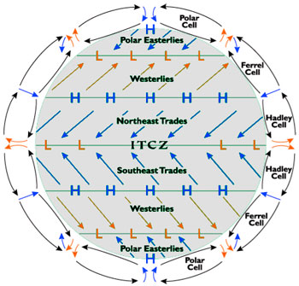
The Global Circulation

Slide 11
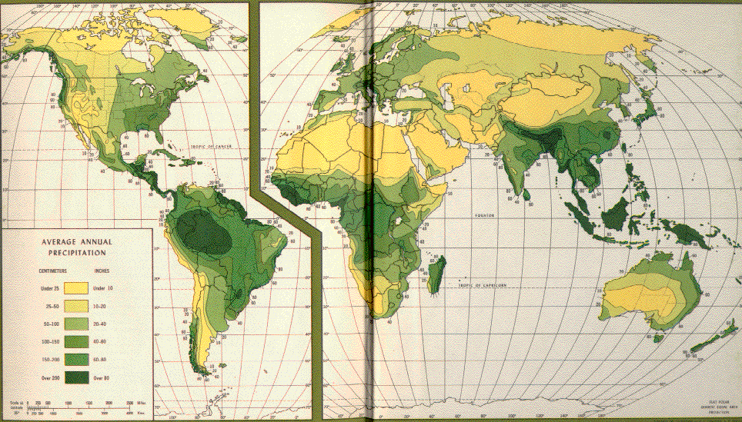
Global Circulation Revealed in Global Precipitation Patterns

Slide 12
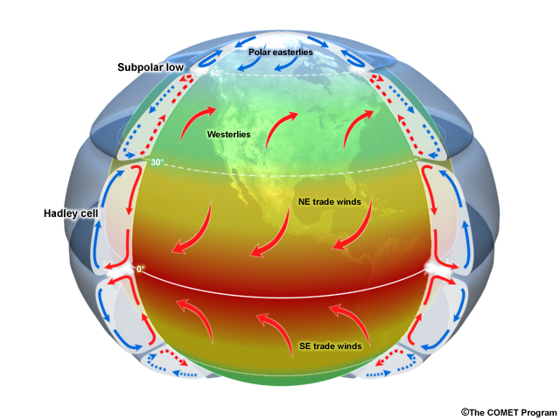
The Global Circulation

Slide 13
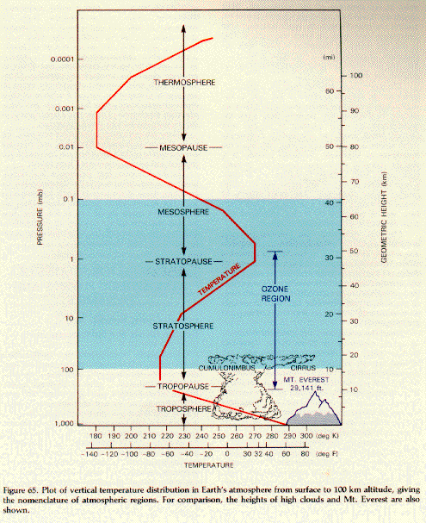
Global Average Vertical Temperature Structure

Slide 14
Global Average Vertical Temperature Structure
To bring air from outside an airplane flying at 35,000 ft into the cabin, the compression to sea-level pressure would raise the air temperature to 430ºC or 806ºF

Slide 16
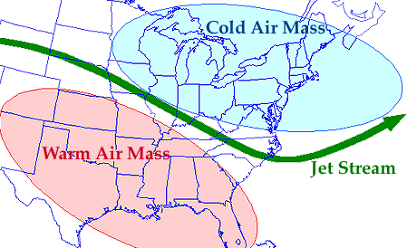
Jet Stream Forms at the Boundary of Air Masses

Slide 17
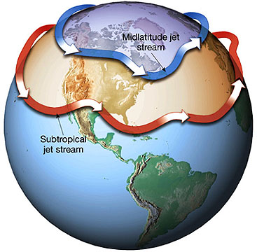

Slide 18
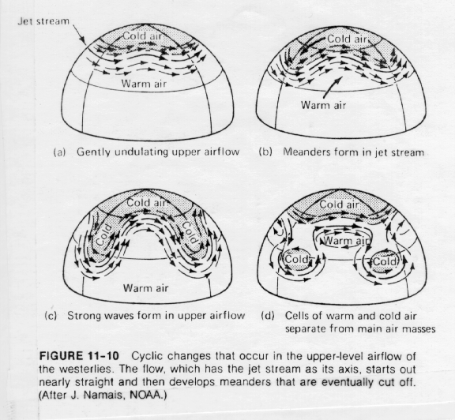
Instabilities at Air Mass Boundaries

Slide 19
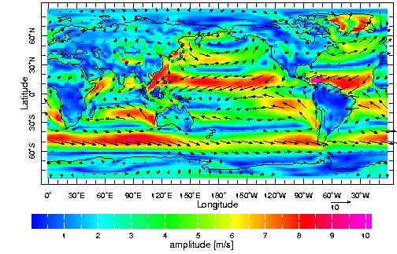
Upper-Level Winds
NOAA NCEP-NCAR CDAS-1 MONTHLY Diagnostic above_ground [ u , v ] climatology (m/s)
January
Wind speed near
surface
http://eesc.columbia.edu/courses/ees/climate/lectures/gen_circ/300mbWinds.html

Slide 20
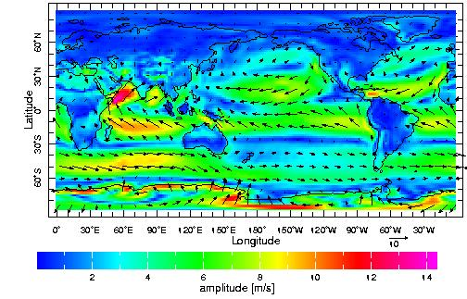
Upper-Level Winds
NOAA NCEP-NCAR CDAS-1
MONTHLY Diagnostic above_ground [ u , v ] climatology (m/s)
July
Wind speed near
surface
http://eesc.columbia.edu/courses/ees/climate/lectures/gen_circ/300mbWinds.html

Slide 21
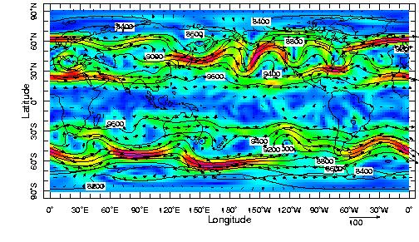
Upper-Level Winds
NOAA NCEP-NCAR CDAS-1 DAILY
300 mb height (m) and winds (m/s)
1 Apr 1997
http://eesc.columbia.edu/courses/ees/climate/lectures/gen_circ/300mbWinds.html

Slide 22
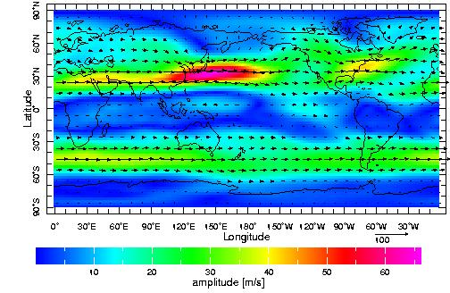
Upper-Level Winds
NOAA NCEP-NCAR CDAS-1
MONTHLY 300 mb [ u , v ] climatology
January
Wind speed at
12 km

Slide 23
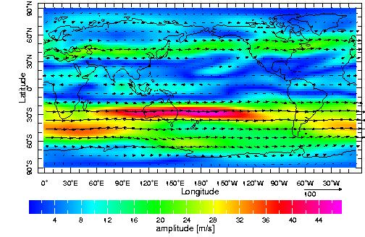
Upper-Level Winds
NOAA NCEP-NCAR CDAS-1
MONTHLY 300 mb [ u , v ] climatology
July
Wind speed at
12 km
http://eesc.columbia.edu/courses/ees/climate/lectures/gen_circ/300mbWinds.html

Slide 24
Continental and Regional influences
Continental scale circulation, jet streams
Great Plains Low-Level Jet
Coastal Jets
Sea breezes
Mountain-valley flows
Mountain compression of stream lines
Monsoons
Off-shore wind

Slide 25
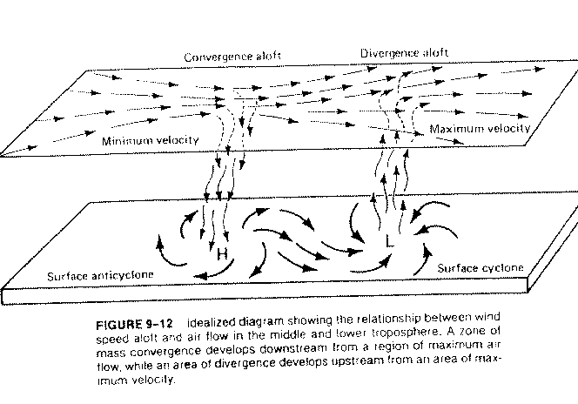
Coupling Surface Flow to Upper-Level Flow
500 mb
6 km

Slide 26
Mechanism of Regional Jets:
Great Plains Low-Level Jet (GPLLJ)
Nocturnal Low-Level Jet (LLJ)
Coastal Jet (CJ)

Slide 27
Mechanism of Regional Jets:
Great Plains Low-Level Jet (GPLLJ)
Nocturnal Low-Level Jet (LLJ)
Coastal Jet (CJ)

Slide 28
F_{p}
L
H
Pressure Gradient

Slide 29
Coriolis Force
F_{c} = -2ΩxV
V
F_{c}
L
F_{p}
H
Pressure Gradient

Slide 30
V
F_{c}
L
F_{p}
H
Pressure Gradient

Slide 31
Geostrophic Balance
V_{g}
F_{p}
F_{c}
L
H

Slide 32
V
F_{c}
F_{p}
L
H
F_{f}
Frictional Force
F_{f} = -C_{d}vV

Slide 33
V
F_{c}
F_{p}
L
H
At night, friction is eliminated, flow is accelerated, V increases

Slide 34
V
F_{c}
F_{p}
L
H
Coriolis force increase, wind vector rotates and speed continues to increase

Slide 35
V
V_{g}
F_{c}
F_{p}
L
H
Wind vector rotates and speed continues to increase and exceeds geostrophic wind

Slide 36
Bermuda High Leads to Southerly Flow over the Great Plains
Low
High

Slide 37
X
Great Plains
Low-Level Jet
Rocky Mountains
Low Press
High Press
High Temp
Low Temp
Missouri River

Slide 38
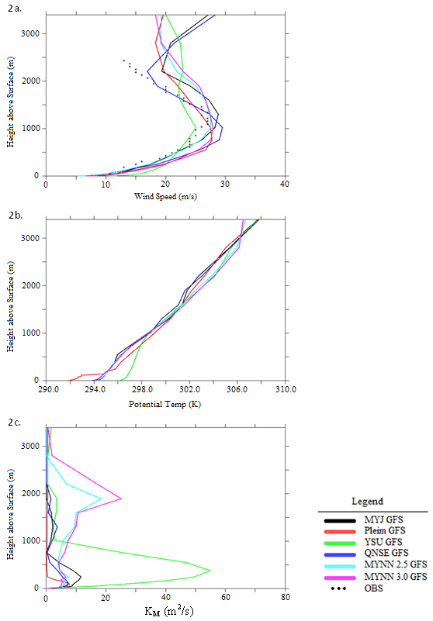
Measured wind speed
Simulation of the Great Plains Low-Level Jet. Adam Deppe thesis, Iowa State University, 2010
Height (m)
GPLLJ Max
Wind Speed (m/s)

Slide 39
Mechanism of Regional Jets:
Great Plains Low-Level Jet (GPLLJ)
Nocturnal Low-Level Jet (LLJ)
Coastal Jet (CJ)

Slide 40
Nocturnal Low-Level Jet (LLJ)
Low Press
Nocturnal
Low-Level Jet
High Press
X
High Temp
Low Temp
~500 m
Nebraska
Illinois

Slide 41
Height above ground
Nocturnal Jet Maximum
(~500 m above ground)
Horizontal wind speed

Slide 42
Mechanism of Regional Jets
Great Plains Low-Level Jet (GPLLJ)
Nocturnal Low-Level Jet (LLJ)
Coastal Jet (CJ)

Slide 43
Coastal Jet (CJ)
Low Press
High Press
High Temp
Low Temp

Slide 44
Coastal Jet (CJ)
Coastal Mountains
Low Press
High Press
High Temp
Low Temp

Slide 45
Mountains produce
an additional pressure
force
V
F_{c}
F_{p}
L
H
F_{f}
Frictional Force
F_{f} = -C_{d}vV

Slide 46
Take Home Messages
Winds are created by horizontal temperature difference (which create density differences and hence pressure difference)
Rotation of the Earth creates bands of high winds (prevailing westerlies) at mid-latitudes
Interactions with the day-night heating and cooling of the earth’s surface create changes in the vertical structure of the horizontal wind
Orographic feature (coastal regions, mountains, etc) create local circulations that enhance or decrease wind speeds

Slide 47
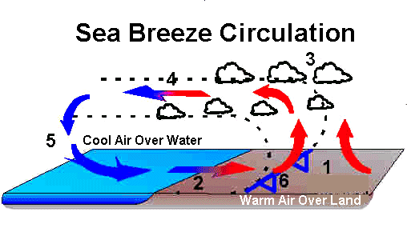
100 km

Slide 49
Musial, W., and B. Ram, 2010: Large-scale Offshore Wind Power in the United States. Assessment of Opportunities and Barriers. NREL/TP-500-40745. 240 pp. [Available online at http://www.osti.gov/bridge]

Slide 52
Musial, W., and B. Ram, 2010: Large-scale Offshore Wind Power in the United States. Assessment of Opportunities and Barriers. NREL/TP-500-40745. 240 pp. [Available online at http://www.osti.gov/bridge]

Slide 53
Musial, W., and B. Ram, 2010: Large-scale Offshore Wind Power in the United States. Assessment of Opportunities and Barriers. NREL/TP-500-40745. 240 pp. [Available online at http://www.osti.gov/bridge]

Slide 59
Takle, E. S., 1975: Wind and Wind Energy in Iowa. Report to the Iowa Energy Council. 99 pp.

Slide 61
Power Law
Height (z)
Logarithmic
Dependence
Windspeed
U* = friction velocity
k = von Karman’s constant (0.40)
z_{o}= roughness length

Slide 63
Number of Occurrences
2
4
6
8
10
12
14
16
18
20
22
Winspeed (m/s)

Slide 64
^{Power law distribution}
Typically p is taken to be 1/7 = 0.143

Slide 65
Weibull Function

Slide 67
Number of Occurrences
2
4
6
8
10
12
14
16
18
20
22
Winspeed (m/s)

