Slide 1
Storage technologies and wind in electricity markets
James D. McCalley
Harpole Professor of Electrical & Computer Engineering
Acknowledgment
Trishna Das | Venkat Krishnan
PhD Student | Research Scientist
Funded in part by the US Department of Energy office of Electricity Delivery and Reliability, “Assessing Storage and Alternatives for Ancillary Service Provision under High Penetration of Variable Generation,” May 2012-May 2013.
44th Energy Information Dissemination Program
Oklahoma State University, Stillwater
June 11, 2013

Slide 2



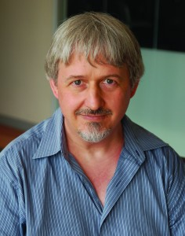






Electric Power and Energy Systems Group
Leigh Tesfatsion
(Economics)
Markets
Ian Dobson
Dynamics, cascading, synchrophasors
Venkat Krishnan
Storage and long-term planning
Dionysios Aliprantis
Power elctrncs, machines
Venkat Ajjarapu
Voltage security
Lizhi Wang
(Industrial Engr)
Optimization, planning & markets
Colin Christy
EPRC Director
Manimaran Govindarasu
Cyber security
Jim McCalley
Planning, wind,
dynamics, storage
Siddhartha Khaitan
Numerical methods for dynamics
…plus 20PhD and 15 MS graduate students researchers.

Slide 3
Research program
Infrastructure investment planning
Venkat Krishnan, Post-doc: Energy & transportation systems
*Diego Meijia, PhD: Long-term uncertainty
Santiago Lemos, PhD: Integrated planning for electric & natural gas infrastructure
*Joseph Slegers, MS: Long-term planning with natural gas for light-duty vehicles
Transmission planning
Oluwaseyi Olatujoye, PhD: Flexibility based planning
*James Slegers, MS: Resource to backbone transmission for high wind penetration
Yifan Li, PhD, PhD: High capacity continental transmission overlay design
Integration of variable generation/storage/frequency
*Trishna Das, PhD: Storage technologies for high penetration of variable gen
Mei Li, PhD: Transmission reconfiguration for large-scale generation shifts
Guangyuan Zhang, PhD: Slow dynamics, markets, and variable generation
Risk-based security constrained economic dispatch (SCED)
*Qin Wang, PhD: Risk-based SCED for electricity markets
Dynamic analysis
Siddhartha Khaitan, Post-doc: Hi-perf comp apps for dynamic analysis in pwr sys
Lei Tang, PhD: A dynamic security assessment processing system (DSAPS)

Slide 4
Outline
Objective
Balancing systems
Storage classifications
Model description
Production cost study results (economic assessment of storage)
Conclusions

Slide 5
Objective
We seek to establish tools and procedures
for evaluating the extent to which storage technologies should play a role in portfolios of future grid services,
given objectives of
  minimizing investment & production costs,
  minimizing environmental impact (e.g., CO₂),
  maximizing system reliability & resilience.
An essential step in this effort is to develop a high-fidelity model for use in day-ahead markets and production cost studies.

Slide 6
Balancing Systems
ENERGY BUY BIDS
DAY-AHEAD MARKET
1 sol/day gives 24 oprting cdtns
min
ΣΣ z_{it}{Cost(GEN_{it})+Cost(RSRV_{it})}
sbjct to ntwrk+status cnstraints
ENERGY & RESERVE SELL OFFERS
REQUIRED RESERVES
LARGE MIXED INTEGER PROGRAM
BOTH CO-OPTIMIZE: energy & reserves
REAL-TIME MARKET
1 sol/5min gives 1 oprtng cdtn
ENERGY BUY BIDS
min
ΣΣ {Cost(GEN_{it})+Cost(RSRV_{it})}
sbjct to ntwrk cnstraints
ENERGY & RESERVE SELL OFFERS
REQUIRED RESERVES
LARGE LINEAR PROGRAM
NETWORK
AUTOMATIC GENERATION CONTROL SYSTEM
FREQUENCY DEVIATION FROM 60 HZ
6

Slide 7
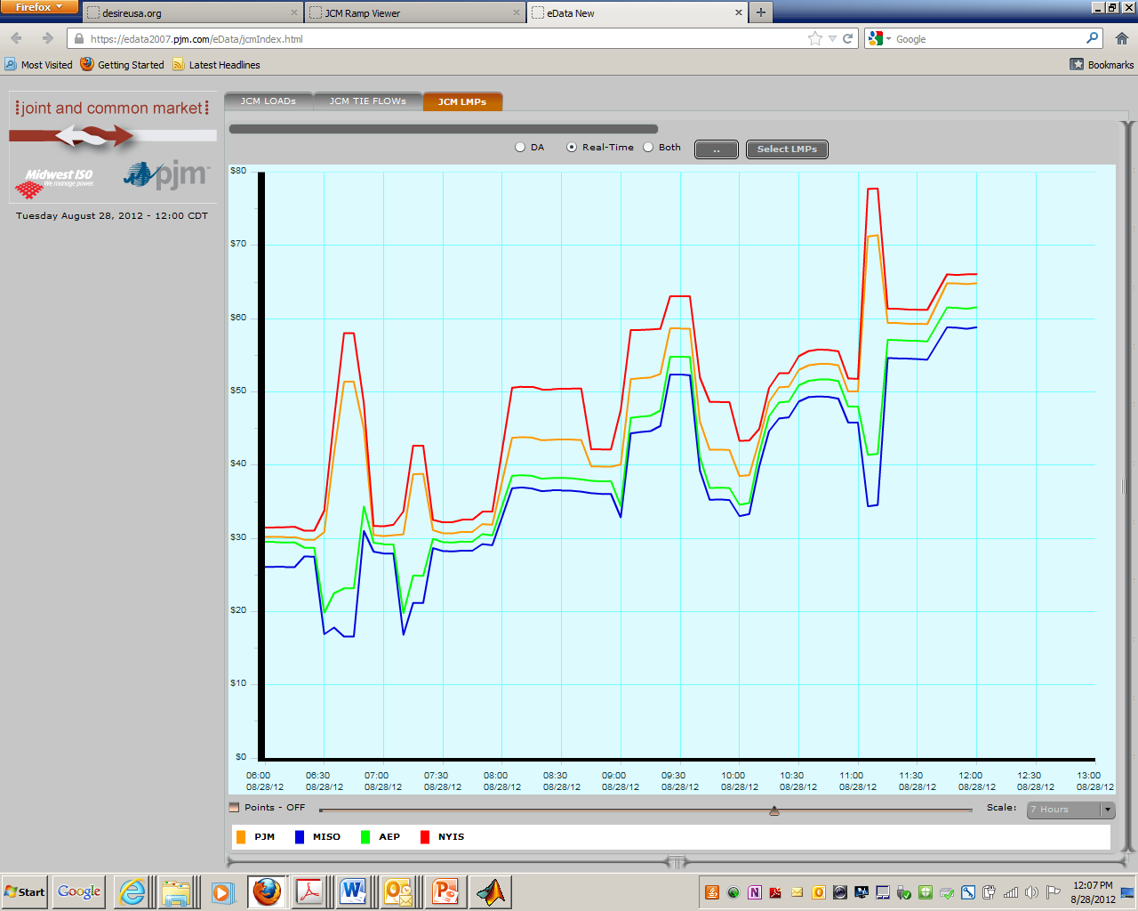
Market prices - Energy
NY
Penn
Ohio
s
Iowa
6:00 am-noon (CST) 8/28/2012
7

Slide 8
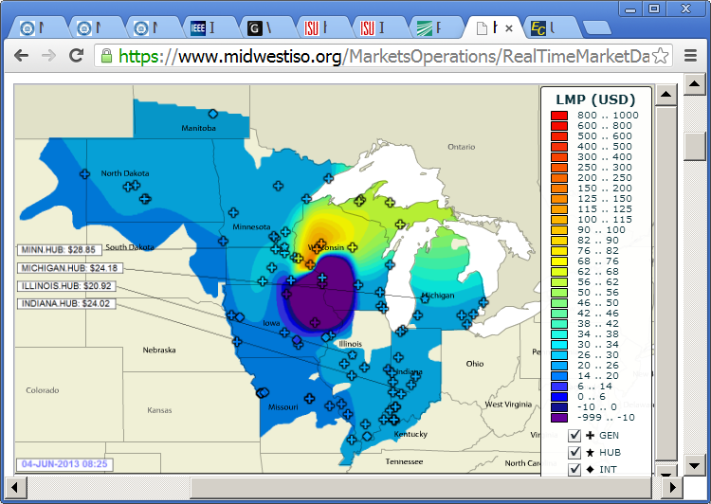
Market prices - Energy
Real-Time 8:25 am (CST) 6/4/2013
8

Slide 9
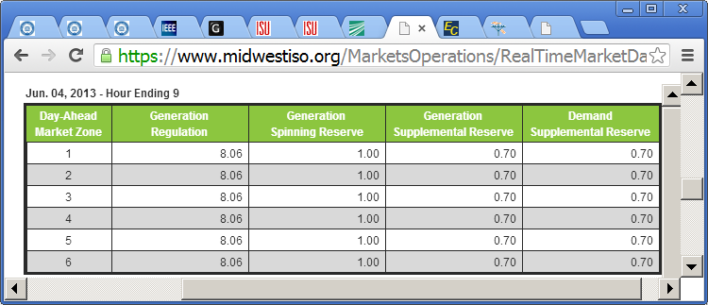
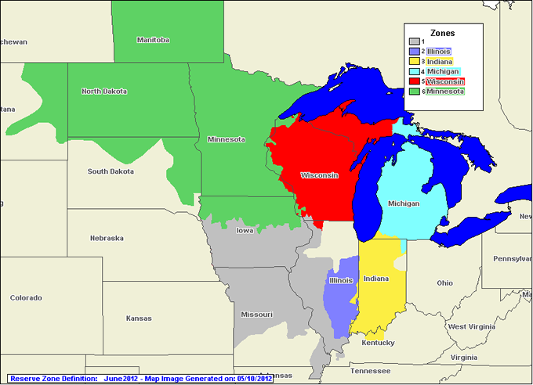
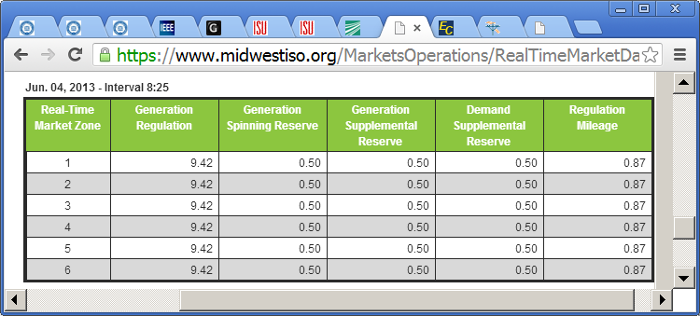
Market prices – Ancillary Services
Day-ahead: hour ending 9 am (CST) 6/4/2013
Real-Time: 8:25 am (CST) 6/4/2013
9

Slide 10
So what is the problem?
Grids need efficient real-time energy markets;
accurate day-ahead markets;
and grid services:
➔transient frequency control,
regulation, load following, reserves,
congestion management, peak capacity
Wind provides energy but increases need for grid services.
Conventional gen provides all grid services.
Increased wind causes conventional gen displacement.
How to provide grid services when wind is high and conventional generation is low?
10

Slide 11
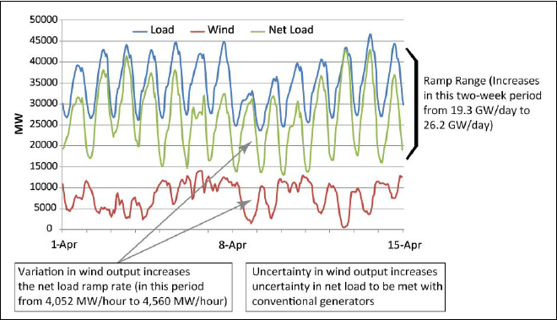

Regulation requirements increase
11

Slide 12
How much role should storage play within portfolio of technologies for high renewable penetration?
Grid service | Grid technologies to improve grid performance
 | Control of variable wind & solar |  |  | Increased cnventional generation |  | Storage |  | Load Cntrl |  | Stoch-astic SCUC | Dec fore-cast error | Wind plant remote trip (SPS) | Add HVDC and utilize control | Add AC Transmission | Geo- diversity of wind
 | Inrtial emu-lation | Freq reg & rmping control | DIR market | Spnng /10 min resrves | Avalble Capcity | Shrt-term | Bulk | Fast | Slow
Efficient real-time market (low market clearing prices) |  |  | √ |  | √ | √ | √ |  | √ | √ | √ |  | √ | √ | √
Efficient day-ahead market (highly accurate conditions) |  |  | √ |  | √ | √ | √ |  | √ | √ | √ |  | √ | √ | √
Transient freq control | √ | √ |  | √ |  | √ | √ | √ |  |  |  |  | √
Regulation (frequency control) |  | √ | √ | √ |  | √ | √ | √ | √ |  | √ |  | √ |  | √
Load following (includes load leveling) |  |  |  | √ | √ |  | √ |  | √ |  |  |  | √ |  | √
Managed transmission congestion |  |  | √ | √ | √ |  | √ |  | √ |  |  | √ | √ | √
Peak capacity |  |  |  |  | √ |  | √ |  | √ |  | √ |  |  | √

Slide 13
Storage Classification – by I/O
Type 1: electric energy not input, not output Examples: are fossil fuels; also natural gas to produce ammonia to produce fertilizer to produce biofuels, all of which can be stored.
Type 2: electric energy input, not output. Example: producing ice during off-peak periods for use in air conditioning during peak periods.
Type 3: electric energy input, output.
Type 4: electric energy not input, but output Examples: concentrated solar thermal generation utilizes solar energy to heat molten salt which is then used as a heat source for a steam-turbine process; hydrogen production via steam-reforming and then conversion to electricity via fuel cells.
13

Slide 14
Storage Classification – by capacity
Bulk storage: Stores large quantities of energy and sustains power production across several hours.
Short-term storage: High ramp rates - instantaneously responds to net-load fluctuations, but with sub-hourly energy sustaining capacity.
 | Batteries |  | Flywheels | Fuel Cells | Thermal Storage | SMES | Super Capacitors | Pumped Hydro | Compressed Air
 | NaS | Lead Acid
Power Density | Good | Good | Very Good | Very Good | Excellent | Excellent | Very Good | Very Good | Very Good
Energy Density | Excellent 170 kWh/m3 | Very Good 40 kWh/m3 | Fair | Very Good | Excellent | Fair | Good | Very Good | Very Good
Recharge Time | Very Good | Good | Excellent | Fair | Very Good | Excellent | Excellent | Fair | Fair
Dynamic Response | ms | ms | ms | 1s | mins | ms | Less than 1 min | Less than 3 min | Less than 10 min
Cost/kW | $1800 | $120 | $100 -$300 | $4000 | $600 | $975 | $120 | $1000 | $400
Round Trip Efficiency % | 89-92 | 75 | 85-90 | 59 | Depends on Storage medium | 90-95 | 95 | 70-85 | 70+

Slide 15
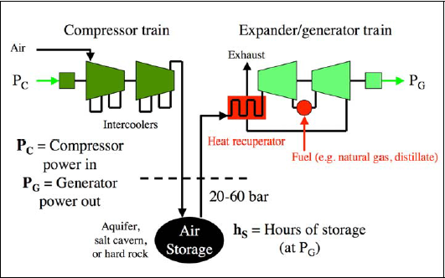
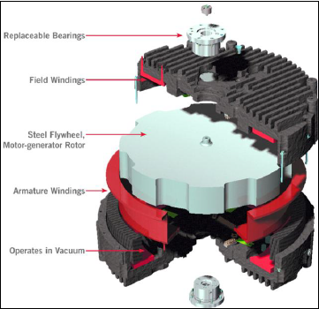
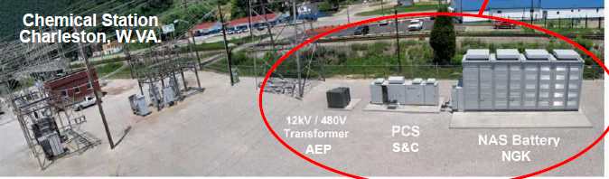
Three types of storage
Compressed Air Energy Storage (CAES)
Flywheel
Batteries
For very readable summary of storage technologies, see P. Parfomak, “Energy storage for power grids and electric transportation: a technology assessment,” Congressional Research Service, March, 2012, at http://www.fas.org/sgp/crs/misc/R42455.pdf.

Slide 16
Storage classification – by operational modes
REGULATION UP
Decrease charging
Increase discharging
SET POINT, CHARGING
SET POINT, DISCHARGING
Increase charging
Decrease discharging
REGULATION DOWN
4-Quadrant
2-Quadrant
CAES, PHS, large capacity batteries
Flywheel, SMES, small capacity batteries
Conventional generator
  Regulation-Up
    Discharge Increase
    Charge Decrease
  Regulation-Down
    Discharge Decrease
    Charge Increase
  Regulation-Up
    Discharge Increase
  Regulation-Down
    Charge Decrease
  Regulation-Up
    Discharge Increase
  Regulation-Down
    Discharge Decrease
Short-term storage has little energy arbitrage potential; therefore no reason to be charging while providing RU or discharging while providing RD.

Slide 17
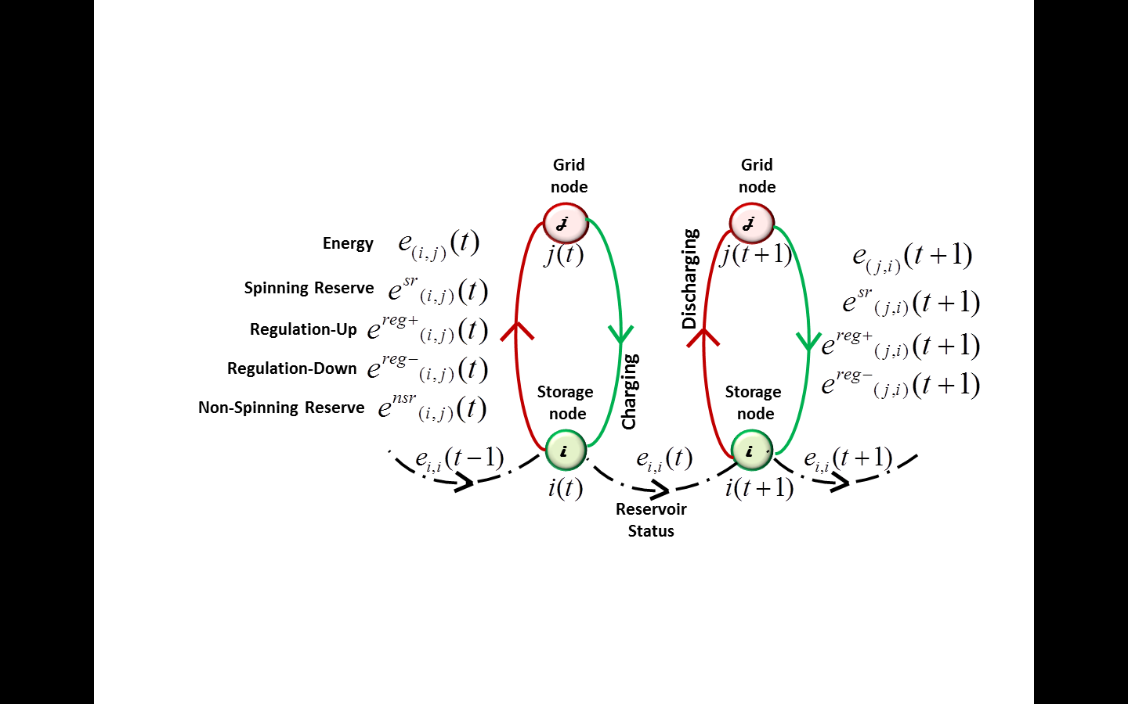
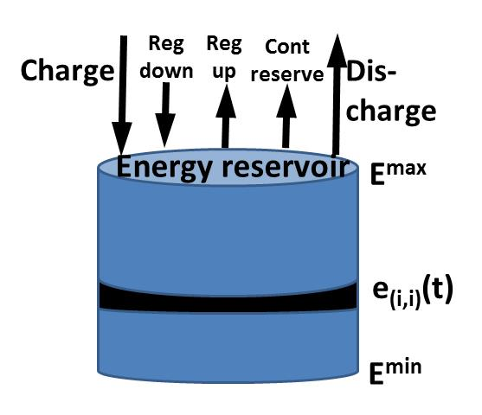
Developed storage model
SOME LIMITATIONS OF PUBLISHED MODELS | CAPABILITIES OF DEVELOPED MODEL
Price-taker/self-scheduler | Active market participant
Models energy arbitrage only | Also models ancillary services (AS)
Models only discharging side of AS | Models discharging & charging sides of AS
Models only charging-RD & discharging-RU | Models charging-RD/RU & discharging-RD/RU
Models reservoir limits for only energy | Models reservoir limits for AS commitments
Not used for smaller dispatch interval | Adapts to smaller dispatch interval (e.g., 5 min)

Slide 18
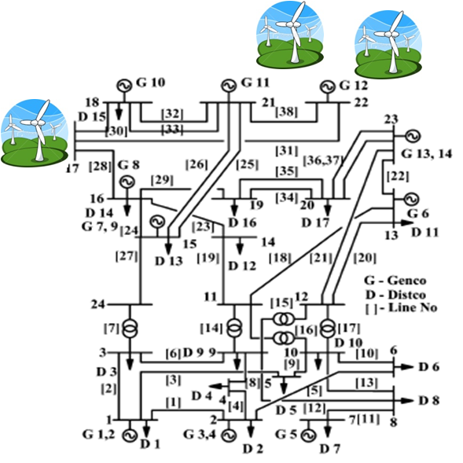
Test system
STORAGE
3405 MW of installed gen capacity (w/o wind)
2490 MW of peak load

Slide 19
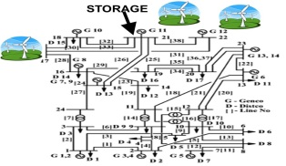
Model: 2 multi-period optimizations
48-hour Mixed Integer Program (MIP)
Unit status constraints
…
Unit ramping constraints
Reservoir update constraint
SYSTEM EQUATIONS
FOR t=1
SYSTEM EQUATIONS FOR t=2
SYSTEM EQUATIONS FOR t=48
Unit statuses, dispatch levels, AS commitments
48-hour Linear Program (LP)
…
Reservoir update constraint
SYSTEM EQUATIONS
FOR t=1
SYSTEM EQUATIONS FOR t=2
SYSTEM EQUATIONS FOR t=576
A “production-cost” model to simulate days, weeks, 1 year of power system operation.
Unit dispatch levels, AS commitments, LMPs

Slide 20
Objective Function for Hourly MIP
Minimize:
Energy Cost ($/MWh)
* Energy Flow (MW)
ANCILLARY SERVICES
Spinning Reserve (SR) Cost ($/MWh)
* Spinning Reserve (MW)
Non-Spinning Reserve (NSR) Cost ($/MWh)
* Non-Spinning Reserve(MW)
Regulation Up (RU) Cost ($/MWh)
* Regulation Up (MW)
Regulation Down (RD) Cost ($/MWh)
* Regulation Down (MW)
Start-Up Cost ($/MWh)
* (Start-Up Indicator + NSR Start-up Indicator)
Shut-Down Cost ($/MWh)
* (Shut-Down Indicator + NSR Shut-Down Indicator)
Penalty($/MWh)
* Load not served (MW)
Notes:
Introduce PC
Align columns
Load Penalty = Not serving 1 MW = $250

Slide 21
General arc equations
All arcs
Energy balance at every node. η_{(i,j)}= η_{(j,i)} represents losses: half on charging side, half on discharging side.
Constrains arc flows within limits.
Transmission arcs
DC power flow relations
Wind arcs
Wind is modeled as market participant, limited by hourly forecast W(t)

Slide 22
Gen/discharge & charge arcs
GEN/DISCHARGE
DESCRIPTION
CHARGE
unit maximum & minimum limits
unit ramp-up and ramp-down constraints
SAME
required system up-reg (R⁺(t)) and down-reg (R⁻⁻(t)) is provided by units that are ON, per the two equations below.
SAME
unit’s reg offer is constrained by its 5-min ramp rate.
required spinning reserves provided by reg & spinning reserves;
required total reserves provided by reg, spinning & nonspinning reserves;
SAME
unit’s reg +spinning reserve offer constrained by 10min ramp rate.
unit’s nonspinning reserve offer constrained by 10min ramp rate.
unit energy, reg, spinning reserve & nonspinning reserve constrained by maximum limit
NONSPINNING RESERVE NOT ALLOWED
unit energy, reg, & spinning reserve constrained by maximum and minimum limits
change in discharge state during time t-1 to t must have a start or a shut at time t
change in nonspinning reserve state during time t-1 to t must have a quick-start or a shut at time t
unit must be charging, discharging, down, or providing non-spinning reserve→
←unit must be discharging , down, or providing nonspinning reserve
➔Each charge/discharge operation must model energy & AS within units capabilities

Slide 23
Reservoir modeling
RESERVOIR UPDATE EQUATION
energy stored in period t-1 less leakage
less energy to be discharged at period t
less reg-up in charging mode
plus reg-down in discharging mode
less spinning reserve in discharging mode
energy
stored in period t
plus reg-down in charging mode
less spinning reserve in charging mode
less reg-up in discharging mode
less nonspinning reserve in discharging mode
plus energy to be charged at period t
Must schedule charge/discharge (blue) accounting for AS commitments (red), imposing storage level (yellow), and reservoir limits (below). Limits are derived from the above.
Charge operation with reg-up and spinning reserve:
Discharge operation with reg-down:
Reservoir level e_{(i,i)}(t), which includes its charge, must have capacity for scheduled reg-up & spinning reserve.
Reservoir level e_{(i,i)}(t), which includes its discharge, must have capacity for scheduled reg-down
RESERVOIR LIMITS WITH A.S. ARE ESSENTIAL.

Slide 24
Production cost study results
Analysis of bulk storage – CAES
  Impact of reservoir levels on ancillary services
  Arbitrage & cross arbitrage
  Effects of different wind penetration levels
  Impacts of thermal plant cycling
  Payback assessment with various penetration levels
Payback assessment of short-term storage

Slide 25
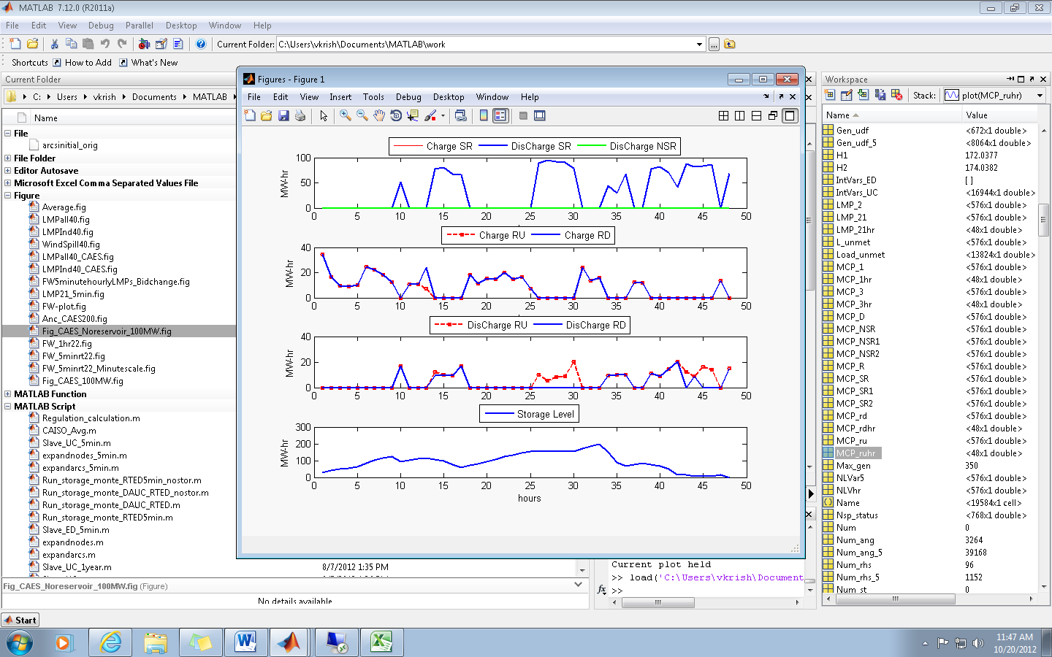
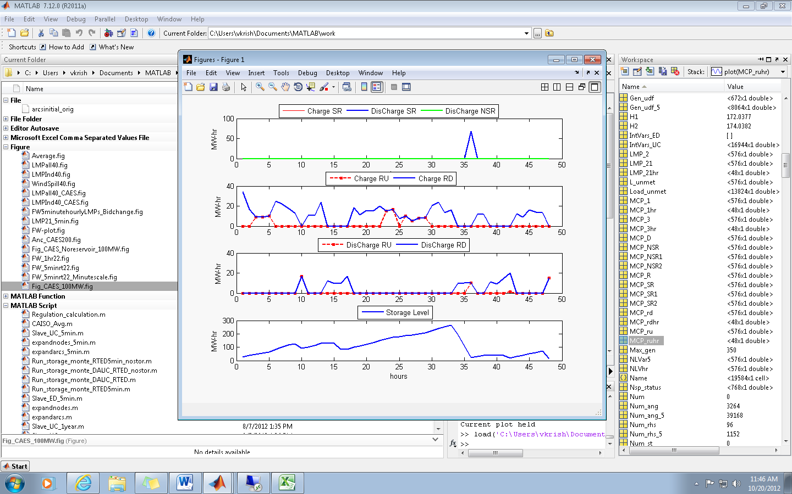
Impact of reservoir limits on ancillary services
SR_Charge, SR_DisCharge, NSR DisCharge
RU & RD via CHARGE
RU & RD via CHARGE
RU & RD via DISCHARGE
RU & RD via DISCHARGE
STORAGE LEVEL
STORAGE LEVEL
Reservoir without AS Limits
Reservoir with AS Limits
Ancillary commitments are independent of reservoir level
 infeasible commitments
2-day revenue of $40.5K from ancillary market
Ensures CAES ancillary commitments are always supported by reservoir energy level
2-day revenue of $11.8K from ancillary market

Slide 26
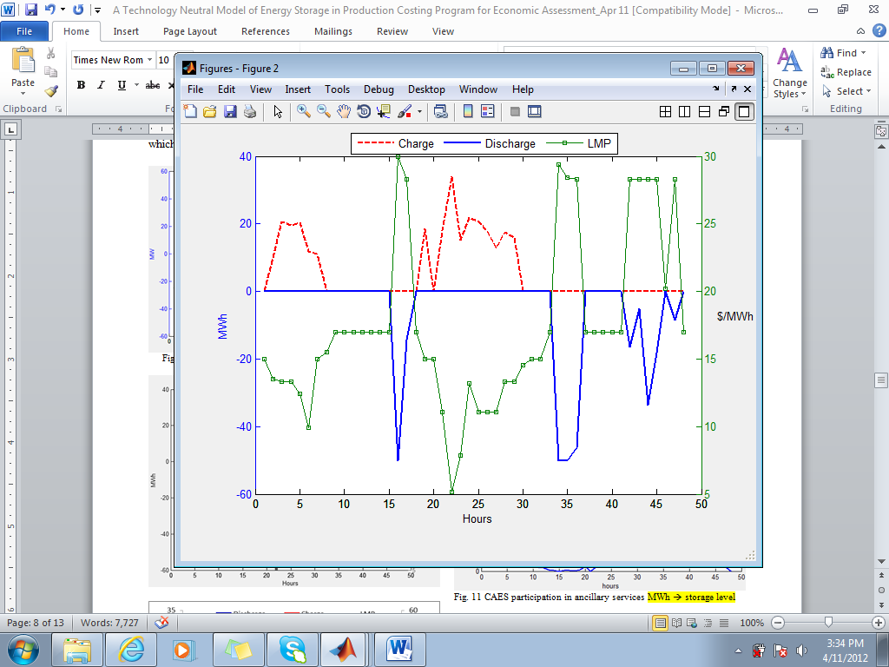
Energy arbitrage
ENERGY-ARBITRAGE: Charging during low-LMP off-peak periods and discharging during high-LMP peak-demand periods
Charge
Charge
Price
Discharge
Discharge
Discharge
CAES is charged during low LMPs (≤15$/MWh) and discharged during high LMPs (≥28.03$/MWh).

Slide 27
Cross-arbitrage
CROSS-ARBITRAGE: Charges from the regulation market and discharges into the energy market or charges from the energy market and discharges into the regulation market
The amount of down-regulation is more than up-regulation, charging up the reservoir for energy dispatch during high LMP periods
With AS, 2-day revenue from energy market is $11.28K
SR_Ch, SR_DisCh, NSR DisCh
CHARGING, DISCHARGING, LMPS
RU & RD via CHARGE
RU & RD via DISCHARGE
CROSS-ARBITRAGE
Without AS, 2-day revenue from energy market is $3.54K.
STORAGE LEVEL

Slide 28
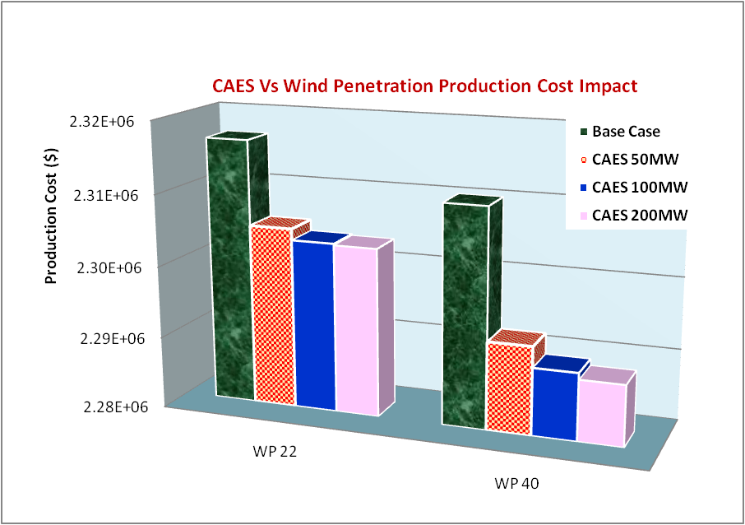
Effects of different wind penetration levels
Different size CAES studied for wind capacity penetrations of 22, 40, 50, 60%
WP decreases production costs.
CAES decreases production costs.
Under 60% wind penetration CAES has negative energy revenue - charging cost is more than discharging revenues
But it still charges enough to supply regulation services (cross-arbitrage) since CAES is a low cost regulation provider
Under high wind penetration, bulk storage may benefit more from ancillary services

Slide 29
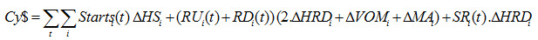
Impacts of thermal power plant cycling
CYCLING: Unit stop/start sequence, load reversal (full to minimum load & back), load following, & high frequency MW changes as seen by AGC.
Degrades heat rate (efficiency), increases maintenance, shortens life.
➔COSTS MONEY!
These costs have not been an issue because many thermal power plants are run base-loaded. But without alternatives, these plants would need to provide ancillary services as wind penetration increases, in which case their offers would be inflated by cycling.
Aptech report for Public Review, “Integrating Wind- Cost of Cycling Analysis for Xcel Energy’s Harrington Station Unit 3, Phase 1: Top-Down Analysis,” March. 2009
http://blankslatecommunications.com/Images/Aptech-HarringtonStation.pdf.

Slide 30
Impacts of cycling: System view
CASE 1:
No CAES,
No cycling in bids
CASE 2:
100MW CAES,
No cycling in bids
CASE 3:
100MW CAES,
Min cycling in bids
CASE 4:
100MW CAES,
Max cycling in bids
Case 1: Without CAES, and without cycling in bids, production cost and cycling cost are very high.
Case 2: CAES lowers both production and cycling costs.
Cases 3, 4: Inclusion of cycling costs in bids increases prod cost but lowers cycling costs.

Slide 31
Impacts of cycling: CAES view
Inclusion of cycling cost in offers results in higher AS prices which benefits CAES. It loses money in energy to make it in AS!
CASE 2
CASE 3
CASE 4
CASE 2
CASE 3
CASE 4

Slide 32
Payback analysis
Attributes | CAES 50MW |  |  | CAES 100MW
Wind Penetration | WP 22 | WP 40 | WP 60 | WP 22 | WP 40 |  | WP 60
Energy Discharge (MWh) | 386.45 | 395.13 | 132.57 | 452.06 |  | 650.23 | 368.22
Up-Reg/Down-Reg (MW-hr) | 288/682 | 513/933 | 883/1206 | 138/682 |  | 474/1025 | 1503/1728
Spin/Non-Spin (MW-hr) | 0/0 | 49.4/0 | 18/0 | 67/0 |  | 58/100 | 245/0
Yearly Fuel Cost (M$) | 1.23 | 1.46 | 2.37 | 1.35 |  | 1.71 | 2.73
Yearly Fixed O&M Cost (M$) | 1.63 | 1.63 | 1.63 | 3.26 |  | 3.26 | 3.26
Investment Cost (M$) | 25.5 | 25.5 | 25.5 | 51 |  | 51 | 51
Ancillary Revenue (K$) | 16.97 | 26.85 | 43.85 | 11.81 |  | 27.58 | 70.07
Energy Revenue (K$) | 8.06 | 8.44 | -0.033 | 11.28 |  | 13.88 | -5.61
Total Yearly Revenue (M$) | 4.55 | 6.42 | 7.97 | 4.20 |  | 7.55 | 11.73
Yearly Profit (M$) | 1.70 | 3.34 | 3.97 | -0.413 |  | 2.57 | 5.74
Payback (years) | 15.02 | 7.64 | 6.42 | - |  | 19.81 | 8.88
Payback period improves under increasing wind penetration levels
  system regulation requirement increases
At the lower penetration level (WP 22%)
  Smaller capacity CAES has a better payback
  For larger CAES, its high investment cost dominates its ability to benefit from markets
  Larger CAES makes less total revenue than smaller CAES, but objective value with larger
  CAES is lower than with smaller CAES. Storage investors need to understand this!
Sensitivity studies show that storage economics significantly benefit from
  inclusion of cycling costs in AS offers: CAES 100 MW @ WP 60% PB ➔ 8 to 5years
  from institution of a CO₂ tax: CAES 100 MW @ WP 40% PB = 20 to 10years

Slide 33
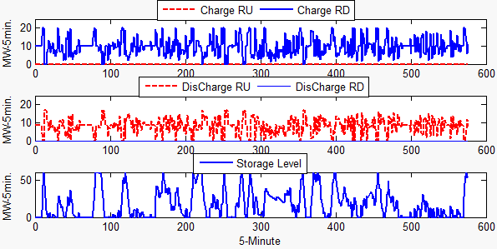
Short-term storage: 20 MW flywheel
Always available with 0 transition cost - directly dispatched using LP
Provides down-reg by charging (accel) & up-reg by discharging (decel)
Does not participate in energy market
2-quadrant regulation commitments bound by max energy that can be charged/discharged in 5-min interval

Slide 34
Analysis of short-term storage 20 MW flywheel
Similar studies performed for a 50 MW Flywheel and a 50 MW Battery, with associated payback analysis.
 | FW 20MW |  |  | FW 50MW |  | Batt 50MW
 | WP 22 | WP 40 | WP 60 | WP 22 | WP 60 | WP 60
Regulation Bid ($/MW-hr) | 2 | 2 | 2 | 2 | 2 | 2
Investment Cost (M$) | 8.15 | 8.15 | 8.15 | 20.375 | 20.375 | 12.5
Rating (MW-hr) | 5 | 5 | 5 | 12.5 | 12.5 | 12.5
Regulation served (MW-hr) | 856.65 | 887.73 | 887.77 | 1243.21 | 2202.48 | 2260.61
Ancillary revenue (K$) | 10.768 | 12.512 (9) | 13.567 | 11.737 | 26.338 | 26.684
Yearly revenue (M$) | 1.96 | 2.275 | 2.47 | 2.135 | 4.795 | 4.86
Yearly op. cost (M$) | 0.155 | 0.16 | 0.16 | 0.225 | 0.4 | 0.41
Yearly profit (M$) | 1.805 | 2.115 | 2.31 | 1.91 | 4.395 | 4.45
Payback (years) | 4.52 | 3.85 (10.62) | 3.53 | 10.67 | 4.64 | 2.81
Small and short-term storage pay back quickly due to ability to provide low regulation offers.

Slide 35
Insights from this work
Storage models for production cost must constrain reservoir levels for energy & AS commitments.
Energy arbitrage & cross-arbitrage are important for storage to obtain revenues and provide grid services
Bulk storage is expensive but can be economic if cycling is modeled.
Short-term storage participates only in AS but is cheap and can therefore be very economic.
All storage looks better as AS requirements (wind/solar) increase, but, need to study options.
Storage economics are not simple and must be studied for a given system, location, size, and type

