Slide 1
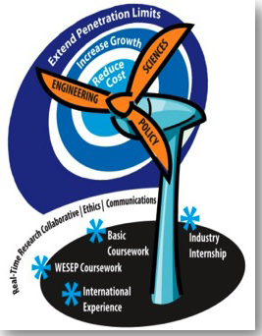
Composite Materials for Wind Turbine Blades
Wind Energy Science, Engineering, and Policy (WESEP) Research Experience for Undergraduates (REU)
Michael Kessler
Materials Science & Engineering
mkessler@iastate.edu

Slide 2
Outline
Background
  Introduction of Research Group at ISU
  Motivation for Structural Composites
  Description of Carbon Fibers for Wind Project
Material Requirements for Turbine Blades
Composite Materials
  Fibers
  Matrix
  Properties

Slide 3
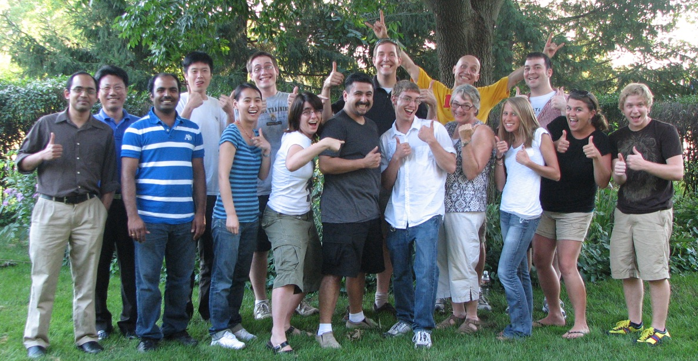
Polymer Composites Research Group http://mse.iastate.edu/polycomp/
mkessler@iastate.edu
Funding:
Army Research Office (ARO)
Air Force Office of Scientific Research (AFOSR)
Strategic Environmental Research and Development Program (SERDP)
National Science Foundation (NSF)
IAWIND – Iowa Power Fund
NASA
Petroleum Research Fund
Grow Iowa Values Fund
Plant Sciences Institute
Consortium for Plant Technology Research (CPBR)

Slide 4
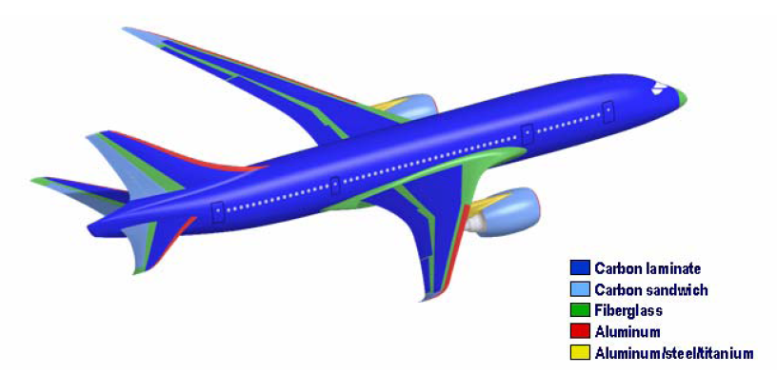
Motivation – Structural Composites
Percentage of composite components in commercial aircraft*
Why PMCs?
Specific Strength and Stiffness
Part reduction
Multifunctional
*Source: “Going to Extremes” National Academies Research Council Report, 2005

Slide 5
Advanced Carbon Fibers
From Lignin for Wind Turbine Applications
PI: Michael R. Kessler, Department of Materials Science and Engr.,
Co-PI: David Grewell, Department of Ag. and Biosystems Engr.,
Iowa State University
Industry Partner:
Siemens Energy, Inc., Fort Madison, IA

Slide 6
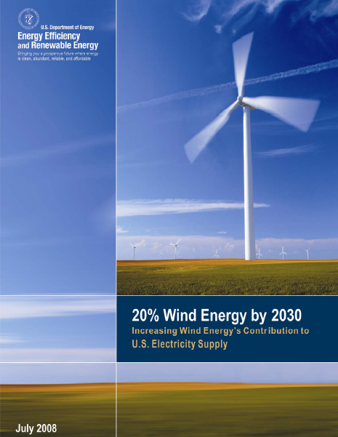
20 % Wind Energy Scenario
300 GW of wind energy production by 2030
  Keys for achieving 20% scenario
    Increasing capacity of wind turbines
    Developing lightweight and low cost turbine blades (Blade weight proportional to cube of length)

Slide 7
Materials For Turbine Blades
Fiber reinforced polymers (FRPs) are widely used for blades
  Lightweight
  Excellent mechanical properties
  Commonly used fiber reinforcements are glass and carbon
Glass Fiber vs. Carbon Fiber
Glass Fiber
Adequate Strength
High failure strain
High density
Low cost
Carbon Fiber
Superior mechanical properties
Low density
High cost (produced from PAN)

Slide 8

Lignin- A Natural Polymer
Lignin, an aromatic biopolymer, is readily derived from plants and wood
The cost of lignin is only $0.11/kg
Available as a byproduct from wood pulping and ethanol fuel production
Can decrease carbon fiber production costs by up to 49 %.
Current applications for lignin use only 2% of total lignin produced

Slide 9
Carbon Fibers from Lignin
Production steps involve
  Fiber spinning
  Thermostabilization
  Carbonization
  Current Challenges
    Poor spinnability of lignin
    Presence of impurities
    Choice of polymer blending agent
    Compatibility between fibers and resins
Warren C.D. et.al. SAMPE Journal 2009 45, 24-36

Slide 10
Project Goals
Develop robust process for manufacturing carbon fibers from lignin/polymer blend
Evaluate polymers for blending, including polymers from natural sources
Optimize lignin/polymer blends to ensure ease of processability and excellent mechanical properties
Investigate surface functionalization strategies to facilitate compatibility with polymer resins used for composites

Slide 11
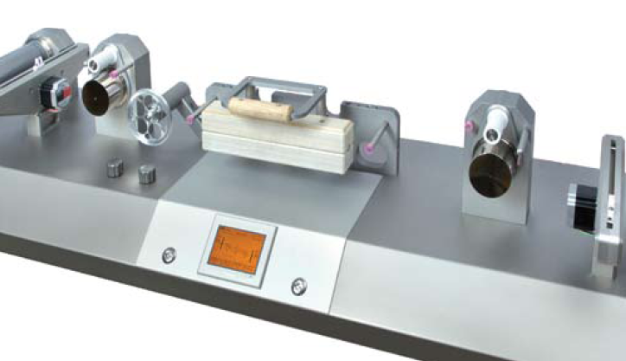
Technical Approach
Evaluate and pretreat high purity grade lignin
Spin fibers from lignin-copolymer blends using unique fiber spinning facility
Characterize surface and mechanical properties of carbon fibers made from lignin precursor
Perform fiber surface treatments (silanes and alternative sizing agents)
Evaluate performance for a prototype coupon (Merit Index)

Slide 12
Outline
Background
  Introduction of Research Group at ISU
  Motivation for Structural Composites
  Description of Carbon Fibers for Wind Project
Material Requirements for Turbine Blades
Composite Materials
  Fibers
  Matrix
  Properties

Slide 13
Material Requirements
High material stiffness is needed to maintain optimal aerodynamic performance,
Low density is needed to reduce gravitaty forces and improve efficiency,
Long-fatigue life is needed to reduce material degradation – 20 year life = 10⁸-10⁹ cycles.

Slide 14
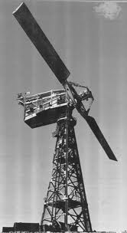
Fatigue
First MW scale wind turbine
  Smith-Putnam wind turbine, installed 1941 in Vermont
  53 meter rotor with two massive steel blades
  Mass caused large bending stresses in blade root
  Fatigue failure after only a few hundred hours of intermittent operation.
  Fatigue failure is a critical design consideration for large wind turbines.

Slide 15
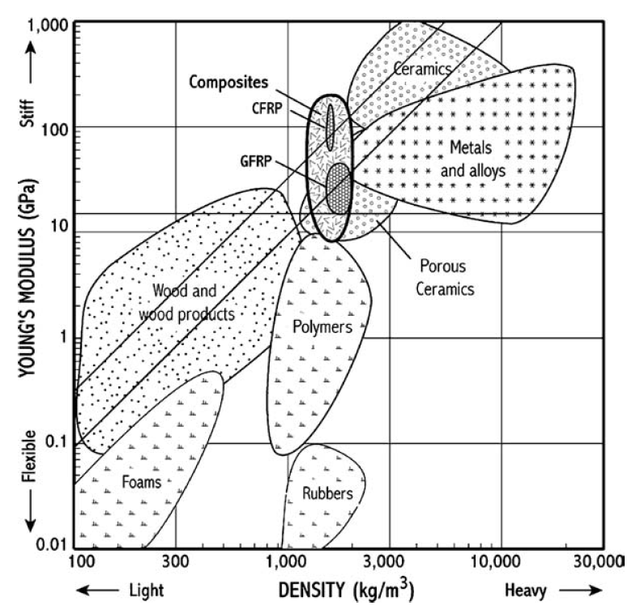
Material Requirements
M_{b}=0.003
M_{b}=0.006
Merit index for beam deflection (minimize mass for a given deflection)
Absolute Stiffness
(~10-20 Gpa)
Resistance against fatigue loads requires a high fracture toughness per unit density, eliminating ceramics and leaving candidate materials as wood and composites.

Slide 16
Terminology
• Composites:
--Multiphase material w/significant
proportions of ea. phase.
• Matrix:
--The continuous phase
--Purpose is to:
transfer stress to other phases
protect phases from environment
• Dispersed phase:
--Purpose: enhance matrix properties.
increase E, σy, TS, creep resist.
--For structural polymers these are typically fibers
--Why are we using fibers?
  For brittle materials, the fracture strength of a small part is usually greater than that of a large component (smaller volume=fewer flaws=fewer big flaws).

Slide 17
Outline
Background
  Introduction of Research Group at ISU
  Motivation for Structural Composites
  Description of Carbon Fibers for Wind Project
Material Requirements for Turbine Blades
Composite Materials
  Fibers
  Matrix
  Properties

Slide 18
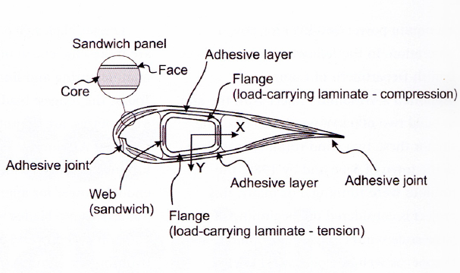
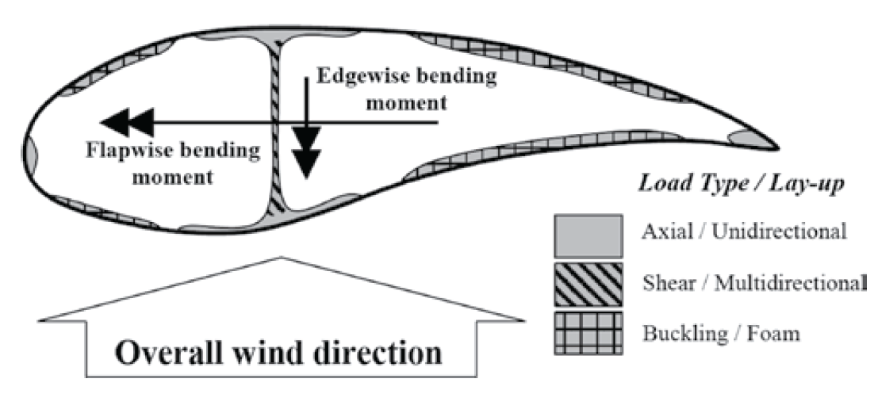
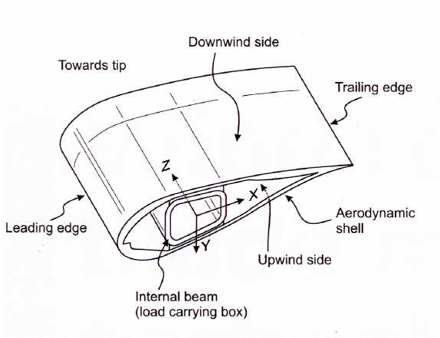
Cross-section of Composite Blade

Slide 19
Material for Rotorblades
Fibers
  Glass
  Carbon
  Others
Polymer Matrix
  Unsaturated Polyesters and Vinyl Esters
  Epoxies
  Other
Composite Materials
D. Hull and T.W. Clyne, An Introduction to Composite Materials, 2nd ed., Cambridge University Press, New York, 1996, Fig. 3.6, p. 47.

Slide 20
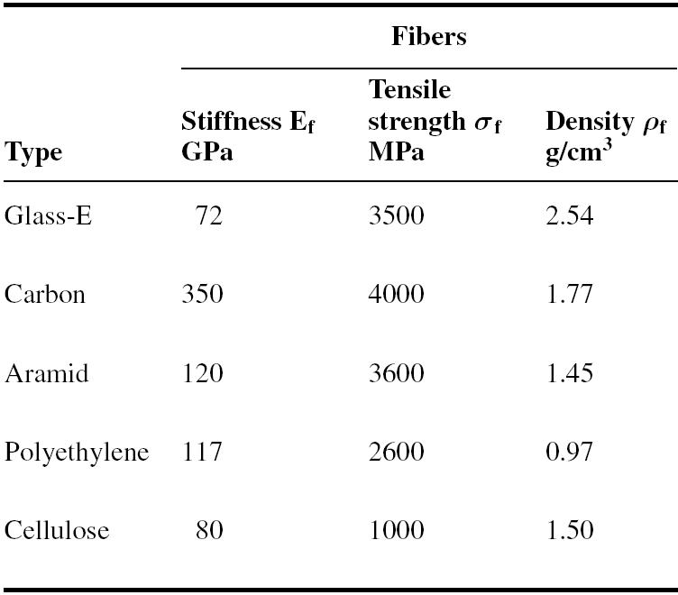
Fibers
Most widely used for turbine blades
Cheapest
Best performance
Expensive

Slide 21
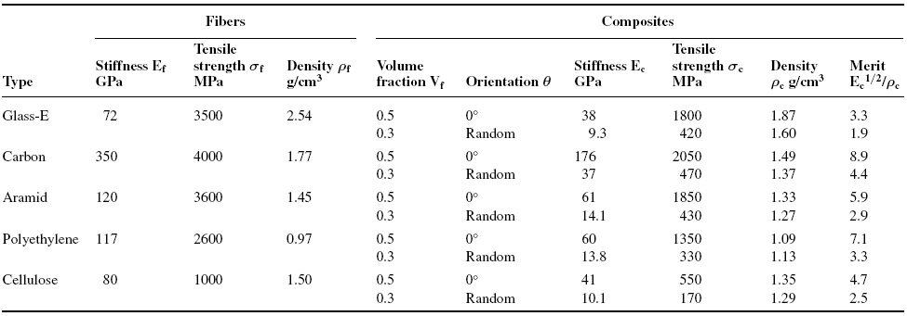
Composite properties from various fibers

Slide 22
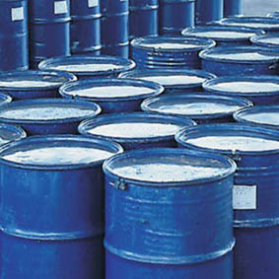
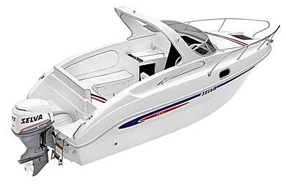
Unsaturated Polyesters
  Linear polyester with C=C bonds in backbone that is crosslinked with comonomers such as styrene or methacrylates.
  Polymerized by free radical initiators
  Fiberglass composites
  Large quantities

Slide 23
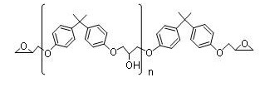
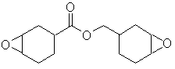
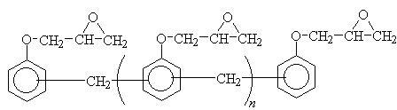
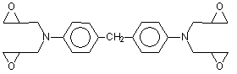
Epoxies
  Common Epoxy Resins
    Bisphenol A-epichlorohydrin (DGEBA)
    Epoxy-Novolac resins
Epoxide Group
Cycloaliphatic epoxides
Tetrafunctional epoxides
Notes:
For DGEBA, n=0 you have Shell Epon 828, Dow DER 332, Ciba-Geigy Araldite AY105
n=2-3 Shell Epon 1001, Dow DER 661, Ciba-Geigy Araldite 6071
n=5-6 Shell Epon 1004, Dow DER 664, Ciba-Geigy Araldite 6084
For Epoxy-Novolac, n=0.2 you have Shell Epon 152, Dow DEN 431, Ciba-Geigy Araldite EPN 1138
n=1.6 you have Shell Epon 154, Dow DEN 438, Ciba-Geigy Araldite EPN 1139

Slide 24
Epoxies (cont’d)
  Common Epoxy Hardners
    Aliphatic amines
    Aromatic amines
Acid anhydrides
DETA
Hexahydrophthalic anhydride (HHPA)
M-Phenylenediamine (mPDA)
Notes:
Aliphatic amine (DETA)

Slide 25
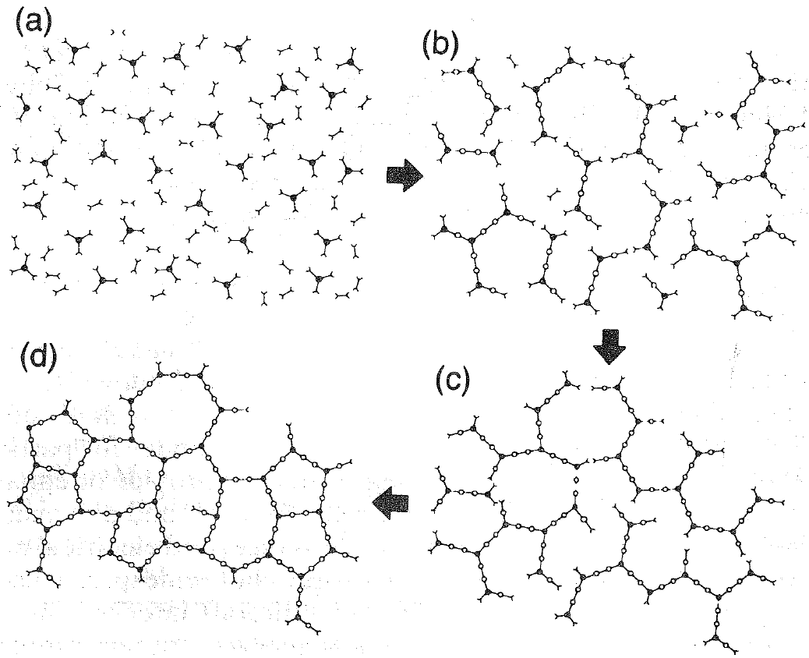
Step Growth Gelation
Thermoset cure starting with two part monomer.
Proceeding by linear growth and branching.
Continuing with formation of gell but incompletely cured.
Ending with a Fully cured polymer network.
From Prime, B., 1997

Slide 26
Composite Materials
Resin and fiber are combined to form composite material.
Material properties depend strongly on
  Properties of fiber
  Properties of polymer matrix
  Fiber architecture
  Volume fraction
  Processing route
From Prime, B., 1997

Slide 27
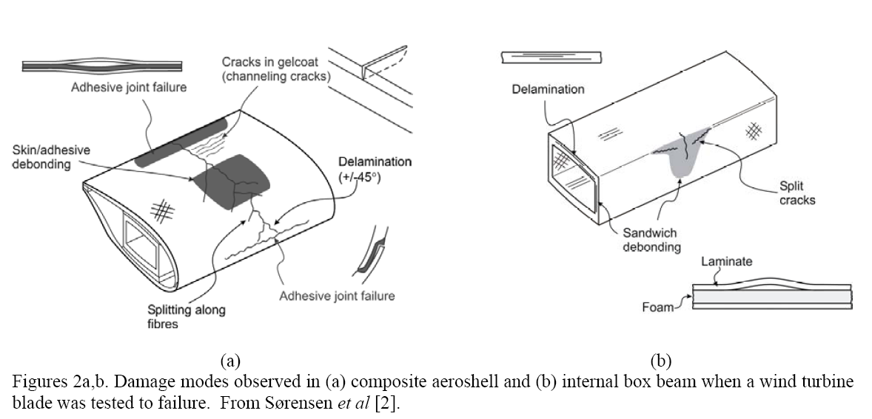
Properties of Composite Materials
Stiffness
Static strength
Fatigue properties
Damage Tolerance

Slide 28
References
Brondsted et al. “Composite Materials for Wind Power Turbine Blades,” Annu. Rev. Mater. Res., 35, 2005, 505-538.
Brondsted et al. “Wind rotor blade materials technology,” European Sustainable Energy Review, 2, 2008, 36-41.
Hayman et al. “Materials Challenges in Present and Future Wind Energy,” MRS Bulletin, 33, 2008, 343-353.

