Slide 1
Grad School Seminar Testing & Admissions Strategies
Anthony Russomanno, MA, MBA
Assistant Vice President
National Director of Educational Partnerships anthonyr@review.com
888.758.7737 x5017

Slide 2
While You Are Waiting - Solve
Complete the Pattern:
O T T F F S S _
Connect the dots, using ONLY 4 straight lines and WITHOUT lifting your pencil
Using 1 line, change this to 6:
IX
l l l
l l l
l l l

Slide 3
Agenda
Intro to Grad School
Factors of Admissions – Role & Importance
Visit PrincetonReview.com
Entrance Exams
Format, Scoring, Differences
GMAT v GRE + Changes
School Preference & Banking
Testing Myths
10 Testing Strategies
The Princeton Review
Value of Prep – Score Improvements
Determining Your Prep Needs
Special Offer
Q & A
Your starting point: Think about your prep options & needs as well as approach to graduate school.

Slide 4
Thinking about Grad School?
LSAT
MCAT
GMAT
GRE
Law School
Medical School
Business School
Everything Else
Psychiatry/Psychology
Nursing
Engineering
Architecture
Humanities
Public Policy
POLL: What test do you plan to take?
FILL OUT THIS CARD!

Slide 5
Thinking about Grad School?
Each year, nearly 500,000 students apply to medical, law, business, and graduate schools.
A great test score on a standardized admissions test (GRE, GMAT, LSAT or MCAT) can significantly enhance your chances of getting into your top choice program.
The Princeton Review can help you create a plan to enhance your test scores.

Slide 6
Top 4 Reasons
To Visit www.PrincetonReview.com
Access amazing FREE student tools including our:
Action Plan, which is a get-into-med, law, business, or grad school timeline and planner
School Search, which employs filters to target med, law, or business schools by test scores, program, GPA, etc
Practice GMAT, LSAT, MCAT or GRE, with a personalized score report detailing your strengths and weaknesses
Great advice articles, easier to navigate on everything from tests to admissions

Slide 7
The Pros & Cons of Grad School
Reasons to Go
Compete on a level playing field
Career advancement
Maximize earning potential
Want to change your life
Opportunities
Isn’t necessarily obvious
Reasons Not to Go
You have a job people would kill for
Current loans
Giving up multiple year’s salary
Put your current career on hold
Assume substantial debt
Personal sacrifices (time, family, etc…)

Slide 8
The Value of a Degree
More Education = More Money
Average lifetime earnings (during the entirety of one's working life, working full-time, year-round)
High school education - $1.2 million
Four-year college degree - $2.1 million
Professional degrees - $4.4 million
Students with an MBA earn almost twice the salary of those with only a bachelor’s degree, and more than a third higher than graduates with other advanced degrees (Mean salary - $92,000)
Notes:
Undergrad Degree + Masters Degree = More Money
More education a person has, the higher her salary is likely to be. A recently released report from the Census Bureau Report came out with some pretty staggering numbers.
Average lifetime earnings (during the entirety of one's working life, working full-time, year-round)
High school education - $1.2 million
Four-year college degree - $2.1 million
Professional degrees - $4.4 million.
Add to this the fact that economic downturns tend to hit lower-income people the hardest as lower-paying jobs are typically cut at a faster rate than management positions

Slide 9
Grad School: First Steps
Talk to an expert and friends
Search the web
Consult rankings – US News and World Report Rankings or www.PrincetonReview.com (list of schools that match your needs and preferences)
Graduate School Recruiter
The Tuition Cost Calculator
Research recent graduating class stats (GPA and scores)
Call schools/admissions staff
Talk to current students & alum
Go to fairs and conferences
Consider your criteria:
Specialize in?
How competitive?
Location- urban/suburban/rural
Hands-on experience?
Financial support?
Career support services?
Types of positions graduates secure?
Other logistical requirements- spouse, day care, etc
Social atmosphere
Family factor
Alumni influence/network
Size
Dr. Who?
Research facilities
School curriculum

Slide 10
Misconception
Brand Name Hype
You need perfect grades and perfect test scores to get into a good school today.
=
Truth: Find the place that is right for you!
Choosing a Grad School – 3 Factors
Academic quality
Chances of getting in
Practical considerations
The Academic Fit
Well-suited
Specializations
Notes:
10
Students fall for the idea that there is link between where you go to school and how much money you make so they need a Big Name School
Find the place that is right for you and you will be happier, plus it will be easier to get in!
What r your preferences – small classes, close to home, tuition, major - pre-med, business?
If you’re a “B” or even a “C” student, you can still go to a good school if you want to. Remember that it’s never too late to improve. If you feel that your GPA isn’t a good representation of how well you can really do, start improving now. It’s almost certainly not too late. They’ll also pay attention to your trend of improvement. Don’t give up. Show them that you’re getting better with age. Even if you’ve only got one semester left to show colleges what you’re capable of doing, show them! Start now.
Be a savvy shopper. Don’t lament the fact that you won’t necessarily be competitive for the same twenty schools everyone else wants to attend. Instead, embrace just how many options you really have.

Slide 11
Applying and Getting In
The Application Process
Deadlines
TIP: Apply Early
Rolling admissions/rounds
Transcripts
Application fees

Slide 12
Factors of Admission
Objective Factors:
GPA
Test Scores – GMAT, GRE, LSAT, MCAT
The Numbers
Students focus on the numbers first
The numbers don’t get you in but ________
Get a ticket
Notes:
Role of test – compare you to others (besides GPA) – a hoop u have to jump through
How important are the entrance exams in the graduate school admissions process?
The importance of standardized test scores varies widely, depending on the type of graduate program you’re investigating. For example, Psychology Ph.D. programs typically require very high GRE scores, while other programs view the GRE as little more than a formality. Law schools place a great deal of importance on the LSAT score (the most easily quantifiable as 50-60% of the process is usually LSAT score - varies from application to application and school to school), but still are primarily concerned with your ability to handle the rigorous workload – evidenced by your undergraduate performance. Not only do Medical Schools look as your MCAT score but they also stress a students GPA which for both sometimes accounts for 35-40% for determination of acceptance. And although many top Business schools won’t admit this, the GMAT has taken on unbelievable importance in admissions – much of which is due to internal institutional pressure to make sure their numbers are in line with other top B-schools.
Generally speaking, the more competitive schools place a greater importance on the entrance exams. Most students focus on the numbers first because it is easy…”If I don’t the numbers then I don’t get in, if I do, then I am in.” It is not all about the numbers - The numbers don’t get you in but can keep you out of the more competitive schools. The numbers are more like a starting point – it just gets you a ticket to the show.
Business School Admissions and the GMAT
While it is really the whole package that determines how competitive a candidate is, the GMAT is very important given today’s competitive environment. The number of GMAT testers is near an all-time high, and GMAT scores are a major factor used to differentiate between applicants. With that being said, there is a whole basket of components that comprises an application, consisting of “objective factors” (GPA, GMAT) and “subjective factors” (essays, work experience, letters of recommendation, interviews, transcripts, and resumes).
Let’s talk about the objective factors first. We’ve already determined that the objective factors are the “numbers”--your GPA and GMAT score. They are used as success indicators to see how you measure up against other candidates.
For example, your GPA tells admissions committees whether you can handle the math and the other academic work. It is also used to compare applicants against the larger pool. Now keep in mind that while the GPA is more important for younger candidates with less work experience, admissions committees still look at it no matter at what stage in your life you’re applying.
The second objective factor is your GMAT score. When considering a school, you should look at its average score as well as its score range. As a rule of thumb, if your score is more than 50 points below a school’s average, your chances for admissions are relatively slim. The writing portion of the exam (AWA) is usually not important.
OK, we’ll get back to the GMAT later.

Slide 13
Factors of Admission
Subjective Factors:
Recommendations
Personal statement
Activities/experience
Interview
Resume/CV
Personal background/miscellaneous
Stand out from the rest of the crowd.
Notes:
Other Important Factors in Admissions
As we mentioned, there are also subjective factors involved in the admissions process. Schools use these components to look at “fit” and to answer the all-important questions, “Why do you need an MBA? Why do you need it here? Why do you need it now?”
Given all the candidates who could be admitted based on numbers alone, how you’ll “fit” with the rest of the class takes on tremendous importance. B-Schools are all about teamwork and networking, so schools need to know what kind of teammate you’ll make, and how you’ll add to their network.
You must be prepared to answer their questions, “Why an MBA? Why here? Why now?” You need to demonstrate that you know the value of this degree and what it will do for you. Even if you don’t know exactly what you want to be when you grow up, you must demonstrate direction. Otherwise, they’ll admit someone else.
OK, so what are the subjective factors we’ve been referring to?

Slide 14
Letters of Recommendation
Choose Wisely - Influential
Rate abilities, open-ended or own letters
Requires great awareness of audience reviewing your application
Contact programs to find out what they’re looking for in applicant’s recommendation letters
Types of recommendations - require two or three letters
Academic, professional, dean
Consider
Who knows your work? Big name?
Time
Bullet point cheat sheet
Input of a professional from work context will be good for practice-oriented careers
5 areas of commentary that all great teacher letters of recommendation have in common.
Classroom contributions
Interest in the subject
Level of achievement
Personal anecdotes
Likeability

Slide 15
Personal Statement
What To Talk About
What you want to study at graduate school
Why you want to study it
What experience you have in your field
What you plan to do with your degree once you have it
Evaluate
How clearly you think; how well you have conceptualized your plans and how well your interests and strengths mesh with their program
TIP: Give Yourself At Least 2 Months To Develop Your Personal Statement
It should…
Be a sales pitch for yourself
Show committee something about yourself that they could never learn from your app
Demonstrate that you are a mature, intelligent and focused person
Show that you’re different from the rest of the pack
Be the most powerful, positive element of your application
Answer the question!
Common Themes
Don’ts

Slide 16
The Rest of The Package
Extra-curriculars/work experience/community involvement
TIP: Don’t try to “beef-up” your app by joining every activity you can find
Support what your personal statement talks about
Join an organization and gain a leadership position
Get an internship
The Interview — Do Them if They’re Offered
Resumes
Highlights your academic and professional achievements
TIP: Take Courses of Interest (but don’t forget requirements)
Major in something that interests you
Take a communications class
Study abroad
Do papers

Slide 17
Putting It All Together
Choosing Targets
Start your list of universities that offer the program you're interested in.
Eliminate - not academically strong enough or unacceptable due to practical considerations.
FAQs
How many schools should I apply to?
Should I apply to schools that I think are out of my league (my GPA or test score might be too low)?
Divide the remaining schools into three groups: 1-2-1 Ratio
100% sure/shoe-ins
Good “match”
Schools you'll get into only if touched by the hand of God

Slide 18
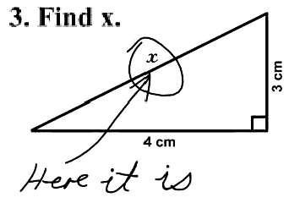
Entrance Exam Myths
These exams test your IQ
High GPA = high test score
Score determines your admissions chances
High scores are everywhere

Slide 19
1. Know Thy Enemy
Author
Content
Format – CAT, CBT, P&P, MST
Scoring
Point System
Order of Difficulty
Predictability
Tricks

Slide 20
Structure of the LSAT
Section Type | Number of Questions | Time
Reading Comprehension | One section, about 27 | 35 min
Logical Reasoning | Two sections, about 25 each | 35 min
Analytical Reasoning | One section, about 25 | 35 min
Experimental Section | One section, about 25 | 35 min
Essay | One essay | 30 min
Note: Score is a composite ranging from 120-180 and in percentiles
Notes:
$160 LSAC

Slide 21
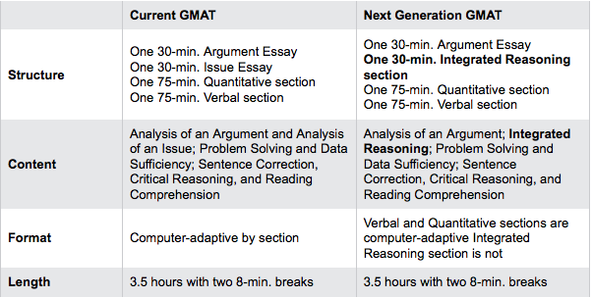
Current vs. New GMAT
Notes:
ACT @Pearson Vue
$250

Slide 22
New GMAT: Test Content
Integrated Reasoning
Table Analysis
Graphics Interpretation
Multi-Source Reasoning/Analysis
Verbal/Writing
Grammar
Argument Analysis
Reading Comprehension
Basic Writing Mechanics
Math
Math Fundamentals/Arithmetic
Algebra
Geometry

Slide 23
What’s A Good Score?
Category | GMAT Score
Avg. Top 11 B-School | 700
Avg. Top 35 B-School | 650
Mean GMAT (International) | 547
Mean GMAT (US) | 529
Top Scoring Major - Physics | 598
2nd Scoring Major - Math | 594
Lowest Scoring Major – Hotel Admin | 480
Scale: 200-800
The score that gets you in
Competition
Notes:
The current GMAT is scored on a 200-800 scale, with sub-scores for Math and Verbal (0-60).
Each current AWA essay is scored by two graders (e-raters) on a scale of 0-6, and your score is the average of the four scores, rounded to the nearest half point.
The scoring system for the Integrated Reasoning section won’t be released until April 2012.
For the Math and Verbal, the scoring software calculates your score based on: The number of questions you complete, the number of questions you answer correctly, and the difficulty of the questions you answer.
So, what’s a good GMAT score? (Teachers: Wait for audience response.) WRONG!! The score that gets you in is a good score. Different programs have different standards.

Slide 24
GMAT: Integrated Reasoning: Sample Q1
TEAM | WINNING PCT. | # OF GAMES | PPG | OPP. PPG
Chicago | .558 | 77 | 101.8 | 100.5
Cleveland | .623 | 77 | 94.7 | 91.3
Kalamazoo | .679 | 81 | 98.2 | 92.9
Kingston | .696 | 79 | 102.4 | 97.3
The above table gives information about winning percentage, number of games played,
points per game (PPG), and opponents points per game (OPP. PPG) for four Imaginary
League Basketball teams for the year 1993.
True False
Kalamazoo and Kingston won the same number of games.
The median PPG for the teams was more than 5 points greater than the
median OPP. PPG for the teams.
If Chicago had scored 20 more total points and given up 20 less total
points, the team would have outscored opponents by more than 2 PPG.
Notes:
GMAC has officially displayed four types of Integrated Reasoning (IR) questions on its website: http://www.gmac.com/gmac/thegmat/nextgenerationgmatinfocenter/question+formats.htm. These include Table Analysis, Graphics Interpretation, Multi-Source Reasoning, and Two-Part Analysis.
The above is an example of a Table Analysis question.
CORRECT ANSWER: TRUE, FALSE, FALSE.
EXPLANATION:
You’ll want your onscreen calculator for this one (don’t forget that a calculator is provided as an onscreen tool in the IR section).
1st True/False question: TRUE. Kalamazoo’s winning pct. Is .679, which is 55/81. Kingston’s winning pct. Is .696, which is 55/79. To figure this out, multiply the # of games by the winning pct. for each team and round appropriately.
2nd True/False question: FALSE. To find the median PPG for the teams, list the PPG for each team in ascending order (least to greatest): This would be 94.7, 98.2, 101.8, 102.4. When you have an even number of terms in your set, the median is the average of the middle two. In this case, that’s (98.2 + 101.8)/2 = 200/2 = 100. Rinse and repeat to find the median for the OPP. PPG: The terms are 91.3, 92.9, 97.3, and 100.5. Again, the median is the average of the middle two, which is (92.9 + 97.3)/2 = 190.2/2 = 95.1. Thus, the median PPG is 100, and the median OPP. PPG is 95.1. 100 – 95.1 = 4.9, so the median PPG is NOT more than 5 points greater than the median OPP. PPG.
3rd True/False question: FALSE. Get savvy about this one. Adding 20 points over 77 games would raise Chicago’s PPG by 20/77, or .26. Thus, the team’s PPG would be 101.8 + 0.26 = 102.06. Giving up 20 less points over 77 games would lower Chicago’s OPP. PPG by 20/77, or .26. Thus, the team’s OPP. PPG would be 100.5 – 0.26 = 100.24. The difference between these two figures (102.06 - 100.24) is roughly 1.8 PPG, so Chicago would NOT be outscoring its opponents by more than 2 PPG.
By the way, this type of question can get significantly more complicated than our example, such that it would be very difficult to squeeze the whole table/question set onto a single PowerPoint slide! But this example gives you one flavor of IR.

Slide 25
GMAT: Integrated Reasoning: Sample Q2
Fictitious Science Magazine Article: …Contrary to popular belief, the Entropods have always been a more capable species than the Chaosaurs. Though they most prefer stable environments, Entropods can create viable habitats for themselves on land or at sea, whereas Chaosaurs can only survive for a short period of time in water. Furthermore, Entropods are generally known to fly at speeds above 70 miles per hour and sometimes at heights above 30,000 feet. To date, no Chaosaur has been observed flying faster than 55 miles per hour or migrating at a height of more than 21,000 feet. Chaosaurs have been thought of as superior to Entropods only because of their supposed ability to recognize human speech patterns; however, the evidence suggests only that, unlike Entropods, Chaosaurs are highly sensitive to sonic modulations…
Based on the description in the paragraph above, which of the following features accurately compares the Entropods and the Chaosaurs? Make only 2 selections, one in each column.
Entropods | Chaosaurs | Comparison
 |  | Migrate at greater altitude
 |  | More adaptable on land
 |  | Less sensitive to variations in sound
 |  | More commonly fly at slower speeds
 |  | Learn less from other similar species
Notes:
GMAC has officially displayed four types of Integrated Reasoning (IR) questions on its website: http://www.gmac.com/gmac/thegmat/nextgenerationgmatinfocenter/question+formats.htm. These include Table Analysis, Graphics Interpretation, Multi-Source Reasoning, and Two-Part Analysis.
The above is an example of a Two-Part Analysis question.
CORRECT ANSWER: Entropods: Less sensitive to variations in sound. Chaosaurs: More commonly fly at slower speeds.
EXPLANATION:
ENTROPODS: The fictitious article excerpt tells us that “…unlike Entropods, Chaosaurs are highly sensitive to sonic modulations.” This means that Entropods are not highly sensitive to sonic modulations; thus, Entropods are less sensitive to variations in sound than Chaosaurs are.
CHAOSAURS: The fictitious article excerpt tells us that “Entropods are generally known to fly at speeds above 70 miles per hour,” whereas “no Chaosaur has been observed flying faster than 55 miles per hour.” Thus, you can safely conclude that Chaosaurs more commonly fly at slower speeds than do Entropods.
Here’s your POE:
Migrate at greater altitude doesn’t work because though we know that Entropods “sometimes [fly] at heights above 30,000 feet” and that “no Chaosaur has been observed…migrating at a height of more than 21,000 feet,” the passage does not specify the height at which Entropods migrate.
More adaptable on land doesn’t work because though “Entropods can create viable habitats for themselves on land or at sea” and “Chaosaurs can only survive for a short period of time in water,” we don’t know about the comparative adaptability of Entropods and Chaosaurs on land.
Learn less from other similar species doesn’t work because other similar species are not discussed anywhere in the fictitious article excerpt.
By the way, this type of question can get significantly more complicated than our example, such that it would be very difficult to squeeze the information given and question set onto a single PowerPoint slide! But this example gives you another flavor of IR.

Slide 26
Structure of the GRE
Section | Old GRE | New GRE
Analytical Writing Assessment | Analysis of an Issue Essay (45 min.) Analysis of an Argument Essay (30 min.) | Analysis of an Issue Essay (30 min.) Analysis of an Argument Essay (30 min.)
Quantitative | 1 Section, 28 Questions/45 min | 2 Sections, each section approx. 20 Questions/35 min
Verbal | 1 Section, 30 Questions/30 min | 2 Sections, each section approx. 20 Questions/30 min
Experimental | Can be Verbal or Quantitative, not identified.* *Some testers may instead get an identified, unscored section for research purposes at the end of the test | Can be Verbal or Quantitative, not identified.* *Some testers may instead get an identified, unscored section for research purposes at the end of the test
Notes:
General – ETS @ Prometric $160
Format:
6 sections with diff timing
Scoring
math score ranging between 130 and 170 in one point increments
verbal score ranging between 130 and 170 in one point increments
writing score on a 1- 6 scale
Skip Questions: mark a question and return to it later
The most notable
no longer be purely Computer Adaptive
will have Computer-Based components
Multi-Stage Test (MST)
3.17 hours of testing
Can skip, return to questions, and changing responses

Slide 27
GRE Test Overview
Old Scale: 200 - 800
New Scale: 130 - 170
In 10pt increments
In 1pt increments
Section | Subject | Q | Time (in minutes)
1 | Essays (Issue and Argument | 2 | 61 (30 per essay, 1 minute break inbetween)
2 | Math or Verbal | 20 | 30 or 35
3 | Math or Verbal | 20 | 30 or 35
Break |  |  | 10
4 | **Experimental** ↕ | 20 | 30 or 35
5 | Math or Verbal | 20 | 30 or 35
6 | Math or Verbal | 20 | 30 or 35
Total |  | 102 | 3hr 55 minutes
Notes:
Analytic
Timing: Both essays will now be 30 minutes.
Issue: Students will be given more specific assignments for how they should respond to the issue given.
Argument: Students will be given more specific assignments for how to analyze the argument. These could include identifying assumptions, strengthening the argument, formulating questions based upon the argument, and others.
Quantitative
Calculator: Students will be given the option to activate and use an on-screen calculator.
Numeric Entry: This is a new question type in which students must generate their own answer rather than selecting from multiple choices.
Select Multiple Answers: These will be similar to multiple choice questions but students will be asked to select multiple correct answer choices.
Charts/Graphs/Tables: A greater percentage of quantitative questions will be based upon charts, tables, or graphs.
Geometry is to be de-emphasized in favor of more data analysis.
Students will be asked more questions using real life scenarios.
General
Reading Comp: Some reading comp questions will have more answer choices and students will be asked to select multiple correct answer choices.
Reading Comp: A new question type asks students to select a sentence in the passage that answers or supports the answer to a given question.
Sentence Comp: Text completions are a new sentence completion question format. Students will be given three answer choices for two or three blanks and must answer all blanks correctly to get credit for the question.
Sentence Equivalence: These are much like sentence completions but students will be asked to select one or more equivalent words or phrases to complete a sentence but keep the meaning the same.
Analogies and antonyms are gone.

Slide 28
GRE - What Changed?
General
Format:
Multi-Stage Test (MST) vs. old CAT
3.17 hours of testing vs. old 2.5
Scoring
math score ranging between 130 and 170 in one point increments
verbal score ranging between 130 and 170 in one point increments
writing score on a 1- 6 scale
500 = 153; 600 = 160; 700 = 166; 450 = 150
Skip Questions: mark a question and return to it later
The most notable
no longer be purely Computer Adaptive
will have Computer-Based components
Notes:
Analytic
Timing: Both essays will now be 30 minutes.
Issue: Students will be given more specific assignments for how they should respond to the issue given.
Argument: Students will be given more specific assignments for how to analyze the argument. These could include identifying assumptions, strengthening the argument, formulating questions based upon the argument, and others.
Quantitative
Calculator: Students will be given the option to activate and use an on-screen calculator.
Numeric Entry: This is a new question type in which students must generate their own answer rather than selecting from multiple choices.
Select Multiple Answers: These will be similar to multiple choice questions but students will be asked to select multiple correct answer choices.
Charts/Graphs/Tables: A greater percentage of quantitative questions will be based upon charts, tables, or graphs.
Geometry is to be de-emphasized in favor of more data analysis.
Students will be asked more questions using real life scenarios.
General
Reading Comp: Some reading comp questions will have more answer choices and students will be asked to select multiple correct answer choices.
Reading Comp: A new question type asks students to select a sentence in the passage that answers or supports the answer to a given question.
Sentence Comp: Text completions are a new sentence completion question format. Students will be given three answer choices for two or three blanks and must answer all blanks correctly to get credit for the question.
Sentence Equivalence: These are much like sentence completions but students will be asked to select one or more equivalent words or phrases to complete a sentence but keep the meaning the same.
Analogies and antonyms are gone.

Slide 29
GRE: Adaptive by Section
SECTION 1
PERFORMANCE
SECTION 2
Hard Verbal
Medium Verbal
Easy Verbal
Hard Math
Medium Math
Easy Math
Notes:
Analytic
Timing: Both essays will now be 30 minutes.
Issue: Students will be given more specific assignments for how they should respond to the issue given.
Argument: Students will be given more specific assignments for how to analyze the argument. These could include identifying assumptions, strengthening the argument, formulating questions based upon the argument, and others.
Quantitative
Calculator: Students will be given the option to activate and use an on-screen calculator.
Numeric Entry: This is a new question type in which students must generate their own answer rather than selecting from multiple choices.
Select Multiple Answers: These will be similar to multiple choice questions but students will be asked to select multiple correct answer choices.
Charts/Graphs/Tables: A greater percentage of quantitative questions will be based upon charts, tables, or graphs.
Geometry is to be de-emphasized in favor of more data analysis.
Students will be asked more questions using real life scenarios.
General
Reading Comp: Some reading comp questions will have more answer choices and students will be asked to select multiple correct answer choices.
Reading Comp: A new question type asks students to select a sentence in the passage that answers or supports the answer to a given question.
Sentence Comp: Text completions are a new sentence completion question format. Students will be given three answer choices for two or three blanks and must answer all blanks correctly to get credit for the question.
Sentence Equivalence: These are much like sentence completions but students will be asked to select one or more equivalent words or phrases to complete a sentence but keep the meaning the same.
Analogies and antonyms are gone.

Slide 30
GRE - Scoring
Current GRE (CAT)
New GRE (MST)
tester starts with a medium difficulty
If answered correctly, testing engine gives a harder question & vice versa
Score is based on three components
MST selects questions in groups
Performance on the first Math section determines the difficulty level of the second Math section
Scored similarly to current GRE

Slide 31
GRE – Math Content – Quantitative
Quantitative | Current GRE | Revised GRE
Format | Multiple choice | Multiple choice Select all that apply Numeric entry
Content | Arithmetic, algebra, geometry, data interpretation | The same….almost!
Question Types | Problem Solving Quantitative Comparison | Problem Solving Quantitative Comparison Numeric Entry Select All That Apply
Calculators | No | Yes -but don’t get too excited…

Slide 32
GRE Content: Numeric Entry
Question 10 of 20
If a is 60% of b, b is 40% of c, and c is 20% of d, then 6d is what percent of 20a?

Slide 33
GRE Content: Numeric Entry
Question 10 of 20
If a is 60% of b, b is 40% of c, and c is 20% of d, then 6d is what percent of 20a?
d= 100
c=

Slide 34
GRE Content: Numeric Entry
Question 10 of 20
If a is 60% of b, b is 40% of c, and c is 20% of d, then 6d is what percent of 20a?
d=100
c=20
b=

Slide 35
Content: Numeric Entry
GRE Content: Numeric Entry
Question 10 of 20
If a is 60% of b, b is 40% of c, and c is 20% of d, then 6d is what percent of 20a?
d=100
c=20
b=8
a=4.8
6d=600
20a=96

Slide 36
Content: Numeric Entry
GRE Content: Numeric Entry
Question 10 of 20
If a is 60% of b, b is 40% of c, and c is 20% of d, then 6d is what percent of 20a?
625
d=100
c=20
b=8
a=4.8
6d=600
20a=96
600 = x
96 100
60,000 / 96 = 625

Slide 37
Content: Numeric Entry
GRE Content: Numeric Entry
Question 10 of 20
If a is 60% of b, b is 40% of c, and c is 20% of d, then 6d is what percent of 20a?
d=100
c=20
b=8
a=4.8
6d=600
20a=96
600 = x
96 100

Slide 38
GRE Content - Verbal
Verbal | Current GRE | New GRE
Question Format | Multiple choice (one answer) | Multiple choice Select all that apply Select-in passage responses
Question Types | Analogies Antonyms Reading Comprehension Sentence Completion | Reading Comprehension Text Completion Sentence Equivalence

Slide 39
GRE CONTENT: Text Completion
2 blanks and three choices per blank:
Altruism is thought by some to be a purely human trait, developed during our evolution as a tribal species. However, studies of other animals ____(i)____ this notion. Chimps will adopt orphaned infants, and many species of birds will warn others, at the risk of exposing themselves, when a predator approaches the flock. These displays of animal altruism ____(ii)____ that animals other than humans also evolved to exhibit this trait.
Blank (i) | Blank (ii)
belie | assuage
conform | intimate
promote | rescind

Slide 40
GRE CONTENT: Text Completion
2 blanks and three choices per blank:
Altruism is thought by some to be a purely human trait, developed during our evolution as a tribal species. However, studies of other animals ____(i)____ this notion. Chimps will adopt orphaned infants, and many species of birds will warn others, at the risk of exposing themselves, when a predator approaches the flock. These displays of animal altruism ____(ii)____ that animals other than humans also evolved to exhibit this trait.
Blank (i) | Blank (ii)
belie | assuage
conform | intimate
promote | rescind

Slide 41
GRE CONTENT: Sentence Equivalence
Select the two answer choices that, when used to complete the sentence, fit the meaning of the sentence as a whole and produce completed sentences that are alike in meaning.
The president of the company was shocked when he arrived at the quiet boardroom the day after the stock market crash; rather than exhibiting outrage, the members of the board were completely _________.
impassive
histrionic
stoic
impassioned
empathetic
fetid

Slide 42
GRE CONTENT: Sentence Equivalence
Select the two answer choices that, when used to complete the sentence, fit the meaning of the sentence as a whole and produce completed sentences that are alike in meaning.
The president of the company was shocked when he arrived at the quiet boardroom the day after the stock market crash; rather than exhibiting outrage, the members of the board were completely _________.
impassive
histrionic
stoic
impassioned
empathetic
fetid
Notes:
No emotion
stinks

Slide 43
GMAT v GRE
Today, 250+ Business schools, including 7 of the top 10 globally, will accept either a GMAT or a GRE score for admissions purposes.
Paradigm Shift
In the past few years, Business Schools have lessened their traditional practice of requiring applicants with 2-3 years work experience. As a result, undergraduates are now attending business school directly out of college.
Business Schools are looking for more diverse candidates; those who have degrees in architecture, engineering, psychology and education. These candidates tend to take the GRE while in college in the event they decide to attend graduate school.
Notes:
The first is an apples to apples comparison. Applicants come in all shapes and sizes, experience varies, how do you compare transcripts from different schools, etc. This is the only element of the applications that all prospects will have in common. In that sense, it doesn’t matter that much what’s being tested, as long as it displays a difference and everyone sees the same thing.
43

Slide 44
GMAT v GRE
YOU HAVE A CHOICE.
GRE VS GMAT
Take the GMAT if you are applying to at least one school that accepts the GMAT only.
Take the GRE if you are applying to a range of business and non-business programs.
Notes:
In some cases
44

Slide 45
Structure of the MCAT
Test Sections | Questions | Time
Tutorial (optional) |  | 5 minutes
Physical Sciences | 52 | 70 minutes
Break (optional) |  | 10 minutes
Verbal Reasoning | 40 | 60 minutes
Break (optional) |  | 10 minutes
Writing Sample | 2 essays | 60 minutes
Break (optional) |  | 10 minutes
Biological Sciences | 52 | 70 minutes
Survey |  | 5 minutes
Total Content Time |  | 4 hours, 20 minutes
Total Test Time |  | 4 hours, 50 minutes
Total Appointment Time |  | 5 hours, 30 minutes
Notes:
AAMC $240

Slide 46
Take It To The Bank
School Test Preference
Banking Your Scores
Notes:
In some cases
46

Slide 47
Word Association
Peanut Butter

Slide 48
Word Association
Table

Slide 49
Word Association
Think of A Number

Slide 50
Average Joe Answers
Jelly or Bread
Chair
Positive Whole Number (i.e. 2, 10, 17) – why doesn’t anyone pick - 1.243 or 3/7

Slide 51
2. Take On Your Own Terms
Personality Types
Know how you study
Pace yourself
Manage the test

Slide 52
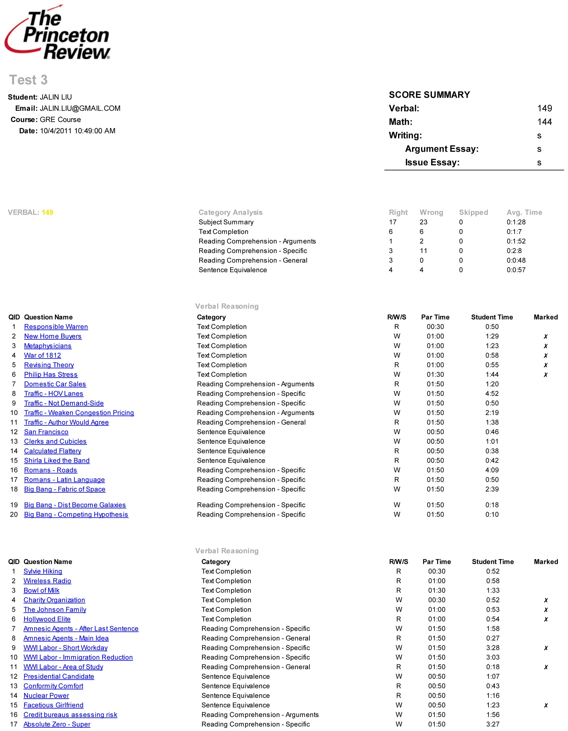
Notes:
This student took the test in order and ran out of time. Questions 19 and 20 however, might have been easy.

Slide 53
Skip and Come Back
Notes:
Could someone read this out loud for me please.
So this is the point that we just talked about. Within a section, you are in control and you should be taking the test in the order that works for you.
Now I want everyone to take a moment and count the number of times the word “the” shows up in this paragraph.
Let me see a show of hands. How many people count 8? 9? 10? Anyone higher than 10?
Over a four hour test you are going to make some reading errors. Once you see a problem wrong it is impossible to un-see it and see it right. When that happens you end up getting stuck on a problem for four minutes and you get it wrong….
[describe how Skip and Come Back works]

Slide 54
3. Guess!
A skill?
When & how?
Skipping
Flip a coin
Letter of the day
Eliminate
Stay cool

Slide 55
4. POE
Narrow down the answer choices
Increased probability
Sesame Street
Be aggressive
4 of 5 wrong
What is the capital of Malawi?
Washington D.C.
Paris
Tokyo
London
Lilongwe

Slide 56
Sample Problem 1
In the figure above, what is the greatest number of non-overlapping regions into which the shaded region can be divided with exactly two straight lines?
6
5
4
3
2

Slide 57
Sample Problem 1
1
1
2
4
2
4
3
3
The question basically asked you to divide this doughnut into the highest number of shaded regions possible using 2 straight lines!

Slide 58
Sample Problem 1
In the figure above, what is the greatest number of non-overlapping regions into which the shaded region can be divided with exactly two straight lines?
6
5
4
3
2
50% chance of getting this right - why might you eliminate 6?
no way that easy
P.O.E.
Strategies used: Rephrase the question in your own words, test writing - is it going to be that easy, P.O.E, physically cross off the wrong answers in the test booklet, Guess after P.O.E, Final leading word.
P.O.E.

Slide 59
Sample Problem 1
1
2
3
5
4

Slide 60
Sample Problem 2
A circle is inscribed in a square, as shown in the figure below. If the square measures 10 feet on a side, which of the following expressions gives the area of the shaded region in square feet?
10² - 10π
10² - 5²π
10 - 5π
5² - 5²π
5² - 10π

Slide 61
Sample Problem 2
A circle is inscribed in a square, as shown in the figure below. If the square measures 10 feet on a side, which of the following expressions gives the area of the shaded region in square feet?
Area of the square minus the area of the circle.
Area (Square) = length x width
10² - 10π
10² - 5²π
10 - 5π
5² - 5²π
5² - 10π
P.O.E. eliminate any answer choice that does not have 10²

Slide 62
Sample Problem 2
A circle is inscribed in a square, as shown in the figure below. If the square measures 10 feet on a side, which of the following expressions gives the area of the shaded region in square feet?
Area of the square minus the area of the circle.
Area (Square) = length x width
10² - 10π
10² - 5²π
10 - 5π
5² - 5²π
5² - 10π
P.O.E. eliminate any answer choice that does not have 10²
P.O.E. eliminate any answer choice that does not have π r2 (missing r²)
In the previous example, we deleted CDE, in this example, we got rid of ACE leaving us with B. You could just ballpark and get this right as well!

Slide 63
5. Triple P with A
Weakness first, strengths later
Stagger
Time it
Free demo.princetonreview.com

Slide 64
Notes:
Let’s take a look at a student’s Score Report

Slide 65
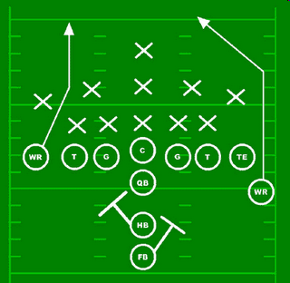
6. Technique
Skills - step by step methods
Game plan
Critical Reading

Slide 66
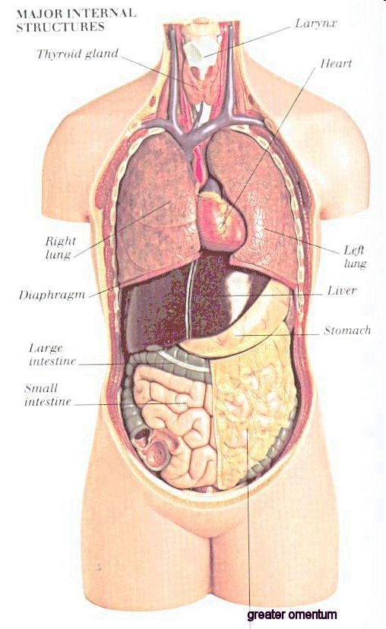
7. Content
Biology
O-chem
Math
Vocab

Slide 67
8. Stay Focused
Take your breaks
Ceiling Tile Theory
Long term - Pick a date and stick with it

Slide 68
9. Scratch Paper
Visualize it
Draw it
Set-up
POE

Slide 69
10. Be Confident
Trust your prep
Built over time

Slide 70
So How To Succeed - MC Test?
C
S
T
P&A
C&E

Slide 71
FAQs
When should I take the test?
Times I can retake? Downside?
What is the best way to prepare?
How can I see how my score compares?
How important is it to prepare?
Notes:
When should the tests be taken?
It depends on when the student plans to apply to graduate school but a good rule of thumb is to finish before working seriously on applications. Schools do not have a formula saying how many students they admit during the first round of admissions, the second round of admissions, etc., but apply early because schools don’t know until midway through the admissions process what the quality of the people applying will be. Your chances are better the earlier you apply. For many graduate schools then, it's best to try to take your exam by the end of Junior year or summer before Senior year/Fall). The GRE, GMAT and MCAT are all on computer are offered many times throughout the year so it should be easier to fit the exam within your time frame. The LSAT is only offered 4 times per year.
How many times can students retake the tests, and is there a downside to retaking them?
Students can take these exams multiple times --but, why would they want to? Ideally, students should take these exams once. But, in reality, most students will want to take these exams more frequently in order to improve their score but it is extremely important to find out how the school vies multiple scores. Every time a student takes the exam, each score shows up on his or her testing record. So, schools see every score. Sometimes schools will average the scores and sometimes take the highest score. Students really don't want to have a lot of test scores on their record especially if the student's scores don't change. Nearly 50% of all MCAT testers take the exam a second time and most of the time it was because they did not prepare properly the first time.
How can students evaluate their test scores and see how they measure up in comparison to other test-takers?
There are averages posted for the exams. Students should also research on the internet the average scores of freshman accepted to the schools they want to attend. It’s a great benchmark, since the only reason to take entrance exams is to get into the grad school of your choice.
How important is it to prepare for these tests?
It depends on the type of school to which the student applies, what their current score is as well as their other factors (recommendations, extracurriculars, experience…). Students should certainly do some level of preparation (when you know your starting score, it is easier to determine the method of prep) --whether by taking a free practice test, buying (and reading!) a preparation book, or by taking a preparation program (private tutoring, small group tutoring, courses, or online programs).
If a student does badly on these tests the first time around, by how many points can he/she hope to raise their score?
It really depends on where the student is starting (and if they prepped) and which test he is taking. For the LSAT, an improvement of 7 points does

Slide 72
See how you score…
Take a Full-Length Practice test at www.PrincetonReview.com/demo
Detailed score report
Determine test prep needs

Slide 73
Why The Princeton Review?
The first step toward reaching your goals is choosing a test prep company that delivers results.
Prep on your terms. We've designed our programs to provide you with just this: a personalized prep experience to fit your learning, style, schedule, and budget.
Buy with confidence - Guaranteed Results. We have so much faith in our programs that we guarantee your score will improve. Our students end up scoring higher on the actual exams after preparing with The Princeton Review and consistently get into their top-choice programs.
Learn from experts. Our smart, enthusiastic, innovative instructors are rigorously trained and completely dedicated to helping you succeed.
Unique Methodology & Curriculum. We’ve spent the past 30+ years perfecting the skills to master and teach these tests. Our philosophy of teaching sets us apart from other companies. The program is also reinforced by top-notch materials and full-length practice testing with score analysis.
Experience and Depth. We focus on the exams that get people into school. We revolutionized test prep. What we learn about one test translates over to an effective strategy for another test.
Materials. We will spend millions of dollars in R&D to make sure you receive the most up-to-date material whether it’s through printed material, online tools and practice exams.
Which option best suits your needs?
Private Tutoring
Small Group Tutoring
Classroom Courses
Online Courses
Books

Slide 74
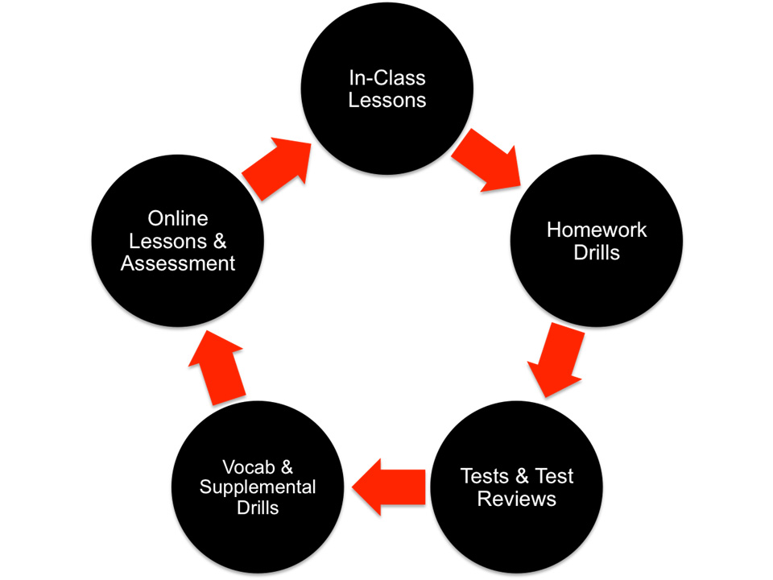
Notes:
In the course we have a system…

Slide 75
Your Special Offer
How to Redeem the Offer?
Email anthonyr@review.com for special promotional code.
Enroll online at www.PrincetonReview.com - during check out, enter your unique code in the field 'Promo Code‘
Offer
$250 Off: Classroom, LiveOnline and Small Group Instruction for the GRE, LSAT, GMAT, MCAT and DAT.
15% off Private Tutoring.

Slide 76
Q & A
Email anthonyr@review.com or call: 888-758-7737 ext 5017 For more info, visit www.PrincetonReview.com or call 800.2Review Be a leader, passionate, empathetic and intellectually curious!

