Slide 1
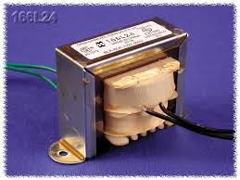
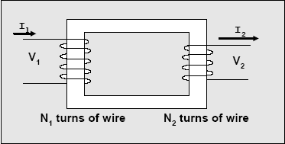
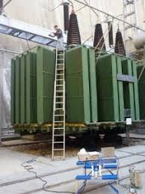
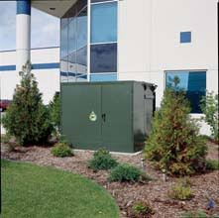
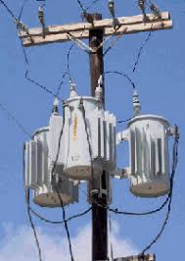
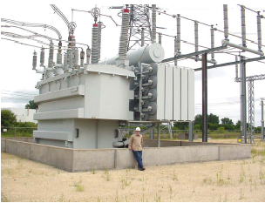
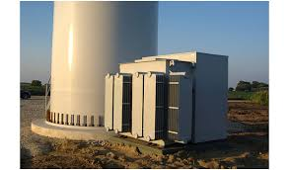
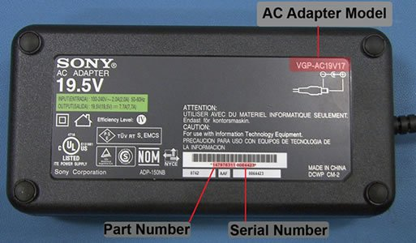
Three-Phase Transformers
Section 9 of transformer notes on website provide only first part of the material in these slides, the rest is covered only in these slides.
Quiz Thursday over HW5 and what we cover today.

Slide 2
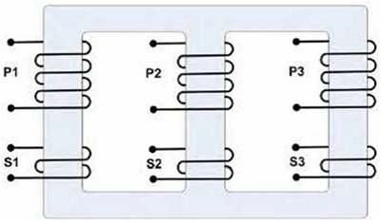
Three-Phase Transformers - Types
Three-phase xfmrs have 6 windings:
  Phases A, B, and C on primary
  Phases a, b, and c on secondary
Two approaches for developing a 3phase xfmr:
One “three-phase bank” on a single core (a single magnetic circuit)
Interconnect 3 single-phase xfmrs

Slide 3
Three-phase banks
One “three-phase bank” on a single core (a single magnetic circuit)
“Core”-type construction
primary and secondary windings are wound outside and surround their leg
“Shell”-type construction
windings pass inside core, so that core forms a shell around the windings.

Slide 4
Three-phase banks
One “three-phase bank” on a single core (a single magnetic circuit)
“Core”-type construction
primary and secondary windings are wound outside and surround their leg
The shell-type requires more ferromagnetic material than does the core-type and so is typically more costly on a per-MVA basis.
However, its mag circuit provides multiple paths for flux to flow; this reduces flux density seen by each leg which is advantageous for short-circuit performance (thermal & mechanical); so shell-types are used more frequently when high capacity is required.
“Shell”-type construction
windings pass inside core, so that core forms a shell around the windings.

Slide 5
3 single-phase banks – connection types
Physical connections
Circuit diagrams
There is no connection between intersecting wires unless there is a “dot” at their intersection.
Each phase of above circuit diagrams contain a winding in them.
From now on, we will simply refer to “3 phase xfmrs” without regards to whether they are a three-phase bank or 3 single phase units. We will usually, however, need to indicate their type of connection (Y-Y, Y-Δ, Δ-Y, or Δ-Δ).

Slide 6
An important concept
For a Y-Y connected 3-phase transformer, the ratio of the line-to-neutral voltages on either side is the same as the ratio of the line-to-line voltages on either side. Likewise, the ratio of the line-currents is the same as the ratio of the phase currents.
Proof:
This means that the ratio of the line-to-line voltages on either side equals the ratio of the line-to-neutral voltages on either side if we can convert the transformer to an “equivalent Y-Y.”
And this means that if we want the ratio of the “equivalent Y-Y”, all we need to get is the ratio of the actual line-to-line voltages!
Fact: Getting a per-phase equivalent cct depends on getting an equivalent Y-Y connected transformer.

Slide 7
Voltage & current transformation ratios
Two concepts:
The voltage transformation ratio for 3-phase xfmrs is always given as the ratio of the line-to-line voltage magnitude on either side, V_{ab1}/V_{ab2}.
The voltage transformation of the phase voltages is always
V_{ϕ1}/ V_{ϕ2} =N₁/N₂ (phase voltages are across the windings).
This is ratio across phases
This is ratio across phases
For Y-Y or Δ-Δ, the ratio of the line-to-line voltages is the ratio of the phase voltages. Likewise:

Slide 8
Per-phase equivalent circuit for Y-Y or Δ-Δ
When analyzing balanced 3-phase ccts with xfmrs, you must obtain the per-phase equivalent cct of the xfmr. The effective turns ratio of this per-phase equivalent xfmr cct will be the ratio of the phase-to-phase voltages for the equivalent Y-Y connected transformer, which will be the same as the ratio of the line-to-line voltages of the actual Y-Y connected transformer.
If the actual connection is Y-Y, then the effective turns ratio is [N₁/N₂]_{eff}=N₁/N₂ of the windings (easy!).
If the actual connection is Δ-Δ, then the effective turns ratio is [N₁/N₂]_{eff}=N₁/N₂ of the windings (easy!).

Slide 9
Per-phase equivalent circuit for Y-Y or Δ-Δ
The “exact” equivalent circuit parameters of a 150-kVA, 2400volt/240volt single-phase transformer are R₁=0.2Ω, R₂=2mΩ, X₁=0.45Ω, X₂=4.5mΩ, R_{c}=10kΩ, and X_{m}=1.55kΩ. R₁, X₁, R_{c}, and X_{m} are given referred to the primary side; R₂ and X₂ are given referred to the secondary side. A company purchases three of these single-phase transformers and connects them in a Y-Y configuration to a three-phase Y-connected load Z_{L}.
  (5 pts) Draw per-phase “exact” equivalent of the circuit (transformer and load) with all elements, except the load, referred to primary side.
  (5 pts) Label all impedance elements on the diagram with their ohmic value (use letters and numerical value).
  (5 pts) Identify on the diagram the turns ratio (N₁/N₂)_{eff} to be used in the per-phase circuit (identify numerical value).
  (5 pts) Label the secondary current referred to the primary, I’₂ (do not need numerical value, just location & directionality).
  (5 pts) Label the voltage across the secondary winding, referred to the primary, E’₂ (do not need numerical value, just location & directionality).
  Would the effective turns ratio to be used in the per-phase circuit change from that identified in (c) if:
    i. the transformers were connected Δ- Δ?
    ii. the transformers were connected Y-Δ?
    iii. the transformers were connected Δ-Y?

Slide 10
Per-phase equivalent circuit for Y-Y or Δ-Δ
(a, b, c, d, e)
(f)
  Would the effective turns ratio to be used in the per-phase circuit change from that identified in (c) if:
    i. the transformers were connected Δ- Δ? No.
    ii. the transformers were connected Y-Δ? Yes.
    iii. the transformers were connected Δ-Y? Yes.

Slide 11
Voltage & current transformation ratios
Two concepts:
The voltage transformation ratio for 3-phase xfmrs is always given as the ratio of the line-to-line voltage magnitude on either side, V_{ab1}/V_{ab2}.
The voltage transformation of the phase voltages is always
V_{ϕ1}/ V_{ϕ2} =N₁/N₂ (phase voltages are across the windings).
For Δ-Y or Y-Δ, the ratio of the line-to-line voltages is not the ratio of the phase voltages. Likewise:
Relative to voltage ratios, current ratios get inverse sqrt(3) but same angle.

Slide 12
Per-phase equivalent circuit for Y-Δ or Δ-Y
When analyzing balanced 3-phase ccts with xfmrs, you must obtain the per-phase equivalent cct of the xfmr. The effective turns ratio of this per-phase equivalent xfmr cct will be the ratio of the phase-to-phase voltages for the equivalent Y-Y connected transformer, which will be the same as the ratio of the line-to-line voltages of the actual Y-Y connected transformer.
If the actual connection is Δ-Y, then this turns ratio is
These are also the turns ratio of the equivalent Y-Y xfmr.
If the actual connection is Y-Δ, then this turns ratio is
These are also the turns ratio of the equivalent Y-Y xfmr.
Observe: Referring voltages and currents gets 30° phase shift and factor of √3; referring impedances does not get phase shift but does have a factor of 3.

Slide 13
Per-phase equivalent circuit for Y-Δ
The “exact” equivalent circuit parameters of a 150-kVA, 2400volt/240volt single-phase transformer are R₁=0.2Ω, R₂=2mΩ, X₁=0.45Ω, X₂=4.5mΩ, R_{c}=10kΩ, and X_{m}=1.55kΩ. R₁, X₁, R_{c}, and X_{m} are given referred to the primary side; R₂ and X₂ are given referred to the secondary side. A company purchases three of these single-phase transformers and connects them in a Y-Δ
configuration to a three-phase Δ-connected load Z_{L}.
  (5 pts) Draw per-phase “exact” equivalent of the circuit (transformer and load) with all elements, except the load, referred to primary side.
  (5 pts) Label all impedance elements on the diagram with their ohmic value (use letters and numerical value).
  (5 pts) Identify on the diagram the turns ratio (N₁/N₂)_{eff} to be used in the per-phase circuit (identify numerical value).
  (5 pts) Label the secondary current referred to the primary, I’₂ (do not need numerical value, just location & directionality).
  (5 pts) Label the voltage across the secondary winding, referred to the primary, E’₂ (do not need numerical value, just location & directionality).

Slide 14
Per-phase equivalent circuit for Y-Δ
(a, b, c, d, e)
17.32∟30°:1
Observe here that for referring impedances we need only the magnitude of the effective turns ratio (and not phase). Reason for this is shown on Slide 12.

