Slide 1
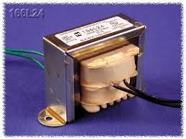
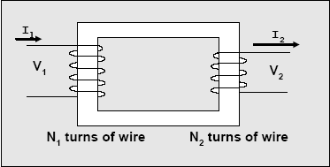
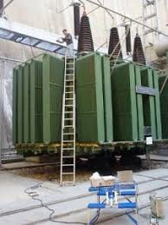
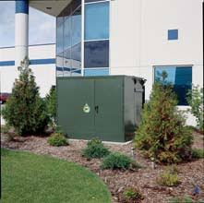
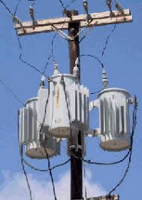
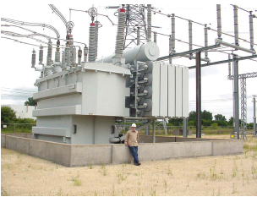
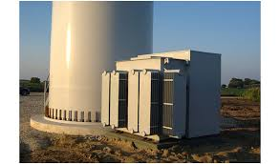
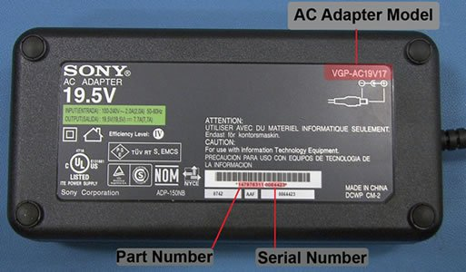
Power Transformers
Download/read notes on transformers from website.
Download HW4 on website; I will give due-date next week.
Read Chapters 5 and 6 in Kirtley’s text

Slide 2
Power Industry Uses of Transformers
Instrument Transformers:
Current (CT) and potential (PT) transformers: Step down quantity from power system level (gen, trans, dist) so that quantity is compatible at the instrument level, in order to perform protective relaying (you need to take EE 457 to learn about these).
Power Transformers:
Step up voltage from generator to transmission (GSU)
Step down voltage from transmission to distribution primary levels
Step down voltage from distribution primary to distribution secondary
Interconnecting different system voltage levels in HV and EHV systems

Slide 3
Magnetic circuits
Ampere’s Law:
➔Line integral of mag fld intensity about a closed path equals current enclosed.
Apply it here:
Make the path the dotted line.
H is along direction of ϕ, which is same direction as dL
Let l be length of dotted path, therefore LHS is Hl
RHS is current enclosed: Ni.

Slide 4
Magnetic circuits
Recall

Slide 5
Magnetic circuits
Define: magnetomotive force (MMF):
reluctance:
This looks suspiciously familiar. What does this remind you of?
Write down the relations for F, R, and ϕ.

Slide 6
Magnetic circuits
Units:
ϕ webers (kg-m²/sec²/Amp)
B webers/m²=tesla
F ampere-turns
R amperes/weber
μ = μ_{r}μ₀=μ_{r}(4π×10⁻⁷)Ntn/Amp²

Slide 7
Example
Compute ϕ.

Slide 8
Example

Slide 9
Inductance
Recall:
Define:
Flux Linkage:
Self Inductance:

Slide 10
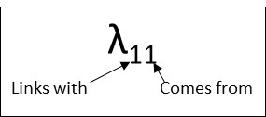
Inductance
Some notation that will be useful later:
The self inductance L₁₁ is the ratio of
the flux from coil 1 linking with coil 1, λ₁₁
to the current in coil 1, i₁
Linking? … Passing through the coil interior

Slide 11
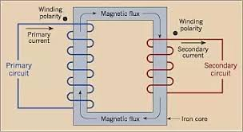
Inductance
Flux not linking
Flux linking

Slide 12
Inductance
Some notation that will be useful later:
The self inductance L₁₁ is the ratio of
the flux from coil 1 linking with coil 1, λ₁₁
to the current in coil 1, i₁
Inductance L₁₁? The ability of a current in coil 1, i₁, to create flux φ₁₁ that links with coil 1.

Slide 13
Inductance
To make large self-inductance, we need to
make N₁, μ, and A large;
make l small
And so a large L₁₁ results from
many turns (N₁)
large μ (core made of iron)
large cross section (A)
compact construction (small l)

Slide 14
And so a large L₁₁ results from
many turns (N₁)
large μ (core made of iron)
large cross section (A)
compact construction (small l)
Recalling
we see that a magnetic circuit characterized by a large self-inductance will have a small magnetic path reluctance.

Slide 15
Example
Example 2: Compute the self-inductance of the magnetic circuit given in Ex 1.
We just found that
Alternative derivation:

Slide 16
Example
Example 2: Compute the self-inductance of the magnetic circuit given in Ex 1.
From Ex 1, N₁=100 and

Slide 17
Mutual inductance
φ
i₂
i₁
N₁
N₂
From our self-inductance work, we express for each coil
where we recall the self inductance L_{jj} is the ratio of
the flux from coil j linking with coil j, λ_{jj}
to the current in coil j, i_{j}

Slide 18
Mutual inductance
λ_{jj}
The self inductance L_{jj} is the ratio of
the flux from coil j linking with coil j, λ_{jj}
to the current in coil j, i_{j}
λ_{ij}
Likewise, mutual inductance L_{ij} is the ratio of
the flux from coil j linking with coil i, λ_{ij}
to the current in coil j, i_{j}

Slide 19
Mutual inductance
λ₁₂
Mutual inductance L₁₂ is the ratio of
the flux from coil 2 linking with coil 1, λ₁₂
to the current in coil 2, i₂
λ₂₁
Mutual inductance L₂₁ is the ratio of
the flux from coil 1 linking with coil 2, λ₂₁
to the current in coil 1, i₁

Slide 20
Mutual inductance
Recall that
Likewise
And the mutual inductances become

Slide 21
Mutual inductance
Assumption: All flux produced by each coil links with the other coil. This implies there is no leakage flux.
This leakage flux is assumed to be zero.
In reality there is some leakage flux, it is quite small because the iron has much less reluctance than the air
φ
i₂
i₁
N₁
N₂
With no leakage flux, it must be the case that all flux developed by one coil must completely link with the other coil.

Slide 22
Mutual inductance
If all flux developed by one coil completely links with the other coil, then
the flux from coil 2 linking with coil 1 is equal to the flux from coil 2 linking with coil 2, i.e.,
the flux from coil 1 linking with coil 2 is equal to the flux from coil 1 linking with coil 1,
Substitute above into slide 20 inductance expressions:

Slide 23
Mutual inductance
Comparing the above leads to
This says that the mutual inductances are reciprocal:
The ratio of
  flux from coil 2 linking with coil 1, λ₁₂, to i₂
is the same as the ratio of
  flux from coil 1 linking with coil 2, λ₂₁, to i₁

Slide 24
Mutual inductance
We showed on slide 14 that
Solve for N₁ and N₂:
Substitute into slide 22 mutual inductance expression:

Slide 25
Mutual inductance
It is conventional to denote mutual inductance as M:
Mutual inductance gives the ratio of:
flux from coil k linking with coil j, λ_{jk}
to the current in coil k, i_{k},

Slide 26
Polarity & dot convention for coupled ccts
φ₁₁
φ₂₁
i₂
i₁
N₁
N₂
e₂
v₁
e₁
Open cct
DC voltage
We have a dial to increase v₁
Coil 1: very small resistance so in steady-state, i₁≠∞
Increase voltage v₁ to some higher value
➔ current i₁ increases with time
➔ flux from coil 1, φ₁₁, increases with time
➔ flux linkages λ₁₁ increases with time.
Who speaks when you have dλ/dt (=d(Nϕ)/dt)≠0?

Slide 27
Polarity & dot convention for coupled ccts
φ₁₁
φ₂₁
i₂
i₁
N₁
N₂
e₂
v₁
e₁
Who speaks when you have dλ/dt (=d(Nϕ)/dt)≠0?
Faraday! ➔
But what about the sign of the right-hand-side (RHS)? Is it positive or negative?

Slide 28
Polarity & dot convention for coupled ccts
φ₁₁
φ₂₁
i₂
i₁
N₁
N₂
e₂
v₁
e₁
But what about the sign of the right-hand-side (RHS)? Is it positive or negative?
The sign of RHS is positive because self-induced voltage across a coil is always positive at terminal the current enters, & e₁ is defined positive at this terminal.
If e₁ would have been defined negative at terminal in which the current entered, then sign of RHS would be negative.

Slide 29
Polarity & dot convention for coupled ccts
φ₁₁
φ₂₁
i₂
i₁
N₁
N₂
e₂
v₁
e₁
If e₁ would have been defined negative at terminal in which the current entered, then sign of RHS would be negative.

Slide 30
Polarity & dot convention for coupled ccts
φ₁₁
φ₂₁
i₂
i₁
N₁
N₂
e₂
v₁
e₁
Now consider coil 2… it sees same flux that coil 1 sees which we denote by φ₂₁ (and correspondingly, the flux linkages are denoted as λ₂₁). Considering our action of using the dial to increase v₁, we again have, by Faraday’s Law,
Is the sign of RHS positive or negative?

Slide 31
Polarity & dot convention for coupled ccts
φ₁₁
φ₂₁
i₂
i₁
N₁
N₂
e₂
v₁
e₁
Is the sign of RHS positive or negative?
That is, how do we know which of below are correct?

Slide 32
Polarity & dot convention for coupled ccts
φ₁₁
φ₂₁
i₂
i₁
N₁
N₂
e₂
v₁
e₁
That is, how do we know which of below are correct?
Alternatively: Does assumed e₂ polarity match actual polarity of voltage induced by changing current i₁?
If yes, we choose positive sign. If not, we choose negative sign.

Slide 33
Polarity & dot convention for coupled ccts
φ₁₁
φ₂₁
i₂
i₁
N₁
N₂
e₂
v₁
e₁
That is, how do we know which of below are correct?
Use Lenz’s Law: induced voltage e₂ must be in a direction so as to establish a current in a direction to produce a flux opposing the change in flux that produced e₂.
See www.khanacademy.org/science/physics/magnetic-forces-and-magnetic-fields/magnetic-flux-faradays-law/v/lenzs-law

Slide 34
Polarity & dot convention for coupled ccts
φ₁₁
φ₂₁
i₂
i₁
N₁
N₂
e₂
v₁
e₁
When e₁ increases, i₁ increases, and by the right-hand-rule (RHR), φ₂₁ increases.
Assumed polarity of e₂ causes current to flow into the load in direction shown. How do we know e₂ polarity is correct?
Use Lenz’s Law: induced voltage e₂ must be in a direction so as to establish a current in a direction to produce a flux opposing the change in flux that produced e₂.

Slide 35
Polarity & dot convention for coupled ccts
φ₁₁
φ₂₁
i₂
i₁
N₁
N₂
e₂
v₁
e₁
We know e₂ polarity is correct because RHR says that a current in direction of i₂ causes flux in direction opposite to the direction of the φ₂₁ increase.
This is “the φ₂₁ increase,” i.e., it is “the change in flux that produced e₂” and not necessarily the direction of φ₂₁ itself (in this particular case, “the φ₂₁ increase” is the same as the direction of φ₂₁ itself).

Slide 36
Polarity & dot convention for coupled ccts
φ₁₁
φ₂₁
i₂
i₁
N₁
N₂
e₂
v₁
e₁
We know e₂ polarity is correct because RHR says that a current in direction of i₂ causes flux in direction opposite to the direction of the φ₂₁ increase.
Question: How might we obtain a different answer?

Slide 37
Polarity & dot convention for coupled ccts
φ₁₁
φ₂₁
i₁
N₁
N₂
e₂
v₁
e₁
i₂
There are two ways.
First way: Switch sign of e₂, as above. Here, we also must switch current i₂ direction, because, in using Lenz’s Law, the i₂ direction must be consistent with the e₂ direction.
Here, the current i₂, by RHR, produces a flux in the same direction as the φ₂₁ increase, in violation of Lenz’s Law:

Slide 38
Polarity & dot convention for coupled ccts
φ₁₁
φ₂₁
i₂
i₁
N₁
N₂
e₂
v₁
e₁
There are two ways.
Second way: Switch the sense of the coil 2 wrapping, while keeping the directions of e₂ and i₂ as they were originally.
The current i₂, by RHR, produces flux in same direction as the φ₂₁ increase. Therefore

Slide 39
Polarity & dot convention for coupled ccts
φ₁₁
φ₂₁
i₂
i₁
N₁
N₂
e₂
v₁
e₁
Let’s articulate what we are trying to do:
We want to know which secondary terminal, when defined with positive voltage polarity, results in using Faraday’s Law with a positive sign.
On paper, there are 2 approaches for doing this.
1. Draw the physical winding go through Lenz’s Law analysis as we have done in previous slides.

Slide 40
Polarity & dot convention for coupled ccts
φ₁₁
φ₂₁
i₂
i₁
N₁
N₂
e₂
v₁
e₁
On paper, there are 2 approaches for doing this.
Draw the physical winding; go through Lenz’s Law analysis as we have done in previous slides.
Use the “dot convention.”
In dot convention, we mark 1 terminal on each coil so that
when e₂ is defined positive at dotted terminal of coil 2
and i₁ is into the dotted terminal of coil 1, then

Slide 41
Example
Ex 3: Express the voltage for each pair of coils below.
From previous slide: In dot convention, we mark 1 terminal on each coil so that
when e₂ is defined positive at dotted terminal of coil 2, and
i₁ is into the dotted terminal of coil 1, then
i₁
3
3
e₂
i₁
(1) Recall the sign on the RHS is determined not by direction of flux flow (or current i₁ flow) but by direction of change in flux flow (or current i₁ flow). (2) Our above dot convention seems to depend only on direction of current (i₁) flow and not on direction of change in current flow.
3
3
e₂
i₁
3
3
e₂
Question: How can our dot convention give correct sign if it does not account for direction of change in current i₁ flow?
i₁
Answer: It does account for direction of change in current flow in that the above e₂ equation implies positive direction of change (di₁/dt is positive).
3
3
e₂

Slide 42
A second question
So far, we have focused on answering this question:
➔Given dotted terminals, how to determine the sign to use in Faraday’s law?
A second question:
➔If you are given the physical layout, how do you obtain the dot-markings?
Approach 1: Use Lenz’s Law and the right-hand-rule (RHR) to determine if a defined voltage direction at the secondary produces a current in the secondary that generates flux opposing the flux change that caused that voltage. (This is actually a conceptual summary of Approach 2 below.)

Slide 43
A second question
➔If you are given the physical layout, how do you obtain the dot-markings?
Approach 2: Do it by steps. (This is actually a step-by-step articulation of the first approach.)
Arbitrarily pick a terminal on one side and dot it.
Assign a current into the dotted terminal.
Use RHR to determine flux direction for current assigned in step 2.
Arbitrarily pick a terminal on the other side and assign a current out of (into) it.
Use RHR to determine flux direction for current assigned in Step 4.
Compare the direction of the two fluxes (the one from Step 3 and the one from Step 5). If the two flux directions are opposite (same), then the terminal chosen in Step 4 is correct. If the two flux directions are same (opposite), then the terminal chosen in Step 4 is incorrect – dot the other terminal.
This approach depends on the following principle (consistent with words in italics in above steps): Current entering one dotted terminal and leaving the other dotted terminal should produce fluxes inside the core that are in opposite directions.
An alternative statement of this principle is as follows (consistent with words in underline bold in above steps): Currents entering the dotted terminals should produce fluxes inside the core that are in the same direction.

Slide 44
Example
Example 4: Determine the dotted terminals for the configuration below, and then write the relation between i₁ and e₂.
Remember: Current entering one dotted terminal and leaving the other dotted terminal should produce fluxes inside the core that are in opposite directions.
i₁
N₁
N₂
e₂

Slide 45
Example
Example 4: Determine the dotted terminals for the configuration below, and then write the relation between i₁ and e₂.
Solution: Steps 1-3:
φ₁₁
i₁
N₁
N₂
e₂
Remember: Current entering one dotted terminal and leaving the other dotted terminal should produce fluxes inside the core that are in opposite directions.
Steps 4-6:
φ₁₁
i₁
N₁
N₂
e₂
φ₂₂
i₂

Slide 46
Example
Example 4: Determine the dotted terminals for the configuration below, and then write the relation between i₁ and e₂.
Solution:
Now write equation for the coupled circuits. Recall that in dot convention, we mark 1 terminal on either side of transformer so that
when e₂ is defined positive at the dotted terminal of coil 2 and
i₁ is into the dotted terminal of coil 1, then
Here, however, although i₁ is into the coil 1 dotted terminal, e₂ is defined negative at the coil 2 dotted terminal. Therefore
φ₁₁
i₁
N₁
N₂
e₂
φ₂₂
i₂

Slide 47
Example
Example 4: Determine the dotted terminals for the configuration below, and then write the relation between i₁ and e₂.
Solution: there is another way we could have solved this problem, as follows
Steps 1-3:
N₁
N₂
e₂
i'₁
φ₁₁
Steps 4-6:
i₂
N₁
N₂
e₂
i'₁
φ₁₁
φ₂₂

Slide 48
Example
Example 4: Determine the dotted terminals for the configuration below, and then write the relation between i₁ and e₂.
Solution: There is another way we could have solved this problem!
Write equation for the coupled circuits. Recall that in dot convention, we mark 1 terminal on either side of transformer so that
when e₂ is defined positive at the dotted terminal of coil 2 and
i₁ is into the dotted terminal of coil 1, then
Here, i’₂ is into the coil 1 dotted terminal, e₂ is defined positive at the coil 2 dotted terminal. Therefore
i₂
N₁
N₂
e₂
If, however, we wanted to express e₂ as a function of i₁ (observing that i₁=-i'₁) then we would have
i'₁
φ₁₁
φ₂₂

Slide 49
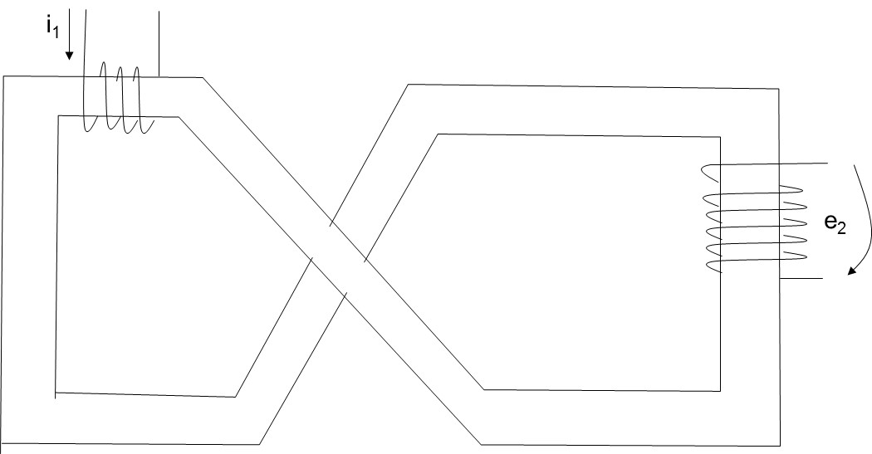
Example
Example 5: For the configuration below, determine the dotted terminals and write the relation between i₁ and e₂.
Note: Problems 1a,b,c,d are very similar to this one.

Slide 50
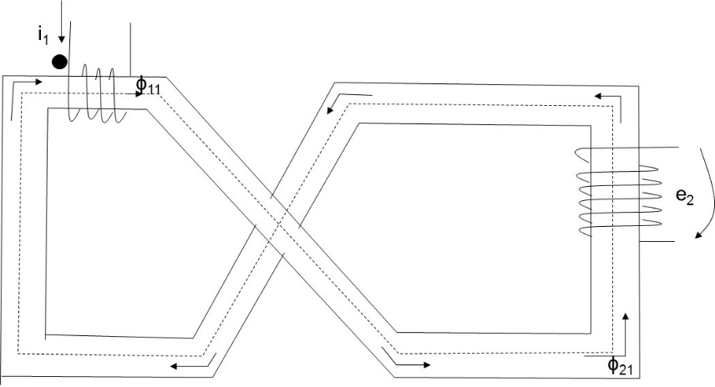
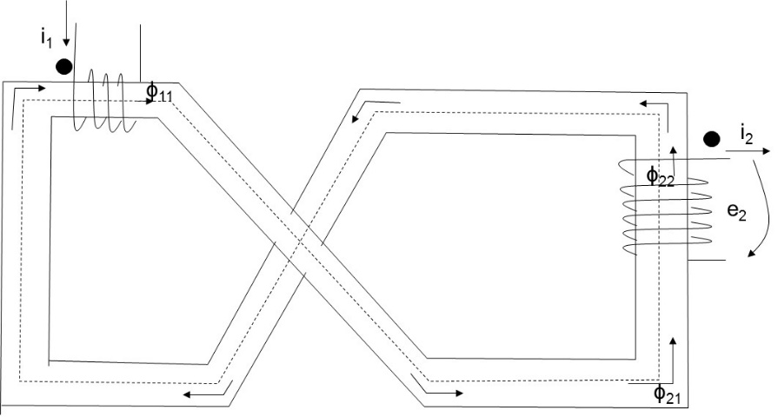
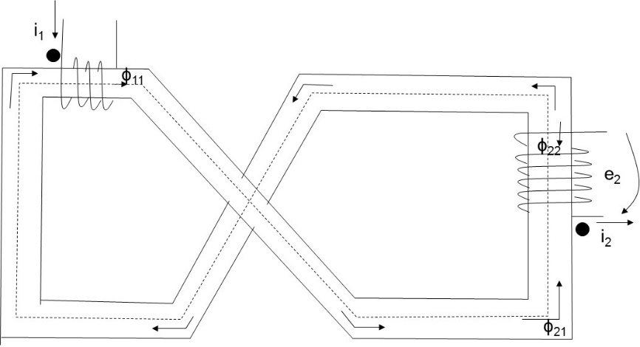
Example
Example 5: For the configuration below, determine the dotted terminals and write the relation between i₁ and e₂.
Solution:
Steps 1-3:
Steps 4-6: Here we arbitrarily assign dot to upper terminal of coil 2; then, with i₂ out of this dotted terminal, we use RHR to determine flux φ₂₂ is in same direction as coil 1 flux. This means our choice of coil 2 terminal location dot is wrong.
Therefore we know dot must be at other terminal, and the below shows clearly this is the case, since the flux from coil 2, φ₂₂, is opposite to the flux from coil 1, φ₂₁.

Slide 51
Example
Example 5: For the configuration below, determine the dotted terminals and write the relation between i₁ and e₂.
Solution:
Now we can write the equation for e₂. Recall that in the dot convention, we mark one terminal on either side so that
when e₂ is defined positive at the dotted terminal of coil 2 and
i₁ is into the dotted terminal of coil 1, then

Slide 52
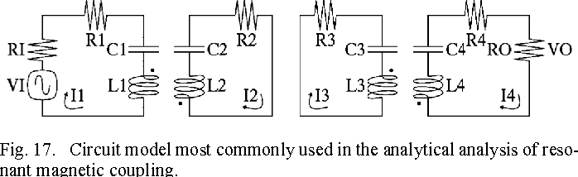
Writing circuit equations for coupled coils
We have so-far focused on transformers or similar circuits having magnetic coupling between coils. We may also encounter other kinds of circuits having elements that are magnetically coupled.
Example
Example: In this paper, the feasibility of resonant electrical coupling as a wireless power transfer technique is studied.
Published 2015 in IEEE Transactions on Microwave Theory and…
We are well-positioned to handle such circuits by combining our (new) knowledge of the dot convention with our (old) knowledge of circuit analysis.
Issue: When we write a voltage equation, we must account for
the self-induced voltage in an inductor from its own current
as well as any mutually-induced voltage in the inductor from a current in a coupled coil.

Slide 53
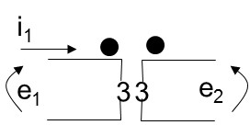
Writing circuit equations for coupled coils
Consider below circuit, where there may be currents in both windings:
Let’s define λ₁ as the sum of
λ₁₁, the flux from coil 1 seen by coil 1
λ₁₂, the flux from coil 2 seen by coil 1.
Therefore:
What does Faraday’s law say about e₁ as a function of λ₁?
But from slides 12 and 25:

Slide 54
Writing circuit equations for coupled coils
Consider below circuit, where there may be currents in both windings:
But wait… we have equated the sum of the derivatives to e₁, where e₁ has a certain assumed polarity. How
can we be sure that the sign of both of those derivative terms is indeed positive? Until we can be sure of that, I want to write the above equation as:

Slide 55
Writing circuit equations for coupled coils
Consider below circuit, where there may be currents in both windings:
Let’s begin with the first (“self”) term (it is easiest!):
Rule for determining the sign of the self term: The polarity of the self term is determined entirely by the direction of the current i₁:
when this current is into the positive terminal (as defined by the polarity of e₁), then the sign of the self term is positive;
when this current is out of the positive terminal (as defined by the polarity of e₁), then the sign of the self term is negative.

Slide 56
Writing circuit equations for coupled coils
Consider below circuit, where there may be currents in both windings:
Now we need to determine how to know whether to add or subtract the mutual term from the self term. We should not be surprised to learn that we will make this determination using the dot convention.
Rule for determining the sign of the mutual term: Assume both coils correctly dotted.
Choose reference current directions for each coil (if not chosen for you).
Apply following to determine reference polarity of voltage induced by mutual effects:
  If reference current direction enters dotted terminal of a coil, the reference polarity of voltage that it induces in other coil is positive at its dotted terminal.
  If reference current direction leaves dotted terminal of a coil, the reference polarity of voltage that it induces in other coil is negative at its dotted terminal.

Slide 57
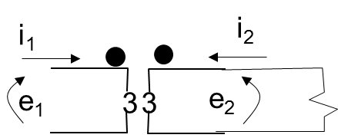
Writing circuit equations for coupled coils
Example 6: Express voltages e₁ and e₂ as a function of currents i₁and i₂ in the following circuit.
Then, what is e₂?
First, let’s express e₁. Here, we observe two things:
i₁ enters the positive terminal, and therefore the self term is positive.
i₂ enters the dotted terminal of coil 2, therefore the reference polarity of the voltage it induces in coil 1 is positive at its dotted terminal, and its dotted terminal is the positive terminal.

Slide 58
Writing circuit equations for coupled coils
Example 6: Express voltages e₁ and e₂ as a function of currents i₁and i₂ in the following circuit.
Now let’s express e₂. Here, we observe two things:
i₂ enters the positive terminal, and therefore the self term is positive.
i₁ enters the dotted terminal of coil 1, therefore the reference polarity of the voltage it induces in coil 2 is positive at its dotted terminal, and its dotted terminal is the positive terminal.

Slide 59
Writing circuit equations for coupled coils
Example 6: Express voltages e₁ and e₂ as a function of currents i₁and i₂ in the following circuit.

Slide 60
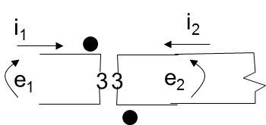
Writing circuit equations for coupled coils
Example 7: Express voltages e₁ and e₂ as a function of currents i₁and i₂ in the following circuit.
Let’s express e₁. Here, we observe two things:
i₁ enters the positive terminal, therefore the self term is positive.
i₂ leaves the dotted terminal of coil 2, therefore the reference polarity of the voltage it induces in coil 1 is negative at its dotted terminal, and its undotted terminal is the positive terminal.

Slide 61
Writing circuit equations for coupled coils
Example 7: Express voltages e₁ and e₂ as a function of currents i₁and i₂ in the following circuit.
Now let’s express e₂. Here, we observe two things:
i₂ enters the positive terminal, and therefore the self term is positive.
i₁ enters the dotted terminal of coil 1, therefore the reference polarity of the voltage it induces in coil 2 is positive at its dotted terminal, but its dotted terminal is the negative terminal.

Slide 62
Writing circuit equations for coupled coils
Example 7: Express voltages e₁ and e₂ as a function of currents i₁and i₂ in the following circuit.

Slide 63
Writing circuit equations for coupled coils
HW problem 4: Write a set of mesh current equations that describe the circuit below in terms of i₁, i­₂, and i₃.
Number of nodes=4;
number of branches where current not known=b=6
b-(n-1)=6-3=3.
We need three mesh equations.
We write these for the three “windows” in the cct. above.

Slide 64
Writing circuit equations for coupled coils
HW problem 4: Write a set of mesh current equations that describe the circuit below in terms of i₁, i­₂, and i₃.
Focus on top loop. Apply KVL starting from Node 1 moving clockwise.
With i₂ in direction shown, we assume voltage polarity of 4H inductor is defined positive at its dotted end. With i₂ into the 4H inductor, the self term is positive. But the KVL moves across 4H inductor from positive to negative, therefore the first term in the mesh equation is negative.
The mutually induced term of 4H inductor is also negated by this KVL movement. Also, observe the coupled current i₁ is into dotted side of 9H inductor, but i₃ is out of it. So:
Node 1
The rest of the top loop is easy.

Slide 65
Writing circuit equations for coupled coils
HW problem 4: Write a set of mesh current equations that describe the circuit below in terms of i₁, i­₂, and i₃.
Focus on left loop. Apply KVL starting from Node 2 moving clockwise.
The first two parts are easy.
The next part is the self-induced term of the 9H inductor. With i₁ in direction shown, we assume voltage polarity of 9H inductor is defined positive at its dotted end. With i₁ into the 9H inductor, the self term is positive. But the KVL moves across 9H inductor from positive to negative, therefore the self term in the mesh equation is negative. Note it is comprised of current i₁ into the dot (positive) and i₃ out of the dot (negative)
Node 2
We still need the mutual term from the 4H inductor. It would be positive since i₂ is into the dot of the 4 H inductor and out voltage is defined positive at the dot of the 9H inductor, but it is also influenced by the KVL direction of movement.

Slide 66
Writing circuit equations for coupled coils
HW problem 4: Write a set of mesh current equations that describe the circuit below in terms of i₁, i­₂, and i₃.

Slide 67
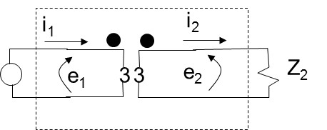
Development of turns ratio relations for ideal xfmr
Ideal xfmr: No Losses, infinite permeability.
Objective: See how
i₁ and i₂ are related
e₁ and e₂ are related
in the steady-state.
Dashed box: The “ideal” xfmr
N₁ N₂
Voltage equation for left-hand-loop:
Remember:
Self term: when same-side current enters its positive terminal, self term is positive.
Mutual term: when opposite-side current enters its dotted terminal, mutual term is positive at its dotted terminal.
Voltage equation for right-hand-loop:
So we have equations (*) and (**):

Slide 68
Development of turns ratio relations for ideal xfmr
Ideal xfmr: No Losses, infinite permeability.
Objective: See how
i₁ and i₂ are related
e₁ and e₂ are related
in the steady-state.
Dashed box: The “ideal” xfmr
N₁ N₂
Important concept (see xfmr HW prob #6):
Differential equations: characterize electrical relationships for
  any time periods
  under any type of excitation.
Phasor equations: characterize electrical relationships for
  time periods where conditions are in a steady-state
  under sinusoidal excitation
We may convert differential equations to phasor equations.
How?...

Slide 69
Development of turns ratio relations for ideal xfmr
Ideal xfmr: No Losses, infinite permeability.
Objective: See how
i₁ and i₂ are related
e₁ and e₂ are related
in the steady-state.
Dashed box: The “ideal” xfmr
N₁ N₂
We may convert differential equations to phasor equations.
How?... Observe what we get when we differentiate a sinusoid:
Time Domain
Phasor Domain
i(t)=|I|sinωt
I=|I|∠0
Original function scaled by ω; rotated forward by 90°.
di/dt=|I|ωcosωt
ω|I|∠90
di/dt=|I|ωsin(ωt+90)
=ω|I|∠0∠90=jωI
Differentiation in time domain is multiplication by jω in phasor (Fourier) domain! Let’s use this to transform (*) and (**)…

Slide 70
Development of turns ratio relations for ideal xfmr
Ideal xfmr: No Losses, infinite permeability.
Objective: See how
i₁ and i₂ are related
e₁ and e₂ are related
in the steady-state.
Dashed box: The “ideal” xfmr
N₁ N₂
Recall:
Assume: μ is very large (infinite permeability).
Then R is very small.
Then L₂ is very large.
Then |jωL₂|>>|Z₂|.
So (#) becomes

Slide 71
Development of turns ratio relations for ideal xfmr
Ideal xfmr: No Losses, infinite permeability.
Objective: See how
i₁ and i₂ are related
e₁ and e₂ are related
in the steady-state.
Dashed box: The “ideal” xfmr
N₁ N₂
Recall, slide 25:
Recall, slide 14:
Substitution into (!!)
ratio of currents in coils on either side of an ideal transformer is in inverse proportion to the ratio of the coils’ turns

Slide 72
Development of turns ratio relations for ideal xfmr
Ideal xfmr: No Losses, infinite permeability.
Objective: See how
i₁ and i₂ are related
e₁ and e₂ are related
in the steady-state.
Dashed box: The “ideal” xfmr
N₁ N₂
Substitute (#) into (&); obtain common denominator; simplify:
Use

Slide 73
Development of turns ratio relations for ideal xfmr
Ideal xfmr: No Losses, infinite permeability.
Objective: See how
i₁ and i₂ are related
e₁ and e₂ are related
in the steady-state.
Dashed box: The “ideal” xfmr
N₁ N₂
Use |jωL₂|>>|Z₂|.
Recall, slide 14:
From (#*)
Use Z₂I₂=E₂:
ratio of voltage across coils on either side of an ideal transformer is in proportion to the ratio of the coils’ turns
Substitute:

Slide 74
Development of turns ratio relations for ideal xfmr
Ideal xfmr: No Losses, infinite permeability.
Objective: See how
i₁ and i₂ are related
e₁ and e₂ are related
in the steady-state.
Dashed box: The “ideal” xfmr
N₁ N₂
ratio of voltage across coils on either side of an ideal transformer is in proportion to the ratio of the coils’ turns
ratio of currents in coils on either side of an ideal transformer is in inverse proportion to the ratio of the coils’ turns

Slide 75
Power for ideal xfmr
Ideal xfmr: No Losses, infinite permeability.
Objective: Does ideal “power transformer” transform power?
Dashed box: The “ideal” xfmr
N₁ N₂
Preliminary comment: This discussion has nothing to do with losses in a real xfmr. We are still considering an ideal xfmr (no losses).
Express power on both sides of transformer:
Substitute expressions for E₂ and I₂ into expression for S₂:

Slide 76
Power for ideal xfmr
Ideal xfmr: No Losses, infinite permeability.
Objective: Does ideal “power transformer” transform power?
Dashed box: The “ideal” xfmr
N₁ N₂
We have just proved that, for an ideal transformer, S₁=S₂, enabling us to conclude that “power transformers” do not transform power. It is a good thing, because doing so would result in a violation of the conservation of energy (otherwise known as the first law of thermodynamics), since “power transformation” would imply that we could provide one side with a certain amount of power P₁ and get out a greater amount of power P₂ on the other side. If we allowed, then, such a device to operate for an amount of time T, the output energy P₂T would be greater than the input energy P₁T, thus, the violation.
IDEAL TRANSFORMER

Slide 77
Referring Quantities
Objective: Can we somehow “move” Z₂ to the primary side of the ideal xfmr and then do all analysis there, so that our analysis need not have to account for the effect of the ideal xfmr?
N₁ N₂
Primary side
Secondary side
Closely-related question: What impedance is “seen” looking into the primary terminals of the ideal xfmr? In other words, what is Z₁=E₁/I₁?
From our turns ratio relations:
Substitution into the expression for Z₁:
Answer to closely-related question: Looking into the primary terminals of an ideal xfmr supplying Z₂ across its secondary terminals, we “see” the impedance Z₂ scaled by the turns ratio squared.

Slide 78
Referring Quantities
Objective: Can we somehow “move” Z₂ to the primary side of the ideal xfmr and then do all analysis there, so that our analysis need not have to account for the effect of the ideal xfmr?
N₁ N₂
Primary side
Secondary side
Closely-related question: What impedance is “seen” looking into the primary terminals of the ideal xfmr? In other words, what is Z₁=E₁/I₁?
IDEAL TRANSFORMER
These equations relate currents, voltages, impedances, and powers that
exist on one side of the transformer, i.e., the secondary (primary), to
corresponding currents, voltages, impedances, and powers, that exist on the other side of the transformer, i.e., the primary (secondary).

Slide 79
Referring Quantities
Objective: Can we somehow “move” Z₂ to the primary side of the ideal xfmr and then do all analysis there, so that our analysis need not have to account for the effect of the ideal xfmr?
N₁ N₂
Primary side
Secondary side
Closely-related question: What impedance is “seen” looking into the primary terminals of the ideal xfmr? In other words, what is Z₁=E₁/I₁?
IDEAL TRANSFORMER
Relating quantities on one side of the xfmr to quantities on the other side is fine, but does that accomplish our above main objective?
Can we “move” Z₂ to the primary side of the ideal xfmr?
I think we can, based on our answer to the “closely-related question” if we move it scaled by the turns ratio squared. Let’s see how this looks…

Slide 80
Referring Quantities
Objective: Can we somehow “move” Z₂ to the primary side of the ideal xfmr and then do all analysis there, so that our analysis need not have to account for the effect of the ideal xfmr?
N₁ N₂
Primary side
Secondary side
Closely-related question: What impedance is “seen” looking into the primary terminals of the ideal xfmr? In other words, what is Z₁=E₁/I₁?
Equivalent ccts
Write Ohm’s law on primary side:
i₁
e₁
What is this telling us? It is taking the answer to the “closely related question” (which is that we “see” Z₁=(N₁/N₂)² Z₂ from the primary side) and showing that it is equivalent to “seeing” Z₂ looking into the load terminals from the secondary.

Slide 81
Referring Quantities
Objective: Can we somehow “move” Z₂ to the primary side of the ideal xfmr and then do all analysis there, so that our analysis need not have to account for the effect of the ideal xfmr?
N₁ N₂
Primary side
Secondary side
Closely-related question: What impedance is “seen” looking into the primary terminals of the ideal xfmr? In other words, what is Z₁=E₁/I₁?
What is this telling us? It is taking the answer to the “closely related question” (which is that we “see” Z₁=(N₁/N₂)² Z₂ from the primary side) and showing that it is equivalent to “seeing” Z₂ looking into the load terminals from the secondary.
The point is that we can “see” Z₂ on the primary side, but it looks like Z₁=(N₁/N₂)² Z₂.
This means that the below circuit gives us everything we need to know about primary-side quantities when the secondary side is loaded with Z₂.
This is actually what we set out to achieve in our objective! The circuit to the left is the circuit we need! We have achieved our objective ☺.
e₁

Slide 82
Referring Quantities
N₁ N₂
Primary side
Secondary side
This is actually what we set out to achieve in our objective! The circuit to the left is the circuit we need! We have achieved our objective ☺.
e₁
In fact, in addition to the impedances Z₁ and Z₂, we can say similar things about the voltages and currents.
Z₁=(N₁/N₂)²Z₂ is primary side equivalent of Z₂.
e₁=(N₁/N₂)e₂ is the primary side equivalent of e₂.
i₁=(N₂/N₁)i₂ is the primary side equivalent of i₂.
You can move quantities from secondary side to primary side!
And it works the other way too…
Z₂=(N₂/N₁)²Z₁ is secondary side equivalent of Z₁.
e₂=(N₂/N₁)e₁ is the secondary side equivalent of e₁.
i₂=(N₁/N₂)i₁ is the secondary side equivalent of i₁.
You can move quantities from primary side to secondary side!

Slide 83
Referring Quantities
Notation:
First, observe that subscripts “1” and “2” (for turns, currents, voltages, impedances) tell us whether the quantity actually exists (physically) on the primary side (having subscript of “1”) or the secondary side (having subscript of “2”).
Second, we use unprimed notation, i.e., I₁, E₁, Z₁, and I₂, E₂, Z₂, to denote the quantity represented on the side on which it actually exists. Thus, we say
  I₁, E₁, Z₁ are the current, voltage, and impedance of primary side quantities referred to the primary side, and
  I₂, E₂, Z₂ are the current, voltage, and impedance of secondary side quantities referred to the secondary side.
Third, we use primed notation, i.e., I’’₁, E’’₁, Z’’₁, and I’₂, E’₂, Z’₂, to denote the quantity represented on the opposite side from where it actually exists. Thus, we say
  I’’₁, E’’₁, Z’’₁ are the current, voltage, and impedance of primary side quantities referred to the secondary side, and
  I’₂, E’₂, Z’₂ are the current, voltage, and impedance of secondary side quantities referred to the primary side.

Slide 84
Referring Quantities
Referring quantities from secondary to primary
Referring secondary current to primary
Referring secondary voltage to primary
Referring secondary impedance to primary
Referring quantities from primary to secondary
Referring secondary current to primary
Referring secondary voltage to primary
Referring secondary impedance to primary

Slide 85
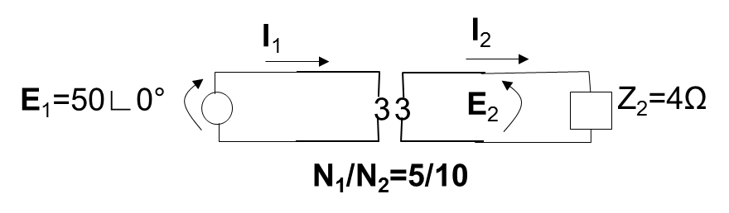
Referring Quantities
Example 8: Find the current I₁ in the primary side of the below circuit.
Solution: We can solve this problem in one of two ways.
Approach 1: Refer all quantities to secondary, solve for I₂; then refer this current to the primary.
Approach 2: Refer all quantities to primary, solve for I₁.
Approach 2:
We begin by referring Z₂ to the primary side via:
So we know what Z’₂ is… it is the secondary impedance Z₂ as seen from the primary side. Let’s redraw the circuit accordingly.

Slide 86
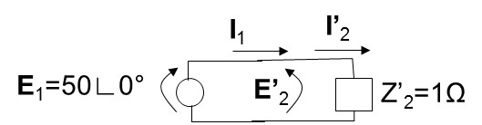
Referring Quantities
Example 8: Find the current I₁ in the primary side of the below circuit.
Solution: We can solve this problem in one of two ways.
Approach 1: Refer all quantities to secondary, solve for I₂; then refer this current to the primary.
Approach 2: Refer all quantities to primary, solve for I₁.
Approach 2:
Use of Ohm’s Law results in
And we are done ☺
But wait…what if we wanted to obtain secondary quantities, such as I₂ and E₂?

Slide 87
Referring Quantities
Example 8: Find the current I₁ in the primary side of the below circuit.
Solution: We can solve this problem in one of two ways.
Approach 1: Refer all quantities to secondary, solve for I₂; then refer this current to the primary.
Approach 2: Refer all quantities to primary, solve for I₁.
Approach 2:
But wait…what if we wanted to obtain secondary quantities, such as I₂ and E₂?
Then we refer I’₂ and E’₂ (which are quantities we obtain on the primary side) back to the secondary side. We already know I’₂; we obtain E’₂ by inspection of the above circuit, observing that it is the same as E₁, i.e., E’₂=50∟0°.

Slide 88
Referring Quantities
Example 8: Find the current I₁ in the primary side of the below circuit.
Solution: We can solve this problem in one of two ways.
Approach 1: Refer all quantities to secondary, solve for I₂; then refer this current to the primary.
Approach 2: Refer all quantities to primary, solve for I₁.
Approach 2:
Check:

Slide 89
Referring Quantities: Example 9
I₁
I_{1w}
I₂
Z₁=1.2+j4.0Ω
0.012+j0.04Ω
3
3
j11,544Ω
3
4
+j2 Ω
80,000Ω
3
3
V₁=
4000∟0°
E₁
E₂
V₂
3
Find I₂ and V₂.
Ideal Xfmr
N₁/N₂=10/1
First, we need to refer all quantities to one side or the other. Because there are more elements on the primary side, it is easier to refer secondary quantities to primary quantities.

Slide 90
Referring Quantities: Example 9
I_{1w}
Z_{2s}= 0.012+j0.04Ω
I₂
I₁
Z₁=1.2+j4.0Ω
3
3
j11,544Ω
3
Z_{2L}=4
+j2 Ω
80,000Ω
3
3
V₁=
4000∟0°
E₁
E₂
V₂
3
Ideal Xfmr
N₁/N₂=10/1
Apply to first impedance (call it Z_{2s}):
Apply to second impedance (call it Z_{2L}):

Slide 91
Referring Quantities: Example 9
I_{1w}
Z’_{2s}= 1.2+j4Ω
I’₂
I₁
Z₁=1.2+j4.0Ω
3
3
j11,544Ω
3
Z’_{2L}= 400
+j200 Ω
80,000Ω
V₁=
4000∟0°
E₁=E’₂
V’₂
3
Now we have a circuit to solve. Recall our goal is to find I₂ & V_{2.} I am going to do this as follows:
Get Z_{eq} =80,000//j11,544//(401.2+j204) (parallel combination)
Get I₁=V₁/[Z₁+Z_{eq}].(Ohm’s law)
Use KVL or voltage division to get E’₂
Get I_{1w}=I’₂=E’₂/[Z’_{2s}+Z’_{2L}] (Ohm’s law)
Get V’₂=I’₂[Z’_{2L}] (Ohm’s law)
Refer I’₂ and V’₂ back to the secondary (turns ratio)

Slide 92
Referring Quantities: Example 9
I_{1w}
Z’_{2s}= 1.2+j4Ω
I’₂
I₁
Z₁=1.2+j4.0Ω
3
3
j11,544Ω
3
Z’_{2L}= 400
+j200 Ω
80,000Ω
V₁=
4000∟0°
E₁=E’₂
V’₂
3
Get Z_{eq} =80,000//j11,544//(401.2+j204). This is a parallel combination of the 80,000Ω resistor, the j11,544Ω inductor, and the series combination Z’_{2a}+Z’_{2L}, as indicated by the dotted arrows above. Recalling the parallel combination of three impedances is given by

Slide 93
Referring Quantities: Example 9
I₁
Z₁=1.2+j4.0Ω
3
V₁=
4000∟0°
E₁=E’₂
3
Get I₁=V₁/[Z₁+Z_{eq}]. This is just an application of Ohm’s law
Comment: We really don’t need I₁, because we can get E₁=E’₂ (step 3) by voltage division. But if you want to perform step 3 by KVL, we do need I₁.

Slide 94
Referring Quantities: Example 9
I₁
Z₁=1.2+j4.0Ω
3
V₁=
4000∟0°
E₁=E’₂
3
Use KVL or voltage division to get E’₂
I will first do it by KVL:
Now do it by voltage division:

Slide 95
Referring Quantities: Example 9
I_{1w}
Z’_{2s}= 1.2+j4Ω
I’₂
I₁
Z₁=1.2+j4.0Ω
3
3
j11,544Ω
3
Z’_{2L}= 400
+j200 Ω
80,000Ω
V₁=
4000∟0°
E₁=E’₂
V’₂
3
Get I_{1w}=I’₂=E’₂/[Z’_{2s}+Z’_{2L}] (Ohm’s law).

Slide 96
Referring Quantities: Example 9
I_{1w}
Z’_{2s}= 1.2+j4Ω
I’₂
I₁
Z₁=1.2+j4.0Ω
3
3
j11,544Ω
3
Z’_{2L}= 400
+j200 Ω
80,000Ω
V₁=
4000∟0°
E₁=E’₂
V’₂
3
Get V’₂=I’₂[Z’_{2L}] (Ohm’s law)

Slide 97
Referring Quantities: Example 9
I_{1w}
Z’_{2s}= 1.2+j4Ω
I’₂
I₁
Z₁=1.2+j4.0Ω
3
3
j11,544Ω
3
Z’_{2L}= 400
+j200 Ω
80,000Ω
V₁=
4000∟0°
E₁=E’₂
V’₂
3
Refer I’₂ and V’₂ back to the secondary (turns ratio)

Slide 98
Comment
I strongly encourage you to read chapters 5 and 6 in Kirtley’s text.
Chapter 5: Magnetic circuits
Chapter 6: Transformers
Don’t get stuck. Read through whole thing.
Find where he addresses the same thing I address.
Identify what he emphasizes that is different.
Identify what he emphasizes that is similar.
Be motivated to learn/understand so as to do well in this and other classes.
Be motivated to learn/understand engineering to help you become a competent engineer in the workplace.

Slide 99
Exact & approximate transformer models
I₁
I_{1w}
I₂
Z₁=R₁+jX₁
Z₂=R₂+jX₂
3
3
I_{e}
R_{c}
3
jX_{m}
I_{c}
I_{m}
3
3
E₂
Z_{2L}
V₁
E₁
V₂
3
Ideal Xfmr
N₁/N₂=10/1
The circuit we have been using in the last example is actually the “exact equivalent model” of the xfmr.
(Aside: “Exact” and “model” is an oxymoron.)
Note the nomenclature given to the voltages, currents, and impedances above. Let’s define them.

Slide 100
Exact & approximate transformer models
I₁
I_{1w}
I₂
Z₁=R₁+jX₁
Z₂=R₂+jX₂
3
3
I_{e}
R_{c}
3
jX_{m}
I_{c}
I_{m}
3
3
E₂
Z_{2L}
V₁
E₁
V₂
3
Ideal Xfmr
N₁/N₂=10/1
Z₁, Z₂: series impedances of each side
R₁, R₂: winding resistances of each side
X₁, X₂: leakage reactance of each side
R_{c}: core loss resistance; represents
losses due to eddy currents and
hysteresis.
X_{m}: magnetizing inductance; represents
current necessary to overcome the core reluctance in setting up flux.
V₁, V₂: Source, load voltages, respectively
E₁, E₂: Voltages across internally-modeled
prim & sec coils, respectively.
I₁, I₂: Currents into and out of xfmr prim
& sec terminals, respectively.
I_{1w}, I₂: Currents in internally-modeled
prim & sec coils, respectively.
I_{e}: Exciting current.
I_{c}, I_{m}: Core loss &magnetizing currents

Slide 101
Exact & approximate transformer models
I₁
I_{1w}
I₂
Z₁=R₁+jX₁
Z₂=R₂+jX₂
3
3
I_{e}
R_{c}
3
jX_{m}
I_{c}
I_{m}
3
3
E₂
Z_{2L}
V₁
E₁
V₂
3
Ideal Xfmr
N₁/N₂=10/1
Let’s illustrate how to refer secondary-side quantities to primary side. There are only two of them: Z₂, Z_{2L}.
Now draw the circuit...

Slide 102
Exact & approximate transformer models
I₁
I_{1w}
I’₂
Z₁=R₁+jX₁
3
3
I_{e}
R_{c}
3
jX_{m}
E₁=E’₂
I_{c}
I_{m}
V₁
V’₂
3
Observe that the ideal transformer is no longer used.
This model is called the “exact equivalent model referred to the primary.”

Slide 103
Exact & approximate transformer models
I₁
I_{1w}
I’₂
Z₁=R₁+jX₁
3
3
I_{e}
R_{c}
3
jX_{m}
E₁=E’₂
I_{c}
I_{m}
V₁
V’₂
3
Fact: The shunt element, R_{C}//jX_{m}, is actually quite large, in comparison to the series impedances Z₁, Z’₂.
This implies
Voltage drop across Z₁is small; most of V₁ appears across shunt R_{C}//jX_{m}.
I_{e} very small; current thru Z₁ same as current thru Z₂.

Slide 104
Exact & approximate transformer models
I₁
I’₂
I_{1w}
Z₁=R₁+jX₁
3
3
I_{e}
R_{c}
3
jX_{m}
I_{c}
I_{m}
E₁=E’₂
V₁
V’₂
3
Combining Z₁ and Z_{2,} the above becomes:
I₁
I’₂
I_{1w}
3
I_{e}
R_{c}
3
jX_{m}
V₁
I_{c}
I_{m}
V’₂
3
This is called approximate circuit #1.

Slide 105
Exact & approximate transformer models
But note that with approximate circuit #1, the voltage seem by the portion of the circuit with Z₁+Z’_{2L} is V₁. This implies that the shunt R_{c}//jX_{m} does not affect I’₂. Thus, if I am not interested in loss analysis (and therefore don’t care about I_{c}²R_{c}), meaning I am mainly interested in voltage drop across the transformer, then the below is a good model.
I₁
I’₂
I_{1w}
3
V₁
V’₂
3
This is called approximate circuit #2.

Slide 106
Exact & approximate transformer models
A final model results from the fact that, for a transformer, the series reactance is significantly larger than the series impedance, i.e., with Z₁=R₁+jX₁, Z’₂=R’₂+jX’₂:
Then the following VERY simple model becomes quite reasonable. Indeed, this model, consisting of a single reactance, is often used in analysis of large power systems.
I₁
I’₂
I_{1w}
3
V₁
V’₂
3
This is called approximate circuit #3.

