Slide 1
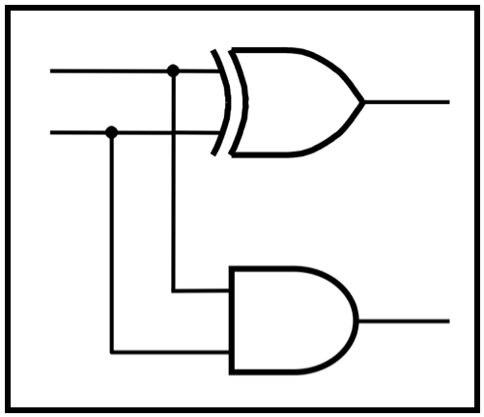
CprE 2810:
Digital Logic
Instructor: Alexander Stoytchev
http://www.ece.iastate.edu/~alexs/classes/

Slide 2
Assembly Examples
CprE 2810: Digital Logic
Iowa State University, Ames, IA
Copyright © Alexander Stoytchev

Slide 3
Assembly Examples
(for the i281 CPU)
CprE 2810: Digital Logic
Iowa State University, Ames, IA
Copyright © Alexander Stoytchev

Slide 4
c₁
100000
100001
100010
100011
100100
100101
100110
100111
101000
00110100 00000000
00110000 00000001
10001100 00000000
11010011 00000000
11110010 00000011
01000100 00000000
01010000 00000001
11100000 11111011
10100100 00000010
OpCode
Decoder
Control
c₁ c₂ c₃ c₄ c₅ c₆ c₇ c₈ c₉ c₁₀ c₁₁ c₁₂ c₁₃ c₁₄ c₁₅ c₁₆ c₁₇ c₁₈
0 0 0 0 0 0 0 0 0 0 0 0 0 0 0 0 0 0
Code Memory
c₈
c₉
c₁₀
c₁₄
Registers
c₄
c₅
Flags
A
c₁₂
c₁₃
0 0 0 0
00000000
A
B
C
D
B
00000000
c₁₅
c₆
c₇
ALU
0
1
c₁₈
C
00000000
A
B
C
D
c₁₁
0
1
0
1
D
00000000
c₁₇
0000
0001
0010
0011
0100
0101
0110
0111
00000101
00000000
00000000
00000000
00000000
00000000
00000000
00000000
c₁₆
0
1
c₂
c₃
PC
Update
Logic
1
0
PC
Switches
000000
Data Memory
i281 CPU

Slide 5
c₁
100000
100001
100010
100011
100100
100101
100110
100111
101000
00110100 00000000
00110000 00000001
10001100 00000000
11010011 00000000
11110010 00000011
01000100 00000000
01010000 00000001
11100000 11111011
10100100 00000010
6
16
8 high
OpCode
Decoder
27
Control
4
16
c₁ c₂ c₃ c₄ c₅ c₆ c₇ c₈ c₉ c₁₀ c₁₁ c₁₂ c₁₃ c₁₄ c₁₅ c₁₆ c₁₇ c₁₈
8 low
6
0 0 0 0 0 0 0 0 0 0 0 0 0 0 0 0 0 0
Code Memory
c₈
c₉
c₁₀
c₁₄
Registers
c₄
c₅
Flags
4
A
c₁₂
c₁₃
0 0 0 0
00000000
A
B
C
D
8
4
B
00000000
c₁₅
6 low
8
8
c₁₈
c₆
c₇
ALU
0
1
8
8
8
C
00000000
A
B
C
D
c₁₁
0
1
8
8
8
0
1
4 low
D
00000000
8
c₁₇
8
8
4
8
0000
0001
0010
0011
0100
0101
0110
0111
00000101
00000000
00000000
00000000
00000000
00000000
00000000
00000000
8
4
8
c₁₆
6 low
8
0
1
c₂
c₃
8
6
Switches
16
8 low
PC
Update
Logic
1
0
6
PC
6
6
6
000000
16
Data Memory
i281 CPU

Slide 6
Write
Select
Write Enable
c₁
100000
100001
100010
100011
100100
100101
100110
100111
101000
00110100 00000000
00110000 00000001
10001100 00000000
11010011 00000000
11110010 00000011
01000100 00000000
01010000 00000001
11100000 11111011
10100100 00000010
6
16
8 high
OpCode
Decoder
27
Control
Input
4
16
c₁ c₂ c₃ c₄ c₅ c₆ c₇ c₈ c₉ c₁₀ c₁₁ c₁₂ c₁₃ c₁₄ c₁₅ c₁₆ c₁₇ c₁₈
8 low
6
0 0 0 0 0 0 0 0 0 0 0 0 0 0 0 0 0 0
Read
Select
Code Memory
Write
Select
Write Enable
Write Enable
c₈
c₉
c₁₀
c₁₄
c₁₄
Registers
Port0 Read Select
ALU Select
Flags
c₄
c₅
c₁₂
Flags
4
c₁₃
0 0 0 0
A
00000000
A
B
C
D
0 0 0 0
8
4
ALU Result Mux
REG Writeback Mux
B
00000000
c₁₅
6 low
8
Port1 Read Select
8
c₁₈
Input
c₆
c₇
ALU Source Mux
ALU
0
1
8
8
8
C
00000000
A
B
C
D
c₁₁
0
1
8
8
8
0
1
4 low
Write Enable
D
00000000
8
Read
Select
c₁₇
8
8
4
8
DMEM Input Mux
0000
0001
0010
0011
0100
0101
0110
0111
00000101
00000000
00000000
00000000
00000000
00000000
00000000
00000000
8
4
8
c₁₆
Write
Select
6 low
PC Mux
8
0
1
c₂
Write Enable
8
c₃
Switches
16
8 low
Input
PC
Update
Logic
6
1
0
PC
6
6
6
6
100000
16
Data Memory
i281 CPU

Slide 7
c₁
100000
100001
100010
100011
100100
100101
100110
100111
101000
00110100 00000000
00110000 00000001
10001100 00000000
11010011 00000000
11110010 00000011
01000100 00000000
01010000 00000001
11100000 11111011
10100100 00000010
OpCode
Decoder
Control
c₁ c₂ c₃ c₄ c₅ c₆ c₇ c₈ c₉ c₁₀ c₁₁ c₁₂ c₁₃ c₁₄ c₁₅ c₁₆ c₁₇ c₁₈
0 0 0 0 0 0 0 0 0 0 0 0 0 0 0 0 0 0
Code Memory
c₈
c₉
c₁₀
c₁₄
Registers
c₄
c₅
Flags
A
c₁₂
c₁₃
0 0 0 0
00000000
A
B
C
D
B
00000000
c₁₅
c₆
c₇
ALU
0
1
c₁₈
C
00000000
A
B
C
D
c₁₁
0
1
0
1
D
00000000
c₁₇
0000
0001
0010
0011
0100
0101
0110
0111
00000101
00000000
00000000
00000000
00000000
00000000
00000000
00000000
c₁₆
0
1
c₂
c₃
PC
Update
Logic
1
0
PC
Switches
000000
Data Memory
i281 CPU

Slide 8
The Assembly Language Instructions

Slide 9
The i281 Assembly Instructions
NOOP NO OPeration
INPUTC INPUT into Code memory
INPUTCF INPUT into Code memory with oFfset
INPUTD INPUT into Data memory
INPUTDF INPUT into Data memory with oFfset
MOVE MOVE the contents of one register into another
LOADI LOAD Immediate value
LOADP LOAD Pointer address
ADD ADD two registers
ADDI ADD an Immediate value to a register
SUB SUBtract two registers
SUBI SUBtract an Immediate value from a register
LOAD LOAD from a data memory address into a register
LOADF LOAD with an oFfset specified by another register
STORE STORE a register into a data memory address
STOREF STORE with an oFfset specified by another register
SHIFTL SHIFT Left all bits in a register
SHIFTR SHIFT Right all bits in a register
CMP CoMPare the values in two registers
JUMP JUMP unconditionally to a specified address
BRE BRanch if Equal
BRZ BRanch if Zero
BRNE BRanch if Not Equal
BRNZ BRanch if Not Zero
BRG BRanch if Greater
BRGE BRanch if Greater than or Equal

Slide 10
The i281 Assembly Instructions
NOOP NO OPeration
INPUTC INPUT into Code memory
INPUTCF INPUT into Code memory with oFfset
INPUTD INPUT into Data memory
INPUTDF INPUT into Data memory with oFfset
MOVE MOVE the contents of one register into another
LOADI LOAD Immediate value
LOADP LOAD Pointer address
ADD ADD two registers
ADDI ADD an Immediate value to a register
SUB SUBtract two registers
SUBI SUBtract an Immediate value from a register
LOAD LOAD from a data memory address into a register
LOADF LOAD with an oFfset specified by another register
STORE STORE a register into a data memory address
STOREF STORE with an oFfset specified by another register
SHIFTL SHIFT Left all bits in a register
SHIFTR SHIFT Right all bits in a register
CMP CoMPare the values in two registers
JUMP JUMP unconditionally to a specified address
BRE BRanch if Equal
BRZ BRanch if Zero
BRNE BRanch if Not Equal
BRNZ BRanch if Not Zero
BRG BRanch if Greater
BRGE BRanch if Greater than or Equal

Slide 11
The OPCODEs
( Mapped to Machine Language )

Slide 12
The OPCODEs
NOOP
0 | 0 | 0 | 0 | d | d | d | d | d | d | d | d | d | d | d | d
INPUTC
0 | 0 | 0 | 1 | d | d | 0 | 0 | C | A | D | D | R | E | S | S
INPUTCF
0 | 0 | 0 | 1 | R | X | 0 | 1 | C | A | D | D | R | E | S | S
INPUTD
0 | 0 | 0 | 1 | d | d | 1 | 0 | D | A | D | D | R | E | S | S
INPUTDF
0 | 0 | 0 | 1 | R | X | 1 | 1 | D | A | D | D | R | E | S | S
MOVE
0 | 0 | 1 | 0 | R | X | R | Y | 0 | 0 | 0 | 0 | 0 | 0 | 0 | 0
LOADI/LOADP
0 | 0 | 1 | 1 | R | X | d | d | I | M | M | E | D | V | A | L

Slide 13
The OPCODEs
ADD
0 | 1 | 0 | 0 | R | X | R | Y | d | d | d | d | d | d | d | d
ADDI
0 | 1 | 0 | 1 | R | X | d | d | I | M | M | E | D | V | A | L
SUB
0 | 1 | 1 | 0 | R | X | R | Y | d | d | d | d | d | d | d | d
SUBI
0 | 1 | 1 | 1 | R | X | d | d | I | M | M | E | D | V | A | L
LOAD
1 | 0 | 0 | 0 | R | X | d | d | D | A | D | D | R | E | S | S
LOADF
1 | 0 | 0 | 1 | R | X | R | Y | D | A | D | D | R | E | S | S
STORE
1 | 0 | 1 | 0 | R | X | d | d | D | A | D | D | R | E | S | S
STOREF
1 | 0 | 1 | 1 | R | X | R | Y | D | A | D | D | R | E | S | S

Slide 14
The OPCODEs
SHIFTL
1 | 1 | 0 | 0 | R | X | d | 0 | d | d | d | d | d | d | d | d
SHIFTR
1 | 1 | 0 | 0 | R | X | d | 1 | d | d | d | d | d | d | d | d
CMP
1 | 1 | 0 | 1 | R | X | R | Y | d | d | d | d | d | d | d | d
JUMP
1 | 1 | 1 | 0 | d | d | d | d | P | C | O | F | F | S | E | T
BRE/BRZ
1 | 1 | 1 | 1 | d | d | 0 | 0 | P | C | O | F | F | S | E | T
BRNE/BRNZ
1 | 1 | 1 | 1 | d | d | 0 | 1 | P | C | O | F | F | S | E | T
BRG
1 | 1 | 1 | 1 | d | d | 1 | 0 | P | C | O | F | F | S | E | T
BRGE
1 | 1 | 1 | 1 | d | d | 1 | 1 | P | C | O | F | F | S | E | T

Slide 15
Sample Assembly Programs for the i281 CPU

Slide 16
Sample Assembly Programs for the i281 CPU
(most of these are available in the simulator)

Slide 17
Arithmetic 1

Slide 18
C Version
// Arithmetic1
//
// C version
int main()
{
int x=2;
int z;
z = x+3;
// printf("%d\n", z);
}

Slide 19
Assembly Version
; Assembly version
.data
x BYTE 2
z BYTE ?
.code
LOAD A, [x]
MOVE C, A ; z=x;
ADDI C, 3 ; z+=3;
STORE [z], C ; update the memory for z
; Register allocation
;
; A: x
; B: <not used>
; C: z
; D: <not used>

Slide 20
C vs. Assembly
// Arithmetic1
//
// C version
int main()
{
int x=2;
int z;
z = x+3;
// printf("%d\n", z);
}
; Assembly version
.data
x BYTE 2
z BYTE ?
.code
LOAD A, [x]
MOVE C, A ; z=x;
ADDI C, 3 ; z+=3;
STORE [z], C ; update the
; memory for z

Slide 21
Arithmetic 2

Slide 22
C Version
// Arithmetic 2
//
// C version
int main()
{
int x=2;
int y=3;
int z;
z = x+y;
// printf("%d\n", z);
}

Slide 23
Assembly Version
; Arithmetic 2
; Assembly version
.data
x BYTE 2
y BYTE 3
z BYTE ?
.code
LOAD A, [x]
LOAD B, [y]
MOVE C, A ; z=x;
ADD C, B ; z+=y;
STORE [z], C
; Register allocation
;
; A: x
; B: y
; C: z
; D: <not used>

Slide 24
C vs. Assembly
// Arithmetic 2
//
// C version
int main()
{
int x=2;
int y=3;
int z;
z = x+y;
// printf("%d\n", z);
}
; Arithmetic 2
; Assembly version
.data
x BYTE 2
y BYTE 3
z BYTE ?
.code
LOAD A, [x]
LOAD B, [y]
MOVE C, A ; z=x;
ADD C, B ; z+=y;
STORE [z], C

Slide 25
User Input from the Switches
(arithmetic example)

Slide 26
c₁
100000
100001
100010
100011
100100
100101
100110
100111
101000
00110100 00000000
00110000 00000001
10001100 00000000
11010011 00000000
11110010 00000011
01000100 00000000
01010000 00000001
11100000 11111011
10100100 00000010
6
16
8 high
OpCode
Decoder
27
Control
4
16
c₁ c₂ c₃ c₄ c₅ c₆ c₇ c₈ c₉ c₁₀ c₁₁ c₁₂ c₁₃ c₁₄ c₁₅ c₁₆ c₁₇ c₁₈
8 low
6
0 0 0 0 0 0 0 0 0 0 0 0 0 0 0 0 0 0
Code Memory
c₈
c₉
c₁₀
c₁₄
Registers
c₄
c₅
Flags
4
A
c₁₂
c₁₃
0 0 0 0
00000000
A
B
C
D
8
4
B
00000000
c₁₅
6 low
8
8
c₁₈
c₆
c₇
ALU
0
1
8
8
8
C
00000000
A
B
C
D
c₁₁
0
1
8
8
8
0
1
4 low
D
00000000
8
c₁₇
8
8
4
8
0000
0001
0010
0011
0100
0101
0110
0111
00000101
00000000
00000000
00000000
00000000
00000000
00000000
00000000
8
4
8
c₁₆
6 low
8
0
1
c₂
c₃
8
6
Switches
16
8 low
PC
Update
Logic
1
0
6
PC
6
6
6
000000
user input
from the switches
16
Data Memory
i281 CPU

Slide 27
C vs. Assembly
#include<stdio.h>
int x = 2;
int y;
int result;
// Addition with User input
// for the second variable (y)
void main()
{
scanf("%d", &y);
result = x + y;
//printf("%d", result);
}
; Arithmetic with user input from switches
; Assembly version
.data
x BYTE 2
y BYTE ?
result BYTE ?
.code
LOAD A, [x] ; Reg. A <- [x]
INPUTD [y] ; [y] <- Input
LOAD B, [y] ; Reg. B <- [y]
ADD A, B ; A <- A + B
STORE [result], A ; result <- Reg A

Slide 28
C vs. Assembly
#include<stdio.h>
int x = 2;
int y;
int result;
// Addition with User input
// for the second variable (y)
void main()
{
scanf("%d", &y);
result = x + y;
//printf("%d", result);
}
; Arithmetic with user input from switches
; Assembly version
.data
x BYTE 2
y BYTE ?
result BYTE ?
.code
LOAD A, [x] ; Reg. A <- [x]
INPUTD [y] ; [y] <- Input
LOAD B, [y] ; Reg. B <- [y]
ADD A, B ; A <- A + B
STORE [result], A ; result <- Reg A
Read the current value from switches SW07 to SW01
and store this value in the DMEM cell with label y.

Slide 29
Multiplication

Slide 30
C Version
// Multiplication
//
// C version
int main()
{
int x=3;
int z;
z = x*5;
// printf("%d\n", z);
}

Slide 31
Assembly Version
; Multiplication
.data
x BYTE 3
z BYTE ?
.code
LOAD A, [x]
MOVE C, A ; z=x;
MOVE B, A ; B=x;
SHIFTL B ; B=2x
SHIFTL B ; B=4x
ADD C, B ; C=4x+x
STORE [z], C ; update the memory for z
; Register allocation
;
; A: x
; B: temporary results for 2x and 4x
; C: z
; D: <not used>

Slide 32
C vs. Assembly
// Multiplication
//
// C version
int main()
{
int x=2;
int z;
z = x*5;
// printf("%d\n", z);
}
; Multiplication
.data
x BYTE 3
z BYTE ?
.code
LOAD A, [x]
MOVE C, A ; z=x;
MOVE B, A ; B=x;
SHIFTL B ; B=2x
SHIFTL B ; B=4x
ADD C, B ; C=4x+x
STORE [z], C ; update the
; memory for z

Slide 33
Multiplication
(implemented with repeated addition)

Slide 34
C Version
// Multiplication
//
// C version
int main()
{
int x=2;
int z;
z = x*5;
// printf("%d\n", z);
}

Slide 35
C Version
// Multiplication
//
// C version
int main()
{
int x=3;
int z=0;
for(int i=0; i<5; i++){
z+=x;
}
// printf("%d\n", z);
}

Slide 36
Assembly Version
; Assembly version
;
; The CPU does not have OPCODEs for multiplication.
; Therefore, it is emulated with repeated addition.
.data
x BYTE 3
z BYTE ?
.code
LOAD A, [x]
LOADI C, 0 ; z=0
LOADI B, 0 ; i=0
LOADI D, 5 ; sentinel value
For: CMP B, D ; i<5?
BRGE End ; if(i>=5), exit for loop
ADD C, A ; z+=x
ADDI B, 1 ; i++
JUMP For ; jump to For loop
End: STORE [z], C ; update the z value in memory

Slide 37
Assembly Version
; Assembly version
;
; The CPU does not have OPCODEs for multiplication.
; Therefore, it is emulated with repeated addition.
.data
x BYTE 3
z BYTE ?
.code
LOAD A, [x]
LOADI C, 0 ; z=0
LOADI B, 0 ; i=0
LOADI D, 5 ; sentinel value
For: CMP B, D ; i<5?
BRGE End ; if(i>=5), exit for loop
ADD C, A ; z+=x
ADDI B, 1 ; i++
JUMP For ; jump to For loop
End: STORE [z], C ; update the z value in memory
; Register allocation
;
; A: x
; B: i (optimized to register)
; C: z
; D: 5

Slide 38
C vs. Assembly
// Multiplication
//
// C version
int main()
{
int x=3;
int z=0;
for(int i=0; i<5; i++){
z+=x;
}
// printf("%d\n", z);
}
; Assembly version
.data
x BYTE 3
z BYTE ?
.code
LOAD A, [x]
LOADI C, 0 ; z=0
LOADI B, 0 ; i=0
LOADI D, 5 ; sentinel value
For: CMP B, D ; i<5?
BRGE End ; if(i>=5), exit loop
ADD C, A ; z+=x
ADDI B, 1 ; i++
JUMP For ; jump to For loop
End: STORE [z], C ; update the z
; value in memory

Slide 39
If Statement:
Comparison of Signed Numbers

Slide 40
The i281 Assembly Instructions
NOOP NO OPeration
INPUTC INPUT into Code memory
INPUTCF INPUT into Code memory with oFfset
INPUTD INPUT into Data memory
INPUTDF INPUT into Data memory with oFfset
MOVE MOVE the contents of one register into another
LOADI LOAD Immediate value
LOADP LOAD Pointer address
ADD ADD two registers
ADDI ADD an Immediate value to a register
SUB SUBtract two registers
SUBI SUBtract an Immediate value from a register
LOAD LOAD from a data memory address into a register
LOADF LOAD with an oFfset specified by another register
STORE STORE a register into a data memory address
STOREF STORE with an oFfset specified by another register
SHIFTL SHIFT Left all bits in a register
SHIFTR SHIFT Right all bits in a register
CMP CoMPare the values in two registers
JUMP JUMP unconditionally to a specified address
BRE BRanch if Equal
BRZ BRanch if Zero
BRNE BRanch if Not Equal
BRNZ BRanch if Not Zero
BRG BRanch if Greater
BRGE BRanch if Greater than or Equal

Slide 41
The i281 Assembly Instructions
NOOP NO OPeration
INPUTC INPUT into Code memory
INPUTCF INPUT into Code memory with oFfset
INPUTD INPUT into Data memory
INPUTDF INPUT into Data memory with oFfset
MOVE MOVE the contents of one register into another
LOADI LOAD Immediate value
LOADP LOAD Pointer address
ADD ADD two registers
ADDI ADD an Immediate value to a register
SUB SUBtract two registers
SUBI SUBtract an Immediate value from a register
LOAD LOAD from a data memory address into a register
LOADF LOAD with an oFfset specified by another register
STORE STORE a register into a data memory address
STOREF STORE with an oFfset specified by another register
SHIFTL SHIFT Left all bits in a register
SHIFTR SHIFT Right all bits in a register
CMP CoMPare the values in two registers
JUMP JUMP unconditionally to a specified address
BRE BRanch if Equal
BRZ BRanch if Zero
BRNE BRanch if Not Equal
BRNZ BRanch if Not Zero
BRG BRanch if Greater
BRGE BRanch if Greater than or Equal
These 6 are used to
implement comparisons

Slide 42
The i281 Assembly Instructions
NOOP NO OPeration
INPUTC INPUT into Code memory
INPUTCF INPUT into Code memory with oFfset
INPUTD INPUT into Data memory
INPUTDF INPUT into Data memory with oFfset
MOVE MOVE the contents of one register into another
LOADI LOAD Immediate value
LOADP LOAD Pointer address
ADD ADD two registers
ADDI ADD an Immediate value to a register
SUB SUBtract two registers
SUBI SUBtract an Immediate value from a register
LOAD LOAD from a data memory address into a register
LOADF LOAD with an oFfset specified by another register
STORE STORE a register into a data memory address
STOREF STORE with an oFfset specified by another register
SHIFTL SHIFT Left all bits in a register
SHIFTR SHIFT Right all bits in a register
CMP CoMPare the values in two registers
JUMP JUMP unconditionally to a specified address
BRE BRanch if Equal
BRZ BRanch if Zero
BRNE BRanch if Not Equal
BRNZ BRanch if Not Zero
BRG BRanch if Greater
BRGE BRanch if Greater than or Equal
BRL BRanch if Less
BRLE BRanch if Less than or Equal
These two instructions
are NOT supported
by this CPU

Slide 43
The i281 Assembly Instructions
NOOP NO OPeration
INPUTC INPUT into Code memory
INPUTCF INPUT into Code memory with oFfset
INPUTD INPUT into Data memory
INPUTDF INPUT into Data memory with oFfset
MOVE MOVE the contents of one register into another
LOADI LOAD Immediate value
LOADP LOAD Pointer address
ADD ADD two registers
ADDI ADD an Immediate value to a register
SUB SUBtract two registers
SUBI SUBtract an Immediate value from a register
LOAD LOAD from a data memory address into a register
LOADF LOAD with an oFfset specified by another register
STORE STORE a register into a data memory address
STOREF STORE with an oFfset specified by another register
SHIFTL SHIFT Left all bits in a register
SHIFTR SHIFT Right all bits in a register
CMP CoMPare the values in two registers
JUMP JUMP unconditionally to a specified address
BRE BRanch if Equal
BRZ BRanch if Zero
BRNE BRanch if Not Equal
BRNZ BRanch if Not Zero
BRG BRanch if Greater
BRGE BRanch if Greater than or Equal
BRL BRanch if Less
BRLE BRanch if Less than or Equal
comparison
of signed
numbers
only

Slide 44
Common Comparisons
(x < y) (x <= y) (x == y) (x!= y) (x >= y) (x > y)

Slide 45
Common Comparisons
(x < y) (x <= y) (x == y) (x!= y) (x >= y) (x > y)
These two comparisons
are NOT supported
by this CPU.
But with the help of the compiler
we can still use these comparisons.

Slide 46
If Equal

Slide 47
C vs. Assembly
// If Equal
//
// C version
int main()
{
int x=3;
int y=5;
int z=0;
if(x==y)
z=x;
}
; If Equal
;
; Assembly version
.data
x BYTE 3
y BYTE 5
z BYTE 0
.code
LOAD A, [x]
LOAD B, [y]
CMP A, B
BRE Assign
JUMP End
Assign: STORE [z], A
End: NOOP

Slide 48
C vs. Assembly
// If Equal
//
// C version
int main()
{
int x=3;
int y=5;
int z=0;
if(x==y)
z=x;
}
; If Equal
;
; Assembly version
.data
x BYTE 3
y BYTE 5
z BYTE 0
.code
LOAD A, [x]
LOAD B, [y]
CMP A, B
BRE Assign
JUMP End
Assign: STORE [z], A
End: NOOP
This code is inefficient.
It takes 3 instructions.

Slide 49
C vs. Assembly
// If Equal
//
// C version
int main()
{
int x=3;
int y=5;
int z=0;
if(x==y)
z=x;
}
; If Equal
;
; Assembly version
.data
x BYTE 3
y BYTE 5
z BYTE 0
.code
LOAD A, [x]
LOAD B, [y]
CMP A, B
BRNE End
STORE [z], A
End: NOOP
This version is better:
instead of x == y,
check if x != y

Slide 50
C vs. Assembly
// If Equal
//
// C version
int main()
{
int x=3;
int y=5;
int z=0;
if(x==y)
z=x;
}
; If Equal
;
; Assembly version
.data
x BYTE 3
y BYTE 5
z BYTE 0
.code
LOAD A, [x]
LOAD B, [y]
CMP A, B
BRNE End
STORE [z], A
End: NOOP

Slide 51
If Not Equal

Slide 52
C vs. Assembly
// If Not Equal
//
// C version
int main()
{
int x=3;
int y=5;
int z=0;
if(x != y)
z=x;
}
; If Not Equal
;
; Assembly version
.data
x BYTE 3
y BYTE 5
z BYTE 0
.code
LOAD A, [x]
LOAD B, [y]
CMP A, B
BRE End
STORE [z], A
End: NOOP

Slide 53
C vs. Assembly
// If Not Equal
//
// C version
int main()
{
int x=3;
int y=5;
int z=0;
if(x != y)
z=x;
}
; If Not Equal
;
; Assembly version
.data
x BYTE 3
y BYTE 5
z BYTE 0
.code
LOAD A, [x]
LOAD B, [y]
CMP A, B
BRE End
STORE [z], A
End: NOOP
instead of x != y,
check if x == y

Slide 54
If Less

Slide 55
C vs. Assembly
// If Less
//
// C version
int main()
{
int x=3;
int y=5;
int z=0;
if(x < y)
z=x;
}
; If Less
;
; Assembly version
.data
x BYTE 3
y BYTE 5
z BYTE 0
.code
LOAD A, [x]
LOAD B, [y]
CMP A, B
BRGE End
STORE [z], A
End: NOOP

Slide 56
C vs. Assembly
// If Less
//
// C version
int main()
{
int x=3;
int y=5;
int z=0;
if(x < y)
z=x;
}
; If Less
;
; Assembly version
.data
x BYTE 3
y BYTE 5
z BYTE 0
.code
LOAD A, [x]
LOAD B, [y]
CMP A, B
BRGE End
STORE [z], A
End: NOOP
instead of x < y,
check if x >= y and
skip the z=x part if true.

Slide 57
If Less or Equal

Slide 58
C vs. Assembly
// If Less or Equal
//
// C version
int main()
{
int x=3;
int y=5;
int z=0;
if(x <= y)
z=x;
}
; If Less or Equal
;
; Assembly version
.data
x BYTE 3
y BYTE 5
z BYTE 0
.code
LOAD A, [x]
LOAD B, [y]
CMP A, B
BRG End
STORE [z], A
End: NOOP

Slide 59
C vs. Assembly
// If Less or Equal
//
// C version
int main()
{
int x=3;
int y=5;
int z=0;
if(x <= y)
z=x;
}
; If Less or Equal
;
; Assembly version
.data
x BYTE 3
y BYTE 5
z BYTE 0
.code
LOAD A, [x]
LOAD B, [y]
CMP A, B
BRG End
STORE [z], A
End: NOOP
instead of x <= y,
check if x > y

Slide 60
Common Comparisons
(x < y) (x <= y) (x == y) (x!= y) (x >= y) (x > y)
CMP x,y CMP x,y CMP x,y CMP x,y CMP x,y CMP x,y
BRGE End BRG End BRNE End BRE End BRL End BRLE End
Where x and y are two registers.

Slide 61
Common Comparisons
(x < y) (x <= y) (x == y) (x!= y) (x >= y) (x > y)
CMP x,y CMP x,y CMP x,y CMP x,y CMP x,y CMP x,y
BRGE End BRG End BRNE End BRE End BRL End BRLE End
These two instructions
are NOT supported
by this CPU.

Slide 62
Common Comparisons
Therefore, invert the order.
(y <= x) (y < x)
(x < y) (x <= y) (x == y) (x!= y) (x >= y) (x > y)
CMP x,y CMP x,y CMP x,y CMP x,y CMP x,y CMP x,y
BRGE End BRG End BRNE End BRE End BRL End BRLE End

Slide 63
Common Comparisons
Therefore, invert the order.
(y <= x) (y < x)
(x < y) (x <= y) (x == y) (x!= y) (x >= y) (x > y)
CMP x,y CMP x,y CMP x,y CMP x,y CMP x,y CMP x,y
BRGE End BRG End BRNE End BRE End BRL End BRLE End
CMP y,x CMP y,x
BRG End BRGE End

Slide 64
If Greater or Equal

Slide 65
C vs. Assembly
// If Greater or Equal
//
// C version
int main()
{
int x=3;
int y=5;
int z=0;
if(x >= y)
z=x;
}
; If Greater or Equal
;
; Assembly version
.data
x BYTE 3
y BYTE 5
z BYTE 0
.code
LOAD A, [x]
LOAD B, [y]
CMP B, A ; these are swapped
BRG End
STORE [z], A
End: NOOP

Slide 66
C vs. Assembly
// If Greater or Equal
//
// C version
int main()
{
int x=3;
int y=5;
int z=0;
if(x >= y)
z=x;
}
; If Greater or Equal
;
; Assembly version
.data
x BYTE 3
y BYTE 5
z BYTE 0
.code
LOAD A, [x]
LOAD B, [y]
CMP B, A ; these are swapped
BRG End
STORE [z], A
End: NOOP
need to swap the direction

Slide 67
C vs. Assembly
// If Greater or Equal
//
// C version
int main()
{
int x=3;
int y=5;
int z=0;
if(y <= x)
z=x;
}
; If Greater or Equal
;
; Assembly version
.data
x BYTE 3
y BYTE 5
z BYTE 0
.code
LOAD A, [x]
LOAD B, [y]
CMP B, A ; these are swapped
BRG End ; B,A instead of A,B
STORE [z], A
End: NOOP

Slide 68
C vs. Assembly
// If Greater or Equal
//
// C version
int main()
{
int x=3;
int y=5;
int z=0;
if(y <= x)
z=x;
}
; If Greater or Equal
;
; Assembly version
.data
x BYTE 3
y BYTE 5
z BYTE 0
.code
LOAD A, [x]
LOAD B, [y]
CMP B, A ; these are swapped
BRG End
STORE [z], A
End: NOOP
instead of y <= x,
check if y > x

Slide 69
If Greater

Slide 70
C vs. Assembly
// If Greater
//
// C version
int main()
{
int x=3;
int y=5;
int z=0;
if(x > y)
z=x;
}
; If Greater
;
; Assembly version
.data
x BYTE 3
y BYTE 5
z BYTE 0
.code
LOAD A, [x]
LOAD B, [y]
CMP B, A ; these are swapped
BRGE End
STORE [z], A
End: NOOP

Slide 71
C vs. Assembly
// If Greater
//
// C version
int main()
{
int x=3;
int y=5;
int z=0;
if(y < x)
z=x;
}
; If Greater
;
; Assembly version
.data
x BYTE 3
y BYTE 5
z BYTE 0
.code
LOAD A, [x]
LOAD B, [y]
CMP B, A ; these are swapped
BRGE End
STORE [z], A
End: NOOP

Slide 72
C vs. Assembly
// If Greater
//
// C version
int main()
{
int x=3;
int y=5;
int z=0;
if(y < x)
z=x;
}
; If Greater
;
; Assembly version
.data
x BYTE 3
y BYTE 5
z BYTE 0
.code
LOAD A, [x]
LOAD B, [y]
CMP B, A ; these are swapped
BRGE End
STORE [z], A
End: NOOP
instead of y < x,
check if y >= x

Slide 73
Common Comparisons
(y <= x) (y < x)
(x < y) (x <= y) (x == y) (x!= y) (x >= y) (x > y)
CMP x,y CMP x,y CMP x,y CMP x,y CMP x,y CMP x,y
BRGE End BRG End BRNE End BRE End BRL End BRLE End
CMP y,x CMP y,x
BRG End BRGE End

Slide 74
If Statement:
Comparison of Unsigned Numbers
(not supported by this CPU)

Slide 75
Comparison of Signed Numbers
Equal ZF
Not equal ZF
Greater ZF • XNOR( NF, OF )
Greater or Equal XNOR( NF, OF )
Less XOR( NF, OF )
Less or Equal ZF + XOR( NF, OF )

Slide 76
Comparison of Unsigned Numbers
Equal ZF
Not equal ZF
Above ZF • CF
Above or Equal CF
Below CF
Below or Equal ZF + CF

Slide 77
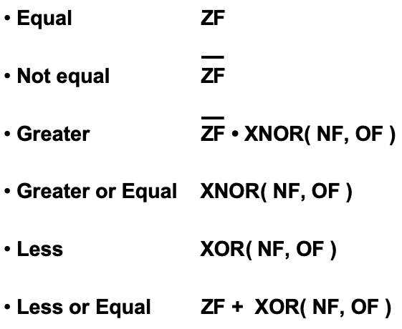
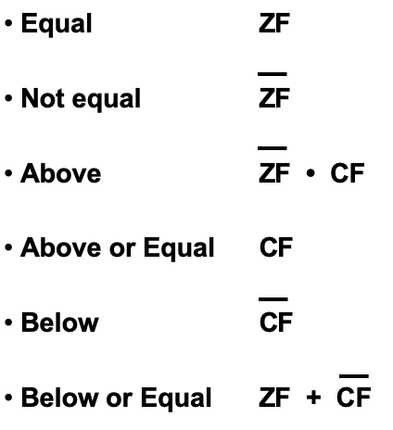
Signed v.s. Unsigned

Slide 78
Signed v.s. Unsigned
they overlap only here

Slide 79
Signed v.s. Unsigned
BRE Ranch if Equal
BRZ BRanch if Zero
BRNE BRanch if Not Equal
BRNZ BRanch if Not Zero
BRA BRanch if Above
BRAE BRanch if Above or Equal
BRB BRanch if Below
BRBE BRanch if Below or Equal
BRE BRanch if Equal
BRZ BRanch if Zero
BRNE BRanch if Not Equal
BRNZ BRanch if Not Zero
BRG BRanch if Greater
BRGE BRanch if Greater than or Equal
BRL BRanch if Less
BRLE BRanch if Less than or Equal

Slide 80
Signed v.s. Unsigned
BRE Ranch if Equal
BRZ BRanch if Zero
BRNE BRanch if Not Equal
BRNZ BRanch if Not Zero
BRA BRanch if Above
BRAE BRanch if Above or Equal
BRB BRanch if Below
BRBE BRanch if Below or Equal
BRE BRanch if Equal
BRZ BRanch if Zero
BRNE BRanch if Not Equal
BRNZ BRanch if Not Zero
BRG BRanch if Greater
BRGE BRanch if Greater than or Equal
BRL BRanch if Less
BRLE BRanch if Less than or Equal
The OPCODEs in blue
are NOT implemented
on this CPU

Slide 81
Thus, comparing unsigned numbers requires adding new OPCODEs
BRE Ranch if Equal
BRZ BRanch if Zero
BRNE BRanch if Not Equal
BRNZ BRanch if Not Zero
BRA BRanch if Above
BRAE BRanch if Above or Equal
BRB BRanch if Below
BRBE BRanch if Below or Equal

Slide 82
Thus, comparing unsigned numbers requires adding new OPCODEs
BRE Ranch if Equal
BRZ BRanch if Zero
BRNE BRanch if Not Equal
BRNZ BRanch if Not Zero
BRA BRanch if Above
BRAE BRanch if Above or Equal
BRB BRanch if Below
BRBE BRanch if Below or Equal
at a minimum
you need only
these two

Slide 83
Thus, comparing unsigned numbers requires adding new OPCODEs
BRE Ranch if Equal
BRZ BRanch if Zero
BRNE BRanch if Not Equal
BRNZ BRanch if Not Zero
BRA BRanch if Above
BRAE BRanch if Above or Equal
BRB BRanch if Below
BRBE BRanch if Below or Equal
or these two

Slide 84
OPCODEs that check the Flags

Slide 85
c₁
100000
100001
100010
100011
100100
100101
100110
100111
101000
00110100 00000000
00110000 00000001
10001100 00000000
11010011 00000000
11110010 00000011
01000100 00000000
01010000 00000001
11100000 11111011
10100100 00000010
6
16
8 high
OpCode
Decoder
27
Control
4
16
c₁ c₂ c₃ c₄ c₅ c₆ c₇ c₈ c₉ c₁₀ c₁₁ c₁₂ c₁₃ c₁₄ c₁₅ c₁₆ c₁₇ c₁₈
8 low
6
0 0 0 0 0 0 0 0 0 0 0 0 0 0 0 0 0 0
Code Memory
c₈
c₉
c₁₀
c₁₄
Registers
c₄
c₅
Flags
4
A
c₁₂
c₁₃
0 0 0 0
00000000
A
B
C
D
8
4
B
00000000
c₁₅
6 low
8
8
c₁₈
c₆
c₇
ALU
0
1
8
8
8
C
00000000
A
B
C
D
c₁₁
0
1
8
8
8
0
1
4 low
D
00000000
8
c₁₇
8
8
4
8
0000
0001
0010
0011
0100
0101
0110
0111
00000101
00000000
00000000
00000000
00000000
00000000
00000000
00000000
8
4
8
c₁₆
6 low
8
0
1
c₂
c₃
8
6
Switches
16
8 low
PC
Update
Logic
1
0
6
PC
6
6
6
100000
16
Data Memory
i281 CPU

Slide 86
The Flags Register
Carry
Flag
Overflow
Flag
Negative
Flag
Zero
Flag
Write
Enable
0
0
0
0
D
Q
D
Q
D
Q
D
Q
1
1
1
1
Q
Q
Q
Q
Clock
Carry
Overflow
Negative
Zero

Slide 87
You could also add OPCODEs that just check a specific flag
BRC BRanch if Carry
BRNC BRanch if No Carry
BRO BRanch if Overflow
BRNO BRanch if No Overflow
BRN BRanch if Negative
BRNN BRanch if Not Negative
BRZ BRanch if Zero
BRNZ BRanch if Not Zero
only these two
are currently
supported

Slide 88
You could also add OPCODEs that just check a specific flag
BRC BRanch if Carry
BRNC BRanch if No Carry
BRO BRanch if Overflow
BRNO BRanch if No Overflow
BRN BRanch if Negative
BRNN BRanch if Not Negative
BRZ BRanch if Zero
BRNZ BRanch if Not Zero
BRE
BRNE
equivalent to

Slide 89
You could also add OPCODEs that just check a specific flag
equivalent to
BRC BRanch if Carry
BRNC BRanch if No Carry
BRO BRanch if Overflow
BRNO BRanch if No Overflow
BRN BRanch if Negative
BRNN BRanch if Not Negative
BRZ BRanch if Zero
BRNZ BRanch if Not Zero
BRAE
BRB

Slide 90
Signed v.s. Unsigned

Slide 91
How to add more BRanch OpCODEs
BRE/BRZ
1 | 1 | 1 | 1 | d | d | 0 | 0 | P | C | O | F | F | S | E | T
BRNE/BRNZ
1 | 1 | 1 | 1 | d | d | 0 | 1 | P | C | O | F | F | S | E | T
BRG
1 | 1 | 1 | 1 | d | d | 1 | 0 | P | C | O | F | F | S | E | T
BRGE
1 | 1 | 1 | 1 | d | d | 1 | 1 | P | C | O | F | F | S | E | T

Slide 92
How to add more BRanch OpCODES
BRE/BRZ
1 | 1 | 1 | 1 | d | d | 0 | 0 | P | C | O | F | F | S | E | T
BRNE/BRNZ
1 | 1 | 1 | 1 | d | d | 0 | 1 | P | C | O | F | F | S | E | T
BRG
1 | 1 | 1 | 1 | d | d | 1 | 0 | P | C | O | F | F | S | E | T
BRGE
1 | 1 | 1 | 1 | d | d | 1 | 1 | P | C | O | F | F | S | E | T
could use this don’t’ care bit and
update the OpCODE decoder

Slide 93
How to add more BRanch OpCODES
BRE/BRZ
1 | 1 | 1 | 1 | d | d | 0 | 0 | P | C | O | F | F | S | E | T
BRNE/BRNZ
1 | 1 | 1 | 1 | d | d | 0 | 1 | P | C | O | F | F | S | E | T
BRG
1 | 1 | 1 | 1 | d | d | 1 | 0 | P | C | O | F | F | S | E | T
BRGE
1 | 1 | 1 | 1 | d | d | 1 | 1 | P | C | O | F | F | S | E | T
could use these two don’t care bits and
update the OpCODE decoder

Slide 94
c₁
100000
100001
100010
100011
100100
100101
100110
100111
101000
00110100 00000000
00110000 00000001
10001100 00000000
11010011 00000000
11110010 00000011
01000100 00000000
01010000 00000001
11100000 11111011
10100100 00000010
6
16
8 high
OpCode
Decoder
27
Control
4
16
c₁ c₂ c₃ c₄ c₅ c₆ c₇ c₈ c₉ c₁₀ c₁₁ c₁₂ c₁₃ c₁₄ c₁₅ c₁₆ c₁₇ c₁₈
8 low
6
0 0 0 0 0 0 0 0 0 0 0 0 0 0 0 0 0 0
Code Memory
c₈
c₉
c₁₀
c₁₄
Registers
c₄
c₅
Flags
4
A
c₁₂
c₁₃
0 0 0 0
00000000
A
B
C
D
8
4
B
00000000
c₁₅
6 low
8
8
c₁₈
c₆
c₇
ALU
0
1
8
8
8
C
00000000
A
B
C
D
c₁₁
0
1
8
8
8
0
1
4 low
D
00000000
8
c₁₇
8
8
4
8
0000
0001
0010
0011
0100
0101
0110
0111
00000101
00000000
00000000
00000000
00000000
00000000
00000000
00000000
8
4
8
c₁₆
6 low
8
0
1
c₂
c₃
8
6
Switches
16
8 low
PC
Update
Logic
1
0
6
PC
6
6
6
100000
16
Data Memory
i281 CPU

Slide 95
y₀
NOOP
MOVE
LOADI/LOADP
ADD
ADDI
SUB
SUBI
LOAD
LOADF
STORE
STOREF
CMP
JUMP
1
En
y₁
INPUTC
INPUTCF
INPUTD
INPUTDF
En
y₀
y₂
y₁
y₃
y₂
2-to-4 decoder
w₁
y₄
w₀
y₃
y₅
y₆
y₇
En
y₀
SHIFTL
SHIFTR
4-to-16 decoder
y₁
y₈
y₉
1-to-2 decoder
w₃
y₁₀
w₀
w₂
y₁₁
y₁₂
En
y₀
BRE/BRZ
BRNE/BRNZ
BRG
BRGE
w₁
y₁₃
y₁
w₀
y₁₄
y₂
2-to-4 decoder
y₁₅
w₁
w₀
y₃
I₁₅ | I₁₄ | I₁₃ | I₁₂ | I₁₁ | I₁₀ | I₉ | I₈ | I₇ | I₆ | I₅ | I₄ | I₃ | I₂ | I₁ | I₀
8
ADDR/VAL/OFFSET
RY
RX
2
2

Slide 96
y₀
NOOP
MOVE
LOADI/LOADP
ADD
ADDI
SUB
SUBI
LOAD
LOADF
STORE
STOREF
CMP
JUMP
1
En
y₁
INPUTC
INPUTCF
INPUTD
INPUTDF
En
y₀
y₂
y₁
y₃
y₂
2-to-4 decoder
w₁
y₄
w₀
y₃
y₅
y₆
y₇
En
y₀
SHIFTL
SHIFTR
4-to-16 decoder
y₁
y₈
y₉
1-to-2 decoder
w₃
y₁₀
w₀
w₂
y₁₁
y₁₂
En
y₀
BRE/BRZ
BRNE/BRNZ
BRG
BRGE
w₁
y₁₃
y₁
w₀
y₁₄
y₂
2-to-4 decoder
y₁₅
w₁
w₀
y₃
use 3 bits
change to
3-to-8 decoder
I₁₅ | I₁₄ | I₁₃ | I₁₂ | I₁₁ | I₁₀ | I₉ | I₈ | I₇ | I₆ | I₅ | I₄ | I₃ | I₂ | I₁ | I₀
8
ADDR/VAL/OFFSET
RY
RX
2
2

Slide 97
y₀
NOOP
MOVE
LOADI/LOADP
ADD
ADDI
SUB
SUBI
LOAD
LOADF
STORE
STOREF
CMP
JUMP
1
En
y₁
INPUTC
INPUTCF
INPUTD
INPUTDF
En
y₀
y₂
y₁
y₃
y₂
2-to-4 decoder
w₁
y₄
w₀
y₃
y₅
y₆
y₇
En
y₀
SHIFTL
SHIFTR
4-to-16 decoder
y₁
y₈
y₉
1-to-2 decoder
w₃
y₁₀
w₀
w₂
y₁₁
y₁₂
En
y₀
BRE/BRZ
BRNE/BRNZ
BRG
BRGE
w₁
y₁₃
y₁
w₀
y₁₄
y₂
2-to-4 decoder
y₁₅
w₁
w₀
y₃
use 4 bits
change to
4-to-16 decoder
I₁₅ | I₁₄ | I₁₃ | I₁₂ | I₁₁ | I₁₀ | I₉ | I₈ | I₇ | I₆ | I₅ | I₄ | I₃ | I₂ | I₁ | I₀
8
ADDR/VAL/OFFSET
RY
RX
2
2

Slide 98
If-Else Statement

Slide 99
C vs. Assembly
// If-Else Statement
//
// C version
int main()
{
int x=3;
int y=5;
int z;
if (x<y)
z=x;
else
z=y;
}
; If If-Else Statement
;
; Assembly version
.data
x BYTE 3
y BYTE 5
z BYTE ?
.code
LOAD A, [x]
LOAD B, [y]
If: CMP A, B
BRGE Else
STORE [z], A
JUMP End
Else: STORE [z], B
End: NOOP

Slide 100
If with two conditions (OR)

Slide 101
C vs. Assembly
// If with 2 conditions (OR)
//
// C version
int main()
{
int x=9;
int min=1;
int max=8;
int inRange=1;
if ( (x<min) || (x>max) )
inRange=0;
}
; Assembly version
.data
x BYTE 9
min BYTE 1
max BYTE 8
inRange BYTE 1
.code
LOAD A, [x]
LOAD B, [min]
LOAD C, [max]
First: CMP A, B ; x < min ?
BRGE Second
Set: LOADI D, 0
STORE [inRange], D
JUMP End
Second: CMP C, A ; max < x ?
BRGE End
JUMP Set
End: NOOP

Slide 102
C vs. Assembly
// If with 2 conditions (OR)
// this is closer to assembly
int main()
{
int x=9;
int min=1;
int max=8;
int inRange=1;
if(x < min) // First
{
Set:
inRange=0;
goto End;
}
else if(max < x) // Second
{
goto Set;
}
End:
}
; Assembly version
.data
x BYTE 9
min BYTE 1
max BYTE 8
inRange BYTE 1
.code
LOAD A, [x]
LOAD B, [min]
LOAD C, [max]
First: CMP A, B ; x < min ?
BRGE Second
Set: LOADI D, 0
STORE [inRange], D
JUMP End
Second: CMP C, A ; max < x ?
BRGE End
JUMP Set
End: NOOP
// swapped condition

Slide 103
C vs. Assembly
// If with 2 conditions (OR)
// this is closer to assembly
int main()
{
int x=9;
int min=1;
int max=8;
int inRange=1;
if(x < min) // First
{
Set:
inRange=0;
goto End;
}
else if(max < x) // Second
{
goto Set;
}
End:
}
; Assembly version
.data
x BYTE 9
min BYTE 1
max BYTE 8
inRange BYTE 1
.code
LOAD A, [x]
LOAD B, [min]
LOAD C, [max]
First: CMP A, B
BRGE Second
Set: LOADI D, 0
STORE [inRange], D
JUMP End
Second: CMP C, A ; max < x ?
BRGE End
JUMP Set
End: NOOP
instead of x < min,
check if x >= min

Slide 104
C vs. Assembly
// If with 2 conditions (OR)
// this is closer to assembly
int main()
{
int x=9;
int min=1;
int max=8;
int inRange=1;
if(x < min) // First
{
Set:
inRange=0;
goto End;
}
else if(max < x) // Second
{
goto Set;
}
End:
}
; Assembly version
.data
x BYTE 9
min BYTE 1
max BYTE 8
inRange BYTE 1
.code
LOAD A, [x]
LOAD B, [min]
LOAD C, [max]
First: CMP A, B
BRGE Second
Set: LOADI D, 0
STORE [inRange], D
JUMP End
Second: CMP C, A
BRGE End
JUMP Set
End: NOOP
instead of max < x,
check if max >= x

Slide 105
If with two conditions (AND)

Slide 106
C vs. Assembly
// If with 2 conditions (AND)
//
// C version
int main()
{
int x=5;
int min=1;
int max=8;
int inRange=0;
if ( (x>=min) && (x<=max) )
inRange=1;
}
; Assembly version
.data
x BYTE 5
min BYTE 1
max BYTE 8
inRange BYTE 0
.code
LOAD A, [x]
LOAD B, [min]
LOAD C, [max]
CMP B, A ; min <= x ?
BRG End
CMP A, C ; x <= max ?
BRG End
LOADI D, 1
STORE [inRange], D
End: NOOP

Slide 107
C vs. Assembly
// If with 2 conditions (AND)
//
// C version
int main()
{
int x=5;
int min=1;
int max=8;
int inRange=0;
if(min<=x) // swapped dir.
{
if(x<=max)
{
inRange=1;
}
}
}
; Assembly version
.data
x BYTE 5
min BYTE 1
max BYTE 8
inRange BYTE 0
.code
LOAD A, [x]
LOAD B, [min]
LOAD C, [max]
CMP B, A ; min <= x ?
BRG End
CMP A, C ; x <= max ?
BRG End
LOADI D, 1
STORE [inRange], D
End: NOOP

Slide 108
C vs. Assembly
// If with 2 conditions (AND)
//
// C version
int main()
{
int x=5;
int min=1;
int max=8;
int inRange=0;
if(min<=x) // swapped dir.
{
if(x<=max)
{
inRange=1;
}
}
}
; Assembly version
.data
x BYTE 5
min BYTE 1
max BYTE 8
inRange BYTE 0
.code
LOAD A, [x]
LOAD B, [min]
LOAD C, [max]
CMP B, A
BRG End
CMP A, C ; x <= max ?
BRG End
LOADI D, 1
STORE [inRange], D
End: NOOP
instead of min <= x,
check if min > x

Slide 109
C vs. Assembly
// If with 2 conditions (AND)
//
// C version
int main()
{
int x=5;
int min=1;
int max=8;
int inRange=0;
if(min<=x) // swapped dir.
{
if(x<=max)
{
inRange=1;
}
}
}
; Assembly version
.data
x BYTE 5
min BYTE 1
max BYTE 8
inRange BYTE 0
.code
LOAD A, [x]
LOAD B, [min]
LOAD C, [max]
CMP B, A
BRG End
CMP A, C
BRG End
LOADI D, 1
STORE [inRange], D
End: NOOP
instead of x <= max,
check if x > max

Slide 110
Switch Statement

Slide 111
C vs. Assembly
// Switch Statement
//
// C version
int main()
{
int x=6;
int y;
switch(x)
{
case 0: y=2*x;
break;
case 1: y=x+3;
break;
case 2: y=x-1;
break;
default: y=x/2;
break;
}
}
; Assembly version
.data
x BYTE 6
y BYTE ?
.code
LOAD A, [x]
Zero: LOADI C, 0
CMP A, C
BRNE One
MOVE B, A
SHIFTL B
JUMP End
One: LOADI C, 1
CMP A, C
BRNE Two
MOVE B, A
ADDI B, 3
JUMP End
Two: LOADI C, 2
CMP A, C
BRNE Default
MOVE B, A
SUBI B, 1
JUMP End
Default: MOVE B, A
SHIFTR B
End: STORE [y], B
NOOP

Slide 112
C vs. Assembly
// Switch Statement
//
// C version
int main()
{
int x=6;
int y;
switch(x)
{
case 0: y=2*x;
break;
case 1: y=x+3;
break;
case 2: y=x-1;
break;
default: y=x/2;
break;
}
}
; Assembly version
.data
x BYTE 6
y BYTE ?
.code
LOAD A, [x]
Zero: LOADI C, 0
CMP A, C
BRNE One
MOVE B, A
SHIFTL B
JUMP End
One: LOADI C, 1
CMP A, C
BRNE Two
MOVE B, A
ADDI B, 3
JUMP End
Two: LOADI C, 2
CMP A, C
BRNE Default
MOVE B, A
SUBI B, 1
JUMP End
Default: MOVE B, A
SHIFTR B
End: STORE [y], B
NOOP

Slide 113
C vs. Assembly
// Switch Statement
//
// C version
int main()
{
int x=6;
int y;
switch(x)
{
case 0: y=2*x;
break;
case 1: y=x+3;
break;
case 2: y=x-1;
break;
default: y=x/2;
break;
}
}
; Assembly version
.data
x BYTE 6
y BYTE ?
.code
LOAD A, [x]
Zero: LOADI C, 0
CMP A, C
BRNE One
MOVE B, A
SHIFTL B
JUMP End
One: LOADI C, 1
CMP A, C
BRNE Two
MOVE B, A
ADDI B, 3
JUMP End
Two: LOADI C, 2
CMP A, C
BRNE Default
MOVE B, A
SUBI B, 1
JUMP End
Default: MOVE B, A
SHIFTR B
End: STORE [y], B
NOOP

Slide 114
C vs. Assembly
// Switch Statement
//
// C version
int main()
{
int x=6;
int y;
switch(x)
{
case 0: y=2*x;
break;
case 1: y=x+3;
break;
case 2: y=x-1;
break;
default: y=x/2;
break;
}
}
; Assembly version
.data
x BYTE 6
y BYTE ?
.code
LOAD A, [x]
Zero: LOADI C, 0
CMP A, C
BRNE One
MOVE B, A
SHIFTL B
JUMP End
One: LOADI C, 1
CMP A, C
BRNE Two
MOVE B, A
ADDI B, 3
JUMP End
Two: LOADI C, 2
CMP A, C
BRNE Default
MOVE B, A
SUBI B, 1
JUMP End
Default: MOVE B, A
SHIFTR B
End: STORE [y], B
NOOP

Slide 115
C vs. Assembly
// Switch Statement
//
// C version
int main()
{
int x=6;
int y;
switch(x)
{
case 0: y=2*x;
break;
case 1: y=x+3;
break;
case 2: y=x-1;
break;
default: y=x/2;
break;
}
}
; Assembly version
.data
x BYTE 6
y BYTE ?
.code
LOAD A, [x]
Zero: LOADI C, 0
CMP A, C
BRNE One
MOVE B, A
SHIFTL B
JUMP End
One: LOADI C, 1
CMP A, C
BRNE Two
MOVE B, A
ADDI B, 3
JUMP End
Two: LOADI C, 2
CMP A, C
BRNE Default
MOVE B, A
SUBI B, 1
JUMP End
Default: MOVE B, A
SHIFTR B
End: STORE [y], B
NOOP

Slide 116
C vs. Assembly
// Switch Statement
//
// C version
int main()
{
int x=6;
int y;
switch(x)
{
case 0: y=2*x;
break;
case 1: y=x+3;
break;
case 2: y=x-1;
break;
default: y=x/2;
break;
}
}
; Assembly version
.data
x BYTE 6
y BYTE ?
.code
LOAD A, [x]
Zero: LOADI C, 0
CMP A, C
BRNE One
MOVE B, A
SHIFTL B
JUMP End
One: LOADI C, 1
CMP A, C
BRNE Two
MOVE B, A
ADDI B, 3
JUMP End
Two: LOADI C, 2
CMP A, C
BRNE Default
MOVE B, A
SUBI B, 1
JUMP End
Default: MOVE B, A
SHIFTR B
End: STORE [y], B
NOOP

Slide 117
C vs. Assembly
// Switch Statement
//
// C version
int main()
{
int x=6;
int y;
switch(x)
{
case 0: y=2*x;
break;
case 1: y=x+3;
break;
case 2: y=x-1;
break;
default: y=x/2;
break;
}
}
; Assembly version
.data
x BYTE 6
y BYTE ?
.code
LOAD A, [x]
Zero: LOADI C, 0
CMP A, C
BRNE One
MOVE B, A
SHIFTL B
JUMP End
One: LOADI C, 1
CMP A, C
BRNE Two
MOVE B, A
ADDI B, 3
JUMP End
Two: LOADI C, 2
CMP A, C
BRNE Default
MOVE B, A
SUBI B, 1
JUMP End
Default: MOVE B, A
SHIFTR B
End: STORE [y], B
NOOP

Slide 118
C vs. Assembly
// Switch Statement
//
// C version
int main()
{
int x=6;
int y;
switch(x)
{
case 0: y=2*x;
break;
case 1: y=x+3;
break;
case 2: y=x-1;
break;
default: y=x/2;
break;
}
}
; Assembly version
.data
x BYTE 6
y BYTE ?
.code
LOAD A, [x]
Zero: LOADI C, 0
CMP A, C
BRNE One
MOVE B, A
SHIFTL B
JUMP End
One: LOADI C, 1
CMP A, C
BRNE Two
MOVE B, A
ADDI B, 3
JUMP End
Two: LOADI C, 2
CMP A, C
BRNE Default
MOVE B, A
SUBI B, 1
JUMP End
Default: MOVE B, A
SHIFTR B
End: STORE [y], B
NOOP
not mapped to instruction;
just goes to next line

Slide 119
Working with Arrays

Slide 120
C vs. Assembly
// Array
//
// C version
int array[]={1, 2, 3, 4};
int main()
{
array[0] = 0;
array[1] += 5;
array[2] -= 1;
array[3] += array[2];
}
; Array
;
; Assembly version
.data
array BYTE 1, 2, 3, 4
.code
LOADI A, 0
STORE [array + 0], A
LOAD B, [array + 1]
ADDI B, 5
STORE [array + 1], B
LOAD C, [array + 2]
SUBI C, 1
STORE [array + 2], C
LOAD D, [array + 3]
ADD D, C
STORE [array + 3], D

Slide 121
C vs. Assembly
// Array
//
// C version
int array[]={1, 2, 3, 4};
int main()
{
array[0] = 0;
array[1] += 5;
array[2] -= 1;
array[3] += array[2];
}
; Array
;
; Assembly version
.data
array BYTE 1, 2, 3, 4
.code
LOADI A, 0
STORE [array + 0], A
LOAD B, [array + 1]
ADDI B, 5
STORE [array + 1], B
LOAD C, [array + 2]
SUBI C, 1
STORE [array + 2], C
LOAD D, [array + 3]
ADD D, C
STORE [array + 3], D

Slide 122
C vs. Assembly
// Array
//
// C version
int array[]={1, 2, 3, 4};
int main()
{
array[0] = 0;
array[1] += 5;
array[2] -= 1;
array[3] += array[2];
}
; Array
;
; Assembly version
.data
array BYTE 1, 2, 3, 4
.code
LOADI A, 0
STORE [array + 0], A
LOAD B, [array + 1]
ADDI B, 5
STORE [array + 1], B
LOAD C, [array + 2]
SUBI C, 1
STORE [array + 2], C
LOAD D, [array + 3]
ADD D, C
STORE [array + 3], D

Slide 123
Machine Code vs. Assembly
// Machine Code
ADDR: DMEM
0000: 00000001
0001: 00000010
0010: 00000011
0011: 00000100
IMEM
0011_00_00_00000000
1010_00_00_00000000
1000_01_00_00000001
0101_01_00_00000101
1010_01_00_00000001
1000_10_00_00000010
0111_10_00_00000001
1010_10_00_00000010
1000_11_00_00000011
0100_11_10_00000000
1010_11_00_00000011
; Array
;
; Assembly version
.data
array BYTE 1, 2, 3, 4
.code
LOADI A, 0
STORE [array + 0], A
LOAD B, [array + 1]
ADDI B, 5
STORE [array + 1], B
LOAD C, [array + 2]
SUBI C, 1
STORE [array + 2], C
LOAD D, [array + 3]
ADD D, C
STORE [array + 3], D

Slide 124
Machine Code vs. Assembly
// Machine Code
ADDR: DMEM
0000: 00000001
0001: 00000010
0010: 00000011
0011: 00000100
IMEM
0011_00_00_00000000
1010_00_00_00000000
1000_01_00_00000001
0101_01_00_00000101
1010_01_00_00000001
1000_10_00_00000010
0111_10_00_00000001
1010_10_00_00000010
1000_11_00_00000011
0100_11_10_00000000
1010_11_00_00000011
; Array
;
; Assembly version
.data
array BYTE 1, 2, 3, 4
.code
LOADI A, 0
STORE [array + 0], A
LOAD B, [array + 1]
ADDI B, 5
STORE [array + 1], B
LOAD C, [array + 2]
SUBI C, 1
STORE [array + 2], C
LOAD D, [array + 3]
ADD D, C
STORE [array + 3], D

Slide 125
Machine Code vs. Assembly
// Machine Code
ADDR: DMEM
0000: 00000001
0001: 00000010
0010: 00000011
0011: 00000100
IMEM
0011_00_00_00000000
1010_00_00_00000000
1000_01_00_00000001
0101_01_00_00000101
1010_01_00_00000001
1000_10_00_00000010
0111_10_00_00000001
1010_10_00_00000010
1000_11_00_00000011
0100_11_10_00000000
1010_11_00_00000011
; Array
;
; Assembly version
.data
array BYTE 1, 2, 3, 4
.code
LOADI A, 0
STORE [array + 0], A
LOAD B, [array + 1]
ADDI B, 5
STORE [array + 1], B
LOAD C, [array + 2]
SUBI C, 1
STORE [array + 2], C
LOAD D, [array + 3]
ADD D, C
STORE [array + 3], D

Slide 126
Working with Arrays
And Looping Over Their Elements

Slide 127
C vs. Assembly
// Array plus 5
// C version
int array[]={1, 2, 3, 4};
int N = 4;
int main()
{
int i;
// add 5 to all elements
for( i=0; i< N; i++)
{
array[i] += 5;
}
}
; Array plus 5
; Assembly version
.data
array BYTE 1, 2, 3, 4
N BYTE 4
.code
LOADI A, 0 ; i = 0
For: LOAD D, [N] ; D <- N
CMP A, D ; i < N ?
BRGE End ; if no, exit loop
LOADF C, [array + A] ; load array[i]
ADDI C, 5 ; add 5
STOREF [array + A], C ; store the result
Iinc: ADDI A, 1 ; i++
JUMP For ; next iteration
End: NOOP
; Register allocation:
; A: i
; B: <not used>
; C: temp variable for loading the array elements
; D: N

Slide 128
C vs. Assembly
// Array plus 5
// C version
int array[]={1, 2, 3, 4};
int N = 4;
int main()
{
int i;
// add 5 to all elements
for( i=0; i< N; i++)
{
array[i] += 5;
}
}
; Array plus 5
; Assembly version
.data
array BYTE 1, 2, 3, 4
N BYTE 4
.code
LOADI A, 0 ; i = 0
For: LOAD D, [N] ; D <- N
CMP A, D ; i < N ?
BRGE End ; if no, exit loop
LOADF C, [array + A] ; load array[i]
ADDI C, 5 ; add 5
STOREF [array + A], C ; store the result
Iinc: ADDI A, 1 ; i++
JUMP For ; next iteration
End: NOOP
; Register allocation:
; A: i
; B: <not used>
; C: temp variable for loading the array elements
; D: N

Slide 129
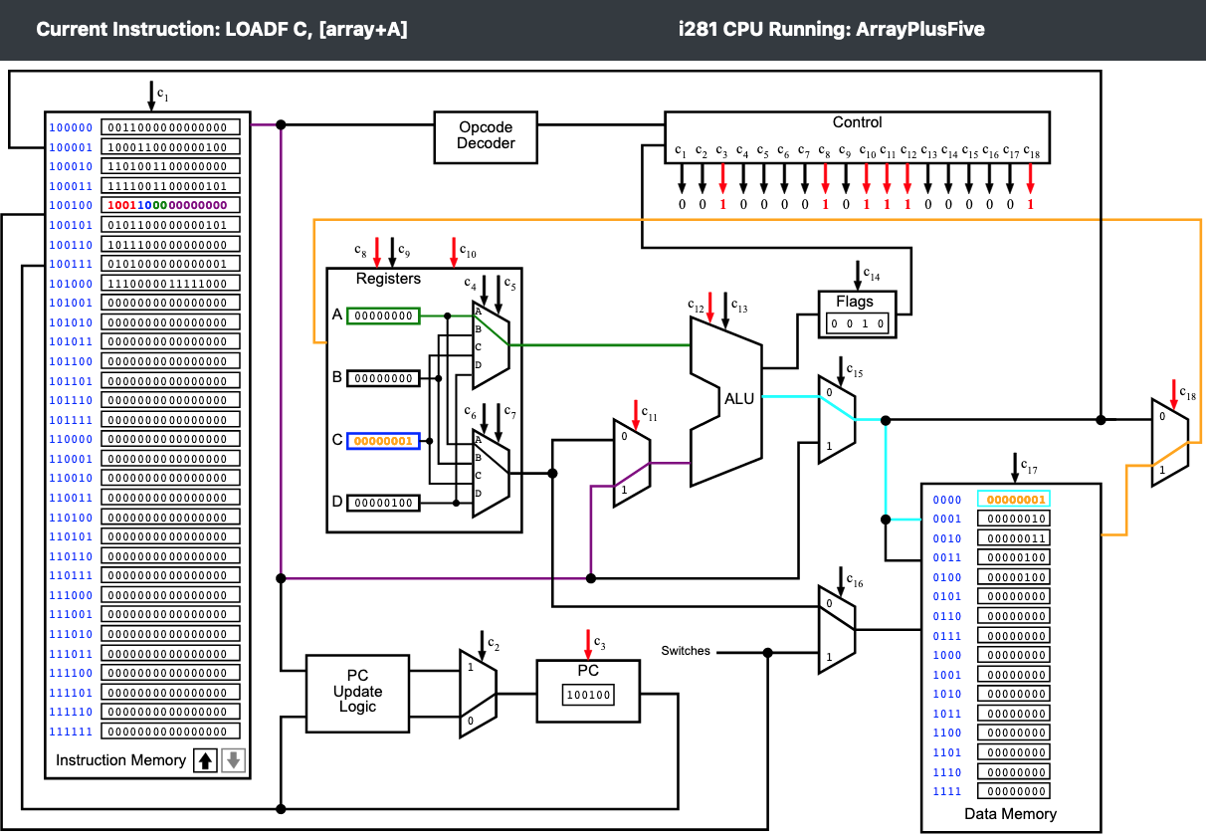

Slide 130

2nd iteration

Slide 131

3rd iteration

Slide 132
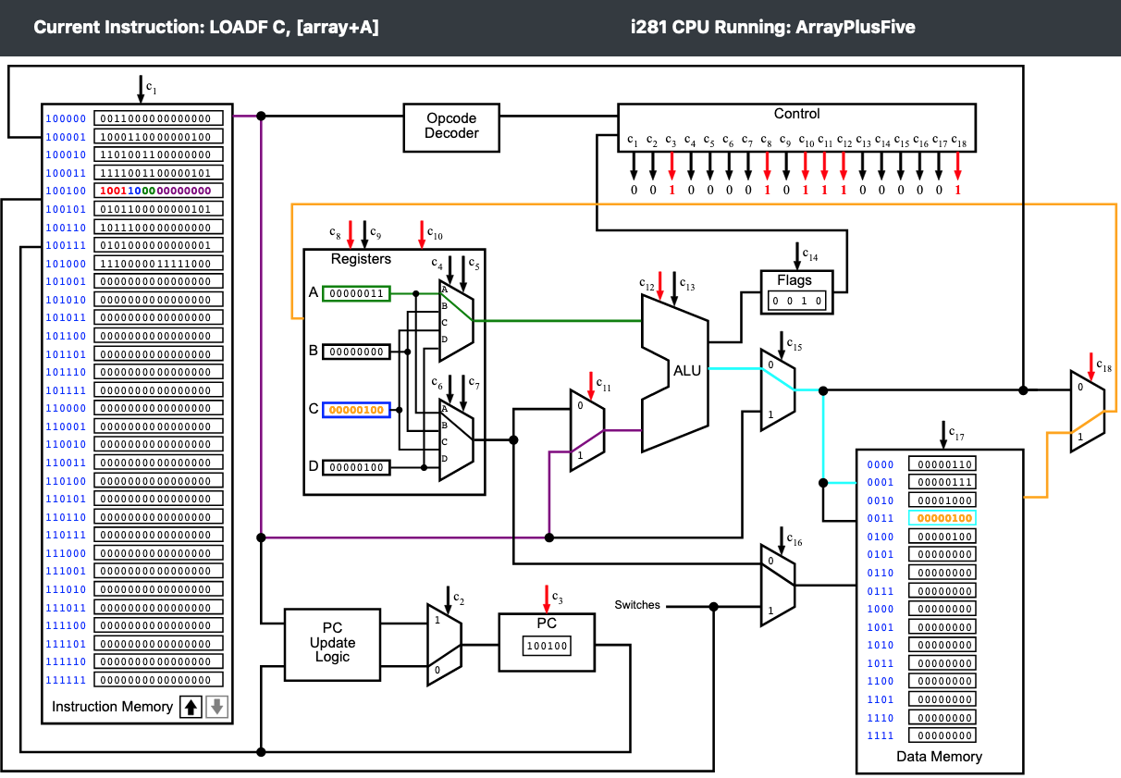
4th iteration

Slide 133
C vs. Assembly
// Array plus 5
// C version
int array[]={1, 2, 3, 4};
int N = 4;
int main()
{
int i;
// add 5 to all elements
for( i=0; i< N; i++)
{
array[i] += 5;
}
}
; Array plus 5
; Assembly version
.data
array BYTE 1, 2, 3, 4
N BYTE 4
.code
LOADI A, 0 ; i = 0
For: LOAD D, [N] ; D <- N
CMP A, D ; i < N ?
BRGE End ; if no, exit loop
LOADF C, [array + A] ; load array[i]
ADDI C, 5 ; add 5
STOREF [array + A], C ; store the result
Iinc: ADDI A, 1 ; i++
JUMP For ; next iteration
End: NOOP
; Register allocation:
; A: i
; B: <not used>
; C: temp variable for loading the array elements
; D: N

Slide 134
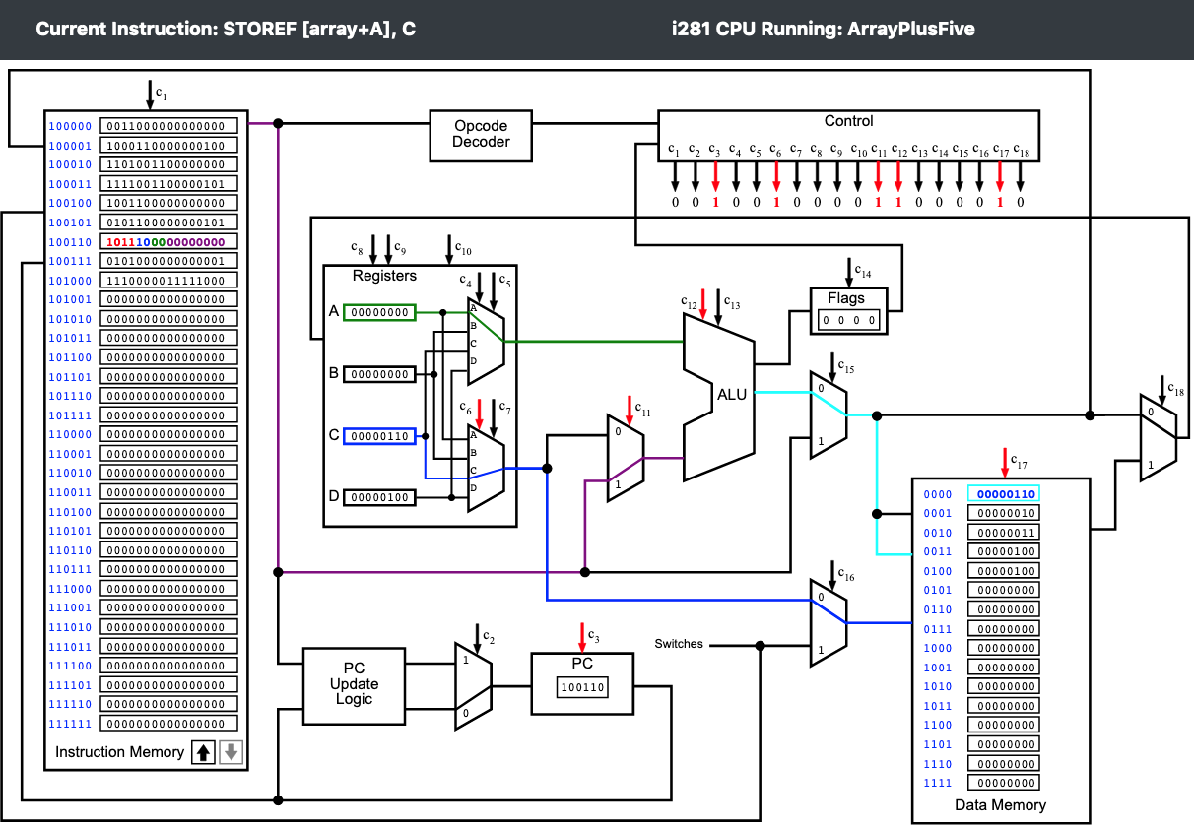

Slide 135

2nd iteration

Slide 136

3rd iteration

Slide 137

4th iteration

Slide 138
C vs. Assembly
// Array plus 5
// C version
int array[]={1, 2, 3, 4};
int N = 4;
int main()
{
int i;
// add 5 to all elements
for( i=0; i< N; i++)
{
array[i] += 5;
}
}
; Array plus 5
; Assembly version
.data
array BYTE 1, 2, 3, 4
N BYTE 4
.code
LOADI A, 0 ; i = 0
For: LOAD D, [N] ; D <- N
CMP A, D ; i < N ?
BRGE End ; if no, exit loop
LOADF C, [array + A] ; load array[i]
ADDI C, 5 ; add 5
STOREF [array + A], C ; store the result
Iinc: ADDI A, 1 ; i++
JUMP For ; next iteration
End: NOOP
; Register allocation:
; A: i
; B: <not used>
; C: temp variable for loading the array elements
; D: N

Slide 139
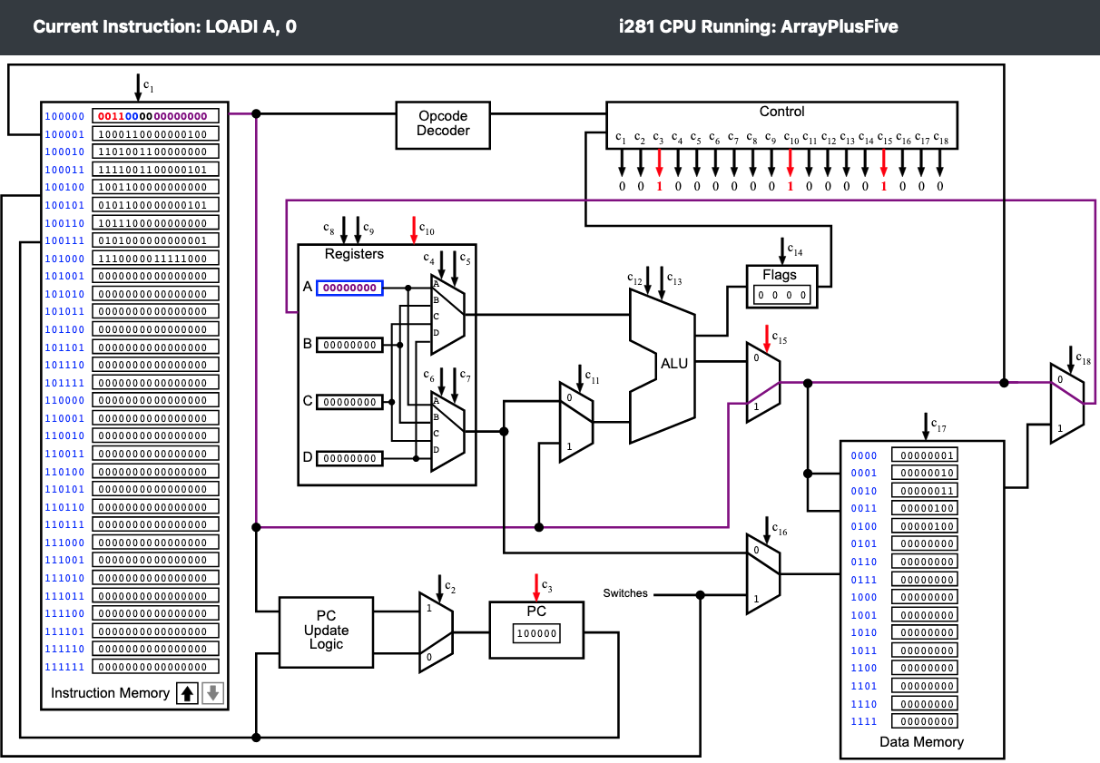

Slide 140


Slide 141
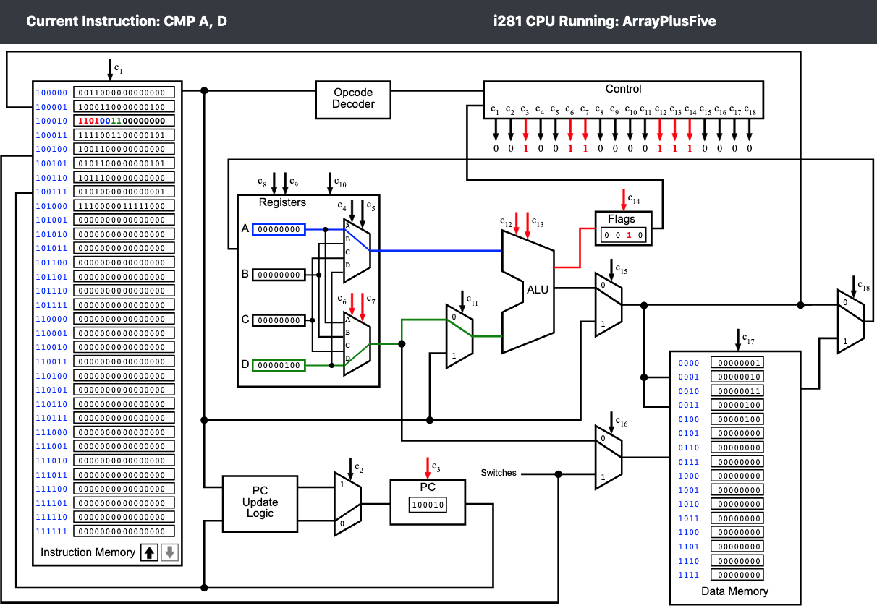

Slide 142
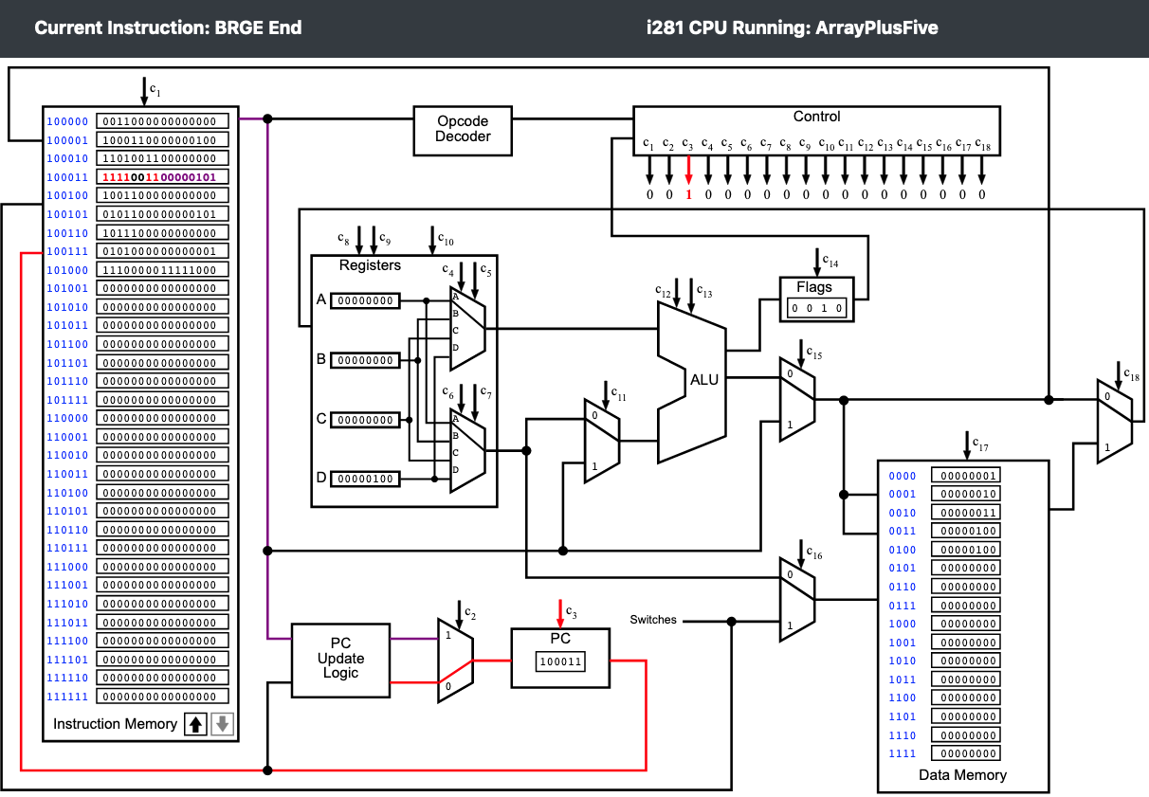

Slide 144
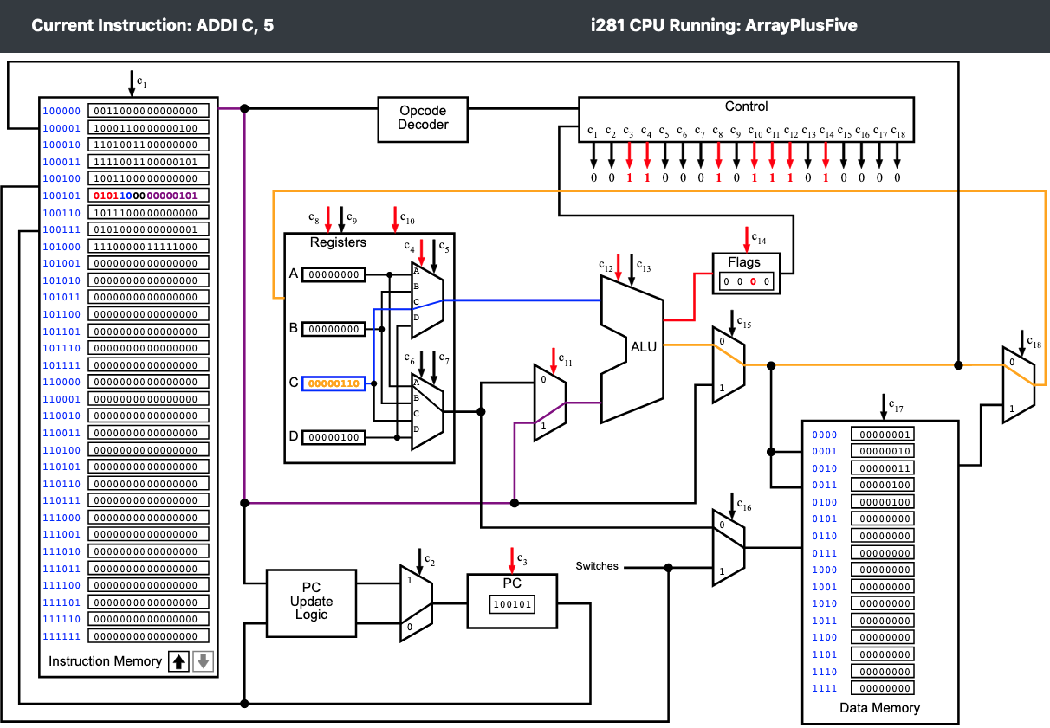

Slide 146
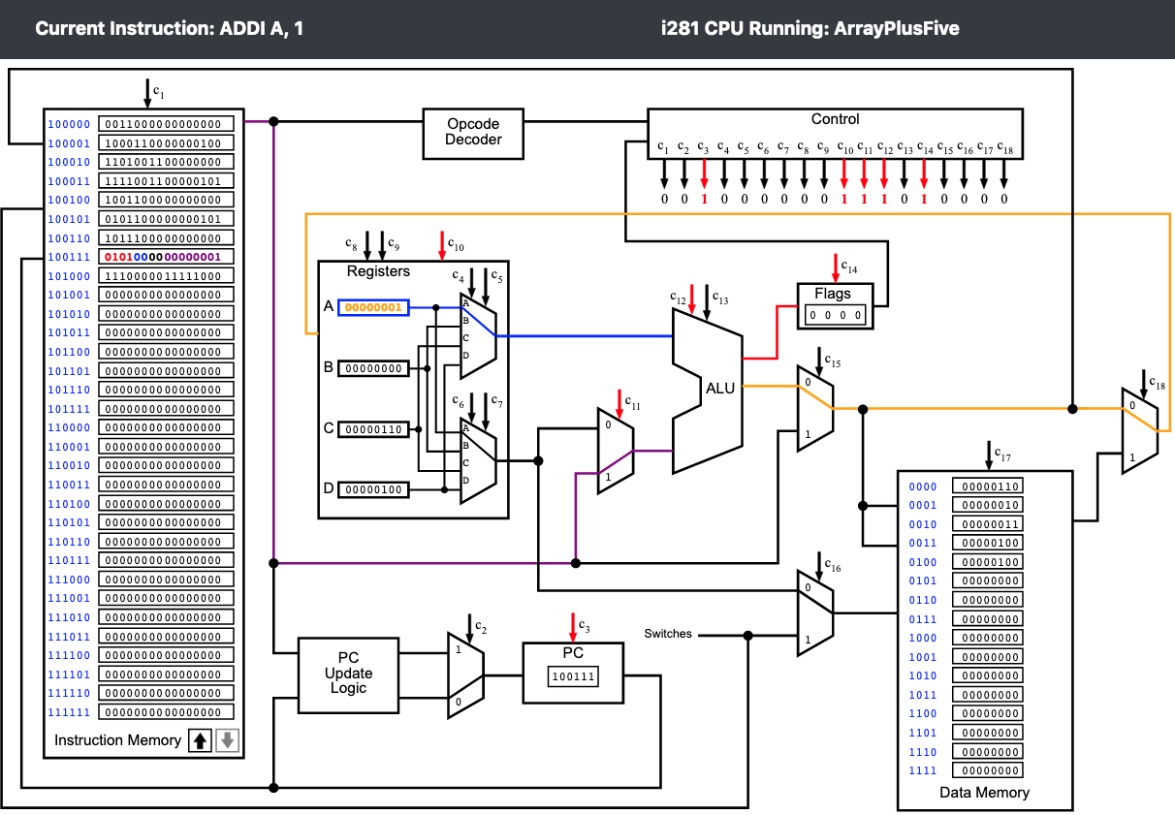

Slide 147
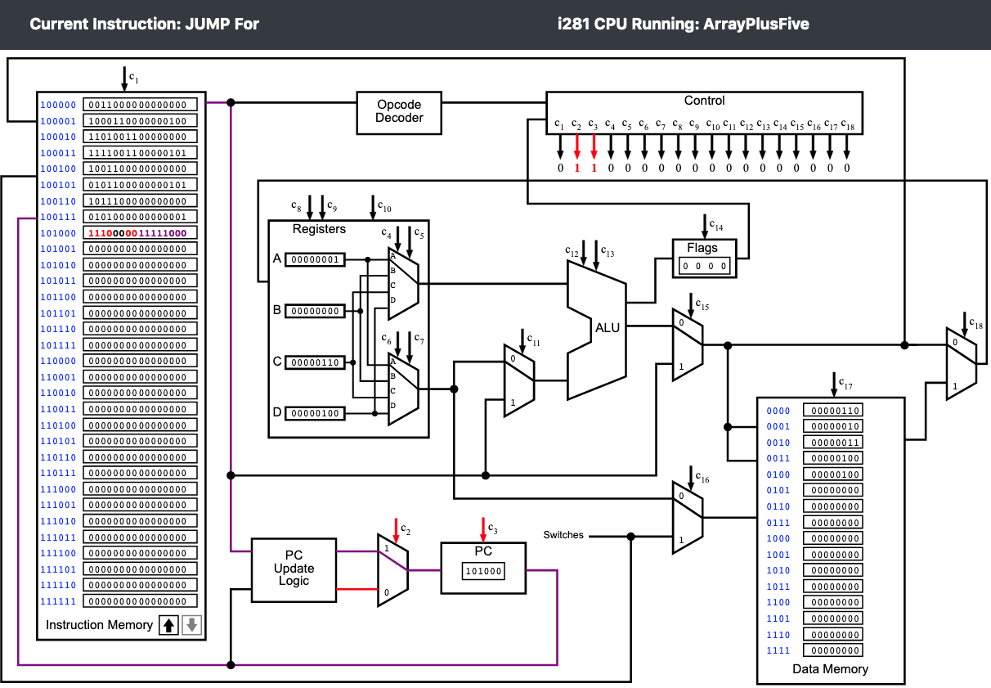

Slide 148


Slide 149
For Loop Example:
Add the numbers from 1 to 5

Slide 150
Add the numbers from 1 to 5
; Register allocation:
; A: i
; B: sum
; C: <not used>
; D: N
// C Version
// using a for loop
int main()
{
int N=5;
int i, sum;
sum=0;
for(i=1; i<=N; i++) {
sum+=i;
}
// printf("%d\n", sum);
}
; Assembly Version
.data
N BYTE 5
i BYTE ?
sum BYTE ?
.code
LOADI B, 0 ; sum=0
LOADI A, 1 ; i=1
LOAD D, [N] ; register_D=N
Loop: CMP A, D ; i<=N ?
BRG End ; exit if i>N
Add: ADD B, A ; sum+=i
ADDI A, 1 ; i++
JUMP Loop ; next iteration
End: STORE [sum], B ; write B to sum
See the previous lectures for an animation of the program execution.

Slide 151
Do Loop Example:
Add the numbers from 1 to 5

Slide 152
C Version
// Add the numbers from 1 to 5 using a do loop.
int N=5;
int main()
{
int i, sum;
i=0;
sum=0;
do
{
i++;
sum+=i;
}while( i < N );
}

Slide 153
Assembly Version
; Add the numbers from 1 to 5 using a do loop.
.data
N BYTE 5
sum BYTE ?
.code
LOADI A, 0 ; i = 0
LOADI B, 0 ; sum=0
LOAD D, [N] ; register D = N
Do: ADDI A, 1 ; i++
ADD B, A ; sum+=i
CMP D, A ; N > i ? (register ordering is swapped)
BRG Do ; if true, jump to Do
End: STORE [sum], B ; store sum to memory
; Register allocation:
; A: i (the variable i is optimized to register A)
; B: sum
; C: <not used>
; D: N

Slide 154
Do Loop
// Add the numbers from
// 1 to 5 using a do loop
int N=5;
int main()
{
int i, sum;
i=0;
sum=0;
do
{
i++;
sum+=i;
}while( i < N );
}
; assembly version
.data
N BYTE 5
sum BYTE ?
.code
LOADI A, 0 ; i = 0
LOADI B, 0 ; sum=0
LOAD D, [N] ; register D = N
Do: ADDI A, 1 ; i++
ADD B, A ; sum+=i
CMP D, A ; N > i ?
BRG Do ; if true, jump to Do
End: STORE [sum], B ; store sum to memory
; Register allocation:
; A: i (the variable i is optimized to register A)
; B: sum
; C: <not used>
; D: N

Slide 155
Machine Code Version
Data Memory:
00000101
00000000
Code Memory:
0011000000000000
0011010000000000
1000110000000000
0101000000000001
0100010000000000
1101110000000000
1111001011111100
1010010000000001

Slide 156
Assembly v.s. Machine Code
.data
N BYTE 5
sum BYTE ?
.code
LOADI A, 0
LOADI B, 0
LOAD D, [N]
Do: ADDI A, 1
ADD B, A
CMP D, A
BRG Do
End: STORE [sum], B
Data Memory:
00000101
00000000
Code Memory:
0011000000000000
0011010000000000
1000110000000000
0101000000000001
0100010000000000
1101110000000000
1111001011111100
1010010000000001

Slide 157
Assembly v.s. Machine Code
.data
N BYTE 5
sum BYTE ?
.code
LOADI A, 0
LOADI B, 0
LOAD D, [N]
Do: ADDI A, 1
ADD B, A
CMP D, A
BRG Do
End: STORE [sum], B
Data Memory:
00000101
00000000
Code Memory:
00110000_00000000
00110100_00000000
10001100_00000000
01010000_00000001
01000100_00000000
11011100_00000000
11110010_11111100
10100100_00000001

Slide 158
Assembly v.s. Machine Code
.data
N BYTE 5
sum BYTE ?
.code
LOADI A, 0
LOADI B, 0
LOAD D, [N]
Do: ADDI A, 1
ADD B, A
CMP D, A
BRG Do
End: STORE [sum], B
Data Memory:
00000101
00000000
Code Memory:
0011_00_00_00000000
0011_01_00_00000000
1000_11_00_00000000
0101_00_00_00000001
0100_01_00_00000000
1101_11_00_00000000
1111_00_10_11111100
1010_01_00_00000001

Slide 159
Assembly v.s. Machine Code
.data
N BYTE 5
sum BYTE ?
.code
LOADI A, 0
LOADI B, 0
LOAD D, [N]
Do: ADDI A, 1
ADD B, A
CMP D, A
BRG Do
End: STORE [sum], B
Data Memory:
00000101
00000000
Code Memory:
0011_00_00_00000000
0011_01_00_00000000
1000_11_00_00000000
0101_00_00_00000001
0100_01_00_00000000
1101_11_00_00000000
1111_00_10_11111100
1010_01_00_00000001

Slide 160
Assembly v.s. Machine Code
.data
N BYTE 5
sum BYTE ?
.code
LOADI A, 0
LOADI B, 0
LOAD D, [N]
Do: ADDI A, 1
ADD B, A
CMP D, A
BRG Do
End: STORE [sum], B
Data Memory:
00000101
00000000
Code Memory:
0011_00_00_00000000
0011_01_00_00000000
1000_11_00_00000000
0101_00_00_00000001
0100_01_00_00000000
1101_11_00_00000000
1111_00_10_11111100
1010_01_00_00000001

Slide 161
Assembly v.s. Machine Code
.data
N BYTE 5
sum BYTE ?
.code
LOADI A, 0
LOADI B, 0
LOAD D, [N]
Do: ADDI A, 1
ADD B, A
CMP D, A
BRG Do
End: STORE [sum], B
Data Memory:
00000101
00000000
Code Memory:
0011_00_00_00000000
0011_01_00_00000000
1000_11_00_00000000
0101_00_00_00000001
0100_01_00_00000000
1101_11_00_00000000
1111_00_10_11111100
1010_01_00_00000001

Slide 162
Assembly v.s. Machine Code
.data
N BYTE 5
sum BYTE ?
.code
LOADI A, 0
LOADI B, 0
LOAD D, [N]
Do: ADDI A, 1
ADD B, A
CMP D, A
BRG Do
End: STORE [sum], B
Data Memory:
00000101
00000000
Code Memory:
0011_00_00_00000000
0011_01_00_00000000
1000_11_00_00000000
0101_00_00_00000001
0100_01_00_00000000
1101_11_00_00000000
1111_00_10_11111100
1010_01_00_00000001

Slide 163
Assembly v.s. Machine Code
.data
N BYTE 5
sum BYTE ?
.code
LOADI A, 0
LOADI B, 0
LOAD D, [N]
Do: ADDI A, 1
ADD B, A
CMP D, A
BRG Do
End: STORE [sum], B
Data Memory:
00000101
00000000
Code Memory:
0011_00_00_00000000
0011_01_00_00000000
1000_11_00_00000000
0101_00_00_00000001
0100_01_00_00000000
1101_11_00_00000000
1111_00_10_11111100
1010_01_00_00000001

Slide 164
Assembly v.s. Machine Code
.data
N BYTE 5
sum BYTE ?
.code
LOADI A, 0
LOADI B, 0
LOAD D, [N]
Do: ADDI A, 1
ADD B, A
CMP D, A
BRG Do
End: STORE [sum], B
Data Memory:
00000101
00000000
Code Memory:
0011_00_00_00000000
0011_01_00_00000000
1000_11_00_00000000
0101_00_00_00000001
0100_01_00_00000000
1101_11_00_00000000
1111_00_10_11111100
1010_01_00_00000001

Slide 165
Assembly v.s. Machine Code
.data
N BYTE 5
sum BYTE ?
.code
LOADI A, 0
LOADI B, 0
LOAD D, [N]
Do: ADDI A, 1
ADD B, A
CMP D, A
BRG Do
End: STORE [sum], B
Data Memory:
00000101
00000000
Code Memory:
0011_00_dd_00000000
0011_01_dd_00000000
1000_11_dd_00000000
0101_00_dd_00000001
0100_01_00_dddddddd
1101_11_00_dddddddd
1111_dd_10_11111100
1010_01_dd_00000001

Slide 166
Assembly v.s. Machine Code
.data
N BYTE 5
sum BYTE ?
.code
LOADI A, 0
LOADI B, 0
LOAD D, [N]
Do: ADDI A, 1
ADD B, A
CMP D, A
BRG Do
End: STORE [sum], B
Data Memory:
00000101
00000000
Code Memory:
0011_00_00_00000000
0011_01_00_00000000
1000_11_00_00000000
0101_00_00_00000001
0100_01_00_00000000
1101_11_00_00000000
1111_00_10_11111100
1010_01_00_00000001

Slide 167
While Loop Example:
Add the numbers from 1 to 5

Slide 168
While Loop
// Add the numbers from
// 1 to 5 using a while loop
int N=5;
int sum;
int i;
int main()
{
i=1;
sum=0;
while( i <= N )
{
sum+=i;
i++;
}
}
; assembly version
.data
N BYTE 5
sum BYTE ?
; i is optimized to register A
.code
LOADI A, 1 ; i = 1
LOADI B, 0 ; sum=0
LOAD D, [N] ; register D = N
While: CMP A, D ; i <= N ?
BRG End ; if no, exit the loop
ADD B, A ; sum+=i
ADDI A, 1 ; i++
JUMP While ; next iteration
End: STORE [sum], B ; store sum to memory
; Register allocation:
; A: i
; B: sum
; C: <not used>
; D: N

Slide 169
Bubble Sort

Slide 170
C Version
int array[] = {7, 3, 2, 1, 6, 4, 5, 8};
int last = 7; // last valid index in the array
int temp;
int i, j;
int main()
{
for (i = 0; i < last; i++)
for (j = 0; j < last-i; j++)
if (array[j] > array[j+1]){
temp = array[j];
array[j] = array[j+1];
array[j+1] = temp;
}
//for(i = 0; i < N; i++){
// printf("%d, ", array[i]);
//}
}

Slide 171
Assembly Version
.data
array BYTE 7, 3, 2, 1, 6, 4, 5, 8
last BYTE 7
temp BYTE ?
.code
LOADI A, 0 ; i = 0;
Outer: LOAD D, [last] ; Load last into D
LOADI B, 0 ; j = 0;
CMP A, D ; i < last
BRGE End ; If i >= last break out of the outer loop
Inner: LOAD D, [last] ; Re-Load last into D (this register is shared)
SUB D, A ; D = D - A (i.e., D = last - i)
CMP B, D ; j < last - i
BRGE Iinc ; If j >= last-i branch to Iinc
If: LOADF C, [array+B] ; C = array[j]
LOADF D, [array+B+1] ; D = array[j+1] (compiler adds 1 to addr. of array)
CMP D, C ; if array[j+1] < array[j] (switched direction)
BRGE Jinc
Swap: STOREF [array+B], D
STOREF [array+B+1], C
Jinc: ADDI B, 1 ; j++
JUMP Inner
Iinc: ADDI A, 1 ; i++
JUMP Outer
End: NOOP ; Do nothing
; Register allocation:
; A: i
; B: j
; C: array[j]
; D: last, array[j+1]
; Notes: i and j are optimized away. They exist only in registers, not in the main memory.

Slide 172
Assembly Version
.data
array BYTE 7, 3, 2, 1, 6, 4, 5, 8
last BYTE 7
temp BYTE ?
.code
LOADI A, 0 ; i = 0;
Outer: LOAD D, [last] ; Load last into D
LOADI B, 0 ; j = 0;
CMP A, D ; i < last
BRGE End ; If i >= last break out of the outer loop
Inner: LOAD D, [last] ; Re-Load last into D (this register is shared)
SUB D, A ; D = D - A (i.e., D = last - i)
CMP B, D ; j < last - i
BRGE Iinc ; If j >= last-i branch to Iinc
If: LOADF C, [array+B] ; C = array[j]
LOADF D, [array+B+1] ; D = array[j+1] (compiler adds 1 to addr. of array)
CMP D, C ; if array[j+1] < array[j] (switched direction)
BRGE Jinc
Swap: STOREF [array+B], D
STOREF [array+B+1], C
Jinc: ADDI B, 1 ; j++
JUMP Inner
Iinc: ADDI A, 1 ; i++
JUMP Outer
End: NOOP ; Do nothing
; Register allocation:
; A: i
; B: j
; C: array[j]
; D: last, array[j+1]
; Notes: i and j are optimized away. They exist only in registers, not in the main memory.

Slide 173
Bubble Sort
int array[] = {7, 3, 2, 1, 6, 4, 5, 8};
int last = 7; // last valid index
int temp;
int i, j;
int main()
{
for (i = 0; i < last; i++)
for (j = 0; j < last-i; j++)
if (array[j] > array[j+1]){
temp = array[j];
array[j] = array[j+1];
array[j+1] = temp;
}
//for(i = 0; i < N; i++){
// printf("%d, ", array[i]);
//}
}
.data
array BYTE 7, 3, 2, 1, 6, 4, 5, 8
last BYTE 7
temp BYTE ?
.code
LOADI A, 0 ; i = 0;
Outer: LOAD D, [last] ; Load last into D
LOADI B, 0 ; j = 0;
CMP A, D ; i < last
BRGE End ; If i >= last
Inner: LOAD D, [last] ; Re-Load last into D
SUB D, A ; D=D-A, i.e., D=last-i
CMP B, D ; j < last - i
BRGE Iinc ; If j >= last-i
If: LOADF C, [array+B] ; C = array[j]
LOADF D, [array+B+1] ; D = array[j+1]
CMP D, C ; array[j+1] < array[j]
BRGE Jinc
Swap: STOREF [array+B], D
STOREF [array+B+1], C
Jinc: ADDI B, 1 ; j++
JUMP Inner
Iinc: ADDI A, 1 ; i++
JUMP Outer
End: NOOP
; Register allocation:
; A: i
; B: j
; C: array[j]
; D: last, array[j+1] (shared)
; Notes: i and j are optimized away to registers.

Slide 175
Machine Code Version
.data
array BYTE 7, 3, 2, 1, 6, 4, 5, 8
last BYTE 7
temp BYTE ?
.code
LOADI A, 0
Outer: LOAD D, [last]
LOADI B, 0
CMP A, D
BRGE End
Inner: LOAD D, [last]
SUB D, A
CMP B, D
BRGE Iinc
If: LOADF C, [array+B]
LOADF D, [array+B+1]
CMP D, C
BRGE Jinc
Swap: STOREF [array+B], D
STOREF [array+B+1], C
Jinc: ADDI B, 1
JUMP Inner
Iinc: ADDI A, 1
JUMP Outer
End: NOOP

Slide 176
Machine Code Version
.data
array BYTE 7, 3, 2, 1, 6, 4, 5, 8
last BYTE 7
temp BYTE ?
.code
LOADI A, 0
Outer: LOAD D, [last]
LOADI B, 0
CMP A, D
BRGE End
Inner: LOAD D, [last]
SUB D, A
CMP B, D
BRGE Iinc
If: LOADF C, [array+B]
LOADF D, [array+B+1]
CMP D, C
BRGE Jinc
Swap: STOREF [array+B], D
STOREF [array+B+1], C
Jinc: ADDI B, 1
JUMP Inner
Iinc: ADDI A, 1
JUMP Outer
End: NOOP
Data Memory:
00000111
00000011
00000010
00000001
00000110
00000100
00000101
00001000
00000111
00000000

Slide 177
Machine Code Version
.data
array BYTE 7, 3, 2, 1, 6, 4, 5, 8
last BYTE 7
temp BYTE ?
.code
LOADI A, 0
Outer: LOAD D, [last]
LOADI B, 0
CMP A, D
BRGE End
Inner: LOAD D, [last]
SUB D, A
CMP B, D
BRGE Iinc
If: LOADF C, [array+B]
LOADF D, [array+B+1]
CMP D, C
BRGE Jinc
Swap: STOREF [array+B], D
STOREF [array+B+1], C
Jinc: ADDI B, 1
JUMP Inner
Iinc: ADDI A, 1
JUMP Outer
End: NOOP
Data Memory:
00000111 //array[0]
00000011 //array[1]
00000010 //array[2]
00000001 //array[3]
00000110 //array[4]
00000100 //array[5]
00000101 //array[6]
00001000 //array[7]
00000111 //last
00000000 //temp

Slide 178
Machine Code Version
.data
array BYTE 7, 3, 2, 1, 6, 4, 5, 8
last BYTE 7
temp BYTE ?
.code
LOADI A, 0
Outer: LOAD D, [last]
LOADI B, 0
CMP A, D
BRGE End
Inner: LOAD D, [last]
SUB D, A
CMP B, D
BRGE Iinc
If: LOADF C, [array+B]
LOADF D, [array+B+1]
CMP D, C
BRGE Jinc
Swap: STOREF [array+B], D
STOREF [array+B+1], C
Jinc: ADDI B, 1
JUMP Inner
Iinc: ADDI A, 1
JUMP Outer
End: NOOP
Address
0000
0001
0010
0011
0100
0101
0110
0111
1000
1001
Data Memory:
00000111 //array[0]
00000011 //array[1]
00000010 //array[2]
00000001 //array[3]
00000110 //array[4]
00000100 //array[5]
00000101 //array[6]
00001000 //array[7]
00000111 //last
00000000 //temp

Slide 179
Machine Code Version
.data
array BYTE 7, 3, 2, 1, 6, 4, 5, 8
last BYTE 7
temp BYTE ?
.code
LOADI A, 0
Outer: LOAD D, [last]
LOADI B, 0
CMP A, D
BRGE End
Inner: LOAD D, [last]
SUB D, A
CMP B, D
BRGE Iinc
If: LOADF C, [array+B]
LOADF D, [array+B+1]
CMP D, C
BRGE Jinc
Swap: STOREF [array+B], D
STOREF [array+B+1], C
Jinc: ADDI B, 1
JUMP Inner
Iinc: ADDI A, 1
JUMP Outer
End: NOOP
Address
0000
0001
0010
0011
0100
0101
0110
0111
1000
1001
1010
1011
1100
1101
1110
1111
Data Memory:
00000111 //array[0]
00000011 //array[1]
00000010 //array[2]
00000001 //array[3]
00000110 //array[4]
00000100 //array[5]
00000101 //array[6]
00001000 //array[7]
00000111 //last
00000000 //temp
00000000
00000000
00000000
00000000
00000000
00000000

Slide 180
Machine Code Version
.data
array BYTE 7, 3, 2, 1, 6, 4, 5, 8
last BYTE 7
temp BYTE ?
.code
LOADI A, 0
Outer: LOAD D, [last]
LOADI B, 0
CMP A, D
BRGE End
Inner: LOAD D, [last]
SUB D, A
CMP B, D
BRGE Iinc
If: LOADF C, [array+B]
LOADF D, [array+B+1]
CMP D, C
BRGE Jinc
Swap: STOREF [array+B], D
STOREF [array+B+1], C
Jinc: ADDI B, 1
JUMP Inner
Iinc: ADDI A, 1
JUMP Outer
End: NOOP

Slide 181
Machine Code Version
.data
array BYTE 7, 3, 2, 1, 6, 4, 5, 8
last BYTE 7
temp BYTE ?
.code
LOADI A, 0
Outer: LOAD D, [last]
LOADI B, 0
CMP A, D
BRGE End
Inner: LOAD D, [last]
SUB D, A
CMP B, D
BRGE Iinc
If: LOADF C, [array+B]
LOADF D, [array+B+1]
CMP D, C
BRGE Jinc
Swap: STOREF [array+B], D
STOREF [array+B+1], C
Jinc: ADDI B, 1
JUMP Inner
Iinc: ADDI A, 1
JUMP Outer
End: NOOP
Code Memory:
0011000000000000
1000110000001000
0011010000000000
1101001100000000
1111001100001110
1000110000001000
0110110000000000
1101011100000000
1111001100001000
1001100100000000
1001110100000001
1101111000000000
1111001100000010
1011110100000000
1011100100000001
0101010000000001
1110000011110100
0101000000000001
1110000011101110
0000000000000000

Slide 182
Machine Code Version
.data
array BYTE 7, 3, 2, 1, 6, 4, 5, 8
last BYTE 7
temp BYTE ?
.code
LOADI A, 0
Outer: LOAD D, [last]
LOADI B, 0
CMP A, D
BRGE End
Inner: LOAD D, [last]
SUB D, A
CMP B, D
BRGE Iinc
If: LOADF C, [array+B]
LOADF D, [array+B+1]
CMP D, C
BRGE Jinc
Swap: STOREF [array+B], D
STOREF [array+B+1], C
Jinc: ADDI B, 1
JUMP Inner
Iinc: ADDI A, 1
JUMP Outer
End: NOOP
Address
100000
100001
100010
100011
100100
100101
100110
100111
101000
101001
101010
101011
101100
101101
101110
101111
110000
110001
110010
110011
Code Memory:
0011000000000000
1000110000001000
0011010000000000
1101001100000000
1111001100001110
1000110000001000
0110110000000000
1101011100000000
1111001100001000
1001100100000000
1001110100000001
1101111000000000
1111001100000010
1011110100000000
1011100100000001
0101010000000001
1110000011110100
0101000000000001
1110000011101110
0000000000000000

Slide 183
Machine Code Version
.data
array BYTE 7, 3, 2, 1, 6, 4, 5, 8
last BYTE 7
temp BYTE ?
.code
LOADI A, 0
Outer: LOAD D, [last]
LOADI B, 0
CMP A, D
BRGE End
Inner: LOAD D, [last]
SUB D, A
CMP B, D
BRGE Iinc
If: LOADF C, [array+B]
LOADF D, [array+B+1]
CMP D, C
BRGE Jinc
Swap: STOREF [array+B], D
STOREF [array+B+1], C
Jinc: ADDI B, 1
JUMP Inner
Iinc: ADDI A, 1
JUMP Outer
End: NOOP
Address
100000
100001
100010
100011
100100
100101
100110
100111
101000
101001
101010
101011
101100
101101
101110
101111
110000
110001
110010
110011
110100
. . .
111110
111111
Code Memory:
0011000000000000
1000110000001000
0011010000000000
1101001100000000
1111001100001110
1000110000001000
0110110000000000
1101011100000000
1111001100001000
1001100100000000
1001110100000001
1101111000000000
1111001100000010
1011110100000000
1011100100000001
0101010000000001
1110000011110100
0101000000000001
1110000011101110
0000000000000000
0000000000000000
. . .
0000000000000000
0000000000000000

Slide 185
Assembly v.s. Machine Code
.code
LOADI A, 0
Outer: LOAD D, [last]
LOADI B, 0
CMP A, D
BRGE End
Inner: LOAD D, [last]
SUB D, A
CMP B, D
BRGE Iinc
If: LOADF C, [array+B]
LOADF D, [array+B+1]
CMP D, C
BRGE Jinc
Swap: STOREF [array+B], D
STOREF [array+B+1], C
Jinc: ADDI B, 1
JUMP Inner
Iinc: ADDI A, 1
JUMP Outer
End: NOOP
Code Memory:
0011000000000000
1000110000001000
0011010000000000
1101001100000000
1111001100001110
1000110000001000
0110110000000000
1101011100000000
1111001100001000
1001100100000000
1001110100000001
1101111000000000
1111001100000010
1011110100000000
1011100100000001
0101010000000001
1110000011110100
0101000000000001
1110000011101110
0000000000000000

Slide 186
Assembly v.s. Machine Code
.code
LOADI A, 0
Outer: LOAD D, [last]
LOADI B, 0
CMP A, D
BRGE End
Inner: LOAD D, [last]
SUB D, A
CMP B, D
BRGE Iinc
If: LOADF C, [array+B]
LOADF D, [array+B+1]
CMP D, C
BRGE Jinc
Swap: STOREF [array+B], D
STOREF [array+B+1], C
Jinc: ADDI B, 1
JUMP Inner
Iinc: ADDI A, 1
JUMP Outer
End: NOOP
Code Memory:
00110000_00000000
10001100_00001000
00110100_00000000
11010011_00000000
11110011_00001110
10001100_00001000
01101100_00000000
11010111_00000000
11110011_00001000
10011001_00000000
10011101_00000001
11011110_00000000
11110011_00000010
10111101_00000000
10111001_00000001
01010100_00000001
11100000_11110100
01010000_00000001
11100000_11101110
00000000_00000000

Slide 187
Assembly v.s. Machine Code
.code
LOADI A, 0
Outer: LOAD D, [last]
LOADI B, 0
CMP A, D
BRGE End
Inner: LOAD D, [last]
SUB D, A
CMP B, D
BRGE Iinc
If: LOADF C, [array+B]
LOADF D, [array+B+1]
CMP D, C
BRGE Jinc
Swap: STOREF [array+B], D
STOREF [array+B+1], C
Jinc: ADDI B, 1
JUMP Inner
Iinc: ADDI A, 1
JUMP Outer
End: NOOP
Code Memory:
0011_00_00_00000000
1000_11_00_00001000
0011_01_00_00000000
1101_00_11_00000000
1111_00_11_00001110
1000_11_00_00001000
0110_11_00_00000000
1101_01_11_00000000
1111_00_11_00001000
1001_10_01_00000000
1001_11_01_00000001
1101_11_10_00000000
1111_00_11_00000010
1011_11_01_00000000
1011_10_01_00000001
0101_01_00_00000001
1110_00_00_11110100
0101_00_00_00000001
1110_00_00_11101110
0000_00_00_00000000

Slide 188
Assembly v.s. Machine Code
.code
LOADI A, 0
Outer: LOAD D, [last]
LOADI B, 0
CMP A, D
BRGE End
Inner: LOAD D, [last]
SUB D, A
CMP B, D
BRGE Iinc
If: LOADF C, [array+B]
LOADF D, [array+B+1]
CMP D, C
BRGE Jinc
Swap: STOREF [array+B], D
STOREF [array+B+1], C
Jinc: ADDI B, 1
JUMP Inner
Iinc: ADDI A, 1
JUMP Outer
End: NOOP
Code Memory:
0011_00_00_00000000
1000_11_00_00001000
0011_01_00_00000000
1101_00_11_00000000
1111_00_11_00001110
1000_11_00_00001000
0110_11_00_00000000
1101_01_11_00000000
1111_00_11_00001000
1001_10_01_00000000
1001_11_01_00000001
1101_11_10_00000000
1111_00_11_00000010
1011_11_01_00000000
1011_10_01_00000001
0101_01_00_00000001
1110_00_00_11110100
0101_00_00_00000001
1110_00_00_11101110
0000_00_00_00000000

Slide 189
Assembly v.s. Machine Code
.code
LOADI A, 0
Outer: LOAD D, [last]
LOADI B, 0
CMP A, D
BRGE End
Inner: LOAD D, [last]
SUB D, A
CMP B, D
BRGE Iinc
If: LOADF C, [array+B]
LOADF D, [array+B+1]
CMP D, C
BRGE Jinc
Swap: STOREF [array+B], D
STOREF [array+B+1], C
Jinc: ADDI B, 1
JUMP Inner
Iinc: ADDI A, 1
JUMP Outer
End: NOOP
Code Memory:
0011_00_00_00000000
1000_11_00_00001000
0011_01_00_00000000
1101_00_11_00000000
1111_00_11_00001110
1000_11_00_00001000
0110_11_00_00000000
1101_01_11_00000000
1111_00_11_00001000
1001_10_01_00000000
1001_11_01_00000001
1101_11_10_00000000
1111_00_11_00000010
1011_11_01_00000000
1011_10_01_00000001
0101_01_00_00000001
1110_00_00_11110100
0101_00_00_00000001
1110_00_00_11101110
0000_00_00_00000000

Slide 190
Assembly v.s. Machine Code
.code
LOADI A, 0
Outer: LOAD D, [last]
LOADI B, 0
CMP A, D
BRGE End
Inner: LOAD D, [last]
SUB D, A
CMP B, D
BRGE Iinc
If: LOADF C, [array+B]
LOADF D, [array+B+1]
CMP D, C
BRGE Jinc
Swap: STOREF [array+B], D
STOREF [array+B+1], C
Jinc: ADDI B, 1
JUMP Inner
Iinc: ADDI A, 1
JUMP Outer
End: NOOP
Code Memory:
0011_00_00_00000000
1000_11_00_00001000
0011_01_00_00000000
1101_00_11_00000000
1111_00_11_00001110
1000_11_00_00001000
0110_11_00_00000000
1101_01_11_00000000
1111_00_11_00001000
1001_10_01_00000000
1001_11_01_00000001
1101_11_10_00000000
1111_00_11_00000010
1011_11_01_00000000
1011_10_01_00000001
0101_01_00_00000001
1110_00_00_11110100
0101_00_00_00000001
1110_00_00_11101110
0000_00_00_00000000

Slide 191
Assembly v.s. Machine Code
.code
LOADI A, 0
Outer: LOAD D, [last]
LOADI B, 0
CMP A, D
BRGE End
Inner: LOAD D, [last]
SUB D, A
CMP B, D
BRGE Iinc
If: LOADF C, [array+B]
LOADF D, [array+B+1]
CMP D, C
BRGE Jinc
Swap: STOREF [array+B], D
STOREF [array+B+1], C
Jinc: ADDI B, 1
JUMP Inner
Iinc: ADDI A, 1
JUMP Outer
End: NOOP
Code Memory:
0011_00_00_00000000
1000_11_00_00001000
0011_01_00_00000000
1101_00_11_00000000
1111_00_11_00001110
1000_11_00_00001000
0110_11_00_00000000
1101_01_11_00000000
1111_00_11_00001000
1001_10_01_00000000
1001_11_01_00000001
1101_11_10_00000000
1111_00_11_00000010
1011_11_01_00000000
1011_10_01_00000001
0101_01_00_00000001
1110_00_00_11110100
0101_00_00_00000001
1110_00_00_11101110
0000_00_00_00000000

Slide 192
Assembly v.s. Machine Code
.code
LOADI A, 0
Outer: LOAD D, [last]
LOADI B, 0
CMP A, D
BRGE End
Inner: LOAD D, [last]
SUB D, A
CMP B, D
BRGE Iinc
If: LOADF C, [array+B]
LOADF D, [array+B+1]
CMP D, C
BRGE Jinc
Swap: STOREF [array+B], D
STOREF [array+B+1], C
Jinc: ADDI B, 1
JUMP Inner
Iinc: ADDI A, 1
JUMP Outer
End: NOOP
Code Memory:
0011_00_00_00000000
1000_11_00_00001000
0011_01_00_00000000
1101_00_11_00000000
1111_00_11_00001110
1000_11_00_00001000
0110_11_00_00000000
1101_01_11_00000000
1111_00_11_00001000
1001_10_01_00000000
1001_11_01_00000001
1101_11_10_00000000
1111_00_11_00000010
1011_11_01_00000000
1011_10_01_00000001
0101_01_00_00000001
1110_00_00_11110100
0101_00_00_00000001
1110_00_00_11101110
0000_00_00_00000000

Slide 193
Assembly v.s. Machine Code
.code
LOADI A, 0
Outer: LOAD D, [last]
LOADI B, 0
CMP A, D
BRGE End
Inner: LOAD D, [last]
SUB D, A
CMP B, D
BRGE Iinc
If: LOADF C, [array+B]
LOADF D, [array+B+1]
CMP D, C
BRGE Jinc
Swap: STOREF [array+B], D
STOREF [array+B+1], C
Jinc: ADDI B, 1
JUMP Inner
Iinc: ADDI A, 1
JUMP Outer
End: NOOP
Code Memory:
0011_00_00_00000000
1000_11_00_00001000
0011_01_00_00000000
1101_00_11_00000000
1111_00_11_00001110
1000_11_00_00001000
0110_11_00_00000000
1101_01_11_00000000
1111_00_11_00001000
1001_10_01_00000000
1001_11_01_00000001
1101_11_10_00000000
1111_00_11_00000010
1011_11_01_00000000
1011_10_01_00000001
0101_01_00_00000001
1110_00_00_11110100
0101_00_00_00000001
1110_00_00_11101110
0000_00_00_00000000

Slide 194
Assembly v.s. Machine Code
.code
LOADI A, 0
Outer: LOAD D, [last]
LOADI B, 0
CMP A, D
BRGE End
Inner: LOAD D, [last]
SUB D, A
CMP B, D
BRGE Iinc
If: LOADF C, [array+B]
LOADF D, [array+B+1]
CMP D, C
BRGE Jinc
Swap: STOREF [array+B], D
STOREF [array+B+1], C
Jinc: ADDI B, 1
JUMP Inner
Iinc: ADDI A, 1
JUMP Outer
End: NOOP
Code Memory:
0011_00_00_00000000
1000_11_00_00001000
0011_01_00_00000000
1101_00_11_00000000
1111_00_11_00001110
1000_11_00_00001000
0110_11_00_00000000
1101_01_11_00000000
1111_00_11_00001000
1001_10_01_00000000
1001_11_01_00000001
1101_11_10_00000000
1111_00_11_00000010
1011_11_01_00000000
1011_10_01_00000001
0101_01_00_00000001
1110_00_00_11110100
0101_00_00_00000001
1110_00_00_11101110
0000_00_00_00000000

Slide 195
Assembly v.s. Machine Code
.code
LOADI A, 0
Outer: LOAD D, [last]
LOADI B, 0
CMP A, D
BRGE End
Inner: LOAD D, [last]
SUB D, A
CMP B, D
BRGE Iinc
If: LOADF C, [array+B]
LOADF D, [array+B+1]
CMP D, C
BRGE Jinc
Swap: STOREF [array+B], D
STOREF [array+B+1], C
Jinc: ADDI B, 1
JUMP Inner
Iinc: ADDI A, 1
JUMP Outer
End: NOOP
Code Memory:
0011_00_00_00000000
1000_11_00_00001000
0011_01_00_00000000
1101_00_11_00000000
1111_00_11_00001110
1000_11_00_00001000
0110_11_00_00000000
1101_01_11_00000000
1111_00_11_00001000
1001_10_01_00000000
1001_11_01_00000001
1101_11_10_00000000
1111_00_11_00000010
1011_11_01_00000000
1011_10_01_00000001
0101_01_00_00000001
1110_00_00_11110100
0101_00_00_00000001
1110_00_00_11101110
0000_00_00_00000000

Slide 196
Assembly v.s. Machine Code
.code
LOADI A, 0
Outer: LOAD D, [last]
LOADI B, 0
CMP A, D
BRGE End
Inner: LOAD D, [last]
SUB D, A
CMP B, D
BRGE Iinc
If: LOADF C, [array+B]
LOADF D, [array+B+1]
CMP D, C
BRGE Jinc
Swap: STOREF [array+B], D
STOREF [array+B+1], C
Jinc: ADDI B, 1
JUMP Inner
Iinc: ADDI A, 1
JUMP Outer
End: NOOP
Code Memory:
0011_00_dd_00000000
1000_11_dd_00001000
0011_01_dd_00000000
1101_00_11_dddddddd
1111_dd_11_00001110
1000_11_dd_00001000
0110_11_00_dddddddd
1101_01_11_dddddddd
1111_dd_11_00001000
1001_10_01_00000000
1001_11_01_00000001
1101_11_10_dddddddd
1111_dd_11_00000010
1011_11_01_00000000
1011_10_01_00000001
0101_01_dd_00000001
1110_dd_dd_11110100
0101_00_dd_00000001
1110_dd_dd_11101110
0000_dd_dd_dddddddd

Slide 197
Assembly v.s. Machine Code
.code
LOADI A, 0
Outer: LOAD D, [last]
LOADI B, 0
CMP A, D
BRGE End
Inner: LOAD D, [last]
SUB D, A
CMP B, D
BRGE Iinc
If: LOADF C, [array+B]
LOADF D, [array+B+1]
CMP D, C
BRGE Jinc
Swap: STOREF [array+B], D
STOREF [array+B+1], C
Jinc: ADDI B, 1
JUMP Inner
Iinc: ADDI A, 1
JUMP Outer
End: NOOP
Code Memory:
0011_00_00_00000000
1000_11_00_00001000
0011_01_00_00000000
1101_00_11_00000000
1111_00_11_00001110
1000_11_00_00001000
0110_11_00_00000000
1101_01_11_00000000
1111_00_11_00001000
1001_10_01_00000000
1001_11_01_00000001
1101_11_10_00000000
1111_00_11_00000010
1011_11_01_00000000
1011_10_01_00000001
0101_01_00_00000001
1110_00_00_11110100
0101_00_00_00000001
1110_00_00_11101110
0000_00_00_00000000

Slide 198
For more examples try the i281 simulator

Slide 199
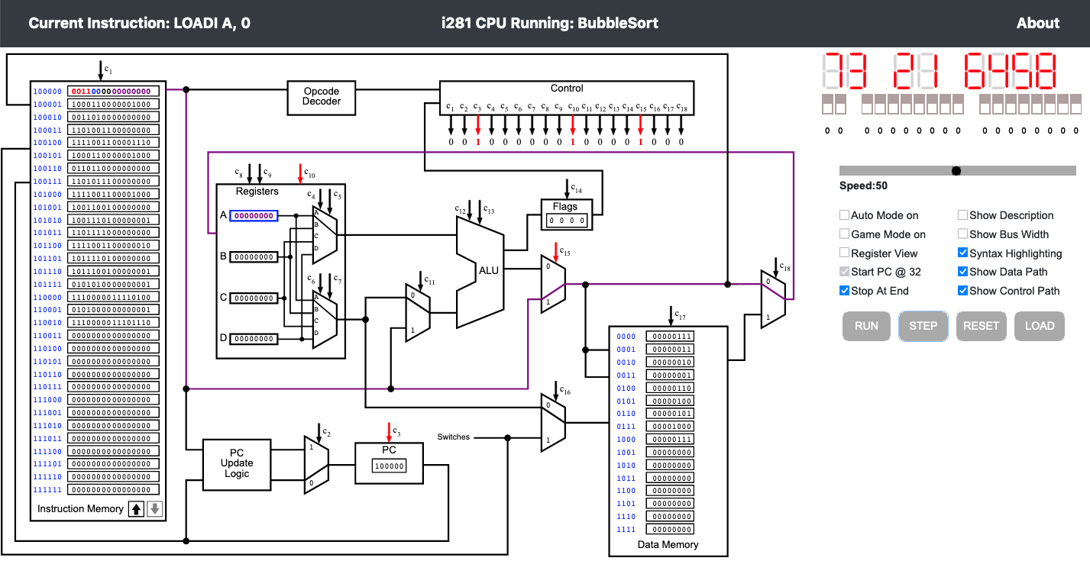
i281 Simulator
To try the simulator, go to the class web page and follow the link.

Slide 200
Questions?

Slide 201
THE END

