Slide 1
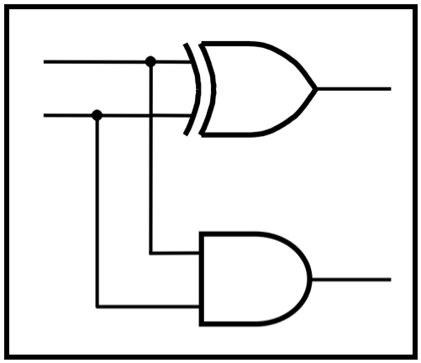
CprE 2810: Digital Logic
Instructor: Alexander Stoytchev
http://www.ece.iastate.edu/~alexs/classes/

Slide 2
Register Machines
CprE 2810: Digital Logic
Iowa State University, Ames, IA
Copyright © Alexander Stoytchev

Slide 3
Administrative Stuff
Homework 12 is due on Wednesday Dec. 3 @ 10 pm
Homework 13 will be due next week.

Slide 4
Administrative Stuff
Extra credit lab is due on Dec 7 @ midnight
Demo your circuit to the TA during your last lab

Slide 5
Administrative Stuff
The FINAL exam is scheduled for
Wednesday Dec 17 @ 2:15 – 4:15 PM

Slide 6
Final Exam Format
The exam will cover: Chapter 1 to Chapter 6, and Sections 7.1-7.2, register machines, and i281 CPU
Emphasis will be on Chapter 5, 6, and 7
The exam will be closed book but open notes.
You can bring up to 5 pages of handwritten or typed notes.

Slide 7
Final Exam Format
The exam will be out of 135 points
You need 95 points to get an A on this exam
It will be great if you can score more than 100 points.
but you can’t roll over your extra points ☹

Slide 8
Topics for the Final Exam
K-maps for 2, 3, and 4 variables
Multiplexers (circuits and function)
Synthesis of logic functions using multiplexers
Shannon’s Expansion Theorem
1’s complement and 2’s complement representation
Addition and subtraction of binary numbers
Circuits for adding and subtracting
Serial adder
Latches (circuits, behavior, timing diagrams)
Flip-Flops (circuits, behavior, timing diagrams)
Counters (up, down, synchronous, asynchronous)
Registers and Register Files

Slide 9
Topics for the Final Exam
Synchronous Sequential Circuits
FSMs
Moore Machines
Mealy Machines
State diagrams, state tables, state-assigned tables
State minimization
Designing a counter
Arbiter Circuits
Reverse engineering a circuit
ASM Charts
Register Machines and programs for them
ALU, PC, and control for a simple processor (i281 CPU)
Assembly and machine language (i281 assembly)
Something from Star Wars

Slide 10
Reading Material for Today
“The Seven Secrets of Computer Power Revealed” by Daniel Dennett.
This is Chapter 24 in his latest book “Intuition Pumps and Other Tools for Thinking”, 2013

Slide 11
Reading Material for Today
“The Seven Secrets of Computer Power Revealed” by Daniel Dennett.
This is Chapter 24 in his latest book “Intuition Pumps and Other Tools for Thinking”, 2013
Chapter 24 in reverse is: 42!

Slide 12
What is a register?

Slide 13
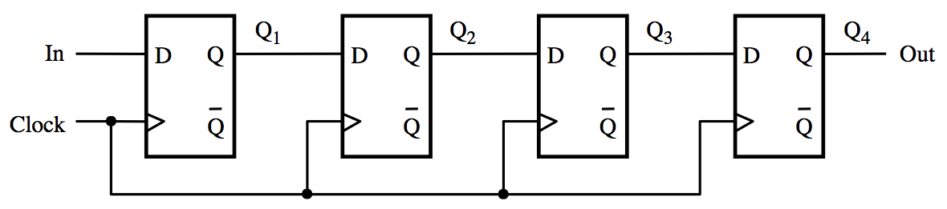
What is a register?
[ Figure 5.17 from the textbook ]

Slide 14
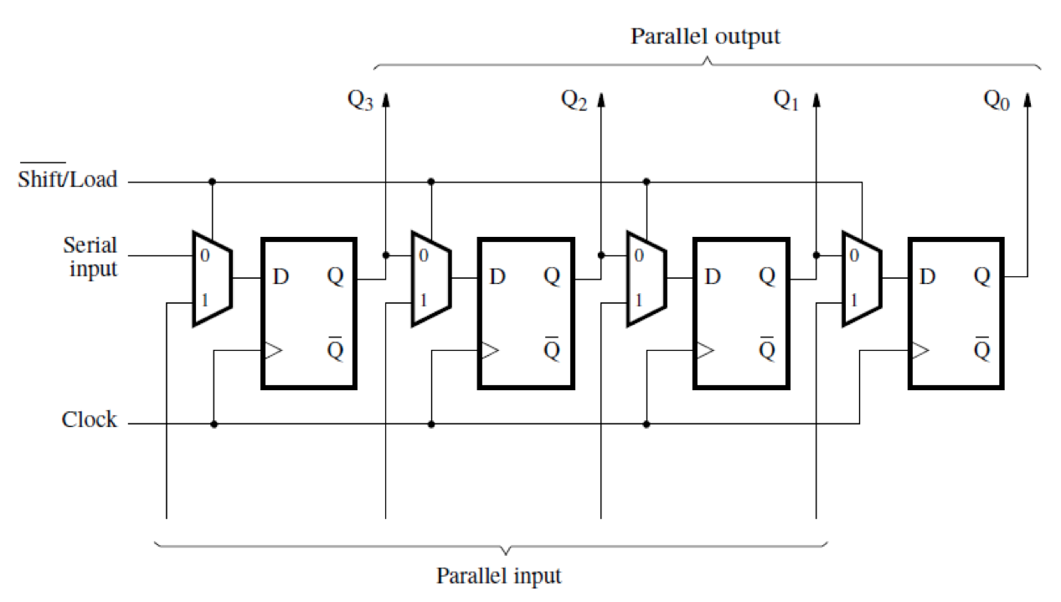
What is a register?
[ Figure 5.18 from the textbook ]

Slide 15
What can be stored in this register?
[ Figure 5.18 from the textbook ]

Slide 16
We Need a Simpler Abstraction

Slide 17
What is a register?

Slide 18
What is a register?

Slide 19
What can be stored in this register?

Slide 20

What can be stored in this register?

Slide 21
How many balls can be stored?

Slide 22
How many balls can be stored?
. . .
Infinitely Many

Slide 23
What is a register machine?

Slide 24
What is a register machine?

Slide 25
What is a register machine?
Register 1
Register 2
Register 3
The registers are numbered

Slide 26
What is a register machine?
Register 1
Register 2
Register 3
The registers are numbered
and each could store a
different number of balls.

Slide 27
Things to Notice
There could be many registers, not just three, as long as they are finitely many.
The address of each register is an integer.
Each register stores an integer number of balls.
Storing 3.14 balls in a register is not possible.

Slide 28
In addition to the registers there is also a processing unit

Slide 29
In addition to the registers there is also a processing unit
It operates on the registers by changing their contents
The operations are ordered sequentially and given a number (just like line numbers in BASIC)
There are only three possible operations
Increment a register and go to another step
Decrement a register and go to another step
End

Slide 30
Two Basic Operations (that can be performed on a register)
Increment the contents of a register by 1
Decrement the contents of a register by 1
In both cases the address of the register must be given

Slide 31
Incrementing a Register
Register 5

Slide 32
Incrementing a Register
Register 5

Slide 33
Incrementing a Register
Register 5

Slide 34
Decrementing a Register
Register 3

Slide 35
Decrementing a Register
Register 3

Slide 36
Decrementing a Register
Register 3

Slide 37
Decrementing a Register
x
Register 3

Slide 38
Decrementing a Register
This is our if statement
x
Register 3

Slide 39
Sample Program:
Add the contents of register 1 to the contents of register 2
Register 1
Register 2
Register 3
STEP | INSTRUCTION | REGISTER | GO TO STEP | [BRANCH TO STEP]
1. | Deb | 1 | 2 | 3
2. | Inc | 2 | 1
3. | End

Slide 40
Sample Program:
Add the contents of register 1 to the contents of register 2
This register is not used
by this program.
Register 1
Register 2
Register 3
STEP | INSTRUCTION | REGISTER | GO TO STEP | [BRANCH TO STEP]
1. | Deb | 1 | 2 | 3
2. | Inc | 2 | 1
3. | End

Slide 41
Sample Program:
Add the contents of register 1 to the contents of register 2
Register 1
Register 2
Register 3
STEP | INSTRUCTION | REGISTER | GO TO STEP | [BRANCH TO STEP]
1. | Deb | 1 | 2 | 3
2. | Inc | 2 | 1
3. | End
⇧

Slide 42
Sample Program:
Add the contents of register 1 to the contents of register 2
Register 1
Register 2
Register 3
STEP | INSTRUCTION | REGISTER | GO TO STEP | [BRANCH TO STEP]
1. | Deb | 1 | 2 | 3
2. | Inc | 2 | 1
3. | End
⇧

Slide 43
Sample Program:
Add the contents of register 1 to the contents of register 2
Register 1
Register 2
Register 3
STEP | INSTRUCTION | REGISTER | GO TO STEP | [BRANCH TO STEP]
1. | Deb | 1 | 2 | 3
2. | Inc | 2 | 1
3. | End
⇧

Slide 44
Sample Program:
Add the contents of register 1 to the contents of register 2
Register 1
Register 2
Register 3
STEP | INSTRUCTION | REGISTER | GO TO STEP | [BRANCH TO STEP]
1. | Deb | 1 | 2 | 3
2. | Inc | 2 | 1
3. | End
⇧

Slide 45
Sample Program:
Add the contents of register 1 to the contents of register 2
Register 1
Register 2
Register 3
STEP | INSTRUCTION | REGISTER | GO TO STEP | [BRANCH TO STEP]
1. | Deb | 1 | 2 | 3
2. | Inc | 2 | 1
3. | End
⇧

Slide 46
Sample Program:
Add the contents of register 1 to the contents of register 2
Register 1
Register 2
Register 3
STEP | INSTRUCTION | REGISTER | GO TO STEP | [BRANCH TO STEP]
1. | Deb | 1 | 2 | 3
2. | Inc | 2 | 1
3. | End
⇧

Slide 47
Sample Program:
Add the contents of register 1 to the contents of register 2
Register 1
Register 2
Register 3
STEP | INSTRUCTION | REGISTER | GO TO STEP | [BRANCH TO STEP]
1. | Deb | 1 | 2 | 3
2. | Inc | 2 | 1
3. | End
⇧

Slide 48
Sample Program:
Add the contents of register 1 to the contents of register 2
Register 1
Register 2
Register 3
STEP | INSTRUCTION | REGISTER | GO TO STEP | [BRANCH TO STEP]
1. | Deb | 1 | 2 | 3
2. | Inc | 2 | 1
3. | End
⇧

Slide 49
Sample Program:
Add the contents of register 1 to the contents of register 2
Register 1
Register 2
Register 3
STEP | INSTRUCTION | REGISTER | GO TO STEP | [BRANCH TO STEP]
1. | Deb | 1 | 2 | 3
2. | Inc | 2 | 1
3. | End
⇧

Slide 50
Sample Program:
Add the contents of register 1 to the contents of register 2
Register 1
Register 2
Register 3
STEP | INSTRUCTION | REGISTER | GO TO STEP | [BRANCH TO STEP]
1. | Deb | 1 | 2 | 3
2. | Inc | 2 | 1
3. | End
⇧

Slide 51
Sample Program:
Add the contents of register 1 to the contents of register 2
Register 1
Register 2
Register 3
STEP | INSTRUCTION | REGISTER | GO TO STEP | [BRANCH TO STEP]
1. | Deb | 1 | 2 | 3
2. | Inc | 2 | 1
3. | End
⇧

Slide 52
Sample Program:
Add the contents of register 1 to the contents of register 2
Register 1
Register 2
Register 3
STEP | INSTRUCTION | REGISTER | GO TO STEP | [BRANCH TO STEP]
1. | Deb | 1 | 2 | 3
2. | Inc | 2 | 1
3. | End
⇧

Slide 53
Sample Program:
Add the contents of register 1 to the contents of register 2
Register 1
Register 2
Register 3
STEP | INSTRUCTION | REGISTER | GO TO STEP | [BRANCH TO STEP]
1. | Deb | 1 | 2 | 3
2. | Inc | 2 | 1
3. | End
⇧

Slide 54
Sample Program:
Add the contents of register 1 to the contents of register 2
Register 1
Register 2
Register 3
STEP | INSTRUCTION | REGISTER | GO TO STEP | [BRANCH TO STEP]
1. | Deb | 1 | 2 | 3
2. | Inc | 2 | 1
3. | End
⇧

Slide 55
Sample Program:
Add the contents of register 1 to the contents of register 2
Register 1
Register 2
Register 3
STEP | INSTRUCTION | REGISTER | GO TO STEP | [BRANCH TO STEP]
1. | Deb | 1 | 2 | 3
2. | Inc | 2 | 1
3. | End
⇧

Slide 56
Sample Program:
Add the contents of register 1 to the contents of register 2
Register 1
Register 2
Register 3
STEP | INSTRUCTION | REGISTER | GO TO STEP | [BRANCH TO STEP]
1. | Deb | 1 | 2 | 3
2. | Inc | 2 | 1
3. | End
⇧

Slide 57
Sample Program:
Add the contents of register 1 to the contents of register 2
Register 1
Register 2
Register 3
STEP | INSTRUCTION | REGISTER | GO TO STEP | [BRANCH TO STEP]
1. | Deb | 1 | 2 | 3
2. | Inc | 2 | 1
3. | End
⇧

Slide 58
Sample Program:
Add the contents of register 1 to the contents of register 2
Register 1
Register 2
Register 3
STEP | INSTRUCTION | REGISTER | GO TO STEP | [BRANCH TO STEP]
1. | Deb | 1 | 2 | 3
2. | Inc | 2 | 1
3. | End
⇧

Slide 59
Sample Program:
Add the contents of register 1 to the contents of register 2
Register 1
Register 2
Register 3
STEP | INSTRUCTION | REGISTER | GO TO STEP | [BRANCH TO STEP]
1. | Deb | 1 | 2 | 3
2. | Inc | 2 | 1
3. | End
⇧

Slide 60
Sample Program:
Add the contents of register 1 to the contents of register 2
Register 1
Register 2
Register 3
STEP | INSTRUCTION | REGISTER | GO TO STEP | [BRANCH TO STEP]
1. | Deb | 1 | 2 | 3
2. | Inc | 2 | 1
3. | End
⇧

Slide 61
Sample Program:
Add the contents of register 1 to the contents of register 2
Register 1
Register 2
Register 3
STEP | INSTRUCTION | REGISTER | GO TO STEP | [BRANCH TO STEP]
1. | Deb | 1 | 2 | 3
2. | Inc | 2 | 1
3. | End
⇧

Slide 62
Sample Program:
Add the contents of register 1 to the contents of register 2
Register 1
Register 2
Register 3
STEP | INSTRUCTION | REGISTER | GO TO STEP | [BRANCH TO STEP]
1. | Deb | 1 | 2 | 3
2. | Inc | 2 | 1
3. | End
⇧

Slide 63
Sample Program:
Add the contents of register 1 to the contents of register 2
Register 1
Register 2
Register 3
STEP | INSTRUCTION | REGISTER | GO TO STEP | [BRANCH TO STEP]
1. | Deb | 1 | 2 | 3
2. | Inc | 2 | 1
3. | End
⇧

Slide 64
Sample Program:
Add the contents of register 1 to the contents of register 2
Register 1
Register 2
Register 3
STEP | INSTRUCTION | REGISTER | GO TO STEP | [BRANCH TO STEP]
1. | Deb | 1 | 2 | 3
2. | Inc | 2 | 1
3. | End
⇧

Slide 65
Sample Program:
Add the contents of register 1 to the contents of register 2
Register 1
Register 2
Register 3
STEP | INSTRUCTION | REGISTER | GO TO STEP | [BRANCH TO STEP]
1. | Deb | 1 | 2 | 3
2. | Inc | 2 | 1
3. | End
⇧

Slide 66
Sample Program:
Add the contents of register 1 to the contents of register 2
Register 1
Register 2
Register 3
STEP | INSTRUCTION | REGISTER | GO TO STEP | [BRANCH TO STEP]
1. | Deb | 1 | 2 | 3
2. | Inc | 2 | 1
3. | End
⇧

Slide 67
Sample Program:
Add the contents of register 1 to the contents of register 2
Register 1
Register 2
Register 3
STEP | INSTRUCTION | REGISTER | GO TO STEP | [BRANCH TO STEP]
1. | Deb | 1 | 2 | 3
2. | Inc | 2 | 1
3. | End
⇧

Slide 68
Sample Program:
Add the contents of register 1 to the contents of register 2
x
Register 1
Register 2
Register 3
STEP | INSTRUCTION | REGISTER | GO TO STEP | [BRANCH TO STEP]
1. | Deb | 1 | 2 | 3
2. | Inc | 2 | 1
3. | End
⇧

Slide 69
Sample Program:
Add the contents of register 1 to the contents of register 2
x
Register 1
Register 2
Register 3
STEP | INSTRUCTION | REGISTER | GO TO STEP | [BRANCH TO STEP]
1. | Deb | 1 | 2 | 3
2. | Inc | 2 | 1
3. | End
⇧

Slide 70
Sample Program:
Add the contents of register 1 to the contents of register 2
Register 1
Register 2
Register 3
STEP | INSTRUCTION | REGISTER | GO TO STEP | [BRANCH TO STEP]
1. | Deb | 1 | 2 | 3
2. | Inc | 2 | 1
3. | End
⇧

Slide 71
Sample Program:
Add the contents of register 1 to the contents of register 2
Register 1
Register 2
Register 3
STEP | INSTRUCTION | REGISTER | GO TO STEP | [BRANCH TO STEP]
1. | Deb | 1 | 2 | 3
2. | Inc | 2 | 1
3. | End
⇧

Slide 72
Sample Program:
Add the contents of register 1 to the contents of register 2
Register 1
Register 2
Register 3
STEP | INSTRUCTION | REGISTER | GO TO STEP | [BRANCH TO STEP]
1. | Deb | 1 | 2 | 3
2. | Inc | 2 | 1
3. | End
⇧

Slide 73
Sample Program:
Add the contents of register 1 to the contents of register 2
Register 1
Register 2
Register 3
STEP | INSTRUCTION | REGISTER | GO TO STEP | [BRANCH TO STEP]
1. | Deb | 1 | 2 | 3
2. | Inc | 2 | 1
3. | End

Slide 75
Same program, different initial conditions
Add the contents of register 1 to the contents of register 2
Register 1
Register 2
Register 3
STEP | INSTRUCTION | REGISTER | GO TO STEP | [BRANCH TO STEP]
1. | Deb | 1 | 2 | 3
2. | Inc | 2 | 1
3. | End

Slide 76
Some Questions
Where do the balls that are deleted go?
Where do the balls that are added come from?

Slide 77
Same program, different initial conditions
Add the contents of register 1 to the contents of register 2
Register 1
Register 2
Register 3
STEP | INSTRUCTION | REGISTER | GO TO STEP | [BRANCH TO STEP]
1. | Deb | 1 | 2 | 3
2. | Inc | 2 | 1
3. | End

Slide 79
Another Program:
Move the contents of register 2 to register 3
Register 1
Register 2
Register 3
STEP | INSTRUCTION | REGISTER | GO TO STEP | [BRANCH TO STEP]
1. | Deb | 3 | 1 | 2
2. | Deb | 2 | 3 | 4
3. | Inc | 3 | 2
4. | End

Slide 81
Yet Another Program:
Copy the contents of register 1 to register 3
Register 1
Register 2
Register 3
STEP | INSTRUCTION | REGISTER | GO TO STEP | [BRANCH TO STEP]
1. | Deb | 3 | 1 | 2
2. | Deb | 2 | 2 | 3
3. | Deb | 1 | 4 | 6
4. | Inc | 3 | 5
5. | Inc | 2 | 3
6. | Deb | 2 | 7 | 8
7. | Inc | 1 | 6
8. | End

Slide 82
RodRego
You can download a register machine emulator from:
http://sites.tufts.edu/rodrego/
It works on both Macs and PCs. It’s pretty cool.
This web link is also in the book chapter.
There is also a version that works in a browser:
https://rodrego.it.tufts.edu/

Slide 83
What are the seven secrets?

Slide 84
Secret #1
Competence Without Comprehension - the register machine can do perfect arithmetic without having to comprehend what it is doing.

Slide 85
Secret #2
What a number in a register stands for depends on the program that we have composed.

Slide 86
Secret #3
Since the number in a register machine can stand for anything, this means that the register machine can, in principle, be designed to “notice” anything, to “discriminate" any pattern or feature that can be associated with a number – or a number of numbers.

Slide 87
Secret #4
Since a number can stand for anything, a number can stand for an instruction or an address.

Slide 88
Secret #5
All possible programs can be given a unique number as a name, which can then be treated as a list of instructions to be executed by a Universal machine.

Slide 89
Secret #6
All the improvements in computers since Turing invented his imaginary paper-tape machine are simply ways of making them faster.

Slide 90
Secret #7
There are no more secrets.

Slide 91
What about real computers?
Do they really work in this way?

Slide 92
Questions?

Slide 93
THE END

