Slide 1
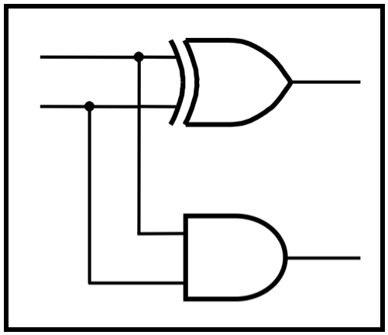
CprE 2810:
Digital Logic
Instructor: Alexander Stoytchev
http://www.ece.iastate.edu/~alexs/classes/

Slide 2
Design Examples
CprE 2810: Digital Logic
Iowa State University, Ames, IA
Copyright © Alexander Stoytchev

Slide 3
Administrative Stuff
HW3 is due on Monday Sep 15 @ 10pm
Please write clearly on the first page the following three things:
  Your First and Last Name
  Your Student ID Number
  Your Lab Section Letter
Submit on Canvas as *one* PDF file.
Please orient your pages such that the text can be read without the need to rotate the page.

Slide 4
Quick Review

Slide 5
Axioms of Boolean Algebra
1a. 0 • 0 = 0
1b. 1 + 1 = 1
2a. 1 • 1 = 1
2b. 0 + 0 = 0
3a. 0 • 1 = 1 • 0 = 0
3b. 1 + 0 = 0 + 1 = 1
4a. If x=0, then
4b. If x=1, then
x = 1
x = 0

Slide 6
The Three Basic Logic Gates
x
1
x
x
x
1
x
x
1
•
2
x
1
+
x
2
x
2
x
2
NOT gate
AND gate
OR gate
[ Figure 2.8 from the textbook ]

Slide 7
Single-Variable Theorems
5a. x • 0 = 0
5b. x + 1 = 1
6a. x • 1 = x
6b. x + 0 = x
7a. x • x = x
7b. x + x = x
8a. x •
8b. x +
9.
x = 0
x = 1
x = x

Slide 8
Two- and Three-Variable Properties
10a. x • y = y • x
10b. x + y = y + x
11a. x • (y • z) = (x • y) • z
11b. x + (y + z) = (x + y) + z
12a. x • (y + z) = x•y + x•z
12b. x + y • z = (x + y)•(x + z)
13a. x + x • y = x
13b. x • (x + y) = x
Commutative
Associative
Distributive
Absorption

Slide 9
Two- and Three-Variable Properties
14a. x • y + x •
14b. (x + y)•(x +
15a. x • y = x + y
15b. x + y = x • y
16a. x + x•y = x + y
16b. x•(x + y) = x•y
17a. x•y + y•z + x•z = x•y + x•z
17b. (x+y)•(y+z)•(x+z)=(x+y)•(x+z)
Combining
DeMorgan’s
theorem
Consensus
y = x
y) = x

Slide 10
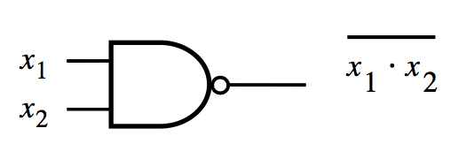
NAND Gate
x₁ | x₂ | f
0 | 0 | 1
0 | 1 | 1
1 | 0 | 1
1 | 1 | 0

Slide 11
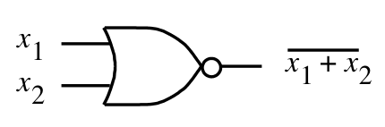
NOR Gate
x₁ | x₂ | f
0 | 0 | 1
0 | 1 | 0
1 | 0 | 0
1 | 1 | 0

Slide 12
Why do we need two more gates?
They can be implemented with fewer transistors.
Each of the new gates can be used to implement
the three basic logic gates: NOT, AND, OR.

Slide 13
Implications
Any Boolean function can be implemented
with only NAND gates!

Slide 14
Implications
Any Boolean function can be implemented
with only NAND gates!
The same is also true for NOR gates!

Slide 15
minterms
(for two variables)

Slide 16
The Four minterms
x | y | m₀
0 | 0 | 1
0 | 1 | 0
1 | 0 | 0
1 | 1 | 0
x | y | m₁
0 | 0 | 0
0 | 1 | 1
1 | 0 | 0
1 | 1 | 0
x | y | m₂
0 | 0 | 0
0 | 1 | 0
1 | 0 | 1
1 | 1 | 0
x | y | m₃
0 | 0 | 0
0 | 1 | 0
1 | 0 | 0
1 | 1 | 1
m₀(x, y)
m₁(x, y)
m₂(x, y)
m₃(x, y)

Slide 17
The Four minterms
x | y | m₀
0 | 0 | 1
0 | 1 | 0
1 | 0 | 0
1 | 1 | 0
x | y | m₁
0 | 0 | 0
0 | 1 | 1
1 | 0 | 0
1 | 1 | 0
x | y | m₂
0 | 0 | 0
0 | 1 | 0
1 | 0 | 1
1 | 1 | 0
x | y | m₃
0 | 0 | 0
0 | 1 | 0
1 | 0 | 0
1 | 1 | 1
m₀(x, y)
m₁(x, y)
m₂(x, y)
m₃(x, y)

Slide 18
The Four minterms
x | y |  | m₀(x, y) | m₁(x, y) | m₂(x, y) | m₃(x, y)
0 | 0 |  | 1 | 0 | 0 | 0
0 | 1 |  | 0 | 1 | 0 | 0
1 | 0 |  | 0 | 0 | 1 | 0
1 | 1 |  | 0 | 0 | 0 | 1

Slide 19
The Four minterms
x | y |  | x y | x y | x y | x y
0 | 0 |  | 1 | 0 | 0 | 0
0 | 1 |  | 0 | 1 | 0 | 0
1 | 0 |  | 0 | 0 | 1 | 0
1 | 1 |  | 0 | 0 | 0 | 1

Slide 20
Circuits for the four minterms
y
m₀(x, y) = x y
x
x
m₁(x, y) = x y
y
x
m₂(x, y) = x y
y
y
x
m₃(x, y) = x y

Slide 21
Maxterms
(for two variables)

Slide 22
The Four Maxterms
x | y | M₀
0 | 0 | 0
0 | 1 | 1
1 | 0 | 1
1 | 1 | 1
x | y | M₁
0 | 0 | 1
0 | 1 | 0
1 | 0 | 1
1 | 1 | 1
x | y | M₂
0 | 0 | 1
0 | 1 | 1
1 | 0 | 0
1 | 1 | 1
x | y | M₃
0 | 0 | 1
0 | 1 | 1
1 | 0 | 1
1 | 1 | 0
M₀(x, y)
M₁(x, y)
M₂(x, y)
M₃(x, y)

Slide 23
The Four Maxterms
x | y | M₀
0 | 0 | 0
0 | 1 | 1
1 | 0 | 1
1 | 1 | 1
x | y | M₁
0 | 0 | 1
0 | 1 | 0
1 | 0 | 1
1 | 1 | 1
x | y | M₂
0 | 0 | 1
0 | 1 | 1
1 | 0 | 0
1 | 1 | 1
x | y | M₃
0 | 0 | 1
0 | 1 | 1
1 | 0 | 1
1 | 1 | 0
M₀(x, y)
M₁(x, y)
M₂(x, y)
M₃(x, y)

Slide 24
The Four Maxterms
x | y |  | M₀(x, y) | M₁(x, y) | M₂(x, y) | M₃(x, y)
0 | 0 |  | 0 | 1 | 1 | 1
0 | 1 |  | 1 | 0 | 1 | 1
1 | 0 |  | 1 | 1 | 0 | 1
1 | 1 |  | 1 | 1 | 1 | 0

Slide 25
The Four Maxterms
x | y |  | x + y | x + y | x + y | x + y
0 | 0 |  | 0 | 1 | 1 | 1
0 | 1 |  | 1 | 0 | 1 | 1
1 | 0 |  | 1 | 1 | 0 | 1
1 | 1 |  | 1 | 1 | 1 | 0

Slide 26
minterms and Maxterms
(for two variables)

Slide 27
minterms and Maxterms
x | y | m₀
0 | 0 | 1
0 | 1 | 0
1 | 0 | 0
1 | 1 | 0
x | y | m₁
0 | 0 | 0
0 | 1 | 1
1 | 0 | 0
1 | 1 | 0
x | y | m₂
0 | 0 | 0
0 | 1 | 0
1 | 0 | 1
1 | 1 | 0
x | y | m₃
0 | 0 | 0
0 | 1 | 0
1 | 0 | 0
1 | 1 | 1
x | y | M₀
0 | 0 | 0
0 | 1 | 1
1 | 0 | 1
1 | 1 | 1
x | y | M₁
0 | 0 | 1
0 | 1 | 0
1 | 0 | 1
1 | 1 | 1
x | y | M₂
0 | 0 | 1
0 | 1 | 1
1 | 0 | 0
1 | 1 | 1
x | y | M₃
0 | 0 | 1
0 | 1 | 1
1 | 0 | 1
1 | 1 | 0

Slide 28
minterms and Maxterms
m₀(x, y) = x y
M₀(x, y) = x + y
m₁(x, y) = x y
M₁(x, y) = x + y
m₂(x, y) = x y
M₂(x, y) = x + y
m₃(x, y) = x y
M₃(x, y) = x + y

Slide 29
minterms
(for three variables)

Slide 30
The Eight minterms
x | y | z | m₀ | m₁ | m₂ | m₃ | m₄ | m₅ | m₆ | m₇
0 | 0 | 0 | 1 | 0 | 0 | 0 | 0 | 0 | 0 | 0
0 | 0 | 1 | 0 | 1 | 0 | 0 | 0 | 0 | 0 | 0
0 | 1 | 0 | 0 | 0 | 1 | 0 | 0 | 0 | 0 | 0
0 | 1 | 1 | 0 | 0 | 0 | 1 | 0 | 0 | 0 | 0
1 | 0 | 0 | 0 | 0 | 0 | 0 | 1 | 0 | 0 | 0
1 | 0 | 1 | 0 | 0 | 0 | 0 | 0 | 1 | 0 | 0
1 | 1 | 0 | 0 | 0 | 0 | 0 | 0 | 0 | 1 | 0
1 | 1 | 1 | 0 | 0 | 0 | 0 | 0 | 0 | 0 | 1

Slide 31
The Eight minterms
x | y | z | m₀ | m₁ | m₂ | m₃ | m₄ | m₅ | m₆ | m₇
0 | 0 | 0 | 1 | 0 | 0 | 0 | 0 | 0 | 0 | 0
0 | 0 | 1 | 0 | 1 | 0 | 0 | 0 | 0 | 0 | 0
0 | 1 | 0 | 0 | 0 | 1 | 0 | 0 | 0 | 0 | 0
0 | 1 | 1 | 0 | 0 | 0 | 1 | 0 | 0 | 0 | 0
1 | 0 | 0 | 0 | 0 | 0 | 0 | 1 | 0 | 0 | 0
1 | 0 | 1 | 0 | 0 | 0 | 0 | 0 | 1 | 0 | 0
1 | 1 | 0 | 0 | 0 | 0 | 0 | 0 | 0 | 1 | 0
1 | 1 | 1 | 0 | 0 | 0 | 0 | 0 | 0 | 0 | 1

Slide 32
Expressions for the minterms
m₀ = x y z
m₁ = x y z
m₂ = x y z
m₃ = x y z
m₄ = x y z
m₅ = x y z
m₆ = x y z
m₇ = x y z

Slide 33
Expressions for the minterms
0 0 0
0 0 1
0 1 0
0 1 1
1 0 0
1 0 1
1 1 0
1 1 1
m₀ = x y z
m₁ = x y z
m₂ = x y z
m₃ = x y z
m₄ = x y z
m₅ = x y z
m₆ = x y z
m₇ = x y z
The bars coincide
with the 0’s
in the binary expansion
of the minterm sub-index

Slide 34
Maxterms
(for three variables)

Slide 35
The Eight Maxterms
x | y | z | M₀ | M₁ | M₂ | M₃ | M₄ | M₅ | M₆ | M₇
0 | 0 | 0 | 0 | 1 | 1 | 1 | 1 | 1 | 1 | 1
0 | 0 | 1 | 1 | 0 | 1 | 1 | 1 | 1 | 1 | 1
0 | 1 | 0 | 1 | 1 | 0 | 1 | 1 | 1 | 1 | 1
0 | 1 | 1 | 1 | 1 | 1 | 0 | 1 | 1 | 1 | 1
1 | 0 | 0 | 1 | 1 | 1 | 1 | 0 | 1 | 1 | 1
1 | 0 | 1 | 1 | 1 | 1 | 1 | 1 | 0 | 1 | 1
1 | 1 | 0 | 1 | 1 | 1 | 1 | 1 | 1 | 0 | 1
1 | 1 | 1 | 1 | 1 | 1 | 1 | 1 | 1 | 1 | 0

Slide 36
The Eight Maxterms
x | y | z | M₀ | M₁ | M₂ | M₃ | M₄ | M₅ | M₆ | M₇
0 | 0 | 0 | 0 | 1 | 1 | 1 | 1 | 1 | 1 | 1
0 | 0 | 1 | 1 | 0 | 1 | 1 | 1 | 1 | 1 | 1
0 | 1 | 0 | 1 | 1 | 0 | 1 | 1 | 1 | 1 | 1
0 | 1 | 1 | 1 | 1 | 1 | 0 | 1 | 1 | 1 | 1
1 | 0 | 0 | 1 | 1 | 1 | 1 | 0 | 1 | 1 | 1
1 | 0 | 1 | 1 | 1 | 1 | 1 | 1 | 0 | 1 | 1
1 | 1 | 0 | 1 | 1 | 1 | 1 | 1 | 1 | 0 | 1
1 | 1 | 1 | 1 | 1 | 1 | 1 | 1 | 1 | 1 | 0

Slide 37
Expressions for the Maxterms
M₀ = x + y + z
M₁ = x + y + z
M₂ = x + y + z
M₃ = x + y + z
M₄ = x + y + z
M₅ = x + y + z
M₆ = x + y + z
M₇ = x + y + z

Slide 38
Expressions for the Maxterms
0 0 0
0 0 1
0 1 0
0 1 1
1 0 0
1 0 1
1 1 0
1 1 1
M₀ = x + y + z
M₁ = x + y + z
M₂ = x + y + z
M₃ = x + y + z
M₄ = x + y + z
M₅ = x + y + z
M₆ = x + y + z
M₇ = x + y + z
The bars coincide
with the 1’s
in the binary expansion
of the maxterm sub-index

Slide 39
minterms and Maxterms
(for three variables)

Slide 40
minterms and Maxterms
m₀ = x y z
m₁ = x y z
m₂ = x y z
m₃ = x y z
m₄ = x y z
m₅ = x y z
m₆ = x y z
m₇ = x y z
M₀ = x + y + z
M₁ = x + y + z
M₂ = x + y + z
M₃ = x + y + z
M₄ = x + y + z
M₅ = x + y + z
M₆ = x + y + z
M₇ = x + y + z

Slide 41
Synthesis Example

Slide 42
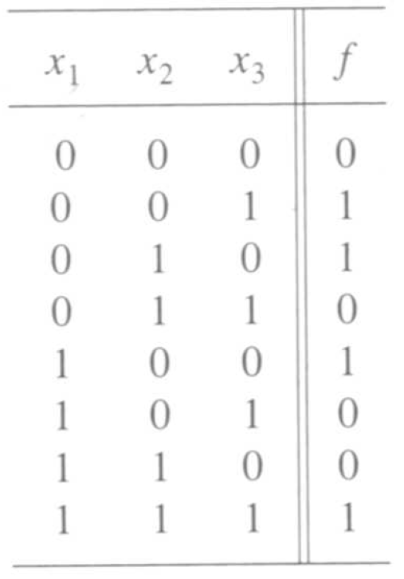
Truth table for a three-way light control
[ Figure 2.31 from the textbook ]

Slide 43
Let’s Derive the SOP form

Slide 44
minterms and Maxterms
(with three variables)
[ Figure 2.22 from the textbook ]

Slide 45
Let’s Derive the SOP form

Slide 46
Let’s Derive the SOP form
x₁ x₂ x₃
x₁ x₂ x₃
x₁ x₂ x₃
x₁ x₂ x₃

Slide 47
Let’s Derive the SOP form
x₁ x₂ x₃
x₁ x₂ x₃
x₁ x₂ x₃
x₁ x₂ x₃

Slide 48
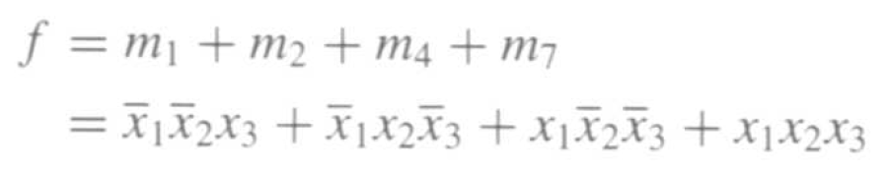
Let’s Derive the SOP form
x₁ x₂ x₃
x₁ x₂ x₃
x₁ x₂ x₃
x₁ x₂ x₃

Slide 49
Sum-of-products realization
f
x₁
x₂
x₃
[ Figure 2.32a from the textbook ]

Slide 50
Let’s Derive the POS form
[ Figure 2.31 from the textbook ]

Slide 51
Let’s Derive the POS form

Slide 52
minterms and Maxterms
(with three variables)
[ Figure 2.22 from the textbook ]

Slide 53
Let’s Derive the POS form

Slide 54
Let’s Derive the POS form
( x₁ + x₂ + x₃ )
( x₁ + x₂ + x₃ )
( x₁ + x₂ + x₃ )
( x₁ + x₂ + x₃ )

Slide 55
Let’s Derive the POS form
( x₁ + x₂ + x₃ )
( x₁ + x₂ + x₃ )
( x₁ + x₂ + x₃ )
( x₁ + x₂ + x₃ )

Slide 56
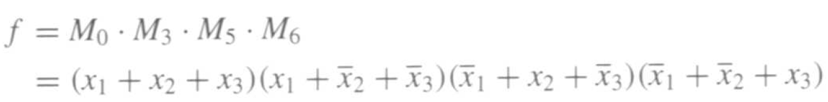
Let’s Derive the POS form
( x₁ + x₂ + x₃ )
( x₁ + x₂ + x₃ )
( x₁ + x₂ + x₃ )
( x₁ + x₂ + x₃ )

Slide 57
Product-of-sums realization
x₃
x₂
x₁
f
[ Figure 2.32b from the textbook ]

Slide 58
Function Synthesis

Slide 59
Example 2.10
Implement the function f(x₁, x₂, x₃) = Σ m(2, 3, 4, 6, 7)

Slide 60
Minterms and Maxterms
(with three variables)
[ Figure 2.22 from the textbook ]

Slide 61
minterms and Maxterms
(with three variables)

Slide 62
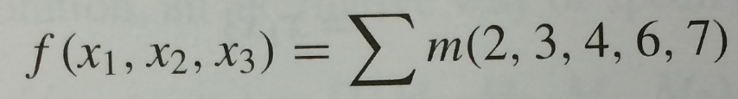
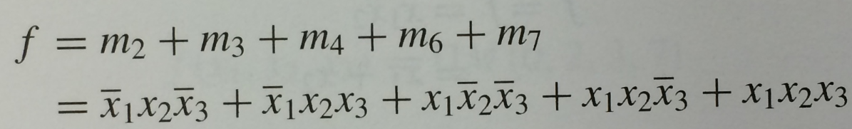
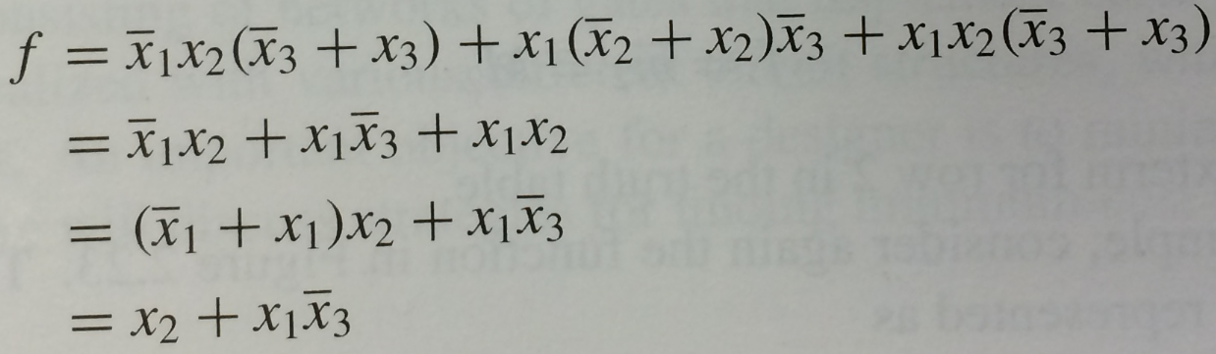
The SOP expression is:
This could be simplified as follows:

Slide 63
Recall Property 14a
14a. x • y + x •
14b. (x + y)•(x +
Combining
y = x
y) = x

Slide 64
SOP realization of the function
The SOP expression is: f = x₂ + x₁x₃
x₂
f
x₁
x₃
[ Figure 2.30a from the textbook ]

Slide 65
Example 2.12
Implement the function f(x₁, x₂, x₃) = Π M(0, 1, 5),
which is equivalent to f(x₁, x₂, x₃) = Σ m(2, 3, 4, 6, 7)

Slide 66
minterms and Maxterms
(with three variables)

Slide 67

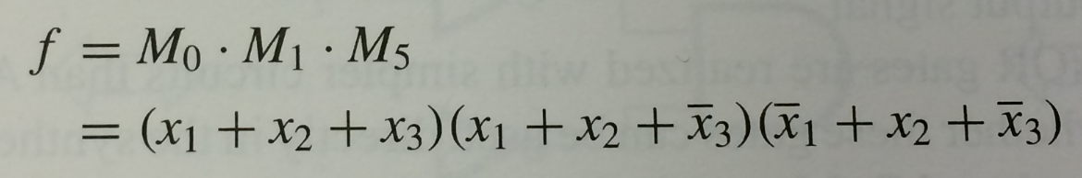
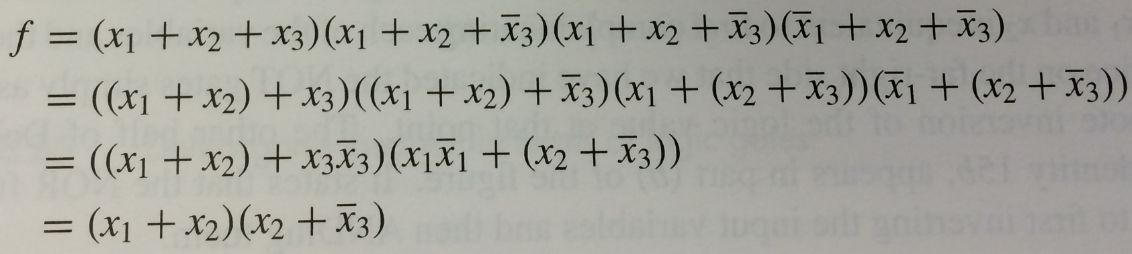
The POS expression is:
This could be simplified as follows:

Slide 68
Recall Property 14b
14a. x • y + x •
14b. (x + y)•(x +
Combining
y = x
y) = x

Slide 69
POS realization of the function
The POS expression is: f = (x₁ + x₂) (x₂ + x₃)
x₁
x₂
f
x₃
[ Figure 2.29a from the textbook ]

Slide 70
More Examples

Slide 71
Example 2.14
Implement the function f(x₁, x₂, x₃) = Σ m(2, 3, 4, 6, 7)
using only NAND gates.

Slide 72
Example 2.14
Implement the function f(x₁, x₂, x₃) = Σ m(2, 3, 4, 6, 7)
using only NAND gates.
The SOP expression is: f = x₂ + x₁x₃

Slide 73
NAND-gate realization of the function
x₂
f
x₁
x₃
(a) SOP implementation
x₂
x₁
f
x₃
(b) NAND implementation
[ Figure 2.30 from the textbook ]

Slide 74
Example 2.13
Implement the function f(x₁, x₂, x₃) = Σ m(2, 3, 4, 6, 7)
using only NOR gates.

Slide 75
Example 2.13
Implement the function f(x₁, x₂, x₃) = Σ m(2, 3, 4, 6, 7)
using only NOR gates.
The POS expression is: f = (x₁ + x₂) (x₂ + x₃)

Slide 76
NOR-gate realization of the function
x₁
x₂
f
x₃
(a) POS implementation
x₁
x₂
f
x₃
(b) NOR implementation
[ Figure 2.29 from the textbook ]

Slide 77
Implementation with Chips

Slide 78
(a) Dual-inline package
V
DD
Gnd
(b) Structure of 7404 chip
Figure B.21. A 7400-series chip.

Slide 79
V
DD
7404
7408
7432
x
1
x
2
x
3
f
Figure B.22. An implementation of f = x₁x₂ + x₂x₃.

Slide 80
Multiplexers

Slide 81
2-to-1 Multiplexer (Definition)
Has two inputs: x₁ and x₂
Also has another input line s
If s=0, then the output is equal to x₁
If s=1, then the output is equal to x₂

Slide 82
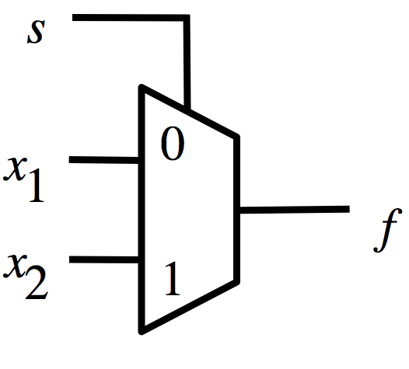
Graphical Symbol for a 2-to-1 Multiplexer
[ Figure 2.33c from the textbook ]

Slide 83
Analysis of the 2-to-1 Multiplexer
(when the input s=0)
0
x₁

Slide 84
Analysis of the 2-to-1 Multiplexer
(when the input s=1)
1
x₂

Slide 85
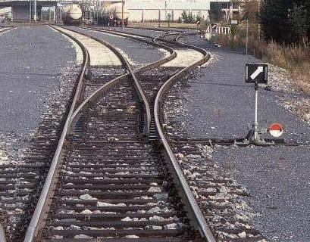
Analogy: Railroad Switch
http://en.wikipedia.org/wiki/Railroad_switch]

Slide 86
Analogy: Railroad Switch
x₁
x₂
select
f
http://en.wikipedia.org/wiki/Railroad_switch]

Slide 87
Analogy: Railroad Switch
x₁
x₂
select
f
This is not a perfect analogy because the trains can go in either direction,
while the multiplexer would only allow them to go from top to bottom.
http://en.wikipedia.org/wiki/Railroad_switch]

Slide 88
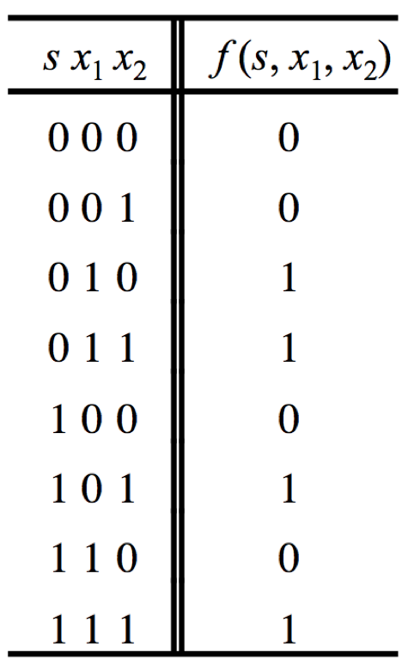
Truth Table for a 2-to-1 Multiplexer
[ Figure 2.33a from the textbook ]

Slide 89
Let’s Derive the SOP form

Slide 90
Let’s Derive the SOP form

Slide 91
Let’s Derive the SOP form
Where should we
put the negation signs?
s x₁ x₂
s x₁ x₂
s x₁ x₂
s x₁ x₂

Slide 92
Let’s Derive the SOP form
s x₁ x₂
s x₁ x₂
s x₁ x₂
s x₁ x₂

Slide 93
Let’s Derive the SOP form
s x₁ x₂
s x₁ x₂
s x₁ x₂
s x₁ x₂
f (s, x_{1,} x₂) =
s x₁ x₂
+
s x₁ x₂
+
s x₁ x₂
+
s x₁ x₂

Slide 94
Let’s simplify this expression
f (s, x_{1,} x₂) =
s x₁ x₂
+
s x₁ x₂
+
s x₁ x₂
+
s x₁ x₂

Slide 95
Let’s simplify this expression
f (s, x_{1,} x₂) =
s x₁ x₂
+
s x₁ x₂
+
s x₁ x₂
+
s x₁ x₂
f (s, x_{1,} x₂) =
s x₁ (x₂ + x₂)
+
+
s (x₁ +x₁ )x₂

Slide 96
Let’s simplify this expression
f (s, x_{1,} x₂) =
s x₁ x₂
+
s x₁ x₂
+
s x₁ x₂
+
s x₁ x₂
f (s, x_{1,} x₂) =
s x₁ (x₂ + x₂)
+
+
s (x₁ +x₁ )x₂
f (s, x_{1,} x₂) =
s x₁
+
s x₂

Slide 97
Circuit for 2-to-1 Multiplexer
x
s
1
f
x
1
0
f
s
x
2
1
x
2
(b) Circuit
(c) Graphical symbol
f (s, x_{1,} x₂) =
s x₁
+
s x₂
[ Figure 2.33b-c from the textbook ]

Slide 98
Analysis of the 2-to-1 Multiplexer
(when the input s=0)
x₁
x₁
1
x₁
f
s
0
0
x₂
0

Slide 99
Analysis of the 2-to-1 Multiplexer
(when the input s=1)
x₁
0
0
x₂
f
s
1
1
x₂
x₂

Slide 100
Analysis of the 2-to-1 Multiplexer
(when the input s=0)
0
x₁

Slide 101
Analysis of the 2-to-1 Multiplexer
(when the input s=1)
1
x₂

Slide 102
More Compact Truth-Table Representation
s
x₁
x₂
f (s, x₁, x₂)
0
0
0
0
0
0
1
0
s
f (s, x₁, x₂)
0
1
0
1
0
x₁
0
1
1
1
1
x₂
1
0
0
0
1
0
1
1
1
1
0
0
1
1
1
1
(a)
Truth
table
[ Figure 2.33 from the textbook ]

Slide 103
4-to-1 Multiplexer

Slide 104
4-to-1 Multiplexer (Definition)
Has four inputs: w₀ , w₁, w₂, w₃
Also has two select lines: s₁ and s₀
If s₁=0 and s₀=0, then the output f is equal to w₀
If s₁=0 and s₀=1, then the output f is equal to w₁
If s₁=1 and s₀=0, then the output f is equal to w₂
If s₁=1 and s₀=1, then the output f is equal to w₃

Slide 105
4-to-1 Multiplexer (Definition)
Has four inputs: w₀ , w₁, w₂, w₃
Also has two select lines: s₁ and s₀
If s₁=0 and s₀=0, then the output f is equal to w₀
If s₁=0 and s₀=1, then the output f is equal to w₁
If s₁=1 and s₀=0, then the output f is equal to w₂
If s₁=1 and s₀=1, then the output f is equal to w₃
We’ll talk more about this when we get
to chapter 4, but here is a quick preview.

Slide 106
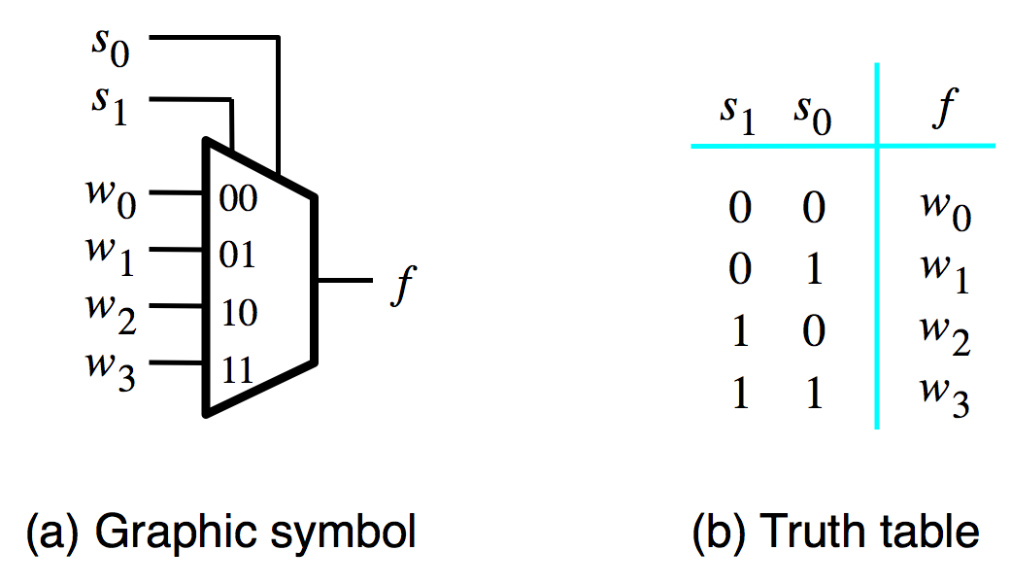
Graphical Symbol and Truth Table
[ Figure 4.2a-b from the textbook ]

Slide 107
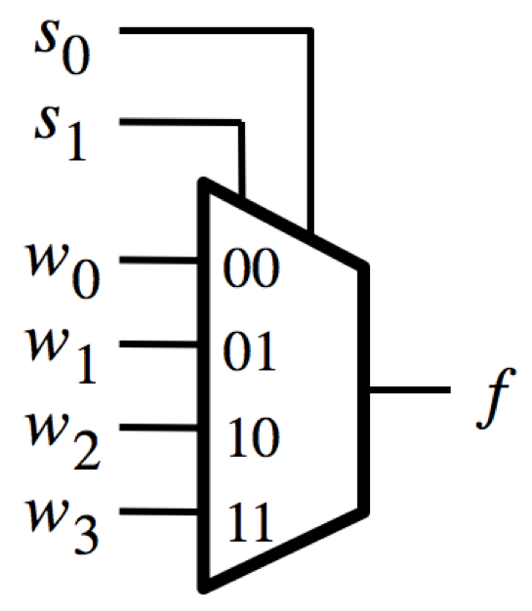
Analysis of the 4-to-1 Multiplexer
( s₁=0 and s₀=0 )
0
0
w₀

Slide 108
Analysis of the 4-to-1 Multiplexer
( s₁=0 and s₀=1 )
1
0
w₁

Slide 109
Analysis of the 4-to-1 Multiplexer
( s₁=1 and s₀=0 )
0
1
w₂

Slide 110
Analysis of the 4-to-1 Multiplexer
( s₁=1 and s₀=1 )
1
1
w₃

Slide 111
The long-form truth table

Slide 112
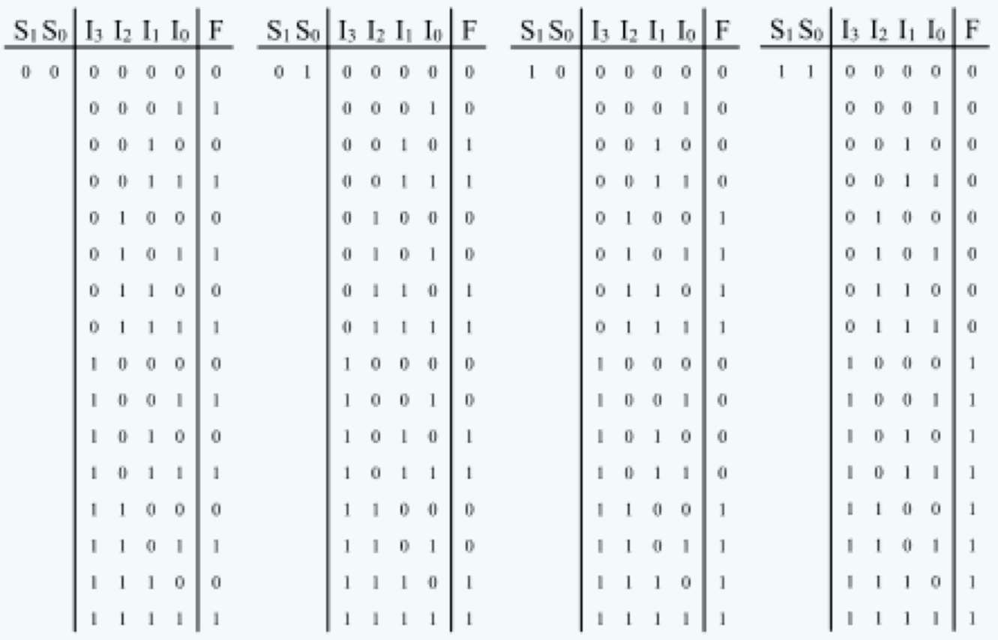
The long-form truth table
[http://www.absoluteastronomy.com/topics/Multiplexer]

Slide 113
The long-form truth table
[http://www.absoluteastronomy.com/topics/Multiplexer]

Slide 114
The long-form truth table
[http://www.absoluteastronomy.com/topics/Multiplexer]

Slide 115
The long-form truth table
[http://www.absoluteastronomy.com/topics/Multiplexer]

Slide 116
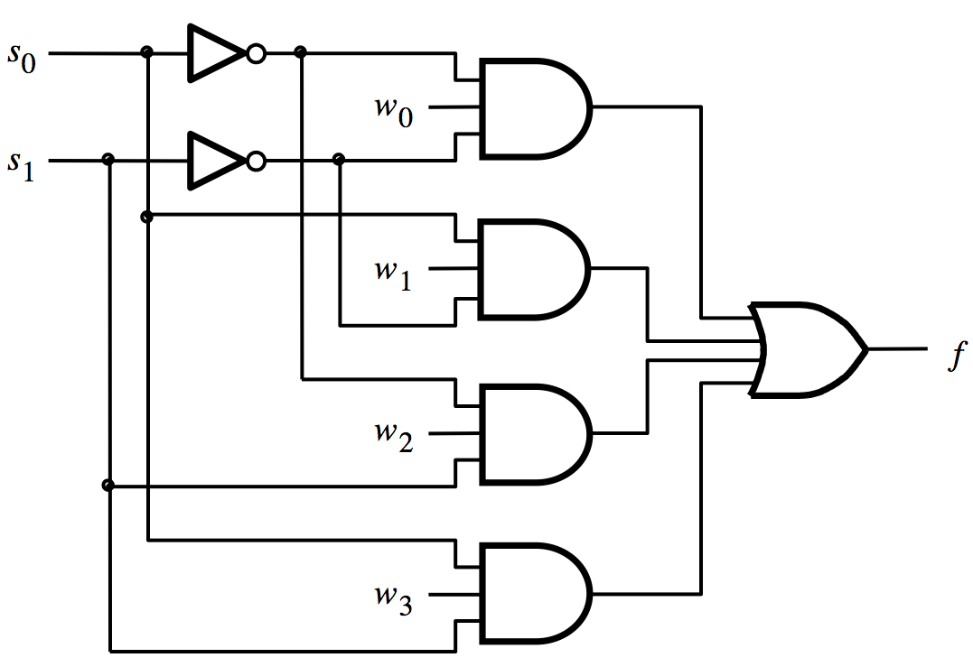
4-to-1 Multiplexer (SOP circuit)
f = s₁ s₀ w₀ + s₁ s₀ w₁ + s₁ s₀ w₂ + s₁ s₀ w₃
[ Figure 4.2c from the textbook ]

Slide 117
Analysis of the 4-to-1 Multiplexer
( s₁=0 and s₀=0 )
0
0

Slide 118
Analysis of the 4-to-1 Multiplexer
( s₁=0 and s₀=0 )
0
1
0
1
0
1
1
0
0
0

Slide 119
Analysis of the 4-to-1 Multiplexer
( s₁=0 and s₀=0 )
0
1
w₀
0
1
0
0
1
1
0
0
0
0
0

Slide 120
Analysis of the 4-to-1 Multiplexer
( s₁=0 and s₀=0 )
0
1
w₀
0
1
0
0
1
w₀
1
0
0
0
0
0

Slide 121
Analysis of the 4-to-1 Multiplexer
( s₁=0 and s₀=1 )
1
0
0
0
1
1
w₁
1
w₁
0
0
0
1
0
0

Slide 122
Analysis of the 4-to-1 Multiplexer
( s₁=1 and s₀=0 )
0
1
0
1
0
0
0
0
w₂
1
w₂
1
0
0
1

Slide 123
Analysis of the 4-to-1 Multiplexer
( s₁=1 and s₀=1 )
1
0
0
1
0
1
0
0
w₃
0
0
1
1
w₃
1

Slide 124
4-to-1 Multiplexer
(alternative implementation)

Slide 125
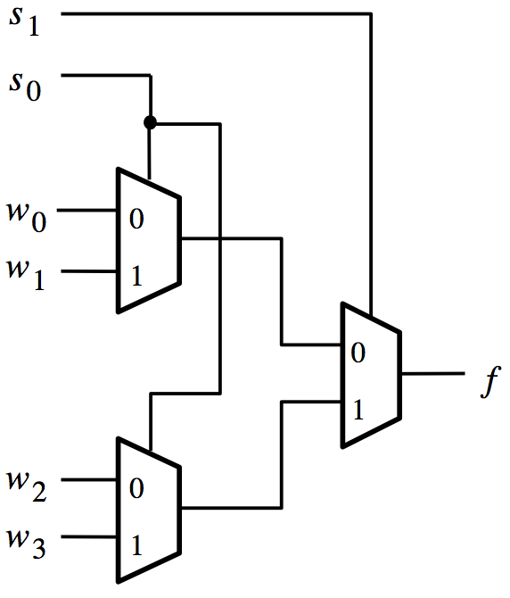
Using three 2-to-1 multiplexers
to build one 4-to-1 multiplexer
[ Figure 4.3 from the textbook ]

Slide 126
Analysis of the Hierarchical Implementation
( s₁=0 and s₀=0 )
0
0
0
0
w₀
w₀
0
w₂
[ Figure 4.3 from the textbook ]

Slide 127
Analysis of the Hierarchical Implementation
( s₁=0 and s₀=1 )
0
1
1
0
w₁
w₁
1
w₃
[ Figure 4.3 from the textbook ]

Slide 128
Analysis of the Hierarchical Implementation
( s₁=1 and s₀=0 )
1
0
0
1
w₀
w₂
0
w₂
[ Figure 4.3 from the textbook ]

Slide 129
Analysis of the Hierarchical Implementation
( s₁=1 and s₀=1 )
1
1
1
1
w₁
w₃
1
w₃
[ Figure 4.3 from the textbook ]

Slide 130
Analogy: Railroad Switches
http://en.wikipedia.org/wiki/Railroad_switch]

Slide 131
Analogy: Railroad Switches
w₀
w₁
w₂
w₃
s₁
f
http://en.wikipedia.org/wiki/Railroad_switch]

Slide 132
Analogy: Railroad Switches
w₀
w₁
w₂
w₃
s₀
these two
switches are
controlled
together
s₁
f
http://en.wikipedia.org/wiki/Railroad_switch]

Slide 133
16-to-1 Multiplexer

Slide 134
16-to-1 Multiplexer
s
0
s
1
w
0
w
3
w
s
2
4
s
3
w
7
f
w
8
w
11
w
12
w
15
[ Figure 4.4 from the textbook ]

Slide 135

[http://upload.wikimedia.org/wikipedia/commons/2/26/SunsetTracksCrop.JPG]

Slide 136
Questions?

Slide 137
THE END

