Slide 1
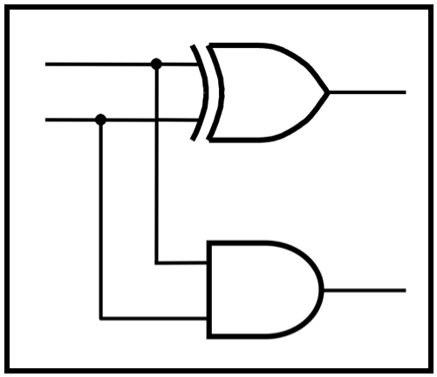
CprE 2810:
Digital Logic
Instructor: Alexander Stoytchev
http://www.ece.iastate.edu/~alexs/classes/

Slide 2
Binary Numbers
CprE 2810: Digital Logic
Iowa State University, Ames, IA
Copyright © Alexander Stoytchev

Slide 3
Administrative Stuff
  This is the official class web page:
  https://www.ece.iastate.edu/~alexs/classes/2025_Fall_2810/
  If you missed the first lecture, the syllabus and other class materials are posted there.

Slide 4
Administrative Stuff
HW1 is out
It is due on Wednesday Sep 3 @ 10 pm.
Submit it on Canvas before the start of the lecture

Slide 5
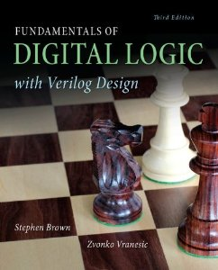
Did you get the textbook?

Slide 6
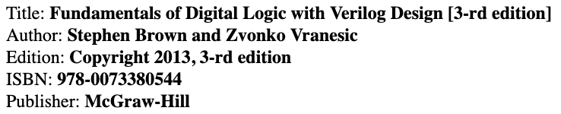
Required Textbook

Slide 7
Required Textbook

Slide 8
Required Textbook

Slide 9
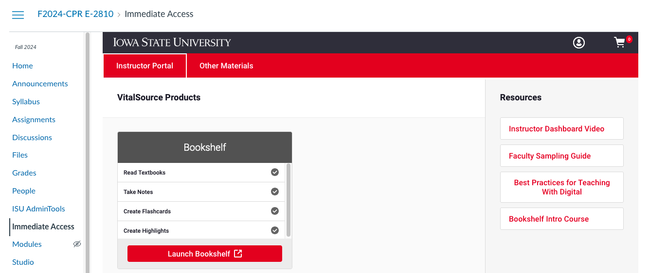
Where is the eBook?
In Canvas,
click here

Slide 10
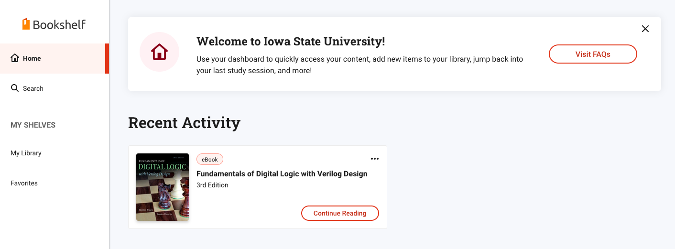
Where is the eBook?
Then click here

Slide 11
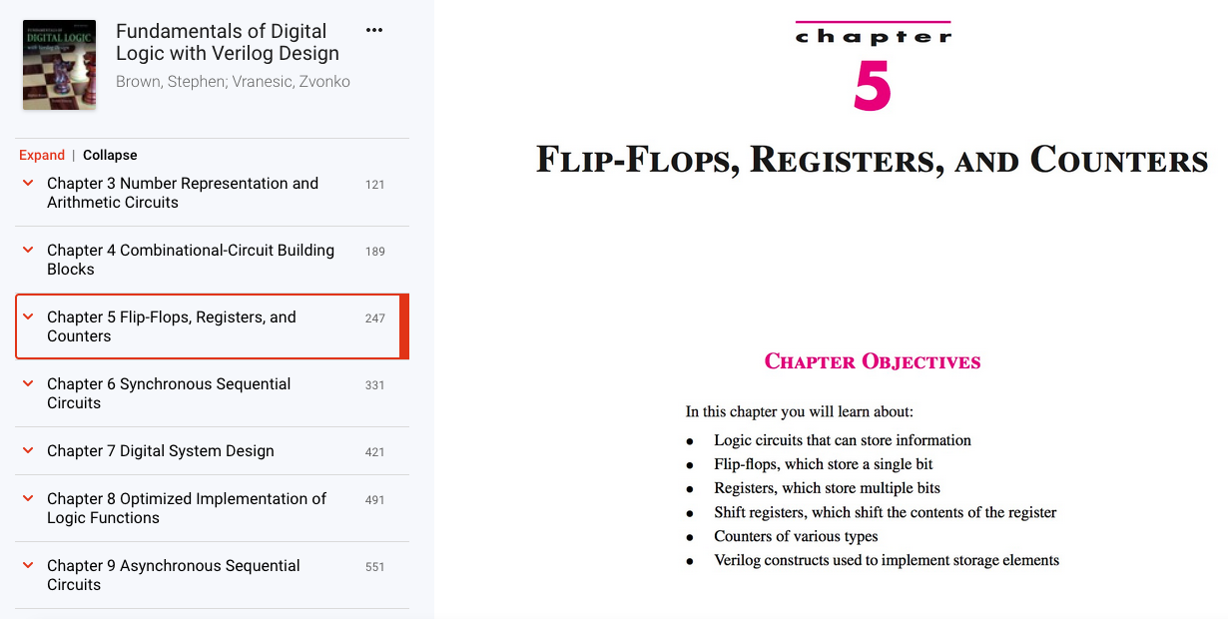
Where is the eBook?

Slide 12
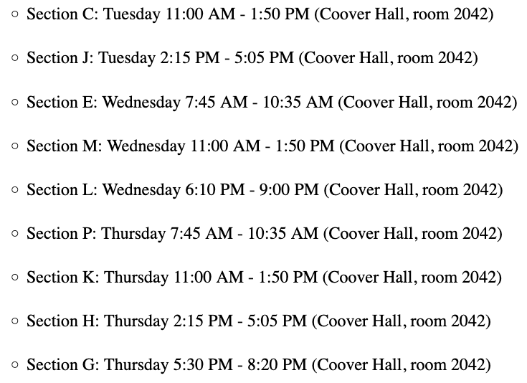
Lab Sections

Slide 13
Administrative Stuff
The labs and recitations start next week:
The lab schedule is also posted on the class web page
The recitation is the first 50 minutes
The other 2 hours are the lab
Changing of sections is not allowed, unless you can formally make the change in the registration system.

Slide 14
The Labs Start Next Week
Please go to the class web page and download and read the lab assignment for next week before you go to your lab.
You must print the answer sheet for each lab ahead of time.
Then answer the pre-lab questions before the start of the lab.
The TAs will check your answers at the beginning of the recitation.

Slide 15
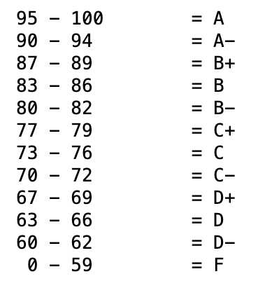
Grading Scale

Slide 16
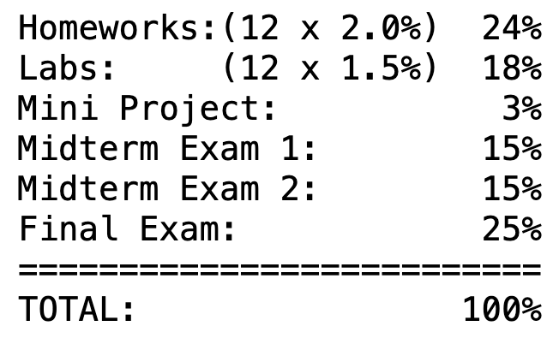
Grading Percentages

Slide 17
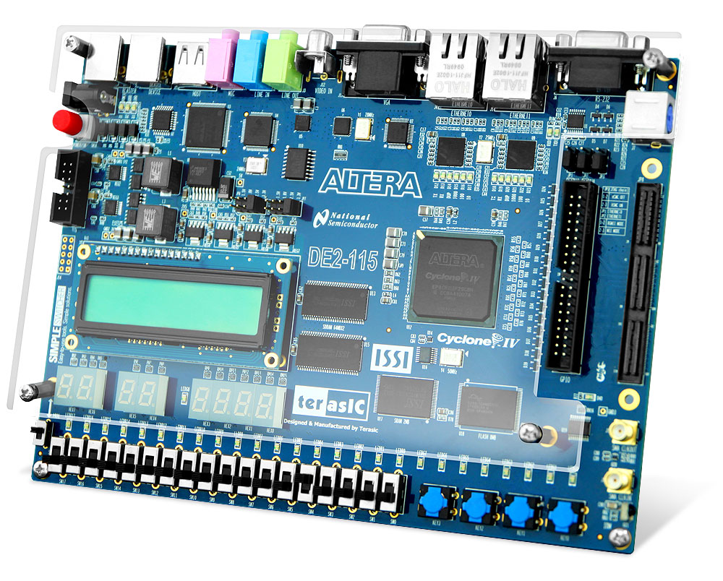
The Labs Start Next Week
Figure 1.5 in the textbook: An FPGA board.

Slide 19
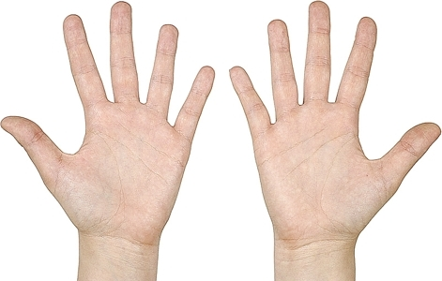
The Decimal System
[http://www.chompchomp.com/images/irregular011.jpg ]

Slide 20
The Decimal System
2
7
1
3
6
8
4
5
0
9
[http://www.chompchomp.com/images/irregular011.jpg ]

Slide 21
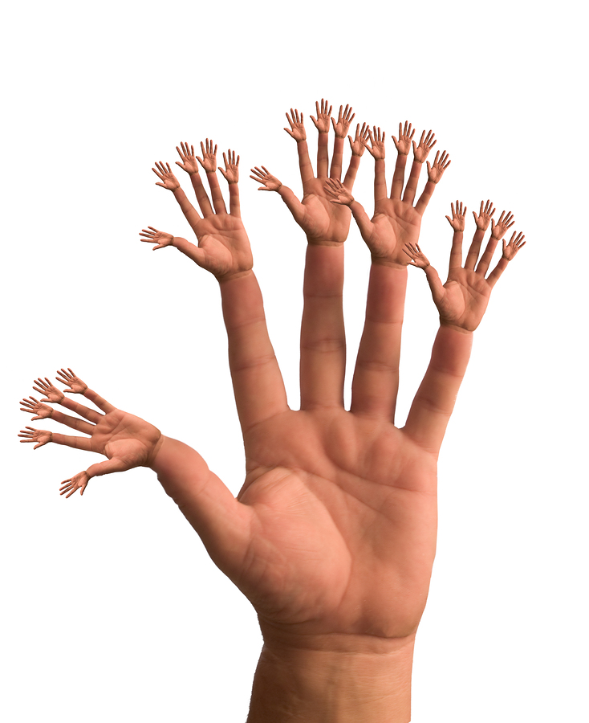
What number system is this one?
[http://freedomhygiene.com/wp-content/themes/branfordmagazine/images/backgrounds/Hands_141756.jpg]

Slide 22

The Binary System
[ http://divaprojections.blogspot.com/2011/11/alien.html]

Slide 23
The Binary System
0
1
[ http://divaprojections.blogspot.com/2011/11/alien.html]

Slide 24

Number Systems

Slide 25
Number Systems
n-th digit
(most significant)
0-th digit
(least significant)

Slide 26
Number Systems
base
power
n-th digit
(most significant)
0-th digit
(least significant)

Slide 27

The Decimal System

Slide 28



The Decimal System

Slide 29
Another Way to Look at This
5
2
4

Slide 30
Another Way to Look at This
10²
10¹
10⁰
5
2
4

Slide 31
Another Way to Look at This
10²
10¹
10⁰
labels
boxes
5
2
4
Each box can contain only one digit and has only one label. From right
to left, the labels are increasing powers of the base, starting from 0.

Slide 32

Base 7

Slide 33
Base 7
base
power

Slide 34
Base 7
base
power
most significant
digit
least significant
digit

Slide 35



Base 7

Slide 36
Another Way to Look at This
7²
7¹
7⁰
10²
10¹
10⁰
5
2
4
=
2
6
3

Slide 37
Binary Numbers (Base 2)

Slide 38
Binary Numbers (Base 2)
base
power
most significant bit
least significant bit

Slide 39
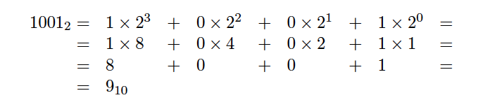
Binary Numbers (Base 2)

Slide 40
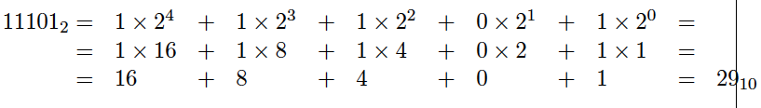
Another Example

Slide 41
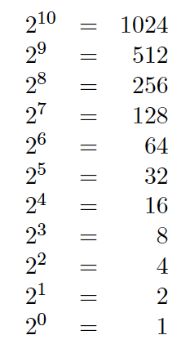
Powers of 2

Slide 42
What is the value of this binary number?
0 0 1 0 1 1 0 0
0 0 1 0 1 1 0 0
0*2⁷ + 0*2⁶ + 1*2⁵ + 0*2⁴ + 1*2³ + 1*2² + 0*2¹ + 0*2⁰
0*128 + 0*64 + 1*32 + 0*16 + 1*8 + 1*4 + 0*2 + 0*1
0*128 + 0*64 + 1*32 + 0*16 + 1*8 + 1*4 + 0*2 + 0*1
32+ 8 + 4 = 44 (in decimal)

Slide 43
Another Way to Look at This
2⁷
2⁶
2⁵
2⁴
2³
2²
2¹
2⁰
0
0
1
0
1
1
0
0

Slide 44
Some Terminology
A binary digit is called a bit
A group of eight bits is called a byte
One bit can represent only two possible states, which are denoted with 1 and 0

Slide 45
Relationship Between a Byte and a Bit
1
0
1
0
1
1
1
0

Slide 46
Relationship Between a Byte and a Bit
1 bit
1
0
1
0
1
1
1
0

Slide 47
Relationship Between a Byte and a Bit
1 bit
1
0
1
0
1
1
1
0
8 bits = 1 byte

Slide 48
Bit Permutations
1 bit
2 bits
3 bits
4 bits
0
1
00
01
10
11
000
001
010
011
100
101
110
111
0000
0001
0010
0011
0100
0101
0110
0111
1000
1001
1010
1011
1100
1101
1110
1111
Each additional bit doubles the number of possible permutations
© 2004 Pearson Addison-Wesley. All rights reserved

Slide 49
Bit Permutations
Each permutation can represent a particular item
There are 2^{N} permutations of N bits
Therefore, N bits are needed to represent 2^{N} unique items
1 bit ?
2 bits ?
3 bits ?
4 bits ?
5 bits ?
2¹ = 2 items
How many
items can be
represented by
2² = 4 items
2³ = 8 items
2⁴ = 16 items
2⁵ = 32 items
© 2004 Pearson Addison-Wesley. All rights reserved

Slide 50
What is the maximum number that can be stored in one byte (8 bits)?

Slide 51
What is the maximum number that can be stored in one byte (8 bits)?
1 1 1 1 1 1 1 1
1 1 1 1 1 1 1 1
1*2⁷ + 1*2⁶ + 1*2⁵ + 1*2⁴ + 1*2³ + 1*2² + 1*2¹ + 1*2⁰
1*128 + 1*64 + 1*32 + 1*16 + 1*8 + 1*4 + 1*2 + 1*1
128 + 64 + 32 + 16 + 8 + 4 + 2 + 1 = 255 (in decimal)
Another way is: 1*2⁸ – 1 = 256 – 1 = 255

Slide 52
What would happen if we try to add 1 to the largest number that can be stored in one byte (8 bits)?
1 1 1 1 1 1 1 1
+
1
-------------------------------
1 0 0 0 0 0 0 0 0
0 0 0 0 0 0 0 0

Slide 53
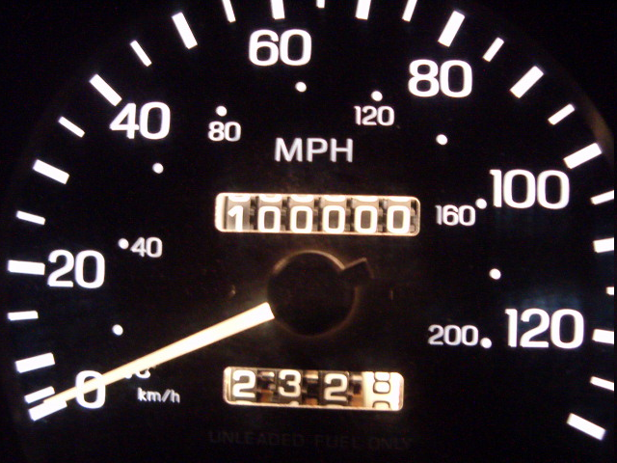
Analogy with car odometers

Slide 54
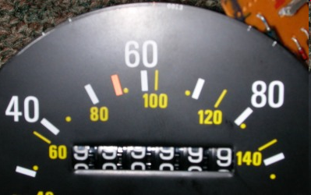
Analogy with car odometers
[http://www.hyperocity.com/volvo240/images/Volvo/odometerrepair/speedo999999.jpg]

Slide 55
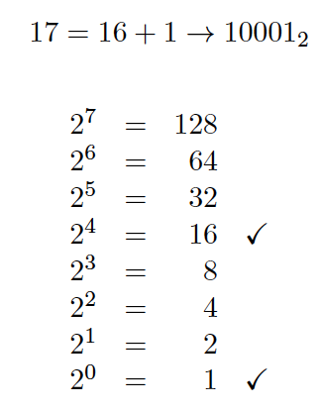
Decimal to Binary Conversion
(Using Guessing)

Slide 56
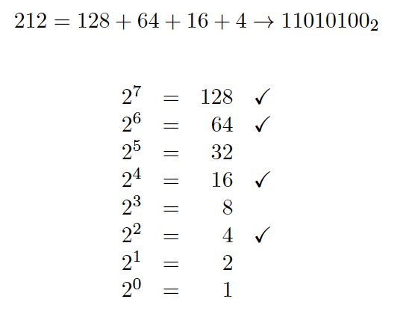
Decimal to Binary Conversion
(Using Guessing)

Slide 57
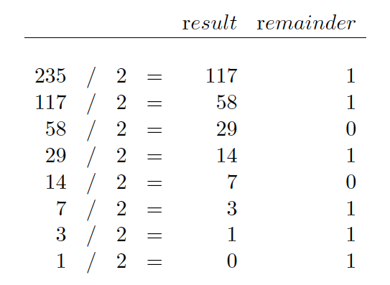
Converting from Decimal to Binary

Slide 58

Converting from Decimal to Binary

Slide 59
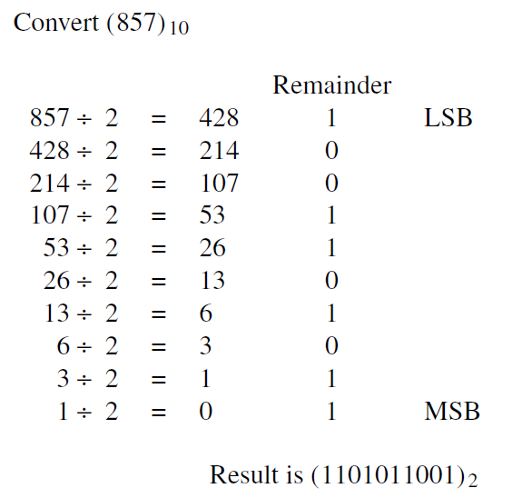
[ Figure 1.6 in the textbook ]

Slide 60
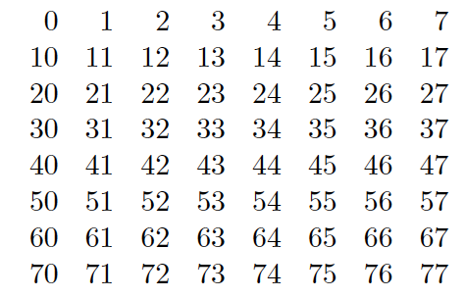
Octal System (Base 8)

Slide 61
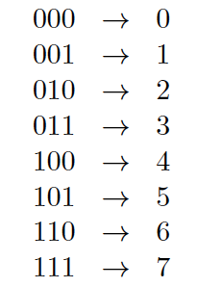
Binary to Octal Conversion

Slide 62
Binary to Octal Conversion
101110010111₂ = ?₈

Slide 63
Binary to Octal Conversion
101110010111₂ = ?₈
101 110 010 111

Slide 64
Binary to Octal Conversion
101110010111₂ = ?₈
101 110 010 111
5 6 2 7

Slide 65
Binary to Octal Conversion
101110010111₂ = ?₈
101 110 010 111
5 6 2 7
Thus, 101110010111₂ = 5627₈

Slide 66
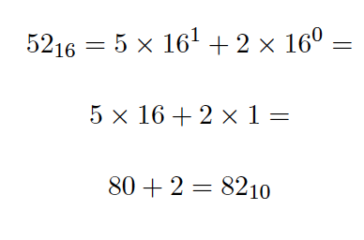
Hexadecimal System (Base 16)

Slide 67
The 16 Hexadecimal Digits
0, 1, 2, 3, 4, 5, 6, 7, 8, 9, A, B, C, D, E, F

Slide 68
The 16 Hexadecimal Digits
0, 1, 2, 3, 4, 5, 6, 7, 8, 9, A, B, C, D, E, F
10, 11, 12, 13, 14, 15

Slide 69




Hexadecimal to Decimal Conversion

Slide 70

Hexadecimal to Decimal Conversion

Slide 71
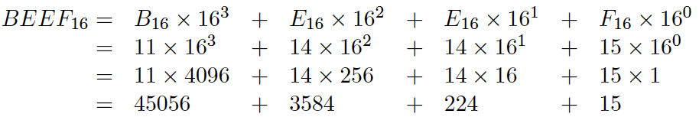

Hexadecimal to Decimal Conversion

Slide 72
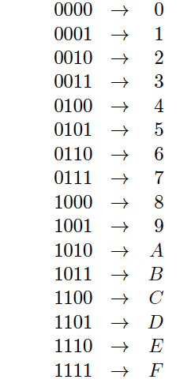
Binary to Hexadecimal Conversion

Slide 73
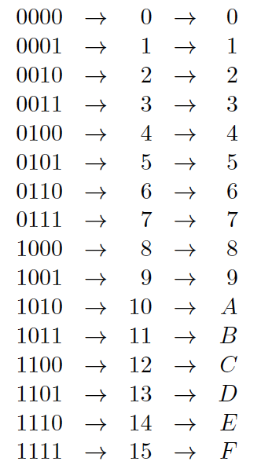
Binary to Hexadecimal Conversion

Slide 74
Binary to Hexadecimal Conversion
101110010111₂ = ?₁₆

Slide 75
Binary to Hexadecimal Conversion
101110010111₂ = ?₁₆
1011 1001 0111

Slide 76
Binary to Hexadecimal Conversion
101110010111₂ = ?₁₆
1011 1001 0111
B 9 7

Slide 77
Binary to Hexadecimal Conversion
101110010111₂ = ?₁₆
1011 1001 0111
B 9 7
Thus, 101110010111₂ = B97₁₆

Slide 78
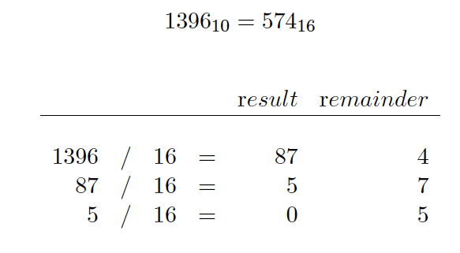
Decimal to Hexadecimal Conversion

Slide 79
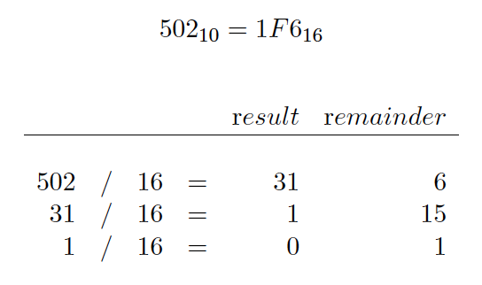
Decimal to Hexadecimal Conversion

Slide 80
Sample Midterm 1 Questions on Number Systems

Slide 81
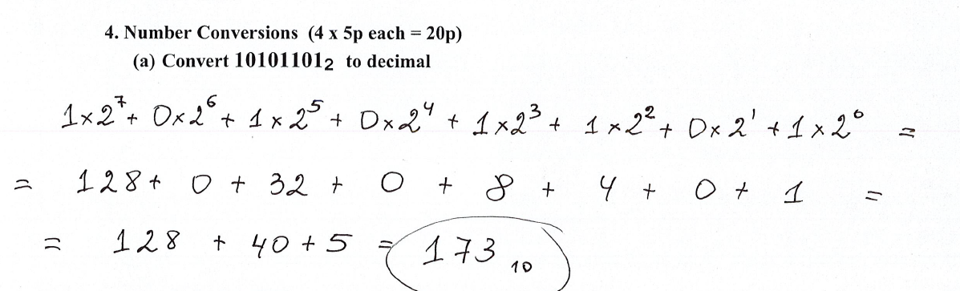

Slide 82
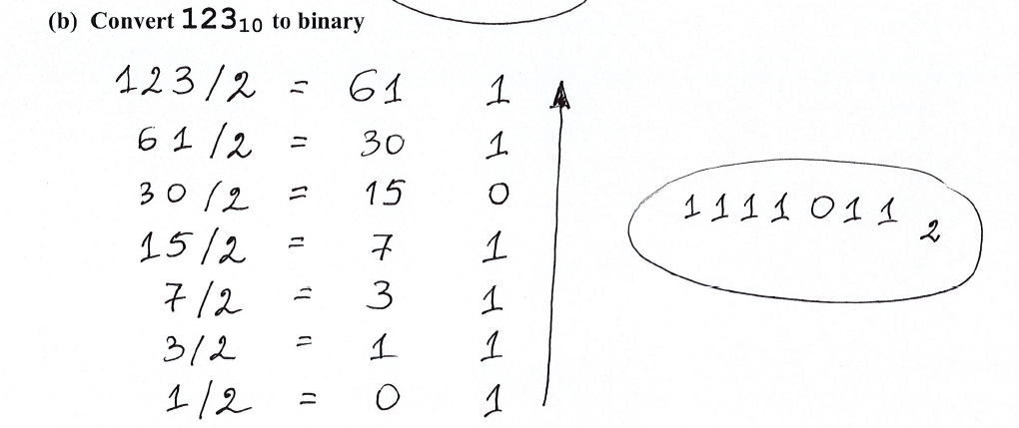

Slide 83
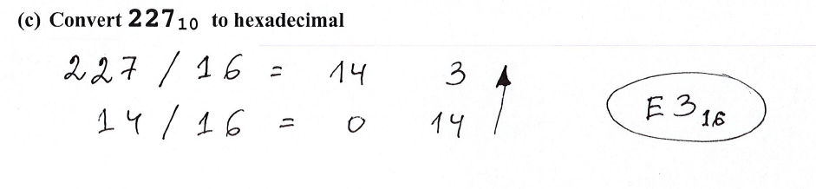

Slide 84
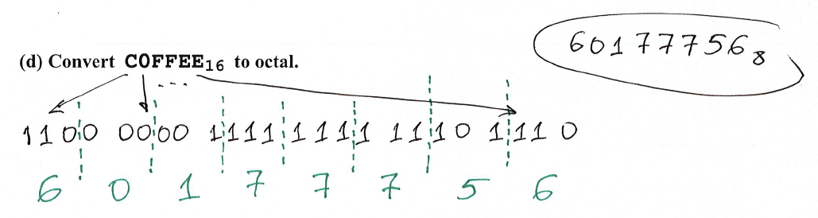

Slide 86
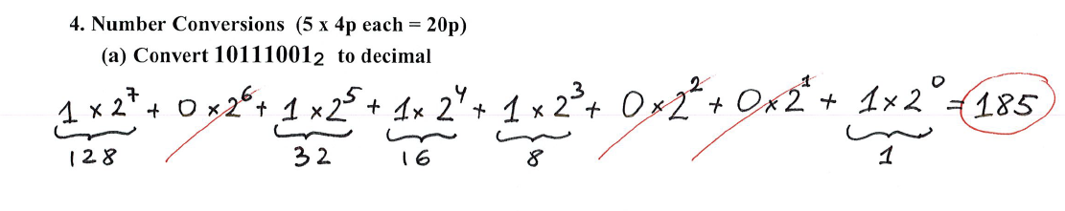

Slide 87
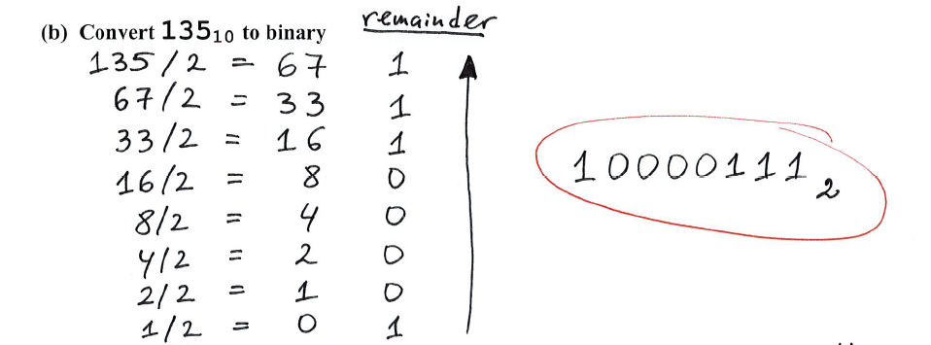

Slide 88
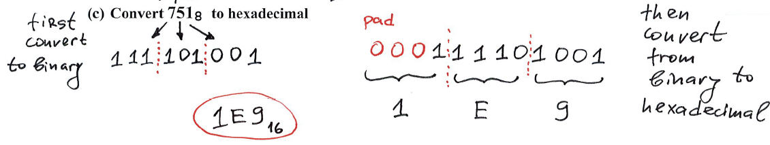

Slide 89
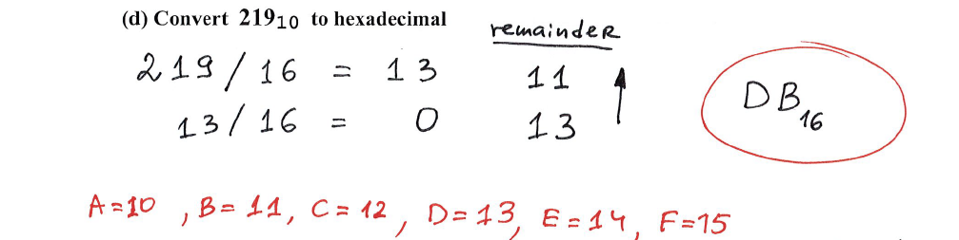

Slide 90
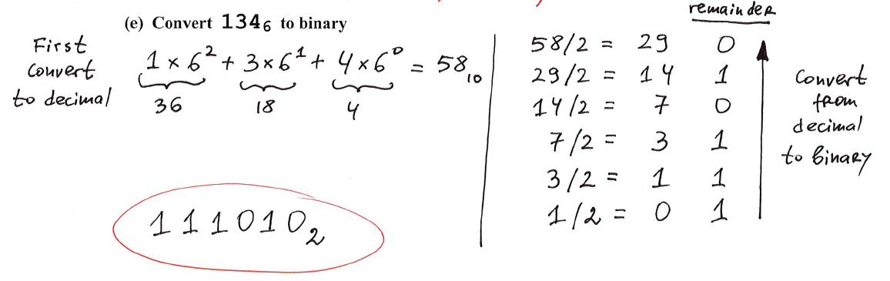

Slide 91
Signed integers are more complicated
We will talk more about them when we start with Chapter 3 in a couple of weeks.

Slide 92
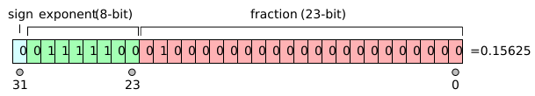
The story with floats is even more complicated
IEEE 754-1985 Standard
[http://en.wikipedia.org/wiki/IEEE_754]

Slide 93
In the example shown above, the sign is zero so s is +1, the exponent is 124 so e is −3, and the significand m is 1.01 (in binary, which is 1.25 in decimal). The represented number is therefore +1.25 × 2⁻³, which is +0.15625.
[http://en.wikipedia.org/wiki/IEEE_754]

Slide 94
On-line IEEE 754 Converter
https://www.h-schmidt.net/FloatConverter/IEEE754.html
More about floating point numbers in Chapter 3.

Slide 95
Storing Characters
This requires some convention that maps binary numbers to characters.
ASCII table
Unicode

Slide 96
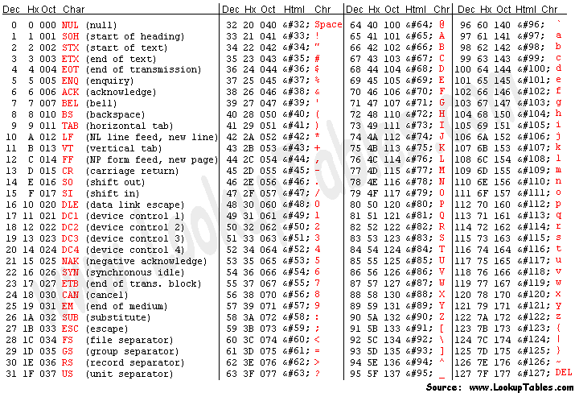
ASCII Table

Slide 97
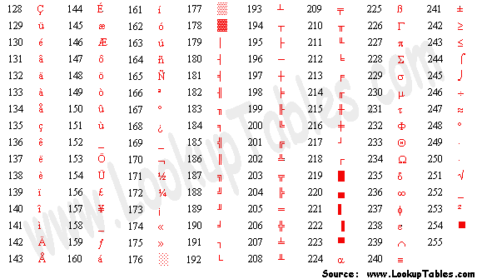
Extended ASCII Codes

Slide 98
The Unicode Character Code
http://www.unicode.org/charts/
https://en.wikipedia.org/wiki/Unicode
The original standard uses 16 bits (2 bytes)
The later extensions use up to 32 bits.

Slide 99
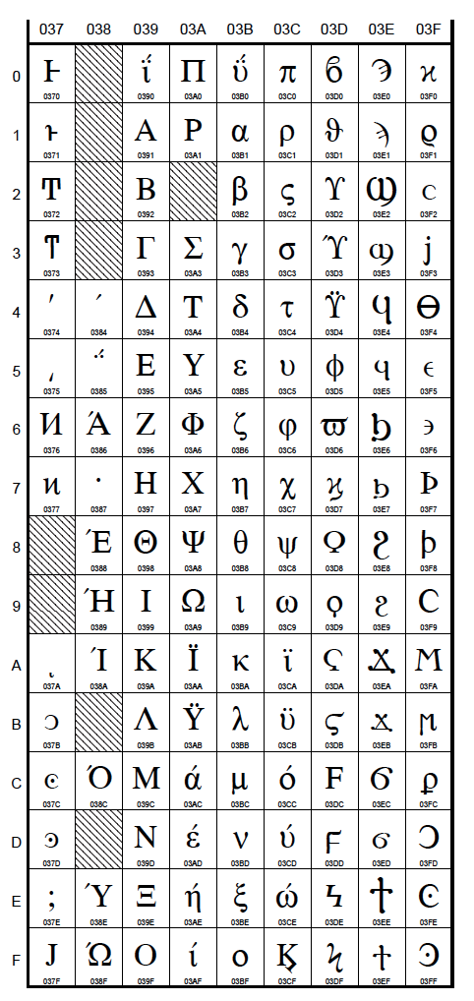
The Greek
Alphabet
http://www.unicode.org/charts/

Slide 100
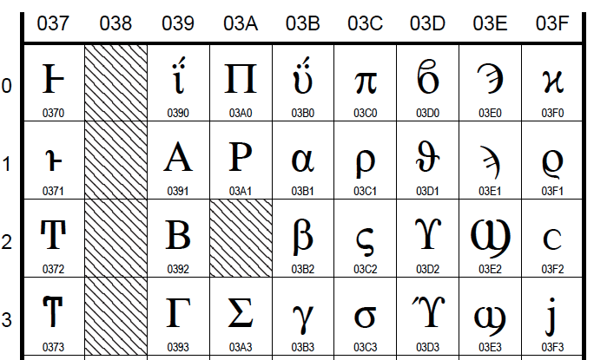
Close up
http://www.unicode.org/charts/

Slide 101
Close up
This is the Hexadecimal number
for the Greek letter alpha: 03B1
http://www.unicode.org/charts/

Slide 102
Close up
This is the Hexadecimal number
for the Greek letter beta: 03B2
http://www.unicode.org/charts/

Slide 103
Close up
This is the Hexadecimal number
for the Greek letter gamma: 03B3
http://www.unicode.org/charts/

Slide 104
Close up
This is the Hexadecimal number
for the Greek letter pi: 03C0
http://www.unicode.org/charts/

Slide 105
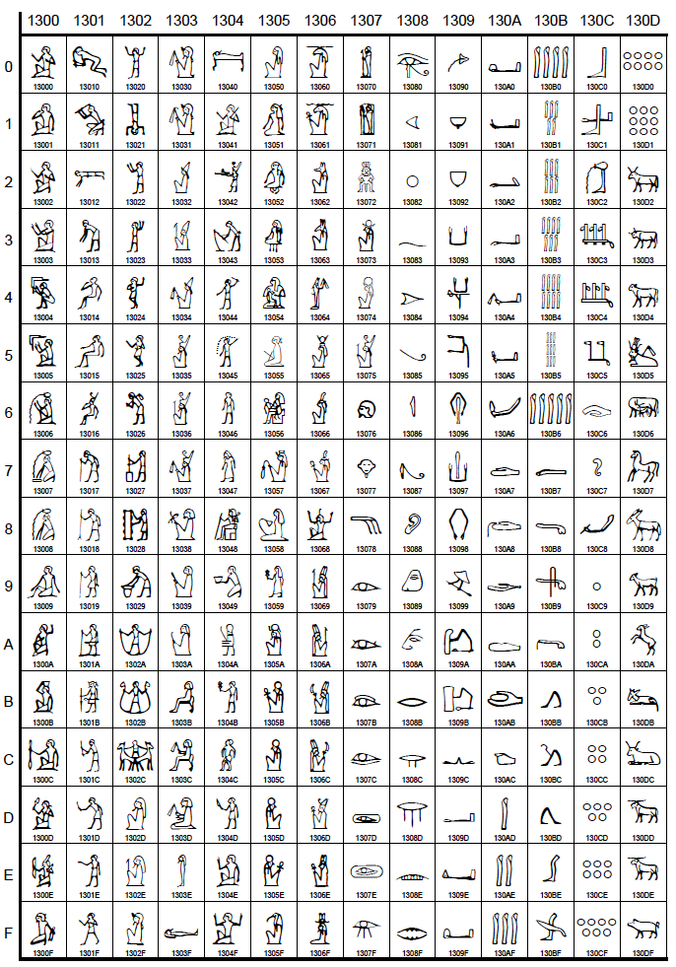
Egyptian
Hieroglyphs
http://www.unicode.org/charts/

Slide 106
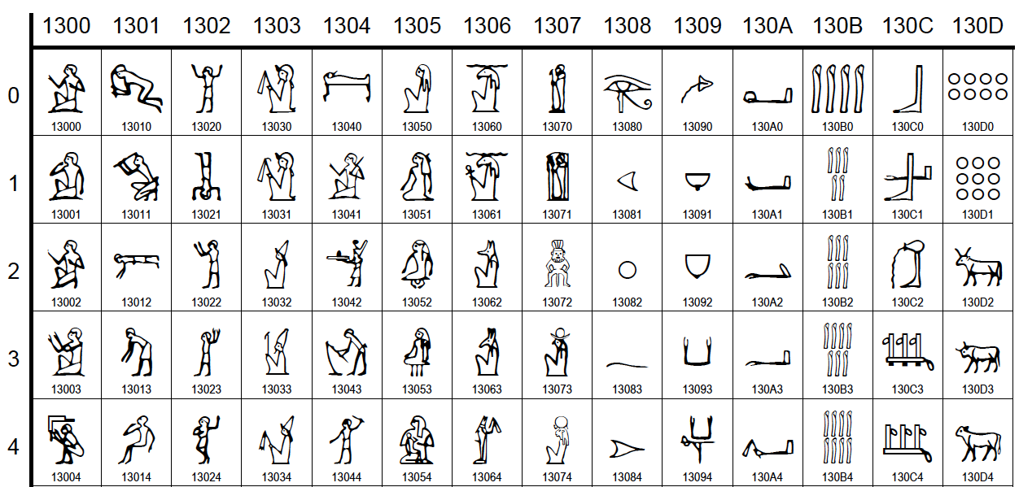
Close up
http://www.unicode.org/charts/

Slide 107
Questions?

Slide 108
THE END

