Slide 1
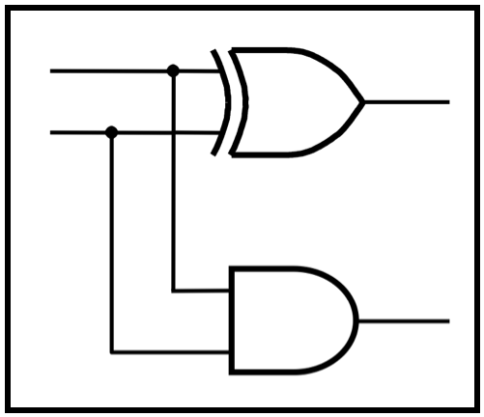
CprE 2810: Digital Logic
Instructor: Alexander Stoytchev
http://www.ece.iastate.edu/~alexs/classes/

Slide 2
No Lecture Today
(due to Midterm 2)

