Slide 1
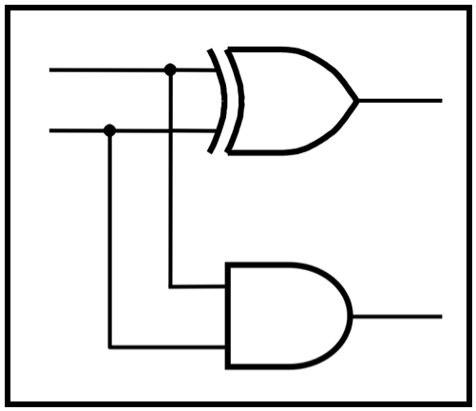
CprE 2810:
Digital Logic
Instructor: Alexander Stoytchev
http://www.ece.iastate.edu/~alexs/classes/

Slide 2
Counters
CprE 2810: Digital Logic
Iowa State University, Ames, IA
Copyright © Alexander Stoytchev

Slide 3
Quick Review

Slide 4
Register File

Slide 5
Register File (Definition)
A circuit that can store several binary numbers, which can be read or written independently.
Each number is stored in a separate n-bit register.
To write: a decoder selects which resister is enabled for writing. An input bus provides the values.
To read: a set of multiplexers select which register will be read and copied to the output bus.
Some register files come with two read ports. In those designs the multiplexer circuitry is doubled.

Slide 6
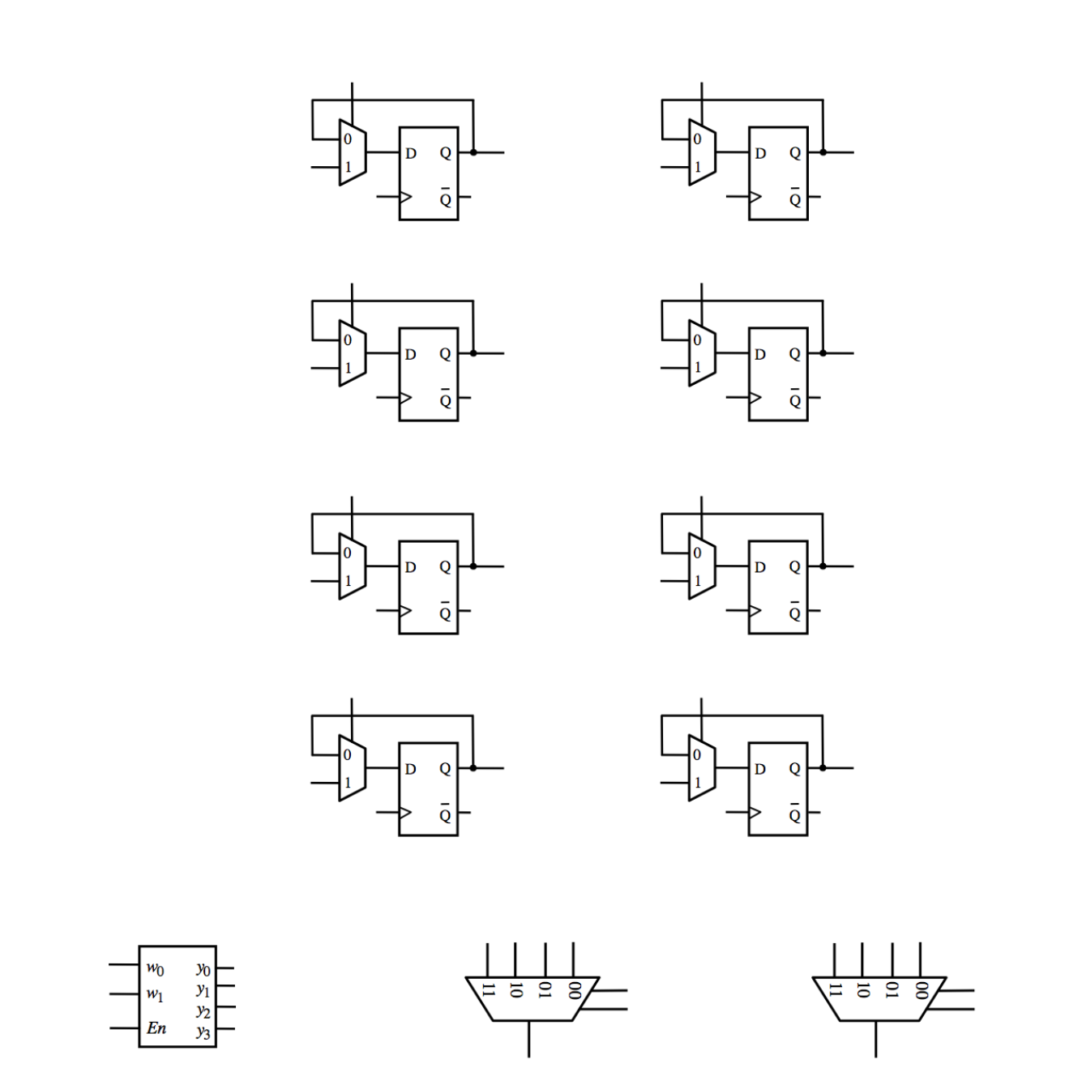
Complete the following circuit diagram to implement a register file with four 2-bit registers, one write port,
one read port, and one write enable line.

Slide 8
Register 0
Register 1
Register 2
Register 3

Slide 9
Register A
Register B
Register C
Register D

Slide 10
A₁
A₀
Register A
B₁
B₀
Register B
C₁
C₀
Register C
D₁
D₀
Register D

Slide 11
In₁
In₀
A₁
A₀
Register A
B₁
B₀
Register B
C₁
C₀
Register C
D₁
D₀
Register D

Slide 12
In₁
In₀
A₁
A₀
Register A
B₁
B₀
Register B
C₁
C₀
Register C
D₁
D₀
Register D
Write_address_0
Write_address_1
Write_enable

Slide 13
In₁
In₀
A₁
A₀
Register A
B₁
B₀
Register B
C₁
C₀
Register C
D₁
D₀
Register D
Write_address_0
Write_address_1
Write_enable

Slide 14
In₁
In₀
A₁
A₀
Register A
B₁
B₀
Register B
C₁
C₀
Register C
D₁
D₀
Register D
Write_address_0
Write_address_1
Read_address_1
Write_enable
Read_address_0
Out₁
Out₀

Slide 15
In₁
In₀
A₁
A₀
Register A
B₁
B₀
Register B
C₁
C₀
Register C
D₁
D₀
Register D
Clock
Write_address_0
Write_address_1
Read_address_1
Write_enable
Read_address_0
Out₁
Out₀

Slide 16
In₁
In₀
A₁
A₀
B₁
B₀
C₁
C₀
D₁
D₀
Clock
Write_address_0
Write_address_1
Read_address_1
Write_enable
Read_address_0
Out₁
Out₀

Slide 17
Components of the Register File

Slide 18
In₁
In₀
A₁
A₀
B₁
B₀
C₁
C₀
2-to-4 decoder
with enable
D₁
D₀
Clock
Write_address_0
Write_address_1
Read_address_1
Write_enable
Read_address_0
Out₁
Out₀

Slide 19
In₁
In₀
A₁
A₀
B₁
B₀
C₁
C₀
D₁
D₀
4-to-1 Multiplexer
Clock
Write_address_0
Write_address_1
Read_address_1
Write_enable
Read_address_0
Out₁
Out₀

Slide 20
In₁
In₀
A₁
A₀
B₁
B₀
C₁
C₀
D₁
D₀
4-to-1 Multiplexer
Clock
Write_address_0
Write_address_1
Read_address_1
Write_enable
Read_address_0
Out₁
Out₀

Slide 21
1-bit Parallel-Access
Register
In₁
In₀
A₁
A₀
B₁
B₀
C₁
C₀
D₁
D₀
Clock
Write_address_0
Write_address_1
Read_address_1
Write_enable
Read_address_0
Out₁
Out₀

Slide 22
1-bit Parallel-Access
Register
In₁
In₀
A₁
A₀
x 8
B₁
B₀
C₁
C₀
D₁
D₀
Clock
Write_address_0
Write_address_1
Read_address_1
Write_enable
Read_address_0
Out₁
Out₀

Slide 23
Putting it all Together

Slide 24
In₁
In₀
A₁
A₀
B₁
B₀
C₁
C₀
D₁
D₀
Clock
Write_address_0
Write_address_1
Read_address_1
Write_enable
Read_address_0
Out₁
Out₀

Slide 25
In₁
In₀
A₁
A₀
B₁
B₀
C₁
C₀
D₁
D₀
Clock
Write_address_0
Write_address_1
Read_address_1
Write_enable
Read_address_0
Out₁
Out₀

Slide 26
Counters

Slide 27
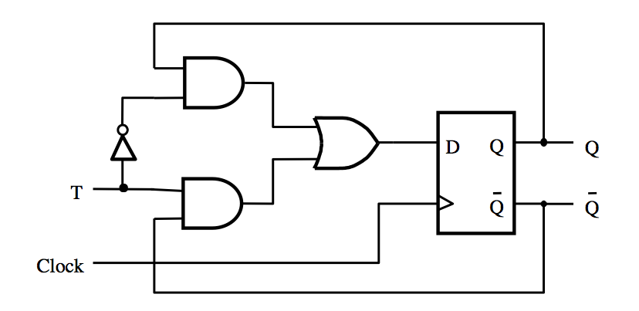
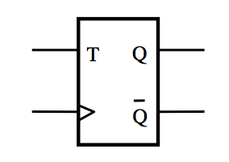
T Flip-Flop
(circuit and graphical symbol)
[ Figure 5.15a,c from the textbook ]

Slide 28
The output of the T Flip-Flop
divides the frequency of the clock by 2

Slide 29
The output of the T Flip-Flop
divides the frequency of the clock by 2
1

Slide 30
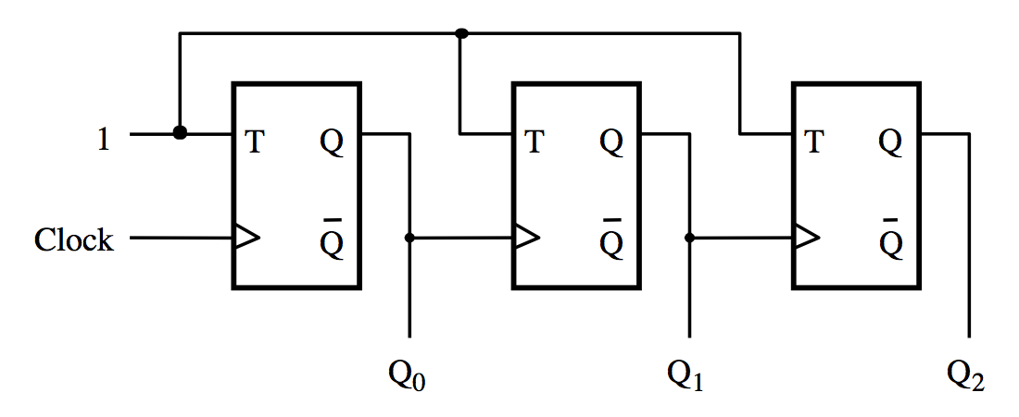
A three-bit down-counter
[ Figure 5.20 from the textbook ]

Slide 31
A three-bit down-counter
The first flip-flop changes
on the positive edge of the clock
[ Figure 5.20 from the textbook ]

Slide 32
A three-bit down-counter
The first flip-flop changes
on the positive edge of the clock
The second flip-flop changes
on the positive edge of Q₀
[ Figure 5.20 from the textbook ]

Slide 33
A three-bit down-counter
The first flip-flop changes
on the positive edge of the clock
The second flip-flop changes
on the positive edge of Q₀
The third flip-flop changes
on the positive edge of Q₁
[ Figure 5.20 from the textbook ]

Slide 34
A three-bit down-counter
1
T
Q
T
Q
T
Q
Clock
Q
Q
Q
Q
0
Q
1
Q
2
(a) Circuit
Clock
Q
0
Q
1
Q
2
Count
0
7
6
5
4
3
2
1
0
(b) Timing diagram
[ Figure 5.20 from the textbook ]

Slide 35
A three-bit down-counter
1
T
Q
T
Q
T
Q
Clock
Q
Q
Q
Q
0
Q
1
Q
2
(a) Circuit
Clock
least
significant
1
0
1
0
1
0
1
0
Q
0
1
1
0
0
1
1
0
0
Q
1
most
significant
1
1
1
1
0
0
0
0
Q
2
Count
0
7
6
5
4
3
2
1
0
(b) Timing diagram

Slide 36
A three-bit down-counter
1
T
Q
T
Q
T
Q
Clock
Q
Q
Q
Q
0
Q
1
Q
2
(a) Circuit
Clock
Q₀ toggles
on the positive
clock edge
Q
0
Q
1
Q
2
Count
0
7
6
5
4
3
2
1
0
(b) Timing diagram

Slide 37
A three-bit down-counter
1
T
Q
T
Q
T
Q
Clock
Q
Q
Q
Q
0
Q
1
Q
2
(a) Circuit
Clock
Q
0
Q₁ toggles
on the positive
edge of Q₀
Q
1
Q
2
Count
0
7
6
5
4
3
2
1
0
(b) Timing diagram

Slide 38
A three-bit down-counter
1
T
Q
T
Q
T
Q
Clock
Q
Q
Q
Q
0
Q
1
Q
2
(a) Circuit
Clock
Q
0
Q
1
Q₂ toggles
on the positive
edge of Q₁
Q
2
Count
0
7
6
5
4
3
2
1
0
(b) Timing diagram

Slide 39
A three-bit down-counter
1
T
Q
T
Q
T
Q
Clock
Q
Q
Q
Q
0
Q
1
Q
2
The propagation delays get longer
(a) Circuit
Clock
Q
0
Q
1
Q
2
Count
0
7
6
5
4
3
2
1
0
(b) Timing diagram

Slide 40
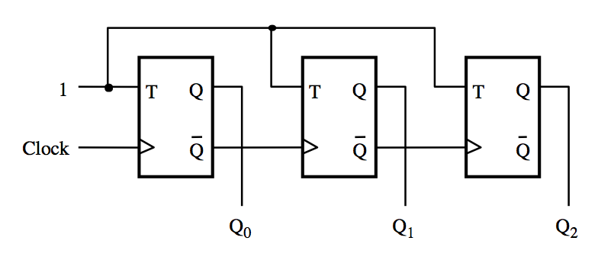
A three-bit up-counter
[ Figure 5.19 from the textbook ]

Slide 41
A three-bit up-counter
The first flip-flop changes
on the positive edge of the clock
[ Figure 5.19 from the textbook ]

Slide 42
A three-bit up-counter
The first flip-flop changes
on the positive edge of the clock
The second flip-flop changes
on the positive edge of Q₀
[ Figure 5.19 from the textbook ]

Slide 43
A three-bit up-counter
The first flip-flop changes
on the positive edge of the clock
The second flip-flop changes
on the positive edge of Q₀
The third flip-flop changes
on the positive edge of Q₁
[ Figure 5.19 from the textbook ]

Slide 44
A three-bit up-counter
1
T
Q
T
Q
T
Q
Clock
Q
Q
Q
Q
0
Q
1
Q
2
(a) Circuit
Clock
Q
0
Q
1
Q
2
Count
0
1
2
3
4
5
6
7
0
(b) Timing diagram
[ Figure 5.19 from the textbook ]

Slide 45
A three-bit up-counter
1
T
Q
T
Q
T
Q
Clock
Q
Q
Q
Q
0
Q
1
Q
2
(a) Circuit
Clock
least
significant
1
0
1
0
1
0
1
0
Q
0
Q
0
1
1
0
0
1
1
0
1
most
significant
0
0
0
1
1
1
1
0
Q
2
Count
0
1
2
3
4
5
6
7
0
(b) Timing diagram
[ Figure 5.19 from the textbook ]

Slide 46
A three-bit up-counter
1
T
Q
T
Q
T
Q
Clock
Q
Q
Q
Q
0
Q
1
Q
2
(a) Circuit
Clock
Q
0
The count
is formed
by the Q’s
Q
1
Q
2
(b) Timing diagram
[ Figure 5.19 from the textbook ]

Slide 47
A three-bit up-counter
1
T
Q
T
Q
T
Q
Clock
Q
Q
Q
Q
0
Q
1
Q
2
(a) Circuit
Clock
Q
0
The toggling
is done
by the Q’s
Q
1
Q
2
(b) Timing diagram

Slide 48
A three-bit up-counter
1
T
Q
T
Q
T
Q
Clock
Q
Q
Q
Q
0
Q
1
Q
2
(a) Circuit
Clock
Q₀ toggles
on the positive
clock edge
Q
0
Q
1
Q
2
(b) Timing diagram

Slide 49
A three-bit up-counter
1
T
Q
T
Q
T
Q
Clock
Q
Q
Q
Q
0
Q
1
Q
2
(a) Circuit
Clock
Q
0
Q₁ toggles
on the positive
Edge of Q₀
Q
1
Q
2
(b) Timing diagram

Slide 50
A three-bit up-counter
1
T
Q
T
Q
T
Q
Clock
Q
Q
Q
Q
0
Q
1
Q
2
(a) Circuit
Clock
Q
0
Q
1
Q₂ toggles
on the positive
edge of Q₁
Q
2
(b) Timing diagram

Slide 51
A three-bit up-counter
1
T
Q
T
Q
T
Q
Clock
Q
Q
Q
Q
0
Q
1
Q
2
The propagation delays get longer
(a) Circuit
Clock
Q
0
Q
1
Q
2
(b) Timing diagram

Slide 52
A three-bit up-counter
1
T
Q
T
Q
T
Q
Clock
Q
Q
Q
Q
0
Q
1
Q
2
The propagation delays get longer
(a) Circuit
Clock
Q
0
Q
1
Q
2
Count
0
1
2
3
4
5
6
7
0
(b) Timing diagram
[ Figure 5.19 from the textbook ]

Slide 53
Synchronous Counters

Slide 54
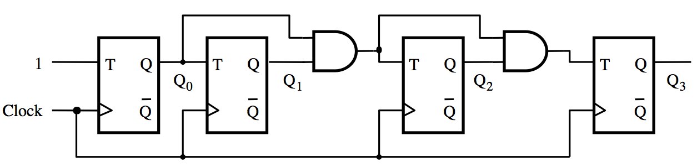
A four-bit synchronous up-counter
[ Figure 5.21 from the textbook ]

Slide 55
A four-bit synchronous up-counter
The propagation delay through all AND gates combined must
not exceed the clock period minus the setup time for the flip-flops
[ Figure 5.21 from the textbook ]

Slide 56
A four-bit synchronous up-counter
1
T
Q
T
Q
T
Q
T
Q
Q
0
Q
1
Q
2
Q
3
Clock
Q
Q
Q
Q
(a) Circuit
Clock
Q
0
Q
1
Q
2
Q
3
Count
0
1
2
3
4
5
6
7
8
9
10
11
12
13
14
15
0
1
(b) Timing diagram
[ Figure 5.21 from the textbook ]

Slide 57
Derivation of the synchronous up-counter
Clock cycle
Q
2
Q
1
Q
0
Q
1
changes
0
0
0
0
1
0
0
1
Q
2
changes
2
0
1
0
3
0
1
1
4
1
0
0
5
1
0
1
6
1
1
0
7
1
1
1
8
0
0
0
[ Table 5.1 from the textbook ]

Slide 58
Derivation of the synchronous up-counter
Clock cycle
Q
2
Q
1
Q
0
Q
1
changes
0
0
0
0
1
0
0
1
Q
2
changes
2
0
1
0
3
0
1
1
4
1
0
0
5
1
0
1
6
1
1
0
7
1
1
1
8
0
0
0
T₀= 1
T₁ = Q₀
T₂ = Q₀ Q₁
[ Table 5.1 from the textbook ]

Slide 59
A four-bit synchronous up-counter
T₀= 1
T₁ = Q₀
T₂ = Q₀ Q₁
[ Figure 5.21 from the textbook ]

Slide 60
In general we have
T₀= 1
T₁ = Q₀
T₂ = Q₀ Q₁
T₃ = Q₀ Q₁ Q₂
…
T_{n} = Q₀ Q₁ Q₂ …Q_{n-1}

Slide 61
Synchronous v.s. Asynchronous Clear

Slide 62
2-Bit Synchronous Up-Counter
(without clear capability)
Q₀
Q₁
1
T
Q
T
Q
Q
Q
Clock

Slide 63
2-Bit Synchronous Up-Counter
(with asynchronous clear)
Q₀
Q₁
1
T
Q
T
Q
Q
Q
Clock
Clear_n

Slide 64
2-Bit Synchronous Up-Counter
(with asynchronous clear)
Q₀
Q₁
1
D
Q
D
Q
Q
Q
Clock
Clear_n
This is the same circuit but uses D Flip-Flops.

Slide 65
2-Bit Synchronous Up-Counter
(with synchronous clear)
Q₀
Q₁
1
D
Q
D
Q
Q
Q
Clock
Clear_n
This counter can be cleared only on the positive clock edge.

Slide 66
Adding Enable Capability

Slide 67
A four-bit synchronous up-counter
[ Figure 5.21 from the textbook ]

Slide 68
Inclusion of Enable and Clear Capability
Enable
T
Q
T
Q
T
Q
T
Q
Clock
Q
Q
Q
Q
Clear_n
[ Figure 5.22 from the textbook ]

Slide 69
Inclusion of Enable and Clear Capability
This is the new thing relative to
the previous figure, plus the clear_n line
Enable
T
Q
T
Q
T
Q
T
Q
Clock
Q
Q
Q
Q
Clear_n
[ Figure 5.22 from the textbook ]

Slide 70
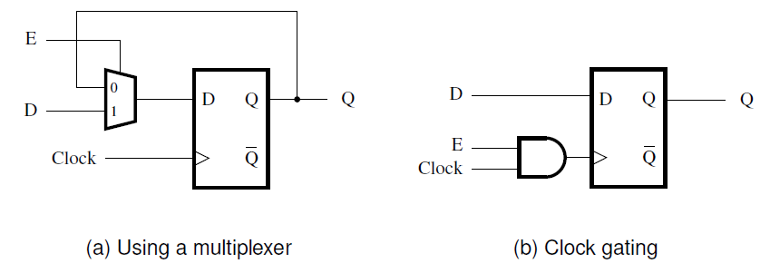
Providing an enable input for a D flip-flop
[ Figure 5.56 from the textbook ]

Slide 71
Synchronous Counter
(with D Flip-Flops)

Slide 72
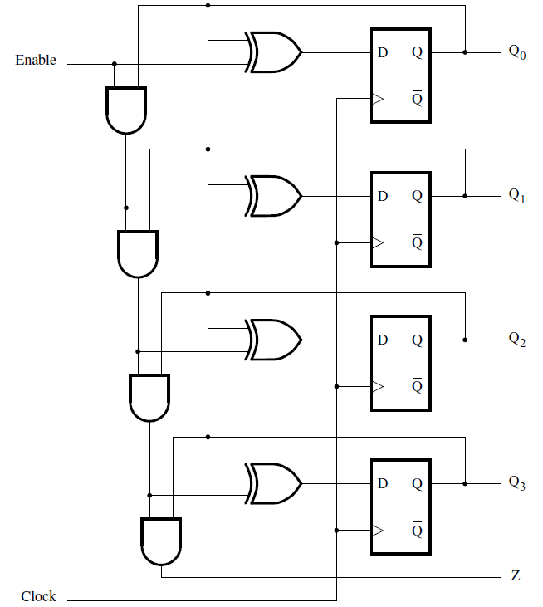
A 4-bit up-counter with D flip-flops
[ Figure 5.23 from the textbook ]

Slide 73
A 4-bit up-counter with D flip-flops
T flip-flop
T flip-flop
T flip-flop
T flip-flop
[ Figure 5.23 from the textbook ]

Slide 74
Equivalent to this circuit with T flip-flops
Enable
T
Q
T
Q
T
Q
T
Q
Clock
Q
Q
Q
Q

Slide 75
Equivalent to this circuit with T flip-flops
Z
Enable
T
Q
T
Q
T
Q
T
Q
Clock
Q
Q
Q
Q
But has one extra output called Z, which can be used to
connect two 4-bit counters to make an 8-bit counter.
When Z=1 the counter will go to 0000 on the next clock edge, i.e.,
the outputs of all flip-flops are currently 1 (maximum count value).

Slide 76
Counters with Parallel Load

Slide 77
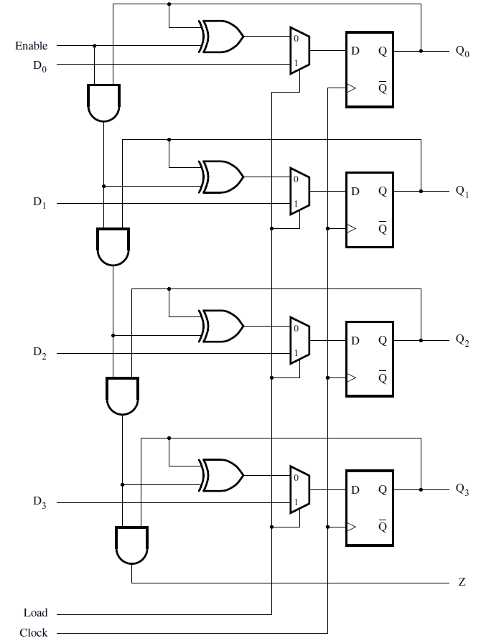
A counter with parallel-load capability
[ Figure 5.24 from the textbook ]

Slide 78
How to load the initial count value

Slide 79
How to load the initial count value
Set "Load" to 1, to open the
"1" line of the multiplexers.
1

Slide 80
How to load the initial count value
1
0
1
0
Set the initial count on
the parallel load lines
(in this case 5).
1

Slide 81
How to load the initial count value
1
0
1
0
1
0
1
0
These bits propagate
to the inputs of
the D Flip-Flops
1

Slide 82
How to load the initial count value
1
0
1
0
1
0
1
0
1
0
1
0
When the next positive edge of
the clock arrives, the outputs
of the flip-flops are updated.
1

Slide 83
A counter with parallel-load capability
[ Figure 5.24 from the textbook ]

Slide 84
Reset Synchronization

Slide 85
Motivation
An n-bit counter counts from 0, 1, …, 2^{n}-1
For example a 3-bit counter counts up as follow
  0, 1, 2, 3, 4, 5, 6, 7, 0, 1, 2, …
What if we want it to count like this
  0, 1, 2, 3, 4, 5, 0, 1, 2, 3, 4, 5, 0, 1, …
In other words, what is the cycle is not a power of 2?

Slide 86
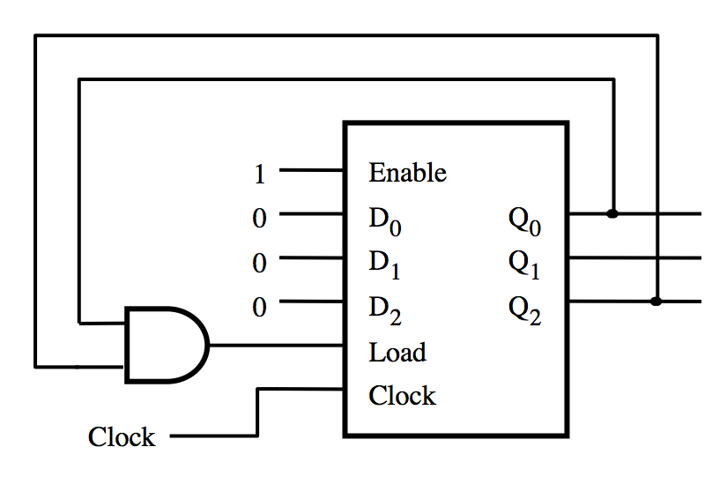
What does this circuit do?
[ Figure 5.25a from the textbook ]

Slide 87
A modulo-6 counter with synchronous reset
1
Enable
0
D
0
Q
0
0
D
1
Q
1
0
D
2
Q
2
Load
Clock
Clock
(a) Circuit
Clock
Q
0
Q
1
Q
2
Count
0
1
2
3
4
5
0
1
(b) Timing diagram
[ Figure 5.25 from the textbook ]

Slide 88
A modulo-6 counter with asynchronous reset
1
T
Q
T
Q
T
Q
Q
0
Q
1
Q
2
Clock
Q
Q
Q
(a) Circuit
Clock
Q
0
Q
1
Q
2
Count
0
1
2
3
4
5
0
1
2
(b) Timing diagram
[ Figure 5.26 from the textbook ]

Slide 89
A modulo-6 counter with asynchronous reset
1
T
Q
T
Q
T
Q
Q
0
Q
1
Q
2
Clock
Q
Q
Q
(a) Circuit
The number 5 is displayed
for a very short amount of time
Clock
Q
0
Q
1
Q
2
Count
0
1
2
3
4
5
0
1
2
(b) Timing diagram
[ Figure 5.26 from the textbook ]

Slide 90
Questions?

Slide 91
THE END

