Slide 1
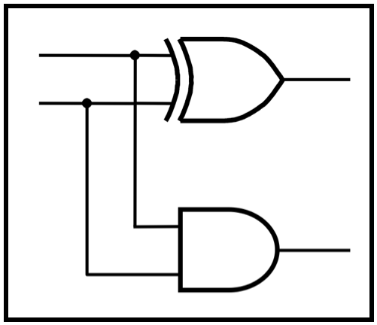
CprE 2810: Digital Logic
Instructor: Alexander Stoytchev
http://www.ece.iastate.edu/~alexs/classes/

Slide 2
Multiplexers
CprE 281: Digital Logic
Iowa State University, Ames, IA
Copyright © Alexander Stoytchev

Slide 3
Administrative Stuff
HW 6 is due on Monday Oct 14 @ 10pm
HW 7 is due on Monday Oct 21 @ 10pm
Next week: Lab 6
Midterm progress report grades are due next week

Slide 4
2-to-1 Multiplexer

Slide 5
2-to-1 Multiplexer (Definition)
Has two inputs: x₁ and x₂
Also has another input line s
If s=0, then the output is equal to x₁
If s=1, then the output is equal to x₂

Slide 6
Graphical Symbol for a 2-to-1 Multiplexer
s
x
1
0
f
x
2
1
[ Figure 2.33c from the textbook ]

Slide 7
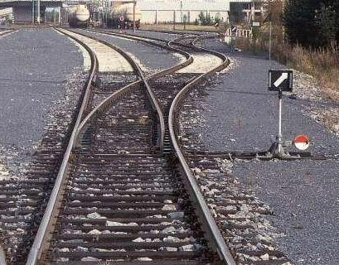
Analogy: Railroad Switch
http://en.wikipedia.org/wiki/Railroad_switch]

Slide 8
Analogy: Railroad Switch
x₁
x₂
select
f
http://en.wikipedia.org/wiki/Railroad_switch]

Slide 9
Analogy: Railroad Switch
x₁
x₂
select
f
This is not a perfect analogy because the trains can go in either direction,
while the multiplexer would only allow them to go from top to bottom.
http://en.wikipedia.org/wiki/Railroad_switch]

Slide 10
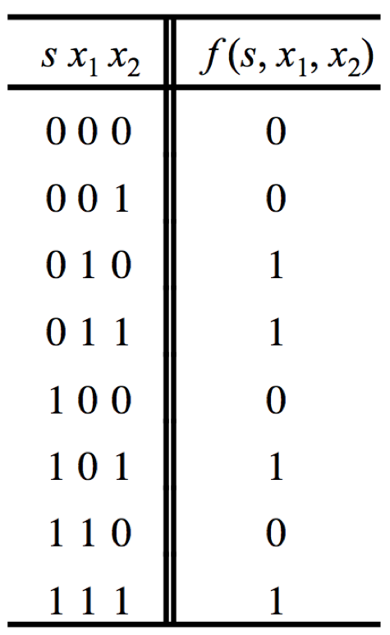
Truth Table for a 2-to-1 Multiplexer
[ Figure 2.33a from the textbook ]

Slide 11
Let’s Derive the SOP form

Slide 12
Let’s Derive the SOP form

Slide 13
Let’s Derive the SOP form
Where should we
put the negation signs?
s x₁ x₂
s x₁ x₂
s x₁ x₂
s x₁ x₂

Slide 14
Let’s Derive the SOP form
s x₁ x₂
s x₁ x₂
s x₁ x₂
s x₁ x₂

Slide 15
Let’s Derive the SOP form
s x₁ x₂
s x₁ x₂
s x₁ x₂
s x₁ x₂
f (s, x_{1,} x₂) =
s x₁ x₂
+
s x₁ x₂
+
s x₁ x₂
+
s x₁ x₂

Slide 16
Let’s simplify this expression
f (s, x_{1,} x₂) =
s x₁ x₂
+
s x₁ x₂
+
s x₁ x₂
+
s x₁ x₂

Slide 17
Let’s simplify this expression
f (s, x_{1,} x₂) =
s x₁ x₂
+
s x₁ x₂
+
s x₁ x₂
+
s x₁ x₂
f (s, x_{1,} x₂) =
s x₁ (x₂ + x₂)
+
+
s (x₁ +x₁ )x₂

Slide 18
Let’s simplify this expression
f (s, x_{1,} x₂) =
s x₁ x₂
+
s x₁ x₂
+
s x₁ x₂
+
s x₁ x₂
f (s, x_{1,} x₂) =
s x₁ (x₂ + x₂)
+
+
s (x₁ +x₁ )x₂
f (s, x_{1,} x₂) =
s x₁
+
s x₂

Slide 19
Circuit for 2-1 Multiplexer
x
s
1
f
x
1
0
f
s
x
2
1
x
2
(b) Circuit
(c) Graphical symbol
f (s, x_{1,} x₂) =
s x₁
+
s x₂
[ Figure 2.33b-c from the textbook ]

Slide 20
Analysis of the 2-to-1 Multiplexer (when the input s=0)
x₁
x₁
1
x₁
f
s
0
0
x₂
0

Slide 21
Analysis of the 2-to-1 Multiplexer (when the input s=1)
x₁
0
0
x₂
f
s
1
1
x₂
x₂

Slide 22
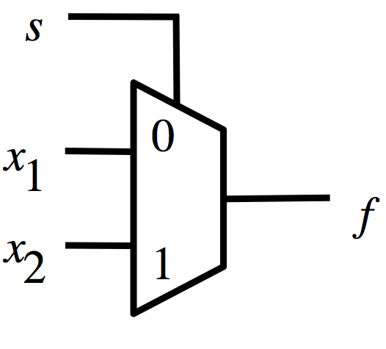
Analysis of the 2-to-1 Multiplexer (when the input s=0)
0
x₁

Slide 23
Analysis of the 2-to-1 Multiplexer (when the input s=1)
1
x₂

Slide 24
More Compact Truth-Table Representation
s
x₁
x₂
f (s, x₁, x₂)
0
0
0
0
0
0
1
0
s
f (s, x₁, x₂)
0
1
0
1
0
x₁
0
1
1
1
1
x₂
1
0
0
0
1
0
1
1
1
1
0
0
1
1
1
1
(a)
Truth
table
[ Figure 2.33 from the textbook ]

Slide 25
4-to-1 Multiplexer

Slide 26
4-to-1 Multiplexer (Definition)
Has four inputs: w₀ , w₁, w₂, w₃
Also has two select lines: s₁ and s₀
If s₁=0 and s₀=0, then the output f is equal to w₀
If s₁=0 and s₀=1, then the output f is equal to w₁
If s₁=1 and s₀=0, then the output f is equal to w₂
If s₁=1 and s₀=1, then the output f is equal to w₃

Slide 27
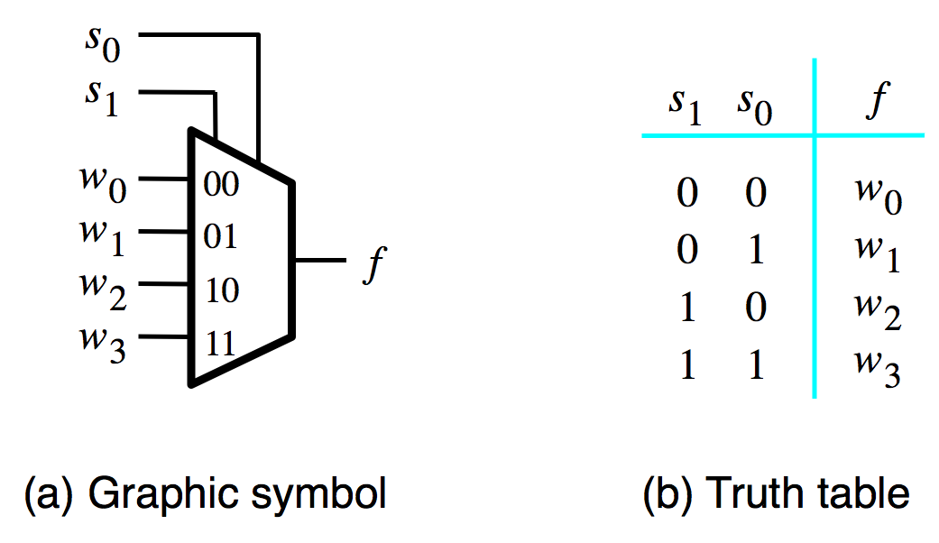
Graphical Symbol and Truth Table
[ Figure 4.2a-b from the textbook ]

Slide 28
The long-form truth table

Slide 29
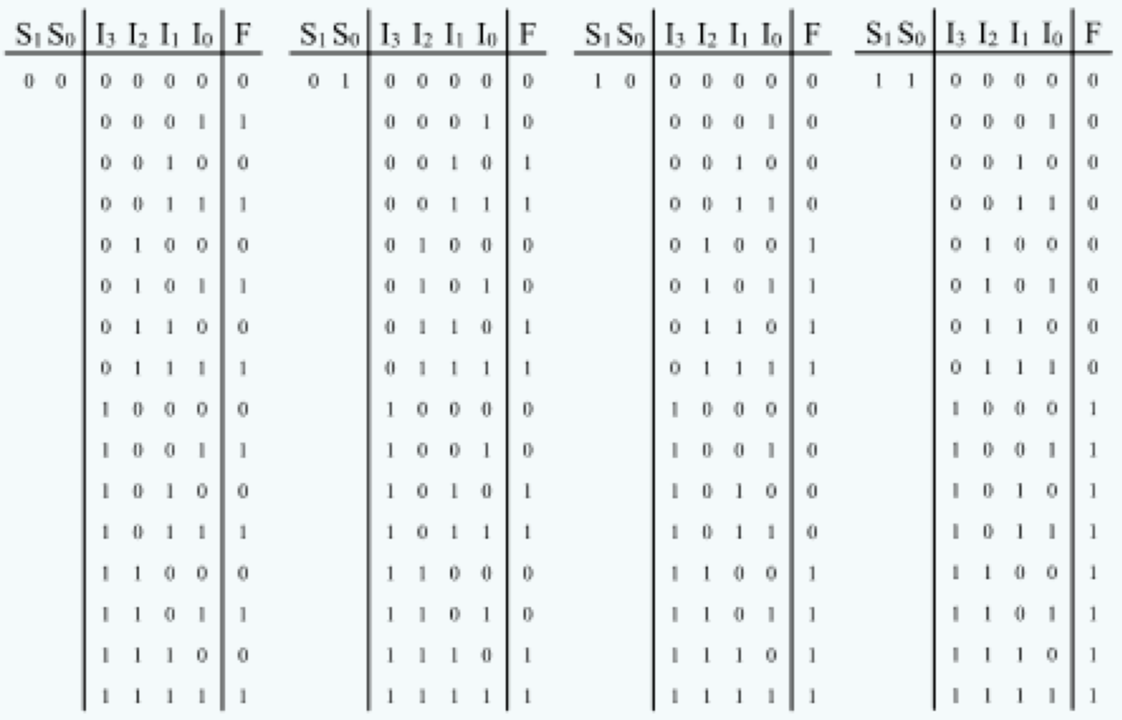
The long-form truth table
[http://www.absoluteastronomy.com/topics/Multiplexer]

Slide 30
The long-form truth table
identical
[http://www.absoluteastronomy.com/topics/Multiplexer]

Slide 31
The long-form truth table
identical
[http://www.absoluteastronomy.com/topics/Multiplexer]

Slide 32
The long-form truth table
identical
[http://www.absoluteastronomy.com/topics/Multiplexer]

Slide 33
The long-form truth table
identical
[http://www.absoluteastronomy.com/topics/Multiplexer]

Slide 34
Graphical Symbol and Truth Table
[ Figure 4.2a-b from the textbook ]

Slide 35
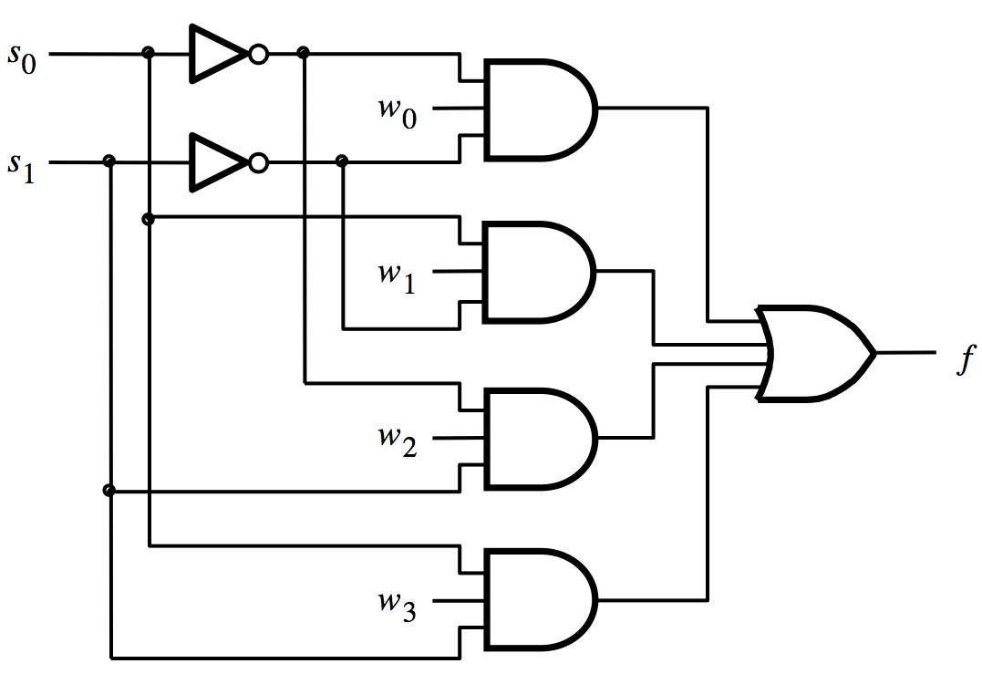
4-to-1 Multiplexer (SOP circuit)
f = s₁ s₀ w₀ + s₁ s₀ w₁ + s₁ s₀ w₂ + s₁ s₀ w₃
[ Figure 4.2c from the textbook ]

Slide 36
Analysis of the 4-to-1 Multiplexer
( s₁=0 and s₀=0 )
0
0

Slide 37
Analysis of the 4-to-1 Multiplexer
( s₁=0 and s₀=0 )
0
1
0
1
0
1
1
0
0
0

Slide 38
Analysis of the 4-to-1 Multiplexer
( s₁=0 and s₀=0 )
0
1
w₀
0
1
0
0
1
1
0
0
0
0
0

Slide 39
Analysis of the 4-to-1 Multiplexer
( s₁=0 and s₀=0 )
0
1
w₀
0
1
0
0
1
w₀
1
0
0
0
0
0

Slide 40
Analysis of the 4-to-1 Multiplexer
( s₁=0 and s₀=1 )
1
0
0
0
1
1
w₁
1
w₁
0
0
0
1
0
0

Slide 41
Analysis of the 4-to-1 Multiplexer
( s₁=1 and s₀=0 )
0
1
0
1
0
0
0
0
w₂
1
w₂
1
0
0
1

Slide 42
Analysis of the 4-to-1 Multiplexer
( s₁=1 and s₀=1 )
1
0
0
1
0
1
0
0
w₃
0
0
1
1
w₃
1

Slide 43
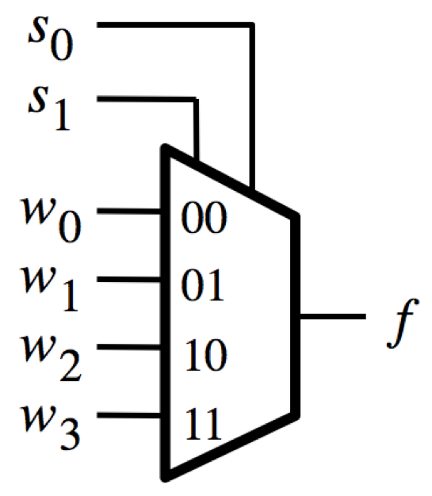
Analysis of the 4-to-1 Multiplexer
( s₁=0 and s₀=0 )
0
0
w₀

Slide 44
Analysis of the 4-to-1 Multiplexer
( s₁=0 and s₀=1 )
1
0
w₁

Slide 45
Analysis of the 4-to-1 Multiplexer
( s₁=1 and s₀=0 )
0
1
w₂

Slide 46
Analysis of the 4-to-1 Multiplexer
( s₁=1 and s₀=1 )
1
1
w₃

Slide 47
Using three 2-to-1 multiplexers
to build one 4-to-1 multiplexer
s
1
s
0
w
0
0
w
1
1
0
f
1
w
2
0
w
3
1
[ Figure 4.3 from the textbook ]

Slide 48
Analogy: Railroad Switches
http://en.wikipedia.org/wiki/Railroad_switch]

Slide 49
Analogy: Railroad Switches
w₀
w₁
w₂
w₃
s₁
f
http://en.wikipedia.org/wiki/Railroad_switch]

Slide 50
Analogy: Railroad Switches
w₀
w₁
w₂
w₃
s₀
these two
switches are
controlled
together
s₁
f
http://en.wikipedia.org/wiki/Railroad_switch]

Slide 51
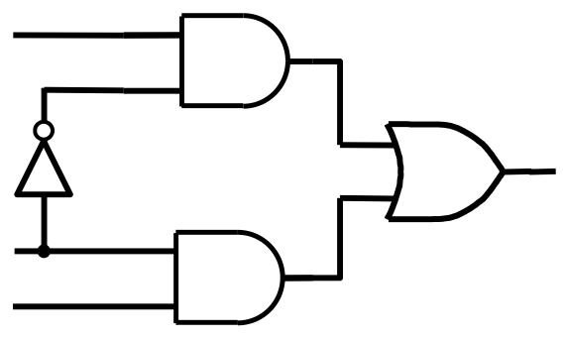
Using three 2-to-1 multiplexers
to build one 4-to-1 multiplexer

Slide 52
Using three 2-to-1 multiplexers
to build one 4-to-1 multiplexer

Slide 53
Using three 2-to-1 multiplexers
to build one 4-to-1 multiplexer

Slide 54
Using three 2-to-1 multiplexers
to build one 4-to-1 multiplexer
w₀
w₁
s₁
f
s₀
w₂
w₃

Slide 55
That is different from the SOP form of the 4-to-1 multiplexer shown below, which uses fewer gates

Slide 56
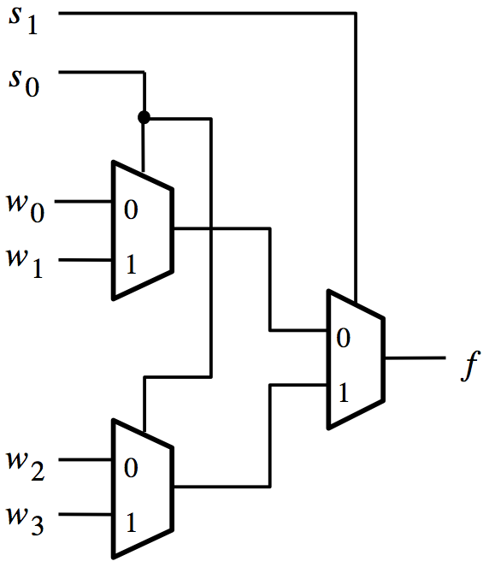
Analysis of the Hierarchical Implementation
( s₁=0 and s₀=0 )
0
0
0
0
w₀
w₀
0
w₂
[ Figure 4.3 from the textbook ]

Slide 57
Analysis of the Hierarchical Implementation
( s₁=0 and s₀=1 )
0
1
1
0
w₁
w₁
1
w₃
[ Figure 4.3 from the textbook ]

Slide 58
Analysis of the Hierarchical Implementation
( s₁=1 and s₀=0 )
1
0
0
1
w₀
w₂
0
w₂
[ Figure 4.3 from the textbook ]

Slide 59
Analysis of the Hierarchical Implementation
( s₁=1 and s₀=1 )
1
1
1
1
w₁
w₃
1
w₃
[ Figure 4.3 from the textbook ]

Slide 60
16-to-1 Multiplexer

Slide 61
16-1 Multiplexer
s
0
s
1
w
0
w
3
w
s
2
4
s
3
w
7
f
w
8
w
11
w
12
w
15
[ Figure 4.4 from the textbook ]

Slide 62
16-1 Multiplexer
0
s
0
0
s
1
w₀
w₁
w₂
w₃
w₄
w₅
w₆
w₇
s
2
s
3
w₀
w₄
w₈
w₁₂
f
w₈
w₉
w₁₀
w₁₁
w₁₂
w₁₃
w₁₄
w₁₅

Slide 63
16-1 Multiplexer
0
0
s
1
s
0
w₀
w₁
w₂
w₃
w₄
w₅
w₆
w₇
s
3
s
2
w₀
w₄
w₈
w₁₂
f
w₈
w₉
w₁₀
w₁₁
w₁₂
w₁₃
w₁₄
w₁₅

Slide 64
16-1 Multiplexer
0
1
s
1
s
0
w₀
w₁
w₂
w₃
w₄
w₅
w₆
w₇
s
3
s
2
w₁
w₅
w₉
w₁₃
f
w₈
w₉
w₁₀
w₁₁
w₁₂
w₁₃
w₁₄
w₁₅

Slide 65
16-1 Multiplexer
1
0
s
1
s
0
w₀
w₁
w₂
w₃
w₄
w₅
w₆
w₇
s
3
s
2
w₂
w₆
w₁₀
w₁₄
f
w₈
w₉
w₁₀
w₁₁
w₁₂
w₁₃
w₁₄
w₁₅

Slide 66
16-1 Multiplexer
1
0
s
1
s
0
w₀
w₁
w₂
w₃
w₄
w₅
w₆
w₇
s
3
s
2
w₃
w₇
w₁₁
w₁₅
f
w₈
w₉
w₁₀
w₁₁
w₁₂
w₁₃
w₁₄
w₁₅

Slide 67
16-1 Multiplexer
1
0
s
1
s
0
w₀
w₁
w₂
w₃
0
0
w₄
w₅
w₆
w₇
s
3
s
2
w₃
w₇
w₁₁
w₁₅
w₃
f
w₈
w₉
w₁₀
w₁₁
w₁₂
w₁₃
w₁₄
w₁₅

Slide 68
16-1 Multiplexer
1
0
s
1
s
0
w₀
w₁
w₂
w₃
0
1
w₄
w₅
w₆
w₇
s
3
s
2
w₃
w₇
w₁₁
w₁₅
w₇
f
w₈
w₉
w₁₀
w₁₁
w₁₂
w₁₃
w₁₄
w₁₅

Slide 69
16-1 Multiplexer
1
0
s
1
s
0
w₀
w₁
w₂
w₃
1
0
w₄
w₅
w₆
w₇
s
3
s
2
w₃
w₇
w₁₁
w₁₅
w₁₁
f
w₈
w₉
w₁₀
w₁₁
w₁₂
w₁₃
w₁₄
w₁₅

Slide 70
16-1 Multiplexer
1
0
s
1
s
0
w₀
w₁
w₂
w₃
1
1
w₄
w₅
w₆
w₇
s
3
s
2
w₃
w₇
w₁₁
w₁₅
w₁₅
f
w₈
w₉
w₁₀
w₁₁
w₁₂
w₁₃
w₁₄
w₁₅

Slide 71
[http://upload.wikimedia.org/wikipedia/commons/2/26/SunsetTracksCrop.JPG]

Slide 72
Multiplexers Are Special

Slide 73
The Three Basic Logic Gates
x
1
x
x
x
1
x
x
x
1
2
x
x
1
+
x
2
2
2
NOT gate
AND gate
OR gate
[ Figure 2.8 from the textbook ]

Slide 74
Truth Table for NOT
x
x
x
x
0
1
1
0

Slide 75
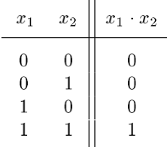
Truth Table for AND
x
1
x
x
x
1
2
2

Slide 76
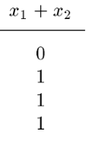
Truth Table for OR
x
1
x
x
1
+
x
2
2

Slide 77
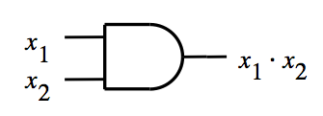
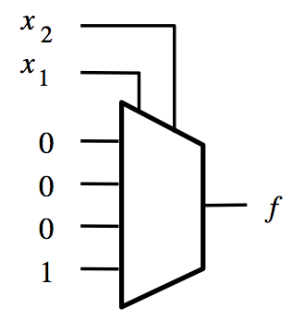
Building an AND Gate with 4-to-1 Mux

Slide 78
Building an AND Gate with 4-to-1 Mux
These two are the same.

Slide 79
Building an AND Gate with 4-to-1 Mux
These two are the same.
And so are these two.

Slide 80
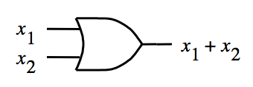
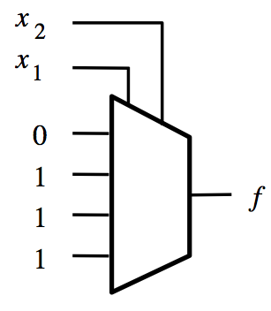
Building an OR Gate with 4-to-1 Mux

Slide 81
Building an OR Gate with 4-to-1 Mux
These two are the same.

Slide 82
Building an OR Gate with 4-to-1 Mux
These two are the same.
And so are these two.

Slide 83
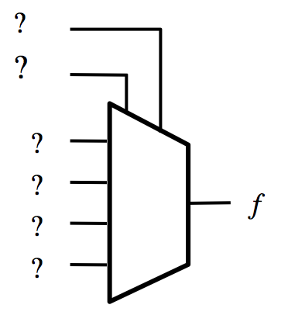
Building a NOT Gate with 4-to-1 Mux
x
x
x
x
0
1
1
0

Slide 84
Building a NOT Gate with 4-to-1 Mux
x
x
x | y | f
0 | 0 | 1
0 | 1 | 1
1 | 0 | 0
1 | 1 | 0
Introduce a dummy variable y.

Slide 85
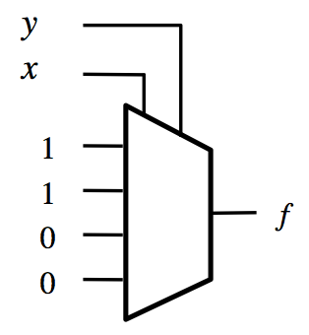
Building a NOT Gate with 4-to-1 Mux
x
x
x | y | f
0 | 0 | 1
0 | 1 | 1
1 | 0 | 0
1 | 1 | 0

Slide 86
Building a NOT Gate with 4-to-1 Mux
x
x
x | y | f
0 | 0 | 1
0 | 1 | 1
1 | 0 | 0
1 | 1 | 0
Now set y to either 0 or 1 (both will work). Why?

Slide 87
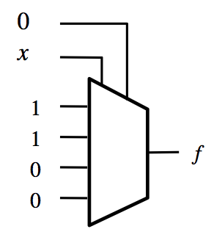
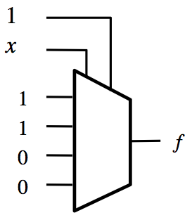
Building a NOT Gate with 4-to-1 Mux
x
x
x
x
0
1
1
0
Two alternative solutions.

Slide 88
Implications
Any Boolean function can be implemented
using only 4-to-1 multiplexers!

Slide 89
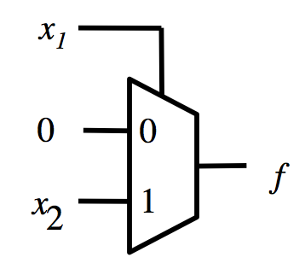
Building an AND Gate with 2-to-1 Mux

Slide 90
Building an AND Gate with 2-to-1 Mux

Slide 91
Building an AND Gate with 2-to-1 Mux
0
x₂

Slide 92
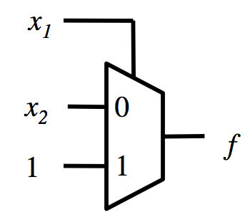
Building an OR Gate with 2-to-1 Mux

Slide 93
Building an OR Gate with 2-to-1 Mux

Slide 94
Building an OR Gate with 2-to-1 Mux
x₂
1

Slide 95
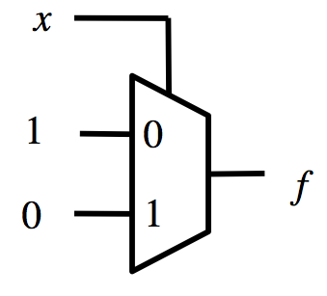
Building a NOT Gate with 2-to-1 Mux
x
x
x
x
0
1
1
0

Slide 96
Building a NOT Gate with 2-to-1 Mux
x
x
x
x
0
1
1
0

Slide 97
Implications
Any Boolean function can be implemented
using only 2-to-1 multiplexers!

Slide 98
AND
OR
0
x₂
x₁
x₁
x₂
1
NOT
1
x
0

Slide 99
AND
OR
0
0
x₂
x₁ x₂
x₁
x₁
x₂
x₁ x₂
1
x₁
NOT
1
x
x
0
0

Slide 100
AND
OR
0
0
x₂
x₁ x₂
x₁ + x₂
x₁ x₂
x₁
x₁
x₂
x₁ x₂
1
x₁
NOT
1
x
x
x
0
0

Slide 101
Switch Circuit

Slide 102
2 x 2 Crossbar switch
s
x
1
y
1
x
2
y
2
[ Figure 4.5a from the textbook ]

Slide 103
2 x 2 Crossbar switch
s=0
x
1
y
1
x
2
y
2
s=1
x
1
y
1
x
2
y
2

Slide 104
Implementation of a 2 x 2 crossbar switch with multiplexers
x
1
0
y
1
1
s
x
2
0
y
2
1
[ Figure 4.5b from the textbook ]

Slide 105
Implementation of a 2 x 2 crossbar switch with multiplexers
x
1
0
y
1
1
0
s
x
2
0
y
2
1
[ Figure 4.5b from the textbook ]

Slide 106
Implementation of a 2 x 2 crossbar switch with multiplexers
x
1
0
y
1
1
1
s
x
2
0
y
2
1
[ Figure 4.5b from the textbook ]

Slide 107
Implementation of a 2 x 2 crossbar switch with multiplexers
x
x₁
1
0
y
1
1
0
s
x₂
x
2
0
y
2
1
[ Figure 4.5b from the textbook ]

Slide 108
Implementation of a 2 x 2 crossbar switch with multiplexers
x
x₂
1
0
y
1
1
1
s
x₁
x
2
0
y
2
1
[ Figure 4.5b from the textbook ]

Slide 109
Implementation of a 2 x 2 crossbar switch with multiplexers

Slide 110
Implementation of a 2 x 2 crossbar switch with multiplexers
x₁
y₁
s
x₂
y₂

Slide 111
Synthesis of Logic Circuits
Using Multiplexers

Slide 112
Synthesis of Logic Circuits
Using Multiplexers
Note: This method is NOT the same as simply replacing each logic gate with a multiplexer!
It is a lot more efficient.

Slide 113
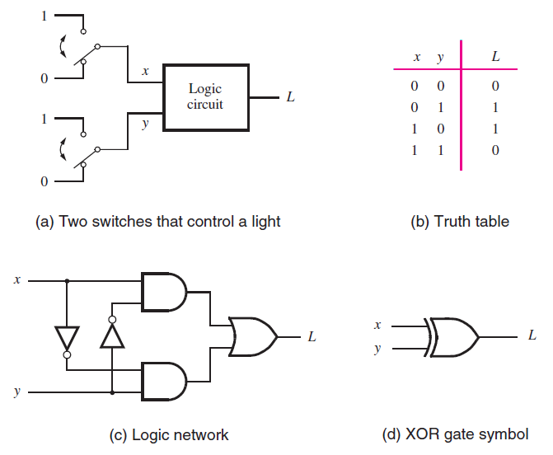
The XOR Logic Gate
[ Figure 2.11 from the textbook ]

Slide 114
The XOR Logic Gate
[ Figure 2.11 from the textbook ]

Slide 115
Implementation of a logic function with a 4-to-1 multiplexer
w
w
f
w
2
1
2
w
1
0
0
0
0
0
1
1
1
1
0
1
1
f
1
1
0
0
[ Figure 4.6a from the textbook ]

Slide 116
Implementation of the same logic function with a 2-to-1 multiplexer
w
1
w
2
f
w
f
1
w
0
0
0
w
1
0
2
0
1
1
w
w
1
2
2
1
0
1
f
1
1
0
(b) Modified truth table
(c) Circuit
[ Figure 4.6b-c from the textbook ]

Slide 117
Implementation of the XOR Logic Gate with a 2-to-1 multiplexer and one NOT
f

Slide 118
Implementation of the XOR Logic Gate with a 2-to-1 multiplexer and one NOT
x
f
y

Slide 119
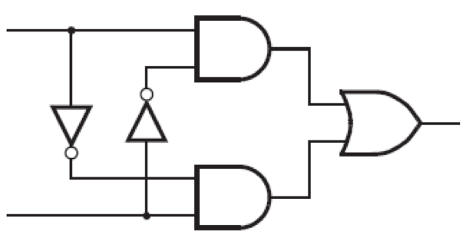
Implementation of the XOR Logic Gate with a 2-to-1 multiplexer and one NOT
x
f
y
These two circuits are equivalent
(the wires of the bottom AND gate are flipped)

Slide 120
In other words,
all four of these are equivalent!
x
y
f
x
f
y
w
2
w
1
x
0
1
f
y
f
1
0

Slide 121
Implementation of another logic function
w
1
w
2
w
3
f
0
0
0
0
0
0
1
0
0
1
0
0
0
1
1
1
1
0
0
0
1
0
1
1
1
1
0
1
1
1
1
1
[ Figure 4.7 from the textbook ]

Slide 122
Implementation of another logic function
w
1
w
2
w
3
f
0
0
0
0
0
0
1
0
0
1
0
0
0
1
1
1
1
0
0
0
1
0
1
1
1
1
0
1
1
1
1
1
[ Figure 4.7 from the textbook ]

Slide 123
Implementation of another logic function
w
1
w
2
w
3
f
w
1
w
2
f
0
0
0
0
0
0
0
1
0
0
0
0
1
w
3
0
1
0
0
1
0
w
3
0
1
1
1
1
1
1
1
0
0
0
1
0
1
1
1
1
0
1
1
1
1
1
[ Figure 4.7 from the textbook ]

Slide 124
Implementation of another logic function
w
1
w
2
w
3
f
w
2
w
1
w
2
f
w
0
0
0
0
1
0
0
0
0
0
0
1
0
0
1
w
w
3
3
f
0
1
0
0
1
0
w
3
0
1
1
1
1
1
1
1
1
0
0
0
1
0
1
1
1
1
0
1
1
1
1
1
[ Figure 4.7 from the textbook ]

Slide 125
Another Example (3-input XOR)

Slide 126
Implementation of 3-input XOR with 2-to-1 Multiplexers
w
1
w
2
w
3
f
0
0
0
0
0
0
1
1
0
1
0
1
0
1
1
0
1
0
0
1
1
0
1
0
1
1
0
0
1
1
1
1
[ Figure 4.8a from the textbook ]

Slide 127
Implementation of 3-input XOR with 2-to-1 Multiplexers
w
1
w
2
w
3
f
0
0
0
0
0
0
1
1
w
⊕
w
0
1
0
1
2
3
0
1
1
0
1
0
0
1
1
0
1
0
w
⊕
w
1
1
0
0
2
3
1
1
1
1
[ Figure 4.8a from the textbook ]

Slide 128
Implementation of 3-input XOR with 2-to-1 Multiplexers
w
1
w
2
w
3
f
0
0
0
0
0
0
1
1
w
⊕
w
0
1
0
1
2
3
w
1
0
1
1
0
w
⊕
w
1
0
0
1
2
3
f
1
0
1
0
w
⊕
w
1
1
0
0
2
3
1
1
1
1
(a) Truth table
(b) Circuit
[ Figure 4.8 from the textbook ]

Slide 129
Implementation of 3-input XOR with 2-to-1 Multiplexers
w
1
w
2
w
3
f
0
0
0
0
w₃
0
0
1
1
w
0
1
0
1
w₃
2
w
1
0
1
1
0
w
3
1
0
0
1
f
1
0
1
0
1
1
0
0
1
1
1
1
(a) Truth table
(b) Circuit
[ Figure 4.8 from the textbook ]

Slide 130
Implementation of 3-input XOR with a 4-to-1 Multiplexer
w
1
w
2
w
3
f
0
0
0
0
0
0
1
1
0
1
0
1
0
1
1
0
1
0
0
1
1
0
1
0
1
1
0
0
1
1
1
1
[ Figure 4.9a from the textbook ]

Slide 131
Implementation of 3-input XOR with a 4-to-1 Multiplexer
w
1
w
2
w
3
f
0
0
0
0
0
0
1
1
0
1
0
1
0
1
1
0
1
0
0
1
1
0
1
0
1
1
0
0
1
1
1
1
[ Figure 4.9a from the textbook ]

Slide 132
Implementation of 3-input XOR with a 4-to-1 Multiplexer
w
1
w
2
w
3
f
0
0
0
0
w
0
0
1
1
3
0
1
0
1
w
0
1
1
0
3
1
0
0
1
w
1
0
1
0
3
1
1
0
0
w
1
1
1
1
3
[ Figure 4.9a from the textbook ]

Slide 133
Implementation of 3-input XOR with a 4-to-1 Multiplexer
w
1
w
2
w
3
f
0
0
0
0
w
0
0
1
1
3
w
2
w
1
0
1
0
1
w
0
1
1
0
3
w
3
1
0
0
1
w
f
1
0
1
0
3
1
1
0
0
w
1
1
1
1
3
(a) Truth table
(b) Circuit
[ Figure 4.9 from the textbook ]

Slide 134
Multiplexor Synthesis Using Shannon’s Expansion

Slide 135
Three-input majority function
w
1
w
2
w
3
f
0
0
0
0
0
0
1
0
0
1
0
0
0
1
1
1
1
0
0
0
1
0
1
1
1
1
0
1
1
1
1
1
[ Figure 4.10a from the textbook ]

Slide 136
Three-input majority function
w
1
w
2
w
3
f
0
0
0
0
w
1
f
0
0
1
0
0
0
1
0
0
1
0
1
1
1
1
0
0
0
1
0
1
1
1
1
0
1
1
1
1
1
[ Figure 4.10a from the textbook ]

Slide 137
Three-input majority function
w
1
w
2
w
3
f
0
0
0
0
w
1
f
0
0
1
0
w
w
0
2
3
0
1
0
0
1
w
+
w
0
1
1
1
2
3
1
0
0
0
1
0
1
1
1
1
0
1
1
1
1
1
[ Figure 4.10a from the textbook ]

Slide 138
Three-input majority function
w
1
w
2
w
3
f
0
0
0
0
w
1
f
0
0
1
0
w
w
0
2
3
0
1
0
0
1
w
+
w
0
1
1
1
2
3
1
0
0
0
1
0
1
1
1
1
0
1
1
1
1
1
(b) Truth table
w
w
1
2
w
3
0
1
f
(b) Circuit
[ Figure 4.10a from the textbook ]

Slide 139
Three-input majority function
w
w
1
2
w
3
0
1
f

Slide 140
Shannon’s Expansion Theorem
Any Boolean function can be rewritten in the form:

Slide 141
Shannon’s Expansion Theorem
Any Boolean function can be rewritten in the form:

Slide 142
Shannon’s Expansion Theorem
Any Boolean function can be rewritten in the form:
cofactor
cofactor

Slide 143
Shannon’s Expansion Theorem
(Example)

Slide 144
Shannon’s Expansion Theorem
(Example)
(w₁ + w₁)

Slide 145
Shannon’s Expansion Theorem
(Example)
(w₁ + w₁)

Slide 146
Shannon’s Expansion Theorem
(Example)
(w₁ + w₁)
w
w
1
2
w
3
0
1
f

Slide 147
Another Example

Slide 148
Factor and implement the following function with a 2-to-1 multiplexer

Slide 149
Factor and implement the following function with a 2-to-1 multiplexer

Slide 150
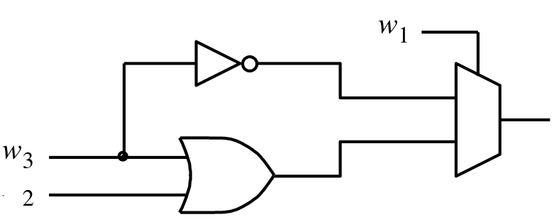
Factor and implement the following function with a 2-to-1 multiplexer
0
1
f
w
[ Figure 4.11a from the textbook ]

Slide 152
Shannon’s Expansion Theorem
(In terms of more than one variable)
This form is suitable for implementation with a 4x1 multiplexer.

Slide 153
Factor and implement the following function with a 4-to-1 multiplexer

Slide 154
Factor and implement the following function with a 4-to-1 multiplexer
= w₁ (w₂ + w₂) w₃ + w₁ w₂ + w₁ (w₂ + w₂) w₃

Slide 155
Factor and implement the following function with a 4-to-1 multiplexer
= w₁ (w₂ + w₂) w₃ + w₁ w₂ + w₁ (w₂ + w₂) w₃
= w₁ w₂ w₃ + w₁ w₂ w₃ + w₁ w₂ + w₁ w₂ w₃ + w₁ w₂ w₃
= w₁ w₂ w₃ + w₁ w₂ w₃ + w₁ w₂ w₃ + w₁ w₂ (1 + w₃)
= w₁ w₂ ( w₃ ) + w₁ w₂ ( w₃ ) + w₁ w₂ (w₃) + w₁ w₂ (1)

Slide 156
Factor and implement the following function with a 4-to-1 multiplexer
= w₁ (w₂ + w₂) w₃ + w₁ w₂ + w₁ (w₂ + w₂) w₃
= w₁ w₂ w₃ + w₁ w₂ w₃ + w₁ w₂ + w₁ w₂ w₃ + w₁ w₂ w₃
= w₁ w₂ w₃ + w₁ w₂ w₃ + w₁ w₂ w₃ + w₁ w₂ (1 + w₃)
= w₁ w₂ ( w₃ ) + w₁ w₂ ( w₃ ) + w₁ w₂ (w₃) + w₁ w₂ (1)
these are the 4 cofactors

Slide 157
Factor and implement the following function with a 4-to-1 multiplexer

Slide 158
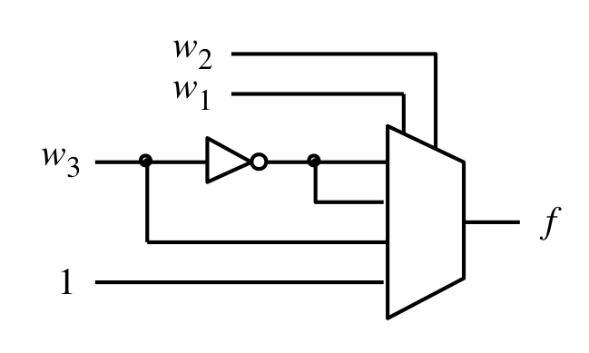
Factor and implement the following function with a 4-to-1 multiplexer
00
01
10
11
[ Figure 4.11b from the textbook ]

Slide 159
Yet Another Example

Slide 160
Factor and implement the following function using only 2-to-1 multiplexers

Slide 161
Factor and implement the following function using only 2-to-1 multiplexers

Slide 162
Factor and implement the following function using only 2-to-1 multiplexers

Slide 163
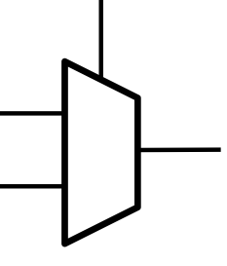
Factor and implement the following function using only 2-to-1 multiplexers
w₁
g
f
h

Slide 164
Factor and implement the following function using only 2-to-1 multiplexers

Slide 165
Factor and implement the following function using only 2-to-1 multiplexers

Slide 166
Factor and implement the following function using only 2-to-1 multiplexers
w₂
w₂
0
w₃
g
h
w₃
1

Slide 167
Finally, we are ready to draw the circuit
w₂
0
w₁
g
w₃
g
f
w₂
h
w₃
h
1

Slide 168
Finally, we are ready to draw the circuit
w₂
0
g
w₁
w₃
f
1
h

Slide 169
Finally, we are ready to draw the circuit
w
2
w
1
0
w
3
f
1
[ Figure 4.12 from the textbook ]

Slide 170
Questions?

Slide 171
THE END

