Slide 1
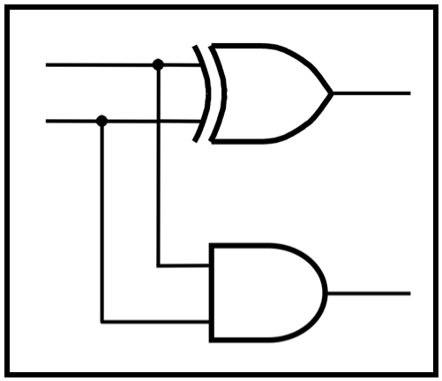
CprE 2810:
Digital Logic
Instructor: Alexander Stoytchev
http://www.ece.iastate.edu/~alexs/classes/

Slide 2
Addition of Unsigned Numbers
CprE 281: Digital Logic
Iowa State University, Ames, IA
Copyright © Alexander Stoytchev

Slide 3
Administrative Stuff
We are now starting with Chapter 3

Slide 4
Administrative Stuff
HW5 is due today @ 10 pm

Slide 5
Administrative Stuff
No homework due next week
HW6 will be due on Monday, Oct 14

Slide 6
Quick Review

Slide 7

Number Systems

Slide 8
Number Systems
n-th digit
(most significant)
0-th digit
(least significant)

Slide 9
Number Systems
base
power
n-th digit
(most significant)
0-th digit
(least significant)

Slide 10

The Decimal System

Slide 11



The Decimal System

Slide 12
Another Way to Look at This
5
2
4

Slide 13
Another Way to Look at This
10²
10¹
10⁰
5
2
4

Slide 14
Another Way to Look at This
10²
10¹
10⁰
labels
boxes
5
2
4
Each box can contain only one digit and has only one label. From right
to left, the labels are increasing powers of the base, starting from 0.

Slide 15

Base 7

Slide 16
Base 7
base
power

Slide 17
Base 7
base
power
most significant
digit
least significant
digit

Slide 18



Base 7

Slide 19
Another Way to Look at This
7²
7¹
7⁰
10²
10¹
10⁰
5
2
4
=
2
6
3

Slide 20
Binary Numbers (Base 2)

Slide 21
Binary Numbers (Base 2)
base
power
most significant bit
least significant bit

Slide 22
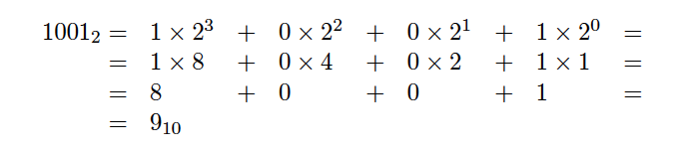
Binary Numbers (Base 2)

Slide 23
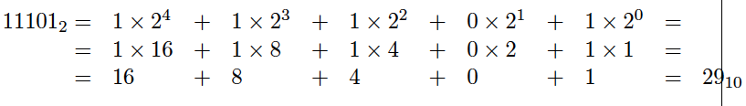
Another Example

Slide 24
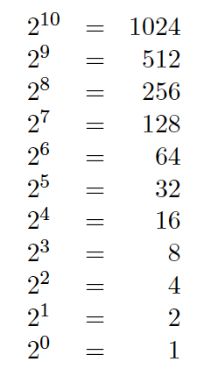
Powers of 2

Slide 25
What is the value of this binary number?
0 0 1 0 1 1 0 0
0 0 1 0 1 1 0 0
0*2⁷ + 0*2⁶ + 1*2⁵ + 0*2⁴ + 1*2³ + 1*2² + 0*2¹ + 0*2⁰
0*128 + 0*64 + 1*32 + 0*16 + 1*8 + 1*4 + 0*2 + 0*1
0*128 + 0*64 + 1*32 + 0*16 + 1*8 + 1*4 + 0*2 + 0*1
32+ 8 + 4 = 44 (in decimal)

Slide 26
Another Way to Look at This
2⁷
2⁶
2⁵
2⁴
2³
2²
2¹
2⁰
0
0
1
0
1
1
0
0

Slide 27
Another Way to Look at This
2⁷
2⁶
2⁵
2⁴
2³
2²
2¹
2⁰
0
0
1
0
1
1
0
0
32
8
4

Slide 28
Signed v.s. Unsigned Numbers

Slide 29
Signed v.s. Unsigned Numbers
positive
and
negative
integers
only
positive
integers

Slide 30
Signed v.s. Unsigned Numbers
positive
and
negative
integers
and zero
only
positive
integers
and zero

Slide 31
Two Different Types of Binary Numbers
Unsigned numbers
All bits jointly represent a positive integer.
Negative numbers cannot be represented this way.
Signed numbers
The left-most bit represents the sign of the number.
If that bit is 0, then the number is positive.
If that bit is 1, then the number is negative.
The magnitude of the largest number that can be represented in this way is twice smaller than the largest number in the unsigned representation.

Slide 32
Two Different Types of Binary Numbers
Unsigned numbers
All bits jointly represent a positive integer.
Negative numbers cannot be represented this way.
Signed numbers
The left-most bit represents the sign of the number.
If that bit is 0, then the number is positive.
If that bit is 1, then the number is negative.
The magnitude of the largest number that can be represented in this way is twice smaller than the largest number in the unsigned representation.
There are 3 different ways
to represent signed numbers.
They will be introduced next time.

Slide 33
Unsigned Representation
2⁷
2⁶
2⁵
2⁴
2³
2²
2¹
2⁰
0
0
1
0
1
1
0
0
This represents + 44.

Slide 34
Unsigned Representation
2⁷
2⁶
2⁵
2⁴
2³
2²
2¹
2⁰
1
0
1
0
1
1
0
0
This represents + 172.

Slide 35
Signed Representation
(using the left-most bit as the sign)
sign
2⁶
2⁵
2⁴
2³
2²
2¹
2⁰
0
0
1
0
1
1
0
0
This represents + 44.

Slide 36
Signed Representation
(using the left-most bit as the sign)
sign
2⁶
2⁵
2⁴
2³
2²
2¹
2⁰
1
0
1
0
1
1
0
0
This represents – 44.

Slide 37
Today’s Lecture is About
Addition of Unsigned Numbers

Slide 38
Important Clarification:
There are two types of addition
Addition of Boolean variables, e.g.,
  x + y where x, y ∊ {0, 1}
Addition of n-bit Binary numbers, e.g.,
  x₄x₃x₂x₁x₀ + y₄y₃y₂y₁y₀ where each x_{k}, y_{k} ∊ {0, 1}

Slide 39
Important Clarification:
There are two types of addition
Addition of Boolean variables, e.g.,
  1 + 0 = 1
Addition of n-bit Binary numbers, e.g.,
  00101 + 00110 = 01011

Slide 40
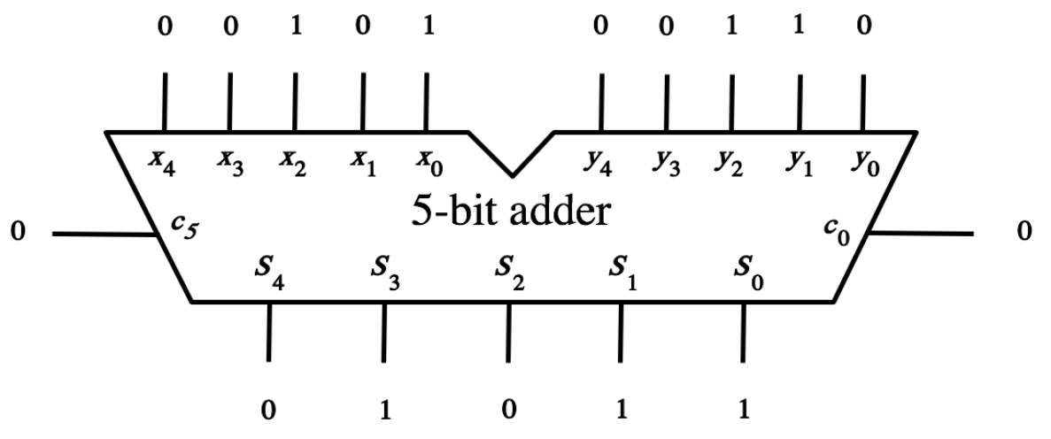
Important Clarification:
There are two types of addition
Addition of Boolean variables, e.g.,
Addition of n-bit Binary numbers, e.g.,
1
1
0

Slide 41
Important Clarification:
There are two types of addition
Addition of Boolean variables, e.g.,
Addition of n-bit Binary numbers, e.g.,
1
1
0
we will derive this
adder circuit today

Slide 42
Important Clarification:
There are two types of addition
Addition of Boolean variables, e.g.,
  1 + 1 = 1 (according to the rules of Boolean algebra)
Addition of n-bit Binary numbers, e.g.,
  1 + 1 = 10 (because in decimal 1 + 1 = 2 )

Slide 43
Addition of 1-bit Unsigned Numbers

Slide 44
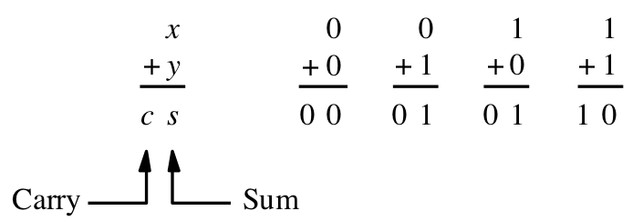
Addition of two 1-bit numbers
[ Figure 3.1a from the textbook ]

Slide 45
Addition of two 1-bit numbers
(there are four possible cases)
[ Figure 3.1a from the textbook ]

Slide 46
Addition of two 1-bit numbers
(there are four possible cases)
0₁₀
1₁₀
1₁₀
2₁₀
[ Figure 3.1a from the textbook ]

Slide 47
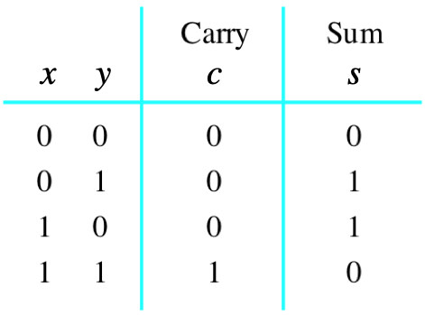
Addition of two 1-bit numbers
(the truth table)
[ Figure 3.1b from the textbook ]

Slide 48
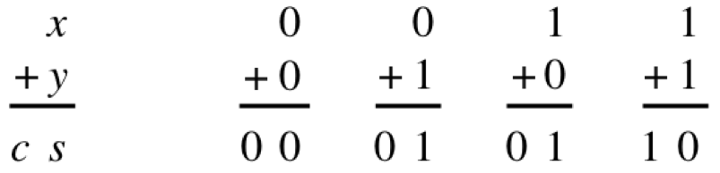
Addition of two 1-bit numbers
[ Figure 2.12 from the textbook ]

Slide 49
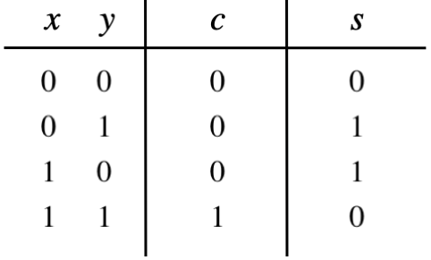
Addition of two 1-bit numbers

Slide 50
Addition of two 1-bit numbers

Slide 51
Addition of two 1-bit numbers

Slide 52
Addition of two 1-bit numbers

Slide 53
Addition of two 1-bit numbers

Slide 54
Addition of two 1-bit numbers

Slide 55
Addition of two 1-bit numbers

Slide 56
Addition of two 1-bit numbers

Slide 57
Addition of two 1-bit numbers

Slide 58
Addition of two 1-bit numbers

Slide 59
Addition of two 1-bit numbers

Slide 60
Addition of two 1-bit numbers

Slide 61
Addition of two 1-bit numbers

Slide 62
Addition of two 1-bit numbers

Slide 63
Addition of two 1-bit numbers
+
+
+
+
=
=
=
=
= 0₁₀
= 1₁₀
= 1₁₀
= 2₁₀

Slide 64
Addition of two 1-bit numbers
?

Slide 65
Addition of two 1-bit numbers
AND

Slide 66
Addition of two 1-bit numbers

Slide 67
Addition of two 1-bit numbers
?

Slide 68
Addition of two 1-bit numbers
XOR

Slide 69
Addition of two 1-bit numbers

Slide 70
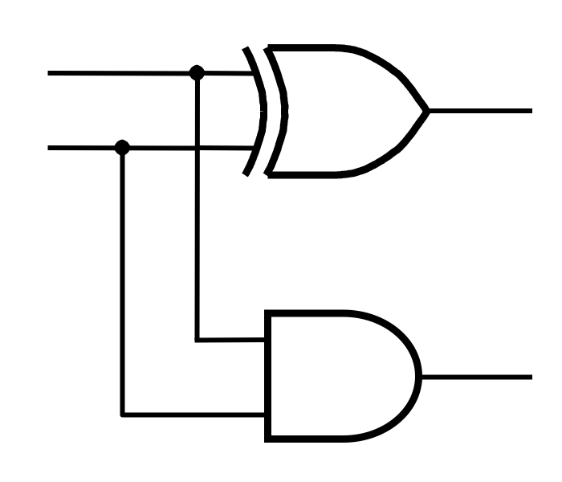
Addition of two 1-bit numbers

Slide 71
Addition of two 1-bit numbers
x
s
y
c

Slide 72
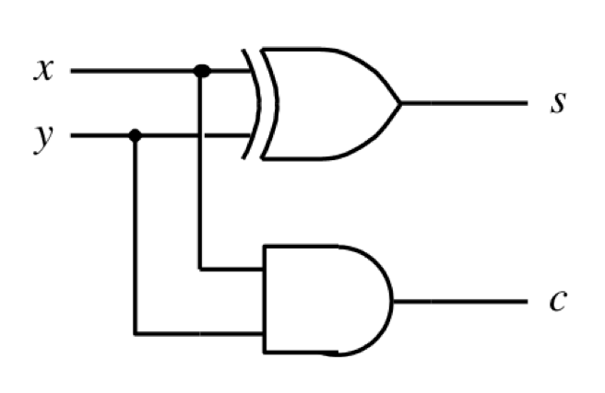
Addition of two 1-bit numbers
(the logic circuit)
[ Figure 3.1c from the textbook ]

Slide 73
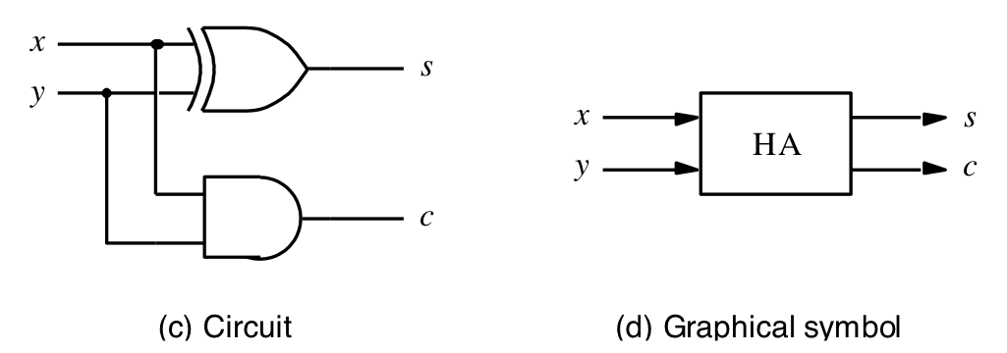
The Half-Adder
[ Figure 3.1c-d from the textbook ]

Slide 74
Addition of Multibit Unsigned Numbers

Slide 75
Analogy with addition in base 10
c₃ c₂ c₁ c₀
x₂ x₁ x₀
y₂ y₁ y₀
s₂ s₁ s₀
+

Slide 76
Analogy with addition in base 10
3 8 9
1 5 7
5 4 6
+

Slide 77
Analogy with addition in base 10
0 1 1 0
3 8 9
1 5 7
5 4 6
carry
+

Slide 78
Analogy with addition in base 10
c₃ c₂ c₁ c₀
x₂ x₁ x₀
y₂ y₁ y₀
s₂ s₁ s₀
+

Slide 79
Analogy with addition in base 10
given these
3 inputs
c₃ c₂ c₁ c₀
x₂ x₁ x₀
y₂ y₁ y₀
s₂ s₁ s₀
+

Slide 80
Analogy with addition in base 10
given these
3 inputs
c₃ c₂ c₁ c₀
x₂ x₁ x₀
y₂ y₁ y₀
s₂ s₁ s₀
+
compute these
2 outputs

Slide 81
Analogy with addition in base 10
c₃ c₂ c₁ c₀
x₂ x₁ x₀
y₂ y₁ y₀
s₂ s₁ s₀
+

Slide 82
Analogy with addition in base 10
c₃ c₂ c₁ c₀
x₂ x₁ x₀
y₂ y₁ y₀
s₂ s₁ s₀
+

Slide 83
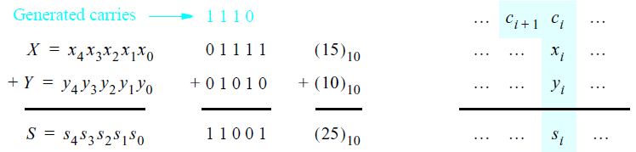
Addition of multibit numbers
Bit position i
[ Figure 3.2 from the textbook ]

Slide 84
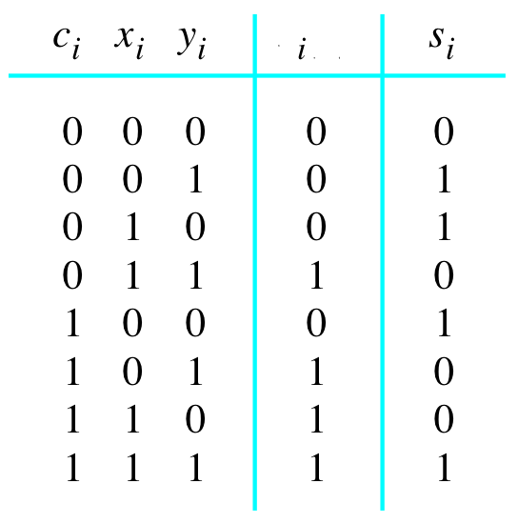

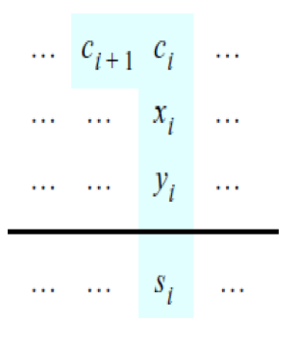
Problem Statement and Truth Table
[ Figure 3.2b from the textbook ]
[ Figure 3.3a from the textbook ]

Slide 85
Problem Statement and Truth Table
+
+
+
+
+
+
+
+
+
+
+
+
+
+
+
+
=
=
=
=
=
=
=
=
= 0₁₀
= 1₁₀
= 1₁₀
= 2₁₀
= 1₁₀
= 2₁₀
= 2₁₀
= 3₁₀
[ Figure 3.2b from the textbook ]
[ Figure 3.3a from the textbook ]

Slide 86
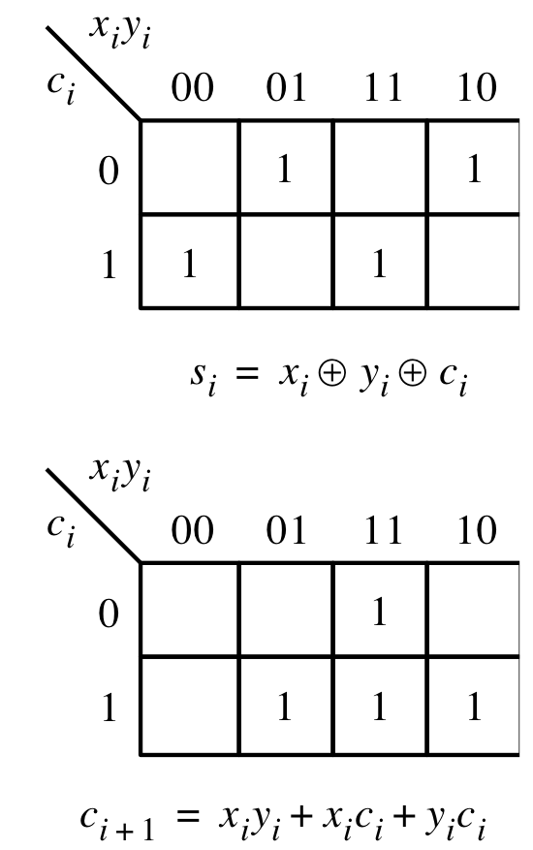
Let’s fill-in the two K-maps
[ Figure 3.3a-b from the textbook ]

Slide 87
Let’s fill-in the two K-maps
Note that the textbook switched
to the other way to draw a K-Map
[ Figure 3.3a-b from the textbook ]

Slide 88
Let’s fill-in the two K-maps
Note that the textbook switched
to the other way to draw a K-Map
[ Figure 3.3a-b from the textbook ]

Slide 89
Let’s fill-in the two K-maps
[ Figure 3.3a-b from the textbook ]

Slide 90
Let’s fill-in the two K-maps
3-input XOR
[ Figure 3.3a-b from the textbook ]

Slide 91
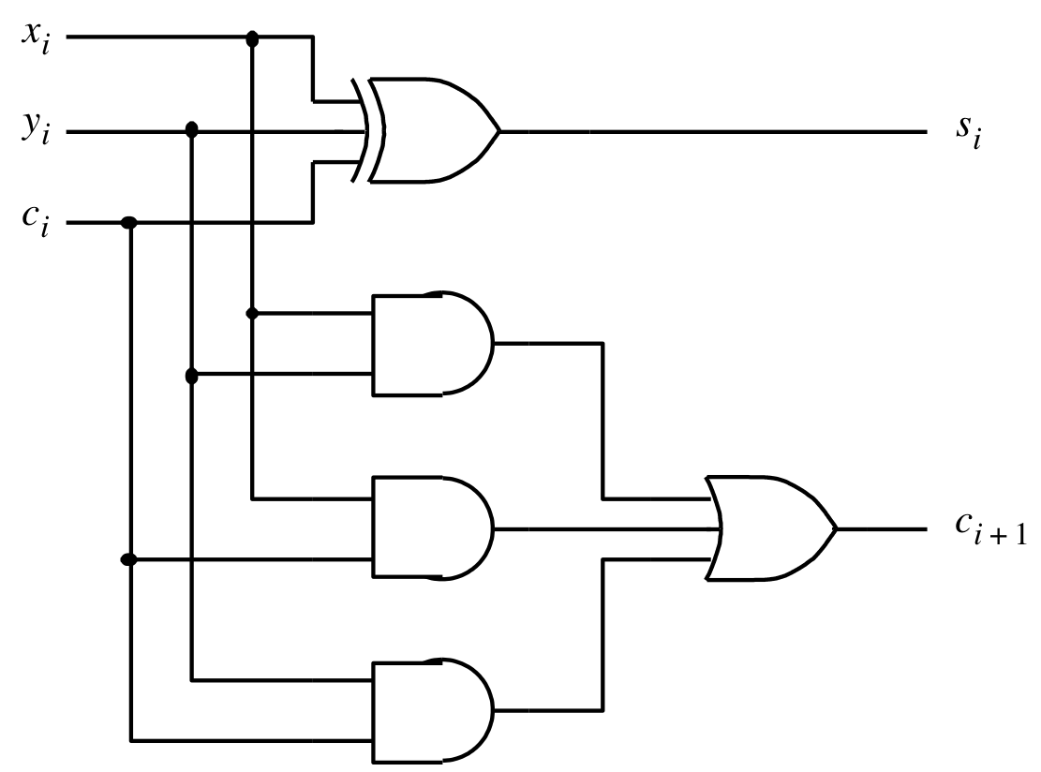


The circuit for the two expressions
[ Figure 3.3c from the textbook ]

Slide 92
This is called the Full-Adder
[ Figure 3.3c from the textbook ]

Slide 93
This is called the Full-Adder
Let's take a closer look at this.
[ Figure 3.3c from the textbook ]

Slide 94
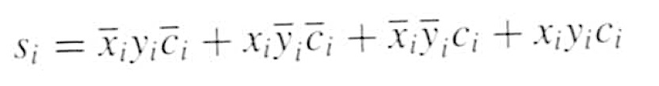
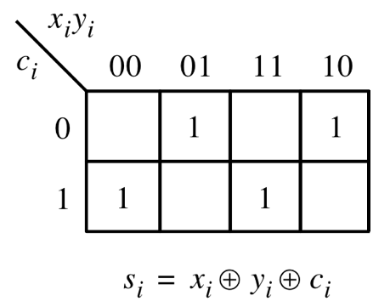
XOR Magic

Slide 95
XOR Magic

Slide 96

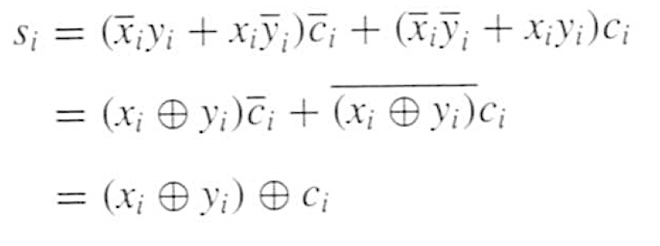
XOR Magic

Slide 97
XOR Magic
Can you prove this?

Slide 98
XOR Magic
x_{i} y_{i} + x_{i} y_{i} = x_{i} + y_{i}

Slide 99
XOR Magic
x_{i} y_{i} + x_{i} y_{i} = x_{i} + y_{i}
XNOR

Slide 100
XOR Magic
x_{i} y_{i} + x_{i} y_{i} = x_{i} + y_{i}
XOR

Slide 101
XOR Magic
x_{i} y_{i} + x_{i} y_{i} = x_{i} + y_{i}
XNOR

Slide 102
XOR Magic
x_{i} y_{i} + x_{i} y_{i} = x_{i} + y_{i}
You can also prove this using the theorems of Boolean algebra.
Try that at home.

Slide 103
The Full-Adder Circuit
Therefore, a 3-input XOR gate can be implemented with two 2-input XOR gates.
[ Figure 3.3c from the textbook ]

Slide 104

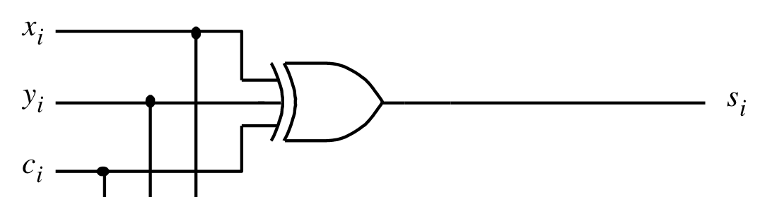
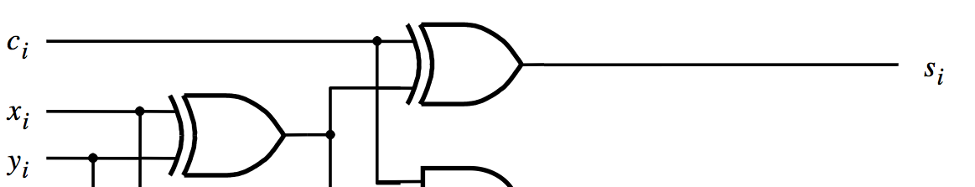
s_{i} can be implemented in two different ways
original version
alternative version

Slide 105
The Full-Adder Circuit
(alternative drawing)
c
i
s
i
x
i
y
i
c
i
+
1
[ Figure 3.4b from the textbook ]

Slide 106
The Full-Adder Circuit
(alternative drawing)
c
i
s
i
x
i
y
i
c
HA
i
+
1
HA
[ Figure 3.4b from the textbook ]

Slide 107
The Full-Adder Circuit
(alternative drawing)
c
s
s
i
s
HA
c
i
x
i
HA
c
c
y
i
+
1
i
(a) Block diagram
c
i
s
i
x
i
y
i
c
i
+
1
(b) Detailed diagram
[ Figure 3.4 from the textbook ]

Slide 108
The Full-Adder Circuit
(alternative drawing)
c
s
s
i
s
HA
c
i
x
i
HA
c
c
y
i
+
1
i
(a) Block diagram
c
i
s
i
x
( x_{i} + y_{i} )c_{i} + x_{i} y_{i}
i
y
i
c
i
+
1
Let's take a closer look at this.
(b) Detailed diagram
[ Figure 3.4 from the textbook ]

Slide 109
The Full-Adder Circuit
It must be equivalent to this.
[ Figure 3.3c from the textbook ]

Slide 110
Let’s Prove This
?
( x_{i} + y_{i} )c_{i} + x_{i} y_{i} =
x_{i} y_{i} + x_{i} c_{i} + c_{i} y_{i}

Slide 111
Let’s Prove This
( x_{i} + y_{i} )c_{i} + x_{i} y_{i} =

Slide 112
Let’s Prove This
( x_{i} + y_{i} )c_{i} + x_{i} y_{i} = ( x_{i} y_{i} + x_{i} y_{i} )c_{i} + x_{i} y_{i}

Slide 113
Let’s Prove This
( x_{i} + y_{i} )c_{i} + x_{i} y_{i} = ( x_{i} y_{i} + x_{i} y_{i} )c_{i} + x_{i} y_{i}
= x_{i} y_{i} c_{i} + x_{i} y_{i} c_{i} + x_{i} y_{i} + x_{i} y_{i}
double
this term

Slide 114
Let’s Prove This
( x_{i} + y_{i} )c_{i} + x_{i} y_{i} = ( x_{i} y_{i} + x_{i} y_{i} )c_{i} + x_{i} y_{i}
= x_{i} y_{i} c_{i} + x_{i} y_{i} c_{i} + x_{i} y_{i} + x_{i} y_{i}

Slide 115
Let’s Prove This
( x_{i} + y_{i} )c_{i} + x_{i} y_{i} = ( x_{i} y_{i} + x_{i} y_{i} )c_{i} + x_{i} y_{i}
= x_{i} y_{i} c_{i} + x_{i} y_{i} c_{i} + x_{i} y_{i} + x_{i} y_{i}
= ( x_{i} c_{i} + x_{i}) y_{i} + x_{i} ( y_{i} c_{i} + y_{i})

Slide 116
Let’s Prove This
( x_{i} + y_{i} )c_{i} + x_{i} y_{i} = ( x_{i} y_{i} + x_{i} y_{i} )c_{i} + x_{i} y_{i}
= x_{i} y_{i} c_{i} + x_{i} y_{i} c_{i} + x_{i} y_{i} + x_{i} y_{i}
= ( x_{i} c_{i} + x_{i}) y_{i} + x_{i} ( y_{i} c_{i} + y_{i})
use Theorem 16a twice
= (c_{i} + x_{i}) y_{i} + x_{i} (c_{i} + y_{i})

Slide 117
Let’s Prove This
( x_{i} + y_{i} )c_{i} + x_{i} y_{i} = ( x_{i} y_{i} + x_{i} y_{i} )c_{i} + x_{i} y_{i}
= x_{i} y_{i} c_{i} + x_{i} y_{i} c_{i} + x_{i} y_{i} + x_{i} y_{i}
= ( x_{i} c_{i} + x_{i}) y_{i} + x_{i} ( y_{i} c_{i} + y_{i})
= (c_{i} + x_{i}) y_{i} + x_{i} (c_{i} + y_{i})
= c_{i} y_{i} + x_{i} y_{i} + x_{i} c_{i} + x_{i} y_{i}

Slide 118
Let’s Prove This
( x_{i} + y_{i} )c_{i} + x_{i} y_{i} = ( x_{i} y_{i} + x_{i} y_{i} )c_{i} + x_{i} y_{i}
= x_{i} y_{i} c_{i} + x_{i} y_{i} c_{i} + x_{i} y_{i} + x_{i} y_{i}
= ( x_{i} c_{i} + x_{i}) y_{i} + x_{i} ( y_{i} c_{i} + y_{i})
= (c_{i} + x_{i}) y_{i} + x_{i} (c_{i} + y_{i})
= c_{i} y_{i} + x_{i} y_{i} + x_{i} c_{i} + x_{i} y_{i}
remove one copy of
this doubled term

Slide 119
Let’s Prove This
( x_{i} + y_{i} )c_{i} + x_{i} y_{i} = ( x_{i} y_{i} + x_{i} y_{i} )c_{i} + x_{i} y_{i}
= x_{i} y_{i} c_{i} + x_{i} y_{i} c_{i} + x_{i} y_{i} + x_{i} y_{i}
= ( x_{i} c_{i} + x_{i}) y_{i} + x_{i} ( y_{i} c_{i} + y_{i})
= (c_{i} + x_{i}) y_{i} + x_{i} (c_{i} + y_{i})
= c_{i} y_{i} + x_{i} y_{i} + x_{i} c_{i} + x_{i} y_{i}
= c_{i} y_{i} + x_{i} y_{i} + x_{i} c_{i}

Slide 120
Therefore, these circuits are equivalent
s_{i} = x_{i} + y_{i} + c_{i}
c
i
s
i
x
i
c_{i+1} =( x_{i} + y_{i} )c_{i} + x_{i} y_{i}
y
i
c
i
+
1

Slide 121
The Full-Adder Abstraction
c
s
i
i
x
FA
i
c
y
i
+
1
i

Slide 122
The Full-Adder Abstraction
c
s
i
i
x
FA
i
c
y
i
+
1
i

Slide 123
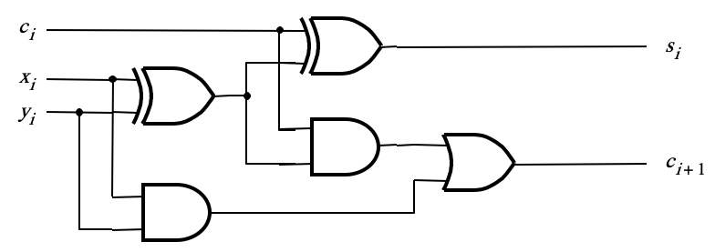
The Full-Adder Abstraction
c
s
i
i
x
FA
i
c
y
i
+
1
i

Slide 124
The Full-Adder Abstraction
c
s
i
i
x
FA
i
c
y
i
+
1
i

Slide 125
The Full-Adder Abstraction
c
s
s
i
HA
i
x
s
c
i
HA
c
y
c
i
+
1
i

Slide 126
The Full-Adder Abstraction
c
s
i
i
x
FA
i
c
y
i
+
1
i

Slide 127
We can place the arrows anywhere
x_{i}
y_{i}
c_{i+1}
FA
c_{i}
s_{i}

Slide 128
n-bit ripple-carry adder
x
n –
1
y
n
–
1
x
1
y
1
x
0
y
0
c
1
c
n
FA
c
n
-
1
c
2
FA
FA
c
0
s
n
–
1
s
1
s
0
MSB position
LSB position
[ Figure 3.5 from the textbook ]

Slide 129
n-bit ripple-carry adder abstraction
x
n –
1
y
n
–
1
x
1
y
1
x
0
y
0
c
1
c
n
FA
c
n
-
1
c
2
FA
FA
c
0
s
n
–
1
s
1
s
0
MSB position
LSB position

Slide 130
n-bit ripple-carry adder abstraction
x
n –
1
y
n
–
1
x
1
y
1
x
0
y
0
c
n
c
0
s
n
–
1
s
1
s
0

Slide 131
The x and y lines are typically
grouped together for better visualization,
but the underlying logic remains the same
x
x
1
x
0
y
y
y
n –
1
n
–
1
1
0
c
n
c
0
s
n
–
1
s
1
s
0

Slide 132
Example:
Computing 5+6 using a 5-bit adder

Slide 133
Example:
Computing 5+6 using a 5-bit adder
5 in decimal
6 in decimal
11 in decimal

Slide 134
Design Example:
Create a circuit that multiplies a number by 3

Slide 135
How to Get 3A from A?
3A = A + A + A
3A = (A+A) + A
3A = 2A +A

Slide 136
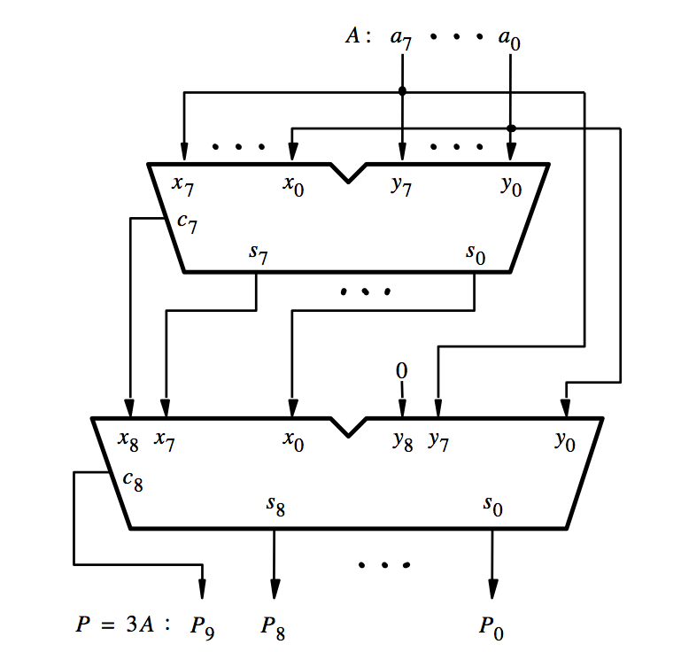
[ Figure 3.6a from the textbook ]

Slide 137
A
A
[ Figure 3.6a from the textbook ]

Slide 138
A
A
2A
[ Figure 3.6a from the textbook ]

Slide 139
A
A
2A
A
[ Figure 3.6a from the textbook ]

Slide 140
A
A
2A
A
3A
[ Figure 3.6a from the textbook ]

Slide 141
Decimal Multiplication by 10
What happens when we multiply a number by 10?
  4 x 10 = ?
542 x 10 = ?
1245 x 10 = ?

Slide 142
Decimal Multiplication by 10
What happens when we multiply a number by 10?
  4 x 10 = 40
542 x 10 = 5420
1245 x 10 = 12450

Slide 143
Decimal Multiplication by 10
What happens when we multiply a number by 10?
  4 x 10 = 40
542 x 10 = 5420
1245 x 10 = 12450
You simply add a zero as the rightmost number

Slide 144
Binary Multiplication by 2
What happens when we multiply a number by 2?
  011 times 2 = ?
101 times 2 = ?
110011 times 2 = ?

Slide 145
Binary Multiplication by 2
What happens when we multiply a number by 2?
  011 times 2 = 0110
101 times 2 = 1010
110011 times 2 = 1100110

Slide 146
Binary Multiplication by 2
What happens when we multiply a number by 2?
  011 times 2 = 0110
101 times 2 = 1010
110011 times 2 = 1100110
You simply add a zero as the rightmost number

Slide 147
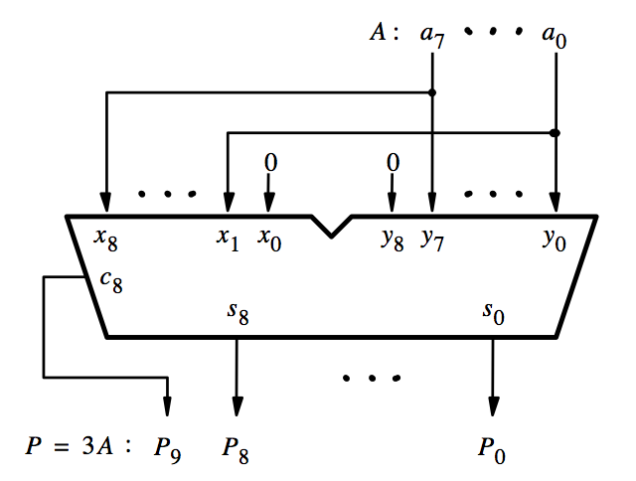
[ Figure 3.6b from the textbook ]

Slide 148
This is how we get 2A
[ Figure 3.6b from the textbook ]

Slide 149
2A
A
3A
[ Figure 3.6b from the textbook ]

Slide 150
Questions?

Slide 151
THE END

