Slide 1
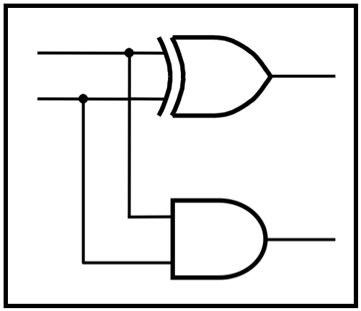
CprE 2810:
Digital Logic
Instructor: Alexander Stoytchev
http://www.ece.iastate.edu/~alexs/classes/

Slide 2
Examples of Solved Problems
CprE 281: Digital Logic
Iowa State University, Ames, IA
Copyright © Alexander Stoytchev

Slide 3
Administrative Stuff
HW4 is due today

Slide 4
Administrative Stuff
HW5 is out
It is due on Monday Sep 30 @ 10pm.
It is posted on the class web page
I also sent you an e-mail with the link.
You can use this as a preparation for the exam.

Slide 5
Administrative Stuff
Midterm Exam #1
When: Friday Sep 27.
What: Chapter 1 and Chapter 2 plus number systems
The exam will be closed book but open notes (you can bring up to 3 pages of handwritten notes).
It will be in this room.
Review session: This Wednesday during lecture

Slide 6
Topics for the Midterm Exam
Binary Numbers
Octal Numbers
Hexadecimal Numbers
Conversion between the different number systems
Truth Tables
Boolean Algebra
Logic Gates
Circuit Synthesis with AND, OR, NOT
Circuit Synthesis with NAND, NOR
Converting an AND/OR/NOT circuit to NAND circuit
Converting an AND/OR/NOT circuit to NOR circuit
SOP and POS expressions

Slide 7
Topics for the Midterm Exam
Mapping a Circuit to Verilog code
Mapping Verilog code to a circuit
Multiplexers
Venn Diagrams
K-maps for 2, 3, and 4 variables
Minimization of Boolean expressions using theorems
Minimization of Boolean expressions with K-maps
Incompletely specified functions (with don’t cares)
Functions with multiple outputs
Something from Star Wars

Slide 8
All possible Boolean functions with two input variables

Slide 9
There are 16 possible Boolean functions with two input variables
x | y | F₀ | F₁ | F₂ | F₃ | F₄ | F₅ | F₆ | F₇ | F₈ | F₉ | F₁₀ | F₁₁ | F₁₂ | F₁₃ | F₁₄ | F₁₅
0 | 0 | 0 | 1 | 0 | 1 | 0 | 1 | 0 | 1 | 0 | 1 | 0 | 1 | 0 | 1 | 0 | 1
0 | 1 | 0 | 0 | 1 | 1 | 0 | 0 | 1 | 1 | 0 | 0 | 1 | 1 | 0 | 0 | 1 | 1
1 | 0 | 0 | 0 | 0 | 0 | 1 | 1 | 1 | 1 | 0 | 0 | 0 | 0 | 1 | 1 | 1 | 1
1 | 1 | 0 | 0 | 0 | 0 | 0 | 0 | 0 | 0 | 1 | 1 | 1 | 1 | 1 | 1 | 1 | 1

Slide 10
There are 16 possible Boolean functions with two input variables
x | y | F₀ | F₁ | F₂ | F₃ | F₄ | F₅ | F₆ | F₇ | F₈ | F₉ | F₁₀ | F₁₁ | F₁₂ | F₁₃ | F₁₄ | F₁₅
0 | 0 | 0 | 1 | 0 | 1 | 0 | 1 | 0 | 1 | 0 | 1 | 0 | 1 | 0 | 1 | 0 | 1
0 | 1 | 0 | 0 | 1 | 1 | 0 | 0 | 1 | 1 | 0 | 0 | 1 | 1 | 0 | 0 | 1 | 1
1 | 0 | 0 | 0 | 0 | 0 | 1 | 1 | 1 | 1 | 0 | 0 | 0 | 0 | 1 | 1 | 1 | 1
1 | 1 | 0 | 0 | 0 | 0 | 0 | 0 | 0 | 0 | 1 | 1 | 1 | 1 | 1 | 1 | 1 | 1
constant 0
constant 1

Slide 11
There are 16 possible Boolean functions with two input variables
x | y | F₀ | F₁ | F₂ | F₃ | F₄ | F₅ | F₆ | F₇ | F₈ | F₉ | F₁₀ | F₁₁ | F₁₂ | F₁₃ | F₁₄ | F₁₅
0 | 0 | 0 | 1 | 0 | 1 | 0 | 1 | 0 | 1 | 0 | 1 | 0 | 1 | 0 | 1 | 0 | 1
0 | 1 | 0 | 0 | 1 | 1 | 0 | 0 | 1 | 1 | 0 | 0 | 1 | 1 | 0 | 0 | 1 | 1
1 | 0 | 0 | 0 | 0 | 0 | 1 | 1 | 1 | 1 | 0 | 0 | 0 | 0 | 1 | 1 | 1 | 1
1 | 1 | 0 | 0 | 0 | 0 | 0 | 0 | 0 | 0 | 1 | 1 | 1 | 1 | 1 | 1 | 1 | 1
NOR(x, y)
OR(x, y)

Slide 12
There are 16 possible Boolean functions with two input variables
x | y | F₀ | F₁ | F₂ | F₃ | F₄ | F₅ | F₆ | F₇ | F₈ | F₉ | F₁₀ | F₁₁ | F₁₂ | F₁₃ | F₁₄ | F₁₅
0 | 0 | 0 | 1 | 0 | 1 | 0 | 1 | 0 | 1 | 0 | 1 | 0 | 1 | 0 | 1 | 0 | 1
0 | 1 | 0 | 0 | 1 | 1 | 0 | 0 | 1 | 1 | 0 | 0 | 1 | 1 | 0 | 0 | 1 | 1
1 | 0 | 0 | 0 | 0 | 0 | 1 | 1 | 1 | 1 | 0 | 0 | 0 | 0 | 1 | 1 | 1 | 1
1 | 1 | 0 | 0 | 0 | 0 | 0 | 0 | 0 | 0 | 1 | 1 | 1 | 1 | 1 | 1 | 1 | 1
_
_
m₁ = x y
M₁ = x + y

Slide 13
There are 16 possible Boolean functions with two input variables
x | y | F₀ | F₁ | F₂ | F₃ | F₄ | F₅ | F₆ | F₇ | F₈ | F₉ | F₁₀ | F₁₁ | F₁₂ | F₁₃ | F₁₄ | F₁₅
0 | 0 | 0 | 1 | 0 | 1 | 0 | 1 | 0 | 1 | 0 | 1 | 0 | 1 | 0 | 1 | 0 | 1
0 | 1 | 0 | 0 | 1 | 1 | 0 | 0 | 1 | 1 | 0 | 0 | 1 | 1 | 0 | 0 | 1 | 1
1 | 0 | 0 | 0 | 0 | 0 | 1 | 1 | 1 | 1 | 0 | 0 | 0 | 0 | 1 | 1 | 1 | 1
1 | 1 | 0 | 0 | 0 | 0 | 0 | 0 | 0 | 0 | 1 | 1 | 1 | 1 | 1 | 1 | 1 | 1
NOT(x)
x

Slide 14
There are 16 possible Boolean functions with two input variables
x | y | F₀ | F₁ | F₂ | F₃ | F₄ | F₅ | F₆ | F₇ | F₈ | F₉ | F₁₀ | F₁₁ | F₁₂ | F₁₃ | F₁₄ | F₁₅
0 | 0 | 0 | 1 | 0 | 1 | 0 | 1 | 0 | 1 | 0 | 1 | 0 | 1 | 0 | 1 | 0 | 1
0 | 1 | 0 | 0 | 1 | 1 | 0 | 0 | 1 | 1 | 0 | 0 | 1 | 1 | 0 | 0 | 1 | 1
1 | 0 | 0 | 0 | 0 | 0 | 1 | 1 | 1 | 1 | 0 | 0 | 0 | 0 | 1 | 1 | 1 | 1
1 | 1 | 0 | 0 | 0 | 0 | 0 | 0 | 0 | 0 | 1 | 1 | 1 | 1 | 1 | 1 | 1 | 1
_
_
m₂ = x y
M₂ = x + y

Slide 15
There are 16 possible Boolean functions with two input variables
x | y | F₀ | F₁ | F₂ | F₃ | F₄ | F₅ | F₆ | F₇ | F₈ | F₉ | F₁₀ | F₁₁ | F₁₂ | F₁₃ | F₁₄ | F₁₅
0 | 0 | 0 | 1 | 0 | 1 | 0 | 1 | 0 | 1 | 0 | 1 | 0 | 1 | 0 | 1 | 0 | 1
0 | 1 | 0 | 0 | 1 | 1 | 0 | 0 | 1 | 1 | 0 | 0 | 1 | 1 | 0 | 0 | 1 | 1
1 | 0 | 0 | 0 | 0 | 0 | 1 | 1 | 1 | 1 | 0 | 0 | 0 | 0 | 1 | 1 | 1 | 1
1 | 1 | 0 | 0 | 0 | 0 | 0 | 0 | 0 | 0 | 1 | 1 | 1 | 1 | 1 | 1 | 1 | 1
NOT(y)
y

Slide 16
There are 16 possible Boolean functions with two input variables
x | y | F₀ | F₁ | F₂ | F₃ | F₄ | F₅ | F₆ | F₇ | F₈ | F₉ | F₁₀ | F₁₁ | F₁₂ | F₁₃ | F₁₄ | F₁₅
0 | 0 | 0 | 1 | 0 | 1 | 0 | 1 | 0 | 1 | 0 | 1 | 0 | 1 | 0 | 1 | 0 | 1
0 | 1 | 0 | 0 | 1 | 1 | 0 | 0 | 1 | 1 | 0 | 0 | 1 | 1 | 0 | 0 | 1 | 1
1 | 0 | 0 | 0 | 0 | 0 | 1 | 1 | 1 | 1 | 0 | 0 | 0 | 0 | 1 | 1 | 1 | 1
1 | 1 | 0 | 0 | 0 | 0 | 0 | 0 | 0 | 0 | 1 | 1 | 1 | 1 | 1 | 1 | 1 | 1
XOR(x, y)
XNOR(x, y)

Slide 17
There are 16 possible Boolean functions with two input variables
x | y | F₀ | F₁ | F₂ | F₃ | F₄ | F₅ | F₆ | F₇ | F₈ | F₉ | F₁₀ | F₁₁ | F₁₂ | F₁₃ | F₁₄ | F₁₅
0 | 0 | 0 | 1 | 0 | 1 | 0 | 1 | 0 | 1 | 0 | 1 | 0 | 1 | 0 | 1 | 0 | 1
0 | 1 | 0 | 0 | 1 | 1 | 0 | 0 | 1 | 1 | 0 | 0 | 1 | 1 | 0 | 0 | 1 | 1
1 | 0 | 0 | 0 | 0 | 0 | 1 | 1 | 1 | 1 | 0 | 0 | 0 | 0 | 1 | 1 | 1 | 1
1 | 1 | 0 | 0 | 0 | 0 | 0 | 0 | 0 | 0 | 1 | 1 | 1 | 1 | 1 | 1 | 1 | 1
NAND(x, y)
AND(x, y)

Slide 18
There are 16 possible Boolean functions with two input variables
x | y | F₀ | F₁ | F₂ | F₃ | F₄ | F₅ | F₆ | F₇ | F₈ | F₉ | F₁₀ | F₁₁ | F₁₂ | F₁₃ | F₁₄ | F₁₅
0 | 0 | 0 | 1 | 0 | 1 | 0 | 1 | 0 | 1 | 0 | 1 | 0 | 1 | 0 | 1 | 0 | 1
0 | 1 | 0 | 0 | 1 | 1 | 0 | 0 | 1 | 1 | 0 | 0 | 1 | 1 | 0 | 0 | 1 | 1
1 | 0 | 0 | 0 | 0 | 0 | 1 | 1 | 1 | 1 | 0 | 0 | 0 | 0 | 1 | 1 | 1 | 1
1 | 1 | 0 | 0 | 0 | 0 | 0 | 0 | 0 | 0 | 1 | 1 | 1 | 1 | 1 | 1 | 1 | 1
0
m₁
_
m₂
_
y
M₂
x
1
NOR
x
y
AND
M₁
OR
XOR
XNOR
NAND

Slide 19
There are 16 possible Boolean functions with two input variables
x | y | F₀ | F₁ | F₂ | F₃ | F₄ | F₅ | F₆ | F₇ | F₈ | F₉ | F₁₀ | F₁₁ | F₁₂ | F₁₃ | F₁₄ | F₁₅
0 | 0 | 0 | 1 | 0 | 1 | 0 | 1 | 0 | 1 | 0 | 1 | 0 | 1 | 0 | 1 | 0 | 1
0 | 1 | 0 | 0 | 1 | 1 | 0 | 0 | 1 | 1 | 0 | 0 | 1 | 1 | 0 | 0 | 1 | 1
1 | 0 | 0 | 0 | 0 | 0 | 1 | 1 | 1 | 1 | 0 | 0 | 0 | 0 | 1 | 1 | 1 | 1
1 | 1 | 0 | 0 | 0 | 0 | 0 | 0 | 0 | 0 | 1 | 1 | 1 | 1 | 1 | 1 | 1 | 1
0
m₀
m₁
_
m₂
_
M₃
m₃
y
M₂
x
1
x
y
M₁
M₀
XOR
XNOR

Slide 20
There are 16 possible Boolean functions with two input variables
x | y | F₀ | F₁ | F₂ | F₃ | F₄ | F₅ | F₆ | F₇ | F₈ | F₉ | F₁₀ | F₁₁ | F₁₂ | F₁₃ | F₁₄ | F₁₅
0 | 0 | 0 | 1 | 0 | 1 | 0 | 1 | 0 | 1 | 0 | 1 | 0 | 1 | 0 | 1 | 0 | 1
0 | 1 | 0 | 0 | 1 | 1 | 0 | 0 | 1 | 1 | 0 | 0 | 1 | 1 | 0 | 0 | 1 | 1
1 | 0 | 0 | 0 | 0 | 0 | 1 | 1 | 1 | 1 | 0 | 0 | 0 | 0 | 1 | 1 | 1 | 1
1 | 1 | 0 | 0 | 0 | 0 | 0 | 0 | 0 | 0 | 1 | 1 | 1 | 1 | 1 | 1 | 1 | 1
0
m₀
m₁
_
m₂
_
M₃
m₃
y
M₂
x
1
x
y
M₁
M₀
m₁ + m₂
M₁ • M₂

Slide 21
There are 16 possible Boolean functions with two input variables
x | y | F₀ | F₁ | F₂ | F₃ | F₄ | F₅ | F₆ | F₇ | F₈ | F₉ | F₁₀ | F₁₁ | F₁₂ | F₁₃ | F₁₄ | F₁₅
0 | 0 | 0 | 1 | 0 | 1 | 0 | 1 | 0 | 1 | 0 | 1 | 0 | 1 | 0 | 1 | 0 | 1
0 | 1 | 0 | 0 | 1 | 1 | 0 | 0 | 1 | 1 | 0 | 0 | 1 | 1 | 0 | 0 | 1 | 1
1 | 0 | 0 | 0 | 0 | 0 | 1 | 1 | 1 | 1 | 0 | 0 | 0 | 0 | 1 | 1 | 1 | 1
1 | 1 | 0 | 0 | 0 | 0 | 0 | 0 | 0 | 0 | 1 | 1 | 1 | 1 | 1 | 1 | 1 | 1
0
m₀
m₁
m₂
M₃
m₃
M₂
M₁
M₀
1
M₀ • M₂
m₀ + m₁
m₀ + m₂
M₁ • M₂
M₀ • M₁
m₁ + m₂

Slide 22
K-Maps for all 16 possible functions with two input variables

Slide 23
K-Maps for the 16 functions
x
x
x
x
y
y
y
y
0
1
0
1
0
1
0
1
0
1
0
0
0
0
0
0
1
0
0
0
1
0
0
1
1
0
1
0
0
1
0
1
_
_
_
_
x y
x y
x y
x y
F₁
F₂
F₄
F₈

Slide 24
K-Maps for the 16 functions
x
x
x
x
y
y
y
y
0
1
0
1
0
1
0
1
0
1
0
0
0
1
0
1
1
0
0
0
1
1
0
1
0
1
1
0
0
1
1
1
_
_
x
x
y
y
F₃
F₁₂
F₅
F₁₀

Slide 25
K-Maps for the 16 functions
x
x
x
x
y
y
y
y
0
1
0
1
0
1
0
1
0
1
1
0
1
0
0
1
1
0
0
1
1
1
0
1
1
1
1
0
1
1
1
1
_
_
_
_
x + y
x + y
x + y
x + y
F₇
F₁₁
F₁₃
F₁₄

Slide 26
K-Maps for the 16 functions
x
x
y
y
0
1
0
1
0
0
0
0
1
1
1
0
0
1
1
1
constant 0
constant 1
F₀
F₁₅

Slide 27
These are not valid groupings, but they correspond to XOR and XNOR
x
x
y
y
0
1
0
1
0
0
1
0
1
0
1
1
0
1
0
1

Slide 28
These are not valid groupings, but they correspond to XOR and XNOR
x
x
y
y
0
1
0
1
0
0
1
0
1
0
1
1
0
1
0
1
XOR(x, y)
XNOR(x, y)
F₆
F₉

Slide 29
The Link Between Truth Tables and Venn Diagrams

Slide 30
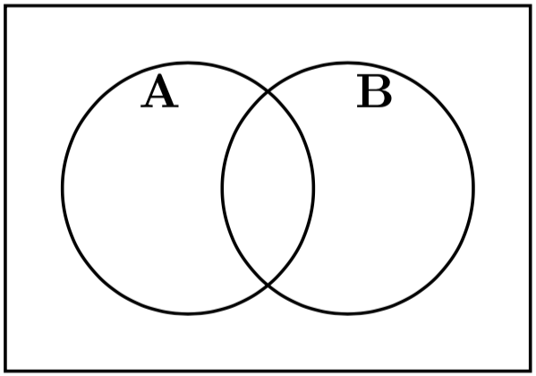
Place the minterms on the Venn diagram
A | B
0 | 0 | m₀
0 | 1 | m₁
1 | 0 | m₂
1 | 1 | m₃

Slide 31
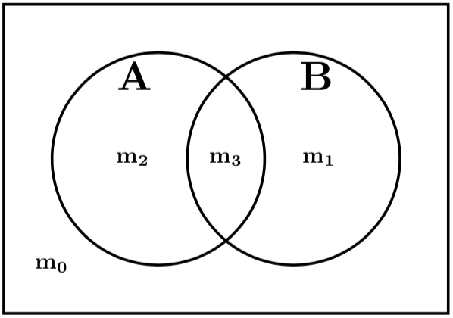
Place the minterms on the Venn diagram
A | B
0 | 0 | m₀
0 | 1 | m₁
1 | 0 | m₂
1 | 1 | m₃

Slide 33
Color the Venn diagram for XOR
A | B | F
0 | 0 | 0
0 | 1 | 1
1 | 0 | 1
1 | 1 | 0

Slide 34
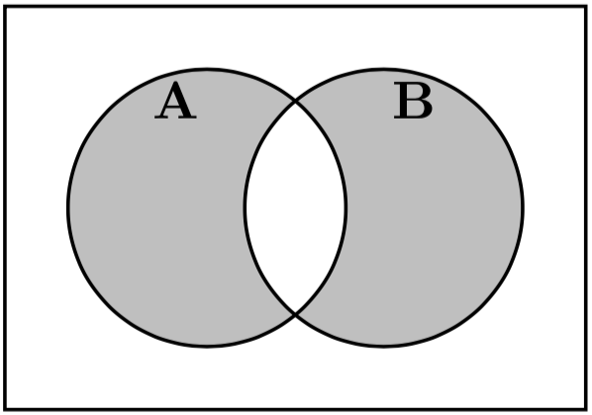
Color the Venn diagram for XOR
A | B | F
0 | 0 | 0
0 | 1 | 1
1 | 0 | 1
1 | 1 | 0

Slide 35
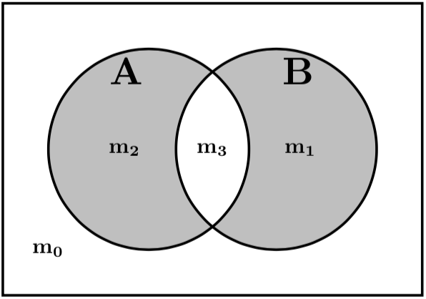
Color the Venn diagram for XOR
m₀
m₁
m₂
m₃
A | B | F
0 | 0 | 0
0 | 1 | 1
1 | 0 | 1
1 | 1 | 0
F = A B + A B

Slide 37
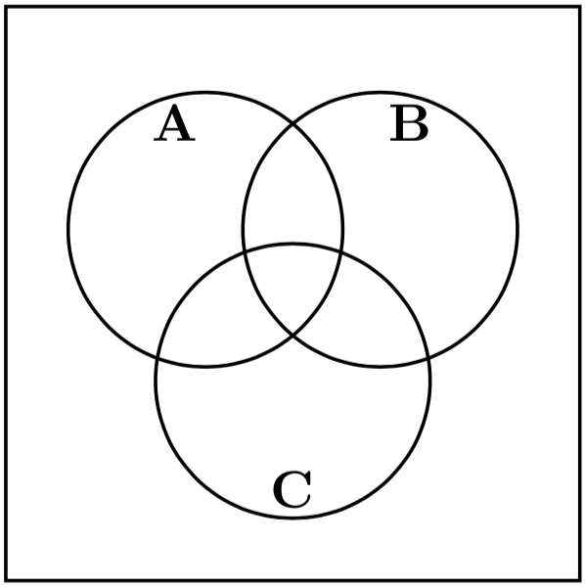
Place the minterms on the Venn diagram
A | B | C
0 | 0 | 0 | m₀
0 | 0 | 1 | m₁
0 | 1 | 0 | m₂
0 | 1 | 1 | m₃
1 | 0 | 0 | m₄
1 | 0 | 1 | m₅
1 | 1 | 0 | m₆
1 | 1 | 1 | m₇

Slide 38
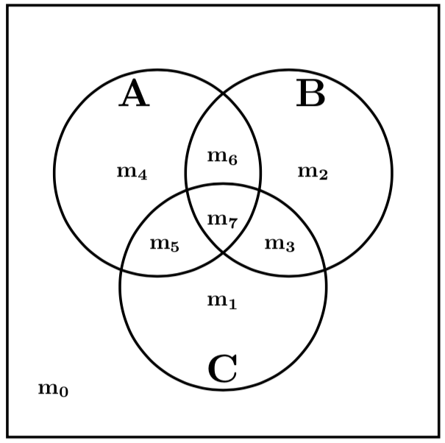
Place the minterms on the Venn diagram
A | B | C
0 | 0 | 0 | m₀
0 | 0 | 1 | m₁
0 | 1 | 0 | m₂
0 | 1 | 1 | m₃
1 | 0 | 0 | m₄
1 | 0 | 1 | m₅
1 | 1 | 0 | m₆
1 | 1 | 1 | m₇

Slide 40
Color the Venn diagram for this function
A | B | C | F
0 | 0 | 0 | 0
0 | 0 | 1 | 0
0 | 1 | 0 | 0
0 | 1 | 1 | 1
1 | 0 | 0 | 1
1 | 0 | 1 | 1
1 | 1 | 0 | 0
1 | 1 | 1 | 1

Slide 41
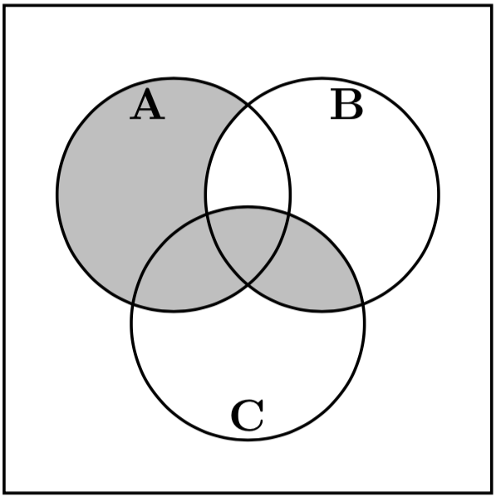
Color the Venn diagram for this function
A | B | C | F
0 | 0 | 0 | 0
0 | 0 | 1 | 0
0 | 1 | 0 | 0
0 | 1 | 1 | 1
1 | 0 | 0 | 1
1 | 0 | 1 | 1
1 | 1 | 0 | 0
1 | 1 | 1 | 1

Slide 42
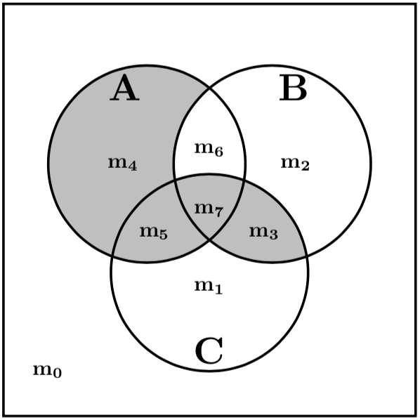
Place the minterms on the Venn diagram
m₀
m₁
m₂
m₃
m₄
m₅
m₆
m₇
A | B | C | F
0 | 0 | 0 | 0
0 | 0 | 1 | 0
0 | 1 | 0 | 0
0 | 1 | 1 | 1
1 | 0 | 0 | 1
1 | 0 | 1 | 1
1 | 1 | 0 | 0
1 | 1 | 1 | 1

Slide 44
Color the Venn diagram for this function
A | B | C | F
0 | 0 | 0 | 1
0 | 0 | 1 | 1
0 | 1 | 0 | 1
0 | 1 | 1 | 0
1 | 0 | 0 | 1
1 | 0 | 1 | 0
1 | 1 | 0 | 0
1 | 1 | 1 | 1

Slide 45
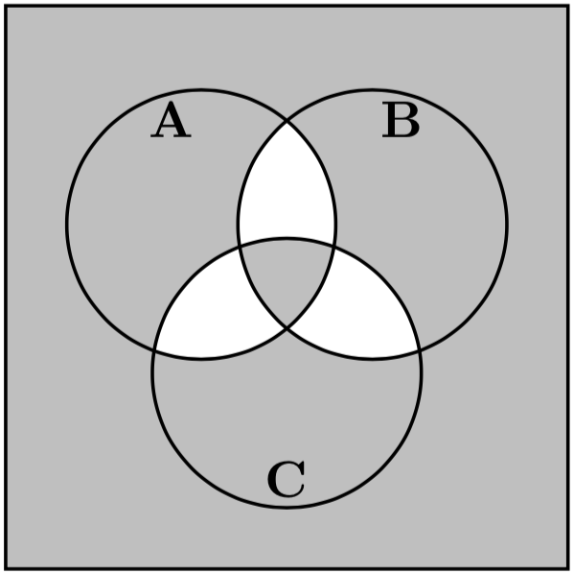
Color the Venn diagram for this function
A | B | C | F
0 | 0 | 0 | 1
0 | 0 | 1 | 1
0 | 1 | 0 | 1
0 | 1 | 1 | 0
1 | 0 | 0 | 1
1 | 0 | 1 | 0
1 | 1 | 0 | 0
1 | 1 | 1 | 1

Slide 46
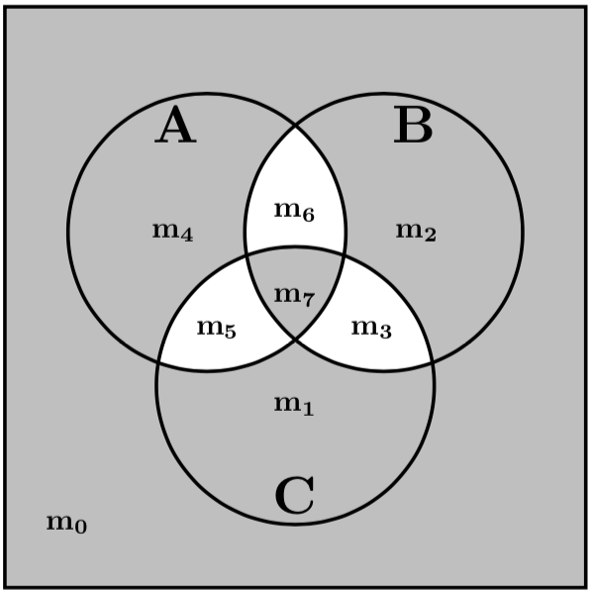
Place the minterms on the Venn diagram
m₀
m₁
m₂
m₃
m₄
m₅
m₆
m₇
A | B | C | F
0 | 0 | 0 | 1
0 | 0 | 1 | 1
0 | 1 | 0 | 1
0 | 1 | 1 | 0
1 | 0 | 0 | 1
1 | 0 | 1 | 0
1 | 1 | 0 | 0
1 | 1 | 1 | 1

Slide 48
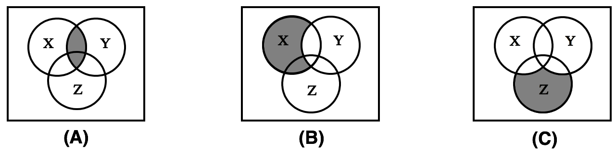
Write the expression that is represented by each of the three Venn diagrams:

Slide 49
Write the expression that is represented by each of the three Venn diagrams:
_
_
_
X Y
X Y
X Y Z

Slide 50
Example 1
Determine if the following equation is valid

Slide 51
?

Slide 52
?
LHS
RHS

Slide 53
Left-Hand Side (LHS)

Slide 54
Left-Hand Side (LHS)

Slide 55
Left-Hand Side (LHS)

Slide 56
Right-Hand Side (RHS)

Slide 57
Right-Hand Side (RHS)

Slide 58
Right-Hand Side (RHS)

Slide 59

?
LHS
RHS
They are equal.

Slide 60
Example 2
Design the minimum-cost product-of-sums expression for the function
f(x₁, x₂, x₃) = Σ m(0, 2, 4, 5, 6, 7)

Slide 61
Minterms and Maxterms
(with three variables)
[ Figure 2.22 from the textbook ]

Slide 62
Minterms and Maxterms
(with three variables)
The function is
1 for these rows

Slide 63
Minterms and Maxterms
(with three variables)
The function is
1 for these rows
The function is
0 for these rows

Slide 64
Two different ways to specify the same function f of three variables
f(x₁, x₂, x₃) = Σ m(0, 2, 4, 5, 6, 7)
f(x₁, x₂, x₃) = Π M(1, 3)

Slide 65
Two different ways to specify the same function f of three variables
f(x₁, x₂, x₃) = Σ m(0, 2, 4, 5, 6, 7)
f(x₁, x₂, x₃) = Π M(1, 3)
= M₁• M₃
= ( x₁ + x₂ + x₃)•( x₁ + x₂ + x₃)

Slide 66
The Minimum POS Expression
f(x₁, x₂, x₃)
= ( x₁ + x₂ + x₃)•( x₁ + x₂ + x₃)
= ( x₁ + x₃ + x₂)•( x₁ + x₃ + x₂)
= ( x₁ + x₃ )
Hint: Use the following Boolean Algebra theorem

Slide 67
Alternative Solution Using K-Maps

Slide 68
Alternative Solution Using K-Maps

Slide 69
Alternative Solution Using K-Maps

Slide 70
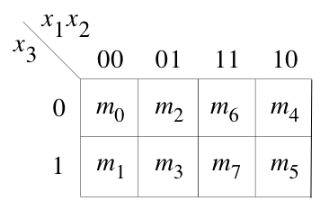
Alternative Solution Using K-Maps

Slide 71
Alternative Solution Using K-Maps
1
1
1
1
0
0
1
1

Slide 72
Alternative Solution Using K-Maps
1
1
1
1
0
0
1
1
( x₁ + x₃ )

Slide 73
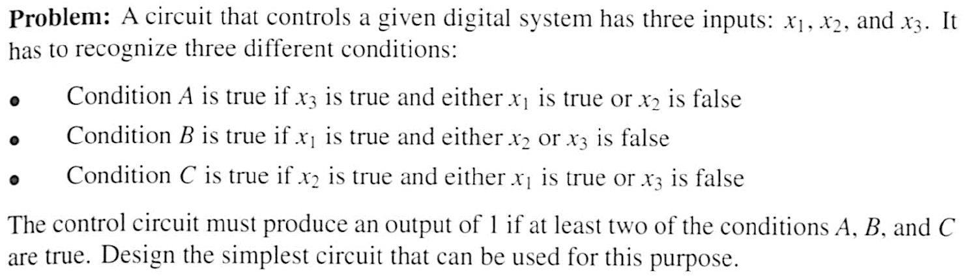
Example 3

Slide 74
Condition A

Slide 75

Condition A

Slide 76
Condition B

Slide 77

Condition B

Slide 78
Condition C

Slide 79

Condition C

Slide 80
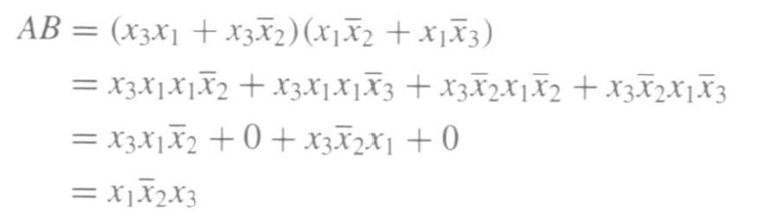
The output of the circuit can be expressed as f = AB + AC + BC

Slide 81
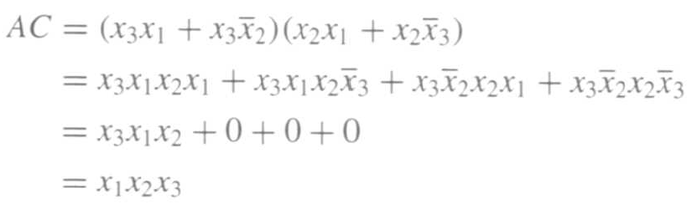
The output of the circuit can be expressed as f = AB + AC + BC

Slide 82
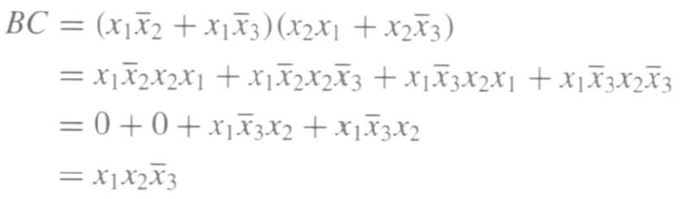
The output of the circuit can be expressed as f = AB + AC + BC

Slide 83
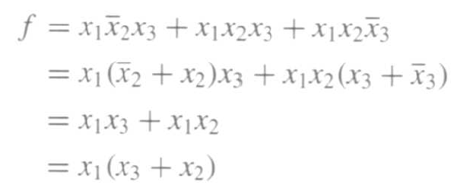
Finally, we get

Slide 84
Example 4
Solve the previous problem using Venn diagrams.

Slide 85




Venn Diagrams
(find the areas that are shaded at least two times)
x₁
x₂
x₁
x₂
x₂
x₃
x₃
(a) Function
A:
(b) Function
B
x₁
x₂
x₁
x₂
x₃
x₃
(c) Function
C
(d) Function
f
[ Figure 2.66 from the textbook ]

Slide 86
Example 5
Design the minimum-cost SOP and POS
expression for the function
f(x₁, x₂, x₃, x₄) = Σ m(4, 6, 8, 10, 11, 12, 15) + D(3, 5, 7, 9)

Slide 87
Let’s Use a K-Map
f(x₁, x₂, x₃, x₄) = Σ m(4, 6, 8, 10, 11, 12, 15) + D(3, 5, 7, 9)

Slide 88
Let’s Use a K-Map
f(x₁, x₂, x₃, x₄) = Σ m(4, 6, 8, 10, 11, 12, 15) + D(3, 5, 7, 9)
0
1
1
1
0
d
0
d
d
d
1
1
0
1
0
1

Slide 89
Let’s Use a K-Map
f(x₁, x₂, x₃, x₄) = Σ m(4, 6, 8, 10, 11, 12, 15) + D(3, 5, 7, 9)
0
1
1
1
0
d
0
d
d
d
1
1
0
1
0
1

Slide 90
Let’s Use a K-Map
f(x₁, x₂, x₃, x₄) = Σ m(4, 6, 8, 10, 11, 12, 15) + D(3, 5, 7, 9)
0
1
1
1
0
d
0
d
d
d
1
1
0
1
0
1

Slide 91
Let’s Use a K-Map
f(x₁, x₂, x₃, x₄) = Σ m(4, 6, 8, 10, 11, 12, 15) + D(3, 5, 7, 9)
0
1
1
1
0
d
0
d
d
d
1
1
0
1
0
1

Slide 92
Two Alternative Solutions
f(x₁, x₂, x₃, x₄) = Σ m(4, 6, 8, 10, 11, 12, 15) + D(3, 5, 7, 9)
0
1
1
1
0
1
1
1
0
d
0
d
0
d
0
d
d
d
1
1
d
d
1
1
0
1
0
1
0
1
0
1

Slide 93
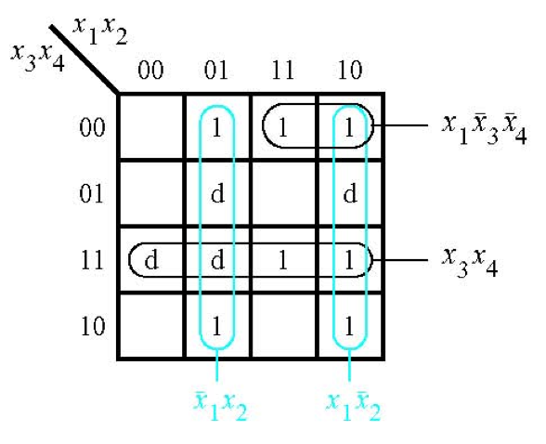
The SOP Expression
_ _ _ _
f = x₁ x₂ + x₁ x₂ + x₁ x₃ x₄ + x₃ x₄
[ Figure 2.67a from the textbook ]

Slide 94
What about the POS Expression?
f(x₁, x₂, x₃, x₄) = Σ m(4, 6, 8, 10, 11, 12, 15) + D(3, 5, 7, 9)
0
1
1
1
0
d
0
d
d
d
1
1
0
1
0
1

Slide 95
What about the POS Expression?
f(x₁, x₂, x₃, x₄) = Σ m(4, 6, 8, 10, 11, 12, 15) + D(3, 5, 7, 9)
0
1
1
1
0
d
0
d
d
d
1
1
0
1
0
1

Slide 96
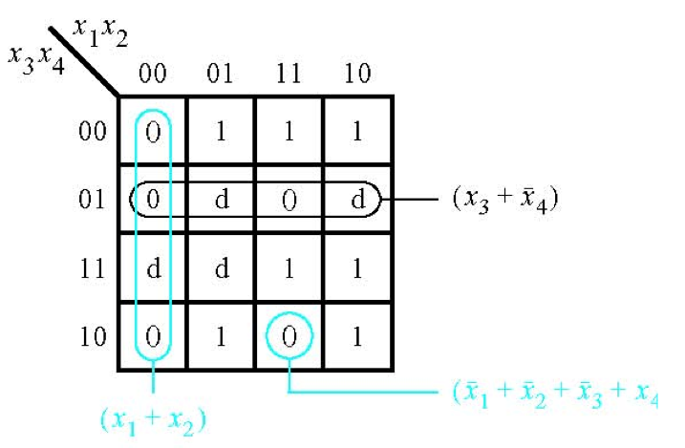
The POS Expression
_ _ _ _
f = (x₁ + x₂)•(x₃ + x₄)•(x₁ + x₂ + x₃ + x₄)
[ Figure 2.67b from the textbook ]

Slide 97
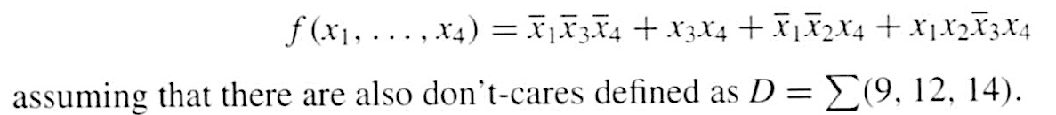
Example 6
Use K-maps to find the minimum-cost SOP and POS
expression for the function

Slide 98

Let’s map the expression to the K-Map

Slide 99
Let’s map the expression to the K-Map
d
d
d

Slide 100
Let’s map the expression to the K-Map
d
d
d

Slide 101
Let’s map the expression to the K-Map
d
d
d

Slide 102
Let’s map the expression to the K-Map
d
d
d

Slide 103
Let’s map the expression to the K-Map
d
d
d

Slide 104
Let’s map the expression to the K-Map
d
d
d

Slide 105
Let’s map the expression to the K-Map
1
d
1
d
0
1
0
1
d
d
1
1
1
1
0
d
0
d
0

Slide 106
Let’s map the expression to the K-Map
1
1
d
0
1
0
1
d
1
1
1
1
0
0
d
0

Slide 107
Let’s map the expression to the K-Map
1
1
d
0
1
0
1
d
1
1
1
1
0
0
d
0

Slide 108
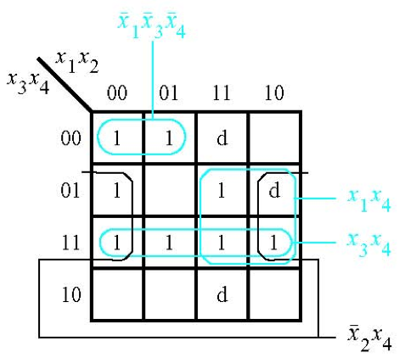

The SOP Expression
[ Figure 2.68a from the textbook ]

Slide 109
What about the POS Expression?
1
1
d
0
1
0
1
d
1
1
1
1
0
0
d
0

Slide 110
What about the POS Expression?
1
1
d
0
1
0
1
d
1
1
1
1
0
0
d
0

Slide 111
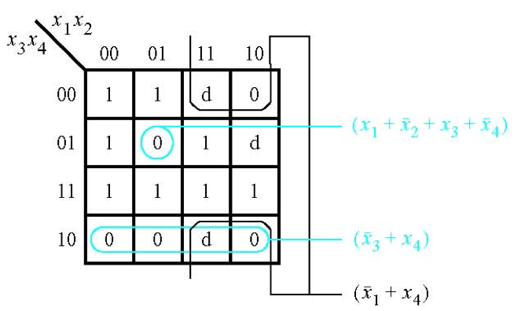

The POS Expression
[ Figure 2.68b from the textbook ]

Slide 112

Example 7
Derive the minimum-cost SOP expression for

Slide 113

First, expand the expression using property 12a

Slide 114

Construct the K-Map for this expression
s₁ s₂ s₃
s₁ s₂
s₃

Slide 115
Construct the K-Map for this expression
s₁ s₂ s₃
s₁ s₂
s₃

Slide 116
Construct the K-Map for this expression
s₁ s₂ s₃
s₁ s₂
s₃

Slide 117
Construct the K-Map for this expression
s₁ s₂ s₃
s₁ s₂
s₃

Slide 118
Construct the K-Map for this expression
s₁ s₂ s₃
s₁ s₂
0
1
0
1
0
1
1
1
s₃
0
0
1
0
1
1
1
1

Slide 119
Construct the K-Map for this expression
s₁ s₂ s₃
s₁ s₂
0
1
0
1
0
1
1
1
s₃
0
0
1
0
1
1
1
1
Simplified Expression: f = s₃ + s₁ s₂

Slide 120
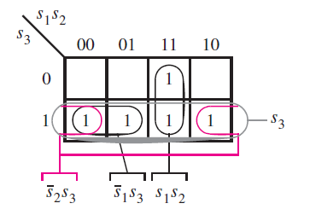
Construct the K-Map for this expression
[ Figure 2.69 from the textbook ]

Slide 121
Construct the K-Map for this expression
Simplified Expression: f = s₃ + s₁ s₂
[ Figure 2.69 from the textbook ]

Slide 122
Example 8
Write the Verilog code for the following circuit …

Slide 123
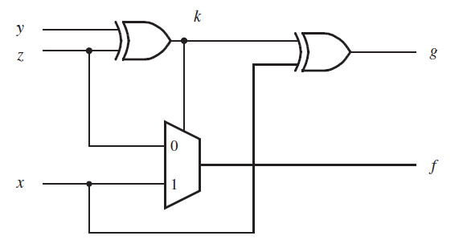
Logic Circuit
[ Figure 2.70 from the textbook ]

Slide 124
Circuit for 2-1 Multiplexer
x
s
1
f
x
1
0
f
s
x
2
1
x
2
(b) Circuit
(c) Graphical symbol
f (s, x_{1,} x₂) =
s x₁
+
s x₂
[ Figure 2.33b-c from the textbook ]

Slide 125
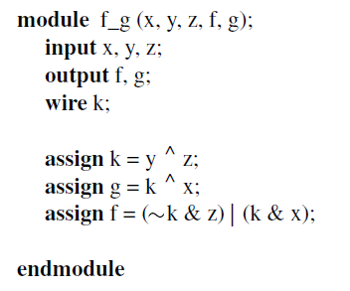
Logic Circuit vs Verilog Code
[ Figure 2.70 from the textbook ]
[ Figure 2.71 from the textbook ]

Slide 126
Example 9
Write the Verilog code for the following circuit …

Slide 127
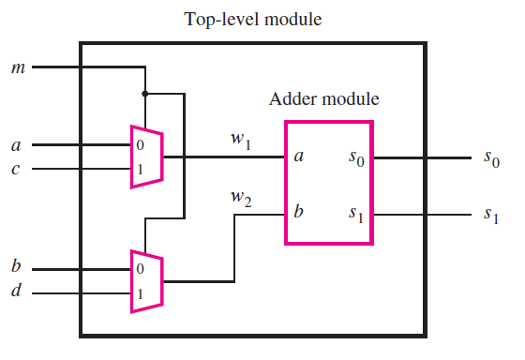
The Logic Circuit for this Example
[ Figure 2.72 from the textbook ]

Slide 128
Circuit for 2-1 Multiplexer
x
s
1
f
x
1
0
f
s
x
2
1
x
2
(b) Circuit
(c) Graphical symbol
f (s, x_{1,} x₂) =
s x₁
+
s x₂
[ Figure 2.33b-c from the textbook ]

Slide 129
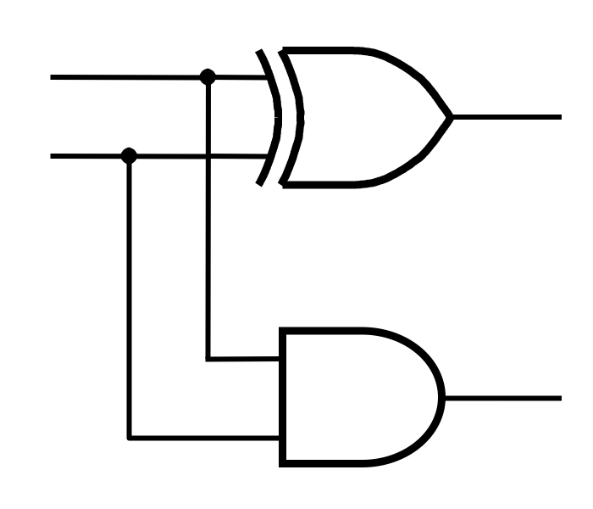
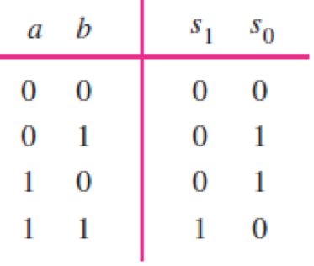
Addition of Binary Numbers

Slide 130
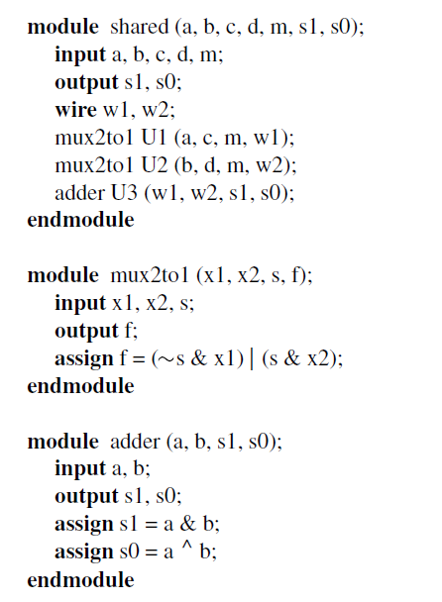
Logic Circuit vs Verilog Code
[ Figure 2.73 from the textbook ]

Slide 131
Some material form Appendix B

Slide 132
Programmable Logic Array (PLA)
x
x
x
1
2
n
Input buffers
and
inverters
x
1
x
x
x
1
n
n
P
1
AND plane
OR plane
P
k
f
f
1
m
[ Figure B.25 from textbook ]

Slide 133
Gate-Level Diagram of a PLA
x
1
x
2
x
3
Programmable
connections
P
OR plane
1
P
2
P
3
P
4
AND plane
f
1
f
2
[ Figure B.26 from textbook ]

Slide 134
Customary Schematic for PLA
x
x
x
1
2
3
OR plane
P
1
P
2
P
3
P
4
AND plane
f
f
1
2
[ Figure B.27 from textbook ]

Slide 135
Programmable Array Logic (PAL)
x
x
x
1
2
3
P
1
f
1
P
2
P
3
f
2
P
4
AND plane
[ Figure B.28 from textbook ]

Slide 136
Programmable Array Logic (PAL)
x
x
x
1
2
3
P
1
f
1
P
2
P
3
f
2
P
4
AND plane
Only the AND plane is programmable.
The OR plane is fixed.
[ Figure B.28 from textbook ]

Slide 137
Questions?

Slide 138
THE END

