Slide 1
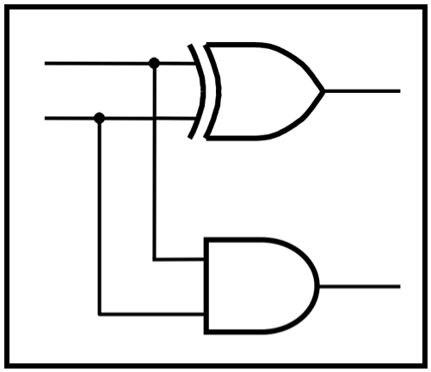
CprE 281:
Digital Logic
Instructor: Alexander Stoytchev
http://www.ece.iastate.edu/~alexs/classes/

Slide 2
Intro to Verilog
CprE 281: Digital Logic
Iowa State University, Ames, IA
Copyright © Alexander Stoytchev

Slide 3
Administrative Stuff
HW3 is due on Monday Sep 16 @ 10pm

Slide 4
Quick Review

Slide 5
The Three Basic Logic Gates
x | NOT
0 | 1
1 | 0
x | y | AND
0 | 0 | 0
0 | 1 | 0
1 | 0 | 0
1 | 1 | 1
x | y | OR
0 | 0 | 0
0 | 1 | 1
1 | 0 | 1
1 | 1 | 1
x
x
x
x
•
y
x
x
+
y
y
y

Slide 6
AND with Switches

Slide 7
AND Circuit
x=0
y=0
+
_
Battery
Light

Slide 8
AND Circuit
x=0
y=1
+
_
Battery
Light

Slide 9
AND Circuit
x=1
y=0
+
_
Battery
Light

Slide 10
AND Circuit
x=1
y=1
+
_
Battery
Light

Slide 11
NOT with Switches

Slide 12
NOT Circuit
Resistor
+
_
Battery
x=1
Light

Slide 13
NOT Circuit
Resistor
+
_
Battery
x=0
Light

Slide 14
NAND with Switches

Slide 15
NAND Circuit
Resistor
x=0
+
_
Battery
Light
y=0

Slide 16
NAND Circuit
Resistor
x=0
+
_
Battery
Light
y=1

Slide 17
NAND Circuit
Resistor
x=1
+
_
Battery
Light
y=0

Slide 18
NAND Circuit
Resistor
x=1
+
_
Battery
Light
y=1

Slide 19
OR with Switches

Slide 20
OR Circuit
x=0
+
_
y=0
Battery
Light

Slide 21
OR Circuit
x=0
+
_
y=1
Battery
Light

Slide 22
OR Circuit
x=1
+
_
y=0
Battery
Light

Slide 23
OR Circuit
x=1
+
_
y=1
Battery
Light

Slide 24
NOR with Switches

Slide 25
NOR Circuit
Resistor
+
_
Battery
x=0
y=0
Light

Slide 26
NOR Circuit
Resistor
+
_
Battery
x=0
y=1
Light

Slide 27
NOR Circuit
Resistor
+
_
Battery
x=1
y=0
Light

Slide 28
NOR Circuit
Resistor
+
_
Battery
x=1
y=1
Light

Slide 29
The Three Basic Logic Gates
x | NOT
0 | 1
1 | 0
x | y | AND
0 | 0 | 0
0 | 1 | 0
1 | 0 | 0
1 | 1 | 1
x | y | OR
0 | 0 | 0
0 | 1 | 1
1 | 0 | 1
1 | 1 | 1
x
x
x
x
•
y
x
x
+
y
y
y

Slide 30
NAND and NOR
x | y | NAND
0 | 0 | 1
0 | 1 | 1
1 | 0 | 1
1 | 1 | 0
x | y | NOR
0 | 0 | 1
0 | 1 | 0
1 | 0 | 0
1 | 1 | 0
x
•
y
x
x
+
y
x
x
y

Slide 31
XOR and XNOR
x | y | XOR
0 | 0 | 0
0 | 1 | 1
1 | 0 | 1
1 | 1 | 0
x | y | XNOR
0 | 0 | 1
0 | 1 | 0
1 | 0 | 0
1 | 1 | 1
x
x
+
y
x
x
+
y
y
y

Slide 32
XNOR with Switches

Slide 33
XNOR Circuit
x=0
y=0
+
_
Battery
Light

Slide 34
XNOR Circuit
x=0
y=1
+
_
Battery
Light

Slide 35
XNOR Circuit
x=1
y=0
+
_
Battery
Light

Slide 36
XNOR Circuit
x=1
y=1
+
_
Battery
Light

Slide 37
XOR with Switches

Slide 38
XOR Circuit
x=0
y=0
+
_
Battery
Light

Slide 39
XOR Circuit
x=0
y=1
+
_
Battery
Light

Slide 40
XOR Circuit
x=1
y=0
+
_
Battery
Light

Slide 41
XOR Circuit
x=1
y=1
+
_
Battery
Light

Slide 42
7-Segment Display Example

Slide 43
7-Segment Display
a
f
g
b
e
c
d

Slide 44
Displaying Some Numbers
a
a
a
f
g
b
f
g
b
f
g
b
e
c
e
c
e
c
d
d
d

Slide 45
Displaying Some Hexadecimal Numbers
a
a
a
a
a
a
f
b
f
b
f
b
f
g
b
f
g
b
f
g
b
g
g
g
e
c
e
c
e
c
e
c
e
c
e
c
d
d
d
d
d
d

Slide 46
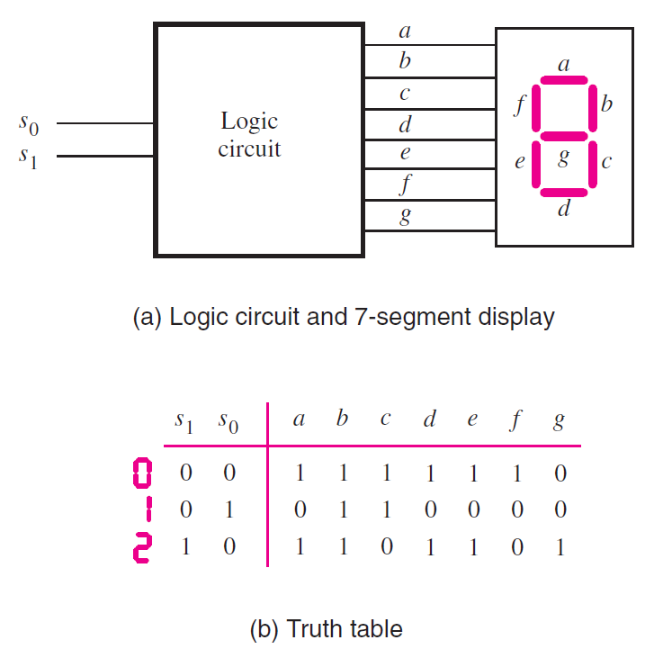
Display of numbers
[ Figure 2.34 from the textbook ]

Slide 47
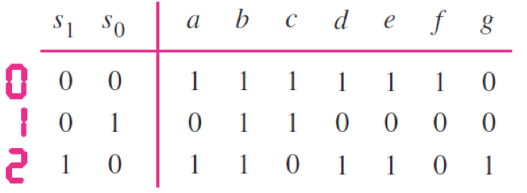
Display of numbers

Slide 48
Display of numbers
a = s₀
c = s₁
e = s₀
g = s₁ s₀
d = s₀
f = s₁ s₀
b = 1

Slide 49
Intro to Verilog

Slide 50
History
Created in 1983/1984
Verilog-95 (IEEE standard 1364-1995)
Verilog 2001 (IEEE Standard 1364-2001)
Verilog 2005 (IEEE Standard 1364-2005)
SystemVerilog
SystemVerilog 2009 (IEEE Standard 1800-2009).

Slide 51
HDL
Hardware Description Language
Verilog HDL
VHDL

Slide 52
Verilog HDL != VHDL
These are two different Languages!
Verilog is closer to C
VHDL is closer to Ada

Slide 53
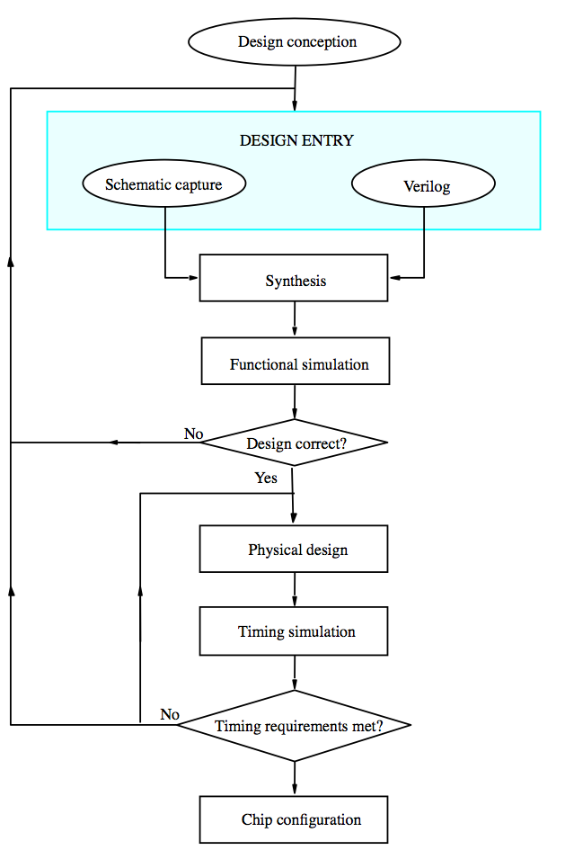
[ Figure 2.35 from the textbook ]

Slide 54
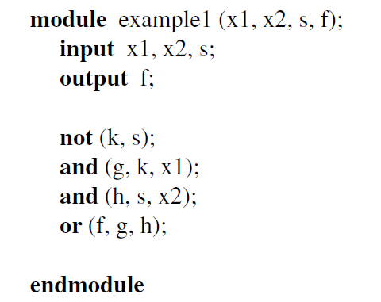
Sample Verilog Program

Slide 55
The Three Basic Logic Gates
x
1
x
•
x
x
1
x
x
x
1
2
x
x
1
+
x
2
2
2
NOT gate
AND gate
OR gate
You can build any circuit using only these three gates
[ Figure 2.8 from the textbook ]

Slide 56
How to specify a NOT gate in Verilog
x
x
NOT gate

Slide 57
How to specify a NOT gate in Verilog
we’ll use the letter y for the output
x
y
NOT gate

Slide 58
How to specify a NOT gate in Verilog
x
y
not (y, x);
NOT gate
Verilog code

Slide 59
How to specify an AND gate in Verilog
x
1
f=
x
•
x
and (f, x1, x2);
x
1
2
2
AND gate
Verilog code

Slide 60
How to specify an OR gate in Verilog
x
1
or (f, x1, x2);
x
f=
x
1
+
x
2
2
OR gate
Verilog code

Slide 61
3-input Logic Gates
x
1
x
x
1
2
x
1
•
x
2
•
x
3
x
2
x
1
+
x
2
+
x
x
3
3
x
3
3-input AND gate
3-input OR gate
and (f, x1, x2, x3);
or (f, x1, x2, x3);

Slide 62
Other Logic Gates
x
1
x
•
x
x
1
x
1
2
x
x
1
+
x
2
2
2
NAND gate
NOR gate
x
1
x
1
x
x
1
⨁
x
2
x
x
1
⨁
x
2
2
2
XOR gate
XNOR gate

Slide 63
Other Logic Gates
nand (f, x1, x2);
nor (f, x1, x2);
x
1
x
•
x
x
1
x
1
2
x
x
1
+
x
2
2
2
NAND gate
NOR gate
x
1
x
1
x
x
1
⨁
x
2
x
x
1
⨁
x
2
2
2
XOR gate
XNOR gate
xor (f, x1, x2);
xnor (f, x1, x2);

Slide 64
Verilog Code
Structural
Behavioral

Slide 65
Structural Verilog

Slide 66
2-to-1 Multiplexer in Verilog
(structural syntax)

Slide 67
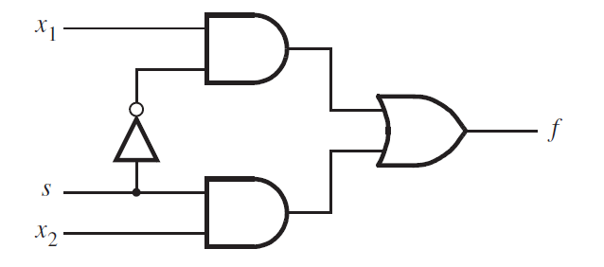
2-1 Multiplexer
[ Figure 2.36 from the textbook ]

Slide 68
Verilog Code for a 2-1 Multiplexer
[ Figure 2.36 from the textbook ]
[ Figure 2.37 from the textbook ]

Slide 69
Verilog Code for a 2-1 Multiplexer
[ Figure 2.36 from the textbook ]
[ Figure 2.37 from the textbook ]

Slide 70
Verilog Code for a 2-1 Multiplexer
[ Figure 2.36 from the textbook ]
[ Figure 2.37 from the textbook ]

Slide 71
Verilog Code for a 2-1 Multiplexer
[ Figure 2.36 from the textbook ]
[ Figure 2.37 from the textbook ]

Slide 72
Verilog Code for a 2-1 Multiplexer
k
[ Figure 2.36 from the textbook ]
[ Figure 2.37 from the textbook ]

Slide 73
Verilog Code for a 2-1 Multiplexer
k
[ Figure 2.36 from the textbook ]
[ Figure 2.37 from the textbook ]

Slide 74
Verilog Code for a 2-1 Multiplexer
g
k
[ Figure 2.36 from the textbook ]
[ Figure 2.37 from the textbook ]

Slide 75
Verilog Code for a 2-1 Multiplexer
g
k
[ Figure 2.36 from the textbook ]
[ Figure 2.37 from the textbook ]

Slide 76
Verilog Code for a 2-1 Multiplexer
g
k
h
[ Figure 2.36 from the textbook ]
[ Figure 2.37 from the textbook ]

Slide 77
Verilog Code for a 2-1 Multiplexer
g
k
h
[ Figure 2.36 from the textbook ]
[ Figure 2.37 from the textbook ]

Slide 78
Verilog Code for a 2-1 Multiplexer
g
k
h
[ Figure 2.36 from the textbook ]
[ Figure 2.37 from the textbook ]

Slide 79
Behavioral Verilog

Slide 80
Verilog Code
Structural
Behavioral

Slide 81
Verilog Code
Structural
Behavioral
Continuous
Procedural

Slide 82
2-to-1 Multiplexer in Verilog
(behavioral-continuous syntax)

Slide 83
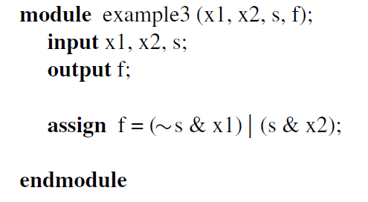
Verilog Code for a 2-1 Multiplexer
// Behavioral-Continuous specification
[ Figure 2.36 from the textbook ]
[ Figure 2.40 from the textbook ]

Slide 84
Verilog Code for a 2-1 Multiplexer
// Behavioral-Continuous specification
[ Figure 2.36 from the textbook ]
[ Figure 2.40 from the textbook ]

Slide 85
Verilog Code for a 2-1 Multiplexer
// Behavioral-Continuous specification
[ Figure 2.36 from the textbook ]
[ Figure 2.40 from the textbook ]

Slide 86
Verilog Code for a 2-1 Multiplexer
// Behavioral-Continuous specification
[ Figure 2.36 from the textbook ]
[ Figure 2.40 from the textbook ]

Slide 87
2-to-1 Multiplexor in Verilog
(behavioral-procedural specification)

Slide 88
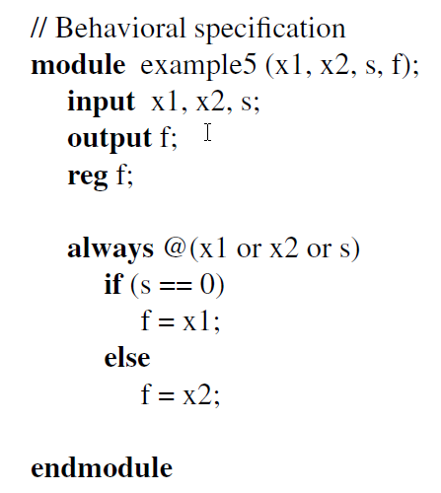
Verilog Code for a 2-1 Multiplexer
// Behavioral-Procedural specification
[ Figure 2.36 from the textbook ]
[ Figure 2.42 from the textbook ]

Slide 89
Verilog Code for a 2-1 Multiplexer
// Behavioral-Procedural specification
procedural statement
[ Figure 2.36 from the textbook ]
[ Figure 2.42 from the textbook ]

Slide 90
Verilog Code for a 2-1 Multiplexer
// Behavioral-Procedural specification
sensitivity list
The always block is executed only when one of the signals in the sensitivity list has changed its value.
[ Figure 2.36 from the textbook ]
[ Figure 2.42 from the textbook ]

Slide 91
Verilog Code for a 2-1 Multiplexer
// Behavioral-Procedural specification
of type register
(can store a value)
reg: does not need to be computed all the time.
It stores a value until you write to it a new value.
[ Figure 2.36 from the textbook ]
[ Figure 2.42 from the textbook ]

Slide 92
Verilog Code for a 2-1 Multiplexer
// Behavioral-Procedural specification
of type register
(can store a value)
Because the signal f is updated inside a procedural statement (i.e., inside an always block) it must be declared of type reg. This is required so it can hold its value until the next time the always block is executed, which will happen only when one of the signals on the sensitivity list has changed its value.
[ Figure 2.36 from the textbook ]
[ Figure 2.42 from the textbook ]

Slide 93
Verilog Code for a 2-1 Multiplexer
// Behavioral-Procedural specification
could be combined on one line:
output reg f;
[ Figure 2.36 from the textbook ]
[ Figure 2.42 from the textbook ]

Slide 94
Verilog Code for a 2-1 Multiplexer
A 2-to-1 Multiplexer has:
one output f
two inputs: x₁ and x₂
It also has another input line s
If s=0, then the output is equal to x₁
If s=1, then the output is equal to x₂
// Behavioral-Procedural specification
[ Figure 2.36 from the textbook ]
[ Figure 2.42 from the textbook ]

Slide 95
Verilog Code for a 2-1 Multiplexer
A 2-to-1 Multiplexer has:
one output f
two inputs: x₁ and x₂
It also has another input line s
If s=0, then the output is equal to x₁
If s=1, then the output is equal to x₂
// Behavioral-Procedural specification
[ Figure 2.36 from the textbook ]
[ Figure 2.42 from the textbook ]

Slide 96
always@ syntax
always @(x,y)
always @(x or y)
always @(*)
always @*

Slide 97
always@ syntax
always @(x,y)
always @(x or y)
always @(*)
always @*
Leave it to the Verilog compiler
to figure out which signals appear
in the always block and add them
to the sensitivity list.

Slide 98
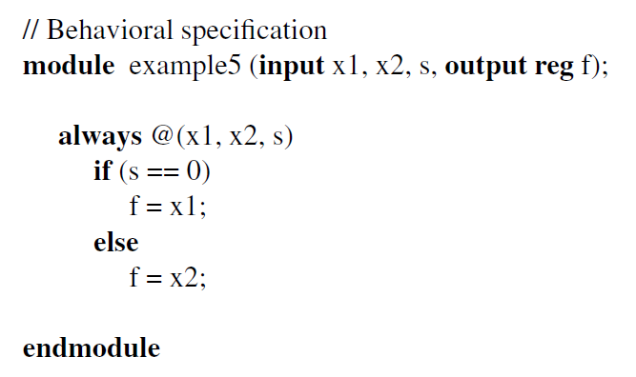
Verilog Code for a 2-1 Multiplexer
// Behavioral-Procedural specification
[ Figure 2.36 from the textbook ]
[ Figure 2.43 from the textbook ]

Slide 99
Structural v.s. Behavioral

Slide 100
Verilog Code:
Structural v.s. Behavioral
// Structural specification
// Behavioral-Continuous specification
[ Figure 2.37 from the textbook ]
[ Figure 2.40 from the textbook ]

Slide 101
Verilog Code:
Structural v.s. Behavioral
// Structural specification
// Behavioral-Procedural specification
[ Figure 2.37 from the textbook ]
[ Figure 2.42 from the textbook ]

Slide 102
Behavioral Verilog:
Continuous v.s. Procedural
// Behavioral-Continuous specification
// Behavioral-Procedural specification
[ Figure 2.40 from the textbook ]
[ Figure 2.42 from the textbook ]

Slide 103
Verilog Code
Structural
Behavioral
(basic components)
Continuous
Procedural
(assign statements)
(always statements)

Slide 104
Another Example

Slide 105
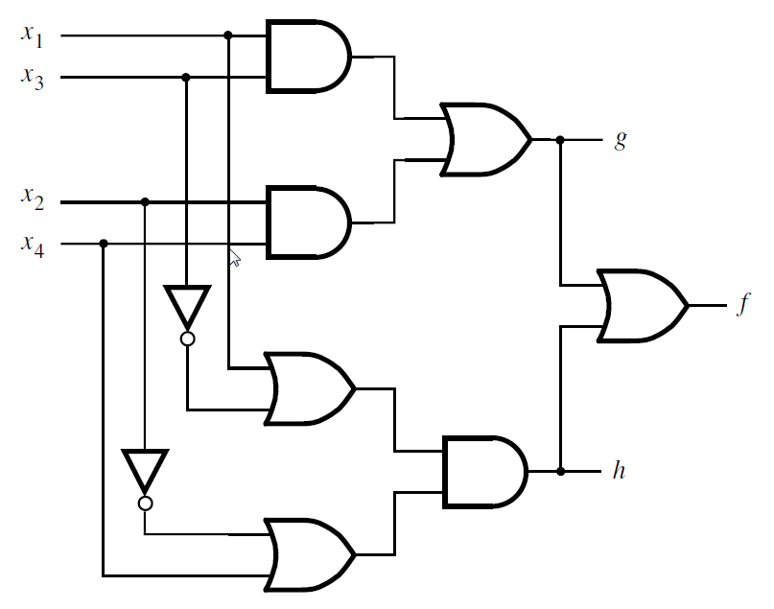
Let’s Write the Code for This Circuit
[ Figure 2.39 from the textbook ]

Slide 106
Structural Verilog
module example2 (x1, x2, x3, x4, f, g, h);
input x1, x2, x3, x4;
output f, g, h;
and (z1, x1, x3);
and (z2, x2, x4);
or (g, z1, z2);
or (z3, x1, ~x3);
or (z4, ~x2, x4);
and (h, z3, z4);
or (f, g, h);
endmodule
[ Figure 2.39 from the textbook ]
[ Figure 2.38 from the textbook ]

Slide 107
Structural Verilog
module example2 (x1, x2, x3, x4, f, g, h);
input x1, x2, x3, x4;
output f, g, h;
and (z1, x1, x3);
and (z2, x2, x4);
or (g, z1, z2);
or (z3, x1, ~x3);
or (z4, ~x2, x4);
and (h, z3, z4);
or (f, g, h);
endmodule
z₁
z₂
z₃
z₄
[ Figure 2.39 from the textbook ]
[ Figure 2.38 from the textbook ]

Slide 108
Behavioral Verilog
module example4 (x1, x2, x3, x4, f, g, h);
input x1, x2, x3, x4;
output f, g, h;
assign g = (x1 & x3) | (x2 & x4);
assign h = (x1 | ~x3) & (~x2 | x4);
assign f = g | h;
endmodule
[ Figure 2.39 from the textbook ]
[ Figure 2.41 from the textbook ]

Slide 109
Structural v.s. Behavioral
module example2 (x1, x2, x3, x4, f, g, h);
input x1, x2, x3, x4;
output f, g, h;
and (z1, x1, x3);
and (z2, x2, x4);
or (g, z1, z2);
or (z3, x1, ~x3);
or (z4, ~x2, x4);
and (h, z3, z4);
or (f, g, h);
endmodule
module example4 (x1, x2, x3, x4, f, g, h);
input x1, x2, x3, x4;
output f, g, h;
assign g = (x1 & x3) | (x2 & x4);
assign h = (x1 | ~x3) & (~x2 | x4);
assign f = g | h;
endmodule
// structural
// behavioral-continuous

Slide 110
Yet Another Example

Slide 111
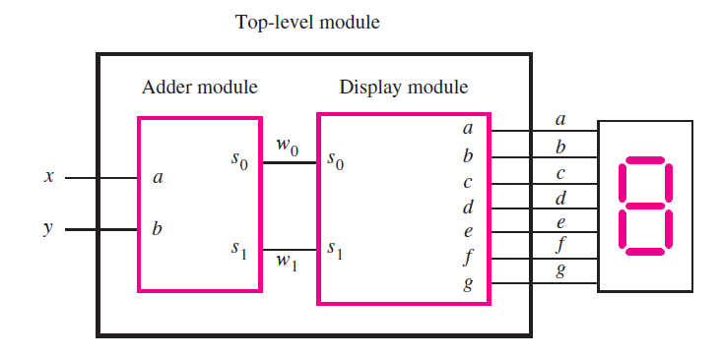
A logic circuit with two modules
[ Figure 2.44 from the textbook ]

Slide 112
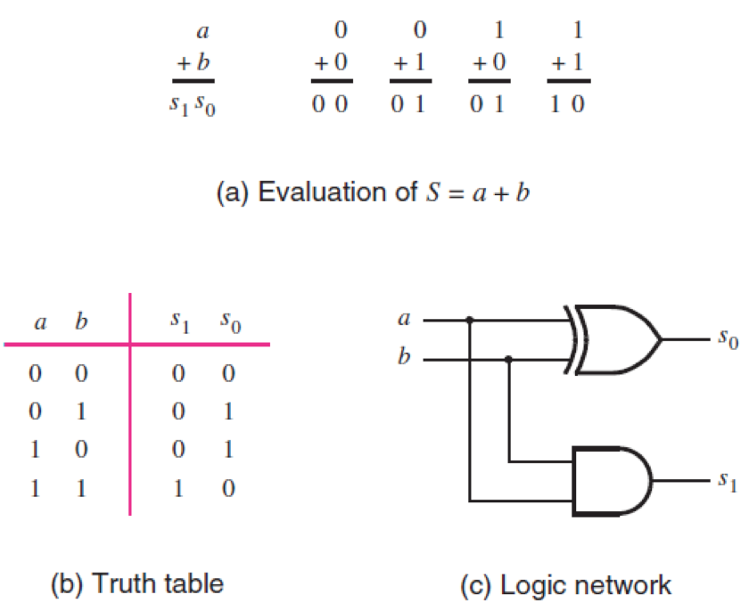
The adder module
[ Figure 2.12 from the textbook ]

Slide 113
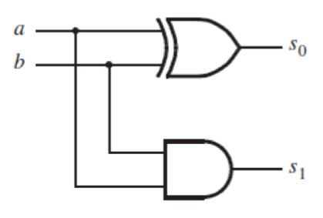
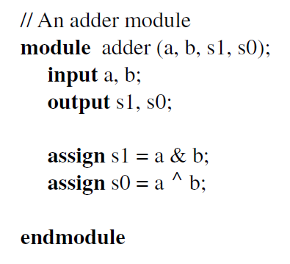
The adder module
[ Figure 2.45 from the textbook ]

Slide 114
The display module
a = s₀
c = s₁
e = s₀
g = s₁ s₀
d = s₀
f = s₁ s₀
b = 1

Slide 115
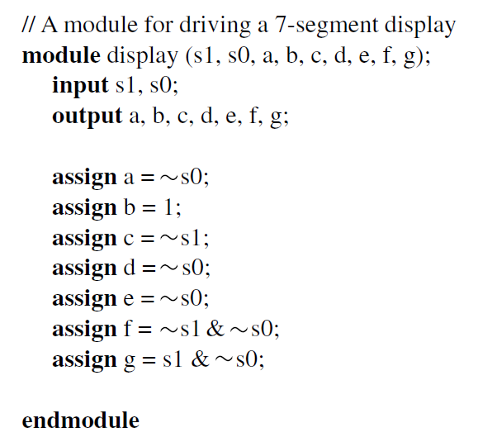
The display module
a = s₀
b = 1
c = s₁
d = s₀
e = s₀
f = s₁ s₀
g = s₁ s₀
[ Figure 2.46 from the textbook ]

Slide 116
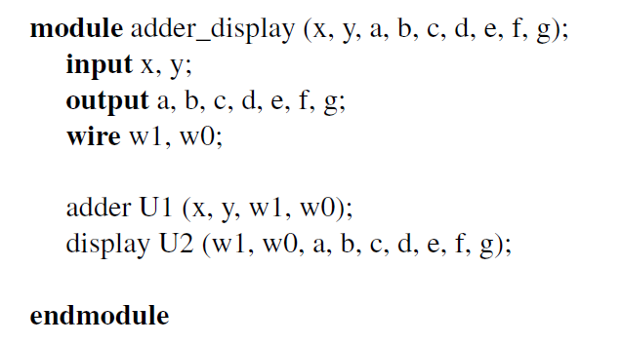
Putting it all together

Slide 117
Putting it all together

Slide 118
Putting it all together

Slide 119
Putting it all together
variables of type wire
(neither input nor output)

Slide 120
Putting it all together
must be computed
all the time, unlike reg

Slide 121
Putting it all together

Slide 122
Putting it all together

Slide 123
Questions?

Slide 124
THE END

