Slide 1
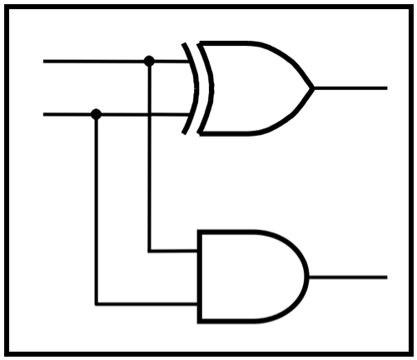
CprE 281:
Digital Logic
Instructor: Alexander Stoytchev
http://www.ece.iastate.edu/~alexs/classes/

Slide 2
Synthesis
Using AND, OR, and NOT Gates
CprE 281: Digital Logic
Iowa State University, Ames, IA
Copyright © Alexander Stoytchev

Slide 3
Administrative Stuff
HW2 is due on Wednesday Sep 6 @ 10pm
Please write clearly on the first page the following three things:
  Your First and Last Name
  Your Student ID Number
  Your Lab Section Letter
Submit on Canvas as *one* PDF file.
Please orient your pages such that the text can be read without the need to rotate the page.

Slide 4
Administrative Stuff
Next week we will start with Lab2
Read the lab assignment and do the prelab at home.
Complete the prelab on paper before you go to the lab. Otherwise you’ll lose 20% of your grade for that lab.

Slide 5
Quick Review

Slide 6
The Three Basic Logic Gates
x
1
x
x
x
1
x
x
1
•
2
x
1
+
x
2
x
2
x
2
NOT gate
AND gate
OR gate
[ Figure 2.8 from the textbook ]

Slide 7
Truth Table for NOT
x
x
0
1
x
x
1
0

Slide 8
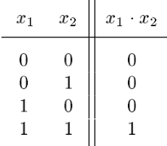
Truth Table for AND
x
1
x
x
x
1
•
2
2

Slide 9
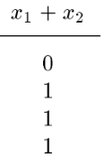
Truth Table for OR
x
1
x
x
1
+
x
2
2

Slide 10
Truth Tables for AND and OR
[ Figure 2.6b from the textbook ]

Slide 11
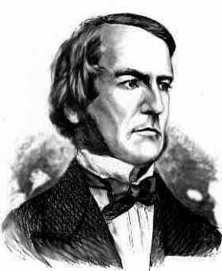
Boolean Algebra
An algebraic structure consists of
  a set of elements {0, 1}
  binary operators {+, •}
  and a unary operator { ’ } or { } or { ~ }
Introduced by George Boole in 1854
An effective means of describing circuits built with switches
A powerful tool that can be used for designing and analyzing logic circuits
George Boole
1815-1864

Slide 12
Different Notations for Negation
All three of these mean “negate x”
  x’
  x
  ~x

Slide 13
Operator Precedence
In regular arithmetic and algebra, multiplication takes precedence over addition.
This is also true in Boolean algebra.
For example, x + y • z means
multiply y by z and add the product to x .
In other words, x + y • z is equal to x + (y • z) ,
not (x + y) • z .

Slide 14
The multiplication dot is optional
In regular algebra, the multiplication operator is often omitted to shorten the equations.
This is also true in Boolean algebra.
Both of these mean the same thing:
xy is equal to x • y

Slide 15



Operator Precedence
(three different ways to write the same)

Slide 16
Operator Precedence
Negation of a single variable takes precedence over multiplication of that variable with another variable.
For example,
A B means negate A first and then multiply A by B

Slide 17
Operator Precedence
However, a horizontal bar over a product of two variables means that the negation is performed after the product is computed.
For example,
A B means multiply A and B and then negate

Slide 18
Operator Precedence
Note that these two expressions are different:
A B is not equal to A B
A B means multiply A and B and then negate
A B means negate A and B separately and then multiply

Slide 19
Operator Precedence
Note that these two expressions are different:
A B is not equal to A B
A | B | AB
0 | 0 | 1
0 | 1 | 1
1 | 0 | 1
1 | 1 | 0
A | B | AB
0 | 0 | 1
0 | 1 | 0
1 | 0 | 0
1 | 1 | 0

Slide 20
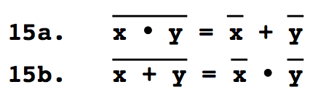
DeMorgan’s Theorem

Slide 21

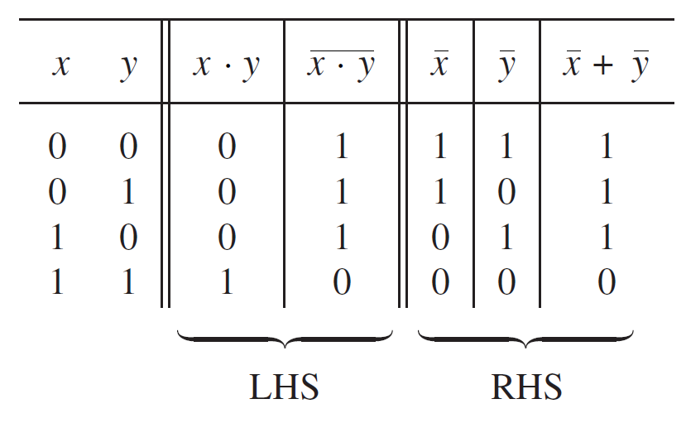
Proof of DeMorgan’s theorem

Slide 22
Proof of DeMorgan’s theorem
These two columns are equal. Therefore, the theorem is true.

Slide 23
How to remember DeMorgan’s theorem
x • y
start with the
left-hand side

Slide 24
How to remember DeMorgan’s theorem
x • y
divide the bar
into 3 equal parts

Slide 25
How to remember DeMorgan’s theorem
x • y
erase the
middle segment

Slide 26
How to remember DeMorgan’s theorem
x + y
change the
product to a sum

Slide 27
How to remember DeMorgan’s theorem
x + y
this is the
right-hand side

Slide 28
How to remember DeMorgan’s theorem
x • y = x + y

Slide 30

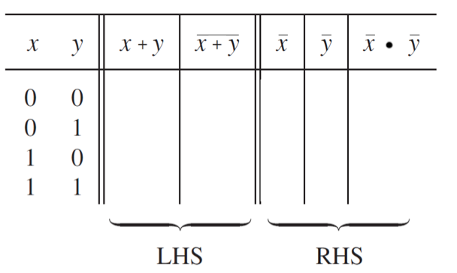
Proof of the other DeMorgan’s theorem
0
1
1
1
1
0
0
0
1
1
0
0
1
0
1
0
1
0
0
0

Slide 31
Proof of the other DeMorgan’s theorem
0
1
1
1
1
0
0
0
1
1
0
0
1
0
1
0
1
0
0
0
These two columns are equal. Therefore, the theorem is true.

Slide 32
A Short Digression

Slide 33
The 2D Plane
y
x

Slide 34
The 2D Plane
y
i = (1, 0)
x

Slide 35
The 2D Plane
y
j = (0, 1)
x

Slide 36
The 2D Plane
y
point p
x

Slide 37
The 2D Plane
y
p = 3i + 2j
x

Slide 38
The unit vectors i and j form a basis
Any point in the 2D plane can be represented as a linear combination of these two vectors.
i=(1, 0)
j=(0, 1)
Note that there is only one 1 in each.

Slide 39
3D Space
z
y
k = (0, 0, 1)
j = (0, 1, 0)
i = (1, 0, 0)
x

Slide 40
3D Space
z
p = 3i + 1j + 2k
y
x

Slide 41
The 3D Basis
In 3D we have i, j, and k
i=(1, 0, 0)
j=(0, 1, 0)
k=(0, 0, 1)
Note that there is only one 1 in each.
Any point in the 3D space can be represented as a linear combination of these three basis vectors.

Slide 42
The 4D Basis
In 4D we have four vectors
x¹ = (1, 0, 0, 0)
x² = (0, 1, 0, 0)
x³ = (0, 0, 1, 0)
x⁴ = (0, 0, 0, 1)
Note that there is only one 1 in each.
Any point in this 4D space can be represented as a linear combination of these four basis vectors.

Slide 43
Basis Functions
(for two variables)

Slide 44
The Four Basis Functions
x | y | f₀₀
0 | 0 | 1
0 | 1 | 0
1 | 0 | 0
1 | 1 | 0
x | y | f₀₁
0 | 0 | 0
0 | 1 | 1
1 | 0 | 0
1 | 1 | 0
x | y | f₁₀
0 | 0 | 0
0 | 1 | 0
1 | 0 | 1
1 | 1 | 0
x | y | f₁₁
0 | 0 | 0
0 | 1 | 0
1 | 0 | 0
1 | 1 | 1
f₀₀(x, y)
f₀₁(x, y)
f₁₀(x, y)
f₁₁(x, y)

Slide 45
The Four Basis Functions
x | y | f₀₀
0 | 0 | 1
0 | 1 | 0
1 | 0 | 0
1 | 1 | 0
x | y | f₀₁
0 | 0 | 0
0 | 1 | 1
1 | 0 | 0
1 | 1 | 0
x | y | f₁₀
0 | 0 | 0
0 | 1 | 0
1 | 0 | 1
1 | 1 | 0
x | y | f₁₁
0 | 0 | 0
0 | 1 | 0
1 | 0 | 0
1 | 1 | 1
f₀₀(x, y)
f₀₁(x, y)
f₁₀(x, y)
f₁₁(x, y)

Slide 46
The Four Basis Functions
x | y |  | f₀₀(x, y) | f₀₁(x, y) | f₁₀(x, y) | f₁₁(x, y)
0 | 0 |  | 1 | 0 | 0 | 0
0 | 1 |  | 0 | 1 | 0 | 0
1 | 0 |  | 0 | 0 | 1 | 0
1 | 1 |  | 0 | 0 | 0 | 1

Slide 47
The Four Basis Functions
x | y |  | x y | x y | x y | x y
0 | 0 |  | 1 | 0 | 0 | 0
0 | 1 |  | 0 | 1 | 0 | 0
1 | 0 |  | 0 | 0 | 1 | 0
1 | 1 |  | 0 | 0 | 0 | 1

Slide 48
Circuits for the four basis functions
y
f₀₀(x, y) = x y
x
x
f₀₁(x, y) = x y
y
x
f₁₀(x, y) = x y
y
y
x
f₁₁(x, y) = x y

Slide 49
The Four Basis Functions
x | y | f₀₀
0 | 0 | 1
0 | 1 | 0
1 | 0 | 0
1 | 1 | 0
x | y | f₀₁
0 | 0 | 0
0 | 1 | 1
1 | 0 | 0
1 | 1 | 0
x | y | f₁₀
0 | 0 | 0
0 | 1 | 0
1 | 0 | 1
1 | 1 | 0
x | y | f₁₁
0 | 0 | 0
0 | 1 | 0
1 | 0 | 0
1 | 1 | 1
f₀₀(x, y) = x y
f₀₁(x, y) = x y
f₁₀(x, y) = x y
f₁₁(x, y) = x y

Slide 50
The Four Basis Functions
x | y | f₀₀
0 | 0 | 1
0 | 1 | 0
1 | 0 | 0
1 | 1 | 0
x | y | f₀₁
0 | 0 | 0
0 | 1 | 1
1 | 0 | 0
1 | 1 | 0
x | y | f₁₀
0 | 0 | 0
0 | 1 | 0
1 | 0 | 1
1 | 1 | 0
x | y | f₁₁
0 | 0 | 0
0 | 1 | 0
1 | 0 | 0
1 | 1 | 1
f₀₀(x, y) = x y
f₀₁(x, y) = x y
f₁₀(x, y) = x y
f₁₁(x, y) = x y
Negate the variable if the corresponding subscript of f is 0.

Slide 51
The Four Basis Functions
x | y | f₀₀
0 | 0 | 1
0 | 1 | 0
1 | 0 | 0
1 | 1 | 0
x | y | f₀₁
0 | 0 | 0
0 | 1 | 1
1 | 0 | 0
1 | 1 | 0
x | y | f₁₀
0 | 0 | 0
0 | 1 | 0
1 | 0 | 1
1 | 1 | 0
x | y | f₁₁
0 | 0 | 0
0 | 1 | 0
1 | 0 | 0
1 | 1 | 1
f₀₀(x, y) = x y
f₀₁(x, y) = x y
f₁₀(x, y) = x y
f₁₁(x, y) = x y
Negate the variable if the corresponding subscript of f is 0.

Slide 52
The Four Basis Functions
x | y | f₀₀
0 | 0 | 1
0 | 1 | 0
1 | 0 | 0
1 | 1 | 0
x | y | f₀₁
0 | 0 | 0
0 | 1 | 1
1 | 0 | 0
1 | 1 | 0
x | y | f₁₀
0 | 0 | 0
0 | 1 | 0
1 | 0 | 1
1 | 1 | 0
x | y | f₁₁
0 | 0 | 0
0 | 1 | 0
1 | 0 | 0
1 | 1 | 1
f₀₀(x, y) = x y
f₀₁(x, y) = x y
f₁₀(x, y) = x y
f₁₁(x, y) = x y
Negate the variable if the corresponding subscript of f is 0.

Slide 53
minterms
(an alternative name for the set of basis functions)

Slide 54
The Four Basis Functions
x | y | f₀₀
0 | 0 | 1
0 | 1 | 0
1 | 0 | 0
1 | 1 | 0
x | y | f₀₁
0 | 0 | 0
0 | 1 | 1
1 | 0 | 0
1 | 1 | 0
x | y | f₁₀
0 | 0 | 0
0 | 1 | 0
1 | 0 | 1
1 | 1 | 0
x | y | f₁₁
0 | 0 | 0
0 | 1 | 0
1 | 0 | 0
1 | 1 | 1
f₀₀(x, y) = x y
f₀₁(x, y) = x y
f₁₀(x, y) = x y
f₁₁(x, y) = x y

Slide 55
The Four Basis Functions
(alternative names)
x | y | f₀₀
0 | 0 | 1
0 | 1 | 0
1 | 0 | 0
1 | 1 | 0
x | y | f₀₁
0 | 0 | 0
0 | 1 | 1
1 | 0 | 0
1 | 1 | 0
x | y | f₁₀
0 | 0 | 0
0 | 1 | 0
1 | 0 | 1
1 | 1 | 0
x | y | f₁₁
0 | 0 | 0
0 | 1 | 0
1 | 0 | 0
1 | 1 | 1
f₀₀(x, y) = x y
f₀₁(x, y) = x y
f₁₀(x, y) = x y
f₁₁(x, y) = x y
m₀
m₁
m₂
m₃

Slide 56
The Four Basis Functions
( minterms )
x | y | m₀
0 | 0 | 1
0 | 1 | 0
1 | 0 | 0
1 | 1 | 0
x | y | m₁
0 | 0 | 0
0 | 1 | 1
1 | 0 | 0
1 | 1 | 0
x | y | m₂
0 | 0 | 0
0 | 1 | 0
1 | 0 | 1
1 | 1 | 0
x | y | m₃
0 | 0 | 0
0 | 1 | 0
1 | 0 | 0
1 | 1 | 1
f₀₀(x, y) = x y
f₀₁(x, y) = x y
f₁₀(x, y) = x y
f₁₁(x, y) = x y
m₀
m₁
m₂
m₃

Slide 57
The Four Basis Functions
( minterms )
x | y |  | x y | x y | x y | x y
0 | 0 |  | 1 | 0 | 0 | 0
0 | 1 |  | 0 | 1 | 0 | 0
1 | 0 |  | 0 | 0 | 1 | 0
1 | 1 |  | 0 | 0 | 0 | 1

Slide 58
Expressions for the minterms
m₀ = x y
m₁ = x y
m₂ = x y
m₃ = x y

Slide 59
Expressions for the minterms
0 0
0 1
1 0
1 1
m₀ = x y
m₁ = x y
m₂ = x y
m₃ = x y
The bars coincide
with the 0’s
in the binary expansion
of the minterm sub-index

Slide 60
Expressions for the minterms
0 0
0 1
1 0
1 1
m₀ = x y
m₁ = x y
m₂ = x y
m₃ = x y
The bars coincide
with the 0’s
in the binary expansion
of the minterm sub-index

Slide 61
Function Synthesis Example
(with two variables)

Slide 62
Synthesize the Following Function
x₁ | x₂ | f(x₁, x₂)
0 | 0 | 1
0 | 1 | 1
1 | 0 | 0
1 | 1 | 1

Slide 63
1) Split the function into a sum of 4 functions
x₁ | x₂ | f(x₁, x₂) |  | f₀₀(x₁, x₂) | f₀₁(x₁, x₂) | f₁₀(x₁, x₂) | f₁₁(x₁, x₂)
0 | 0 | 1 |  | 1 | 0 | 0 | 0
0 | 1 | 1 |  | 0 | 1 | 0 | 0
1 | 0 | 0 |  | 0 | 0 | 1 | 0
1 | 1 | 1 |  | 0 | 0 | 0 | 1

Slide 64
1) Split the function into a sum of 4 functions
x₁ | x₂ | f(x₁, x₂) |  | f₀₀(x₁, x₂) | f₀₁(x₁, x₂) | f₁₀(x₁, x₂) | f₁₁(x₁, x₂)
0 | 0 | 1 |  | 1 | 0 | 0 | 0
0 | 1 | 1 |  | 0 | 1 | 0 | 0
1 | 0 | 0 |  | 0 | 0 | 1 | 0
1 | 1 | 1 |  | 0 | 0 | 0 | 1
f(x₁, x₂) = 1 • f₀₀ + 1 • f₀₁ + 0 • f₁₀ + 1 • f₁₁

Slide 65
2) Write the expressions for all four
x₁ | x₂ | f(x₁, x₂) |  | f₀₀(x₁, x₂) | f₀₁(x₁, x₂) | f₁₀(x₁, x₂) | f₁₁(x₁, x₂)
0 | 0 | 1 |  | 1 | 0 | 0 | 0
0 | 1 | 1 |  | 0 | 1 | 0 | 0
1 | 0 | 0 |  | 0 | 0 | 1 | 0
1 | 1 | 1 |  | 0 | 0 | 0 | 1
f(x₁, x₂) = 1 • f₀₀ + 1 • f₀₁ + 0 • f₁₀ + 1 • f₁₁

Slide 66




2) Write the expressions for all four
x₁ | x₂ | f(x₁, x₂) |  | f₀₀(x₁, x₂) | f₀₁(x₁, x₂) | f₁₀(x₁, x₂) | f₁₁(x₁, x₂)
0 | 0 | 1 |  | 1 | 0 | 0 | 0
0 | 1 | 1 |  | 0 | 1 | 0 | 0
1 | 0 | 0 |  | 0 | 0 | 1 | 0
1 | 1 | 1 |  | 0 | 0 | 0 | 1
f(x₁, x₂) = 1 • f₀₀ + 1 • f₀₁ + 0 • f₁₀ + 1 • f₁₁

Slide 67


3) Then just add them together
x₁ | x₂ | f(x₁, x₂) |  | f₀₀(x₁, x₂) | f₀₁(x₁, x₂) | f₁₀(x₁, x₂) | f₁₁(x₁, x₂)
0 | 0 | 1 |  | 1 | 0 | 0 | 0
0 | 1 | 1 |  | 0 | 1 | 0 | 0
1 | 0 | 0 |  | 0 | 0 | 1 | 0
1 | 1 | 1 |  | 0 | 0 | 0 | 1
f(x₁, x₂) = 1 • f₀₀ + 1 • f₀₁ + 0 • f₁₀ + 1 • f₁₁

Slide 68
3) Then just add them together
x₁ | x₂ | f(x₁, x₂) |  | f₀₀(x₁, x₂) | f₀₁(x₁, x₂) | f₁₀(x₁, x₂) | f₁₁(x₁, x₂)
0 | 0 | 1 |  | 1 | 0 | 0 | 0
0 | 1 | 1 |  | 0 | 1 | 0 | 0
1 | 0 | 0 |  | 0 | 0 | 1 | 0
1 | 1 | 1 |  | 0 | 0 | 0 | 1

Slide 69
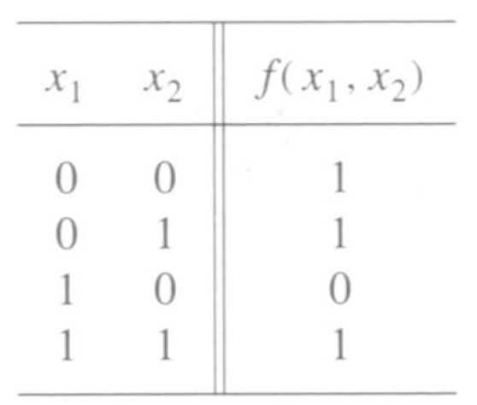
A function to be synthesized
[ Figure 2.19 from the textbook ]

Slide 70
Let’s look at it row by row.
How can we express the last row?

Slide 71
Let’s look at it row by row.
How can we express the last row?

Slide 72
Let’s look at it row by row.
How can we express the last row?
x₂
x₁

Slide 73
What about this row?
x₂
x₁

Slide 74
What about this row?
x₂
x₁

Slide 75
What about this row?
x₁
x₂
x₂
x₁

Slide 76
What about the first row?
x₁
x₂
x₂
x₁

Slide 77
What about the first row?
x₁
x₂
x₂
x₁

Slide 78
What about the first row?
x₂
x₁
x₁
x₂
x₂
x₁

Slide 79
Finally, what about the zero?
x₂
x₁
x₁
x₂
x₂
x₁

Slide 80
Putting it all together
x
1
x
2
f

Slide 81
Let’s verify that this circuit implements correctly the target truth table
x
1
x
2
f

Slide 82
Let’s verify that this circuit implements correctly the target truth table
x
1
x
2
f

Slide 83

Putting it all together
x
1
x
2
f

Slide 84
Canonical Sum-Of-Products (SOP)
x
1
x
2
f
[ Figure 2.20a from the textbook ]

Slide 85
Summary of This Procedure
Get the truth table of the function
Form a product term (AND gate) for each row of the table for which the function is 1
Each product term contains all input variables
In each row, if x_{i} =1 enter it as x_{i} , otherwise use x_{i}
Sum all of these products (OR gate) to get the function

Slide 86

Simplification Steps

Slide 87
Simplification Steps
replicate
this term

Slide 88
Simplification Steps
group
these terms

Slide 89

Simplification Steps
These two terms are trivially equal to 1

Slide 90

Simplification Steps
Drop the 1’s

Slide 91
Minimal-cost realization
x
1
x
f
2
[ Figure 2.20b from the textbook ]

Slide 92
Two implementations for the same function
x
1
x
2
f
(a) Canonical sum-of-products
x
1
x
f
2
(b) Minimal-cost realization
[ Figure 2.20 from the textbook ]

Slide 93
Basis Functions / minterms
(for three variables)

Slide 94
The Eight Basis Functions
x | y | z | f₀₀₀ | f₀₀₁ | f₀₁₀ | f₀₁₁ | f₁₀₀ | f₁₀₁ | f₁₁₀ | f₁₁₁
0 | 0 | 0 | 1 | 0 | 0 | 0 | 0 | 0 | 0 | 0
0 | 0 | 1 | 0 | 1 | 0 | 0 | 0 | 0 | 0 | 0
0 | 1 | 0 | 0 | 0 | 1 | 0 | 0 | 0 | 0 | 0
0 | 1 | 1 | 0 | 0 | 0 | 1 | 0 | 0 | 0 | 0
1 | 0 | 0 | 0 | 0 | 0 | 0 | 1 | 0 | 0 | 0
1 | 0 | 1 | 0 | 0 | 0 | 0 | 0 | 1 | 0 | 0
1 | 1 | 0 | 0 | 0 | 0 | 0 | 0 | 0 | 1 | 0
1 | 1 | 1 | 0 | 0 | 0 | 0 | 0 | 0 | 0 | 1

Slide 95
The Eight Basis Functions
x | y | z | f₀₀₀ | f₀₀₁ | f₀₁₀ | f₀₁₁ | f₁₀₀ | f₁₀₁ | f₁₁₀ | f₁₁₁
0 | 0 | 0 | 1 | 0 | 0 | 0 | 0 | 0 | 0 | 0
0 | 0 | 1 | 0 | 1 | 0 | 0 | 0 | 0 | 0 | 0
0 | 1 | 0 | 0 | 0 | 1 | 0 | 0 | 0 | 0 | 0
0 | 1 | 1 | 0 | 0 | 0 | 1 | 0 | 0 | 0 | 0
1 | 0 | 0 | 0 | 0 | 0 | 0 | 1 | 0 | 0 | 0
1 | 0 | 1 | 0 | 0 | 0 | 0 | 0 | 1 | 0 | 0
1 | 1 | 0 | 0 | 0 | 0 | 0 | 0 | 0 | 1 | 0
1 | 1 | 1 | 0 | 0 | 0 | 0 | 0 | 0 | 0 | 1

Slide 96
The Eight minterms
x | y | z | m₀ | m₁ | m₂ | m₃ | m₄ | m₅ | m₆ | m₇
0 | 0 | 0 | 1 | 0 | 0 | 0 | 0 | 0 | 0 | 0
0 | 0 | 1 | 0 | 1 | 0 | 0 | 0 | 0 | 0 | 0
0 | 1 | 0 | 0 | 0 | 1 | 0 | 0 | 0 | 0 | 0
0 | 1 | 1 | 0 | 0 | 0 | 1 | 0 | 0 | 0 | 0
1 | 0 | 0 | 0 | 0 | 0 | 0 | 1 | 0 | 0 | 0
1 | 0 | 1 | 0 | 0 | 0 | 0 | 0 | 1 | 0 | 0
1 | 1 | 0 | 0 | 0 | 0 | 0 | 0 | 0 | 1 | 0
1 | 1 | 1 | 0 | 0 | 0 | 0 | 0 | 0 | 0 | 1

Slide 97
Expressions for the minterms
m₀ = x y z
m₁ = x y z
m₂ = x y z
m₃ = x y z
m₄ = x y z
m₅ = x y z
m₆ = x y z
m₇ = x y z

Slide 98
Expressions for the minterms
0 0 0
0 0 1
0 1 0
0 1 1
1 0 0
1 0 1
1 1 0
1 1 1
m₀ = x y z
m₁ = x y z
m₂ = x y z
m₃ = x y z
m₄ = x y z
m₅ = x y z
m₆ = x y z
m₇ = x y z
The bars coincide
with the 0’s
in the binary expansion
of the minterm sub-index

Slide 99
Function Synthesis Example
(with three variables)

Slide 100
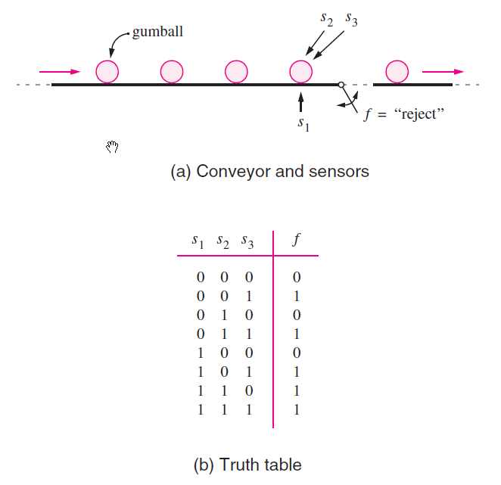
Let’s look at another problem
[ Figure 2.21 from the textbook ]

Slide 101
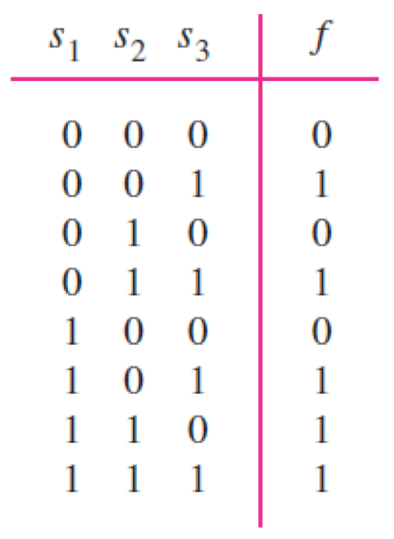
Let’s look at another problem
[ Figure 2.21b from the textbook ]

Slide 102
Let’s look at another problem

Slide 103





Let’s look at another problem

Slide 104
Let’s look at another problem

Slide 105
Let’s look at another problem

Slide 106
Let’s look at another problem

Slide 107
Let’s look at another problem

Slide 108
Let’s look at another problem

Slide 109
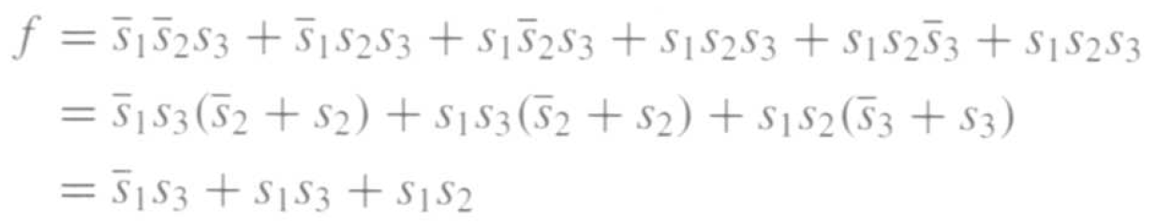

Let’s look at another problem
(minimization)

Slide 110
Let’s look at another problem
(minimization)
s₁
s₂
s₃
f

Slide 111
Maxterms
(an alternative set of basis functions)

Slide 112
The Four Maxterms
x | y | M₀
0 | 0 | 0
0 | 1 | 1
1 | 0 | 1
1 | 1 | 1
x | y | M₁
0 | 0 | 1
0 | 1 | 0
1 | 0 | 1
1 | 1 | 1
x | y | M₂
0 | 0 | 1
0 | 1 | 1
1 | 0 | 0
1 | 1 | 1
x | y | M₃
0 | 0 | 1
0 | 1 | 1
1 | 0 | 1
1 | 1 | 0
M₀(x, y)
M₁(x, y)
M₂(x, y)
M₃(x, y)

Slide 113
The Four Maxterms
x | y | M₀
0 | 0 | 0
0 | 1 | 1
1 | 0 | 1
1 | 1 | 1
x | y | M₁
0 | 0 | 1
0 | 1 | 0
1 | 0 | 1
1 | 1 | 1
x | y | M₂
0 | 0 | 1
0 | 1 | 1
1 | 0 | 0
1 | 1 | 1
x | y | M₃
0 | 0 | 1
0 | 1 | 1
1 | 0 | 1
1 | 1 | 0
M₀(x, y)
M₁(x, y)
M₂(x, y)
M₃(x, y)

Slide 114
The Four Maxterms
x | y |  | M₀(x, y) | M₁(x, y) | M₂(x, y) | M₃(x, y)
0 | 0 |  | 0 | 1 | 1 | 1
0 | 1 |  | 1 | 0 | 1 | 1
1 | 0 |  | 1 | 1 | 0 | 1
1 | 1 |  | 1 | 1 | 1 | 0

Slide 115
The Four Maxterms
x | y |  | x + y | x + y | x + y | x + y
0 | 0 |  | 0 | 1 | 1 | 1
0 | 1 |  | 1 | 0 | 1 | 1
1 | 0 |  | 1 | 1 | 0 | 1
1 | 1 |  | 1 | 1 | 1 | 0

Slide 116
Expressions for the Maxterms
M₀ = x + y
M₁ = x + y
M₂ = x + y
M₃ = x + y

Slide 117
Expressions for the Maxterms
M₀ = x + y
M₁ = x + y
M₂ = x + y
M₃ = x + y
Note that these are now
sums, not products.

Slide 118
Expressions for the Maxterms
0 0
0 1
1 0
1 1
M₀ = x + y
M₁ = x + y
M₂ = x + y
M₃ = x + y
The bars coincide
with the 1’s
in the binary expansion
of the maxterm sub-index

Slide 119
Expressions for the Maxterms
0 0
0 1
1 0
1 1
M₀ = x + y
M₁ = x + y
M₂ = x + y
M₃ = x + y
The bars coincide
with the 1’s
in the binary expansion
of the maxterm sub-index

Slide 120
Minterms and Maxterms

Slide 121
Minterms and Maxterms
Use these for
Sum-of-Products
Minimization
(1’s of the function)
Use these for
Product-of-Sums
Minimization
(0’s of the function)

Slide 122
Minterms and Maxterms
Use these for
Sum-of-Products
Minimization
(1’s of the function)
Use these for
Product-of-Sums
Minimization
(0’s of the function)

Slide 123
Sum-of-Products Form
(uses the ones of the function)

Slide 124
Sum-of-Products Form
(for the AND logic function)
f (x₁, x₂)

Slide 125
Sum-of-Products Form
(for the AND logic function)
f (x₁, x₂)

Slide 126
Sum-of-Products Form
(for the AND logic function)
f (x₁, x₂)
f (x₁, x₂) = m₃ = x₁ x₂
(In this case there is just one product and there is no need for a sum)

Slide 127
Another Example

Slide 128
Sum-of-Products Form
f (x₁, x₂)

Slide 129
Sum-of-Products Form
f (x₁, x₂)

Slide 130
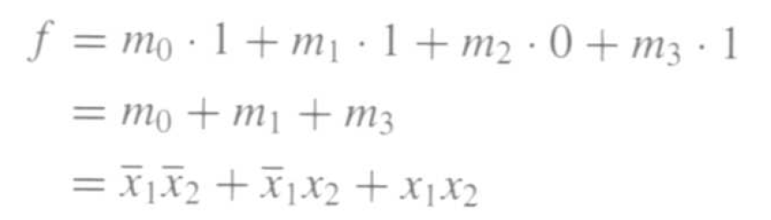
Sum-of-Products Form
f (x₁, x₂)

Slide 131
Product-of-Sums Form
(uses the zeros of the function)

Slide 132
Product-of-Sums Form
(for the OR logic function)
f (x₁, x₂)

Slide 133
Product-of-Sums Form
(for the OR logic function)
f (x₁, x₂)

Slide 134
Product-of-Sums Form
(for the OR logic function)
f (x₁, x₂)
f (x₁, x₂) = M₀ = x₁ + x₂
(In this case there is just one sum and there is no need for a product)

Slide 135
Another Example

Slide 136
Product-of-Sums Form
(for this logic function)
f (x₁, x₂)

Slide 137
Product-of-Sums Form
(for this logic function)
f (x₁, x₂)

Slide 138
Product-of-Sums Form
(for this logic function)
f (x₁, x₂)
f (x₁, x₂) = M₀ • M₂ = ( x₁ + x₂ ) • ( x₁ + x₂ )

Slide 139
Yet Another Example

Slide 140
Product-of-Sums Form
f (x₁, x₂)
We need to minimize using the zeros of the function f.
But let’s first minimize the inverse of f, i.e., f.

Slide 141
Product-of-Sums Form
f (x₁, x₂)
f (x₁, x₂)

Slide 142
Product-of-Sums Form
f (x₁, x₂)
f (x₁, x₂)

Slide 143
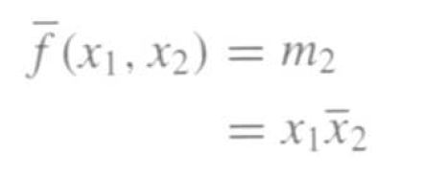
Product-of-Sums Form
f (x₁, x₂)
f (x₁, x₂)

Slide 144
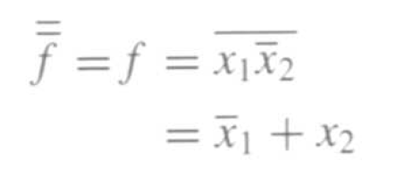
Product-of-Sums Form
f (x₁, x₂)
f (x₁, x₂)

Slide 145

Product-of-Sums Form
f (x₁, x₂)
f (x₁, x₂)

Slide 146
minterms
(for three variables)

Slide 147
The Eight minterms
x | y | z | m₀ | m₁ | m₂ | m₃ | m₄ | m₅ | m₆ | m₇
0 | 0 | 0 | 1 | 0 | 0 | 0 | 0 | 0 | 0 | 0
0 | 0 | 1 | 0 | 1 | 0 | 0 | 0 | 0 | 0 | 0
0 | 1 | 0 | 0 | 0 | 1 | 0 | 0 | 0 | 0 | 0
0 | 1 | 1 | 0 | 0 | 0 | 1 | 0 | 0 | 0 | 0
1 | 0 | 0 | 0 | 0 | 0 | 0 | 1 | 0 | 0 | 0
1 | 0 | 1 | 0 | 0 | 0 | 0 | 0 | 1 | 0 | 0
1 | 1 | 0 | 0 | 0 | 0 | 0 | 0 | 0 | 1 | 0
1 | 1 | 1 | 0 | 0 | 0 | 0 | 0 | 0 | 0 | 1

Slide 148
The Eight minterms
x | y | z | m₀ | m₁ | m₂ | m₃ | m₄ | m₅ | m₆ | m₇
0 | 0 | 0 | 1 | 0 | 0 | 0 | 0 | 0 | 0 | 0
0 | 0 | 1 | 0 | 1 | 0 | 0 | 0 | 0 | 0 | 0
0 | 1 | 0 | 0 | 0 | 1 | 0 | 0 | 0 | 0 | 0
0 | 1 | 1 | 0 | 0 | 0 | 1 | 0 | 0 | 0 | 0
1 | 0 | 0 | 0 | 0 | 0 | 0 | 1 | 0 | 0 | 0
1 | 0 | 1 | 0 | 0 | 0 | 0 | 0 | 1 | 0 | 0
1 | 1 | 0 | 0 | 0 | 0 | 0 | 0 | 0 | 1 | 0
1 | 1 | 1 | 0 | 0 | 0 | 0 | 0 | 0 | 0 | 1

Slide 149
Expressions for the minterms
m₀ = x y z
m₁ = x y z
m₂ = x y z
m₃ = x y z
m₄ = x y z
m₅ = x y z
m₆ = x y z
m₇ = x y z

Slide 150
Expressions for the minterms
0 0 0
0 0 1
0 1 0
0 1 1
1 0 0
1 0 1
1 1 0
1 1 1
m₀ = x y z
m₁ = x y z
m₂ = x y z
m₃ = x y z
m₄ = x y z
m₅ = x y z
m₆ = x y z
m₇ = x y z
The bars coincide
with the 0’s
in the binary expansion
of the minterm sub-index

Slide 151
Maxterms
(for three variables)

Slide 152
The Eight Maxterms
x | y | z | M₀ | M₁ | M₂ | M₃ | M₄ | M₅ | M₆ | M₇
0 | 0 | 0 | 0 | 1 | 1 | 1 | 1 | 1 | 1 | 1
0 | 0 | 1 | 1 | 0 | 1 | 1 | 1 | 1 | 1 | 1
0 | 1 | 0 | 1 | 1 | 0 | 1 | 1 | 1 | 1 | 1
0 | 1 | 1 | 1 | 1 | 1 | 0 | 1 | 1 | 1 | 1
1 | 0 | 0 | 1 | 1 | 1 | 1 | 0 | 1 | 1 | 1
1 | 0 | 1 | 1 | 1 | 1 | 1 | 1 | 0 | 1 | 1
1 | 1 | 0 | 1 | 1 | 1 | 1 | 1 | 1 | 0 | 1
1 | 1 | 1 | 1 | 1 | 1 | 1 | 1 | 1 | 1 | 0

Slide 153
The Eight Maxterms
x | y | z | M₀ | M₁ | M₂ | M₃ | M₄ | M₅ | M₆ | M₇
0 | 0 | 0 | 0 | 1 | 1 | 1 | 1 | 1 | 1 | 1
0 | 0 | 1 | 1 | 0 | 1 | 1 | 1 | 1 | 1 | 1
0 | 1 | 0 | 1 | 1 | 0 | 1 | 1 | 1 | 1 | 1
0 | 1 | 1 | 1 | 1 | 1 | 0 | 1 | 1 | 1 | 1
1 | 0 | 0 | 1 | 1 | 1 | 1 | 0 | 1 | 1 | 1
1 | 0 | 1 | 1 | 1 | 1 | 1 | 1 | 0 | 1 | 1
1 | 1 | 0 | 1 | 1 | 1 | 1 | 1 | 1 | 0 | 1
1 | 1 | 1 | 1 | 1 | 1 | 1 | 1 | 1 | 1 | 0

Slide 154
Expressions for the Maxterms
M₀ = x + y + z
M₁ = x + y + z
M₂ = x + y + z
M₃ = x + y + z
M₄ = x + y + z
M₅ = x + y + z
M₆ = x + y + z
M₇ = x + y + z

Slide 155
Expressions for the Maxterms
0 0 0
0 0 1
0 1 0
0 1 1
1 0 0
1 0 1
1 1 0
1 1 1
M₀ = x + y + z
M₁ = x + y + z
M₂ = x + y + z
M₃ = x + y + z
M₄ = x + y + z
M₅ = x + y + z
M₆ = x + y + z
M₇ = x + y + z
The bars coincide
with the 1’s
in the binary expansion
of the maxterm sub-index

Slide 156
minterms and Maxterms
(for three variables)

Slide 157
minterms and Maxterms
m₀ = x y z
m₁ = x y z
m₂ = x y z
m₃ = x y z
m₄ = x y z
m₅ = x y z
m₆ = x y z
m₇ = x y z
M₀ = x + y + z
M₁ = x + y + z
M₂ = x + y + z
M₃ = x + y + z
M₄ = x + y + z
M₅ = x + y + z
M₆ = x + y + z
M₇ = x + y + z

Slide 158
minterms and Maxterms
(with three variables)
[ Figure 2.22 from the textbook ]

Slide 159
Examples with three-variable functions

Slide 160
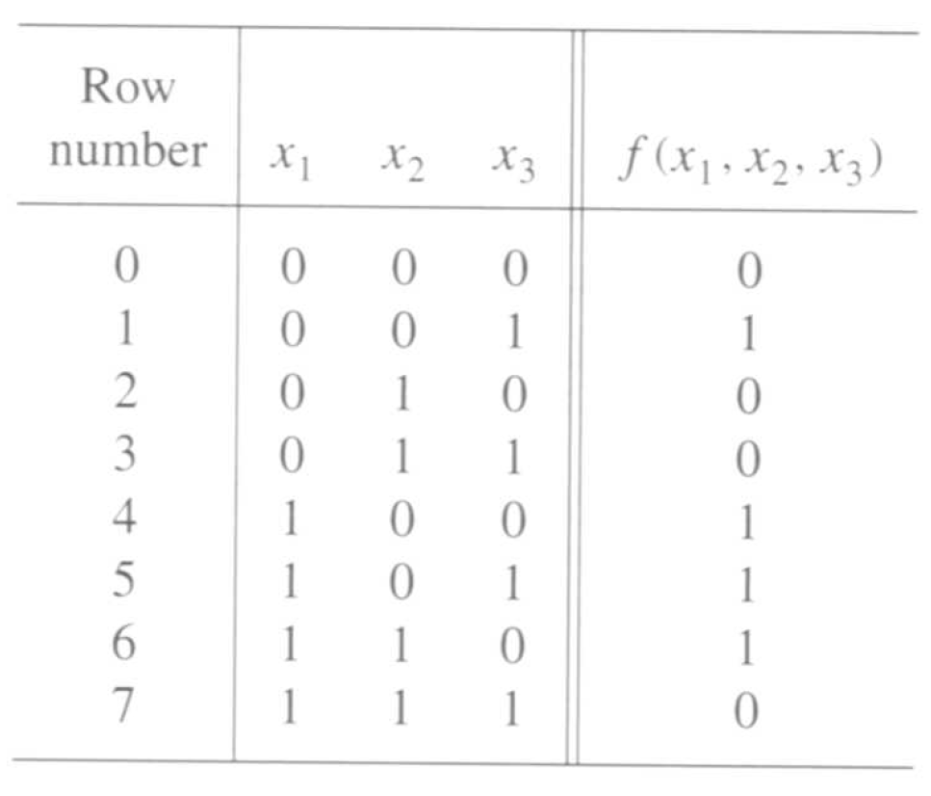
A three-variable function
[ Figure 2.23 from the textbook ]

Slide 161
Sum-of-Products (SOP)

Slide 162
Sum-of-Products (SOP)

Slide 163
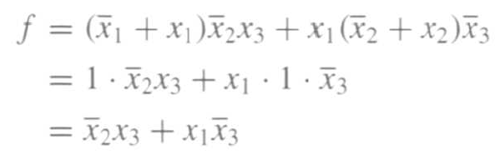
Sum-of-Products (SOP)

Slide 164
Sum-of-products realization of this function
x
2
f
x
3
x
1
f = x₂ x₃ + x₁ x₃
[ Figure 2.24a from the textbook ]

Slide 165
A three-variable function
[ Figure 2.23 from the textbook ]

Slide 166
Product-of-Sums (POS)

Slide 167
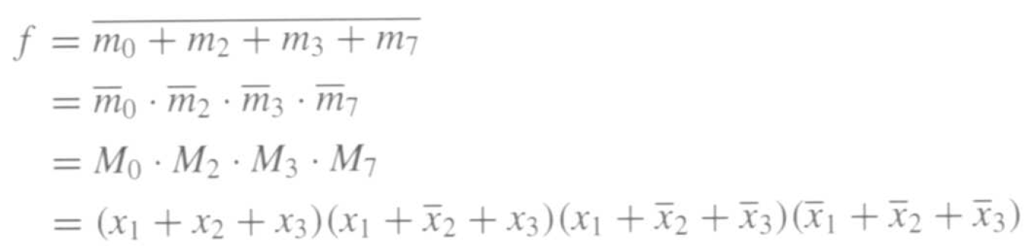
Product-of-Sums (POS)

Slide 168

Product-of-Sums (POS)

Slide 169
Product-of-sums realization of this function
x
1
x
3
f
x
2
f = (x₁ + x₃) • ( x₂ + x₃ )
[ Figure 2.24b from the textbook ]

Slide 170
Two realizations of this function
x
2
f
x
3
x
1
(a) A minimal sum-of-products realization
x
1
x
3
f
x
2
(b) A minimal product-of-sums realization
[ Figure 2.24 from the textbook ]

Slide 171
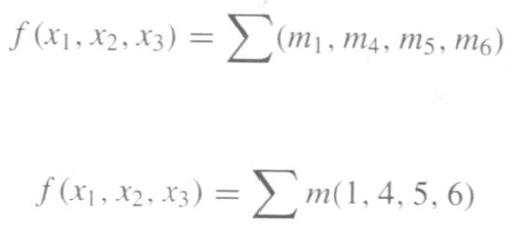
Shorthand Notation for SOP
or

Slide 172
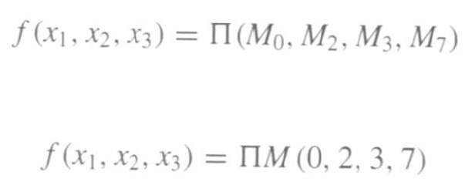
Shorthand Notation for POS
or

Slide 173
Shorthand Notation
Sum-of-Products (SOP)
or
Product-of-Sums (POS)
or

Slide 174
The Cost of a Circuit
Count all gates
Count all inputs/wires to the gates
Add the two partial counts. That is the cost.

Slide 175
What is the cost of this circuit?
x
1
x
2
f

Slide 176
What is the cost of this circuit?
x
1
1
x
2
1
1
1
f
1
1
There are 6 gates.

Slide 177
What is the cost of this circuit?
x
1
2
1
x
2
1
1
3
2
1
1
f
1
1
2
1
There are 6 gates and 11 inputs.
The total cost is 17.

Slide 178
What is the cost of each circuit?
x
2
f
x
3
x
1
(a) A minimal sum-of-products realization
x
1
x
3
f
x
2
(b) A minimal product-of-sums realization

Slide 179
Questions?

Slide 180
THE END

