Slide 1
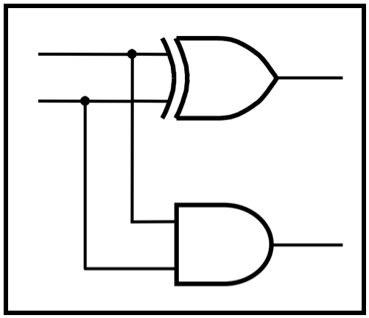
CprE 281:
Digital Logic
Instructor: Alexander Stoytchev
http://www.ece.iastate.edu/~alexs/classes/

Slide 2
Boolean Algebra
CprE 281: Digital Logic
Iowa State University, Ames, IA
Copyright © Alexander Stoytchev

Slide 3
Administrative Stuff
HW1 is due today @ 10 pm
Sample solutions will be posted on Canvas after the deadline.
Look for the solutions under the “Files” tab.
No late homeworks will be accepted.

Slide 4
Administrative Stuff
HW2 is out
It is due on Monday Sep 9 @ 10pm.
Submit it on Canvas before the deadline.

Slide 5

Did you play with this toy?

Slide 6
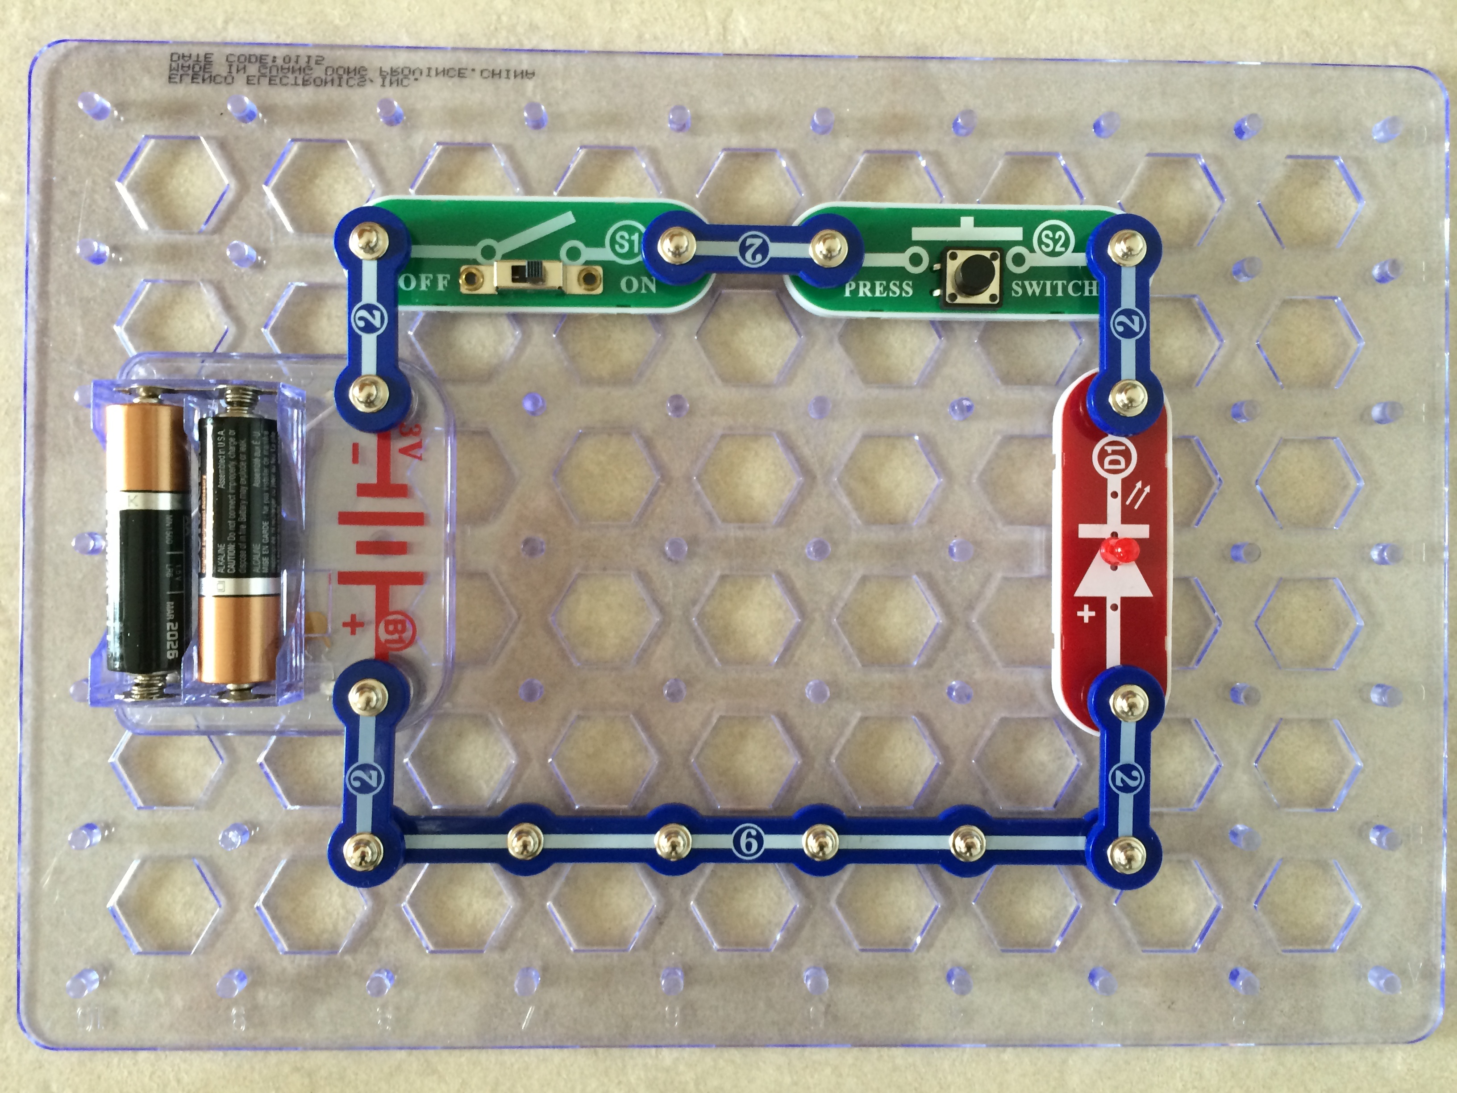
AND Gate

Slide 7
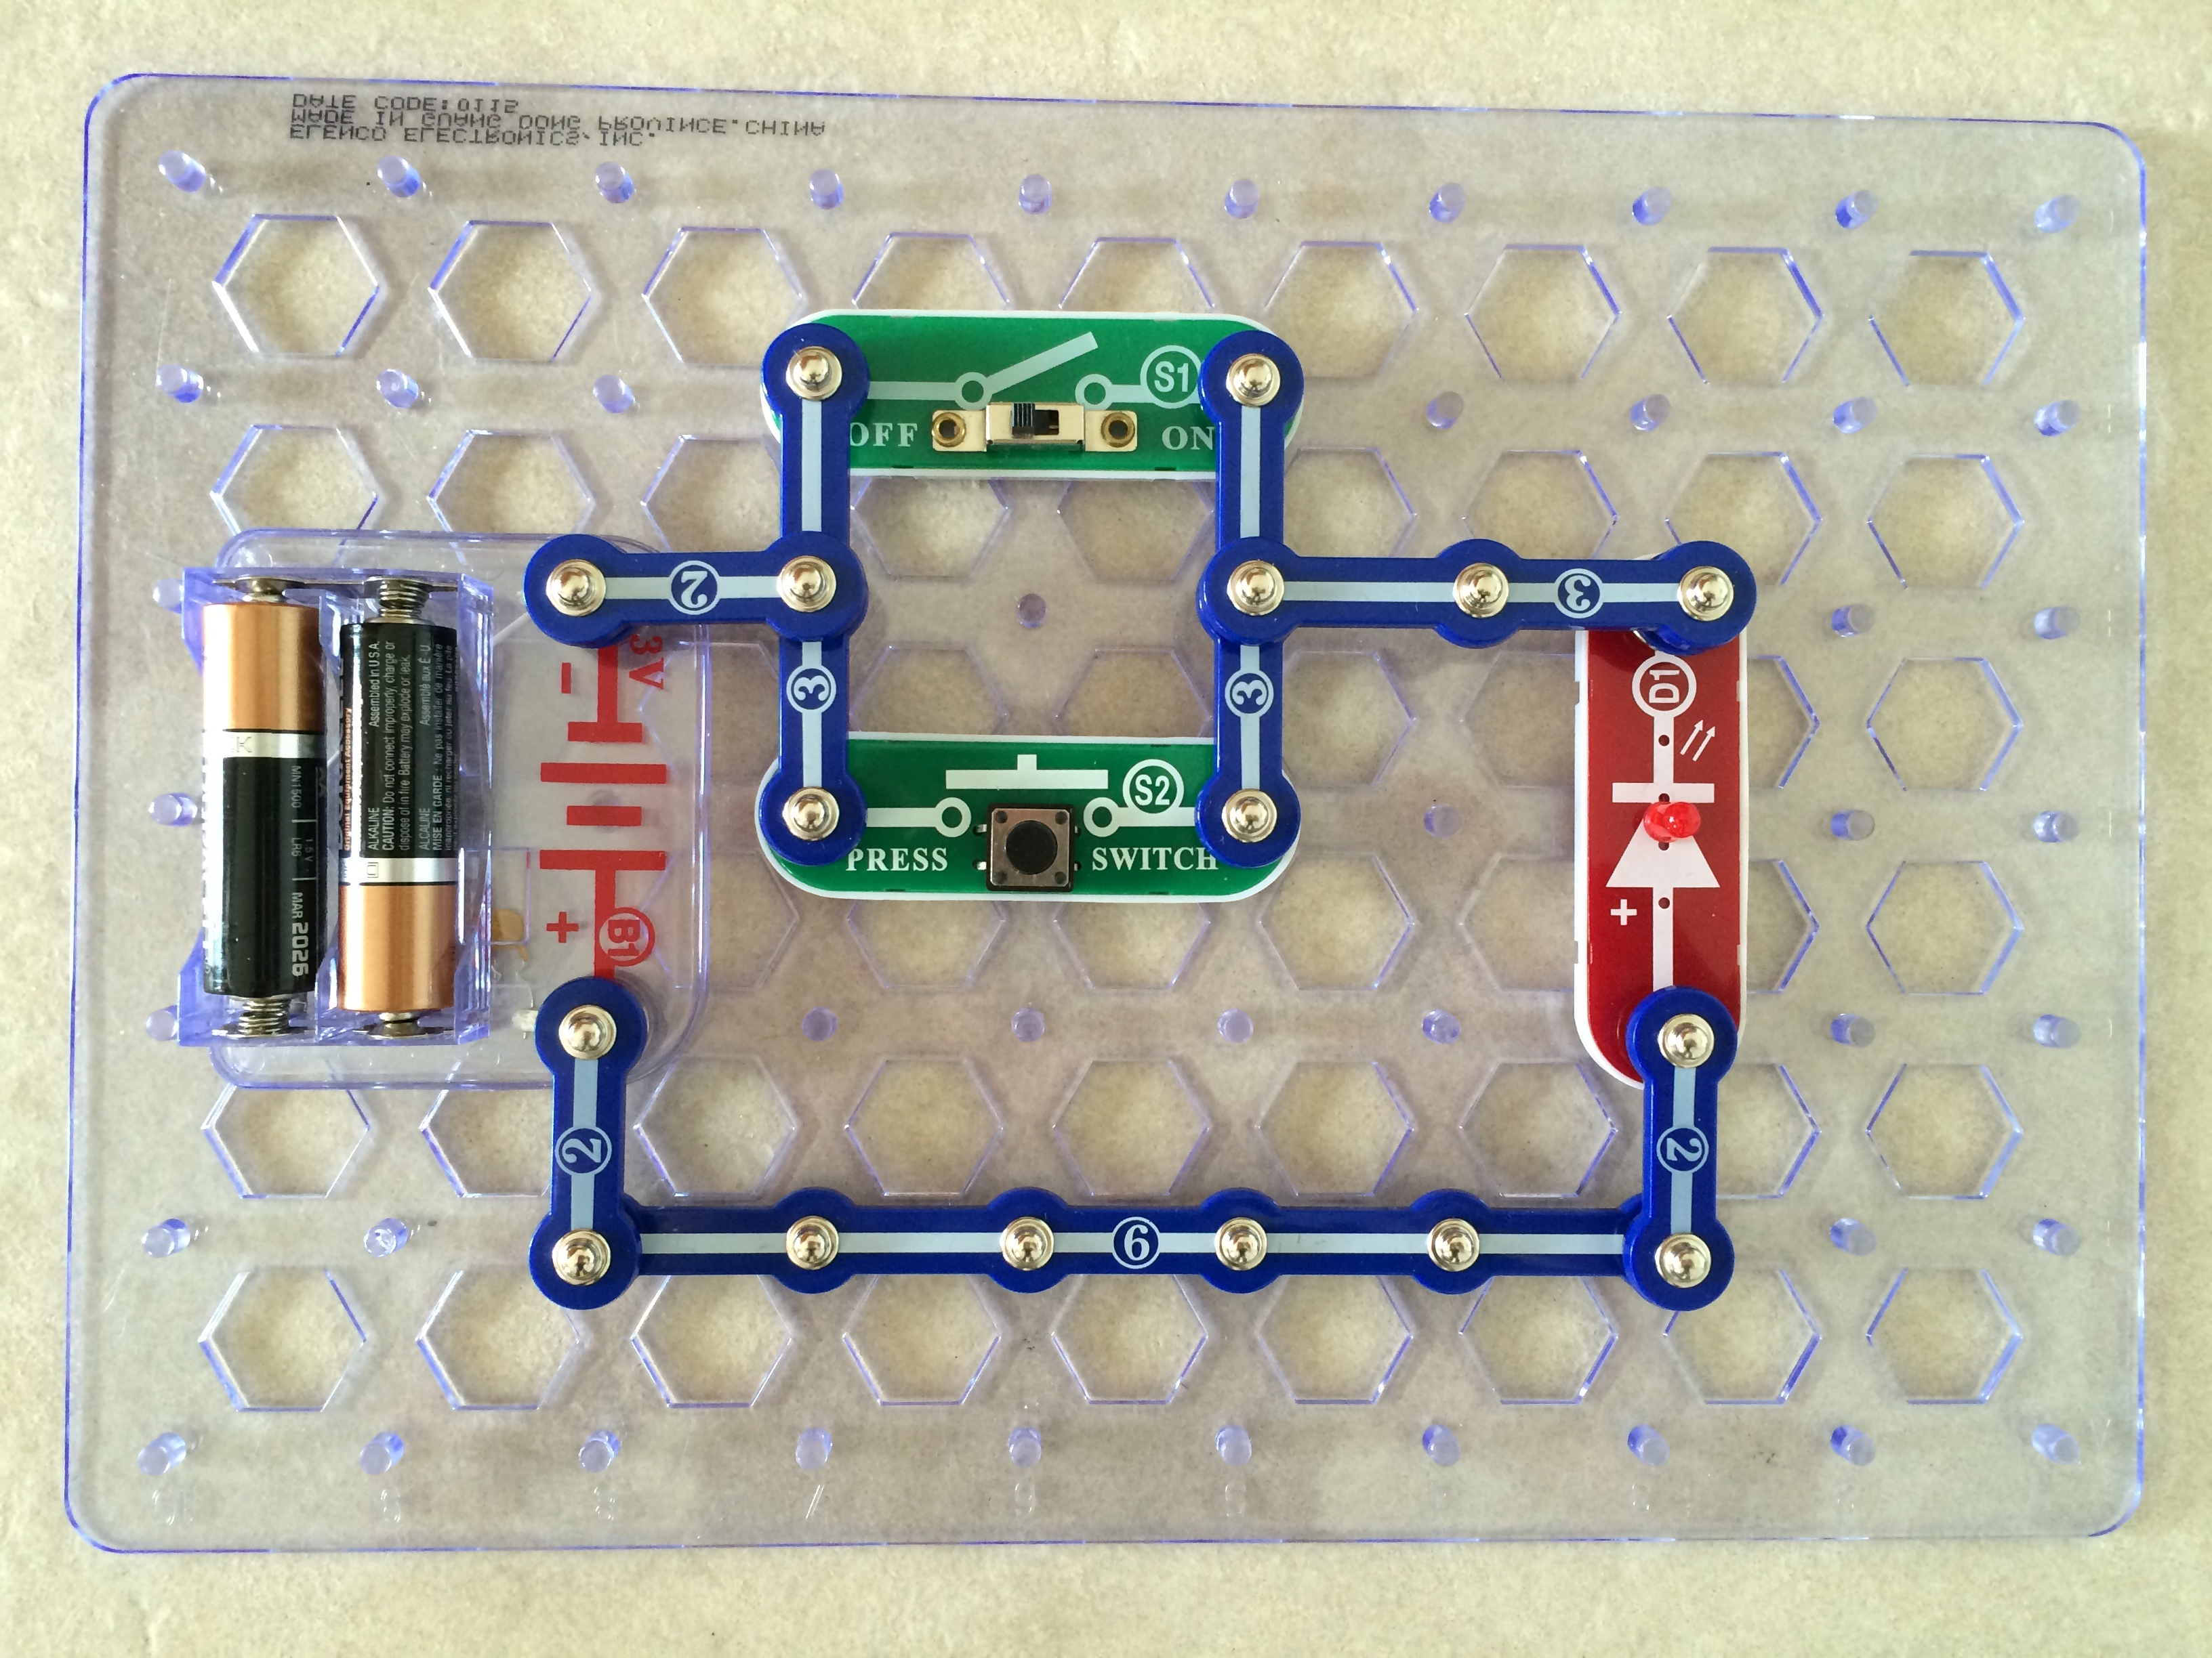
OR Gate

Slide 8
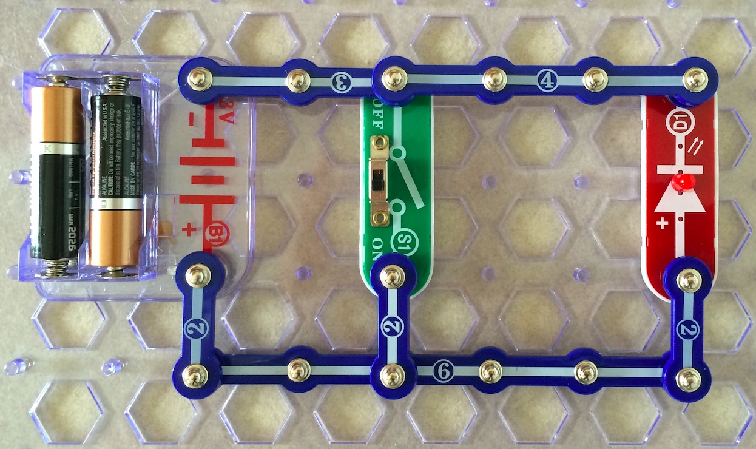
NOT Gate
(the switch is ON but the light is OFF)

Slide 9
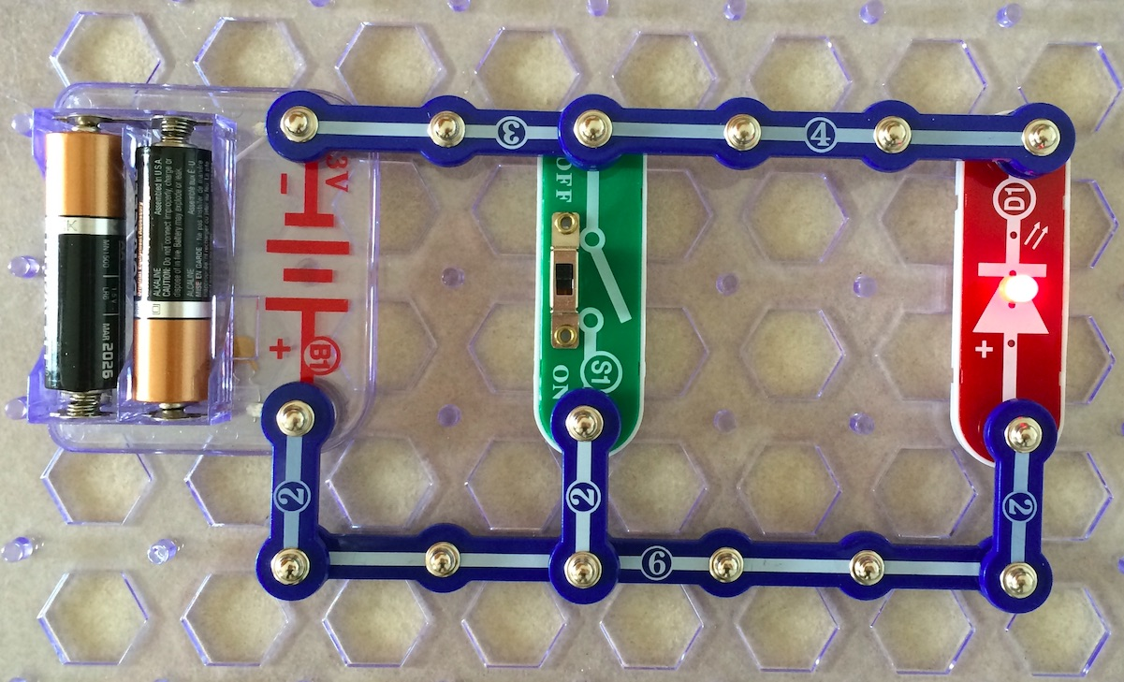
NOT Gate
(the switch is OFF but the light is ON)

Slide 11
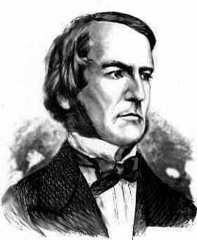
Boolean Algebra
An algebraic structure consists of
  a set of elements {0, 1}
  binary operators {+, •}
  and a unary operator { ’ } or { } or { ~ }
Introduced by George Boole in 1854
An effective means of describing circuits built with switches
A powerful tool that can be used for designing and analyzing logic circuits
George Boole
1815-1864

Slide 12
Different Notations for Negation
All three of these mean “negate x”
  x’
  x
  ~x

Slide 13
Axioms of Boolean Algebra
1a. 0 • 0 = 0
1b. 1 + 1 = 1
2a. 1 • 1 = 1
2b. 0 + 0 = 0
3a. 0 • 1 = 1 • 0 = 0
3b. 1 + 0 = 0 + 1 = 1
4a. If x=0, then
4b. If x=1, then
x = 1
x = 0

Slide 14
Single-Variable Theorems
5a. x • 0 = 0
5b. x + 1 = 1
6a. x • 1 = x
6b. x + 0 = x
7a. x • x = x
7b. x + x = x
8a. x •
8b. x +
9.
x = 0
x = 1
x = x

Slide 15
Two- and Three-Variable Properties
10a. x • y = y • x
10b. x + y = y + x
11a. x • (y • z) = (x • y) • z
11b. x + (y + z) = (x + y) + z
12a. x • (y + z) = x•y + x•z
12b. x + y • z = (x + y)•(x + z)
13a. x + x • y = x
13b. x • (x + y) = x
Commutative
Associative
Distributive
Absorption

Slide 16
Two- and Three-Variable Properties
14a. x • y + x •
14b. (x + y)•(x +
15a. x • y = x + y
15b. x + y = x • y
16a. x + x•y = x + y
16b. x•(x + y) = x•y
17a. x•y + y•z + x•z = x•y + x•z
17b. (x+y)•(y+z)•(x+z)=(x+y)•(x+z)
Combining
DeMorgan’s
theorem
Consensus
y = x
y) = x

Slide 17
Now, let’s prove all of these

Slide 18
The First Four are Axioms
(i.e., they don’t require a proof)
1a. 0 • 0 = 0
1b. 1 + 1 = 1
2a. 1 • 1 = 1
2b. 0 + 0 = 0
3a. 0 • 1 = 1 • 0 = 0
3b. 1 + 0 = 0 + 1 = 1
4a. If x=0, then
4b. If x=1, then
x = 1
x = 0

Slide 19
But here are some other ways to think about them

Slide 20


0
1
0
1
1
0
AND gate
OR gate

Slide 21
0
1
0
1
1
0
AND gate
OR gate
x₁ | x₂ | f
0 | 0 | 0
0 | 1 | 0
1 | 0 | 0
1 | 1 | 1
x₁ | x₂ | f
0 | 0 | 0
0 | 1 | 1
1 | 0 | 1
1 | 1 | 1

Slide 22
0
1
0
1
1
0
AND gate
OR gate
x₁ | x₂ | f
0 | 0 | 0
0 | 1 | 0
1 | 0 | 0
1 | 1 | 1
x₁ | x₂ | f
0 | 0 | 0
0 | 1 | 1
1 | 0 | 1
1 | 1 | 1

Slide 23


1
0
1
0
0
1
AND gate
OR gate

Slide 24
1
0
1
0
0
1
AND gate
OR gate
x₁ | x₂ | f
0 | 0 | 0
0 | 1 | 0
1 | 0 | 0
1 | 1 | 1
x₁ | x₂ | f
0 | 0 | 0
0 | 1 | 1
1 | 0 | 1
1 | 1 | 1

Slide 25
0
0
1
1
0
1
1
0
0
1
1
0

Slide 26
0
0
1
1
0
1
1
0
0
1
1
0
AND gate
OR gate
x₁ | x₂ | f
0 | 0 | 0
0 | 1 | 0
1 | 0 | 0
1 | 1 | 1
x₁ | x₂ | f
0 | 0 | 0
0 | 1 | 1
1 | 0 | 1
1 | 1 | 1

Slide 27
0
0
1
1
0
1
1
0
0
1
1
0
AND gate
OR gate
x₁ | x₂ | f
0 | 0 | 0
0 | 1 | 0
1 | 0 | 0
1 | 1 | 1
x₁ | x₂ | f
0 | 0 | 0
0 | 1 | 1
1 | 0 | 1
1 | 1 | 1

Slide 28
0
0
1
1
0
1
1
0
0
1
1
0
AND gate
OR gate
x₁ | x₂ | f
0 | 0 | 0
0 | 1 | 0
1 | 0 | 0
1 | 1 | 1
x₁ | x₂ | f
0 | 0 | 0
0 | 1 | 1
1 | 0 | 1
1 | 1 | 1

Slide 29
0
1
1
0

Slide 30
0
1
1
0
NOT gate
NOT gate
x
x
x
x
0
1
0
1
1
0
1
0

Slide 31
Single-Variable Theorems
5a. x • 0 = 0
5b. x + 1 = 1
6a. x • 1 = x
6b. x + 0 = x
7a. x • x = x
7b. x + x = x
8a. x •
8b. x +
9.
x = 0
x = 1
x = x

Slide 32


Slide 33
The Boolean variable x can have only two possible values: 0 or 1. Let’s look at each case separately.

Slide 34
The Boolean variable x can have only two possible values: 0 or 1. Let’s look at each case separately.
i) If x = 0, then we have
0 • 0 = 0 // axiom 1a

Slide 35
The Boolean variable x can have only two possible values: 0 or 1. Let’s look at each case separately.
i) If x = 0, then we have
0 • 0 = 0 // axiom 1a
ii) If x = 1, then we have
1 • 0 = 0 // axiom 3a

Slide 37


Slide 38
The Boolean variable x can have only two possible values: 0 or 1. Let’s look at each case separately.
i) If x = 0, then we have
0 + 1 = 1 // axiom 3b

Slide 39
The Boolean variable x can have only two possible values: 0 or 1. Let’s look at each case separately.
i) If x = 0, then we have
0 + 1 = 1 // axiom 3b
ii) If x = 1, then we have
1 + 1 = 1 // axiom 1b

Slide 41

The Boolean variable x can have only two possible values: 0 or 1. Let’s look at each case separately.
i) If x = 0, then we have
0 • 1 = 0 // axiom 3a
ii) If x = 1, then we have
1 • 1 = 1 // axiom 2a

Slide 42
The Boolean variable x can have only two possible values: 0 or 1. Let’s look at each case separately.
i) If x = 0, then we have
0 • 1 = 0 // axiom 3a
ii) If x = 1, then we have
1 • 1 = 1 // axiom 2a

Slide 44

The Boolean variable x can have only two possible values: 0 or 1. Let’s look at each case separately.
i) If x = 0, then we have
0 + 0 = 0 // axiom 2b
ii) If x = 1, then we have
1 + 0 = 1 // axiom 3b

Slide 45
The Boolean variable x can have only two possible values: 0 or 1. Let’s look at each case separately.
i) If x = 0, then we have
0 + 0 = 0 // axiom 2b
ii) If x = 1, then we have
1 + 0 = 1 // axiom 3b

Slide 47

i) If x = 0, then we have
0 • 0 = 0 // axiom 1a
ii) If x = 1, then we have
1 • 1 = 1 // axiom 2a

Slide 48
i) If x = 0, then we have
0 • 0 = 0 // axiom 1a
ii) If x = 1, then we have
1 • 1 = 1 // axiom 2a

Slide 50

i) If x = 0, then we have
0 + 0 = 0 // axiom 2b
ii) If x = 1, then we have
1 + 1 = 1 // axiom 1b

Slide 51
i) If x = 0, then we have
0 + 0 = 0 // axiom 2b
ii) If x = 1, then we have
1 + 1 = 1 // axiom 1b

Slide 53

i) If x = 0, then we have
0 • 1 = 0 // axiom 3a
ii) If x = 1, then we have
1 • 0 = 0 // axiom 3a

Slide 54
i) If x = 0, then we have
0 • 1 = 0 // axiom 3a
ii) If x = 1, then we have
1 • 0 = 0 // axiom 3a

Slide 56

i) If x = 0, then we have
0 + 1 = 1 // axiom 3b
ii) If x = 1, then we have
1 + 0 = 1 // axiom 3b

Slide 57
i) If x = 0, then we have
0 + 1 = 1 // axiom 3b
ii) If x = 1, then we have
1 + 0 = 1 // axiom 3b

Slide 59

i) If x = 0, then we have
x = 1 // axiom 4a
let y = x = 1, then we have
y = 0 // axiom 4b
Therefore,
x = x (when x =0)

Slide 61
ii) If x = 1, then we have
x = 0 // axiom 4b
let y = x = 0, then we have
y = 1 // axiom 4a
Therefore,
x = x (when x =1)

Slide 63


x
x
y
y
y
y
x
x

Slide 64
x
x
y
y
y
y
x
x
AND gate
OR gate
x | y | f
0 | 0 | 0
0 | 1 | 0
1 | 0 | 0
1 | 1 | 1
x | y | f
0 | 0 | 0
0 | 1 | 1
1 | 0 | 1
1 | 1 | 1
The order of the inputs does not matter.

Slide 66
x | y | z | x | y • z | x•(y•z)
0 | 0 | 0
0 | 0 | 1
0 | 1 | 0
0 | 1 | 1
1 | 0 | 0
1 | 0 | 1
1 | 1 | 0
1 | 1 | 1
Truth table for the left-hand side

Slide 67
x | y | z | x | y • z | x•(y•z)
0 | 0 | 0 | 0 | 0
0 | 0 | 1 | 0 | 0
0 | 1 | 0 | 0 | 0
0 | 1 | 1 | 0 | 1
1 | 0 | 0 | 1 | 0
1 | 0 | 1 | 1 | 0
1 | 1 | 0 | 1 | 0
1 | 1 | 1 | 1 | 1
Truth table for the left-hand side

Slide 68
x | y | z | x | y • z | x•(y•z)
0 | 0 | 0 | 0 | 0 | 0
0 | 0 | 1 | 0 | 0 | 0
0 | 1 | 0 | 0 | 0 | 0
0 | 1 | 1 | 0 | 1 | 0
1 | 0 | 0 | 1 | 0 | 0
1 | 0 | 1 | 1 | 0 | 0
1 | 1 | 0 | 1 | 0 | 0
1 | 1 | 1 | 1 | 1 | 1
Truth table for the left-hand side

Slide 69
x | y | z | x • y | z | (x•y)•z
0 | 0 | 0 | 0 | 0 | 0
0 | 0 | 1 | 0 | 1 | 0
0 | 1 | 0 | 0 | 0 | 0
0 | 1 | 1 | 0 | 1 | 0
1 | 0 | 0 | 0 | 0 | 0
1 | 0 | 1 | 0 | 1 | 0
1 | 1 | 0 | 1 | 0 | 0
1 | 1 | 1 | 1 | 1 | 1
Truth table for the right-hand side

Slide 70


These two are identical, which concludes the proof.

Slide 72
x | y | z | x | y + z | x+(y+z)
0 | 0 | 0
0 | 0 | 1
0 | 1 | 0
0 | 1 | 1
1 | 0 | 0
1 | 0 | 1
1 | 1 | 0
1 | 1 | 1
Truth table for the left-hand side

Slide 73
x | y | z | x | y + z | x+(y+z)
0 | 0 | 0 | 0 | 0
0 | 0 | 1 | 0 | 1
0 | 1 | 0 | 0 | 1
0 | 1 | 1 | 0 | 1
1 | 0 | 0 | 1 | 0
1 | 0 | 1 | 1 | 1
1 | 1 | 0 | 1 | 1
1 | 1 | 1 | 1 | 1
Truth table for the left-hand side

Slide 74
x | y | z | x | y + z | x+(y+z)
0 | 0 | 0 | 0 | 0 | 0
0 | 0 | 1 | 0 | 1 | 1
0 | 1 | 0 | 0 | 1 | 1
0 | 1 | 1 | 0 | 1 | 1
1 | 0 | 0 | 1 | 0 | 1
1 | 0 | 1 | 1 | 1 | 1
1 | 1 | 0 | 1 | 1 | 1
1 | 1 | 1 | 1 | 1 | 1
Truth table for the left-hand side

Slide 75
x | y | z | x + y | z | (x+y)+z
0 | 0 | 0 | 0 | 0 | 0
0 | 0 | 1 | 0 | 1 | 1
0 | 1 | 0 | 1 | 0 | 1
0 | 1 | 1 | 1 | 1 | 1
1 | 0 | 0 | 1 | 0 | 1
1 | 0 | 1 | 1 | 1 | 1
1 | 1 | 0 | 1 | 0 | 1
1 | 1 | 1 | 1 | 1 | 1
Truth table for the right-hand side

Slide 76


These two are identical, which concludes the proof.

Slide 77
The Venn Diagram Representation
x
y
z
x
y
+
z

Slide 78
Venn Diagram Basics
(a) Constant 1
(b) Constant 0
x
x
x
x
(c) Variable
x
(d)
x
[ Figure 2.14 from the textbook ]

Slide 79
Venn Diagram Basics
x
y
x
y
(e)
x
y
(f)
x
+
y
x
y
x
y
z
(g)
x
y
(h)
x
y
+
z
[ Figure 2.14 from the textbook ]

Slide 80

Let’s Prove the Distributive Properties

Slide 81
x
y
x
y
z
z
(a)
x
(d)
x
y
x
y
x
y
z
z
(b)
y
+
z
(e)
x
z
x
y
x
y
z
z
(c)
x
(
y
+
z
)
(f)
x
y
+
x
z
[ Figure 2.15 from the textbook ]

Slide 82
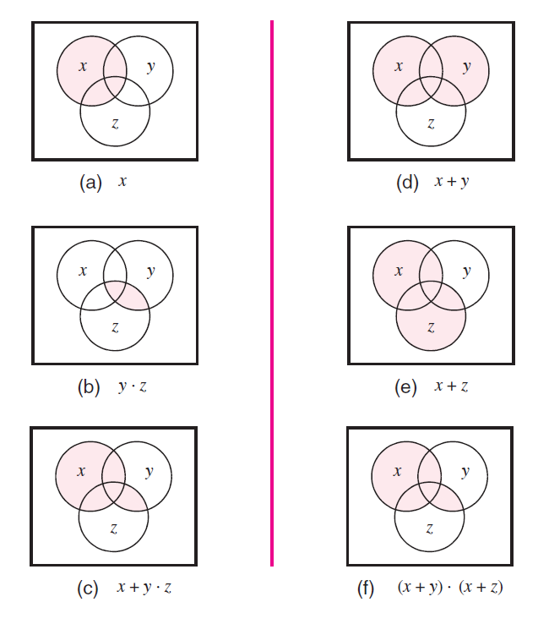
[ Figure 2.17 from the textbook ]

Slide 83

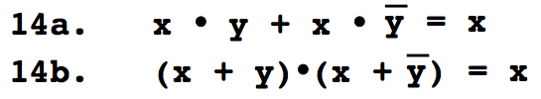
Try to prove these ones at home

Slide 84
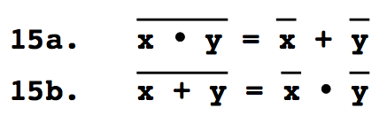
DeMorgan’s Theorem

Slide 85

Proof of DeMorgan’s theorem
[ Figure 2.13 from the textbook ]

Slide 86
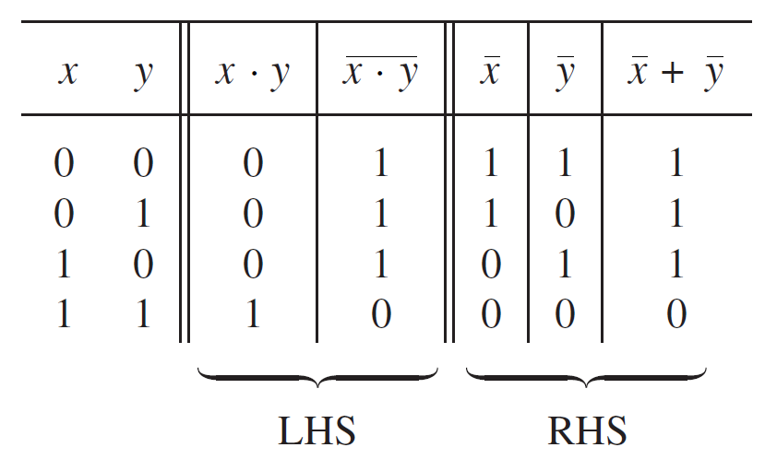
Proof of DeMorgan’s theorem

Slide 87
Proof of DeMorgan’s theorem

Slide 88
Proof of DeMorgan’s theorem

Slide 89
Proof of DeMorgan’s theorem

Slide 90
Proof of DeMorgan’s theorem

Slide 91
Proof of DeMorgan’s theorem

Slide 92
Proof of DeMorgan’s theorem
These two columns are equal. Therefore, the theorem is true.

Slide 93
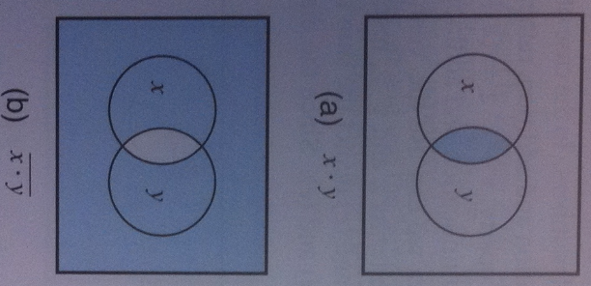
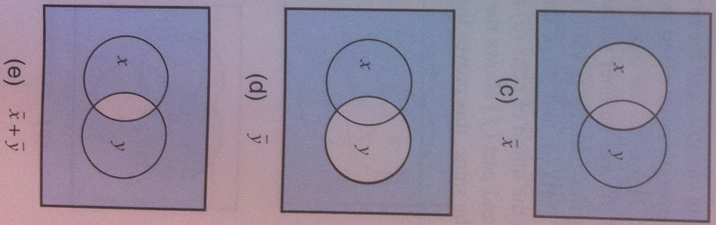
Alternative proof using Venn Diagrams
[ Figure 2.18 from the textbook ]

Slide 95

Let’s prove the other DeMorgan’s theorem

Slide 96
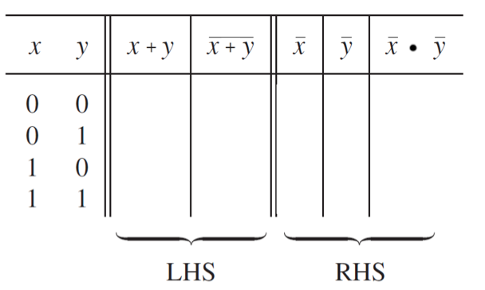
Let’s prove the other DeMorgan’s theorem

Slide 97
Let’s prove the other DeMorgan’s theorem
0
1
1
1

Slide 98
Let’s prove the other DeMorgan’s theorem
0
1
1
1
1
0
0
0

Slide 99
Let’s prove the other DeMorgan’s theorem
0
1
1
1
1
0
0
0
1
1
0
0

Slide 100
Let’s prove the other DeMorgan’s theorem
0
1
1
1
1
0
0
0
1
1
0
0
1
0
1
0

Slide 101
Let’s prove the other DeMorgan’s theorem
0
1
1
1
1
0
0
0
1
1
0
0
1
0
1
0
1
0
0
0

Slide 102
Let’s prove the other DeMorgan’s theorem
These two columns are equal, so the theorem is true.
0
1
1
1
1
0
0
0
1
1
0
0
1
0
1
0
1
0
0
0

Slide 103
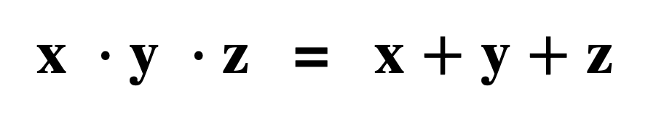
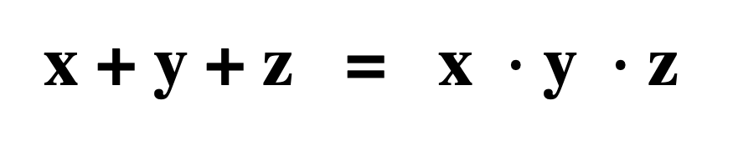
DeMorgan’s Theorem
Generalizes to more than 2 variables

Slide 104
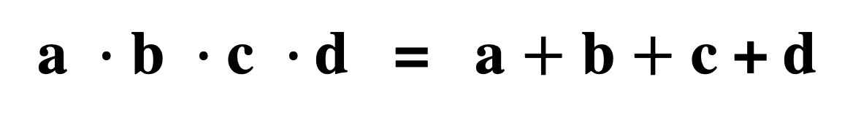
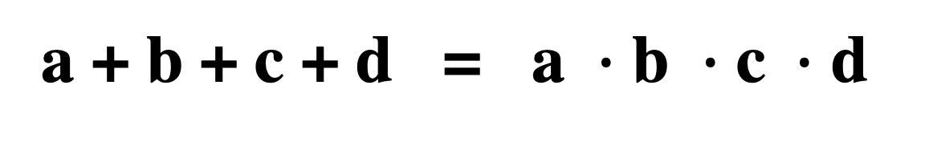
DeMorgan’s Theorem
Generalizes to more than 2 variables

Slide 105
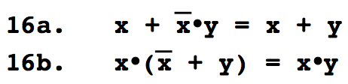
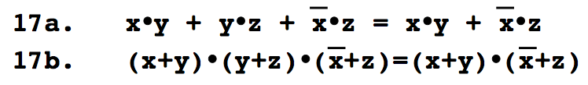
Try to prove these ones at home

Slide 106
Venn Diagram Example
Proof of Property 17a

Slide 107
Left-Hand Side
x
y
x
y
x
y
x
y
z
z
z
z
x
y
x
z
y
z
x
y
+
x z
+
y
z
[ Figure 2.16 from the textbook ]

Slide 108
Left-Hand Side
x
y
x
y
x
y
x
y
z
z
z
z
x
y
x
z
y
z
x
y
+
x z
+
y
z
Right-Hand Side
x
y
x
y
x
y
z
z
z
x
y
x
z
x
y
+
x
z
[ Figure 2.16 from the textbook ]

Slide 109
Left-Hand Side
These two are equal
x
y
x
y
x
y
x
y
z
z
z
z
x
y
x
z
y
z
x
y
+
x z
+
y
z
Right-Hand Side
x
y
x
y
x
y
z
z
z
x
y
x
z
x
y
+
x
z
[ Figure 2.16 from the textbook ]

Slide 110
Questions?

Slide 111
THE END

