Slide 1
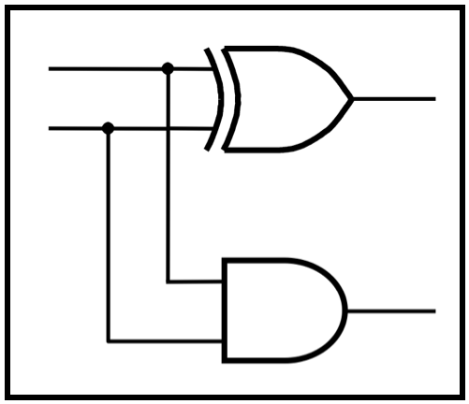
CprE 281: Digital Logic
Instructor: Alexander Stoytchev
http://www.ece.iastate.edu/~alexs/classes/

Slide 2
No Class Today
(due to Labor day)

