Slide 1
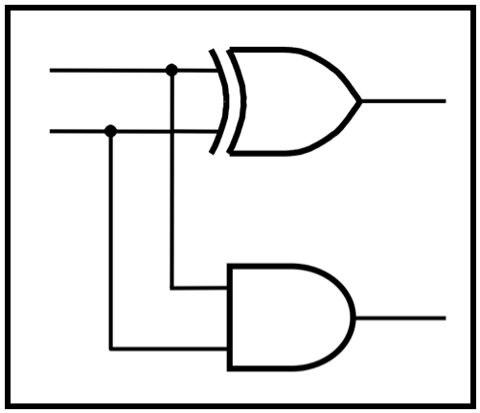
CprE 281:
Digital Logic
Instructor: Alexander Stoytchev
http://www.ece.iastate.edu/~alexs/classes/

Slide 2
Logic Gates
CprE 281: Digital Logic
Iowa State University, Ames, IA
Copyright © Alexander Stoytchev

Slide 3
Administrative Stuff
HW1 is out. It is due on Wednesday Sep 4 @ 10pm.
Submit it as a PDF upload on Canvas before the deadline.
You can write the solutions on paper and then scan the pages to make **one** PDF file.
No late homeworks will be accepted.
Please write clearly on the first page:
  your name
  student ID
  lab section number

Slide 4
Labs Next Week
Please download and read the lab assignment for next week before you go to your lab section.
https://www.ece.iastate.edu/~alexs/classes/2024_Fall_2810/labs/Lab_01/
You must print and complete the prelab before you go to the lab.
The TAs will check your prelab answers at the beginning of the recitation. If you don't have it done you'll lose 20% of the lab grade for that lab.

Slide 6
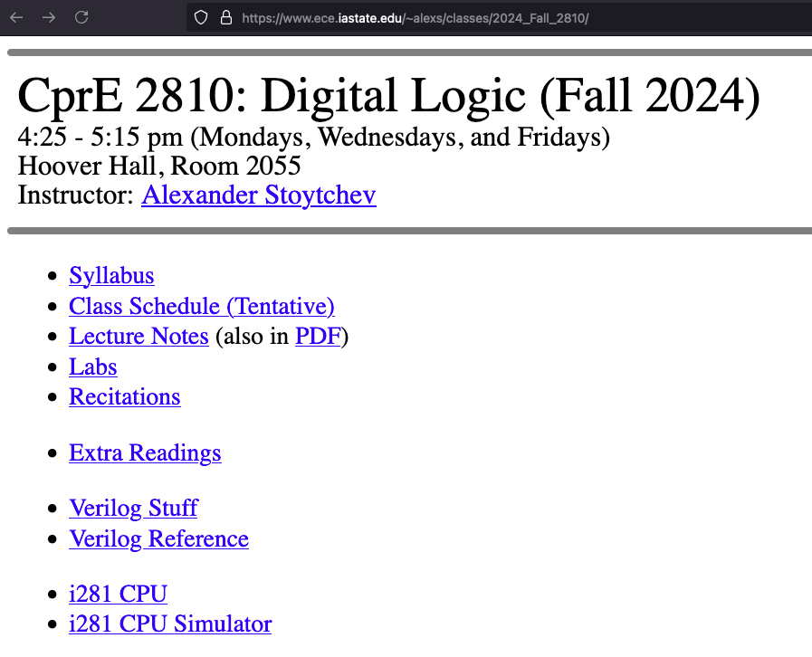

Slide 7
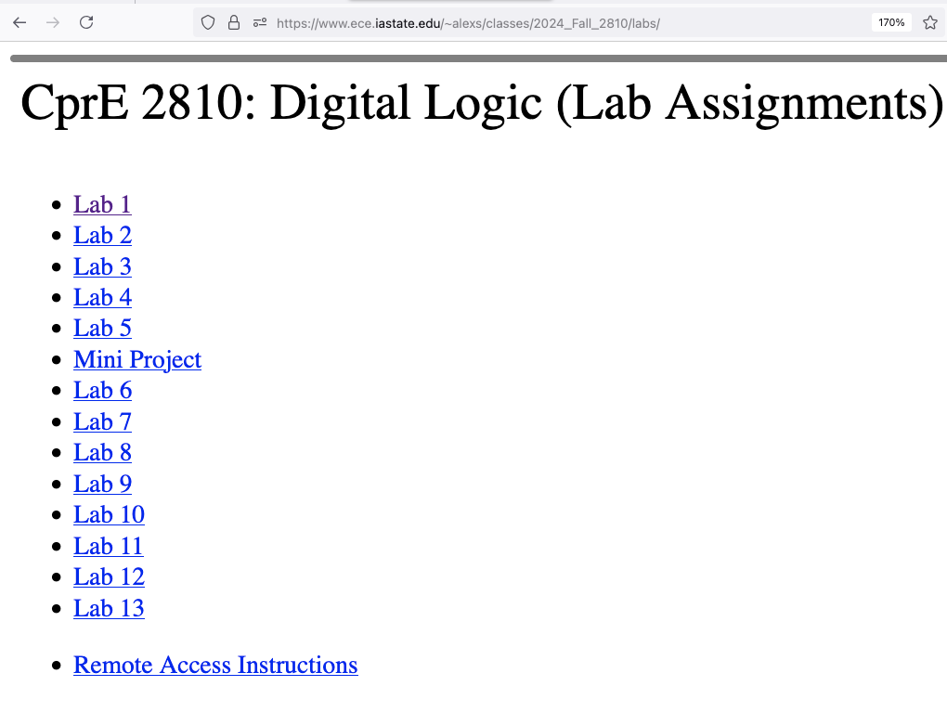

Slide 8
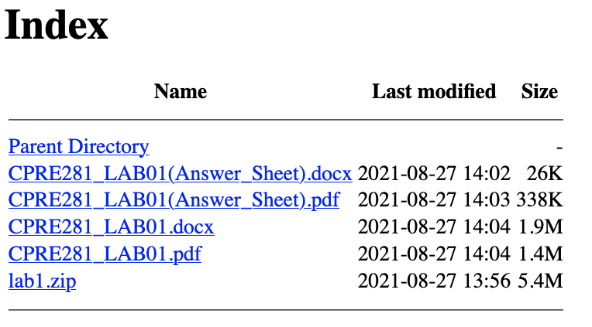

Slide 9
READ one of these at home.
This is the lab assignment.

Slide 10
During the lab next week,
download this ZIP file and
follow the instructions.

Slide 11
Print this file,
complete the prelab,
and bring it with you
to the lab.

Slide 12
This is the same,
but in Word format.

Slide 13
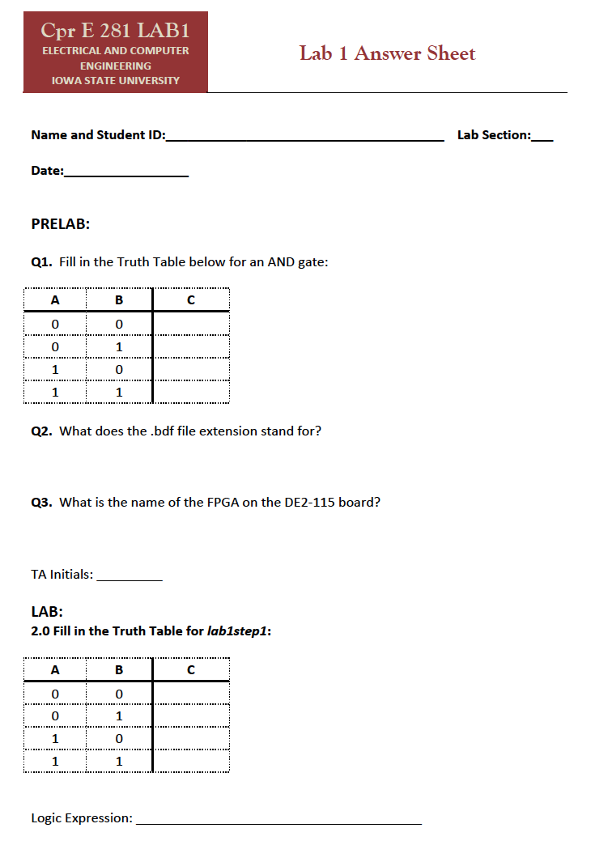
This is the prelab
for lab #1.

Slide 14
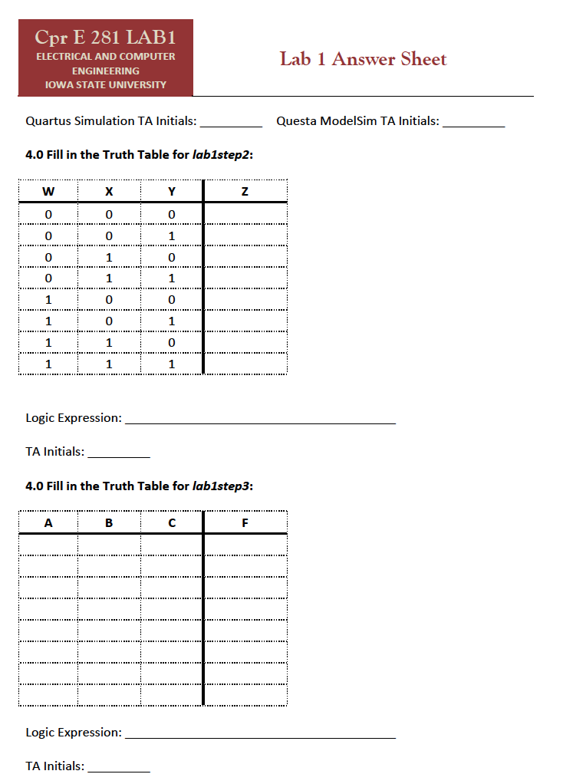

Slide 17
Lab Safety
This class has a substantial hands-on laboratory section. Students will be using expensive, sensitive, and potentially hazardous equipment. Safety in the lab is a number one priority for students and instructors and to ensure a safe laboratory experience, a brief safety presentation will be given during the first lab session. It is mandatory that all students attend this presentation. Moreover, it is expected that students follow any and all posted safety guidelines. All students must sign the lab safety form (posted in the syllabus).
For reference, a copy of the University Laboratory Safety Manual can be found at: www.ehs.iastate.edu/sites/default/files/uploads/publications/manuals/labsm.pdf
See also the safety page of the ECpE Department:
http://www.ece.iastate.edu/the-department/safety/

Slide 19
A Binary Switch
x
=
0
x
=
1
(a) Two states of a switch
S
x
(b) Symbol for a switch
[ Figure 2.1 from the textbook ]

Slide 20
A Light Controlled by a Switch
S
Battery
x
Light
(a) Simple connection to a battery
[ Figure 2.2a from the textbook ]

Slide 21
A Light Controlled by a Switch
x = 0
Battery
Light

Slide 22
A Light Controlled by a Switch
x = 1
Battery
Light

Slide 23
A Light Controlled by a Switch
S
Power
supply
x
Light
(b) Using a ground connection as the return path
[ Figure 2.2b from the textbook ]

Slide 24
Logic AND with Switches
(series connection of the switches)

Slide 25
AND Circuit
x=0
y=0
+
_
Battery
Light

Slide 26
AND Circuit
x=0
y=1
+
_
Battery
Light

Slide 27
AND Circuit
x=1
y=0
+
_
Battery
Light

Slide 28
AND Circuit
x=1
y=1
+
_
Battery
Light

Slide 29
Logic OR with Switches
(parallel connection of the switches)

Slide 30
OR Circuit
x=0
+
_
y=0
Battery
Light

Slide 31
OR Circuit
x=0
+
_
y=1
Battery
Light

Slide 32
OR Circuit
x=1
+
_
y=0
Battery
Light

Slide 33
OR Circuit
x=1
+
_
y=1
Battery
Light

Slide 34
Logic NOT with a Switch
(an inverting circuit)

Slide 35
NOT Circuit
Resistor
+
_
Battery
x=0
Light

Slide 36
NOT Circuit
Resistor
+
_
Battery
x=1
Light

Slide 37
The Three Basic Logic Gates
x
1
x
x
x
1
x
x
1
⋅
2
x
1
+
x
2
x
2
x
2
NOT gate
AND gate
OR gate
[ Figure 2.8 from the textbook ]

Slide 38
Truth Table for NOT
x
x
x
x
0
1
1
0

Slide 39
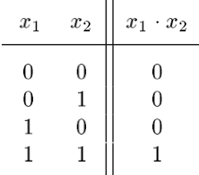
Truth Table for AND
x
1
x
⋅
1
x
2
x
2

Slide 40
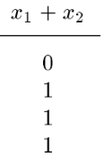
Truth Table for OR
x
1
x
x
1
+
x
2
2

Slide 41
Truth Tables for AND and OR
[ Figure 2.6b from the textbook ]

Slide 42
Logic Gates with n Inputs
x
1
x
x
1
2
x
2
x
1
⋅
x
2
⋅
…
⋅
x
n
x
+
x
+
…
+
x
1
2
n
x
n
x
n
AND gate
OR gate
[ Figure 2.8 from the textbook ]

Slide 43
Truth Table for 3-input AND and OR
[ Figure 2.7 from the textbook ]

Slide 44
A series-parallel connection
of the switches
S
X₁
S
Power
X₃
Light
supply
S
X₂
[ Figure 2.4 from the textbook ]

Slide 45
Example of a Logic Circuit
Implemented with Logic Gates
x
1
x
2
f
=
(
x
1
+
x
2
)
⋅
x
3
x
3
[ Figure 2.8 from the textbook ]

Slide 46
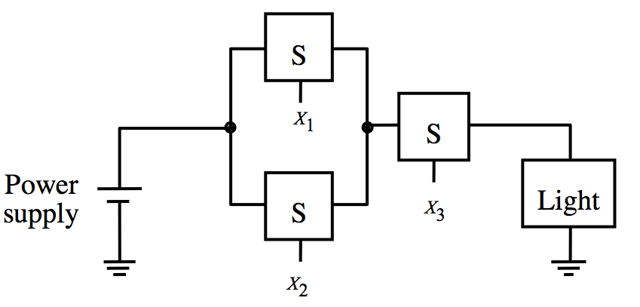
Example of a Logic Circuit
Implemented with Logic Gates
x
1
x
2
f
=
(
x
1
+
x
2
)
⋅
x
3
x
3
[ Figure 2.8 from the textbook ]

Slide 47
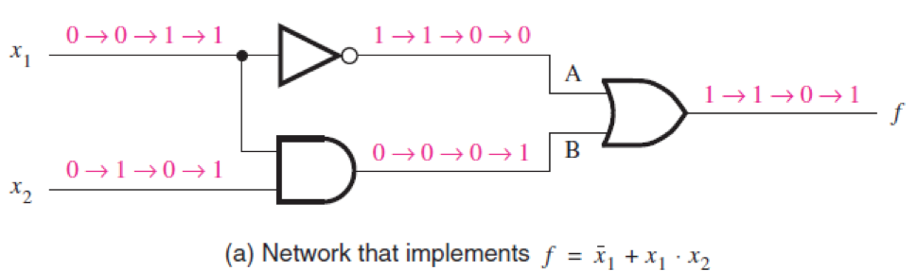
Circuit Analysis
[ Figure 2.10 from the textbook ]

Slide 48
Circuit Analysis
0
0
[ Figure 2.10 from the textbook ]

Slide 49
Circuit Analysis
0
0
0
0
[ Figure 2.10 from the textbook ]

Slide 50
Circuit Analysis
0
0
1
0
0
0
[ Figure 2.10 from the textbook ]

Slide 51
Circuit Analysis
0
0
1
1
0
0
0
0
[ Figure 2.10 from the textbook ]

Slide 52
Circuit Analysis
0
0
1
1
1
0
0
0
0
[ Figure 2.10 from the textbook ]

Slide 53
Circuit Analysis
[ Figure 2.10 from the textbook ]

Slide 54
Circuit Analysis
0
1
[ Figure 2.10 from the textbook ]

Slide 55
Circuit Analysis
0
0
0
1
[ Figure 2.10 from the textbook ]

Slide 56
Circuit Analysis
0
0
1
0
0
1
[ Figure 2.10 from the textbook ]

Slide 57
Circuit Analysis
0
0
1
1
0
0
0
1
[ Figure 2.10 from the textbook ]

Slide 58
Circuit Analysis
0
0
1
1
1
0
0
0
1
[ Figure 2.10 from the textbook ]

Slide 59
Circuit Analysis with Sequential Inputs
[ Figure 2.10 from the textbook ]

Slide 60
Circuit Analysis with Sequential Inputs
[ Figure 2.10 from the textbook ]

Slide 61
Circuit Analysis with Sequential Inputs
[ Figure 2.10 from the textbook ]

Slide 62
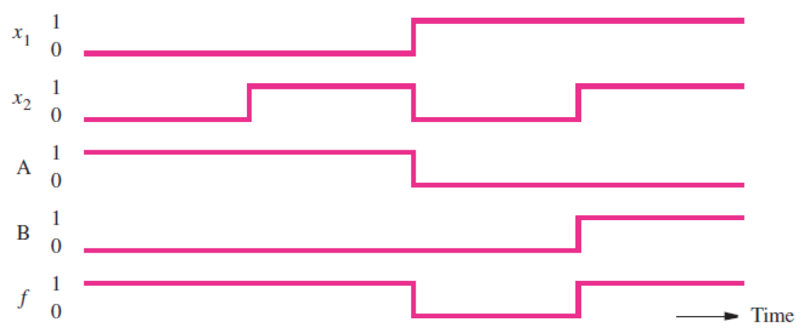
Circuit Analysis with Sequential Inputs
[ Figure 2.10 from the textbook ]

Slide 63
Circuit Analysis with Sequential Inputs
0
0
1
1
0
1
0
1
[ Figure 2.10 from the textbook ]

Slide 64
Circuit Analysis with Sequential Inputs
0
0
1
1
0
1
0
1
[ Figure 2.10 from the textbook ]

Slide 65
Circuit Analysis with Sequential Inputs
0
0
1
1
0
1
0
1
1
1
0
1
[ Figure 2.10 from the textbook ]

Slide 66
Circuit Analysis with Sequential Inputs
0
0
1
1
0
1
0
1
1
1
0
1
[ Figure 2.10 from the textbook ]

Slide 67
Timing Diagram
[ Figure 2.10 from the textbook ]

Slide 68
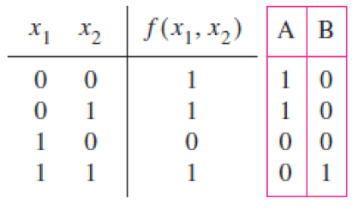
Truth Table for this Logic Circuit
[ Figure 2.10 from the textbook ]

Slide 69
Truth Table for f = x₁ + x₁ x₂

Slide 70
Truth Table for f = x₁ + x₁ x₂
0
0
1
1
1
0
0
0
0

Slide 71
Truth Table for f = x₁ + x₁ x₂
0
0
1
1
1
0
0
0
1

Slide 72
Truth Table for f = x₁ + x₁ x₂
1
1
0
0
0
1
0
0
0

Slide 73
Truth Table for f = x₁ + x₁ x₂
1
1
0
0
1
1
1
1
1

Slide 74
Truth Table for f = x₁ + x₁ x₂

Slide 76
Functionally Equivalent Circuits
[ Figure 2.10 from the textbook ]

Slide 77
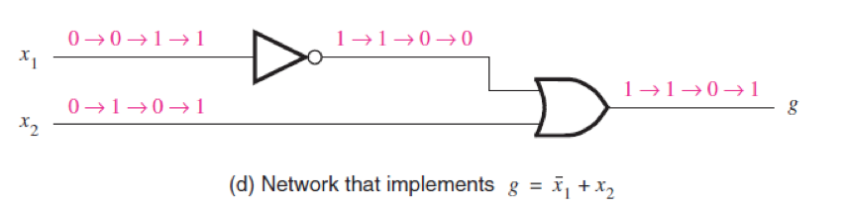
Functionally Equivalent Circuits
[ Figure 2.10 from the textbook ]

Slide 79
Logic XOR with Switches

Slide 80
XOR Circuit
x=0
y=0
+
_
Battery
Light

Slide 81
XOR Circuit
x=0
y=1
+
_
Battery
Light

Slide 82
XOR Circuit
x=1
y=0
+
_
Battery
Light

Slide 83
XOR Circuit
x=1
y=1
+
_
Battery
Light

Slide 84
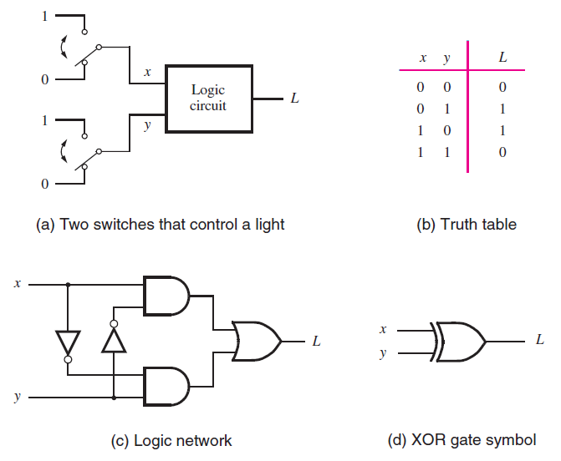
The XOR Logic Gate
[ Figure 2.11 from the textbook ]

Slide 85
The XOR Logic Gate
[ Figure 2.11 from the textbook ]

Slide 86
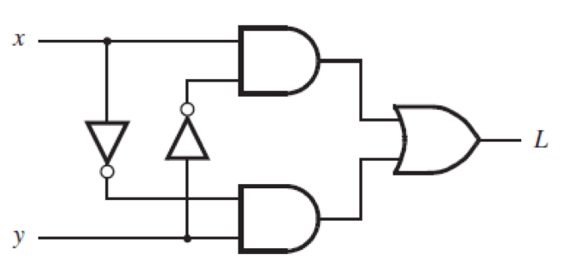
XOR Analysis
[ Figure 2.11c from the textbook ]

Slide 87
XOR Analysis (x=0, y=0)
0
0

Slide 88
XOR Analysis (x=0, y=0)
0
0
0
0

Slide 89
XOR Analysis (x=0, y=0)
0
0
1
1
0
0

Slide 90
XOR Analysis (x=0, y=0)
0
0
1
0
1
0
0
0

Slide 91
XOR Analysis (x=0, y=0)
0
0
1
0
0
1
0
0
0

Slide 92
XOR Analysis
[ Figure 2.11c from the textbook ]

Slide 93
XOR Analysis (x=0, y=1)
0
0
0
0
1
1
1
1
1

Slide 94
XOR Analysis
[ Figure 2.11c from the textbook ]

Slide 95
XOR Analysis (x=1, y=0)
1
1
1
1
1
0
0
0
0

Slide 96
XOR Analysis
[ Figure 2.11c from the textbook ]

Slide 97
XOR Analysis (x=1, y=1)
1
1
0
0
0
0
0
1
1

Slide 98
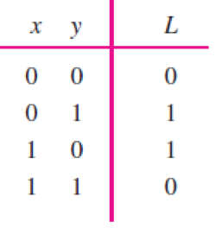
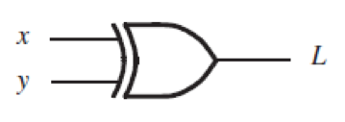
Truth Table for XOR

Slide 99
Truth Table for XOR
The output is 1 only if the two inputs are different.

Slide 101
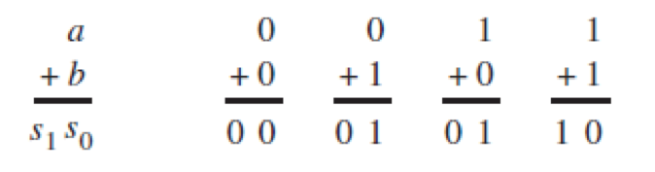
Addition of Binary Numbers
[ Figure 2.12 from the textbook ]

Slide 102
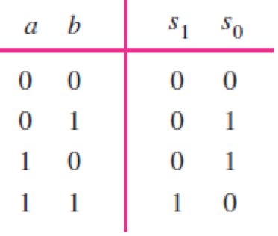
Addition of Binary Numbers
[ Figure 2.12 from the textbook ]

Slide 103
Addition of Binary Numbers

Slide 104
Addition of Binary Numbers

Slide 105
Addition of Binary Numbers

Slide 106
Addition of Binary Numbers

Slide 107
Addition of Binary Numbers

Slide 108
Addition of Binary Numbers

Slide 109
Addition of Binary Numbers

Slide 110
Addition of Binary Numbers

Slide 111
Addition of Binary Numbers

Slide 112
Addition of Binary Numbers

Slide 113
Addition of Binary Numbers

Slide 114
Addition of Binary Numbers

Slide 115
Addition of Binary Numbers

Slide 116
Addition of Binary Numbers
?

Slide 117
Addition of Binary Numbers
AND

Slide 118
Addition of Binary Numbers

Slide 119
Addition of Binary Numbers
?

Slide 120
Addition of Binary Numbers
XOR

Slide 121
Addition of Binary Numbers

Slide 122
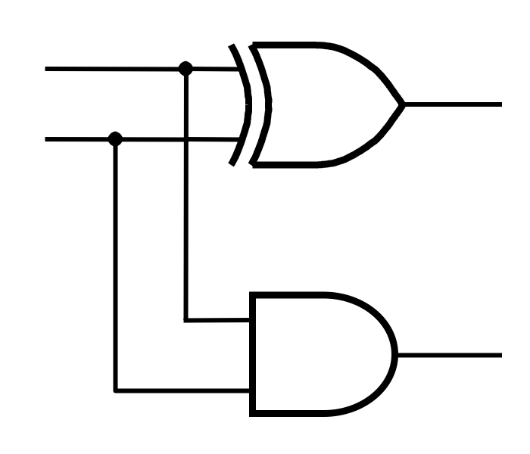
Addition of Binary Numbers

Slide 123
Addition of Binary Numbers
a
s₀
b
s₁

Slide 125

The following examples came from this book

Slide 126
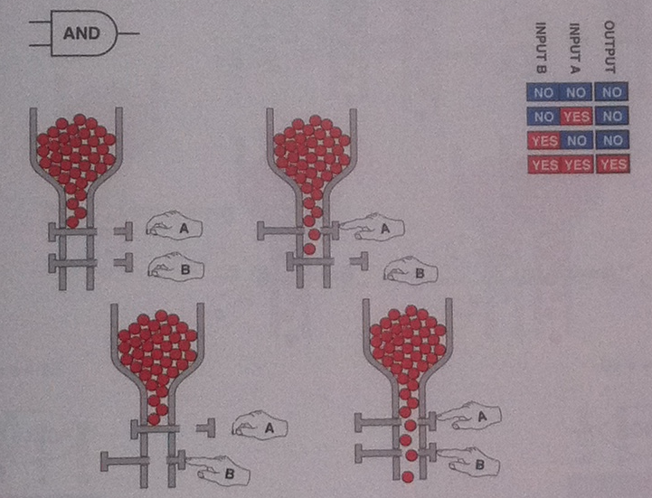
[ Platt 2009 ]

Slide 127
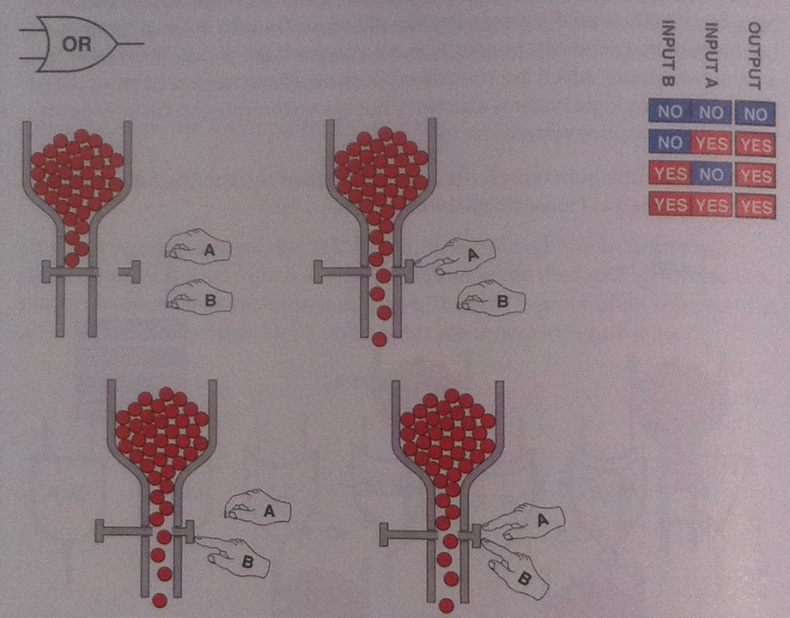
[ Platt 2009 ]

Slide 128
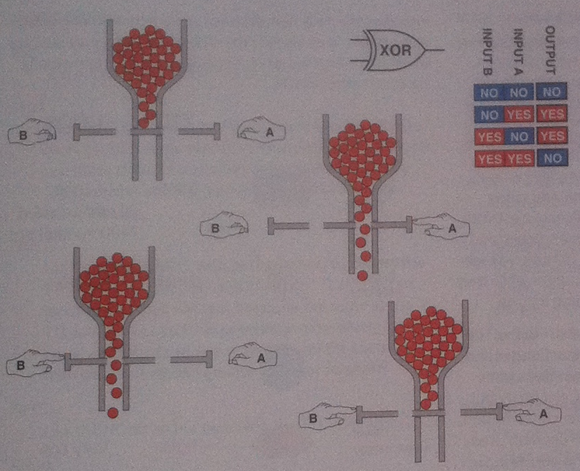
[ Platt 2009 ]

Slide 129
Questions?

Slide 130
THE END

