Slide 1
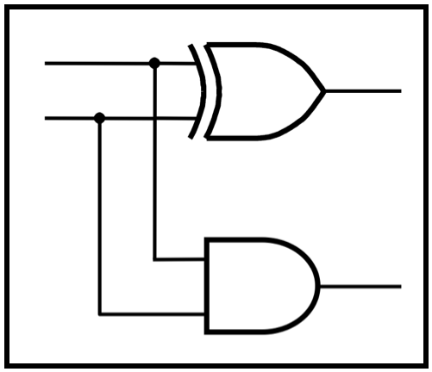
CprE 281: Digital Logic
Guest Lecture by Ben Magstadt
http://www.ece.iastate.edu/~alexs/classes/

Slide 2
Verilog Tutorial
Ben Magstadt – btm573@iastate.edu
Master’s Student
Electrical Engineering
CprE 281: Digital Logic
Iowa State University, Ames, IA
Copyright © 2013

Slide 3
Announcements
Dr. Stoytchev is gone this week
Will still have lecture all week
Homework 3 is due now
Homework 4 is due next Monday (9/23/2013)

Slide 4
Agenda
Overview of Hardware Description Languages
Overview of Verilog
Simulating Verilog Examples

Slide 5
HDL – Hardware Description Language
Used to mirror the behavior of hardware
Used for
Digital design
Schematic
Layout
Digital timing
Digital verification
Analog verification

Slide 6
HDL – Hardware Description Language
Most Popular
Verilog
Used more often
More compatible with Cadence tools
Timing
Simulation
Focused on at Iowa State University
VHDL
Still used some in industry
Usage is decreasing

Slide 7
Verilog at Iowa State University
CprE281
Lab
Final Project
EE330
Homework
Lab
Final Project
EE465/CprE465
Lab
Final Project
Possibly others

Slide 8
Verilog – Main Data types
Input
Output
Inout – Rarely Used (Tool Compatibility Issues)
Wires: No driving strength
Just declare for internal
Use with assigns or from a variable being driven from other module
Registers
Output or just internal
Used elsewhere when driving a variable
More data types
System Verilog: real
Verilog-AMS (Analog Mixed Signal): real, wreal, electrical

Slide 9
Verilog – Coding Styles
Structural
Used to represent logic primitives
not(A, B);
Behavioral
Used to represent more complex logical statements easier
A <= ~A & (B | C);
Inside of an ‘always’ block
assign A = ~A & (B | C);
Outside of an ‘always’ block

Slide 10
Verilog – ‘initial’ Blocks
Used to define initial states of variables
Not floating
Can’t be used when synthesizing a circuit
Used mostly in test benches
Will also work when programming FPGA
Also a ‘final’ block
Seldom used, but good for verifying the final state of system

Slide 11
Verilog – ‘always’ Blocks
Used to produce an action on a variable change
Similar to a D Flip-Flop
always @(posedge clk) begin
A <= B;
end
always @(B) begin
A <= B;
end

Slide 12
Verilog – Other useful functionality
If-else
Only inside of an ‘always’ block
Case
Only inside of an ‘always’ block
For
Only inside of an ‘always’ block
Careful with usage – can produce synthesis errors
Timescale
`timescale 1ns/1ps
reference/precision
Wait
#10: Wait ten time units
Units based on timescale
Only use in test benches and for verification purposes

Slide 13
Verilog: Blocking vs. Non-Blocking Statements
Blocking
Behaves like normal programming languages
Values are instantly entered and can be used on the next line
=
Won’t synthesize if used in an always block
Only for assigns
Non-blocking
<=
All statements are entered at the same time
Example Simulation Later

Slide 14
Verilog Simulation on Campus
Quartus to program FPGA
Great for interactive learning
ModelSim
Able see internal registers
Can see full simulation waveforms
Access from anywhere
Cadence & Cadence tools
Schematic
Layout
Timing

Slide 15
Verilog Simulation: ModelSim Tutorial
On any Linux machine or remote Linux machine on campus
Download Model_Sim.env
Move to a new directory
Enter this new directory in a console
Type: source ModelSim_env.txt
Type: vsim &

Slide 16
Verilog Simulation: ModelSim Tutorial
Close IMPORTANT Information window
File -> New Project
Make a project name
Right Click -> New File
Make sure Add file as type is set to Verilog
Create Verilog file
Name is usually same as the module name (Required in Quartus)
Create Verilog file test bench
Double Click file to open and edit

Slide 17
Verilog Simulation: ModelSim Tutorial
Compile -> Compile All
Green check mark for success/red X for error
Double click red X to see explanation of error
Simulate -> Start Simulation
Uncheck Enable Optimization
Under the work tab, find the test bench
Find wave tab or View -> New Window -> Wave
Right click in object window, then Add -> To Wave -> Signals in Design

Slide 18
Verilog Simulation: ModelSim Tutorial
Find and click the run icon next to the time display
Change the simulation time if necessary
Control + mouse scroll is zoom
Right click on variables to switch radix from Binary, Decimal, Hex, etc.

Slide 19
Verilog Simulation: ModelSim Example
Simple AND gate and other logic
3 Ways
8’bit Adder
2 Ways
Blocking vs. Non-blocking
Choosing math operation
State machine with reset

Slide 20
Contact Info
Ben Magstadt
Email: btm573@iastate.edu
Office: Coover 3133
Website: http://benmagstadt.weebly.com/cpre-281-verilog-tutorial.html
Presentation
Instructions
Source file
Examples

Slide 21
Questions?

Slide 22
THE END

