Slide 1
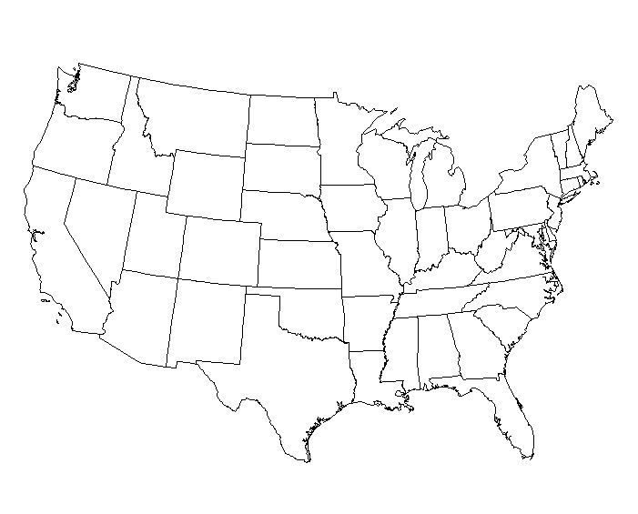
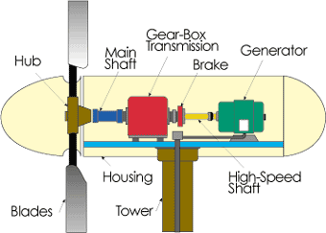
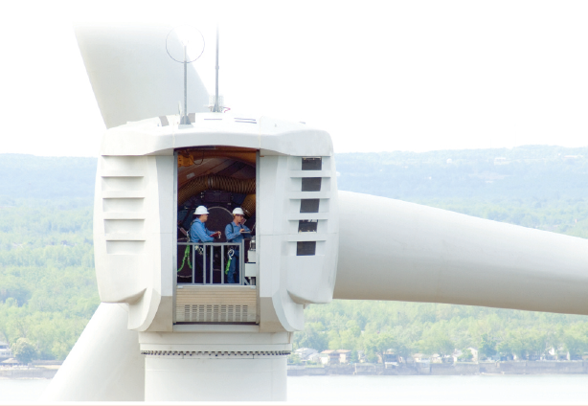
Wind Technology
J. McCalley

Slide 2
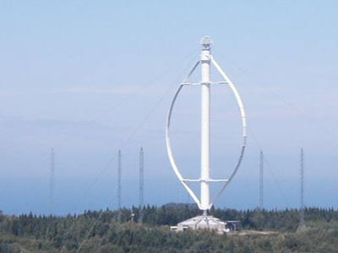
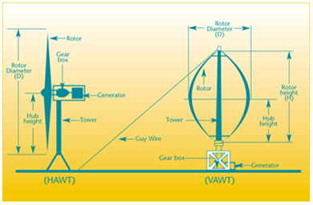
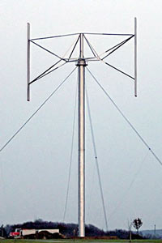
Horizontal vs. Vertical-Axis
Notes:
Anemometer: Measures the wind speed and transmits wind speed data to the controller.
Blades: Most turbines have either two or three blades. Wind blowing over the blades causes the blades to "lift" and rotate.
Brake: A disc brake, which can be applied mechanically, electrically, or hydraulically to stop the rotor in emergencies.
Controller: The controller starts up the machine at wind speeds of about 8 to 16 miles per hour (mph) and shuts off the machine at about 55 mph. Turbines do not operate at wind speeds above about 55 mph because they might be damaged by the high winds.
Gear box: Gears connect the low-speed shaft to the high-speed shaft and increase the rotational speeds from about 30 to 60 rotations per minute (rpm) to about 1000 to 1800 rpm, the rotational speed required by most generators to produce electricity. The gear box is a costly (and heavy) part of the wind turbine and engineers are exploring "direct-drive" generators that operate at lower rotational speeds and don't need gear boxes.
Generator: Usually an off-the-shelf induction generator that produces 60-cycle AC electricity.
High-speed shaft: Drives the generator. Low-speed shaft: The rotor turns the low-speed shaft at about 30 to 60 rotations per minute.
Nacelle: The nacelle sits atop the tower and contains the gear box, low- and high-speed shafts, generator, controller, and brake. Some nacelles are large enough for a helicopter to land on.
Pitch: Blades are turned, or pitched, out of the wind to control the rotor speed and keep the rotor from turning in winds that are too high or too low to produce electricity.
Rotor: The blades and the hub together are called the rotor. Tower: Towers are made from tubular steel (shown here), concrete, or steel lattice. Because wind speed increases with height, taller towers enable turbines to capture more energy and generate more electricity.
Wind direction: This is an "upwind" turbine, so-called because it operates facing into the wind. Other turbines are designed to run "downwind," facing away from the wind.
Wind vane: Measures wind direction and communicates with the yaw drive to orient the turbine properly with respect to the wind.
Yaw drive: Upwind turbines face into the wind; the yaw drive is used to keep the rotor facing into the wind as the wind direction changes. Downwind turbines don't require a yaw drive, the wind blows the rotor downwind.
Yaw motor: Powers the yaw drive.

Slide 3
Horizontal vs. Vertical-Axis
Turbine type | Advantages | Disadvantages
HAWT | Higher wind energy conversion efficiency Access to stronger wind due to tower height Power regulation by stall and pitch angle control at high wind speeds | Higher installation cost, stronger tower to support heavy weight of nacelle Longer cable from top of tower to ground Yaw control required
VAWT | Lower installation cost and easier maintenance due to ground-level gearbox and generator Operation independent of wind direction More suitable for rooftops where strong winds are available without tower height | Lower wind energy conversion efficiency (weaker wind on lower portion of blades & limited aerodynamic performance of blades) Higher torque fluctuations and prone to mechanical vibrations Limited options for power regulation at high wind speeds.
Source: B. Wu, Y. Lang, N. Zargari, and S. Kouro, “Power conversion and control of wind energy systems,” Wiley, 2011.
Notes:
Anemometer: Measures the wind speed and transmits wind speed data to the controller.
Blades: Most turbines have either two or three blades. Wind blowing over the blades causes the blades to "lift" and rotate.
Brake: A disc brake, which can be applied mechanically, electrically, or hydraulically to stop the rotor in emergencies.
Controller: The controller starts up the machine at wind speeds of about 8 to 16 miles per hour (mph) and shuts off the machine at about 55 mph. Turbines do not operate at wind speeds above about 55 mph because they might be damaged by the high winds.
Gear box: Gears connect the low-speed shaft to the high-speed shaft and increase the rotational speeds from about 30 to 60 rotations per minute (rpm) to about 1000 to 1800 rpm, the rotational speed required by most generators to produce electricity. The gear box is a costly (and heavy) part of the wind turbine and engineers are exploring "direct-drive" generators that operate at lower rotational speeds and don't need gear boxes.
Generator: Usually an off-the-shelf induction generator that produces 60-cycle AC electricity.
High-speed shaft: Drives the generator. Low-speed shaft: The rotor turns the low-speed shaft at about 30 to 60 rotations per minute.
Nacelle: The nacelle sits atop the tower and contains the gear box, low- and high-speed shafts, generator, controller, and brake. Some nacelles are large enough for a helicopter to land on.
Pitch: Blades are turned, or pitched, out of the wind to control the rotor speed and keep the rotor from turning in winds that are too high or too low to produce electricity.
Rotor: The blades and the hub together are called the rotor. Tower: Towers are made from tubular steel (shown here), concrete, or steel lattice. Because wind speed increases with height, taller towers enable turbines to capture more energy and generate more electricity.
Wind direction: This is an "upwind" turbine, so-called because it operates facing into the wind. Other turbines are designed to run "downwind," facing away from the wind.
Wind vane: Measures wind direction and communicates with the yaw drive to orient the turbine properly with respect to the wind.
Yaw drive: Upwind turbines face into the wind; the yaw drive is used to keep the rotor facing into the wind as the wind direction changes. Downwind turbines don't require a yaw drive, the wind blows the rotor downwind.
Yaw motor: Powers the yaw drive.

Slide 4
Horizontal vs. Vertical-Axis
The next slide shows detailed comparison between HAWT and VAWT.
Source: Market, cost, and technical analysis of vertical and horizontal axis wind turbines
Task #2: VAWT vs. HAWT technology. May 2003
Prepared for Lawrence Berkeley National Laboratory, Berkeley, California 94701, Subcontract #6703903
Global Energy Concepts, LLC
5729 Lakeview Drive NE, #100
Kirkland, Washington 98033
Phone: 425-822-9008, www.globalenergyconcepts.com
Principal investigator, David J. Malcolm

Slide 5
Horizontal vs. Vertical-Axis
Feature | HAWTs | Curved bladed VAWTs | Straight bladed VAWT | Comments
Aero efficiency | Cp up to 0.50 Possible with efficient airfoils and a twist schedule | Cp up to 0.38 Airfoils limited by symmetry requirement. Tapering of chord not feasible | Cp up to 0.35 Straight VAWT suffer parasitic losses from connections | Efficiency becomes of increasing importance for larger machines.
Braking/ control | Small machines can furl; larger machines can pitch full blade. Mechanical brake can be nominal | No reliable aero braking available for curved VAWTs. Expensive mechanical brakes necessary. | Straight bladed can, in theory, pitch blades but this has not been done | The type of braking will affect safety and the obtaining of certification.
Tip speed | Tip speed can as high as 100 m/s | Generally lower than for HAWTs. More blade is at maximum tip speed | Generally lower than for HAWTs. All of blade is at maximum tip speed | Theory indicates that higher tip speeds can lead to higher efficiencies.
Hub height | Commonly elevated by towers with or without guy cables. Able to benefit from wind shear. | Most VAWTs are on short towers but cantilevered VAWTs could be placed on tall towers | Most VAWTs are on short towers but cantilevered VAWTs could be placed on tall towers | Sites without significant vertical wind shear are a minority although they do exist.
Support | Cantilever tube or guyed tube or truss is common | Smaller VAWTs may be cantilevered but larger machines have all been guyed or with rigid external frame | Cantilevered or guyed tube or truss have all been used | In some locations, small machines must be elevated above surrounding trees, buildings, etc.
Yawing | Some yawing mechanism required | No yawing mechanism required. | No yawing mechanism required | Yawing is a mixed blessing: it requires a mechanism but allows HAWT rotor to be furled out of wind
Furling | Smaller HAWTs often use a furling mechanism to control peak loads. | Furling is not an option | Furling is not an option | Furling comes with its own loads
Drive train | Normally in the nacelle. | Normally at ground level which is an advantage for maintenance | Sometimes at ground level but in larger machines has been at hub height | Ground based system will lower maintenance for VAWTs, particularly the cost of periodic overhauls of gearboxes and generators. Periodic overhaul or replacement are required for these major power train components for both VAWTs and HAWTs.
Direct drive | Common in small machines and power electronics is making it more common in larger machines | The MW Eole turbine used a direct drive plus power electronics. Ground-based drive is suited to larger generator rotors. | Most commercial small VAWTs use direct drive | Seen as suited especially to VAWTs but they have been successfully used in many large HAWTs.
Assembly | crane needed unless tilt-up design | Crane needed for most lifts of the rotor. Smaller crane with rigid frame. | Crane required for most machines | Several HAWTs have had self-erecting features.
Fatigue | Most fatigue is due to turbulence. | Nearly all fatigue is due to the basic aerodynamics of the VAWT. Multiple blades will reduce some fatigue loads. | Nearly all fatigue is due to the basic aerodynamics of the VAWT. Multiple blades will reduce some fatigue loads. | Fatigue is a common driver for components of both HAWTs and VAWTs
Gravity | HAWT blades are subject to gravity-induced fatigue but this is only critical on very large machines | Gravity does not affect any fatigue loads | Gravity does not affect any fatigue loads
Offshore | Large HAWTs now common offshore | Low wind shear favors VAWTs but guyed support very awkward. | Subject to the same rules as HAWTs
Swept area per unit blade length (3 bladed) | 0.52 D | 0.18 D (for H/D=1.5) 0.20 D (for H/D=2.5) | 0.50 D (for all H/D) | The total solidity may be the same due to the lower chord of the VAWT blade
Number of root connections to blade | 3 no connections causing parasitic drag | 6 | Minimum = 3 all connections are at the max radius and incur considerable drag
Number of intermediate blade connections | none | 6 (usually) connections to struts adds some parasitic drag | Variable Again, all connections will be the source of some parasitic drag

Slide 6
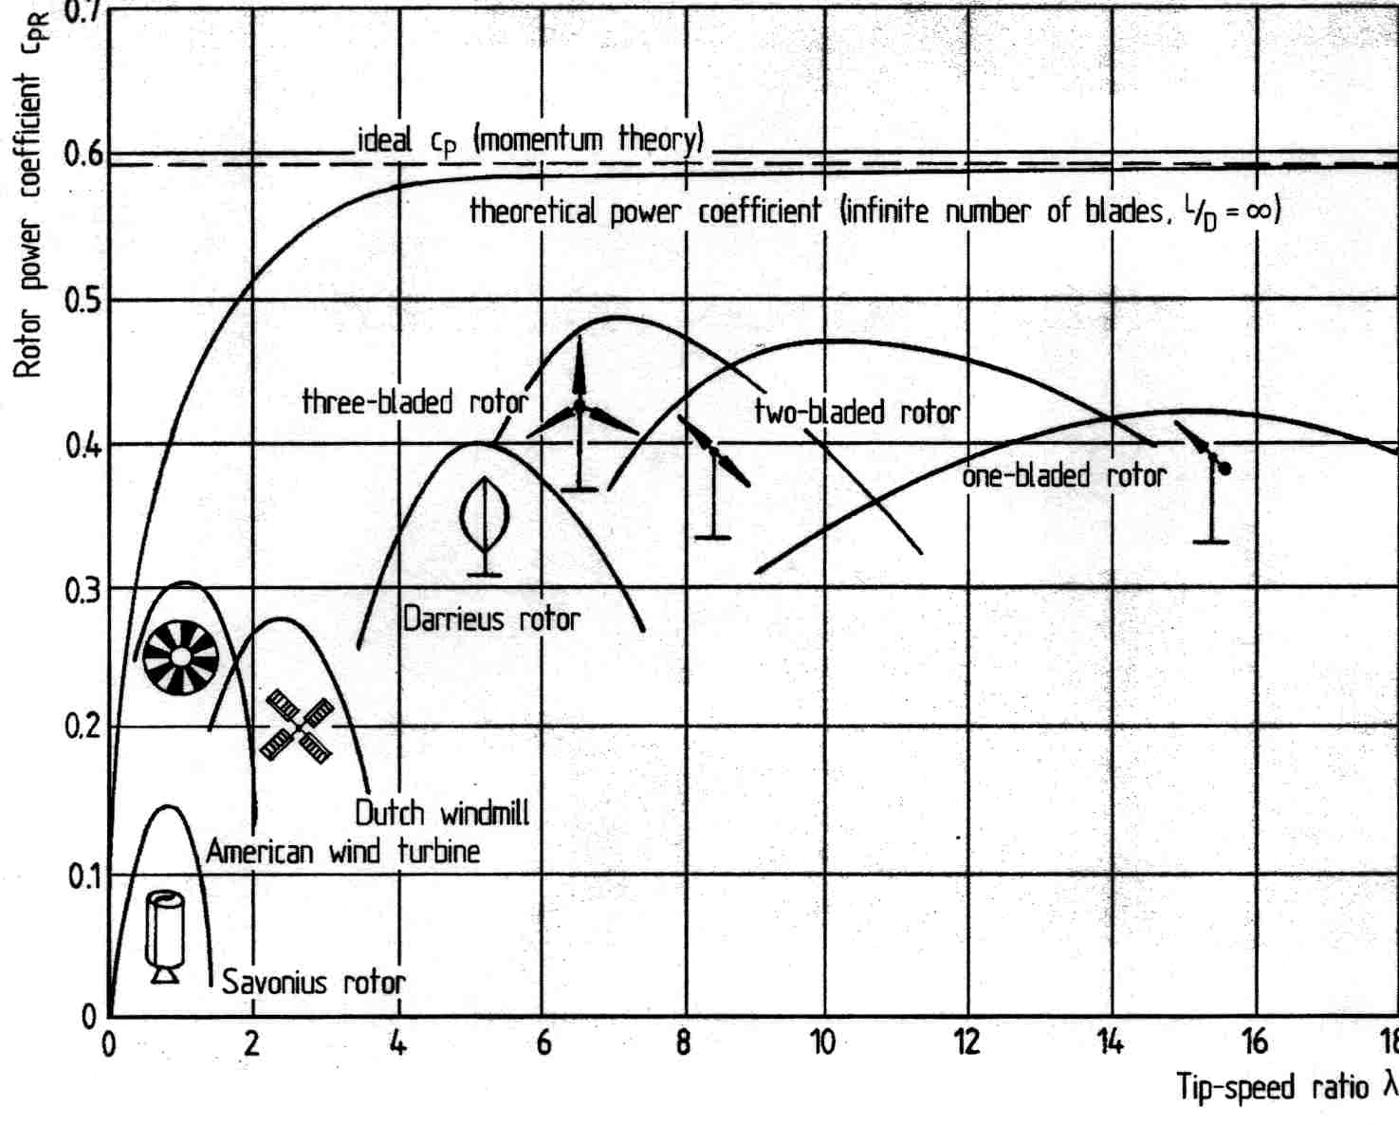
Horizontal vs. Vertical-Axis
The highest aerodynamic efficiency is achieved with the 3-bladed HAWT. This is why most wind turbines today are 3-bladed HAWT.
Source: E. Hau, “Wind turbines: Fundamentals, Technologies, Application, Economics,” 2nd edition, springer, 2005.
Power coefficient:
C_{p}=power extracted/power of wind
➔C_{p}=P_{extracted} / P_{InWind}
TSR: λ=tip speed of blade/wind speed
➔λ=ωR/v_{w}
Notes:
Anemometer: Measures the wind speed and transmits wind speed data to the controller.
Blades: Most turbines have either two or three blades. Wind blowing over the blades causes the blades to "lift" and rotate.
Brake: A disc brake, which can be applied mechanically, electrically, or hydraulically to stop the rotor in emergencies.
Controller: The controller starts up the machine at wind speeds of about 8 to 16 miles per hour (mph) and shuts off the machine at about 55 mph. Turbines do not operate at wind speeds above about 55 mph because they might be damaged by the high winds.
Gear box: Gears connect the low-speed shaft to the high-speed shaft and increase the rotational speeds from about 30 to 60 rotations per minute (rpm) to about 1000 to 1800 rpm, the rotational speed required by most generators to produce electricity. The gear box is a costly (and heavy) part of the wind turbine and engineers are exploring "direct-drive" generators that operate at lower rotational speeds and don't need gear boxes.
Generator: Usually an off-the-shelf induction generator that produces 60-cycle AC electricity.
High-speed shaft: Drives the generator. Low-speed shaft: The rotor turns the low-speed shaft at about 30 to 60 rotations per minute.
Nacelle: The nacelle sits atop the tower and contains the gear box, low- and high-speed shafts, generator, controller, and brake. Some nacelles are large enough for a helicopter to land on.
Pitch: Blades are turned, or pitched, out of the wind to control the rotor speed and keep the rotor from turning in winds that are too high or too low to produce electricity.
Rotor: The blades and the hub together are called the rotor. Tower: Towers are made from tubular steel (shown here), concrete, or steel lattice. Because wind speed increases with height, taller towers enable turbines to capture more energy and generate more electricity.
Wind direction: This is an "upwind" turbine, so-called because it operates facing into the wind. Other turbines are designed to run "downwind," facing away from the wind.
Wind vane: Measures wind direction and communicates with the yaw drive to orient the turbine properly with respect to the wind.
Yaw drive: Upwind turbines face into the wind; the yaw drive is used to keep the rotor facing into the wind as the wind direction changes. Downwind turbines don't require a yaw drive, the wind blows the rotor downwind.
Yaw motor: Powers the yaw drive.

Slide 7
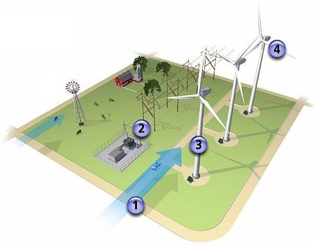
Standard wind turbine components
Notes:
Anemometer: Measures the wind speed and transmits wind speed data to the controller.
Blades: Most turbines have either two or three blades. Wind blowing over the blades causes the blades to "lift" and rotate.
Brake: A disc brake, which can be applied mechanically, electrically, or hydraulically to stop the rotor in emergencies.
Controller: The controller starts up the machine at wind speeds of about 8 to 16 miles per hour (mph) and shuts off the machine at about 55 mph. Turbines do not operate at wind speeds above about 55 mph because they might be damaged by the high winds.
Gear box: Gears connect the low-speed shaft to the high-speed shaft and increase the rotational speeds from about 30 to 60 rotations per minute (rpm) to about 1000 to 1800 rpm, the rotational speed required by most generators to produce electricity. The gear box is a costly (and heavy) part of the wind turbine and engineers are exploring "direct-drive" generators that operate at lower rotational speeds and don't need gear boxes.
Generator: Usually an off-the-shelf induction generator that produces 60-cycle AC electricity.
High-speed shaft: Drives the generator. Low-speed shaft: The rotor turns the low-speed shaft at about 30 to 60 rotations per minute.
Nacelle: The nacelle sits atop the tower and contains the gear box, low- and high-speed shafts, generator, controller, and brake. Some nacelles are large enough for a helicopter to land on.
Pitch: Blades are turned, or pitched, out of the wind to control the rotor speed and keep the rotor from turning in winds that are too high or too low to produce electricity.
Rotor: The blades and the hub together are called the rotor. Tower: Towers are made from tubular steel (shown here), concrete, or steel lattice. Because wind speed increases with height, taller towers enable turbines to capture more energy and generate more electricity.
Wind direction: This is an "upwind" turbine, so-called because it operates facing into the wind. Other turbines are designed to run "downwind," facing away from the wind.
Wind vane: Measures wind direction and communicates with the yaw drive to orient the turbine properly with respect to the wind.
Yaw drive: Upwind turbines face into the wind; the yaw drive is used to keep the rotor facing into the wind as the wind direction changes. Downwind turbines don't require a yaw drive, the wind blows the rotor downwind.
Yaw motor: Powers the yaw drive.

Slide 8
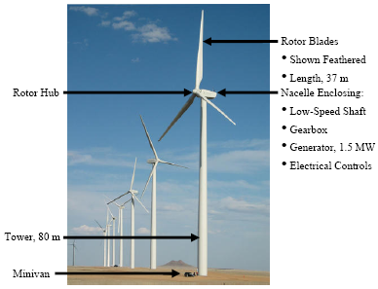
Standard wind turbine components
Notes:
Anemometer: Measures the wind speed and transmits wind speed data to the controller.
Blades: Most turbines have either two or three blades. Wind blowing over the blades causes the blades to "lift" and rotate.
Brake: A disc brake, which can be applied mechanically, electrically, or hydraulically to stop the rotor in emergencies.
Controller: The controller starts up the machine at wind speeds of about 8 to 16 miles per hour (mph) and shuts off the machine at about 55 mph. Turbines do not operate at wind speeds above about 55 mph because they might be damaged by the high winds.
Gear box: Gears connect the low-speed shaft to the high-speed shaft and increase the rotational speeds from about 30 to 60 rotations per minute (rpm) to about 1000 to 1800 rpm, the rotational speed required by most generators to produce electricity. The gear box is a costly (and heavy) part of the wind turbine and engineers are exploring "direct-drive" generators that operate at lower rotational speeds and don't need gear boxes.
Generator: Usually an off-the-shelf induction generator that produces 60-cycle AC electricity.
High-speed shaft: Drives the generator. Low-speed shaft: The rotor turns the low-speed shaft at about 30 to 60 rotations per minute.
Nacelle: The nacelle sits atop the tower and contains the gear box, low- and high-speed shafts, generator, controller, and brake. Some nacelles are large enough for a helicopter to land on.
Pitch: Blades are turned, or pitched, out of the wind to control the rotor speed and keep the rotor from turning in winds that are too high or too low to produce electricity.
Rotor: The blades and the hub together are called the rotor. Tower: Towers are made from tubular steel (shown here), concrete, or steel lattice. Because wind speed increases with height, taller towers enable turbines to capture more energy and generate more electricity.
Wind direction: This is an "upwind" turbine, so-called because it operates facing into the wind. Other turbines are designed to run "downwind," facing away from the wind.
Wind vane: Measures wind direction and communicates with the yaw drive to orient the turbine properly with respect to the wind.
Yaw drive: Upwind turbines face into the wind; the yaw drive is used to keep the rotor facing into the wind as the wind direction changes. Downwind turbines don't require a yaw drive, the wind blows the rotor downwind.
Yaw motor: Powers the yaw drive.

Slide 9
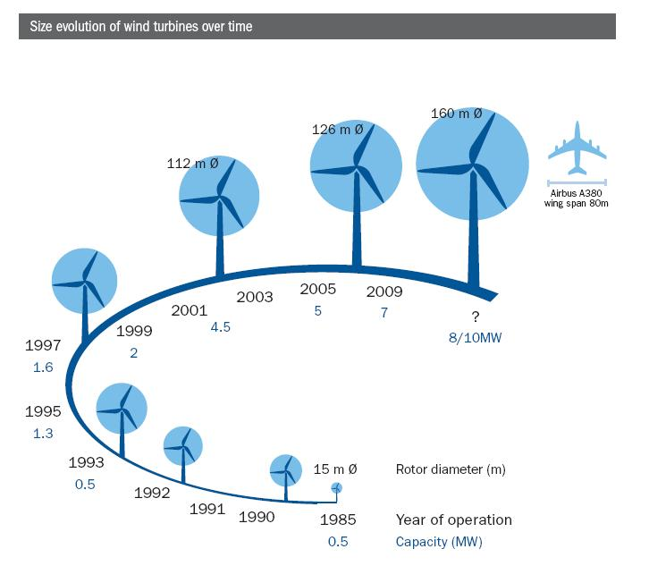
Towers
Steel tube most common.
Other designs can be lattice, concrete, or hybrid concrete-steel.
Must be >30 m high to avoid turbulence caused by trees and buildings. Usually~80 m.
Tower height increases w/ pwr rating/rotor diameter;
More height provides better wind resource;
Given material/design, height limited by base diameter
Steel tube base diameter limited by transportation (14.1 feet), which limits tower height to about 80m.
Lattice, concrete, hybrid designs required for >80m.

Slide 10
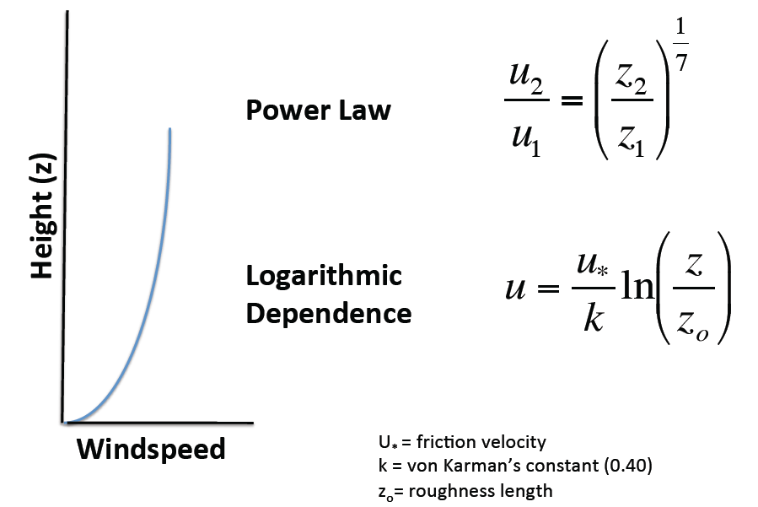
Wind speed and tower height
Source: ISU REU program summer 2011, slides by Eugene Takle

Slide 11
Wind speed and tower height
Height above ground
~1 km
Great Plains Low-Level Jet Maximum
(~1,000 m above ground)
Horizontal wind speed
Source: ISU REU program summer 2011, slides by Eugene Takle

Slide 12
Wind speed/class (new) info
https://www.arcgis.com/home/item.html?id=cb13354183dd46ff969dc794f8d7961f

Slide 13
Wind speed/class (old) and tower height
To get more economically attractive wind energy investments, either move to a class 3 or above location, or… go up in tower height.

Slide 14
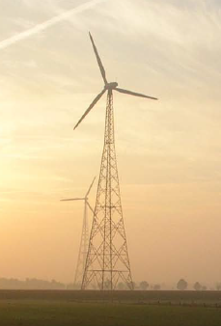
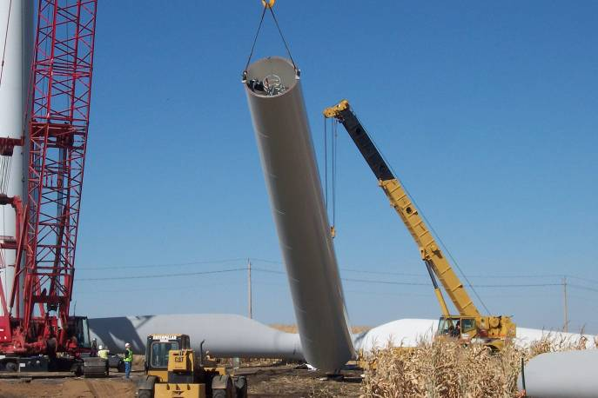
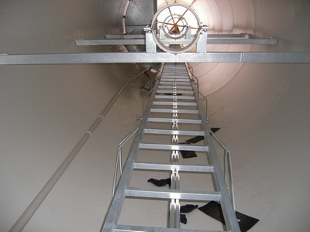
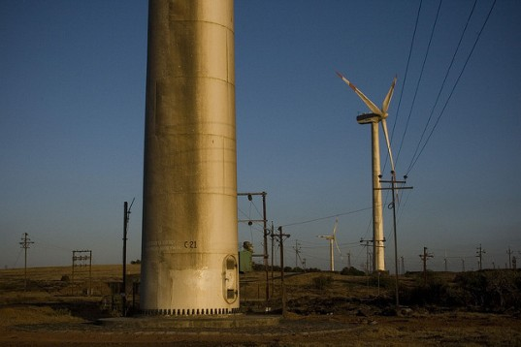
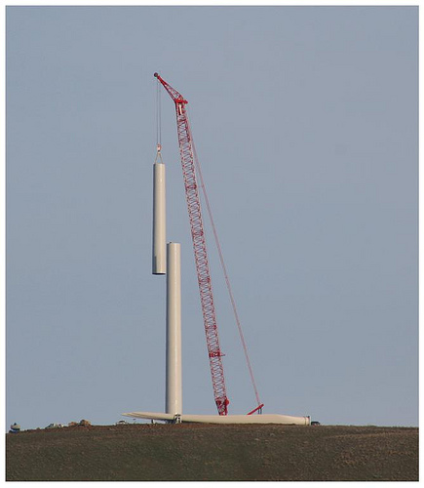
Towers
Lattice tower
Steel-tubular tower
Concrete tower
Steel-tubular tower

Slide 15
Towers
Conical tubular pole towers:
Steel: Short on-site assembly & erection time; cheap steel.
Concrete: less flexible so does not transmit/amplify sound; can be built on-site (no need to transport) or pre-fabricated.
Hybrid: Concrete base, steel top sections; no buckling/corrosion
Lattice truss towers:
  Half the steel for same stiffness and height, resulting in cost and transportation advantage
  Less resistance to wind flow
  Spread structure’s loads over wider area therefore less volume in the foundation
  Less tower shadow
  Lower visual/aesthetic appeal
  Longer assembly time on-site
  Higher maintenance costs

Slide 16
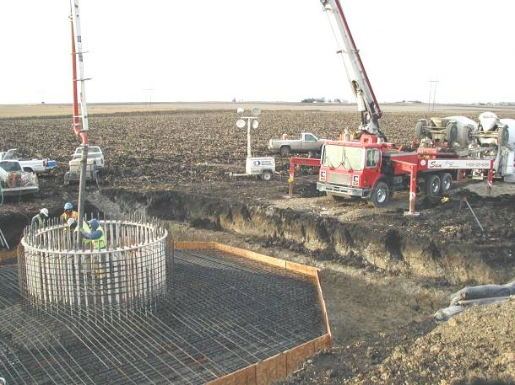
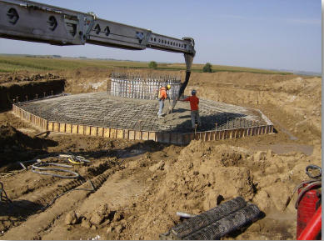
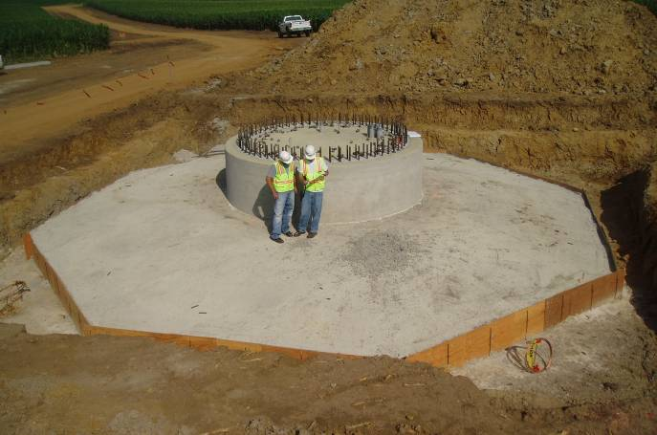
Foundations
Above foundations are slab, the most common. Formwork is set up in foundation pit, rebar is installed before concrete is poured. Foundations may also be pile, if soil is weak, requiring a bedplate to rest atop 20 or more pole-shaped piles, extending into the earth.

Slide 17
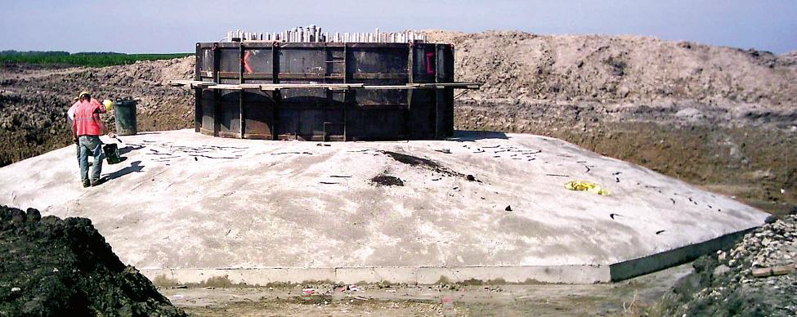
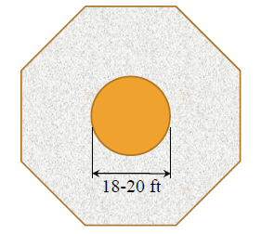

Foundations
Typical dimensions:
➔Footing
•width: 50-65 ft
•avg. depth: 4-6 ft
➔Pedestal
•diameter: 18-20 ft
•height: 8-9 ft
Source: ENGR 340 slides by Jeremy Ashlock

Slide 18
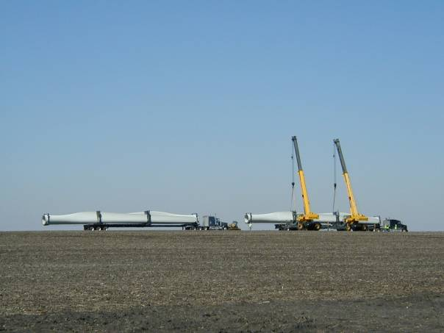
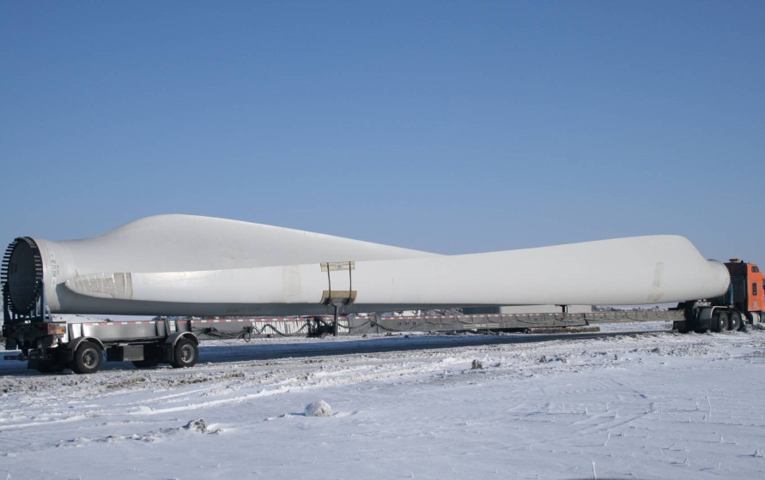
Blades
Materials: aluminum, fiberglass, or carbon-fiber composites to provide strength-to-weight ratio, fatigue life, and stiffness while minimizing weight.
Three blade design is standard.
  Fewer blades cost less (less materials & operate at higher rotational speeds - lower gearing ratio); but acoustic noise, proportional to (blade speed), is too high.
  More than 3 requires more materials, more cost, with only incremental increase in aerodynamic efficiency.

Slide 19
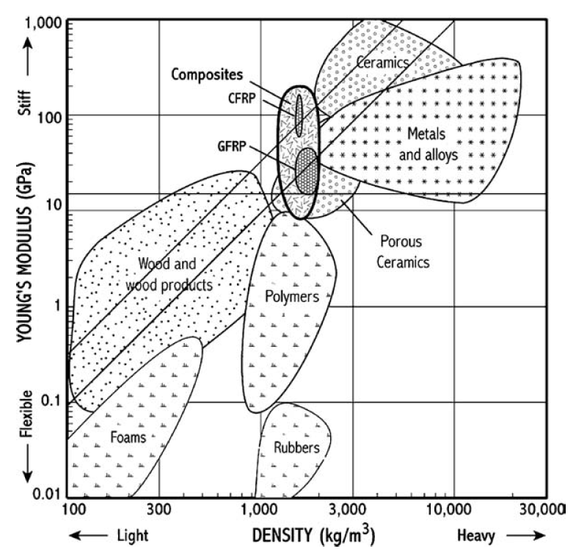
Blades
High material stiffness is needed to maintain optimal aerodynamic performance,
Low density is needed to reduce gravity forces and improve efficiency,
Long-fatigue life is needed to reduce material degradation – 20 year life = 10⁸-10⁹ cycles.
CFRP: Carbon-fiber reinforced polymer; GFRP: Glass-fiber reinforced polymer
Young’s modulus: a measure of the stiffness of an elastic material.
GPa are “giga-pascals” where a pascal is a unit of pressure or stress.
Source: ENGR 340 slides by Mike Kessler

Slide 20
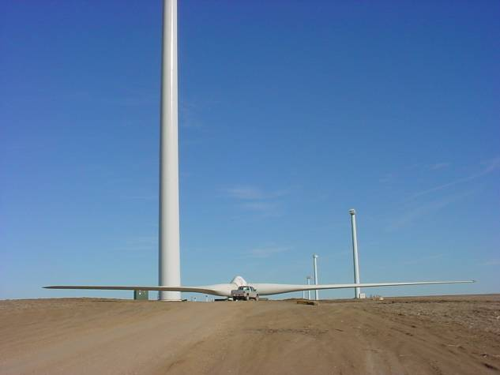
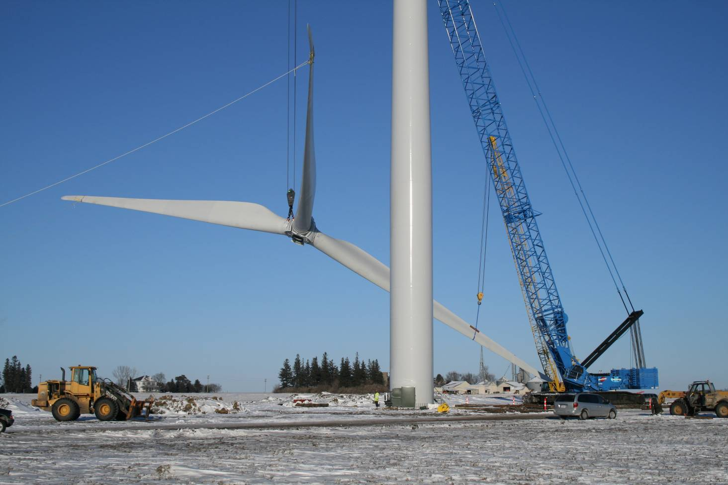
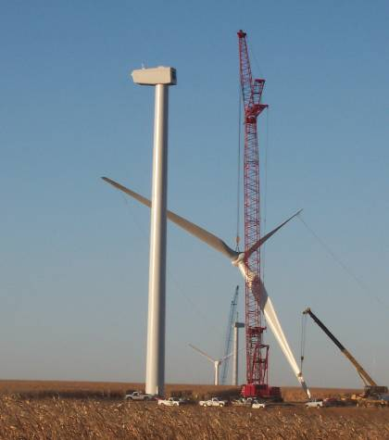
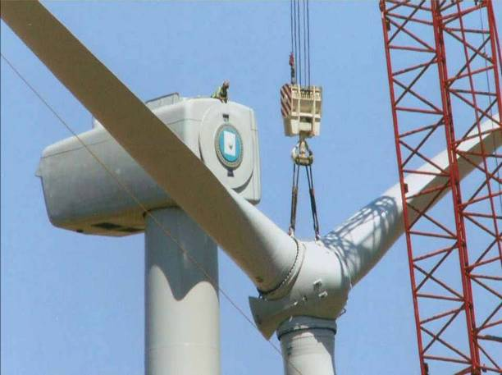
Rotor: blades and hub

Slide 21
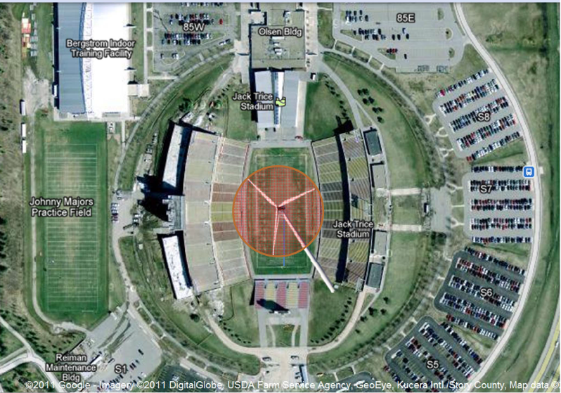
Rotor

Slide 22
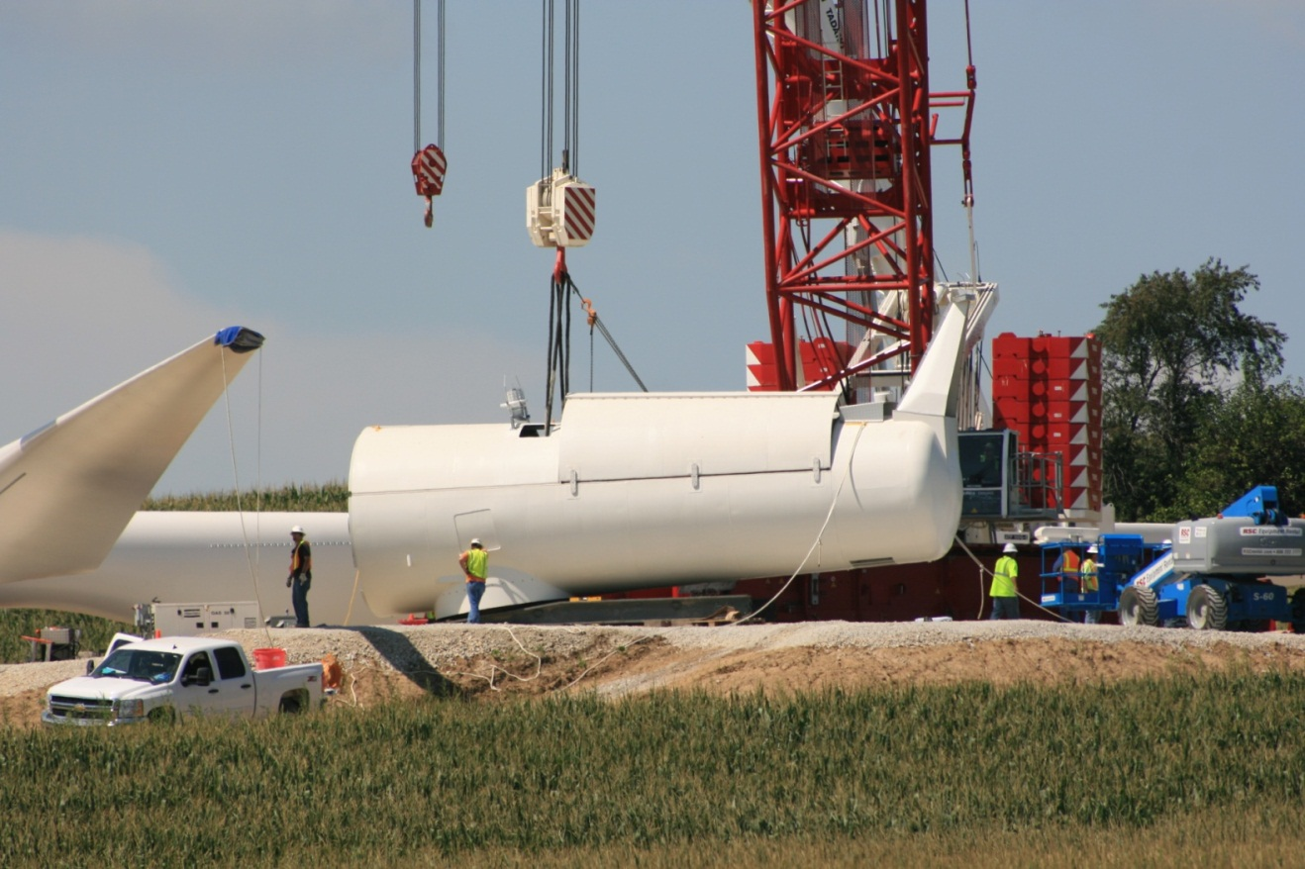
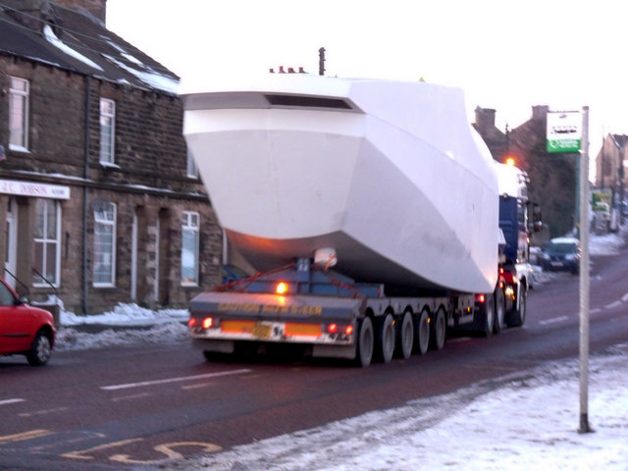
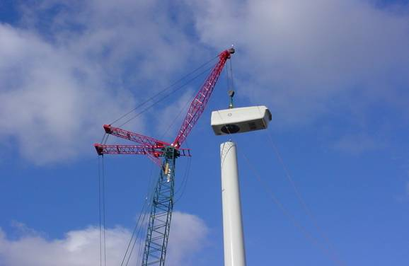
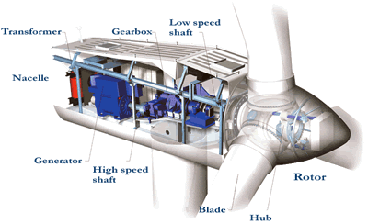
Nacelle (French ~small boat)
Houses mechanical drive-train (rotor hub, low-speed shaft, gear box, high-speed shaft, generator) controls, yawing system.

Slide 23
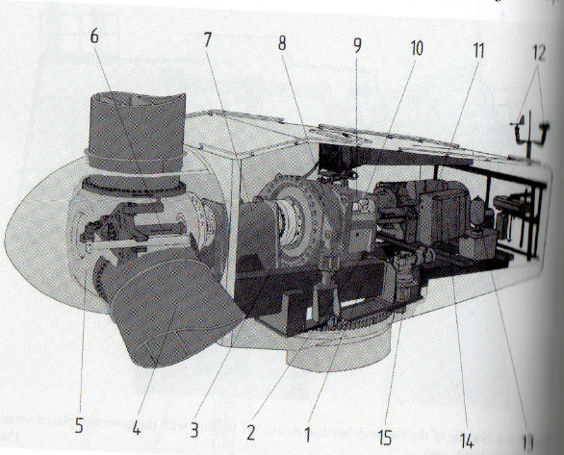
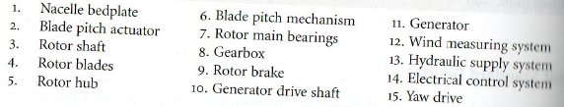

Nacelle
Source: E. Hau, “Wind turbines: fundamentals, technologies, application, economics, 2nd edition, Springer 2006.

Slide 24
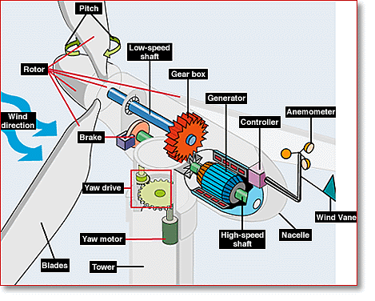
Nacelle
Notes:
Anemometer: Measures the wind speed and transmits wind speed data to the controller.
Blades: Most turbines have either two or three blades. Wind blowing over the blades causes the blades to "lift" and rotate.
Brake: A disc brake, which can be applied mechanically, electrically, or hydraulically to stop the rotor in emergencies.
Controller: The controller starts up the machine at wind speeds of about 8 to 16 miles per hour (mph) and shuts off the machine at about 55 mph. Turbines do not operate at wind speeds above about 55 mph because they might be damaged by the high winds.
Gear box: Gears connect the low-speed shaft to the high-speed shaft and increase the rotational speeds from about 30 to 60 rotations per minute (rpm) to about 1000 to 1800 rpm, the rotational speed required by most generators to produce electricity. The gear box is a costly (and heavy) part of the wind turbine and engineers are exploring "direct-drive" generators that operate at lower rotational speeds and don't need gear boxes.
Generator: Usually an off-the-shelf induction generator that produces 60-cycle AC electricity.
High-speed shaft: Drives the generator. Low-speed shaft: The rotor turns the low-speed shaft at about 30 to 60 rotations per minute.
Nacelle: The nacelle sits atop the tower and contains the gear box, low- and high-speed shafts, generator, controller, and brake. Some nacelles are large enough for a helicopter to land on.
Pitch: Blades are turned, or pitched, out of the wind to control the rotor speed and keep the rotor from turning in winds that are too high or too low to produce electricity.
Rotor: The blades and the hub together are called the rotor. Tower: Towers are made from tubular steel (shown here), concrete, or steel lattice. Because wind speed increases with height, taller towers enable turbines to capture more energy and generate more electricity.
Wind direction: This is an "upwind" turbine, so-called because it operates facing into the wind. Other turbines are designed to run "downwind," facing away from the wind.
Wind vane: Measures wind direction and communicates with the yaw drive to orient the turbine properly with respect to the wind.
Yaw drive: Upwind turbines face into the wind; the yaw drive is used to keep the rotor facing into the wind as the wind direction changes. Downwind turbines don't require a yaw drive, the wind blows the rotor downwind.
Yaw motor: Powers the yaw drive.

Slide 25
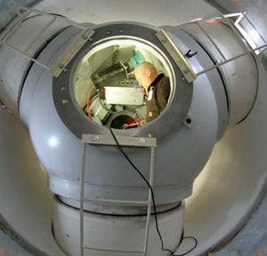
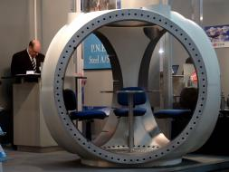
Rotor Hub
The interface between the rotor and the mechanical drive train. Includes blade pitch mechanism.
Most highly stressed components, as all rotor stresses and moments are concentrated here.

Slide 26
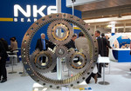
Gearbox
Rotor speed of 6→20 rpm. For 60 Hz machine, wind generator synchronous speed n_{s}=120f/p;
f is frequency, p is # of poles:
➔n_{s}=1800 rpm (4 pole), 1200 (6 pole)
If generator is an induction generator, then gen speed is n_{m}=(1-s)n_{s}. Defining n_{M} as rotor rated speed, the gear ratio is:
With s=-.01, p=4, n_{M}=15, then
r_{gb}=121.2. Gear ratios range
from 50→300.
Planetary bearing for a 1.5MW wind turbine gearbox with one planetary gear stage

Slide 27
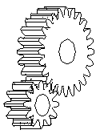
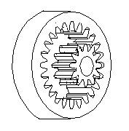
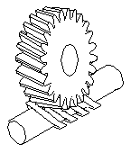
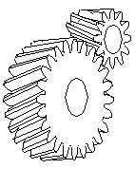
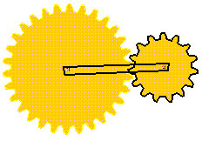
Gearing designs
“parallel shaft”
Spur
(external
contact)
Spur
(internal
contact)
Worm
Helical
Planetary
Parallel (spur) gears can achieve gear ratios of 1:5.
Planetary gears can achieve gear ratios of 1:12.
Wind turbines almost always require 2-3 stages.

Slide 28
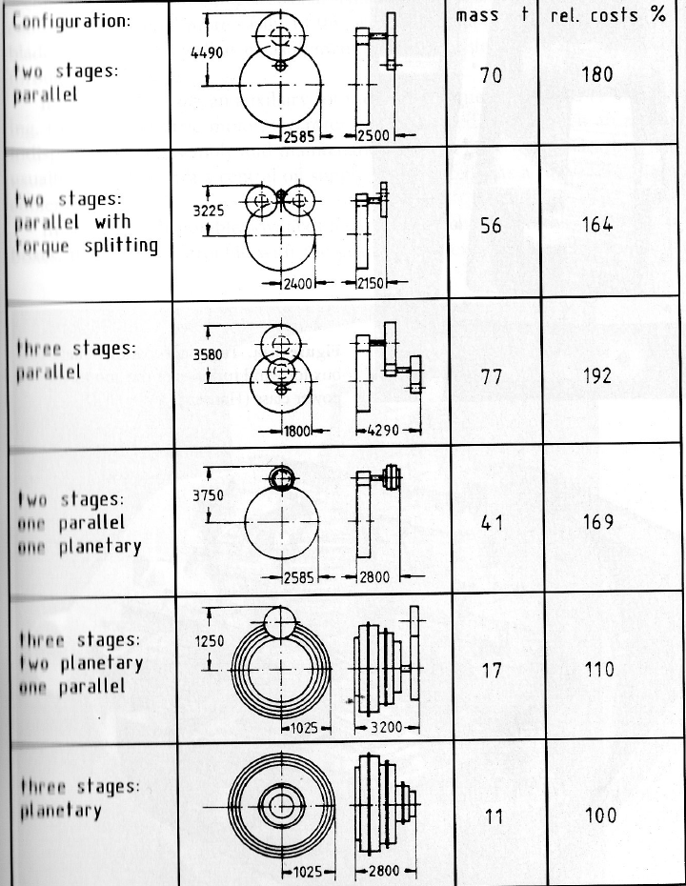
Gearing designs
Tradeoffs between size, mass, and relative cost.
Source: E. Hau, “Wind turbines: fundamentals, technologies, application, economics, 2nd edition, Springer 2006.

Slide 29
Electric Generators
Type 1
Conventional Induction
Generator (fixed speed)
Type 2
Wound-rotor Induction
Generator w/variable rotor resistance
Type 3
Doubly-Fed Induction
Generator (variable speed)
Type 4
Full-converter interface
Plant
ac
dc
Feeders
generator
to
to
dc
ac
full power

Slide 30
Type 3 Doubly Fed Induction Generator
Most common technology today
Provides variable speed via rotor freq control
Converter rating only 1/3 of full power rating
Eliminates wind gust-induced power spikes
More efficient over wide wind speed
Provides voltage control

Slide 31
1. What is a wind plant? Towers, Gens, Blades
Manu-facturer | Capacity | Hub Height | Rotor Diameter | Gen type | Weight (s-tons)
 |  |  |  |  | Nacelle | Rotor | Tower
 | 0.5 MW | 50 m | 40 m
Vestas | 0.85 MW | 44 m, 49 m, 55 m, 65 m, 74 m | 52m | DFIG/Asynch | 22 | 10 | 45/50/60/75/95, wrt to hub hgt
GE (1.5sle) | 1.5 MW | 61-100 m | 70.5-77 m | DFIG | 50 | 31
Vestas | 1.65 MW | 70,80 m | 82 m | Asynch water cooled | 57(52) | 47 (43) | 138 (105/125)
Vestas | 1.8-2.0 MW | 80m, 95,105m | 90m | DFIG/ Asynch | 68 | 38 | 150/200/225
Enercon | 2.0 MW |  | 82 m | Synchronous | 66 | 43 | 232
Gamesa (G90) | 2.0 MW | 67-100m | 89.6m | DFIG | 65 | 48.9 | 153-286
Suzlon | 2.1 MW | 79m | 88 m | Asynch
Siemens (82-VS) | 2.3 MW | 70, 80 m | 101 m | Asynch | 82 | 54 | 82-282
Clipper | 2.5 MW | 80m | 89-100m | 4xPMSG | 113 |  | 209
GE (2.5xl) | 2.5 MW | 75-100m | 100 m | PMSG | 85 | 52.4 | 241
Vestas | 3.0 MW | 80, 105m | 90m | DFIG/Asynch | 70 | 41 | 160/285
Acciona | 3.0 MW | 100-120m | 100-116m | DFIG | 118 | 66 | 850/1150
GE (3.6sl) | 3.6 MW | Site specific | 104 m | DFIG | 185 | 83
Siemens (107-vs) | 3.6 MW | 80-90m | 107m | Asynch | 125 | 95 | 255
Gamesa | 4.5 MW |  | 128 m
REpower (Suzlon) | 5.0 MW | 100–120 m Onshore 90–100 m Offshore | 126 m | DFIG/Asynch | 290 | 120
Enercon | 6.0 MW | 135 m | 126 m | Electrical excited SG | 329 | 176 | 2500
Clipper | 7.5 MW | 120m | 150m

Slide 32
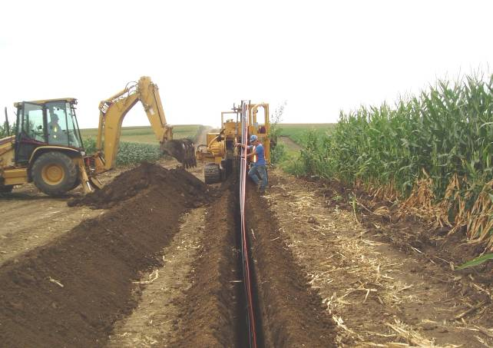
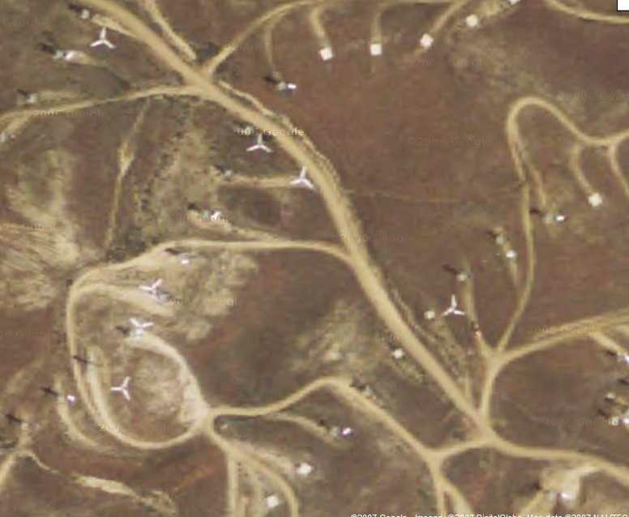
Collector Circuit
Distribution system, often 34.5 kV

Slide 33
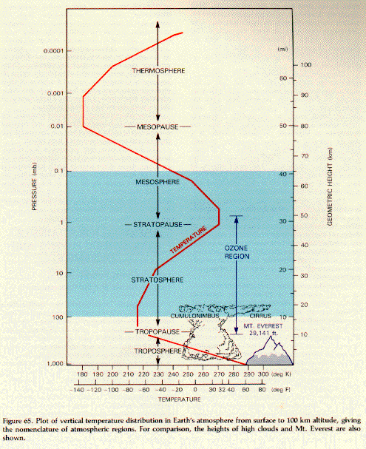
Atmospheric Regions
Source: ISU REU program summer 2011, slides by Eugene Takle

Slide 34
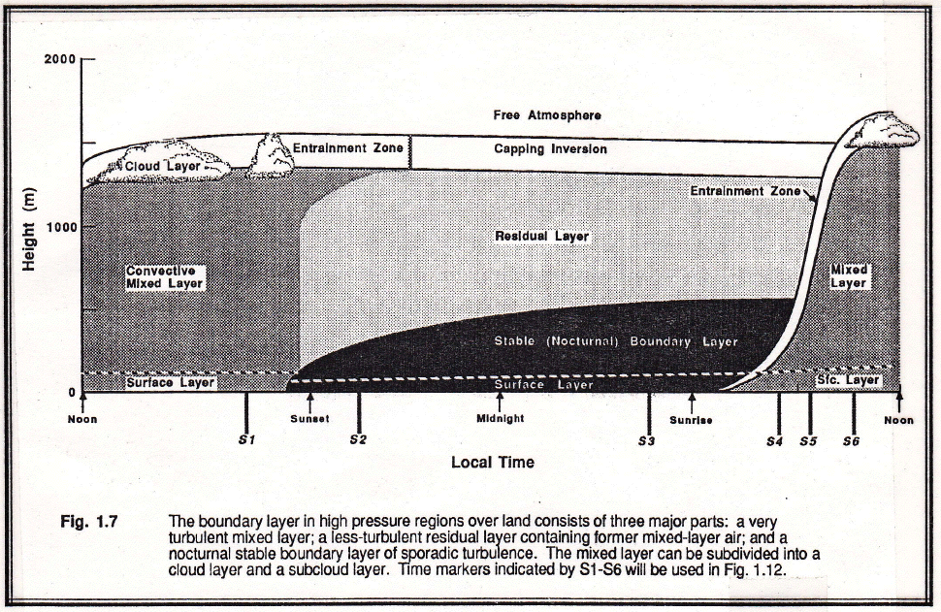
Atmospheric Boundary Layer
(Planetary boundary layer)
Heating is gone and so the residual layer has little turbulence until the heating from the surface in late morning starts to take effect.
During the day, you get the mixed layer, gusty.
Stability refers to mixing and turbulence. It does not refer to wind speed.
At sunset, the cooling begins to occur and it surpresses the turbulence. SO generally we get calm winds at night near the surface in the lowest 20-30 meters.
Source: ISU REU program summer 2011, slides by Eugene Takle

Slide 35
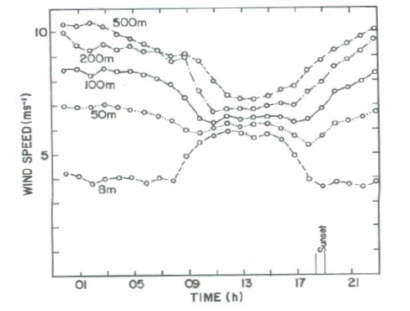
Atmospheric Boundary Layer
(Planetary boundary layer)
The wind speed diurnal pattern changes with height!
Diurnal: Relating to or occurring in a 24-hour period
Source: R. Redburn, “A tall tower wind investigation of northwest Missouri,” MS Thesis, U. of Missouri-Columbia, 2007, available at http://weather.missouri.edu/rains/Thesis-final.pdf.

