Slide 1
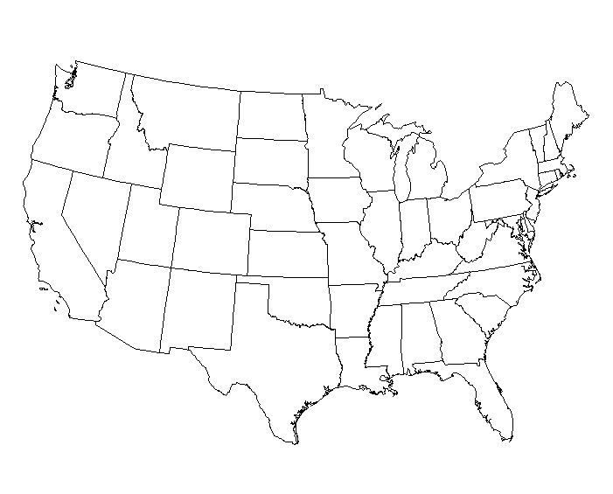
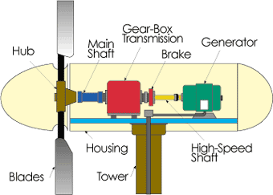
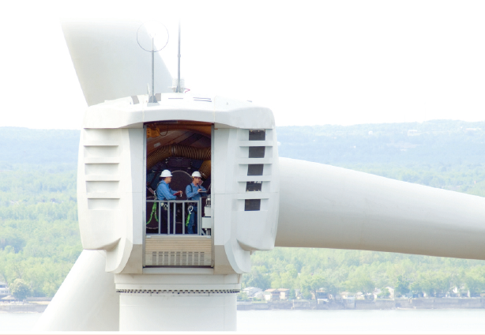
J. McCalley
EE 459/559
Spring 2014
Transient frequency performance and wind penetration

Slide 2
Content
Motivation
Power balance-frequency basics
Frequency Performance Analysis

Slide 3
Motivation
In each interconnection, wind and solar are increasing.
Fossil-based generation is being retired because
  There is potential that EPA’s Clean Power Plan may be enacted, and even if it is not, there is significant resistance to coal-based plants due to their high CO₂ emission rates; some states may act on their own (see next slide).
  There are other environmental concerns, e.g., once-through cooling (OTC) units in California, and the effects of EPA’s Mercury and Air Toxic Standards (MATS).
  Fossil-based generation contributes inertia. Wind + solar do not contribute inertia, unless they use inertial emulation.
  This is partly compensated by increase in gas-fueled gen.
Inertia helps to limit frequency excursions when power imbalance occurs.
➔ Decreased fossil w/ increased wind/solar creates transient frequency risk.

Slide 4
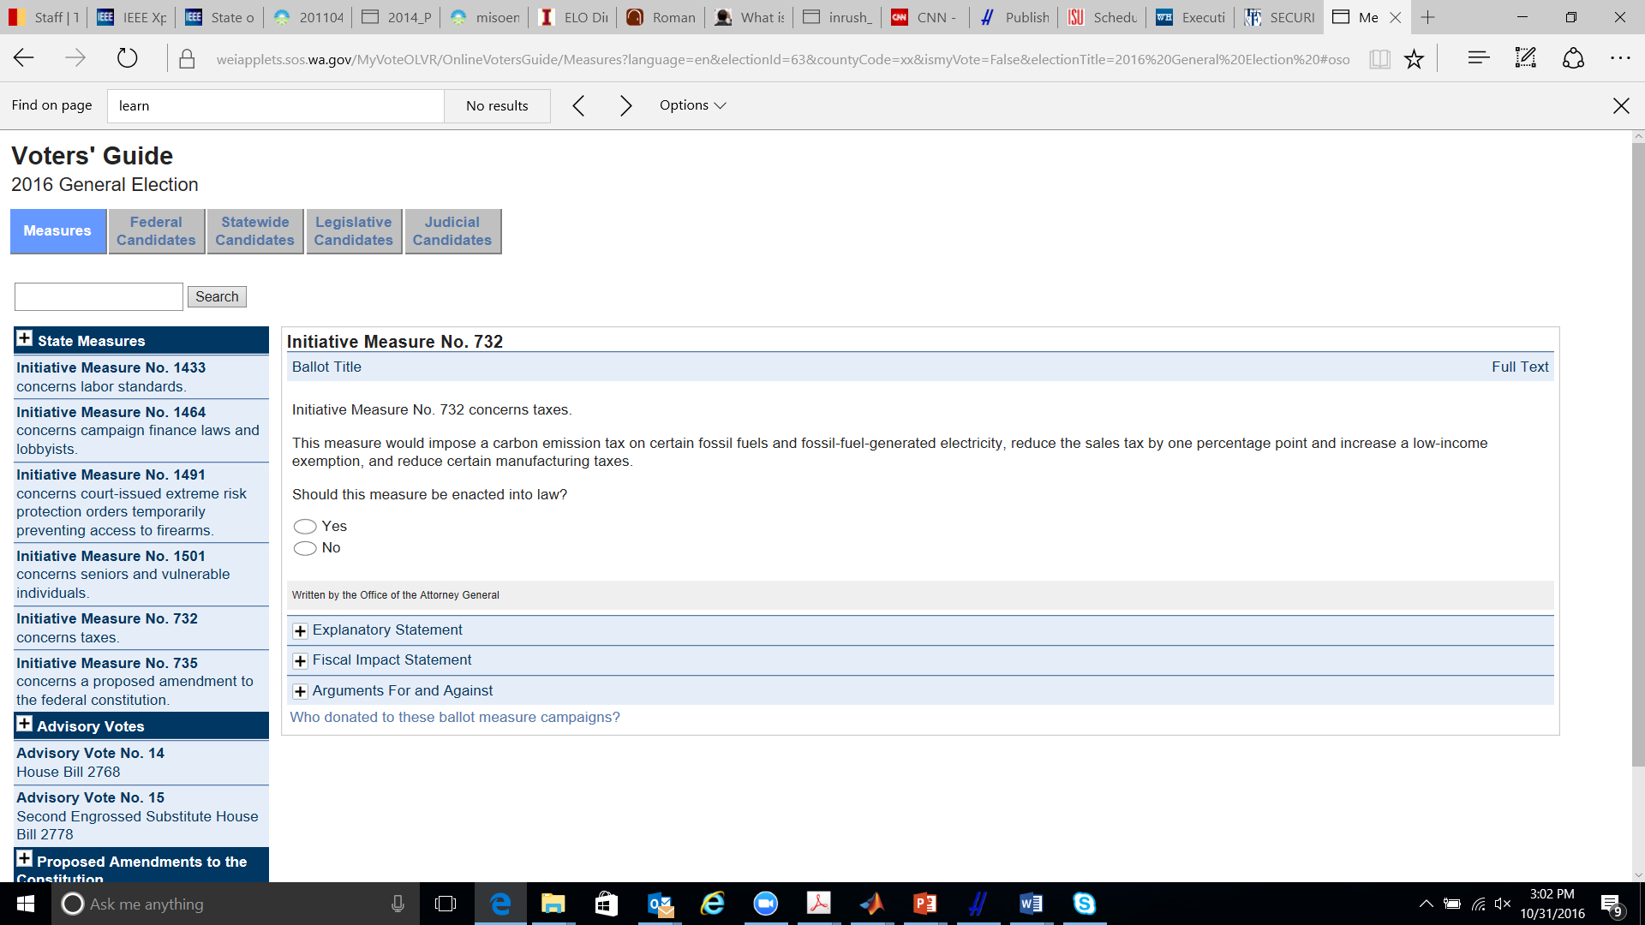
Motivation
I-732 would make Washington the first U.S. state to have a carbon tax. The tax would be levied on refineries and utilities, who would then pass the tax on to consumers in the form of higher gasoline, electricity and natural gas prices. The tax would start at US$15 per ton of carbon dioxide in July 2017, increase to $25 after one year, then rise with inflation plus 3.5 percent in each subsequent year.
https://energyathaas.wordpress.com/2016/10/31/why-arent-environmentalists-supporting-a-carbon-tax-in-washington-state/
https://weiapplets.sos.wa.gov/MyVoteOLVR/OnlineVotersGuide/Measures?language=en&electionId=63&countyCode=xx&ismyVote=False&electionTitle=2016%20General%20Election%20#ososTop

Slide 5
Once-through cooling units in S. California
“California's State Water Resources Control Board (SWRCB) voted on 4 May in favour of adopting the Policy on the Use of Coastal and Estuarine Waters for Power Plant Cooling. The policy applies to 19 existing power plants - including Pacific Gas & Electric's (PG&E's) Diablo Canyon and Southern California Edison's (SCE's) San Onofre nuclear power plants - that currently withdraw over 15 billion gallons per day from the state's coastal and estuarine waters to cool their turbines and then return the water at higher temperatures. The new regulations require such plants to stop this "once-through" practice and install equipment to reduce their impact on marine life.” - May 2010, www.world-nuclear-news.org/RS-California_moves_to_ban_once_through_cooling-0605105.html
www.energy.ca.gov/renewables/tracking_progress/documents/once_through_cooling.pdf

Slide 6
Once-through cooling units in S. California
www.energy.ca.gov/renewables/tracking_progress/documents/once_through_cooling.pdf

Slide 7
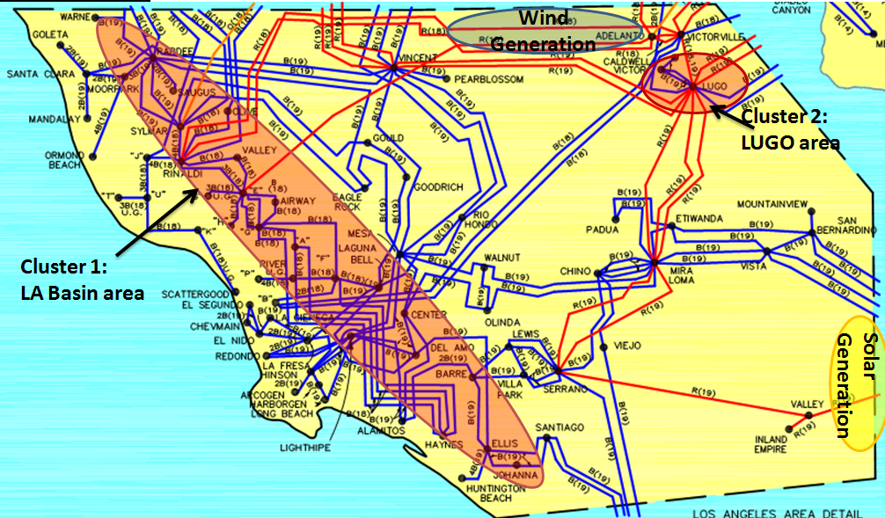
Once-through cooling units in S. California
New wind and solar generation due to Cal requiring 33% by 2020.
There are 8 plants (26 units) that are impacted
Total potential MW capacity at risk = 7,416 MW.
Load center
This is from state regulations, not federal.

Slide 8
Summary of power balance control levels
No. | Control Name | Time frame | Control objectives | Function
1 | Inertial response | 0-5 secs | Power balance and transient frequency dip minimization | Transient frequency control
2 | Primary control, governor | 1-20 secs | Power balance and transient frequency recovery | Transient frequency control
3 | Secondary control, AGC | 4 secs to 3 mins | Power balance and steady-state frequency | Regulation
4 | Real-time market | Every 5 mins | Power balance and economic-dispatch | Load following and reserve provision
5 | Day-ahead market | Every day | Power balance and economic-unit commitment | Unit commitment and reserve provision

Slide 9
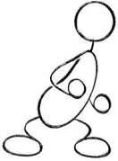
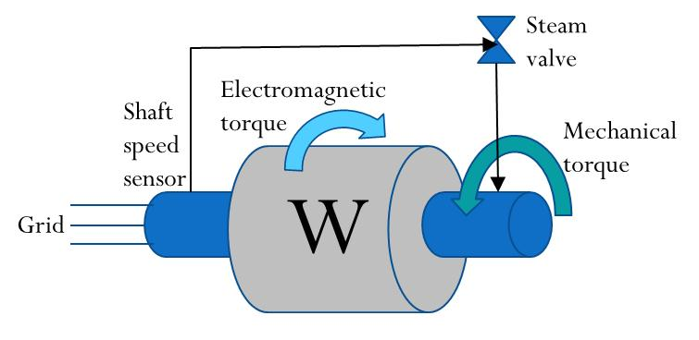
Frequency Study Basics
Inertia
The greater the inertia, the less acceleration will be observed and the less will be the frequency deviation. Inertia is proportional to the total rotating mass.
Primary Control
Senses shaft speed, proportional to frequency, and modifies the mechanical power applied to the turbine to respond to the sensed frequency deviations.
Electrical
Mechanical

Slide 10
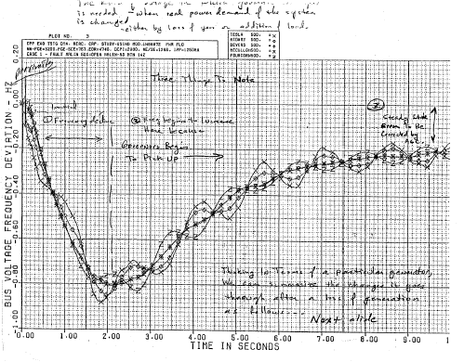
First 2 Levels of Frequency Control
The frequency declines from t=0 to about t=2 seconds. This frequency decline is due to the fact that the loss of generation has caused a generation deficit, and so generators decelerate, utilizing some of their inertial energy to compensate for the generation deficit.
The frequency recovers during the time period from about t=2 seconds to about t=9 seconds. This recovery is primarily due to the effect of governor control (underfrequency load shedding also plays a role).
At the end of the simulation period, the frequency has reached a steady-state, but it is not back to 60 Hz. This steady-state frequency deviation is intentional on the part of the governor control and ensures that different governors do not constantly make adjustments against each other. The resulting steady-state error will be zeroed by the actions of the automatic generation control (AGC).

Slide 11
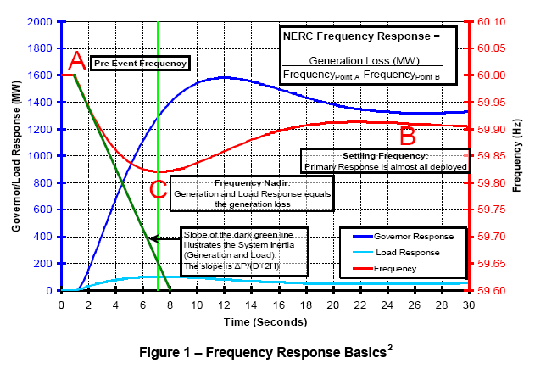
First 2 Levels of Frequency Control – another look
This is load decrease, shown here as a gen increase.
Source: FERC Office of Electric Reliability available at: www.ferc.gov/EventCalendar/Files/20100923101022-Complete%20list%20of%20all%20slides.pdf

Slide 12
4 levels of frequency Control following sudden loss of a generation unit
Transient control
(primary)
AGC
(secondary)
Real-time dispatch
(load following)
1
2
3
4
Numbers 1-4 correspond
to numbers on table in
slide 8. We are here
concerned with #1.
The Sequential Actions of frequency control following the sudden loss of generation and their impact on system frequency

Slide 13
First 4 Levels of Frequency Control – another view
The Sequential Actions of frequency control following the sudden loss of generation and their impact on system frequency

Slide 14
Renewable Integration Effects on Frequency
Our work in these slides is about the first two bullets.
Reduced inertia, assuming renewables do not have inertial emulation
Decreased primary control (governors), assuming renewables do not have primary controllers
Decreased secondary control (AGC), assuming renewables are not dispatchable.
Increased net load variability, a regulation issue
Increased net load uncertainty, a unit commitment issue

Slide 15
Transient frequency control
A power system experiences a load increase (or equivalently, a generation decrease) of ∆P_{Lk} at t=0, located at bus k.
At t=0⁺, each generator i compensates according to its proximity to the change, as captured by the synchronizing power coefficient P_{Sik} between unit i and bus k, according to
ΔP_{Lk}>0➔load increases.
(1)
See Anderson & Fouad, p. 71
It is the change in the electrical power of a given machine due to the change in the angle between its internal EMF and any bus, with all other bus angles held constant.
Equation (1) is derived for a multi-machine power system model where each synchronous generator is modeled with classical machine models, loads are modeled as constant impedance, the network is reduced to generator internal nodes, and mechanical power into the machine is assumed constant. Then the linearized swing equation for gen i is …

Slide 16
Transient frequency control
(2)
KE in MW-sec of turb-gen set, when rotating at ω_{R}
For a load change ΔP_{Lk}, at t=0⁺, substituting (1) into the right-hand-side of (2):
(3)
Bring H_{i} over to the right-hand-side and rearrange to get:
(4)
For ΔP_{Lk}>0, initially, each machine will decelerate but at different rates, according to P_{Sik}/H_{i}.

Slide 17
Transient frequency control
Now rewrite eq. (3) with H_{i} inside the differentiation, use Δω_{i} instead of Δδ_{i}, write it for all generators 1,…,n, then add them up. All H_{i} must be given on a common MVA base.
(5a)
(5b)
We will come back to this equation (5b).

Slide 18
Transient frequency control
Now define the “inertial center” of the system, in terms of angle and speed, as
The weighted average of the angles:
or
(6)
The weighted average of the speeds:
(7)
or
Differentiating with respect to time, we get…

Slide 19
Transient frequency control
(8)
Solve for the numerator on the right-hand-side, to get:
(9)
Now substitute (9) into (5b) to get:
(5b)
(10)

Slide 20
Transient frequency control
(10)
Bring the 2*(summation)/ω_{Re} over to the right-hand-side:
(11a)
Eq. (11a) gives the average deceleration of the system, m, the initial slope of the avg frequency deviation plot vs. time. This has also been called the rate of change of frequency (ROCOF) [*].
All H_{i} (units of seconds) must be given on a common power base for (11a) to be correct. In addition -∆P_{L} should be in per-unit, also on that same common base, so that -∆P_{L}/2 ΣH_{i} is in pu/sec, and m_{ω}=-∆P_{L} ω_{Re}/2 ΣH_{i} is in rad/sec/sec. Alternatively,
Units of Hz/sec
(11b)
[*] G. lalor, A. Mullane, and M. O’Malley, “Frequency control and wind turbine technologies,” IEEE Trans. On Power Systems, Vol. 20, No. 4, Nov. 2005.

Slide 21
Transient frequency control
Consider losing a unit of ∆P_{G} at t=0.
Thus, we can consider that ∆P_{L}=- ∆P_{G}
So ΔP_{G}<0 means generation was lost, and df/dt<0, i.e., frequency declines.

Slide 22
Transient frequency control
Consider losing a unit of ∆P_{G} at t=0.
Assume:
There is no governor action between time t=0⁺ and time t=t₁ (typically, t₁ might be about 1-2 seconds).
The deceleration of the system is constant from t=0⁺ to t=t₁.
The frequency will decline to 60-m_{f}t₁. The next slide illustrates.

Slide 23
Transient frequency control
Frequency(Hz)
t₁
60
Time (sec)→
m_{f1}
60-m_{f1}t₁
m_{f2}
60-m_{f2}t₁
m_{f3}
60-m_{f3}t₁
The greater the ROCOF following loss of a generator ∆P_{G}, the lower will be the frequency dip.
ROCOF increases as total system inertia ΣH_{i} decreases.
Therefore, frequency dip increases (gets lower) as ΣH_{i} decreases.

Slide 24
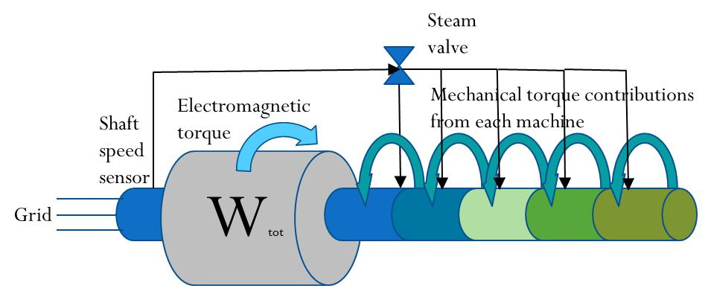
Frequency Basics
Aggregation
  Network frequency is close to uniform throughout the inter-connection during the 0-20 second time period of interest for transient frequency performance➔avg freq is representative.
  For analysis of average frequency, the inertial and primary governing dynamics may be aggregated into a single machine.
  This means the interconnection’s (and not the balancing area’s) inertia is the inertia of consequence when gen trips happen.
After ~30 seconds, however, then AGC begins to have influence; since each BA has its own AGC, this effect is BA-specific (changes to a gen depend on which BA it is in).

Slide 25
Inertia and primary control from wind
The two thick zig-zag arrows show control differences of the two turbine types.
Conventional generation does not have a real-power output control and therefore responds to power deficit in the network (trip of another gen) by giving up inertial energy, thus slowing down. If using real power output control (MPPT), a wind turbine would not have this feature, and so we say they are “inertial-less.” However, “synthetic inertia” is available from manufacturers.
In addition, conventional generation has primary control that implements a “droop” characteristic…. see next slide… most wind units today do not have it.
Notes:
Need more explanations about DFIG and PMSG

Slide 26
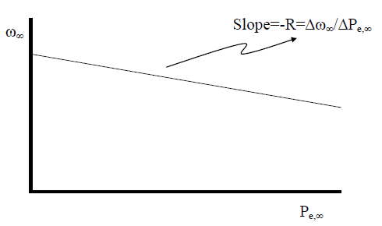
Droop characteristic of steam-turbine primary controller
R is a positive number.
If Δω∞ is neg, then ΔP_{e,∞} is positive.
It is important to understand that the droop characteristic displays steady-state frequency and power deviations.
You can think of ∆P_{Load}(t)=Lu(t) (for positive load increase, L>0), a step change in power demand in the network, as the initiating change,
then we wait a half-minute, at which time all transients have died,
and each unit’s speed governor will have operated so that the frequency will have recovered from the transient dip but will be less than 60 Hz by ∆ω∞, and the generation will have increased (for positive load increase) by ∆P_{e,∞}.
Notes:
Need more explanations about DFIG and PMSG

Slide 27
Inertia and primary control from solar PV and wind: summary
A squirrel-cage machine or a wound-rotor machine (types 1 and 2) do contribute inertia.
DFIG and PMSG wind turbines (types 3 and 4) and Solar PV units cannot see or react to system frequency change directly unless there is an “inertial emulation” (“synthetic inertia”) function deployed, because power electronic converters isolate wind turbine/solar PV from grid frequency.
  ➔No inertial response from normal control methods of wind & solar
Most existing wind plants in North America do not provide synthetic inertia or primary frequency response (PFR).
I am aware of only one North American region that has requirements on inertia & primary control: Hydro Quebec
And ERCOT reports wind participation in primary frequency response (though I cannot identify that they have a requirement).
Notes:
Need more explanations about DFIG and PMSG

Slide 28
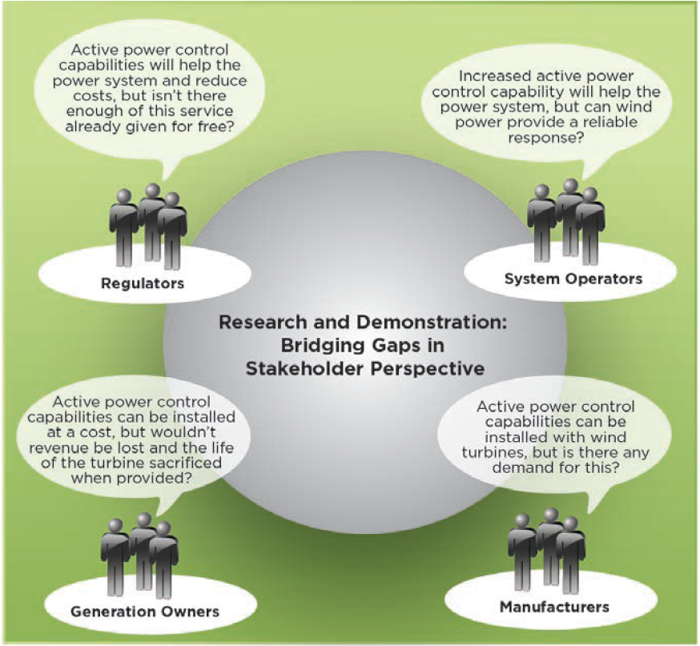
Different perspectives among various stakeholders on the feasibility, benefits, and economic justification for wind power to provide various forms of APC
E. Ela, V. Gevorgian, P. Fleming, Y.C. Zhang, M. Singh, E. Muljadi, A. Scholbrook, J. Aho, A. Buckspan, L. Pao, V. Singhvi, A. Tuohy, P. Pourbeik, D. Brooks, and N. Bhatt, “Active Power Controls from Wind Power: Bridging the Gaps,” NREL/TP-5D00-60574, January 2014.
Notes:
Need more explanations about DFIG and PMSG

Slide 29
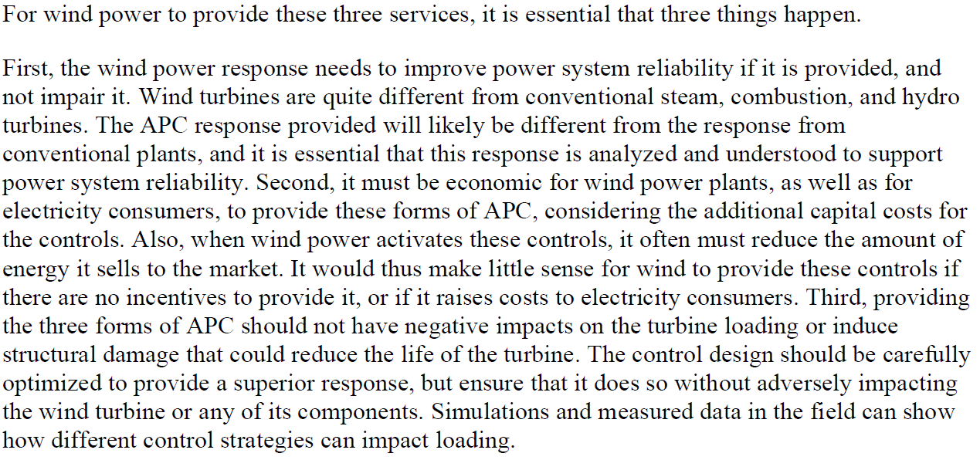
Requirements for using Wind to provide APC
Active power control (APC):
Inertial control
Primary frequency control
Regulation and AGC
E. Ela, V. Gevorgian, P. Fleming, Y.C. Zhang, M. Singh, E. Muljadi, A. Scholbrook, J. Aho, A. Buckspan, L. Pao, V. Singhvi, A. Tuohy, P. Pourbeik, D. Brooks, and N. Bhatt, “Active Power Controls from Wind Power: Bridging the Gaps,” NREL/TP-5D00-60574, January 2014.
Notes:
Need more explanations about DFIG and PMSG

Slide 30
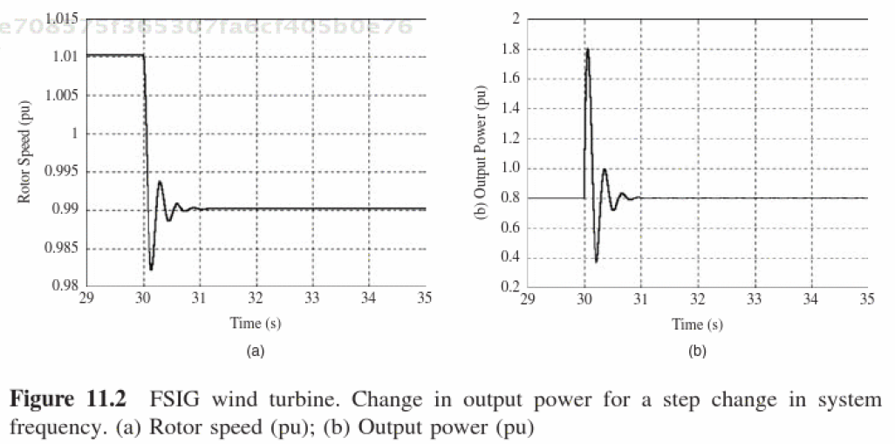
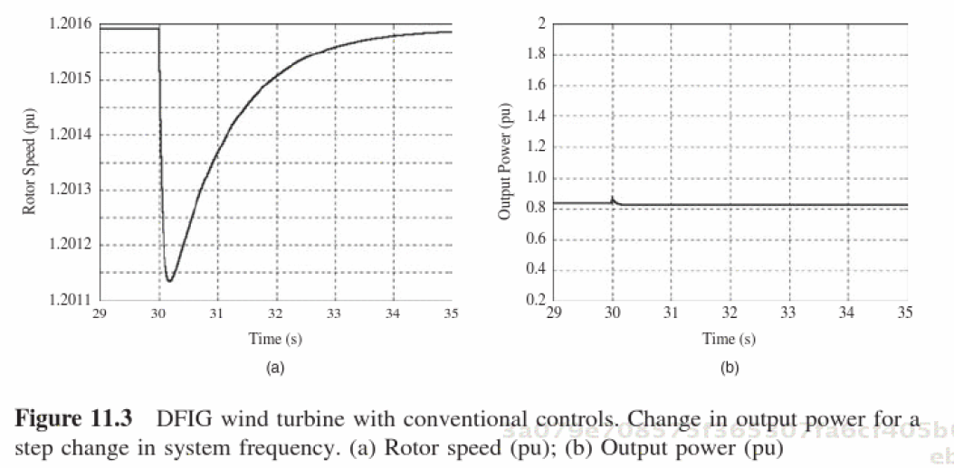
Comparison between FSIG & DFIG for frequency drop
Observe for the fixed speed induction gen that for a frequency change, the speed drops significantly and the power out increases significantly.
Observe for the DFIG that for a frequency change, the speed drops very little (note the difference in scales of this plot in comparison to above plot) and the power out really does not change.
Source: O. Anaya-Lara, N. Jenkins, J. Ekanayake, P. Cartwright, M. Huges, “Wind Energy Generation: Modelling and Control,” Wiley, 2009.

Slide 31
Transient frequency control – the problem
So what is the issue with wind types 3,4 & solar PV….?
Increasing wind & solar PV penetrations tend to displace (decommit) conventional generation.
DFIGs & solar PV, without special control, do not contribute inertia. This “lightens” the system
(decreases denominator) →
causing lower freq dips for same gen trip.
DFIGs & solar PV, without special control, do not have primary control capability.
This causes frequency response degradation; but there are other effects that also cause frequency response degradation such as increased deadband, sliding pressure controls (changes pressure as function of load so to limit fast-response load reserve [*]), blocked governors (typical on nuclear units), use of power load controllers (override governor action after short time delay to force units back to original schedule), and changes in frequency response characteristics of the load.
[*] B. Vitalis, “Constant and sliding-pressure options for new supercritical plants,” Power, Jan/Feb 2006.

Slide 32
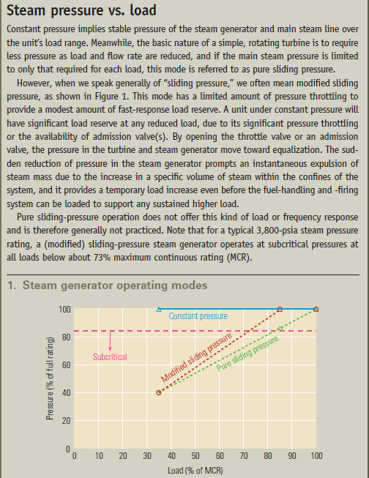
Other frequency response issues (an aside)
Sliding pressure control→
Deadband
S. Niemeyer, “Droop calculator and unit performance evaluation,” slides on SAR-003-TRE-001, March 31, 2009, at www.google.com/url?sa=t&rct=j&q=deadband%20steam%20turbines%20frequency%20droop&source=web&cd=2&ved=0CDQQFjAB&url=http%3A%2F%2Fwww.ercot.com%2Fcontent%2Fmeetings%2Fsar003%2Fkeydocs%2F2009%2F20090331-SAR003%2FSAR-003-TRE-001_Workshop_Droop_Calculator_for_a_Resource.ppt&ei=tzgiUbGbCsLs2gWy14CYAw&usg=AFQjCNHNwPPeY4axWnZ-g4Xo6CrhvMx1Ig&bvm=bv.42553238,d.aWM&cad=rja
B. Vitalis, “Constant and sliding-pressure options for new supercritical plants,” Power, Jan/Feb 2006.

Slide 33
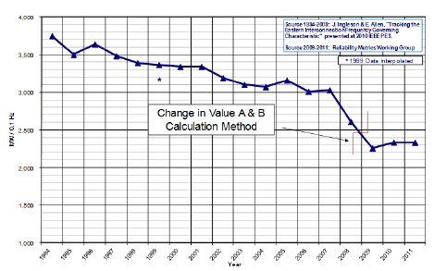
Frequency Governing Characteristic, β
For given ΔP_{loss}, we want denominator to be small. Therefore large β is better.
β,
The above is eastern interconnection characteristic. Decline is not caused by wind/solar. However, IF…
wind/solar displaces conventional units having inertia and having primary control
wind/solar does not have appropriate control.
THEN wind/solar will exacerbate decline in β.
“If Beta were to continue to decline, sudden frequency declines due to loss of large units will bottom out at lower frequencies, and recoveries will take longer.”
Source: J. Ingleson and E. Allen, “Tracking the Eastern Interconnection Frequency Governing Characteristic,” Proc. of the IEEE PES General Meeting, July 2010.

Slide 34
Frequency Governing Characteristic, β
http://www.nerc.com/pa/RAPA/ri/Pages/InterconnectionFrequencyResponse.aspx
EASTERN INTERCONNECTION
This is from a NERC website that tracks frequency response on an ongoing basis. Below is copied from that site.
About This Metric This metric is used to track and monitor Interconnection Frequency Response. Frequency Response is a measure of an Interconnection’s ability to stabilize frequency immediately following the sudden loss of generation or load. It is defined as sum of the change in demand, plus the change in generation, divided by the change in frequency, expressed in megawatts per 0.1 Hertz (MW/0.1 Hz). It is a critical component to the reliable operation of the bulk power system, particularly during disturbances and restoration. The metric measures the average Frequency Response for all events where frequency drops more than the Interconnection’s defined threshold. While the calculations may show trends from year to year, no attempt has been made in this analysis to determine or state what indicates an “acceptable” level of Frequency Response for any of the interconnections. Rather, they show the relative performance from year-to-year and can be a basis for further root-cause analysis. Further, the Frequency Response should not be compared between interconnections as their bulk power system characteristics differ significantly in terms of number of facilities, miles of line, operating principles and simple physical, geographic and climatic conditions. Some annualized Frequency Responses are higher due to the large number of disturbances in the dataset where frequency changes were greater than the generator deadbands.

Slide 35
Frequency Governing Characteristic, β
http://www.nerc.com/pa/RAPA/ri/Pages/InterconnectionFrequencyResponse.aspx
ERCOT
QUEBEC
WECC

Slide 36
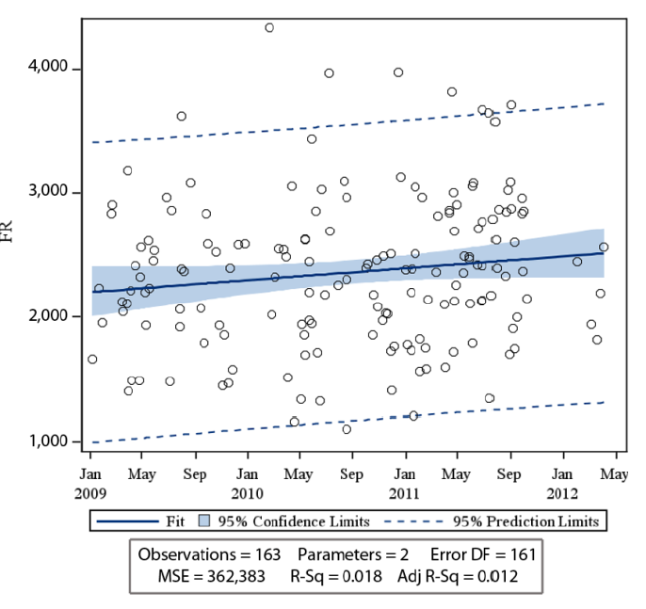
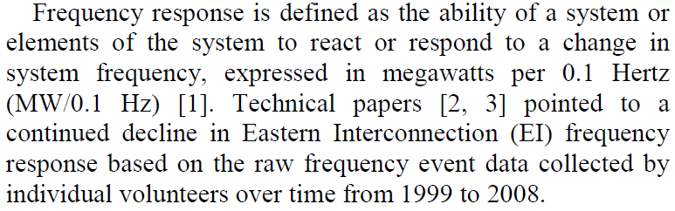
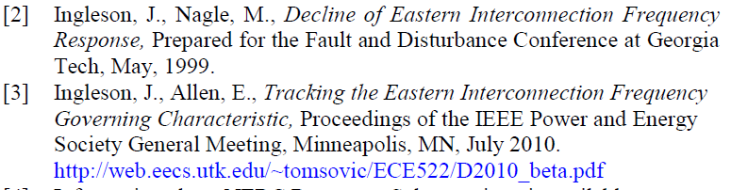
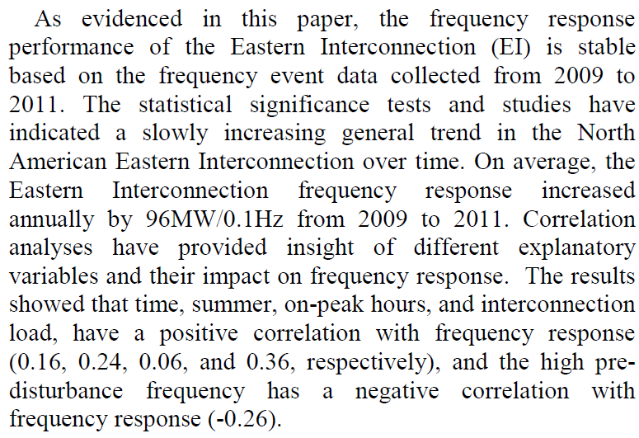
Frequency Governing Characteristic, β
Eastern interconnection frequency response trends
Lauby, M.G. ; Bian, J.J. ; Ekisheva, S. ; Varghese, M.
Power and Energy Society General Meeting (PES), 2013 IEEE
Digital Object Identifier: 10.1109/PESMG.2013.6672990
Publication Year: 2013 , Page(s): 1 - 5
Positive correlation➔FR increases with these variables. “Time” reflects NERC efforts. Other variables reflect conditions when most units are on-line, therefore more units to respond. Negative correlation➔FR decreases with these variables. High pre-disturbance frequency reflects a light-load condition, when the amt of committed units is very small.

Slide 37
Effect of frequency excursions on turbine blade life
White: Safe for continuous operation
Light shade: Restricted time operation
Dark shade: Prohibited operation
Four different manufacturers
A “completely safe” approach would seem to be to ensure frequency remains in the band 59.5→60.5 Hz.
Continuous operation
Restricted time operation
Prohibited operation

Slide 38
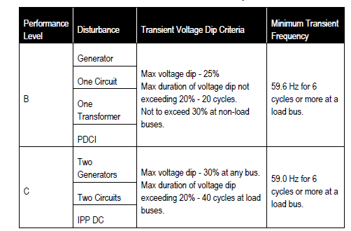
Potential Impacts of Low Frequency Dips
f<59.0 Hz ➔ can impact turbine blade life.
Gens may trip on UF relay (59.94 Hz, 3 min; 58.4, 30 sec; 57.8, 7.5 sec; 57.3, 45 cycles; 57 Hz, instantaneous)
UFLS can trip interruptible load (59.75 Hz) and 5 blocks (59.1, 58.9, 58.7, 58.4, 58.3 Hz)
Can violate performance criteria:
Performance criteria is a “protection” against UFLS.
➔UFLS is a “protection” against
generator tripping.
➔Generator tripping is a
“protection” against loss
of turbine life.
38

Slide 39
Some illustrations
Nadir: The lowest point.

Slide 40
Crete
In 2000, the island of Crete had only 522 MW of conventional generation [*]. One plant has capacity of 132 MW. Let’s consider loss of this 132 MW plant when the capacity is 522 MW. Then remaining capacity is 522-132=390 MW. If we assume that all plants comprising that 390 MW have inertia constant (on their own base) of 3 seconds, then the total inertia following loss of the 132 MW plant, on a 100 MVA base, is
Then, for ∆P_{L}=132/100=1.32 pu, and assuming the nominal frequency is 50 Hz, ROCOF is:
If we assume t₁=2 seconds, then ∆f=-2.82*2=-5.64 Hz, so that the nadir would be
50-5.64=44.36Hz!
For a 60 Hz system, then m_{f}=-3.38Hz/sec, ∆f=-3.38*2=-6.77 Hz, so that the nadir would be 60-6.77=53.23 Hz.
[*] N. Hatziargyriou, G. Contaxis, M. Papadopoulos, B. Papadias, M. Matos, J. Pecas Lopes, E. Nogaret, G. Kariniotakis, J. Halliday, G. Dutton, P. Dokopoulos, A. Bakirtzis, A. Androutsos, J. Stefanakis, A. Gigantidou, “Operation and control of island systems-the Crete case,” IEEE Power Engineering Society Winter Meeting, Volume 2, 23-27 Jan. 2000, pp. 1053 -1056.

Slide 41
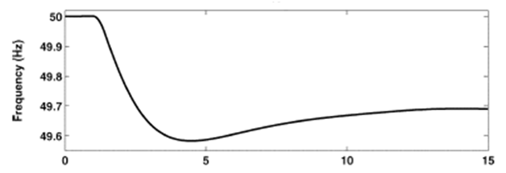
Ireland
Reference [*] reports on frequency issues for Ireland. The authors performed analysis on the 2010 Irish system for which the peak load (occurs in winter) is inferred to be about 7245 MW. The largest credible outage would result in loss of 422 MW. We assume a 15% reserve margin is required, so that the total spinning capacity is 8332 MW.
Consider this 422 MW outage, meaning the remaining generation would be 8332-422=7910MW.
The inertia of the Irish generators is likely to be higher than that of the Crete units, so we will assume all remaining units have inertia of 6 seconds on their own base. Then the total inertia following loss of the 422 MW plant, on a 100 MVA base, is
Then, for ∆P_{L}=422/100=4.32, and assuming the nominal frequency is 50 Hz, ROCOF is:
2.75 sec
Assuming t₁=2.75 seconds, then
∆f=-0.227*2.75=-0.624 Hz,
so that the nadir is 50-0.624=49.38Hz.
The figure [*] illustrates simulated response
for this disturbance.
Nadir
49.35
[*] G. lalor, A. Mullane, and M. O’Malley, “Frequency control and wind turbine technologies,” IEEE Trans. On Power Systems, Vol. 20, No. 4, Nov. 2005.

Slide 42
Note effect of system size
Crete
Ireland
US – ERCOT
Assumed each machine H_{i} is 6 sec on its own base. Then multiply total non-wind capacity by 6 and divide by 100.
US – WECC
US – Eastern Interconnection
Europe
China

Slide 43
Reasons why calculated nadir is lower than simulated one
Governors have some influence in the simulation that is not accounted for in the calculation.
Some portion of the load is modeled with frequency sensitivity in the simulation, and this effect is not accounted for in the calculation.

Slide 44
Some additional issues
Solar-PV is “inertia-less.” Solar-thermal is not.
Loss of X MW during off-peak is usually more severe than loss of X MW during peak.
Spinning reserve levels affect on-line inertia and therefore results of transient freq performance (the more reserves, the more on-line inertia).
Underfrequency load shedding can activate for “worse” initial freq performance (0-2 sec) and so improve 10-20 sec frequency performance.
Severe voltage decline can reduce power consumption due to voltage sensitivity of the load and thus cause improved freq performance.
The contingency selected has much effect.
Loss of 2 units has greater ΔP_{G} but less restrictive criterion, in comparison to loss of 1 unit.
An as-of-yet uncategorized contingency is loss of a unit AND a fast large wind or solar ramp-down. Should this be category C?
Islanding may be the worst contingency. Why? – See next slide.
Notes:
We performed several sensitivity studies on the above-described simulations, all designed to identify conditions which would results in poorer frequency performance. These changes made in these sensitivity cases include the following:
Reduced WECC inertia and governing capability: Although the base cases used for the analysis reflected, for the SCE service area, displacement of conventional synchronous machines resulting from increased renewables, and thus reduced inertia and reduced primary governing capability in the SCE service area, it did not reflect the same characteristic for the rest of the WECC interconnection. This is important since initial frequency performance is largely an interconnection phenomenon rather than a control area phenomenon (as indicated in the description of the “aggregation” concept in Section 4.1), and since it is likely that the rest of the WECC interconnection would also experience growth in renewables. To account for this, we also performed studies simulating the impact of significantly reduced inertia and primary governing throughout the WECC interconnection.
No CST modeled: In the max-solar case, most of solar plants are modeled as Concentrated Solar Thermal (CST), which utilizes a synchronous generator model (and therefore provides inertial response). We changed all of these generators to solar PV units.
Reduced reserve levels: Spinning reserve (assuming it is synchronous generator) increases inertia. We therefore studied the effect of (a) reduced SCE reserves and (b) reduced WECC reserves.
Events followed by fast ramp-down of renewable resource: Fast-moving clouds or wind ramps may reduce solar or wind resources very quickly. We therefore studied the effect of simultaneous occurrence of one of our category C or D events with a solar or wind ramp event.
Combined sensitivities: We also studied the effect of implementing changes #2, 3, and 4 as described above.

Slide 45
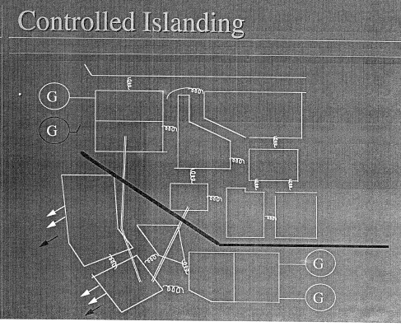
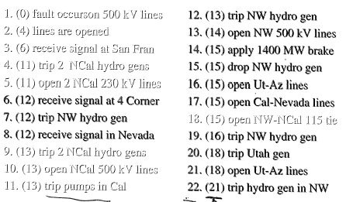
Controlled islanding in WECC
For loss of Pacific AC Intertie (3 500 kV lines connecting Oregon to California), when transfers are close to limit (4800 MW), the below remedial action scheme will operate to separate the WECC into a northern island and a southern island.
The northern island sees overfrequency and therefore trips generation. The southern island sees underfrequency , causing UFLS to activate and trip load. High wind penetration in the southern island becomes more influential because of reduced total inertia within what has become the southern island interconnection.

Slide 46
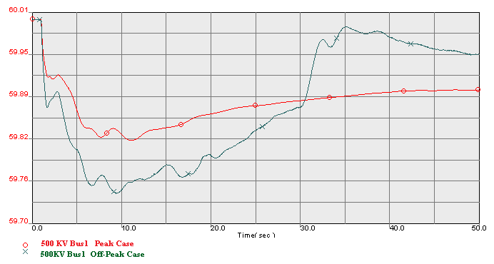
Illustration of effect #2 for loss of 2800 MW
Effect #2: Loss of X MW during off-peak is usually more severe than loss of X MW during peak.
This is a result of a large pumping load being tripped on underfrequency.
For loss of 2800 MW, off- peak case has lower nadir than peak case.
Off-Peak Case
Peak Case
Nadir is around 59.82 / 59.74 Hz.
C: 59.0Hz

Slide 47
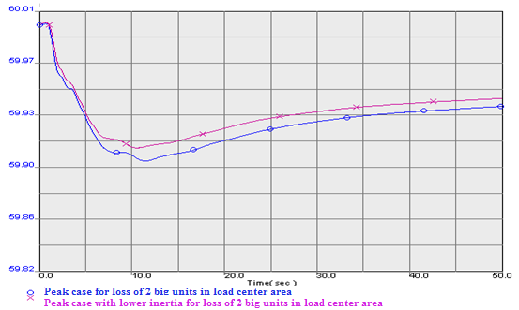
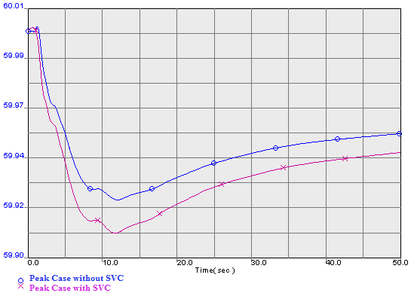
Illustration of effect #5 for loss of 2200 MW
Effect #5: Severe voltage decline can reduce power consumption due to voltage sensitivity of the load and thus cause improved freq performance.
This result is counter-intuitive because low inertia case has higher nadir than high inertia case. This was because in the low inertia case (with many units off-line), loss of the two units caused severe voltage decline in the area, resulting in decreased power consumption due to voltage sensitivity of the load. The voltage decline (and thus the load reduction) did not happen in the high-inertia case because of the reactive support of the additional units.
Low inertia case
High inertia case
This effect was verified by placing a large SVC in the voltage-weak area (causing voltage decline to be avoided), then we see the low inertia case having lower nadir than high inertia case.
High inertia case
Low inertia case

Slide 48
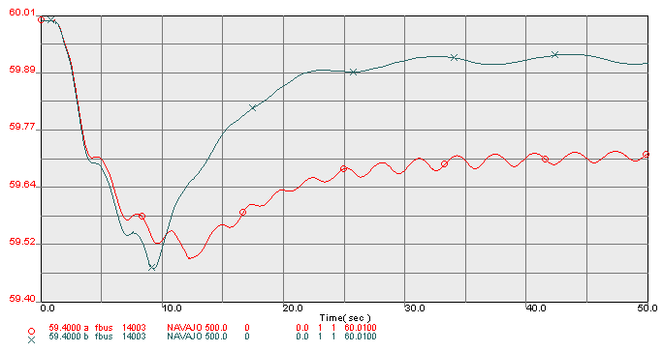
Illustration of effect #3, #4, for loss of PACI followed by controlled islanding (effect #6c)
Effect #3: Spinning reserve levels affect on-line inertia and therefore also the results of transient freq performance (the more reserves, the more on-line inertia).
Effect #4: Underfrequency load shedding can activate for “worse” initial freq performance (0-2 sec) and so improve 10-20 sec frequency performance.
Peak Case with Lower Inertia and Less Reserve
Peak Case
D-
Lower Inertia and less reserve causes bigger ROCOF, which leads to more load shedding and higher frequency during recovery period

Slide 49
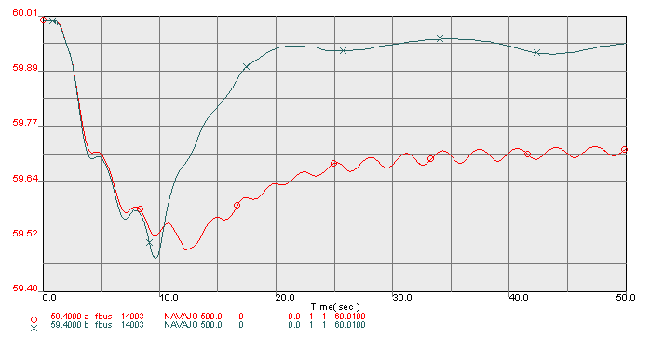
Illustration of effect #1, #4 for loss of PACI followed by controlled islanding (effect #6c)
Effect #1: Solar-PV is “inertia-less.” Solar-thermal (concentrated solar thermal) is not.
Effect #4: Underfrequency load shedding can activate for “worse” initial freq performance (0-2 sec) and so improve 10-20 sec frequency performance.
Max-Solar Case with all Solar PV
Max-Solar Case with CST
D-
For controlled islanding (effect #6c), lower inertia due to converting solar CST to solar PV causes increased ROCOF (effect #1), which leads to more load shedding and higher frequency during recovery period (effect #4).

Slide 50
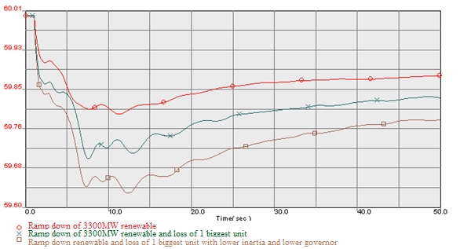
Fast renewable ramp-downs (effect #6b)
Peak Case
Ramp down
Ramp down +loss of 1400 MW unit
Ramp down+loss of 1400 MW unit with lower Inertia, lower governor, and less reserve
B-: 59.6Hz
  Renewable ramp-down: At 0.1 s, turn off 3300 MW renewable( 1500 wind + 1800 Solar). This is an unlikely event . It represents the extreme case of fast increase in cloud cover simultaneous with fast decrease in wind speed.

Slide 51
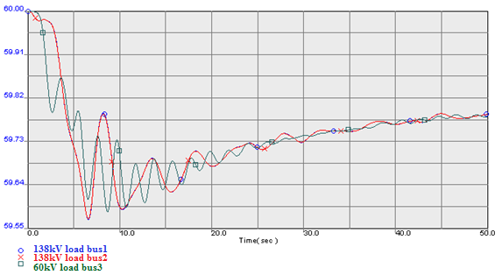
Fast renewable ramp-downs (effect #6b)
Ramp down+loss of 1400 MW unit with lower Inertia, lower governor, and less reserve
Below 59.6 Hz for more than 6 cycles (0.1s)
B-: 59.6Hz
  The above is for the same simulation as the most severe one on the previous slide but with
  the frequency at different load buses is plotted here.

Slide 52
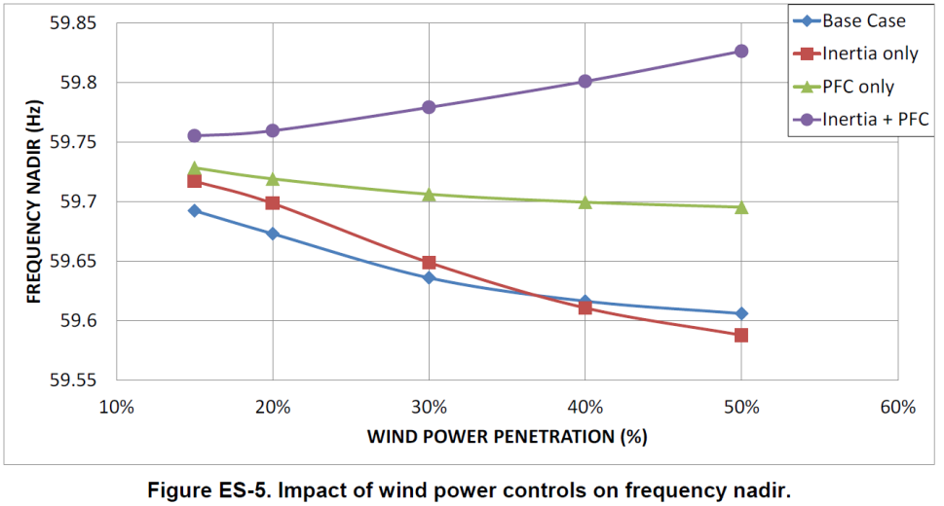
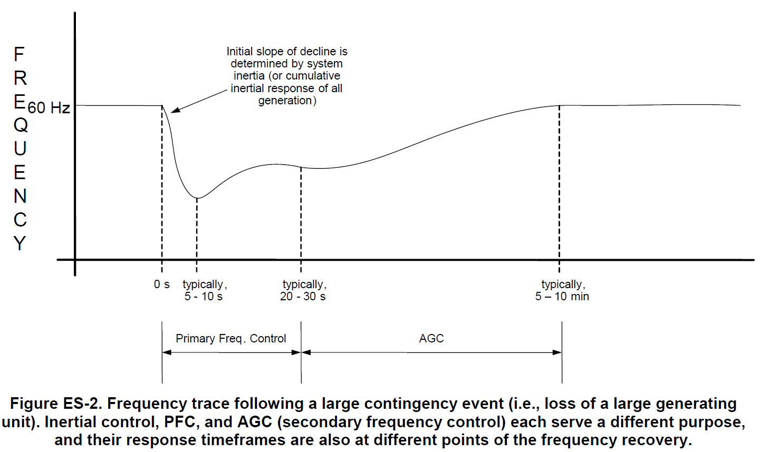
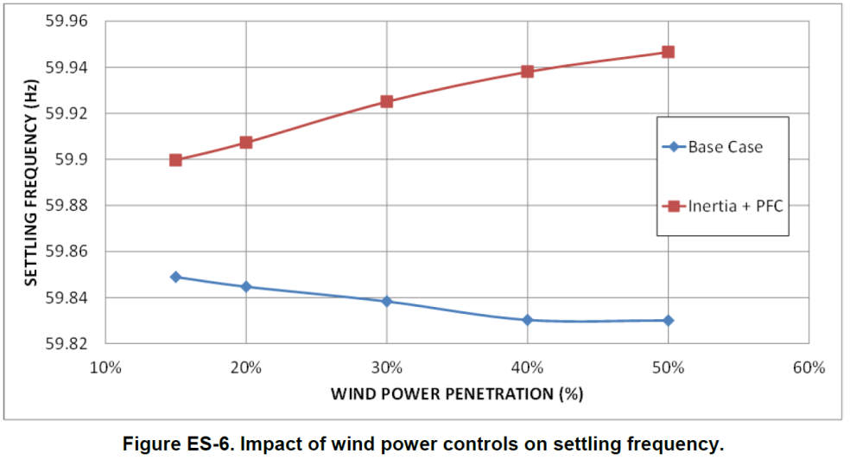
Power Balance Control Levels
Frequency nadir
Plots indicate frequency nadir and settling frequency without any wind control (basecase), and with wind control (inertial and/or primary frequency control).
Settling frequency
E. Ela, V. Gevorgian, P. Fleming, Y.C. Zhang, M. Singh, E. Muljadi, A. Scholbrook, J. Aho, A. Buckspan, L. Pao, V. Singhvi, A. Tuohy, P. Pourbeik, D. Brooks, and N. Bhatt, “Active Power Controls from Wind Power: Bridging the Gaps,” NREL/TP-5D00-60574, January 2014.
52

Slide 53
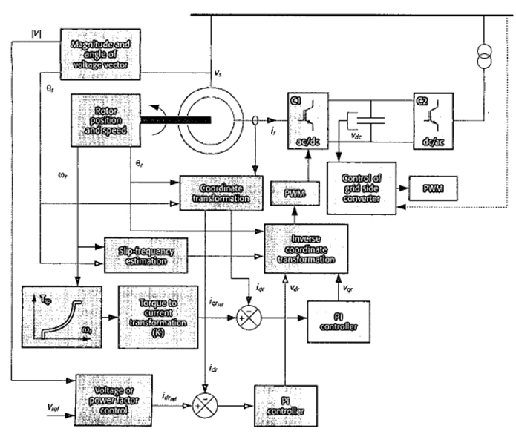
High-level view of control – maximum power tracking
A torque set point, T_{SP}, is det-ermined by the rotor charac-teristic curve for max power extraction. A reference rotor current i_{qrref} is derived from the electromagnetic torque equation & then compared with the measured current i_{qr}. A proportional integral (PI) controller is used to determine the required rotor voltage, v_{qr}.

Slide 54
Control modifications for inertial emulation
Source:G. Ramtharan, J. Ekanayake and N. Jenkins, “Frequency support from doubly-fed induction generator wind turbines,” IET Renewable Power Generation, 2007, 1, (1), 2007.
Without inertial emulation
(based on MPPT only).
With inertial emulation
MPPT Set point torque is provided in exactly the same way here.
The idea behind inertial emulation is to increase power out of the machine in proportion to ROCOF. When dω/dt<0, then a signal is injected into the summer which increases the target torque, thus reducing turbine speed. During the transient period (during which the machine is slowing), the product Tω_{r} (=P) is larger than it would be at the set point, thus “synthetically” releasing inertial energy into the network.
The text by Anaya-Lara, et al., Section 5.5.1.2, provides a nice example of how a wind turbine responds to an additional torque signal, see next slide.

Slide 55
Control modifications for inertial emulation
s=-0.0706 pu,
Source: O. Anaya-Lara, et al., “Wind Energy Generation Systems: Modeling and Control,” Wiley, 2009, Section 5.5.1.2.

Slide 56
Control modifications for inertial emulation
INCREASE REFERENCE TORQUE (T_{sp,mod}) SEEN BY CONTROLLER
DFIG SLOWS, T_{e} INCREASES SHARPLY
CONTROLLER SEES SLOWER SPEED AND FINDS “OPTIMAL” REFERENCE TORQUE T_{SP} (0.2 LOWER THAN BEFORE)
Source: O. Anaya-Lara, et al., “Wind Energy Generation Systems: Modeling and Control,” Wiley, 2009, Section 5.5.1.2.

Slide 57
Control modifications for inertial emulation
Source: O. Anaya-Lara, et al., “Wind Energy Generation Systems: Modeling and Control,” Wiley, 2009, Section 5.5.1.2.

Slide 58
Control modifications for inertial emulation
Source: O. Anaya-Lara, et al., “Wind Energy Generation Systems: Modeling and Control,” Wiley, 2009, Section 5.5.1.2.

Slide 59
Control modifications for inertial emulation
Source: O. Anaya-Lara, et al., “Wind Energy Generation Systems: Modeling and Control,” Wiley, 2009, Section 5.5.1.2.

Slide 60
Additional Slides
The following slides provided courtesy of Sandip Sharma of ERCOT

Slide 61
Some wind units are on PFC
Renewable resources started to assist in frequency control (by having an automatic response to frequency deviations) after 2010.
  NERC’s BAL-001-TRE regional standard was implemented starting April 1, 2015. This reduced Governor Dead-band for most resources including renewables from 36mHz to 17mHZ.

Slide 62
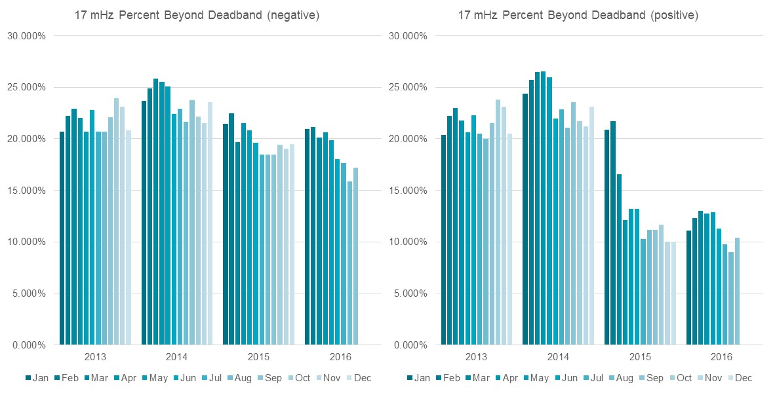
% freq deviations beyond 17mHz deadband

Slide 63
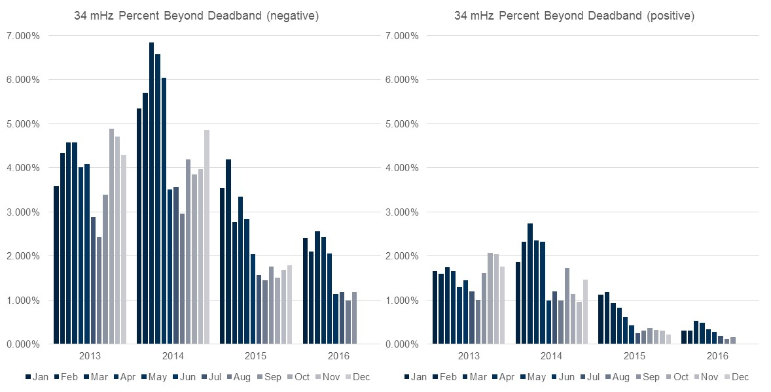
% freq deviations beyond 34mHz deadband

