Slide 1
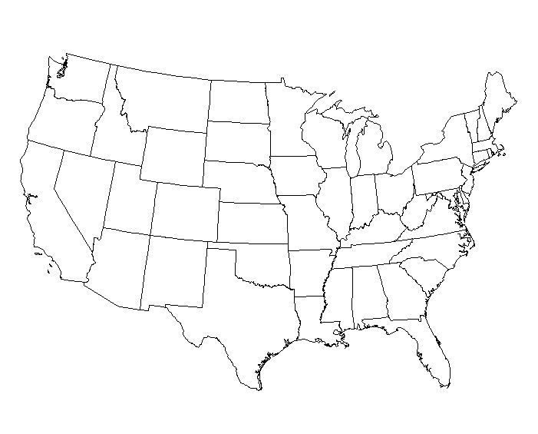
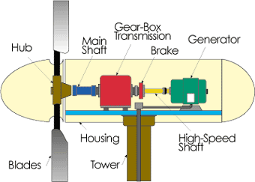
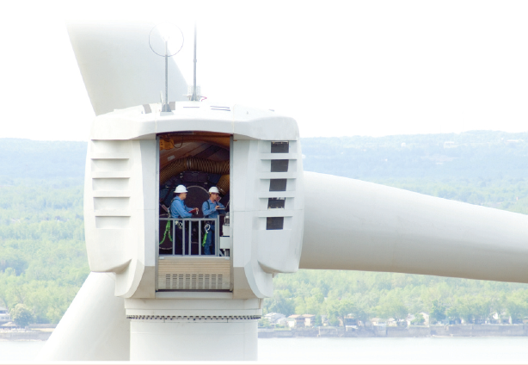
Offshore Wind
J. McCalley

Slide 2
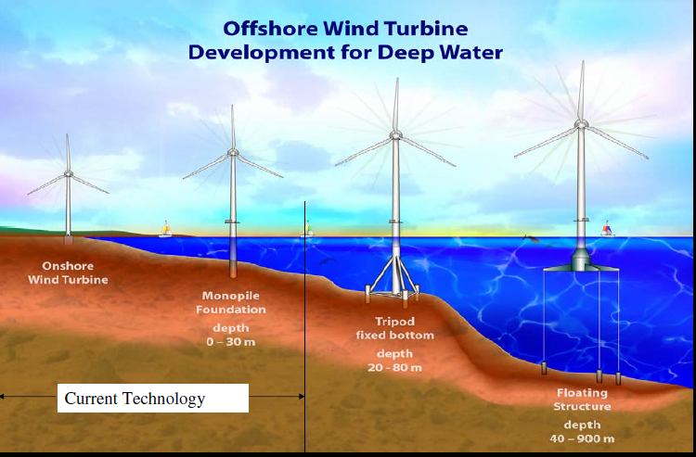
Introduction – structures and depth
Most existing off-shore wind today is in shallow water.
M. Robinson and W. Musial, “Offshore wind technology overview,” October 2006, http://www.nrel.gov/docs/gen/fy07/40462.pdf.

Slide 3
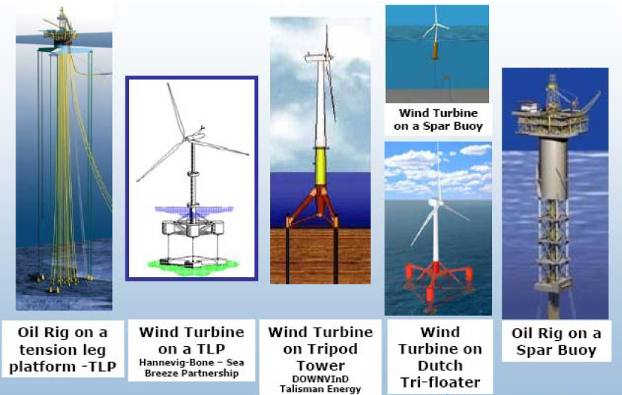
Introduction – structures and depth
Foundation technology for offshore wind can borrow much from designs of ocean-based oil and gas wells.
Technology White Paper on Wind Energy Potential on the U.S. Outer Continental Shelf, Minerals Management Service Renewable Energy and Alternate Use Program, U.S. Department of the Interior
May 2006, http://ocsenergy.anl.gov/documents/docs/OCS_EIS_WhitePaper_Wind.pdf.

Slide 4
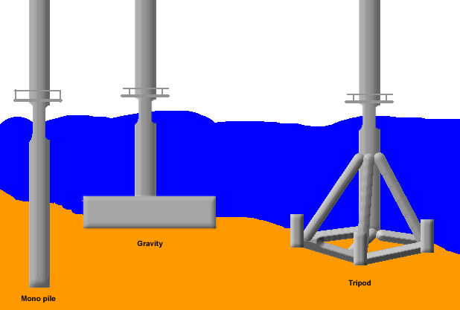
Introduction – shallow water foundations
Three types of foundations used in shallow water:
Least common
Most common

Slide 5
Introduction – shallow water foundations
M. Robinson and W. Musial, “Offshore wind technology overview,” October 2006, http://www.nrel.gov/docs/gen/fy07/40462.pdf.

Slide 6
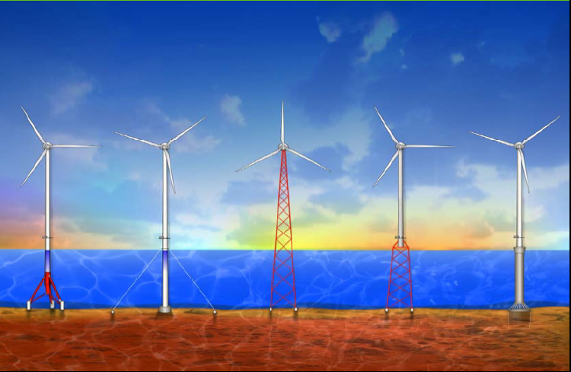
Introduction – transitional depth foundations
30-90m depths
M. Robinson and W. Musial, “Offshore wind technology overview,” October 2006, http://www.nrel.gov/docs/gen/fy07/40462.pdf.

Slide 7
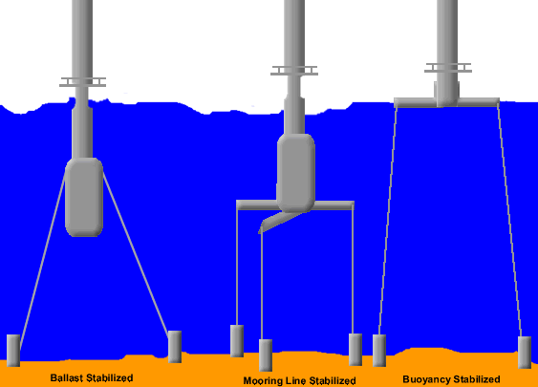
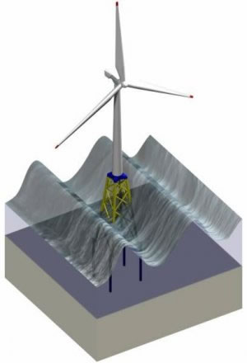
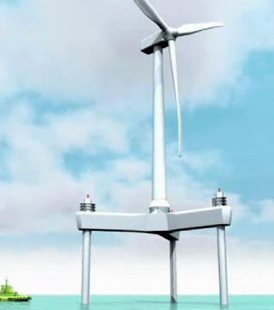
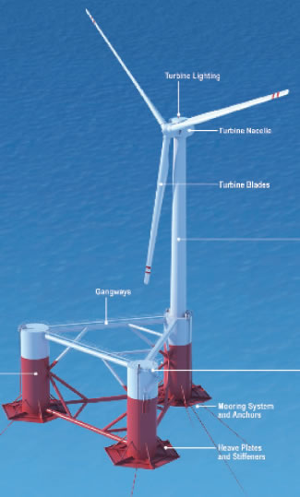
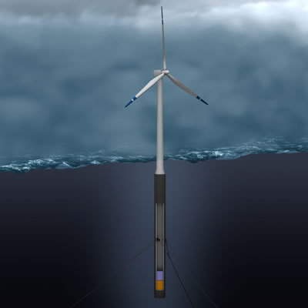
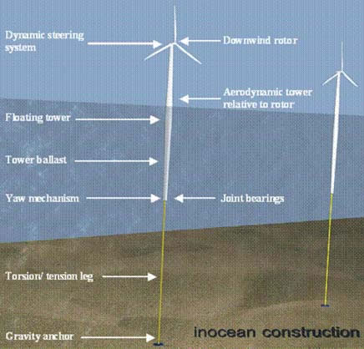
Introduction – deep water foundations

Slide 8
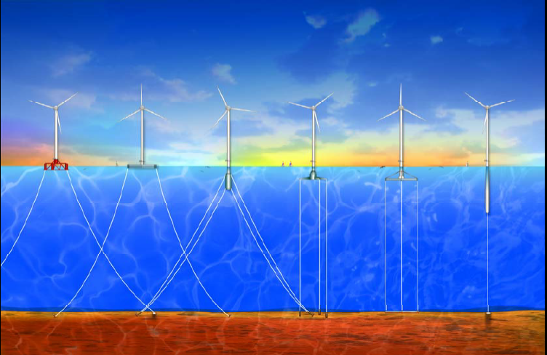
Introduction – deep water foundations
>60m depths
M. Robinson and W. Musial, “Offshore wind technology overview,” October 2006, http://www.nrel.gov/docs/gen/fy07/40462.pdf.

Slide 9
Overnight cost
www.eia.gov/forecasts/aeo/assumptions/pdf/table_8.2.pdf

Slide 10
LCOE
Offshore wind

Slide 11
LCOE

Slide 12
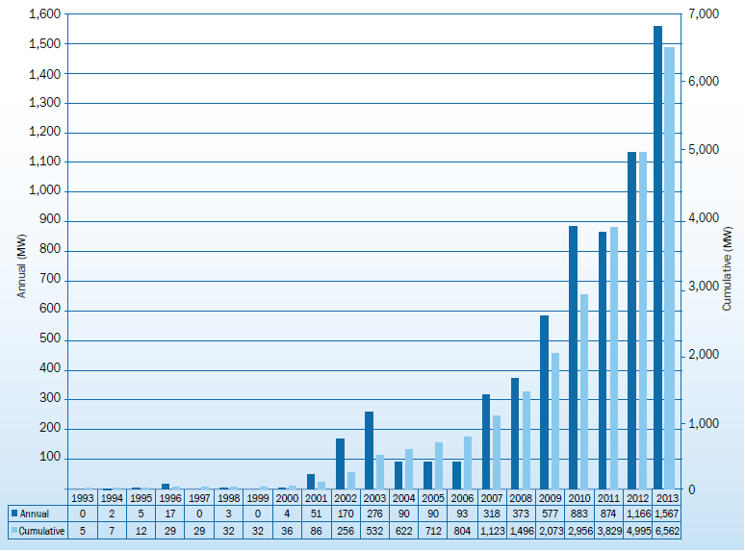

Introduction – EU growth in wind
Annual MW
Cumulative MW
TOTAL EU OFFSHORE WIND AT END OF 2013 IS 6562 MW
European Wind Energy Association, “The European offshore wind industry – key trends and statistics 2013,” January 2014, http://www.ewea.org/statistics/offshore/.

Slide 13
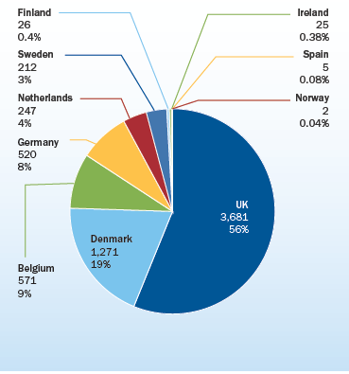
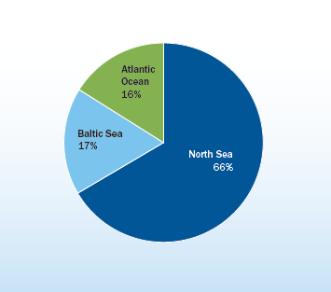
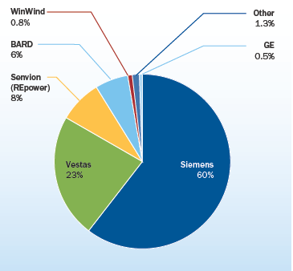
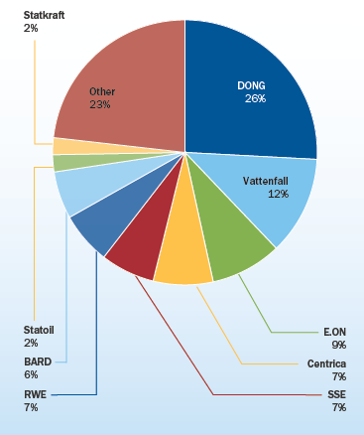
Introduction - Cumulative offshore capacity
@ 2013 End
# of turbines, % MW
% MW
DONG – Denmark
Vattenfall – Sweden
E.ON – Germany
Centrica – UK
SSE – Ireland
RWE - Germany
BARD – Germany
Statoll –
Statkraft - UK
% MW
% MW
European Wind Energy Association, “The European offshore wind industry – key trends and statistics 2013,” January 2014, http://www.ewea.org/statistics/offshore/.

Slide 14
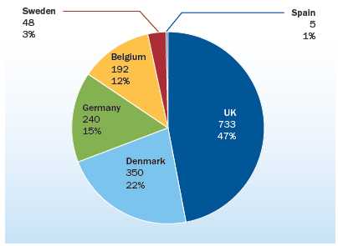
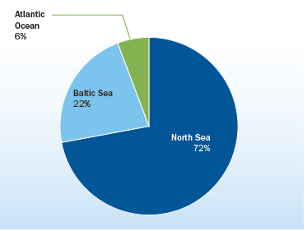
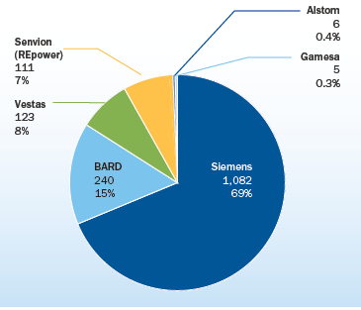
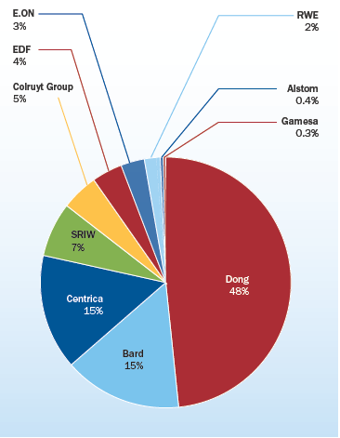
Introduction - 2013 offshore capacity
# of turbines, % MW added in 2013
% MW added in 2013
DONG – Denmark
BARD – Germany
Centrica - UK
SRIW – Belgium
Colruyt – Belgium
EDF - France
E.ON – Germany
RWE – Germany
Alstom - France
MW and % MW added in 2013
% MW added in 2013
European Wind Energy Association, “The European offshore wind industry – key trends and statistics 2013,” January 2014, http://www.ewea.org/statistics/offshore/.

Slide 15
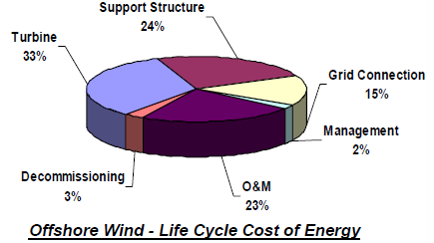
Life cycle costs
Turbine cost (including tower) is 1/3 (lower than inland wind)
Support structure is 1/4 (higher than foundation for inland wind)
Grid connection is significant (higher than inland wind)
O&M is 1/4 (higher than inland wind)
➔ Offshore wind may scale better than inland wind
M. Robinson and W. Musial, “Offshore wind technology overview,” October 2006, http://www.nrel.gov/docs/gen/fy07/40462.pdf.

Slide 16
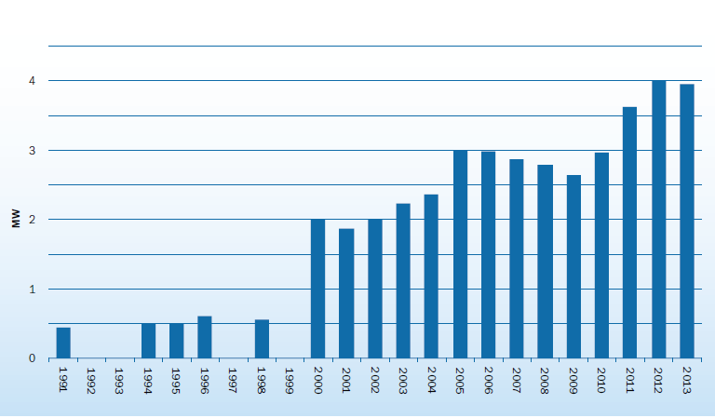
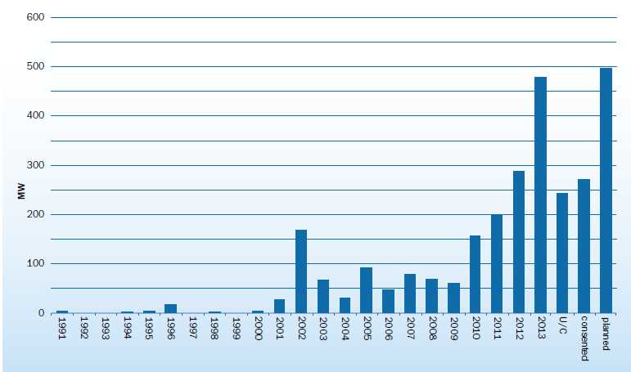
Average size of turbines and wind farms
(added in each year)
(added in each year)
European Wind Energy Association, “The European offshore wind industry – key trends and statistics 2013,” January 2014, http://www.ewea.org/statistics/offshore/.

Slide 17
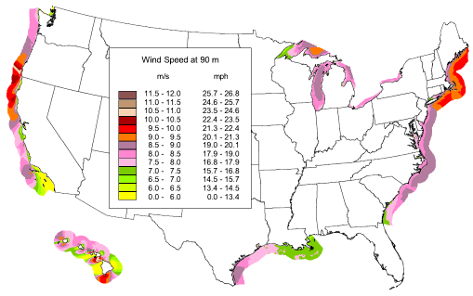
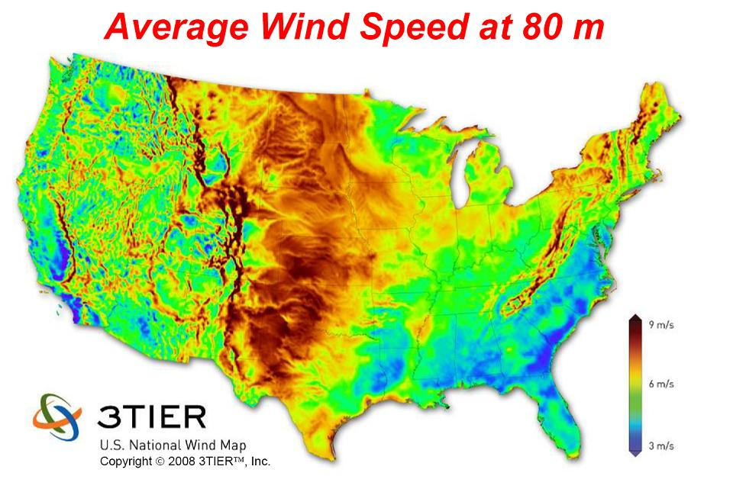
US Wind Resource
US offshore wind resource at 90 m above the surface
9m/s
3m/s
M. Schwartz, D. Heimiller, S. Haymes, and W. Musial, “Assessment of Offshore Wind Energy Resources for the United States,” NREL/TP-500-45889, June 2010, at http://www.nrel.gov/docs/fy10osti/45889.pdf.

Slide 18
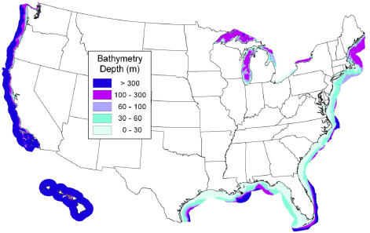
US Coastal and Great Lakes Bathymetry
Bathymetry: The measurement of depth of water in oceans, seas, or lakes.
The East coast and the Gulf of Mexico have extensive areas of shallow water relatively far from shore. On the West coast, the continental shelf descends rapidly into the deep water category. The water depth also increases rapidly away from shore around Hawaii. In the Great Lakes region, Lake Erie and portions of Lake Ontario can be characterized as shallow; the other lakes are primarily deep water, with narrow bands of shallow and transitional water near the shore.
M. Schwartz, D. Heimiller, S. Haymes, and W. Musial, “Assessment of Offshore Wind Energy Resources for the United States,” NREL/TP-500-45889, June 2010, at http://www.nrel.gov/docs/fy10osti/45889.pdf.

Slide 19
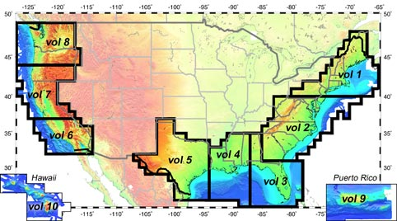
US Coastal and Great Lakes Bathymetry
From National Oceanic and Atmospheric Administration
NOAA National Geophysical Data Center, U.S. Coastal Relief Model, Retrieved date goes here, http://www.ngdc.noaa.gov/mgg/coastal/crm.html

Slide 20
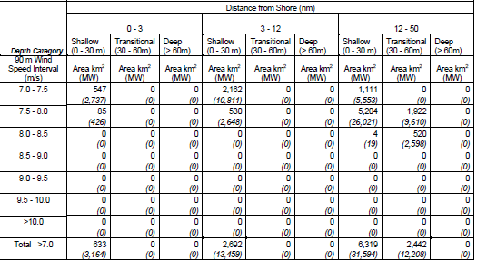
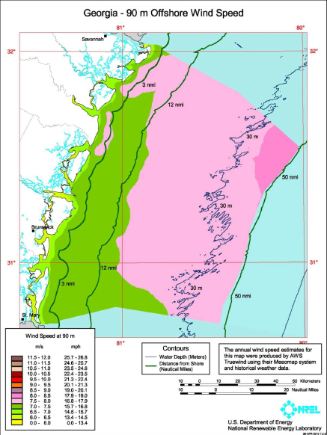
Offshore wind resource by wind speed,
water depth, distance from shore
Arrows in table indicate influences that decrease offshore wind LCOE.
1 n.m. = 1.15077 mi
1 n.m. = 1.852 km
These are for Georgia, but the below reference has similar data for all coastal states and great lakes.
M. Schwartz, D. Heimiller, S. Haymes, and W. Musial, “Assessment of Offshore Wind Energy Resources for the United States,” NREL/TP-500-45889, June 2010, at http://www.nrel.gov/docs/fy10osti/45889.pdf.

Slide 21
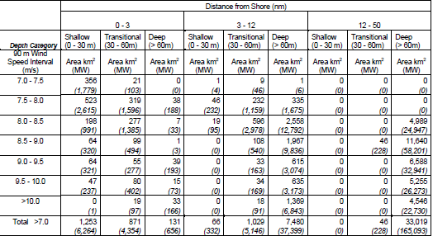
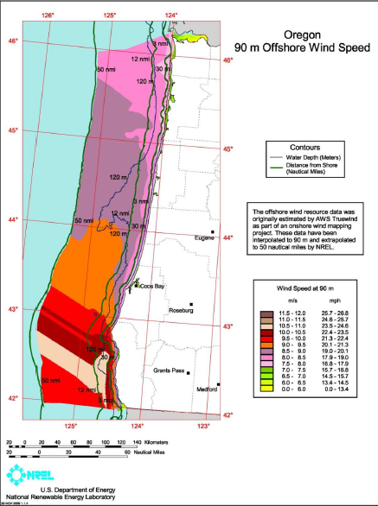
Offshore wind resource by wind speed,
water depth, distance from shore
1 n.m. = 1.15077 mi
1 n.m. = 1.852 km
These are for Oregon, but the below reference has similar data for all coastal states and great lakes.
M. Schwartz, D. Heimiller, S. Haymes, and W. Musial, “Assessment of Offshore Wind Energy Resources for the United States,” NREL/TP-500-45889, June 2010, at http://www.nrel.gov/docs/fy10osti/45889.pdf.

Slide 22
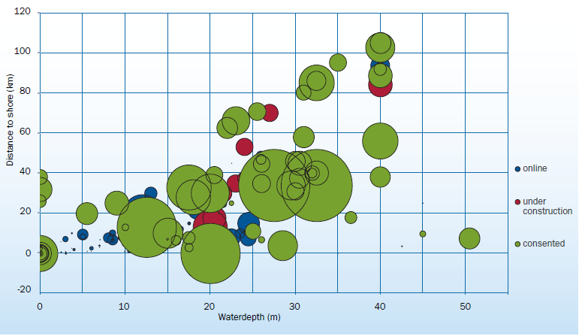
Average water depth and distance to shore of online, under construction & consented wind farms
European Wind Energy Association, “The European offshore wind industry – key trends and statistics 2013,” January 2014, http://www.ewea.org/statistics/offshore/.

Slide 23
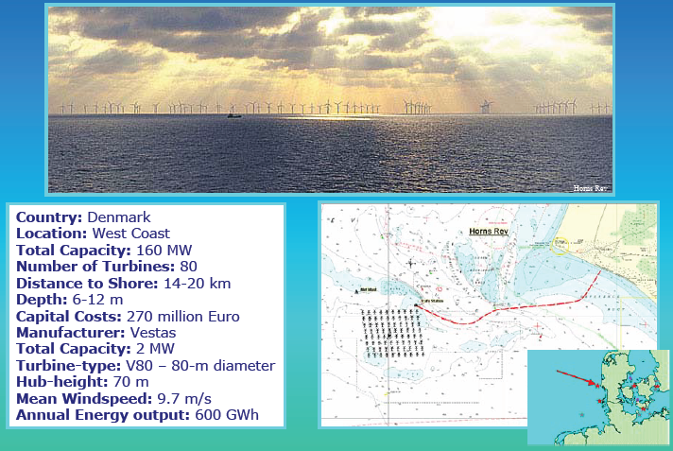
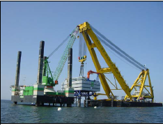
Horns Rev Wind Farm - Denmark
J. Schachner, “Power connections for offshore wind farms,” MS thesis, TUDelft, 2004.
“The wind farm is located at the Danish west coast and is sited 14-20 km offshore in the North Sea, connected to shore with AC at 150 kV….a single 150 kV sub sea-power cable is in operation. Since the turbines are connected with 34 kV, an additional platform with the 34 to 150 kV transformer was necessary.”
North Sea!
M. Robinson and W. Musial, “Offshore wind technology overview,” October 2006, http://www.nrel.gov/docs/gen/fy07/40462.pdf.
←34 to 150 kV transformer

Slide 24
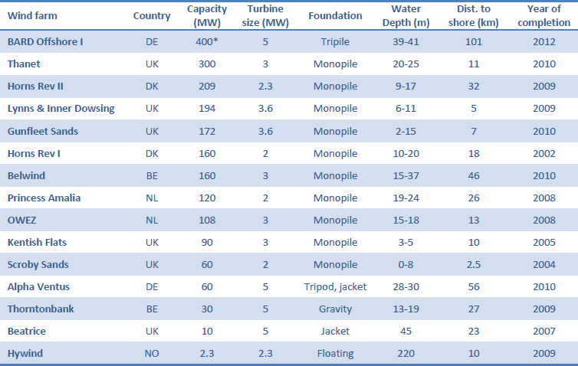
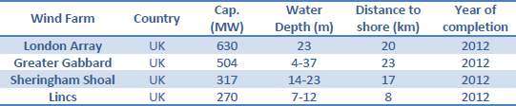
North Sea Offshore, Existing & Under construction, 7/2011
Of 2913 MW EU offshore, 1866 MW is in North Sea
EXISTING
Under cnstrctn
K. Veum, L. Cameron, D. Hernando, M. Korpas, “Roadmap to the deployment of offshore wind energy in the central & southern North Sea: 2020-2030,” July 2011, at www.windspeed.eu/media/publications/WINDSPEED_Roadmap_110719_final.pdf.

Slide 25
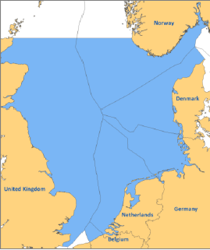
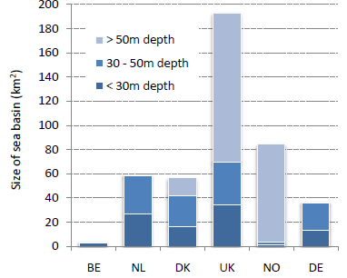
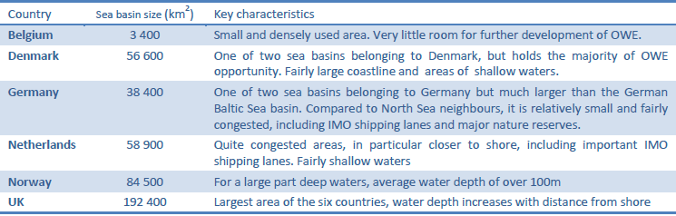
North Sea Offshore Potential
K. Veum, L. Cameron, D. Hernando, M. Korpas, “Roadmap to the deployment of offshore wind energy in the central & southern North Sea: 2020-2030,” July 2011, at www.windspeed.eu/media/publications/WINDSPEED_Roadmap_110719_final.pdf.

Slide 26
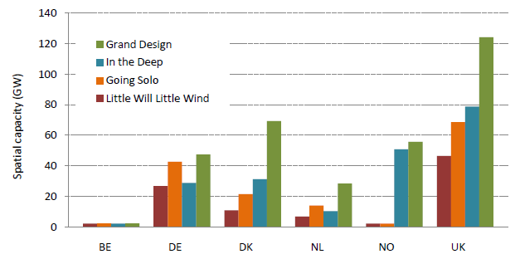
North Sea Offshore Potential
(both shallow and deep water)
(mainly deep water)
(mainly shallow water)
(little shallow or deep water
K. Veum, L. Cameron, D. Hernando, M. Korpas, “Roadmap to the deployment of offshore wind energy in the central & southern North Sea: 2020-2030,” July 2011, at www.windspeed.eu/media/publications/WINDSPEED_Roadmap_110719_final.pdf.

Slide 27
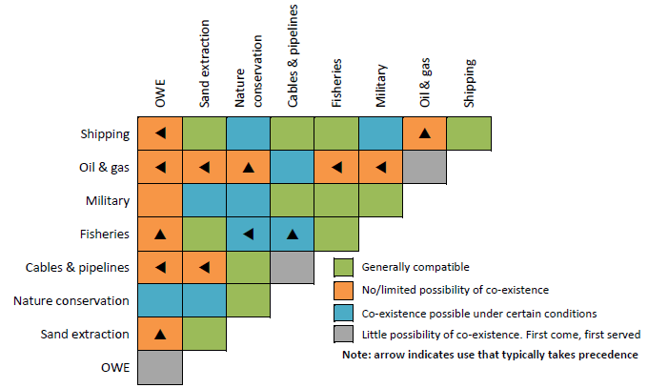
Interactions between sea use functions
K. Veum, L. Cameron, D. Hernando, M. Korpas, “Roadmap to the deployment of offshore wind energy in the central & southern North Sea: 2020-2030,” July 2011, at www.windspeed.eu/media/publications/WINDSPEED_Roadmap_110719_final.pdf.

Slide 28
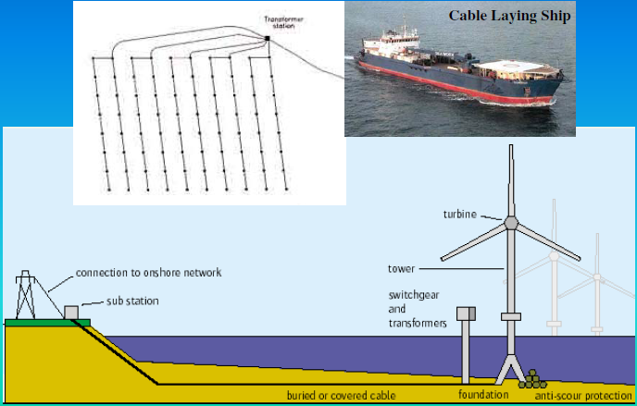
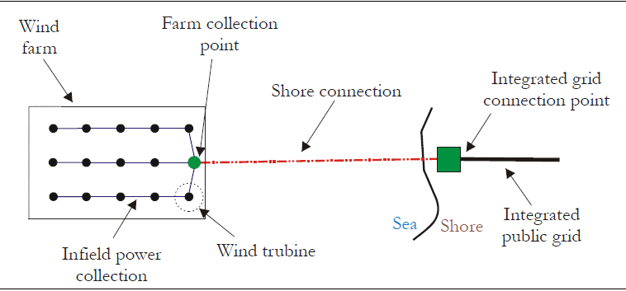
Typical offshore layout
M. Robinson and W. Musial, “Offshore wind technology overview,” October 2006, http://www.nrel.gov/docs/gen/fy07/40462.pdf.
J. Schachner, “Power connections for offshore wind farms,” MS thesis, TUDelft, 2004.
An excellent tutorial on cable-laying is given here:
http://www.iscpc.org/publications/About_SubPower_Cables_2011.pdf and is stored in my resource file.

Slide 29
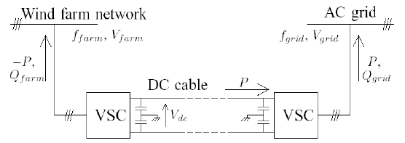
DC-thyristor vs DC-VSC
HVDC transmission uses either thyristor-based converters or voltage source converters (VSC). Most DC designs for offshore wind utilize VSC because VSC is more economic at these lower power ratings.
S. Meier, S. Norrga, H.-P. Nee, ‘’New voltage source converter topology for HVDC grid connection of offshore wind farms,’’ at http://www.ee.kth.se/php/modules/publications/reports/2004/IR-EE-EME_2004_013.pdf.

Slide 30
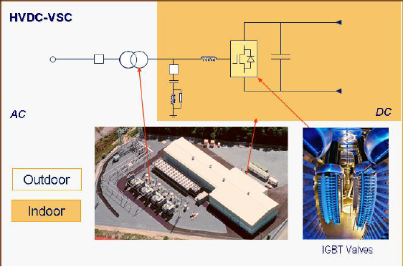
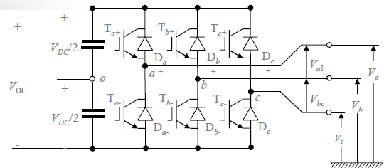
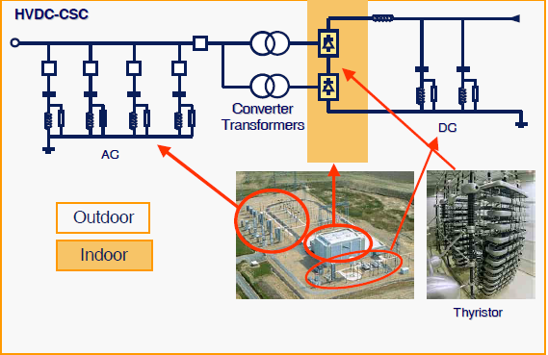

AC vs DC-thyristor vs DC-VSC
Self-commutated voltage source converter
AC
DC
Line commutated current source converter.
AC
DC
M. Bahrman, HVDC Transmission Overview, .
Notes:
Voltage source inverters use the dc voltage (e.g a capacitor in parallel) as a source while the current source inverter (inductor in series) use the dc current as a source (voltage can not be changed abruptly in capacitor and current can not be changed abruptly in inductor)

Slide 31
An interesting idea
Wind farm
Sea-bed transmission
On-shore power grid
VSC
VSC
VSC
VSC
PMG
AC
DC
AC
DC
AC
Wind turbine
Wind farm
Sea-bed transmission
On-shore power grid
VSC
VSC
PMG
AC
DC
AC
Wind turbine

Slide 32
AC vs DC-thyristor vs DC-VSC
AC requires no converter station but has high charging (capacitive) currents that become excessive for long distances. An important issue with AC is whether to step up to transmission voltage in the sea and then transport over high voltage or transport over lower (34.5 kV) voltage and step up to transmission inland.
DC-thyristor has very high power handling capability but converter stations are expensive, and they have short-circuit limitations and therefore locational constraints.
DC-VSC (voltage-source converters) have lower power-handling capabilities, but converter stations are less expensive and they have no short-circuit limitations and can therefore be located anywhere.
J. Schachner, “Power connections for offshore wind farms,” MS thesis, TUDelft, 2004.

Slide 33

AC vs DC-thyristor vs DC-VSC
Switchgear & converters
J. Schachner, “Power connections for offshore wind farms,” MS thesis, TUDelft, 2004.

Slide 34

Losses vs. distance for different AC voltage
Compare 132 kV to 34 kV for 250MW transmission
Compare 132 kV to 34 kV for 100MW transmission
Compare 132 kV to 34 kV for 50MW transmission
Power losses for HV (132 kV) and MV (34 kV)
J. Schachner, “Power connections for offshore wind farms,” MS thesis, TUDelft, 2004.

Slide 35

Breakover distances for AC vs DC
I believe this is for net present worth of {investment + operating costs} but source does not say. But displayed concepts are right:
AC w/farm voltage transmission is only right for short distances at low power
AC w/offshore transformation is right for medium distances at medium power
DC is right for long distances or at high power transfer.
J. Schachner, “Power connections for offshore wind farms,” MS thesis, TUDelft, 2004.

Slide 36

STANDARD NETWORK TOPOLOGIES
FARM-VOLTAGE TRANSMISSION
OFF-SHORE TRANSFORMATION
RADIAL
(STRING)
STAR
This is similar to inland topologies, but here, the location of the step-up transformer is more influential in the economics of the design.
J. Schachner, “Power connections for offshore wind farms,” MS thesis, TUDelft, 2004.

Slide 37
Costs, Reliability & Losses
Off-shore windfarms
“For large scale OWFs a combination of these basic layouts is commonly used, where several strings of turbines are connected to the shore connection point. Its advantages are the simpler cable laying pattern and the shorter cable lengths compared to a strictly star layout. The disadvantages occur with cable failure, because all the turbines upward the failure site on a string have to be switched off and cannot be connected to the grid until the failure has been repaired. Especially during periods of harsh sea conditions in winter the required repair time can be months. Also the number of turbines which can be connected to a string is limited by the power carrying capability of the cable used. With growing turbine power output, the star connection offers the possibility to reduce cable losses by clustering small groups of turbines to high voltage transformer stations as shown in layout IV. Also in case of cable failure at a turbine connection only the single turbine where the failure occurred has to be switched off, the remaining turbines connected to the transformer platform can stay in operation. The big disadvantage is the required transformer platform.”
J. Schachner, “Power connections for offshore wind farms,” MS thesis, TUDelft, 2004.

Slide 38

Wake Interactions
Wakes behind wind turbines at Horns Rev
K. Veum, L. Cameron, D. Hernando, M. Korpas, “Roadmap to the deployment of offshore wind energy in the central & southern North Sea: 2020-2030,” July 2011, at www.windspeed.eu/media/publications/WINDSPEED_Roadmap_110719_final.pdf.

Slide 39

Off-shore wind farm siting
“In view of the recent findings on wakes within offshore wind farms and on wind speed deficits behind these wind farms, the WINDSPEED project considers that, within a defined area, only 30% of the total should realistically be occupied by wind farms. It is assumed that any large scale deployment of offshore wind will likely take the form of multiple wind farm clusters uniformly spaced, allowing adequate distance between each cluster to mitigate the impact of inter wind farm wake losses and the resulting lost production and wake turbulence loading …The remaining 70% shall provide space for wind speed recovery and dissipation of wake turbulent energy, but also possibly permit some form of navigation throughout the area …This provides opportunities for co-use/co-existence with other sea uses such as shipping and fishing.”
“D” is turbine diameter.
K. Veum, L. Cameron, D. Hernando, M. Korpas, “Roadmap to the deployment of offshore wind energy in the central & southern North Sea: 2020-2030,” July 2011, at www.windspeed.eu/media/publications/WINDSPEED_Roadmap_110719_final.pdf.

Slide 40

North Sea HVDC Network?
Decision-support system
“For those scenarios in which some form of offshore grid is assumed to develop – the In the Deep and Grand Design scenarios – the results from the DSS were used to define a number of potential OWE clusters along with onshore connection points. An offshore grid was then designed that interconnects these wind clusters and onshore connection points in such a way as to optimise the investment cost of the grid against the benefit it provides by increased trade opportunities and connections to the new offshore wind generation units.”
K. Veum, L. Cameron, D. Hernando, M. Korpas, “Roadmap to the deployment of offshore wind energy in the central & southern North Sea: 2020-2030,” July 2011, at www.windspeed.eu/media/publications/WINDSPEED_Roadmap_110719_final.pdf.
D. Huertas Hernando, M. Korpas, S. vsn Dyken, “Grid Implications: Optimal design of a subsea power grid in the North Sea,” WP6 Final Report D6.3, June 2011.

Slide 41
Wind-motivated networks?
Is there a “multi-farm collection network” problem that is general/common to both inland & offshore?
There would be differences in implementation, but design method may be very similar.

Slide 42





High Capacity Transmission for Iowa
2010 SmartTransmission Study
2008 Joint Coordinated System Plan
sd
2011 MISO RGOS Study
2010 Green Power Express
sd
2013 Rock Island Clean Line

Slide 43

GIS-based wind farm site potential
Feasibility: land cvr, cities/towns, protected, FAA, exstng WF
Feasible sites > 21 mi²; Sufficient wind>7m/s at 80m
Each square is 5x5 miles; 8MW/mi² (200MW/square)
927 squares are PINK (sufficient wind and feasible site)
PINK: Sufficient wind speed; feasible area
BLUE: Sufficient wind speed; infeasible area
BLACK: Insufficient wind speed; feasible area
RED: Insufficient wind speed; infeasible area

Slide 44

Iowa Transmission System with New Backbone
Derived from public data:
  IUB map, FERC filings, utility websites, EIA, MTEP
Existing system model includes:
transmission >100kV
  319 transmission lines,
  204 nodes, 99 loads,
  81 generators, 40 wind farms
5 bordering states:
gen/load represented at single node
Backbone design:
utilized MTEP-2011 plans + 765kV
loop to connect wind intense areas
with load centers in Iowa & eastward.
THICK PURPLE: 765 kV backbone
THICK RED: New 345kV

Slide 45



Wind Farm Site Identification
Select sites to satisfy target GW level while minimizing {cost of turbines + cost of transmission} per MWhr.
10 GW Future
30 GW Future
765kV Overlay | 10GW | 20GW | 30GW
New Capacity (MW) | 4954 | 14956 | 24960
New Wind Farms (1 windfarm = 200MW square) | 27 | 79 | 133
CF of New Wind | 0.3824 | 0.3751 | 0.3708
Mean Distance (mi) | 4.33 | 6.52 | 8.68
20 GW Future

Slide 46









R2B Transmission Design Results
Transmission designs for each cluster minimize investment costs while satisfying N-1 reliability constraints (20 GW future).
A
B
C
F
D
E
G
H

Slide 47

R2B Transmission Design Results
765kV Overlay 20GW Scenario
 | Wind Farms | Paths | Ccts | 161 Sngle | 161 High | 345 Sngle | 161 Dble | 345 Dble | ROW Miles | Circuit Miles | Cost $M |  | cct miles / Wind Farm | $M/ct/mi
A | 15 | 19 | 24 | 10 | 4 | 0 | 3 | 2 | 109.1 | 133.6 | 120.3 |  | 8.91 | 0.90
B | 11 | 13 | 20 | 6 | 0 | 0 | 6 | 1 | 61.4 | 92.9 | 75 |  | 8.45 | 0.81
C | 13 | 18 | 25 | 10 | 1 | 0 | 6 | 1 | 93.5 | 127.3 | 101.7 |  | 9.79 | 0.80
D | 9 | 12 | 15 | 9 | 0 | 0 | 2 | 1 | 66.2 | 80.2 | 68 |  | 8.91 | 0.85
E | 11 | 17 | 17 | 17 | 0 | 0 | 0 | 0 | 120.3 | 120.3 | 96.2 |  | 10.94 | 0.80
F | 5 | 6 | 9 | 3 | 0 | 0 | 3 | 0 | 48 | 77.2 | 58.8 |  | 15.44 | 0.76
G | 6 | 8 | 10 | 4 | 2 | 0 | 1 | 1 | 49.3 | 62.4 | 59.1 |  | 10.40 | 0.95
H | 6 | 7 | 11 | 3 | 0 | 0 | 4 | 0 | 42.9 | 64.8 | 49.7 |  | 10.80 | 0.77
All | 76 | 100 | 131 | 62 | 7 | 0 | 25 | 6 | 590.7 | 758.7 | 628.8 |  | 9.98 | 0.83
A
B
C
F
D
E
G
H

Slide 48

Wind-motivated networks?
Some thinking on novel designs:
T. Hammons, V. Lescale, K. Uecker, M. Haeusler, D. Retzmann, K. Staschus, S. Lepy, “State of the Art in Ultrahigh-Voltage Transmission,” Proceedings of the IEEE, Vol. 100, No. 2, February 2012.

Slide 49
Wind-motivated networks?
See 2012 class paper by Khondkar Hasan for an intersting hybrid offshore wind-hydrokinetic wind system design, with associated summarization of other hydrokinentic designs.

