Slide 1
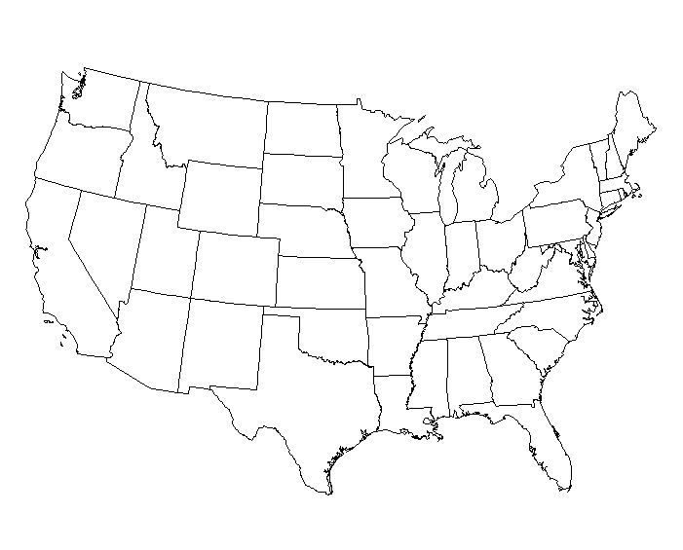
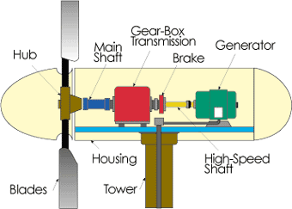
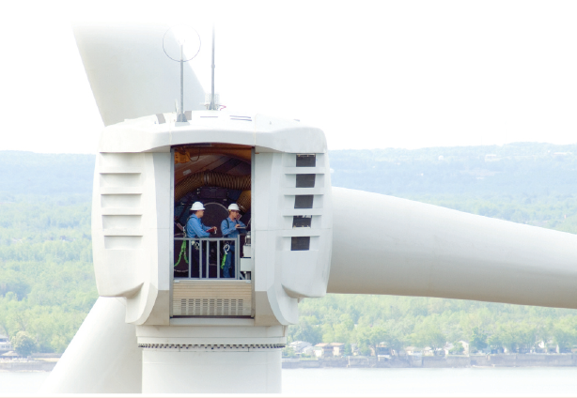
Local Issues #1
Collection Circuits
J. McCalley

Slide 2
Title: Transfer of Power: How President-Elect Trump’s Policies Will Affect the Energy Industry
Date: Tuesday, December 6, 2016
Time: 10:30AM - 11:30AM (Central)
Location: Room 2222 Coover
Presenters: ICF Consultants Chris MacCracken, Carol Babb, Judah Rose, Elliot Roseman, Michael Sloan, Jeff Archibald; https://www.icf.com/)
Abstract:
President-elect Trump’s positions regarding the U.S. energy sector, including his intent to “level the playing field” among generation options, appear likely to have significant impacts, including having energy play a role in job creation and economic expansion, supporting coal production and use, backing away from environmental regulation including policies related to climate change, and promoting infrastructure investment. While the stated objectives of the Trump policies tend to be straightforward, the actual impacts are likely to be influenced by the inter-relationship between different policies, of which important details are uncertain, and by political constraints. Policies favorable to natural gas and oil could negatively impact coal while environmental and power policy will influence both coal and natural gas markets. Trade policy could impact energy policy.
ICF’s views on energy markets presented during this webinar will represent an integrated perspective on energy markets that analyzes the impact of different potential policies on the overall energy market, rather than considering each policy in isolation.
In this webinar, we will discuss:
Stated positions of president-elect Trump related to the energy sector and how they are developing in the weeks following the election
Potential implications for the power, coal, and gas markets, as well as emissions regulations, should those positions become policy
How “sticky” the implications of the policies may be for decisions and investments lasting beyond the next four years
It will take time for these promises to emerge as policies and regulations, and for the interactions of those changes to be understood. To participate in the policy process under the new administration, and or to properly position business strategy, owners, developers, and investors in power and fuel supply and infrastructure must begin to consider the range of alternatives and outcomes on their strategies for the next several years.

Slide 3
High-level design steps for a windfarm
Select site:
  Wind resource, land availability, FAA restrictions, transmission availability
Select turbine placement on site
  Wind resource, soil conditions, FAA restrictions, land agreements, constructability considerations
Select point of interconnection (POI)/collector sub
  For sites remote from nearest transmission, decide how to interconnect
    Use collector sub, collector voltage to POI (transmission sub): low investment, high losses
    Use transmission sub as collector station: high investment, low losses
  Decide via min of net present value (NPV){investment cost + cost of losses}
Design collector system
  Factors affecting design: turbine placement, POI/collector sub location, terrain, reliability, landowner requirements
  Decide via min of NPV{investment cost + cost of losses}

Slide 4
Topologies
Usually radial feeder configuration with turbines connected in “daisy-chain” style
“’Daisy chain’ means the circuit is brought to each wind turbine,
and then the feeder continues on to the next turbine until the last
turbine is reached.” (Miller, Walling, and Piwko, “Electrical Design
of a Wind Plant,” chapter 13, in “Wind power in power systems,”
edited by T. Ackermann, second edition, 2012, Wiley.)
Usually underground cables but can be overhead
  ➔ UG is often chosen because it is out of the way from construction activities (crane travel), and of landowner activities (e.g., farming).
A feeder string may have branch strings

Slide 5
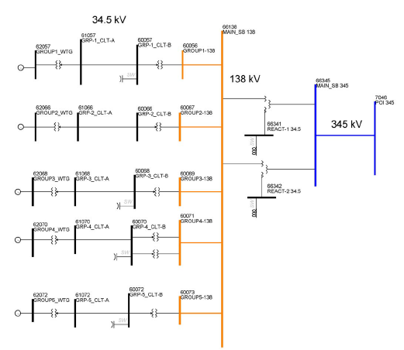
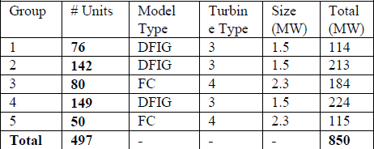
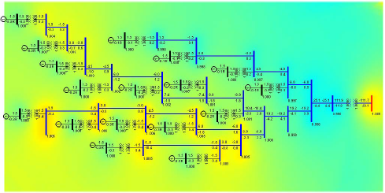
Topologies
Note the 850MW size! There are many larger ones planned, see http://www.re-database.com/index.php/homepage/wind/the-largest-windparks
FC=“Siemens Full converter”; DFIG=“GE Double fed Ind Gen”
The five 34.5 kV feeder systems range in length from few hundred feet to several miles; have 50-100 turbines each
1119 buses, 1095 branches.
Source: J. Feltes, B. Fernandes, P. Keung, “Case Studies of Wind Park Modeling,” Proc. of 2011 IEEE PES General Meeting.

Slide 6
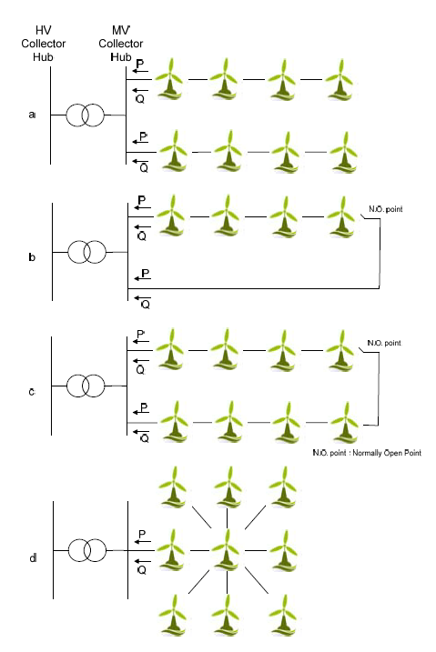
More on topologies
The NO configurations may be wise under light-load conditions when the cables would otherwise produce large vars, but then they need to also be disconnected at the substation end.
Radially designed & radially operated
Ring designed & radially operated
Mixed design:
Combining two of these can also be interesting, e.g., c and d.
Ring designed & radially operated
Star designed & radially operated
Source: M. Altin, R. Teodorescu, B. Bak-Jensen, P. Rodriguez and P. C. Kjær, “Aspects of Wind Power Plant Collector Network Layout and Control Architecture,” available at http://vbn.aau.dk/files/19638975/Publication.
Quinonez-Varela, G.; Ault, G.W.; Anaya-Lara, O.; McDonald, J.R, “Electrical collector system options for large offshore wind farms,” Renewable Power Generation, IET, Volume: 1 , Issue: 2, 2007, pp. 107 - 114

Slide 7
More on topologies
“It is conceivable that a feeder could be configured as a loop; either operated continuously in the looped configuration or with a normally open tie at the end of two radial feeders. Looping will provide increased availability, as it allows the wind turbines to operate when a feeder section is out of service. However, to operate in this mode, the feeder ampacity may have to be increased substantially from that which is required for simple radial configuration. It is common practice to taper the size of radial feeder cables and conductors as the maximum load current decreases away from the substation. If a feeder is to operate in a loop configuration, such as during an outage of a section near the substation end of one feeder, the size of cables and conductors will need to be substantially greater than for a strictly radial configuration. In addition, an extra feeder section is needed to complete the loop. The experience of the wind industry indicates that the extra investment needed to allow looped operation is not justified by the relatively small amount of recovered production otherwise made unavailable due to feeder failures. For this reason, very few wind plants employ a looped collector feeder configuration.”
(Miller, Walling, and Piwko, “Electrical Design of a Wind Plant,” chapter 13, in “Wind power in power systems,” edited by T. Ackermann, second edition, 2012, Wiley.)

Slide 8
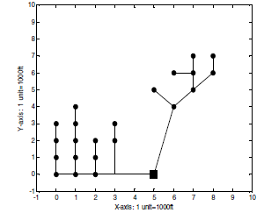
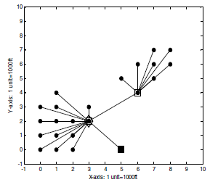
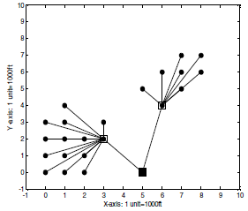
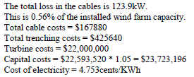
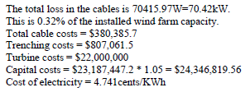
More on topologies
Radial design
Star design
Mixed design
Capital costs=cable costs+trenching costs+turbine costs+5% to account for site
preparation, grid connections, project development, and feasibility study
Source: S. Dutta and T. Overbye, “A clusteritering-based wind farm collector system cable layout design,” Proc of the IEEE PES. 2011 General Meeting

Slide 9
Design considerations
Number of turbines per string is limited by conductor ampacity;
Total number of circuits limited by substation xfmr
For UG, conductor sizing begins with soil:
Soil thermal resistivity characterizes the ability of the soil to dissipate heat generated by energized & loaded power cables.
Soil resistivity is represented by Rho (ρ); units are °C-m/Watt. Lower is better: a lower value means that for a given temp differential between two points 1m apart (the numerator, similar to voltage), you get a higher heat flow or rate of change of energy (the denominator, similar to current).
ρ is the resistance to a quantity of heat flow; the thermal insulating ability of soil.
Lower value of ρ indicates better heat transfer away from cable.
ρ is the reciprocal of thermal conductivity, k [W/°C-cm].

Slide 10
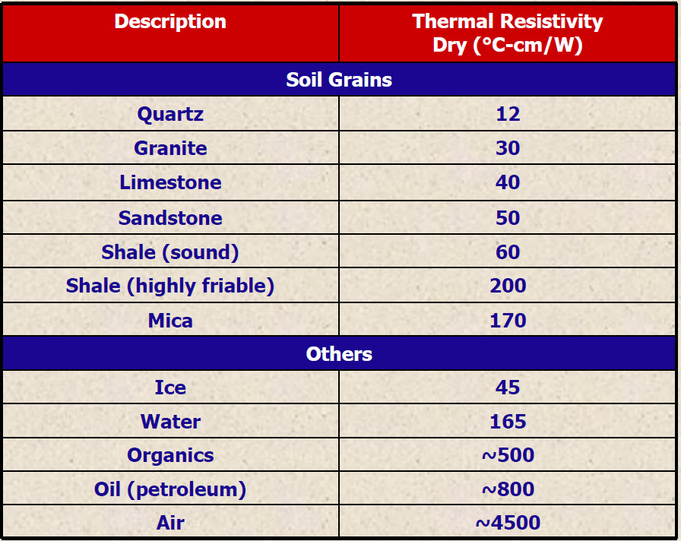
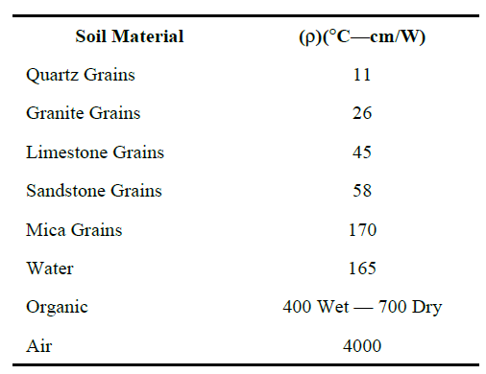
Soil thermal resistivity
Thermal resistivity depends mainly on soil composition (i.e. mineral, organics), texture (i.e. particle size grading), water content, and dry density. This complex interrelationship does not lend itself to a simple formula; testing must be carried out on any given soil to determine its resistivity.
You want high water content and high soil density (see next slide).
Air has a high thermal resistivity and therefore does not dissipate heat very well. Water dissipates heat better.
Soil with lowest thermal resistivity has maximum amount of soil grains & water.
Source: Presentation slides of Geotherm Inc., “Importance of Soil Thermal Charcteristic for Underground Power Cables., March 23, 2010, Spring 2010 ICC Meeting, Nashville, TN
Source: IEEE Standard 442-1981, “IEEE Guide for Soil Thermal Resistivity Measurements,” 1996.

Slide 11
Soil thermal resistivity
If ρ is too high, then one can use Corrective Thermal Backfill (CTB) to significantly lower thermal resistivity.
Native soil thermal resistivities can vary from 30 to 500 °C-cm/W; corrective thermal backfill values range from 35 (wet) to 120 °C-cm/W (dry).
Source: Presentation slides of Geotherm Inc., “Importance of Soil Thermal Charcteristic for Underground Power Cables., March 23, 2010, Spring 2010 ICC Meeting, Nashville, TN
Source: IEEE Standard 442-1981, “IEEE Guide for Soil Thermal Resistivity Measurements,” 1996.

Slide 12
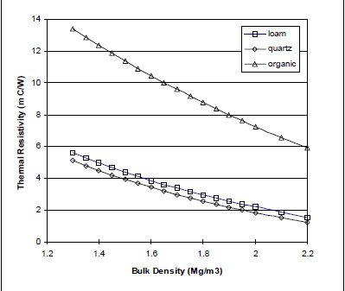
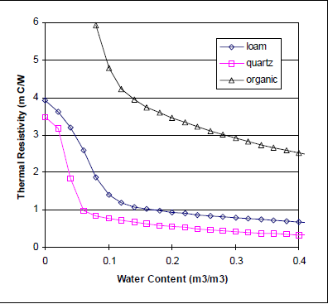
Soil thermal resistivity
Units of ordinate in both plots are m-C/watt (so values are 0.01 of those given in cm-C/watt)
Thermal resistivity of a dry, porous material is strongly dependent on its density. Units of abscissa are
Mega-g/m³ (10⁶ grams/cubic meter)
Adding water to a porous material decreases its thermal resistance. Units of abscissa are m³ water/m³ soil
Source: G. Campbell and K. Bristow, “Underground Power Cable Installations: Soil Thermal Resistivity.”

Slide 13
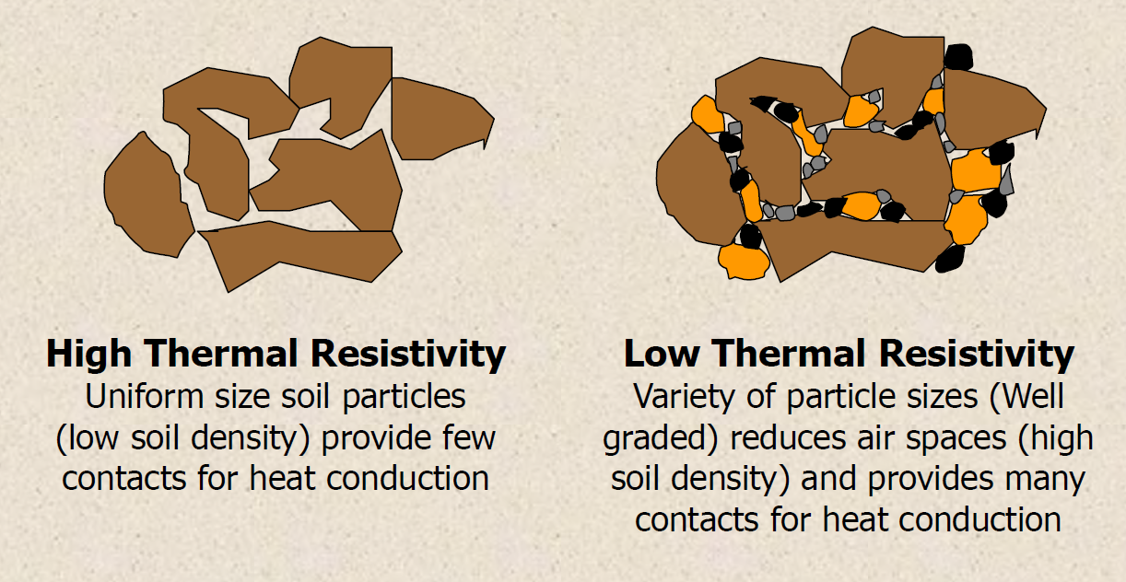
Soil thermal resistivity
Source: Presentation slides of Geotherm Inc., “Importance of Soil Thermal Charcteristic for Underground Power Cables., March 23, 2010, Spring 2010 ICC Meeting, Nashville, TN

Slide 14
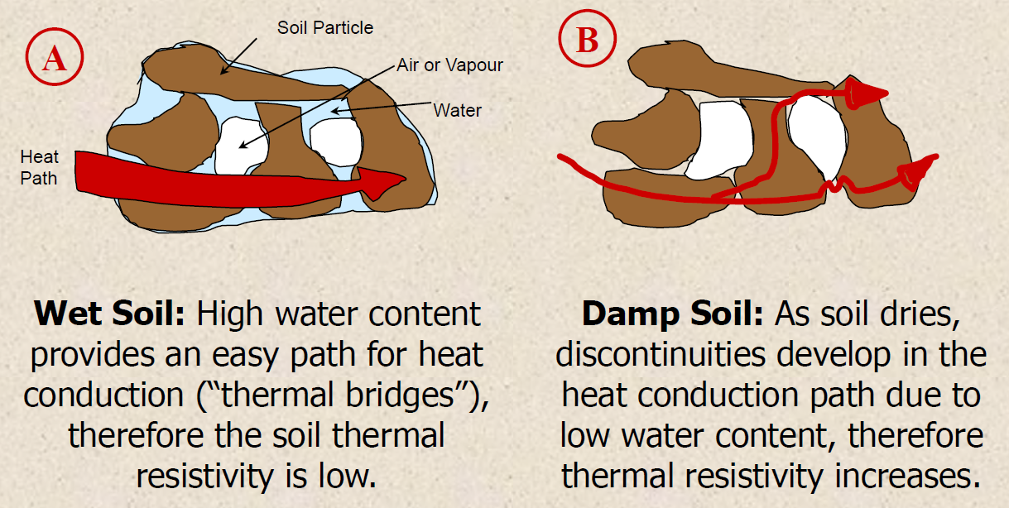
Soil thermal resistivity
Source: Presentation slides of Geotherm Inc., “Importance of Soil Thermal Charcteristic for Underground Power Cables., March 23, 2010, Spring 2010 ICC Meeting, Nashville, TN

Slide 15
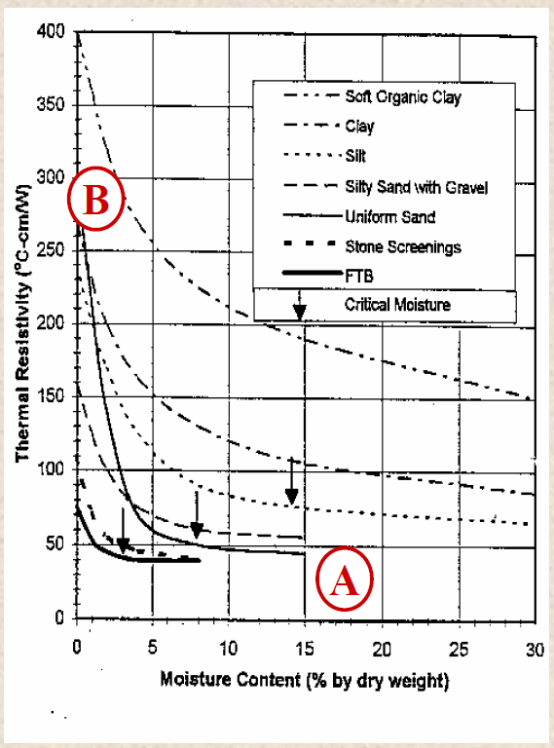
Soil thermal resistivity
A and B correspond to conditions illustrated on previous slide
A: Wet soil (low resistivity)
B: Damp soil (high resistivity)
Source: Presentation slides of Geotherm Inc., “Importance of Soil Thermal Charcteristic for Underground Power Cables., March 23, 2010, Spring 2010 ICC Meeting, Nashville, TN

Slide 16
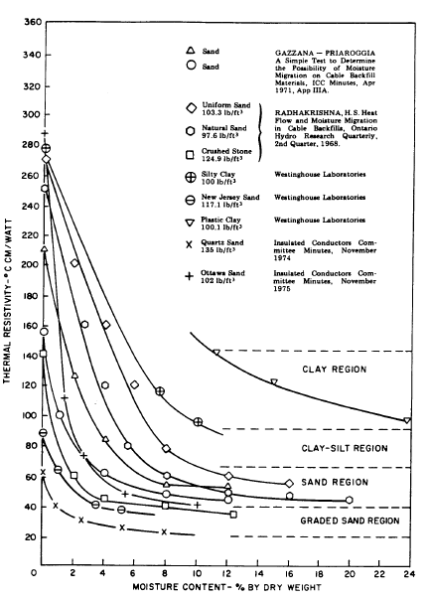
Soil thermal resistivity
This data shows:
ρ decreases with water content
ρ decreases with amount of soil grains (e.g., compare crushed stone to uniform sand and natural sand).
ρ decreases with soil density (e.g., compare Quartz sand to Ottawa sand)
Source: IEEE Standard 442-1981, “IEEE Guide for Soil Thermal Resistivity Measurements,” 1996.

Slide 17
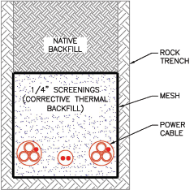
Corrective thermal backfill (CTB)
CTBs and their installation can be expensive, but it does increase ampacity of a given conductor size. One therefore needs to optimize the conductor size and its corresponding cost, the associated losses, the cost of CTB, and resulting ampacity.
The below reference reports that
  “Where a total life-cycle cost evaluation is used, cable thermal ampacity tends to be a less limiting factor. This is because when lost revenue from losses are considered, optimized cable size is typically considerably larger than the size that approaches ampacity limits at peak loading.”
Double-cct trench with trefoil cables and communication conduit
➔Economic consideration of losses can drive large cable size beyond thermal limitations. Note the interplay between economics, losses, and ampacity.
It is possible that if soil resistivity is too high, the cost of UG may be excessive, in which case overhead (or perhaps a section of overhead) can be used, if landowner allows.
Overhead incurs more outages, but UG incurs longer outage durations.
Source: IEEE PES Wind Plant Collector System Design Working Group, chaired by E. Camm, “Wind Power Plant Collector System Design Considerations,” IEEE PES General Meeting, 2009.

Slide 18
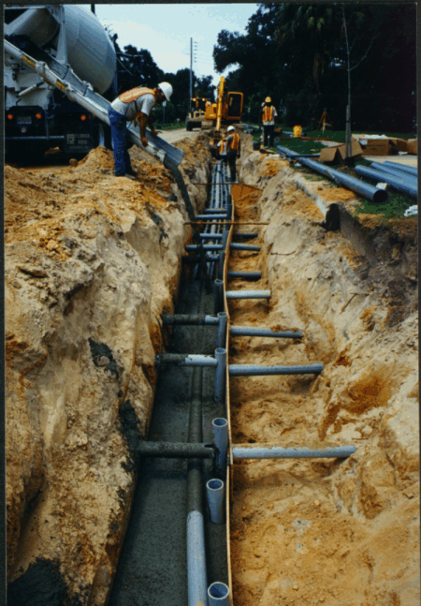
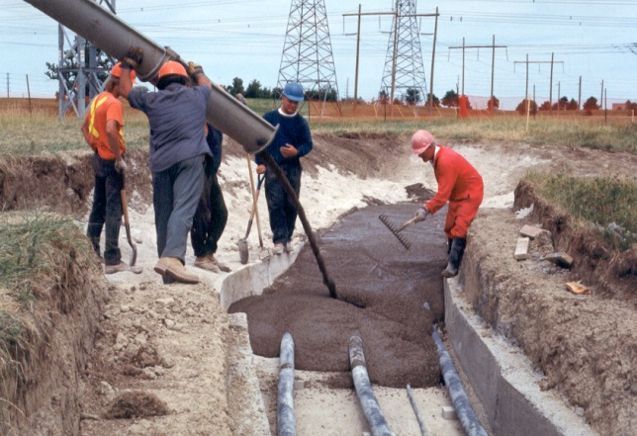
Fluidized thermal backfill (FTB)
CTB can be graded sand or a more highly engineered mixture referred to as fluidized thermal backfill (FTB).
FTP is a material having constituents similar to concrete but with a relatively low strength that allows for future excavation if required. FTB is generally composed of sand, small rock, cement and fly ash. FTB is installed with a mix truck and does not require any compaction to complete the installation. However, FTB is expensive, so its cost must be considered before employing it at a site.
The fluidizing component is fly-ash; its purpose is to enhance flowability and inhibit segregation of materials in freshly mixed FTB.
http://www.geothermusa.com
Source: IEEE PES Wind Plant Collector System Design Working Group, chaired by E. Camm, “Wind Power Plant Collector System Design Considerations,” IEEE PES General Meeting, 2009.
D. Parmar, J. Steinmaniis, “Underground cable need a proper burial,”http://tdworld.com/mag/power_underground_cables_need/

Slide 19
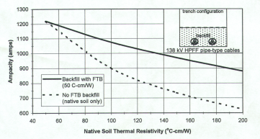
Fluidized thermal backfill (FTB)
Impact of using FTB is to raise conductor ampacity.
Source: http://www.geotherm.net/ftb.htm.

Slide 20
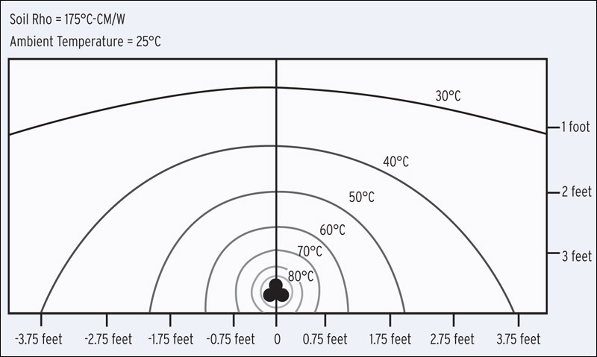
Thermal curves surrounding buried cable
Observe that the rate of temperature decrease with distance from the cable is highest in the area closest to the cables. Thus, using thermal backfill is most effective in the area surrounding the cable.
Source: M. Davis, T. Maples, and B. Rosen, “Cost-Saving Approaches to Wind Farm Design: Exploring Collection-System Alternatives Can Yield Savings,” available at http://www.burnsmcd.com/BenchMark/Article/Cost-Saving-Approaches-to-Wind-Farm-Design.

Slide 21
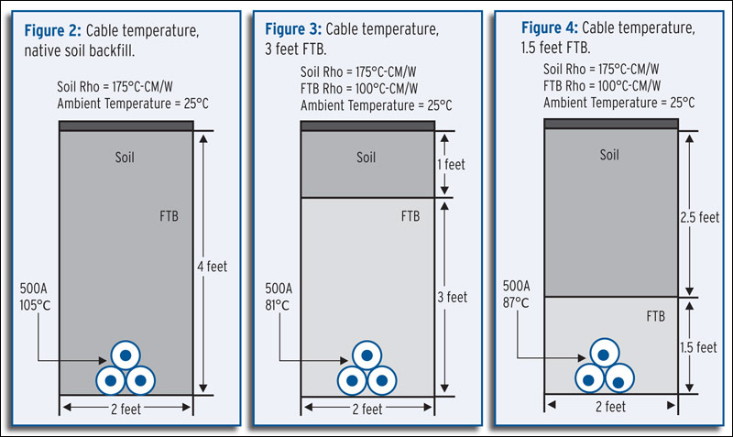
Cable temperatures and backfill materials
A 1000kcmil conductor was used, at 34.5kV. Soil resistivity is 1.75C-m/watt
In each case, I=500A, Ambient Temp=25 °C.
Observe cable temperature varies: 105, 81, 87 °C.
Source: M. Davis, T. Maples, and B. Rosen, “Cost-Saving Approaches to Wind Farm Design: Exploring Collection-System Alternatives Can Yield Savings,” available at http://www.burnsmcd.com/BenchMark/Article/Cost-Saving-Approaches-to-Wind-Farm-Design.

Slide 22
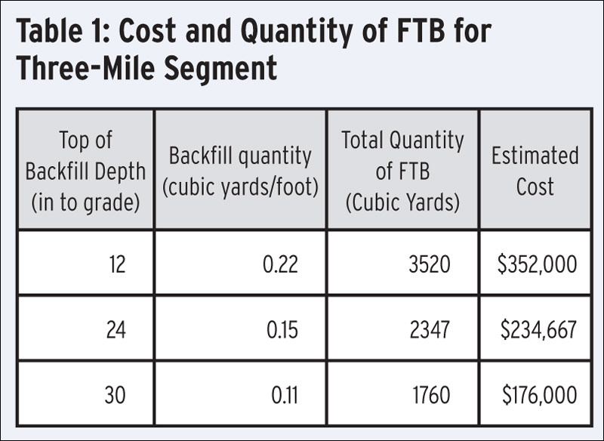
Approximate material cost of FTB is $100/cubic yard.
This three-mile segment is the “homerun” segment, which is the part that runs from the substation to the first wind turbine.
Source: M. Davis, T. Maples, and B. Rosen, “Cost-Saving Approaches to Wind Farm Design: Exploring Collection-System Alternatives Can Yield Savings,” available at http://www.burnsmcd.com/BenchMark/Article/Cost-Saving-Approaches-to-Wind-Farm-Design.

Slide 23
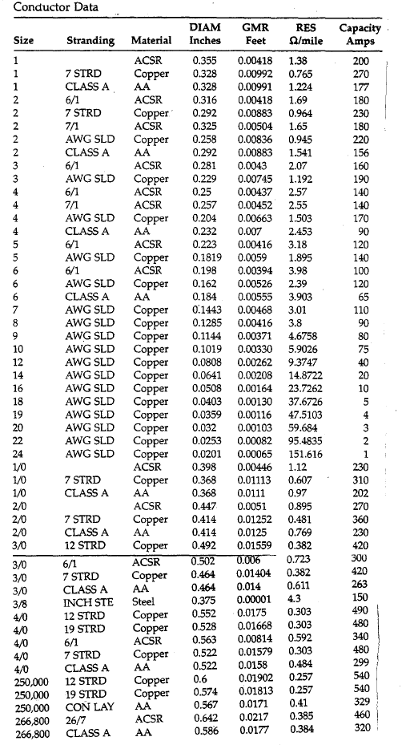
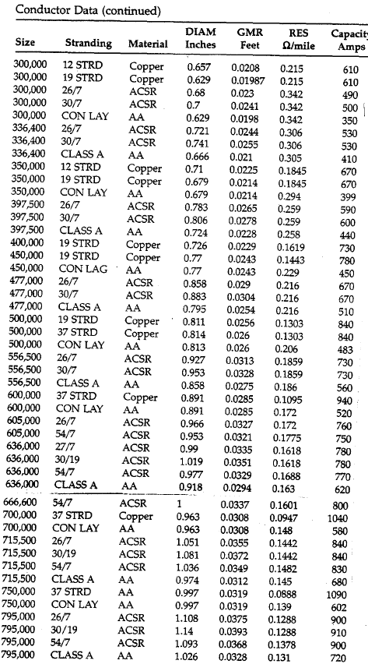

Slide 24
Conductor sizes
The American Wire Gauge (AWG) sizes conductors, ranging from a minimum of no. 40 to a maximum of no. 4/0 (which is the same as “0000”) for solid (single wire) type conductors. The smaller the gauge number, the larger the conductor diameter.
For conductor sizes above 4/0, sizes are given in MCM (thousands of circular mil) or just cmils. MCM means the same as kcmil.
A cmil is a unit of measure for area and corresponds to the area of a circle having a diameter of 1 mil, where 1 mil=10⁻³ inches, or 1 kmil=1 inch.

Slide 25
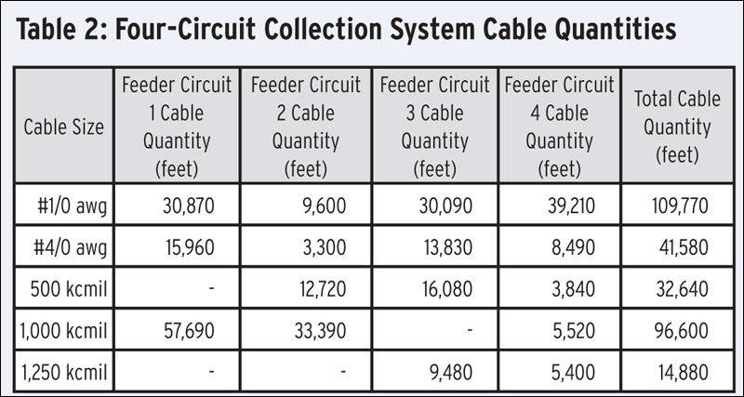
A 100 MW wind farm collection system with four feeder circuits. The amount of different kinds of conductors used in each feeder is specified.
Diameter (in)
0.398
0.522
0.813
1.0
1.118
Source: M. Davis, T. Maples, and B. Rosen, “Cost-Saving Approaches to Wind Farm Design: Exploring Collection-System Alternatives Can Yield Savings,” available at http://www.burnsmcd.com/BenchMark/Article/Cost-Saving-Approaches-to-Wind-Farm-Design.

Slide 26
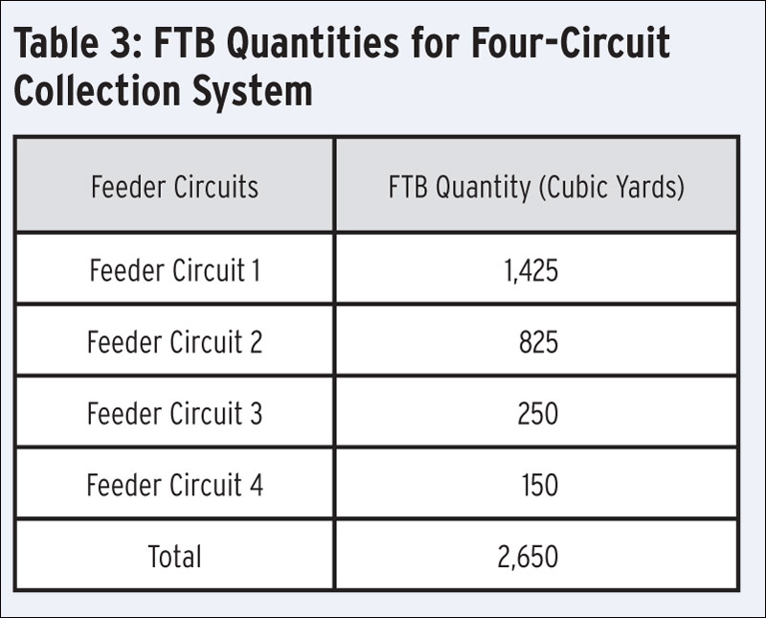
Cable cost: $1.26M
FTB cost: $265k
Total: $1.525M
Total installed cost (includes substation and labor) is $6.8M
Source: M. Davis, T. Maples, and B. Rosen, “Cost-Saving Approaches to Wind Farm Design: Exploring Collection-System Alternatives Can Yield Savings,” available at http://www.burnsmcd.com/BenchMark/Article/Cost-Saving-Approaches-to-Wind-Farm-Design.

Slide 27
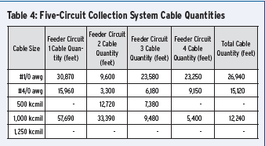

Four-feeder design, with FTB
Feeder circuit 5 Cable quantity (feet)
Total cable quantity (feet)
114510
49710
20100
118200
0
Cable cost: $1.255M (from $1.26M).
Total installed cost is $6.6M (from $6.8M).
Eliminated FTB by adding an additional circuit; reduces required ampacity of homerun cable segments.
You also get increased reliability.
Source: M. Davis, T. Maples, and B. Rosen, “Cost-Saving Approaches to Wind Farm Design: Exploring Collection-System Alternatives Can Yield Savings,” available at http://www.burnsmcd.com/BenchMark/Article/Cost-Saving-Approaches-to-Wind-Farm-Design.

Slide 28
Design options
“For this five-feeder collection system, the overall material cost of the cable is estimated to be $1.255 million. While slightly more cable was required for the additional feeder, there was a reduction in cost due to the use of smaller cables made possible by the reduction of the running current on each of the circuits.
In this wind farm, the estimated total installed cost of the four-feeder collection
system, with FTB utilized on the homerun segments, is $6.8 million. However, when five feeders are employed, the cost decreases to $6.6 million.
Note that installing five feeders involves additional trenching, one additional circuit breaker at the collector substation, and additional protective relays and controls. But in this case, this added cost was more than offset, primarily by the absence of FTB, and to a lesser extent, the lower cost of the smaller cables.”
Observe interplay between number of cables (cost of cables, CB, relays, and controls, and trenching cost), and cost to obtain the required ampacities (circuit size and FTB).
Source: M. Davis, T. Maples, and B. Rosen, “Cost-Saving Approaches to Wind Farm Design: Exploring Collection-System Alternatives Can Yield Savings,” available at http://www.burnsmcd.com/BenchMark/Article/Cost-Saving-Approaches-to-Wind-Farm-Design.

Slide 29
Once we specify turbine locations and # of feeders, we may make decisions via optimization
These costs given per-unit length.
Substation
cost
TC_{fs}: Trench cost of feeder f, segment s
CC_{fsc}: Conductor cost of feeder f, segment s, conductor type c
BFC_{fsc}: backfill cost for feeder f, segment s, backfill type b
Min
Protection cost for each feeder f
L_{fs}: length of feeder f, segment s
x_{fsc}: 1 if conductor type c is chosen for feeder f, segment s, 0 if not
y_{fsb}: 1 if backfill type b is chosen for feeder f, segment s, 0 if not
Subject to:
A set of equations for each feeder f:
V is assumed line-neutral voltage of circuit, θ is assumed power factor angle
C is number of conductor types considered.
AF_{b} is ampacity factor [-1,1] for backfill type b.
1 equation for each segment s:
We also have equations to impose that only 1 conductor type is chosen for each segment.
Amp_{c} is ampacity of conductor c
NT_{fir} is number of turbines on feeder f, segment i, of rating P_{r.}
The inequality causes this to be a MINLP, and so solving it will be challenging.

Slide 30
Design options
“Due to the advantageous arrangement of the turbine and collector substation locations on this project, this outcome cannot be expected for all wind farm collection systems.
For example, collector substations are not always centrally located in the wind farm, as was the case in this particular case study. In order to reduce the length of interconnecting transmission line, they are often located off to the side of the wind farm. When this is the case, the homerun feeder segments can be several miles long. As a result, the cost of a given homerun feeder segment may exceed the cost of the remainder of the cable for that circuit. Therefore, an additional feeder design may not
always be the most economical solution.”
Source: M. Davis, T. Maples, and B. Rosen, “Cost-Saving Approaches to Wind Farm Design: Exploring Collection-System Alternatives Can Yield Savings,” available at http://www.burnsmcd.com/BenchMark/Article/Cost-Saving-Approaches-to-Wind-Farm-Design.

Slide 31
Design options
“In those cases where a fully underground collection system may not be desirable, such as in predominantly wetland areas or in the agriculturally dense Midwest where drain tiles lead to design and construction challenges, overhead design can be considered….
The collection system homeruns and long feeder segments were considered for overhead design…. this consideration is significant because it will be carrying the feeders’ total running current. Underground homeruns can be as long as a few miles and typically require large cable sizes and an FTB envelope in order to carry these high currents….
Given that the FTB costs approximately $100 per yard, replacing underground homeruns with overhead can significantly reduce the amount, and thus cost, associated with FTB and large cable sizes used in an underground collection system….
Underground collection systems are the most preferable installations for wind farm projects. However, where underground installation may not be fully feasible, a combination of underground and overhead installation should be considered. As the case study depicts, it might make better financial sense to design an overhead collection system that is predominantly for the homerun segments.”
Source: M. Davis, T. Maples, and B. Rosen, “Cost-Saving Approaches to Wind Farm Design: Exploring Collection-System Alternatives Can Yield Savings,” available at http://www.burnsmcd.com/BenchMark/Article/Cost-Saving-Approaches-to-Wind-Farm-Design.

Slide 32
Design options
“Either overhead lines or underground cables can be used for collector feeders. Although overhead lines are generally less expensive, a large portion of wind plants use underground cables for the following reasons:
Public acceptance of underground cables is much more favorable. This promotes positive public relations and accelerates the project permitting process. Underground cables are also more acceptable to the land owners from whom the wind plant developer must obtain rights of way.
Underground cables require less frequent maintenance and repair.
Underground cables do not impair crane access to the wind turbine tower, either during initial construction or during wind turbine repairs.
Underground cables are less disruptive to concurrent use of the land, such as for agricultural usage.
In regions with severe wind and icing, and favorable soil conditions, a direct-buried underground cable may actually be less expensive to install than an overhead line.”
(Miller, Walling, and Piwko, “Electrical Design of a Wind Plant,” chapter 13, in “Wind power in power systems,” edited by T. Ackermann, second edition, 2012, Wiley.)

Slide 33
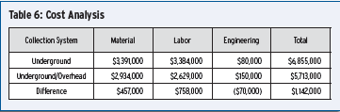
Design options
By replacing the underground homeruns and other long segments with overhead circuits, the total collection system cost would be reduced by approximately $1.15 million. This would result in an overall savings of approximately 17% compared to
a completely underground system.
Observe overhead saves in material costs (bare conductor vs. insulated one!) and in labor (pole installation vs. trenching).
Source: M. Davis, T. Maples, and B. Rosen, “Cost-Saving Approaches to Wind Farm Design: Exploring Collection-System Alternatives Can Yield Savings,” available at http://www.burnsmcd.com/BenchMark/Article/Cost-Saving-Approaches-to-Wind-Farm-Design.

Slide 34

Cable Ampacity Calculations
One may solve the 2-dimensional diffusion equation for heat conduction:
where:
ρ: thermal resistivity of the soil
c: volumetric thermal capacity of the soil
W: rate of energy (heat) generated
Temp gradient in x direction
Temp gradient in y direction
The above equation can be solved using numerical methods (e.g., finite element), with boundary conditions at the soil surface. The objective is to compute the temperature at the cable for the given W (which depends on current) and ultimately, the maximum current that does not cause temperature to exceed the cable temperature rating (often 90°C). A simpler, more insightful method is the Neher-McGrath method.
Sources: F. de Leon, “Calculation of underground cable ampacity,” CYME International T&D, 2005, available at http://www.cyme.com/company/media/whitepapers/2005%2003%20UCA-FL.pdf.
G. Anders, “Rating of Electric Power Cables: Ampacity computations for transmission, distribution, and industrial applications, IEEE Press/McGraw Hill 1997.

Slide 35
Neher-McGrath cable ampacity calculations
“In solving the cable heat dissipation problem, electrical engineers use a fundamental similarity between the heat flow due to the temperature difference between the conductor and its surrounding medium and the flow of electrical current caused by a difference of potential. Using their familiarity with the lumped parameter method to solve differential equations representing current flow in a material subjected to potential difference, they adopt the same method to tackle the heat conduction problem.
The method begins by dividing the physical object into a number of volumes, each of which is represented by a thermal resistance and a capacitance. The thermal resistance is defined as the material's ability to impede heat flow. Similarly, the thermal capacitance is defined as the material's ability to store heat.
The thermal circuit is then modeled by an analogous electrical circuit in which voltages are equivalent to temperatures and currents to heat flows. If the thermal characteristics do not change with temperature, the equivalent circuit is linear and the superposition principle is applicable for solving any form of heat flow problem.”
G. Anders, “Rating of Electric Power Cables: Ampacity computations for transmission, distribution, and industrial applications, IEEE Press/McGraw Hill 1997.

Slide 36
Neher-McGrath cable ampacity calculations
Basic idea:
Subdivide the area above the conductor into layers
Model:
  heat sources as current sources
  thermal resistances as electric resistances, T
  thermal capacitance (ability to store heat) as electric capacitance – we do not need this for ss calculations
  temperature as voltage
Sources: F. de Leon, “Calculation of underground cable ampacity,” CYME International T&D, 2005, available at http://www.cyme.com/company/media/whitepapers/2005%2003%20UCA-FL.pdf.
G. Anders, “Rating of Electric Power Cables: Ampacity computations for transmission, distribution, and industrial applications, IEEE Press/McGraw Hill 1997.
J.H. Neher and M.H. McGrath, “The Calculation of the Temperature Rise and Load Capability of Cable Systems”, AIEE Transactions Part III - Power Apparatus and Systems, Vol. 76, October 1957, pp. 752-772.

Slide 37
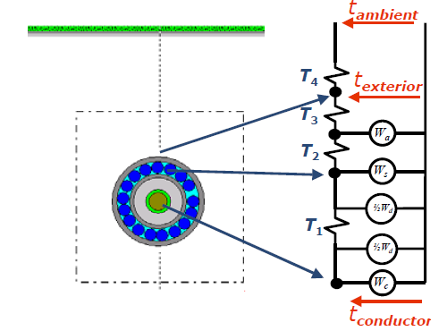
Neher-McGrath cable ampacity calculations
GROUND SURFACE
Thermal resistance:
T₁: conductor to insul shield
T₂: insul shield to jacket
T₃: jacket (or “armor”)
T₄: jacket to ground surface
Units are °K-m/w)
Jacket (armor) losses
Insul shield losses
Units are w/m
Dielectric losses
of the insulation
t_{conductor} is temp (voltage) at conductor.
t_{exterior} is temp (voltage) at exterior of cable
t_{ambient} is temp (votlage) at ground surface
Conductor losses
Sources: F. de Leon, “Calculation of underground cable ampacity,” CYME International T&D, 2005, available at http://www.cyme.com/company/media/whitepapers/2005%2003%20UCA-FL.pdf.
G. Anders, “Rating of Electric Power Cables: Ampacity computations for transmission, distribution, and industrial applications, IEEE Press/McGraw Hill 1997.
J.H. Neher and M.H. McGrath, “The Calculation of the Temperature Rise and Load Capability of Cable Systems”, AIEE Transactions Part III - Power Apparatus and Systems, Vol. 76, October 1957, pp. 752-772.

Slide 38
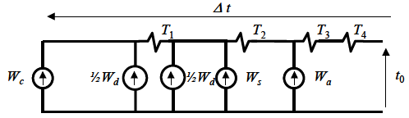

Neher-McGrath cable ampacity calculations
Sources: F. de Leon, “Calculation of underground cable ampacity,” CYME International T&D, 2005, available at http://www.cyme.com/company/media/whitepapers/2005%2003%20UCA-FL.pdf.
G. Anders, “Rating of Electric Power Cables: Ampacity computations for transmission, distribution, and industrial applications, IEEE Press/McGraw Hill 1997.
J.H. Neher and M.H. McGrath, “The Calculation of the Temperature Rise and Load Capability of Cable Systems”, AIEE Transactions Part III - Power Apparatus and Systems, Vol. 76, October 1957, pp. 752-772.

Slide 39
Neher-McGrath cable ampacity calculations
Define:
Insul shield loss factor:
Ratio of electrical losses in insul shield W_{s} (or electrical losses in jacket W_{a}) to electrical losses in conductor W_{c} is provided by manufacturer (equations for computing them given in Ander’s book).
Armor loss factor:
Sources: F. de Leon, “Calculation of underground cable ampacity,” CYME International T&D, 2005, available at http://www.cyme.com/company/media/whitepapers/2005%2003%20UCA-FL.pdf.
G. Anders, “Rating of Electric Power Cables: Ampacity computations for transmission, distribution, and industrial applications, IEEE Press/McGraw Hill 1997.
J.H. Neher and M.H. McGrath, “The Calculation of the Temperature Rise and Load Capability of Cable Systems”, AIEE Transactions Part III - Power Apparatus and Systems, Vol. 76, October 1957, pp. 752-772.

Slide 40
Neher-McGrath cable ampacity calculations
Solve for W_{C}:
Substitute:
Solve for I:
Sources: F. de Leon, “Calculation of underground cable ampacity,” CYME International T&D, 2005, available at http://www.cyme.com/company/media/whitepapers/2005%2003%20UCA-FL.pdf.
G. Anders, “Rating of Electric Power Cables: Ampacity computations for transmission, distribution, and industrial applications, IEEE Press/McGraw Hill 1997.
J.H. Neher and M.H. McGrath, “The Calculation of the Temperature Rise and Load Capability of Cable Systems”, AIEE Transactions Part III - Power Apparatus and Systems, Vol. 76, October 1957, pp. 752-772.

Slide 41
Neher-McGrath cable ampacity calculations
Given per unit length values of
Cable resistance: R_{ac}
Cable dielectric losses: W_{d}
Thermal resistances: T₁, T₂, T₃, T₄
Loss factors: λ₁, λ₂
and given the temperature of the ground t₀ and the temperature rating of the conductor t_{r}, where Δt=t_{r}-t₀, the above equation is used to compute the rated current, I_{r}, or ampacity of the cable.
Identification of these parameters is described in Ch 1 of Anders book, which is available at http://media.wiley.com/product_data/excerpt/97/04716790/0471679097.pdf
Sources: F. de Leon, “Calculation of underground cable ampacity,” CYME International T&D, 2005, available at http://www.cyme.com/company/media/whitepapers/2005%2003%20UCA-FL.pdf.
G. Anders, “Rating of Electric Power Cables: Ampacity computations for transmission, distribution, and industrial applications, IEEE Press/McGraw Hill 1997.
J.H. Neher and M.H. McGrath, “The Calculation of the Temperature Rise and Load Capability of Cable Systems”, AIEE Transactions Part III - Power Apparatus and Systems, Vol. 76, October 1957, pp. 752-772.

Slide 42


Neher-McGrath cable ampacity calculations
Usually windfarm cables, which are 3-phase, are laid out in “flat formation”, but some also use trefoil (pron tree-foil, “3 leaves” )
Trefoil
Flat formation
The previous calculation assumes the conductors are spaced so that the heating from one cable does not significantly affect the temperature seen by the conductor of the other cable. Although this calculation provides an indication of ampacity, it could be a bit lower (particularly for the one in the middle for flat formation) due to heating of the other two conductors.
Sources: F. de Leon, “Calculation of underground cable ampacity,” CYME International T&D, 2005, available at http://www.cyme.com/company/media/whitepapers/2005%2003%20UCA-FL.pdf.
G. Anders, “Rating of Electric Power Cables: Ampacity computations for transmission, distribution, and industrial applications, IEEE Press/McGraw Hill 1997.
J.H. Neher and M.H. McGrath, “The Calculation of the Temperature Rise and Load Capability of Cable Systems”, AIEE Transactions Part III - Power Apparatus and Systems, Vol. 76, October 1957, pp. 752-772.

Slide 43
Equivalent collector systems
The issue: We cannot represent the collector system and all the wind turbines of a windfarm in a system model of a large-scale interconnected power grid because, assuming the grid has many such windfarms, doing so would unnecessarily increase model size beyond what is tractable. Therefore we need to obtain a reduced equivalent.
The method which follows is based on the paper referenced below; the method is now widely used for representing windfarms in power flow models.
E. Muljadi, C. Butterfield, A. Ellis, J. Mechenbier, J. Jochheimer, R. Young, N. Miller, R. Delmerico, R. Zavadil and J. Smith, “Equivalencing the collector system of a large wind power plant,” National Renewable Energy Laboratory, paper NREL/CP-500-38930, Jan 2006. .

Slide 44
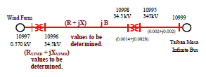
Equivalent collector systems
This is actually a large-scale windfarm, and we want to represent it as shown. Thus, we need to identify parameters R_{xfmr}+jX_{xfmr} and R+jX. Our criteria is that we will observe the same losses in the equivalenced system as in the full system.
E. Muljadi, C. Butterfield, A. Ellis, J. Mechenbier, J. Jochheimer, R. Young, N. Miller, R. Delmerico, R. Zavadil and J. Smith, “Equivalencing the collector system of a large wind power plant,” National Renewable Energy Laboratory, paper NREL/CP-500-38930, Jan 2006. .

Slide 45
Equivalent collector systems
Terminology (as used in below paper):
Trunk line: the circuits to which the turbines are directly connected.
Feeder circuits: connected to the transformer substation or the collector system substation.
All quantities in the following derivations are assumed to be in per-unit.
E. Muljadi, C. Butterfield, A. Ellis, J. Mechenbier, J. Jochheimer, R. Young, N. Miller, R. Delmerico, R. Zavadil and J. Smith, “Equivalencing the collector system of a large wind power plant,” National Renewable Energy Laboratory, paper NREL/CP-500-38930, Jan 2006. .

Slide 46

Equivalent collector systems: trunk line level
Step 1: Derive equiv cct for daisy-chain turbines on trunk lines:
Z₁
Z₂
Z₃
Z₄
I_{s}
I₁
I₂
I₃
I₄
E. Muljadi, C. Butterfield, A. Ellis, J. Mechenbier, J. Jochheimer, R. Young, N. Miller, R. Delmerico, R. Zavadil and J. Smith, “Equivalencing the collector system of a large wind power plant,” National Renewable Energy Laboratory, paper NREL/CP-500-38930, Jan 2006. .

Slide 47
Equivalent collector systems: trunk line level
A simplifying assumption: Current injections from all wind turbines are identical in magnitude and angle, I (a phasor).
Z₁
Z₂
Z₃
Z₄
I_{s}
I₁
I₂
I₃
I₄
Therefore, total current in equivalent representation is:
The voltage drop across each impedance is:
I: current phasor
n: # of turbines on trunk line.
E. Muljadi, C. Butterfield, A. Ellis, J. Mechenbier, J. Jochheimer, R. Young, N. Miller, R. Delmerico, R. Zavadil and J. Smith, “Equivalencing the collector system of a large wind power plant,” National Renewable Energy Laboratory, paper NREL/CP-500-38930, Jan 2006. .

Slide 48
Equivalent collector systems: trunk line level
Power loss in each impedance is:
Total loss is given by:
General expression for a daisy-chain trunk line with n turbines:
E. Muljadi, C. Butterfield, A. Ellis, J. Mechenbier, J. Jochheimer, R. Young, N. Miller, R. Delmerico, R. Zavadil and J. Smith, “Equivalencing the collector system of a large wind power plant,” National Renewable Energy Laboratory, paper NREL/CP-500-38930, Jan 2006. .

Slide 49
Equivalent collector systems: trunk line level
We just derived this:
But for our equivalent system, we get:
Equating these two expressions:
Solve for Z_{s}:
E. Muljadi, C. Butterfield, A. Ellis, J. Mechenbier, J. Jochheimer, R. Young, N. Miller, R. Delmerico, R. Zavadil and J. Smith, “Equivalencing the collector system of a large wind power plant,” National Renewable Energy Laboratory, paper NREL/CP-500-38930, Jan 2006. .

Slide 50
Equivalent collector systems: trunk line level
Z₁
Z₂
Z₃
Z₄
System 1:
I_{s}
I₁
I₂
I₃
I₄
WHERE
System 2:
Under assumption: Current injections from all wind turbines are identical in magnitude and angle, I (a phasor).
THEN
E. Muljadi, C. Butterfield, A. Ellis, J. Mechenbier, J. Jochheimer, R. Young, N. Miller, R. Delmerico, R. Zavadil and J. Smith, “Equivalencing the collector system of a large wind power plant,” National Renewable Energy Laboratory, paper NREL/CP-500-38930, Jan 2006. .

Slide 51
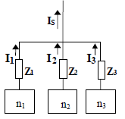

Equivalent collector systems: feeder cct level
Step 2a: Derive equiv cct for multiple trunk lines:
Assume each trunk line has been equivalenced according to step 1.
I_{P}
System a
I_{k}: current in k^{th} trunk line = n_{k}I
Z_{k}: impedance for k^{th} trunk line
n_{k}: number of turbines for k^{th} trunk line
System b
By KCL:
E. Muljadi, C. Butterfield, A. Ellis, J. Mechenbier, J. Jochheimer, R. Young, N. Miller, R. Delmerico, R. Zavadil and J. Smith, “Equivalencing the collector system of a large wind power plant,” National Renewable Energy Laboratory, paper NREL/CP-500-38930, Jan 2006. .

Slide 52
Equivalent collector systems: feeder cct level
Losses:
System a
I_{P}
EQUATE
System b
E. Muljadi, C. Butterfield, A. Ellis, J. Mechenbier, J. Jochheimer, R. Young, N. Miller, R. Delmerico, R. Zavadil and J. Smith, “Equivalencing the collector system of a large wind power plant,” National Renewable Energy Laboratory, paper NREL/CP-500-38930, Jan 2006. .

Slide 53
Equivalent collector systems: feeder cct level
Equating S_{TotLoss,a} to S_{TotLoss,b}, we obtain:
Solving for Z_{P}, we get :
Generalizing the above expression:
There are N trunk lines connected to the same node, and the k^{th} trunk line has n_{k} turbines and equivalent impedance (based on step 1) of Z_{k}.
E. Muljadi, C. Butterfield, A. Ellis, J. Mechenbier, J. Jochheimer, R. Young, N. Miller, R. Delmerico, R. Zavadil and J. Smith, “Equivalencing the collector system of a large wind power plant,” National Renewable Energy Laboratory, paper NREL/CP-500-38930, Jan 2006. .

Slide 54
Equivalent collector systems: feeder cct level
System a:
WHERE
System b:
Under assumption: Current injections from all wind turbines are identical in magnitude and angle, I (a phasor).
THEN
E. Muljadi, C. Butterfield, A. Ellis, J. Mechenbier, J. Jochheimer, R. Young, N. Miller, R. Delmerico, R. Zavadil and J. Smith, “Equivalencing the collector system of a large wind power plant,” National Renewable Energy Laboratory, paper NREL/CP-500-38930, Jan 2006. .

Slide 55
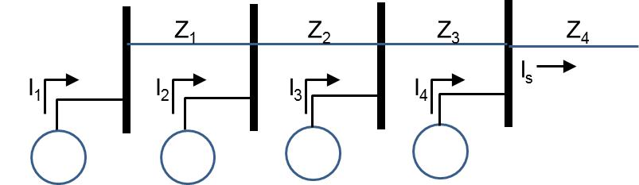
Equivalent collector systems: compare trunk line level approach to feeder cct level approach
System 1:
System a:
System 2:
System b:
WHERE
WHERE
n: Number of turbines on trunk line.
m: turbine number starting from last one
N: Number of trunk lines.
n_{k}: number of turbines on k^{th} trunk line
E. Muljadi, C. Butterfield, A. Ellis, J. Mechenbier, J. Jochheimer, R. Young, N. Miller, R. Delmerico, R. Zavadil and J. Smith, “Equivalencing the collector system of a large wind power plant,” National Renewable Energy Laboratory, paper NREL/CP-500-38930, Jan 2006. .

Slide 56
Equivalent collector systems: hybrid config
What if we added impedances in our “System 1” as shown?
What if we added impedances in our “System a” as shown?
➔We would have additional losses for which we did not account for in our previous expression.
➔We would have additional losses for which we did not account for in our previous expression.
E. Muljadi, C. Butterfield, A. Ellis, J. Mechenbier, J. Jochheimer, R. Young, N. Miller, R. Delmerico, R. Zavadil and J. Smith, “Equivalencing the collector system of a large wind power plant,” National Renewable Energy Laboratory, paper NREL/CP-500-38930, Jan 2006. .

Slide 57
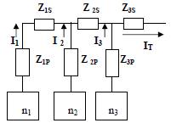
Equivalent collector systems: hybrid config
These configurations are actually equivalent and are quite common. They occur when different trunk lines are connected at different points along the feeder instead of at the same feeder point.
Three trunk line equivalents,
with n₁, n₂, and n₃ turbines, respectively.
E. Muljadi, C. Butterfield, A. Ellis, J. Mechenbier, J. Jochheimer, R. Young, N. Miller, R. Delmerico, R. Zavadil and J. Smith, “Equivalencing the collector system of a large wind power plant,” National Renewable Energy Laboratory, paper NREL/CP-500-38930, Jan 2006. .

Slide 58
Equivalent collector systems: hybrid config
The voltage drop across each impedance is:
Losses in each impedance is:
E. Muljadi, C. Butterfield, A. Ellis, J. Mechenbier, J. Jochheimer, R. Young, N. Miller, R. Delmerico, R. Zavadil and J. Smith, “Equivalencing the collector system of a large wind power plant,” National Renewable Energy Laboratory, paper NREL/CP-500-38930, Jan 2006. .

Slide 59

Equivalent collector systems: hybrid config
Compute losses for both systems.
I_{T}
Z_{T}
Equate:
Solve for Z_{T}:
E. Muljadi, C. Butterfield, A. Ellis, J. Mechenbier, J. Jochheimer, R. Young, N. Miller, R. Delmerico, R. Zavadil and J. Smith, “Equivalencing the collector system of a large wind power plant,” National Renewable Energy Laboratory, paper NREL/CP-500-38930, Jan 2006. .

Slide 60
Equivalent collector systems: hybrid config
Compute losses for both systems.
I_{T}
Z_{T}
N_{P}: number of trunk lines
N_{S}: number of feeder segments
(should have N_{P}=N_{S})
E. Muljadi, C. Butterfield, A. Ellis, J. Mechenbier, J. Jochheimer, R. Young, N. Miller, R. Delmerico, R. Zavadil and J. Smith, “Equivalencing the collector system of a large wind power plant,” National Renewable Energy Laboratory, paper NREL/CP-500-38930, Jan 2006. .

Slide 61
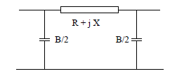
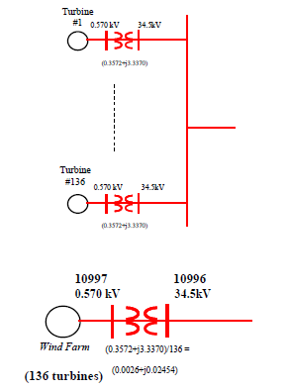
Equivalent collector systems: shunts and xfmrs
Two more issues:
Shunts: add them up (assumes voltage is 1.0 pu everywhere in collector system).
Transformers: Assume all turbine transformers are in parallel and all are the same rating. Divide transformer series impedance by number of turbines.
R_{k}+jX_{k}
B_{k}/2
B_{k}/2
r+jx: series impedance of 1 padmount transformer.
n_{t}: total number of transformers being equivalenced.
B_{i}: sum of actual shunt at bus i and line charging (B_{k}/2) for any circuit k connected to bus i.
Then model B_{tot}/2 at sending-end side of feeder & at receiving-end side of feeder.
E. Muljadi, C. Butterfield, A. Ellis, J. Mechenbier, J. Jochheimer, R. Young, N. Miller, R. Delmerico, R. Zavadil and J. Smith, “Equivalencing the collector system of a large wind power plant,” National Renewable Energy Laboratory, paper NREL/CP-500-38930, Jan 2006. .

Slide 62
Some final comments
All impedances should be in per-unit. The MVA base is chosen to be consistent with the power flow model for which the equivalent will be used; this is normally 100 MVA. The voltage base for a given portion of the system is the nominal line-to-line voltage of that portion of the system. Then Z_{base}=(V_{LL,base})²/S_{3,base}.
It is sometimes useful to represent a windfarm with two or more turbines (multi-turbine equivalent) instead of just one (single-turbine equivalent), because:
  Types: A windfarm may have turbines of different types. This matters little for power flow (static) studies, but it matter for studies of dynamic performance, because in such studies, the dynamics of the machines make a difference, and the various wind turbine generators (types 1, 2, 3, and 4) have different dynamic characteristics. And so, if a windfarm has multiple types, do not form an equivalent out of different types. An exception to this may be when there are two types but most of the MW are of only one type. Then we may choose to represent all with one machine using the type comprising most of the MW.
  Wind diversity: Some turbines may see very different wind resource than other turbines. In such cases, the current output can be quite different from one turbine to another. Grouping turbines by proximity can be useful in these cases.
  Sizes (ratings): A windfarm may have different sizes, in which case the per-unit current out of the turbine for the larger sized turbines will be greater than the per-unit current out of the smaller-sized turbines. This violates the assumption that all turbines output the same current magnitude and phase. But…. there is an alternative way to address this, see next slide.

Slide 63
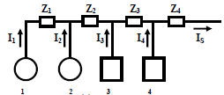
Some final comments
Consider the situation where there is a daisy-chained group of turbines of different ratings, as shown below, where we observe that #1, 2 are different capacities than #3, 4.
If they are the same capacities, then the assumption they all inject identical currents holds,
and I₁=I₂=I₃=I₄=I (see slide 46-47), resulting in:
But now, I₁=I₂≠I₃=I₄. What to do?
One approach is to keep them separate, as indicated on the previous slide.

Slide 64
Some final comments
Assume each turbine is of unique rating (most general case). Also assume that the turbines are compensated/controlled to have unity power factor➔ S_{i}=P_{i}. Then:
Assume sum of power injections=line flows:
Adding up losses and equating to loss expression of reduced model results in:

Slide 65
Some final comments
And for pad-mounted transformers, of different sizes it can be derived (see Muljadi’s second paper)
See paper by J. Phillips for a good treatment of similar material.
Also, look into using Gaussian Elimination (see the Podmore-Germond work) to improve the collection circuit network reduction methods.

