Slide 1
Class 2
Economic systems for electric power planning
Power Generation
Costs and Emissions
J. McCalley

Slide 2


Micro vs macroeconomics
Macroeconomics focuses on behavior of entire economies, looking at, for example, determination of total investment and consumption, how central banks manage money and interest rates, what causes international financial crises.
Microeconomics focuses on decisions of
individual units (firms, companies, households, individual consumers) within an economy:
how individual prices are set
what it means to have an efficient electricity market
how an electricity market can achieve efficiency simply from the self-interested actions of its individual agents.

Slide 3
Production factors
(section 2.3.1 of Kirschen & Strbac)
Production factors are inputs x₁, x₂,… required by a process to produce an output y. In our case, the output is a MWhr.
There are four categories of production factors.
Category | Production factors for producing corn | Production factors for producing MWhr
Raw materials | Seed corn, fertilizer | Coal, natural gas, uranium
Labor | farmer | Administration/management, engineering, technicians
Land & buildings | Cropland | Power house & cooling tower
Machines and technologies | tractors, balers, combines, plows, mowers, planters, sprayers | Boilers, turbines, generators, SCADA system

Slide 4
Short-run vs Long Run
(section 2.3.2 of Kirschen & Strbac)
Short-run: A time frame sufficiently short so that one or more factors of production are fixed over that time frame.
➔It can decrease (and even stop) or increase production.
➔It can generally not modify its facilities.
Long-run: A time frame sufficiently long so that all factors of production can be adjusted (no fixed costs!).
➔It can decrease (and even stop) or increase production.
➔It can build, rebuild, and/or retire facilities.

Slide 5
Costs of generating electric energy
Two ways to classify costs (see p. 29)
Short-run costs (hours, days, weeks, a year):
  Fixed: does not depend on the plant’s energy production; anything that must be paid for production to occur, yet they remain the same whether production is high or low
  Variable: does depend on the plant’s energy production
Long-run costs (a year, a decade, several decades):
  Sunk: a cost that cannot be avoided – the difference between the amount of money paid for a production factor (e.g., an asset) and the amount of money it would receive if it (went out of business &) sold the factor.
  Avoidable: a cost that can be avoided because it has not been incurred yet or because the production factor (asset) can be sold or used in some other way.

Slide 6
Short-run costs for generation plants
Fixed costs (independent of production)
Interest on bonds
Return to stockholders
Property taxes
Insurance
Depreciation
Fixed O&M (fixed labor and maintenance)
Variable costs (depends on production)
Fuel costs
Variable O&M (variable labor and maintenance)
Typical generation data is provided on the next page. Clarifications:
Overnight cost: cost of constructing the plant, in $/kW, if plant could be constructed in a single day. A proxy on non-O&M fixed costs.
The “variable O&M” is in mills/kWhr (a mill is 0.1¢).These values represent labor & maintenance costs. They do not include fuel costs.
Fuel costs are computed through the heat rate. We will discuss this.
The heat rate values given are average values. We will also discuss this

Slide 7
Some typical data for generation plants
J. McCalley, W. Jewell, T. Mount, D. Osborn, and J. Fleeman, “A Wider Horizon: Technologies, Tools, and Procedures for Energy Systems Planning at the National Level,” IEEE Power and Energy Magazine, Vol. 9, Issue 3, May/June 2011, pp. 42-54.
➔We will characterize the relation between short-term variable costs and the amount of electric energy produced by a power plant. Doing so will be useful in understanding how generation owners participate in the electricity market. This is 2009 data; 2018 data next page.

Slide 8
Some typical data for generation plants
2018 Data, EIA
https://www.eia.gov/outlooks/aeo/assumptions/pdf/table_8.2.pdf

Slide 9
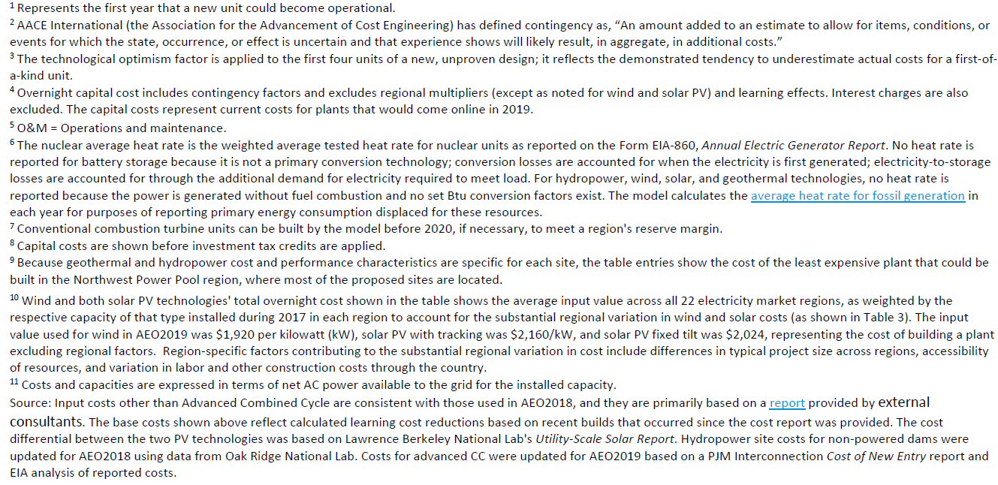
Some typical data for generation plants
2018 Data, EIA
https://www.eia.gov/outlooks/aeo/assumptions/pdf/table_8.2.pdf

Slide 10
Fuels for Thermal Power Plants
Uranium
Coal
Natural gas
Petroleum

Slide 11
Enriched Uranium (3.5%, U-235)
Pressurized water reactor (most common type in US)
Energy content: ~3274MBTU/kg
Total cost of bringing uranium to fuel rods of a nuclear power plant, considering mining, transportation, conversion (to feed for uranium enrichment plants), enrichment, & fabrication, is ~$2770/kg
Nuclear fuel cost = ($2770/kg)*(1kg/3274MBTU)=$0.85/MBTU

Slide 12
Fossil Fuels
Compare fossil fuel prices to typical nuclear fuel price of $0.85/MBTU.
Note the difference between lowest and highest average price over this 26-year period for coal, petroleum, and natural gas➔so coal has had more stable price variability than petroleum and natural gas.
During 2017, coal is $2.06/MBTU, petroleum $7.10/MBTU, and natural gas $3.37/MBTU, so coal is the more economically attractive fossil fuel for producing electricity.

Slide 13
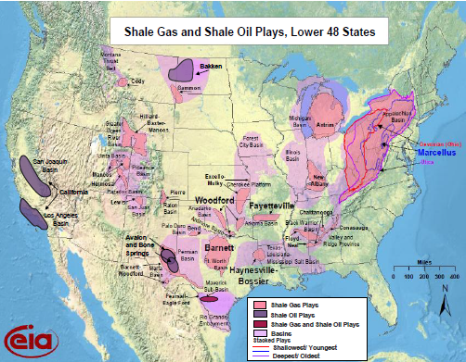

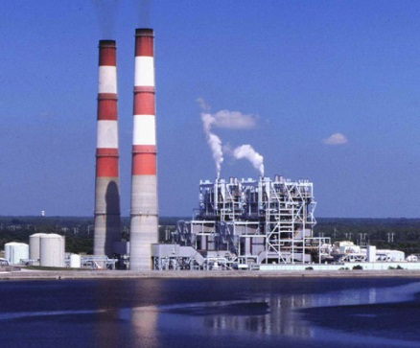
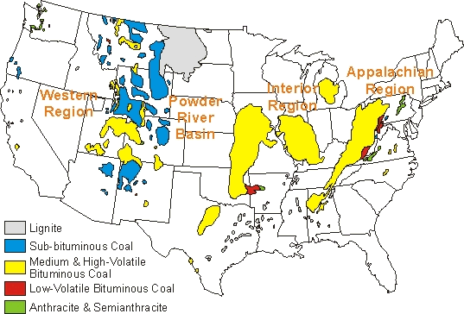
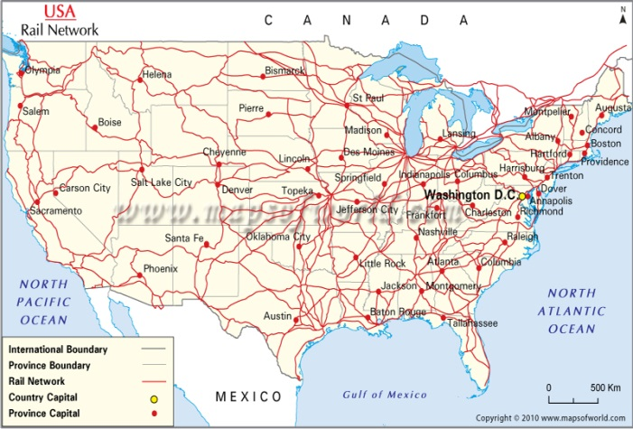
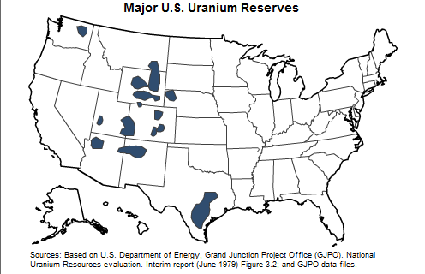
Fuels - transportation
Natural Gas Wells
Natural Gas Pipelines
Power Plant
Coal Deposits
Rail Network
Uranium Reserves
Uranium Enrichment Facilities

Slide 14
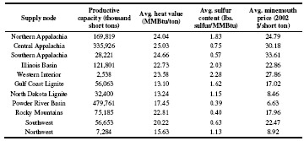
Coal
Lignite (Texas, N. Dakota)
Sub-bituminous (Wyoming)
Bituminous (Central Appalachian)
Anthracite (Pennsylvania)
Age
Carbon content
Heating value (energy content)
Anthracite
Bituminous
Lignite
Sub-bituminous

Slide 15

Coal
Powder River Basin (PRB) coal is sub-bituminous, but it is (a) near the surface and therefore inexpensive to mine and
(b) low sulfur content and therefore can be burned w/o flue-gas desulpherization
An eastbound Union Pacific intermodal train crosses
Duff Avenue in Ames, Iowa (picture is taken looking southbound)

Slide 16
Efficiency
Measure rate of energy input to plant in MBTU/hr.
  ➔R=Coal tons per hr×Energy Content (MBTU/ton)
Measure rate of energy output from plant in MW:
  ➔P_{g} (MW) over 1 hour
Plot fuel input, MBTU/hr as function of P_{g} , MW
Input-output curve
Let’s invert this plot…

Slide 17
Efficiency
Observe: as fuel input is increased, power output per unit fuel input (slope) begins to decrease
This happens because the furnace, boiler, steam pipes leak a larger percentage of input heat as temperatures increase.
This tendency is referred to as the Law of diminishing marginal product (section 2.3.1 of Kirschen & Strbac). It says, for a production process, the rate of increase in output decreases as the input increases, assuming other inputs are fixed.

Slide 18
Efficiency
Efficiency
This is true only if P_{g} and R are in the same units.
Observe units are MW/(MBTU/hr)=MWhr/MBTU.
➔These units are energy/energy, as they should be when computing η.
However, the MBTU and MWhr are different units of energy, and so we
are not getting η exactly, but we are getting something proportional to η.

Slide 19
Efficiency
Obtain P_{g}/R ratio for every point on the I/O curve, and plot against P_{g}.
Efficiency is poor for low generation levels (a connected plant that is operating at zero MW output still has to supply station loads) and increases with generation, but at some optimum level it begins to diminish. Most power plants are designed so that the optimum level is close to the rated output.

Slide 20
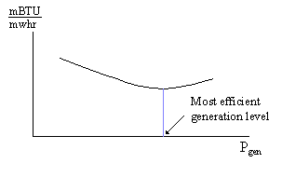
Heat Rate
The heat rate curve is similar except that the y-axis is inverted to yield MBTU/MWhrs, which is proportional to 1/η. We denote heat rate by H.
What are typical heat rates????

Slide 21
Heat Rate
Some typical heat rates for units at maximum output are (in MBTU/MWhrs)
9.5-10.5 for fossil-steam units and nuclear units,
13.0-15.0 for combustion turbines, and
6.0-9.5 for combined cycle units.
Which of these are the most efficient?
The lower the heat rate, the more efficient the unit.
So the order of efficiency in the above units is
6.0-9.5: Combined cycle units (most efficient)
9.5-10.5: Fossil-steam units
13.0-15.0: Combustion turbines (least efficient)

Slide 22
Heat Rate
An easy way to remember the meaning of heat rate H=H(P_{g}) is it is the amount of input energy (MBTU) required to produce a MWhr, at generation level P_{g}.
If we could develop a plant that had no losses, i.e., its efficiency was 100%, what would be its heat rate?
To answer this question, we need to know that 1 BTU=1054.85 joules, 1 watt=1joule/second.
Now just convert everything to joules…

Slide 23
Heat Rate
So the answer to our question:
➔The heat rate of a “perfect” converter (η=1) is 3.41 MBTU/MWhr.
So is 3.41 MBTU/MWhr the max or min heat rate possible?
➔It is not possible to have a lower heat rate than 3.41MBTU/MWhr
The heat rate curve is a fixed characteristic of the plant, although it can change if the cooling water temperature changes significantly (and engineers may sometimes employ seasonal heat rate curves). The heat rate curve may also be influenced by the time between maintenance periods as steam leakages and other heat losses accumulate.

Slide 24
Incremental vs. Average
All use of the term “heat rate” so far in these notes refers to the “average heat rate,” obtained by dividing absolute values of fuel input rate R by absolute values of electric output power P_{g}
This is different than incremental heat rate, as will be illustrated in the following example.

Slide 25
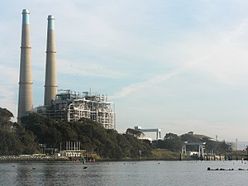
Example 1
Note: First point on incremental heat rate should be eliminated because it uses (0,0) which is not a feasible point.
Moss Landing Unit 7: an efficient gas-fired unit in the PG&E service area, on the coast about 100 miles south of San Francisco.
Full-load average heat-rate:
Units of H are BTU/kWhr and are 1000 times values used previously.
First point of incremental curve computed assuming I/O curve includes the origin, which is not the case. So ignore first point on incremental curve.

Slide 26
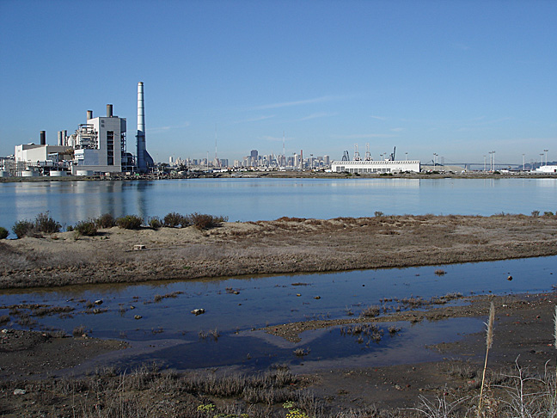
Example 2
Note: First point on incremental heat rate should be eliminated because it uses (0,0) which is not a feasible point.
Hunter’s Point: an old oil-fired unit San Francisco.
Full-load average heat-rate:
Units of H are BTU/kWhr and are 1000 times values used previously.
First point of both incremental and average curves computed assuming I/O curve includes the origin, which is not the case. So ignore first point on both incremental and average curves.

Slide 27
Cost rate (or just cost) curves
We are interested in how the cost per MWhr changes with P_{g}, because that will tell us something about how to achieve the most economic dispatch of generation for a given demand (cost-minimization for dispatch is achieved when marginal or incremental costs of all regulating units are equal).
Denote R is the input/output curve, giving the rate at which the plant uses fuel, in MBTU/hr.
To get cost per MWhr as a function of P_{g}, we assume that we know:
H(P_{g})=R/P_{g}, average heat rate, i.e., the input energy used per MW per hr,
K, the cost of the input fuel in $/MBTU;
We observe from the definition of H that
R=P_{g}H(P_{g}) (*)
where H must be evaluated at P_{g}.
Denote C as the cost per hour in $/hour.
Then C = RK
(➔the cost rate function C is the fuel rate function R scaled by the fuel cost);
and substituting (*), we have
C= P_{g}H(P_{g})K

Slide 28
Cost rate curves
The incremental cost curve for the plant, IC, is obtained from dC/dP_{g}.
IC=dC/dP_{g}=K [ dR/dP_{g} ]
But this is the incremental heat rate.
➔IC=dC/dP_{g}=K [ IHR(P_{g}) ]
Incremental (or marginal) costs give the cost of producing the next unit of commodity.
➔Why are we interested in incremental costs?
Simple version of how markets work:
Demand is fixed (inelastic).
All sellers submit offers of quantity & price.
Market operator chooses in order of increasing price until demand is met.
Market operator pays everyone at the price of the last offer chosen (clearing price).
Incremental costs are important because, in electricity markets, participants are incentivized to offer their incremental costs because
they want to make the lowest offer they can to enhance their likelihood of being selected (if they get selected, they are paid at the clearing price);
they do not want to offer below their incremental cost because if they are selected, there is a chance they could lose money (if the marginal clearing price equals their offer);

Slide 29
Example 3
A 100 MW coal-fired plant uses a type of coal having an energy content of 12,000 BTU/lb. The coal cost is $1.5/MBTU. Typical coal usage corresponding to the daily loading schedule for the plant is as follows:
Time of Day | T, duration (hrs) | P, Electric output (MW) | y, coal used (short tons)
12:00am-6:00am | 6 | 40 | 105.0
6:00am-10:00am | 4 | 70 | 94.5
10:00am-4:00pm | 6 | 80 | 156.0
4:00pm-12:00am | 8 | 100 | 270.0
There are 1054.85 joules/BTU.
There are 2000 lbs per short-ton.
For each of the four loading levels, find
The efficiency η
The heat rate H (MBTU/MWhr)
The cost rate (cost per hour), C ($/hr)
Also, for the loading levels of 40, 70, and 80 MW, use a piecewise linear plot of C vs P to obtain incremental cost IC as a function of P. Then plot incremental cost as a function of unit loading.

Slide 30
Example 3 (continued)
For each of the four loading levels, find
The efficiency η
For first time period, we obtain:
The heat rate H (MMBTU/MWhr)
The cost rate (cost per hour), C ($/hr)

Slide 31
Example 3 (continued)
Repeating previous calculations for remaining three periods…
T (hrs) | P (MW) | y (tons) | η | H (mbtu/mwhr) | C ($/hr)
6 | 40 | 105.0 | 0.33 | 10.5 | 630
4 | 70 | 94.5 | 0.42 | 8.1 | 850
6 | 80 | 156.0 | 0.44 | 7.8 | 936
8 | 100 | 270.0 | 0.42 | 8.1 | 1215
So let’s obtain the incremental cost as a function of loading, P.
Why do we want this? Because it is what we want to offer into the market.
We must do this numerically since we do not have explicit functions for cost rate C.

Slide 32
Example 3 (continued): cost curve
Plot C vs. P characteristic, assuming characteristic is piecewise linear. Then compute slopes between each adjacent points
Now plot incremental costs IC as a function of loading, P.
This plot is called the incremental cost curve.

Slide 33
Example 3 (continued): Incremental cost curve
13.9$/Mwhr
8.6$/Mwhr
7.33$/Mwhr

Slide 34
Example 3 (continued): Incremental cost curve
We may use another procedure to model the incremental costs. In this procedure, we first fit the cost data to a quadratic polynomial. Matlab commands for doing so are below
>> p=[40 70 80 100]';
>> b=[630 850 936 1215]';
>> a = [ones(size(p)) p p.^2];
>> X=a\b
X =
604.8533
-2.9553
0.0903
Solution to aX=b in the least-squares sense, i.e.,
X=(a^{T}a)⁻¹a^{T}b, that is, X is computed to minimize squared difference between b and aX.
The quadratic function is therefore
C(P)=0.0903P²-2.9553P+604.85
>> T = (0:1:100)';
>> Y = [ones(size(T)) T T.^2]*X;
>> plot(T,Y,'-',t,y,'o'), grid on
And we may then plot this using

Slide 35
Example 3 (continued): Incremental cost curve

Slide 36
Example 3 (continued): Incremental cost curve
We can get the incremental cost curve by differentiating C(P):
C(P)=0.0903P²-2.9553P+604.85
➔ IC(P)=0.1806P-2.9553
Both discrete and linear functions should be recognized as legitimate ways to represent incremental costs. The linear function is often used in traditional economic dispatching; the discrete one is typical of market-based offers.

Slide 37
CO₂ Emissions
The fact that coal is the largest contributor to GHG emissions is due to
(a) it is used to produce over a quarter of US electricity,
(b) it has the highest emissions/energy content ratio of any fuels,
(c) its average conversion efficiency is not very good (high heat rate!)

Slide 38
CO₂ Emissions
One indication from this table, that the pounds CO₂/MBTU is based on energy content of the fuel, could be misleading. What is of more interest is the CO₂/MWhr obtained from the fuel together with the heat rate of a particular generation technology.

Slide 39
CO₂ Emissions
To get this, we need efficiencies of the generation technologies.
Let’s compare a natural gas combined cycle (NGCC) plant (η=.58, H=5.88), a gas turbine (η=.39, H=8.74), and a coal-fired power plant (η=.39, H=8.74), where the CO₂ content of the natural gas is 117.08 lbs/MBTU and the CO₂ content of the coal, assuming it uses (Powder River Basin) sub-bituminous coal, is 212.7 lbs/MBTU.

Slide 40
CO₂ Emissions
Let’s compare a natural gas combined cycle (NGCC) plant (η=.58, H=5.88), a gas turbine (η=.39, H=8.74), and a coal-fired power plant (η=.39, H=8.74), where the CO₂ content of the natural gas is 117.08 lbs/MBTU and the CO₂ content of the coal, assuming it uses (Powder River Basin) sub-bituminous coal, is 212.7 lbs/MBTU.
NGCC:
We can also convert the above to Metric tons/MWhr by dividing by 2204 lbs/Metric ton, to get the following figures:
NGCC: 0.312 MT/MWhr
Gas turbine: 0.464 MT/MWhr
Coal-fired plant: 0.844 MT/MWhr.
Gas turbine:
Coal-fired plant:

Slide 41
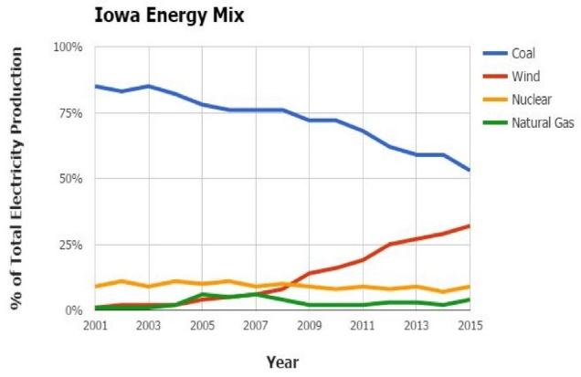
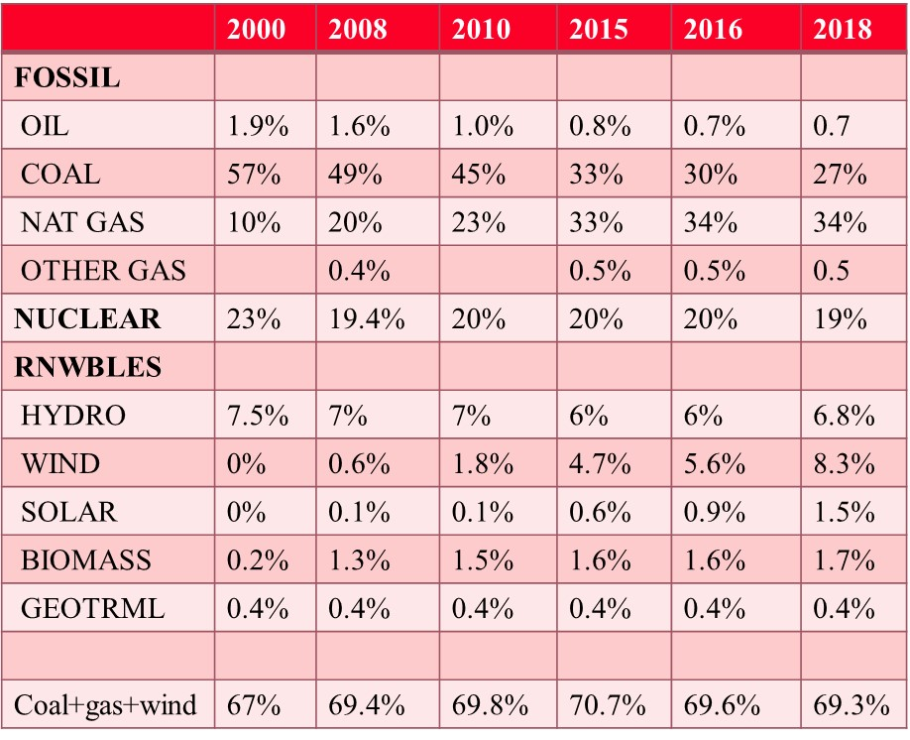
CO₂ Emissions
It is interesting to compare these values with the emission coefficients given by region/state at. A sample of some of these coefficients are provided below for 2002 and 2015
NGCC: 0.312 MT/MWhr
Gas turbine: 0.464 MT/MWhr
Coal-fired plant: 0.844 MT/MWhr.
State | 2002 MT/mwh
Vermont | 0.013
Washington | 0.111
California | 0.275
New York | 0.389
Penn | 0.574
Georgia | 0.619
Texas | 0.664
Ohio | 0.817
Iowa | 0.854
Kentucky | 0.911
N Dakota | 1.017
US Avg | 0.606
State | 2015 MT/mwh
Vermont | 0.028
Washington | 0.085
California | 0.205
New York | 0.211
Penn | 0.388
Iowa | 0.453
Georgia | 0.454
Texas | 0.476
Ohio | 0.665
N Dakota | 0.755
Kentucky | 0.887
US Avg | 0.453
Why was Iowa so high in 2002?
What happened to Iowa between 2002-2015?
Why are N. Dakota and Kentucky so high in 2002?
What happened to N. Dakota between 2002-2015?
Why is California so low?
Why is Washington so low?
Why is Vermont so low?
What happened to Vermont between 2002-2015?
Why did US Avg decrease 2002-2015?

